Slide 1
KÖLNER HAIE
KÖLNER HAIE
- Our way to increased attendance -

Slide 2
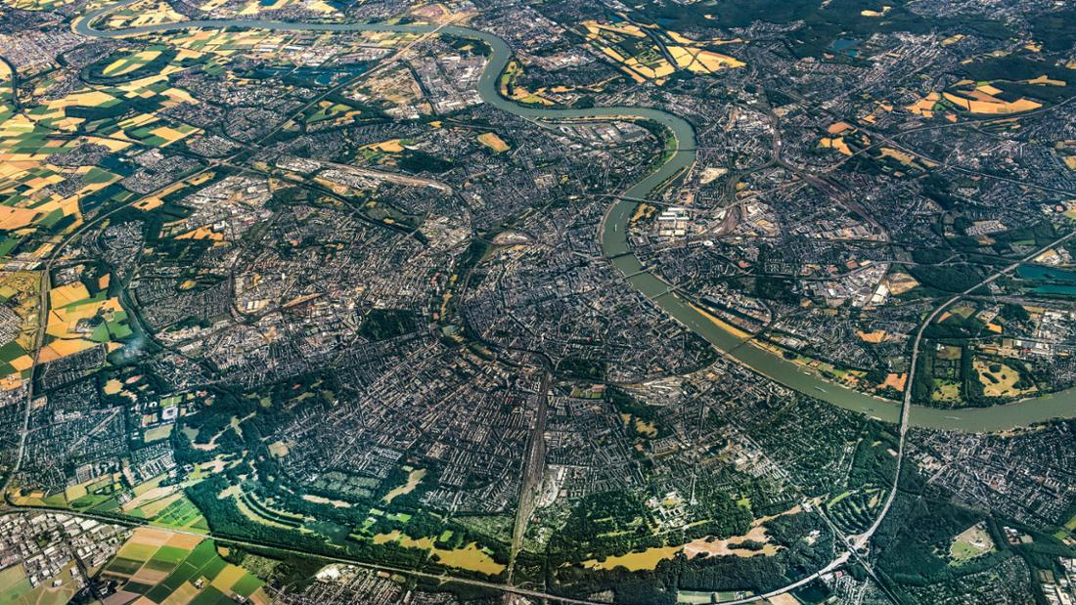
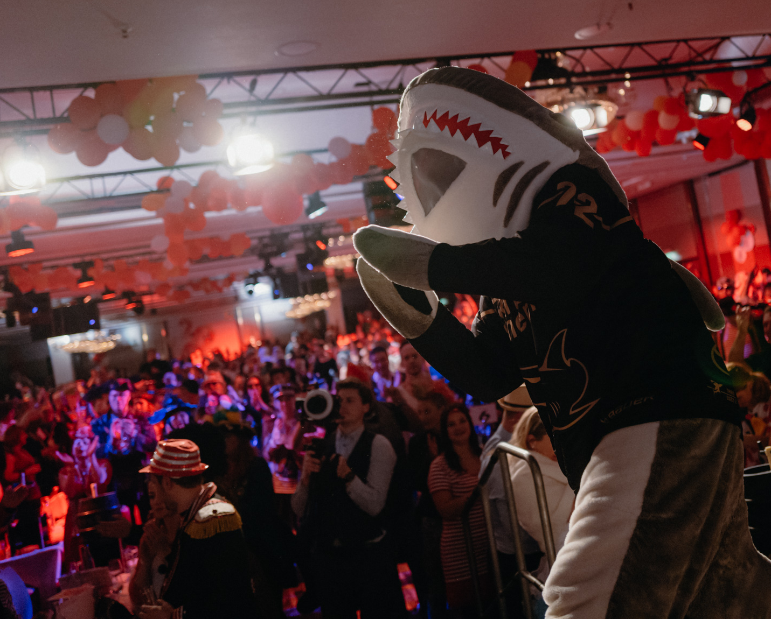
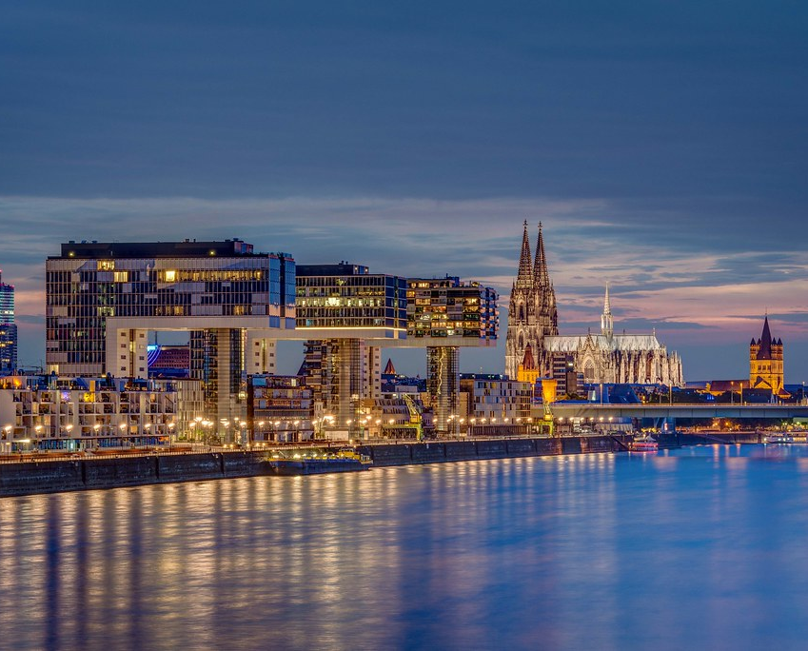
Cologne
City Population: 1.079.301
Metropolitan area: 3.130.000
Passionate people:
carnival
sports teams
intense love for the city
Music & songs
festivals
local patriotism

Slide 3
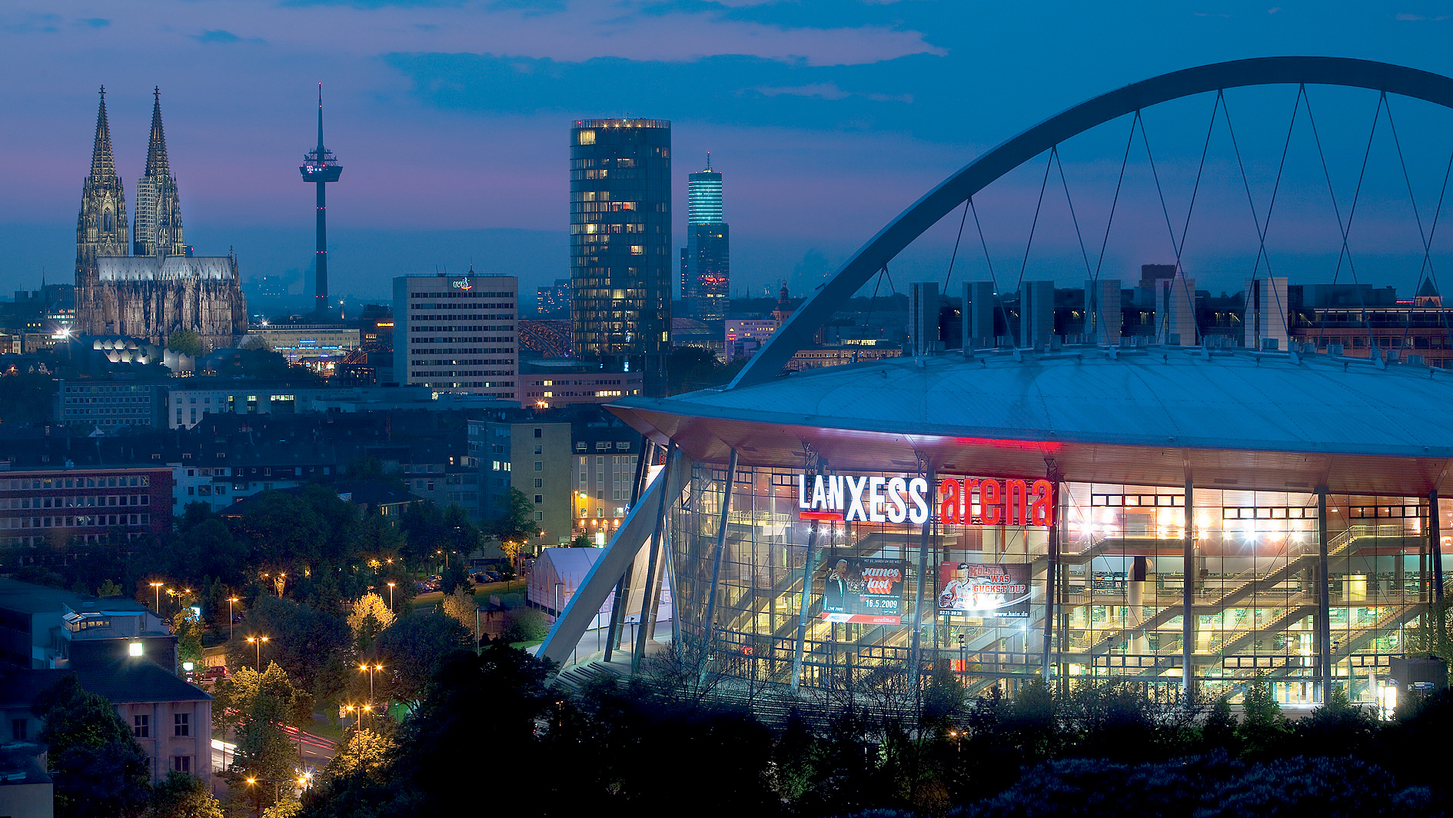
LANXESS arena
Built in: 1998
Max. Capacity: 18.600
All-Time average: 12.240
2023/24 average: 16.993

Slide 4
How did we do it?

Slide 5
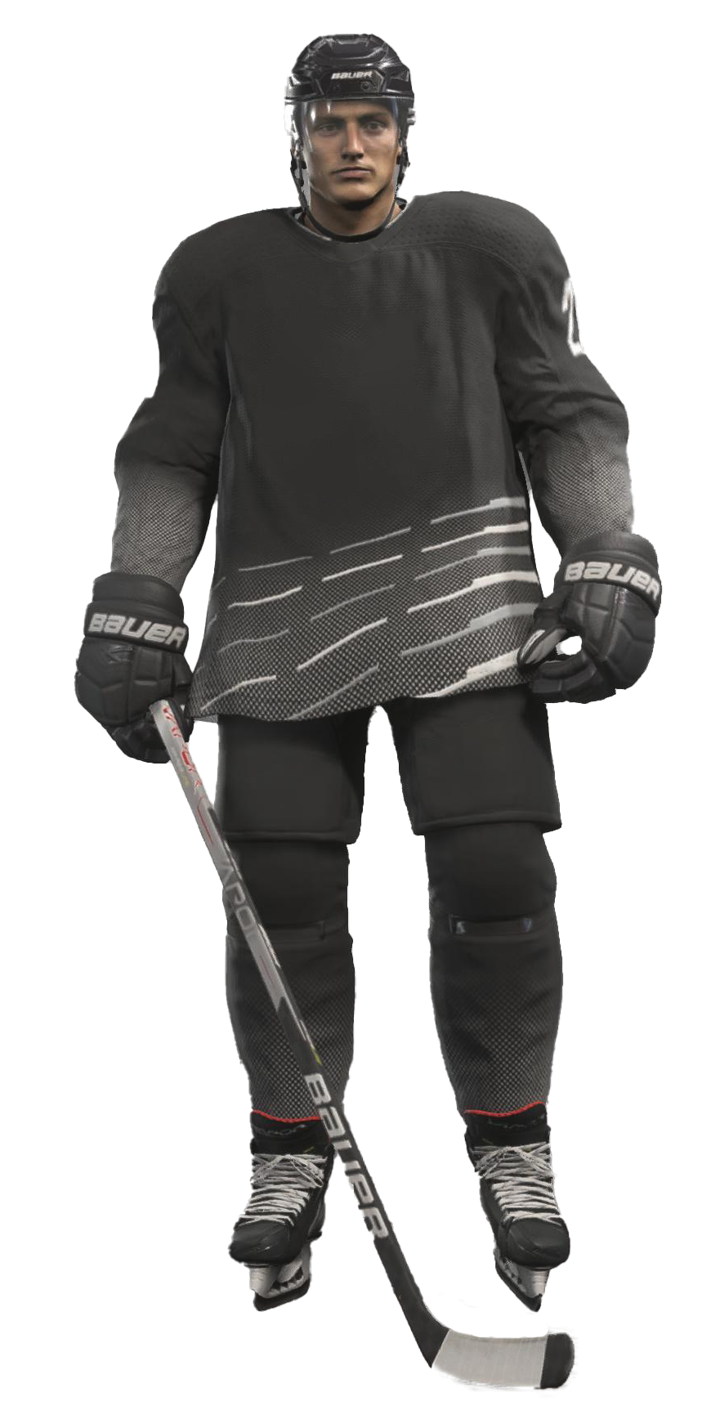
0
1
2
3
4
5
6
7
8
9
status quo 18/19
0
1
2
3
4
5
6
7
8
9
0
1
2
3
4
5
6
7
8
9
0
1
2
3
4
5
6
7
8
9
0
1
average attendance 11.000
30 staff members
enormous potential
newsletter via watering can
critical questions about processes and
brand awareness
13.333 after 19/20 season
Einführung Salesforce
Relaunch der Webseite und des Onlineshops
Daten als größtes Gut
Ads in Social Media
Affiliate Marketing
Cuuub als Touchpoint
Scout: Fraunhofer-Studie
SSO & Relaunch der App
automatisierte Journeys

Slide 6
average attendance 11.000
30 staff members
0
1
2
3
4
5
6
7
8
9
enormous potential
0
1
2
3
4
5
6
7
8
9
0
1
2
3
4
5
6
7
8
9
0
1
2
3
4
5
6
7
8
9
0
1
initial successes 19/20
newsletter via watering can
critical questions about processes and
brand awareness
13.333 after 19/20 season
introduction salesforce
relaunch of website and online store
data as the greatest asset
Ads in Social Media
Affiliate Marketing
Cuuub als Touchpoint
Scout: Fraunhofer-Studie
SSO & Relaunch der App
automatisierte Journeys

Slide 7
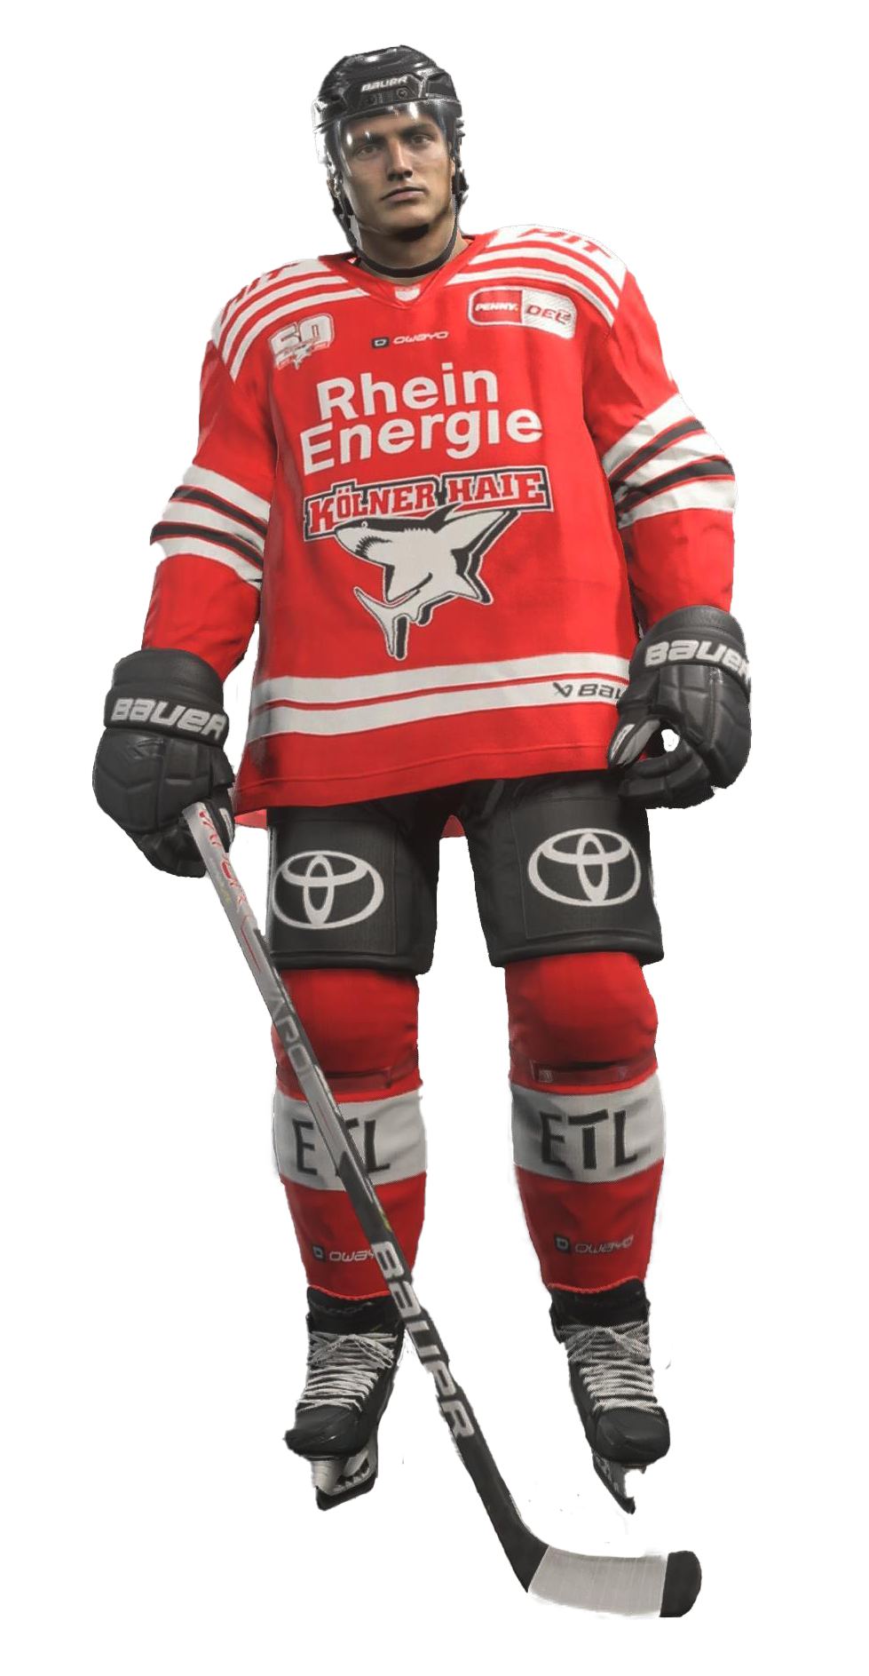
0
1
2
3
4
5
6
7
8
9
0
1
2
3
4
5
6
7
8
9
0
1
2
3
4
5
6
7
8
9
0
1
average attendance 11.000
30 staff members
enormous potential
0
1
2
3
4
5
6
7
8
9
newsletter via watering can
critical questions about processes and
brand awareness
13.333 after 19/20 season
clear strategy
introduction salesforce
relaunch of website and online store
data as the greatest asset
ads in social media
affiliate marketing
individual approach
Scout: Fraunhofer-Studie
SSO & Relaunch der App
automatisierte Journeys

Slide 8
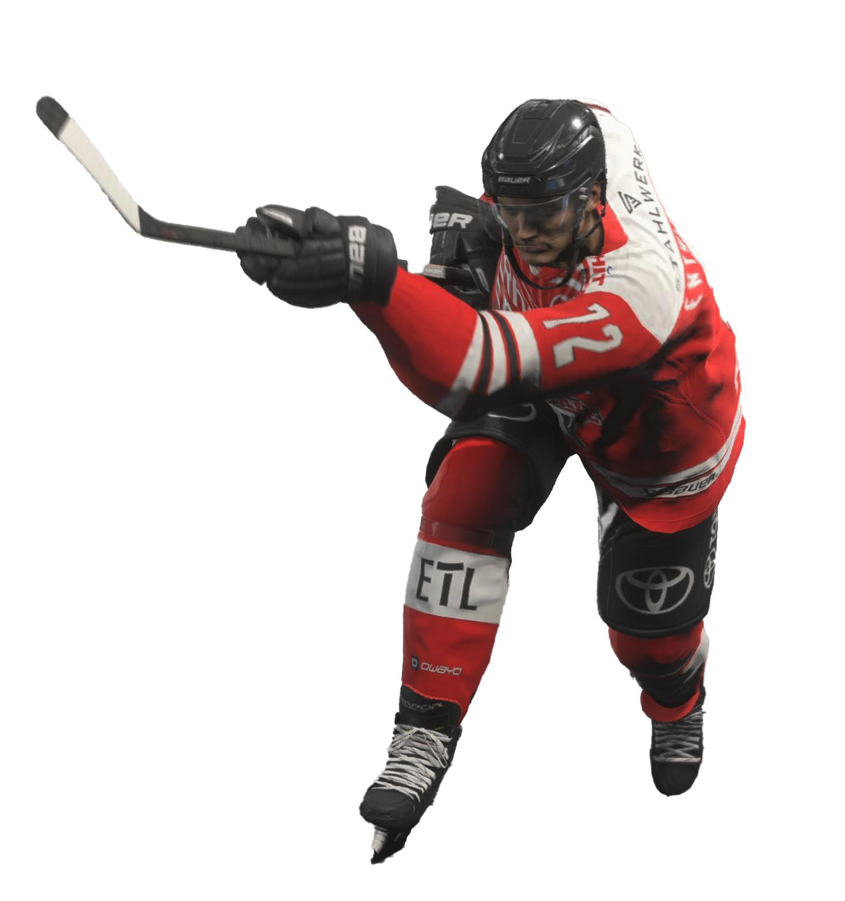
0
1
2
3
4
5
6
7
8
9
0
1
2
3
4
5
6
7
8
9
0
1
2
3
4
5
6
7
8
9
0
1
average attendance 11.000
30 Mitarbeiter
gigantisches Potential
Newsletter per Gießkanne
kritische Fragen zu Prozessen und Wahrnehmung der Marke
13.333 nach der Saison 19/20
0
1
2
3
4
5
6
7
8
9
introduction salesforce
relaunch of website and online store
data as the greatest asset
special skills
ads in social media
affiliate marketing
individual approach
SSO & app relaunch
automated journeys
ticket transfer via app

Slide 9
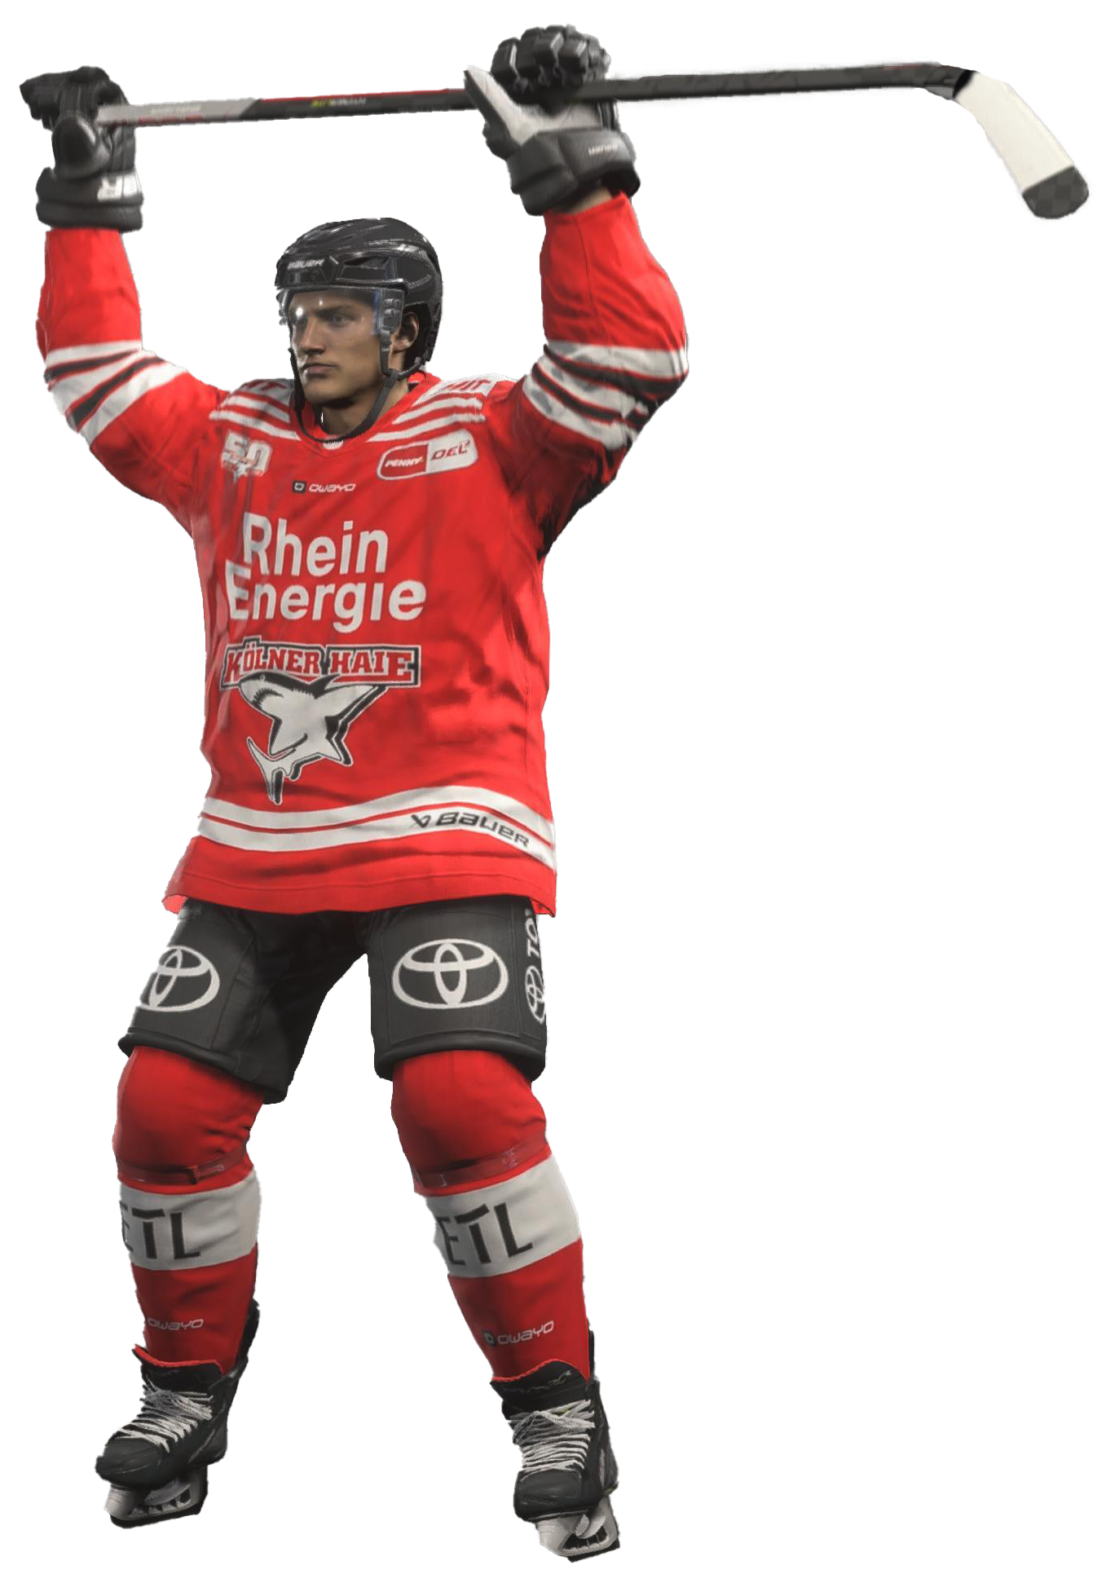
0
1
2
3
4
5
6
7
8
9
0
1
2
3
4
5
6
7
8
9
0
1
2
3
4
5
6
7
8
9
0
1
average attendance 11.000
30 Mitarbeiter
gigantisches Potential
Newsletter per Gießkanne
kritische Fragen zu Prozessen und Wahrnehmung der Marke
13.333 nach der Saison 19/20
Einführung Salesforce
Relaunch der Webseite und des Onlineshops
0
1
2
3
4
5
6
7
8
9
Daten als größtes Gut
ads in social media
affiliate marketing
individual approach
today & next steps
SSO & app relaunch
automated journeys
ticket transfer via app

Slide 11
a matter of mindset
digital expertise
willingness to invest
human resources & technology

Slide 12
Basic groundwork
&
Support from the city

Slide 13
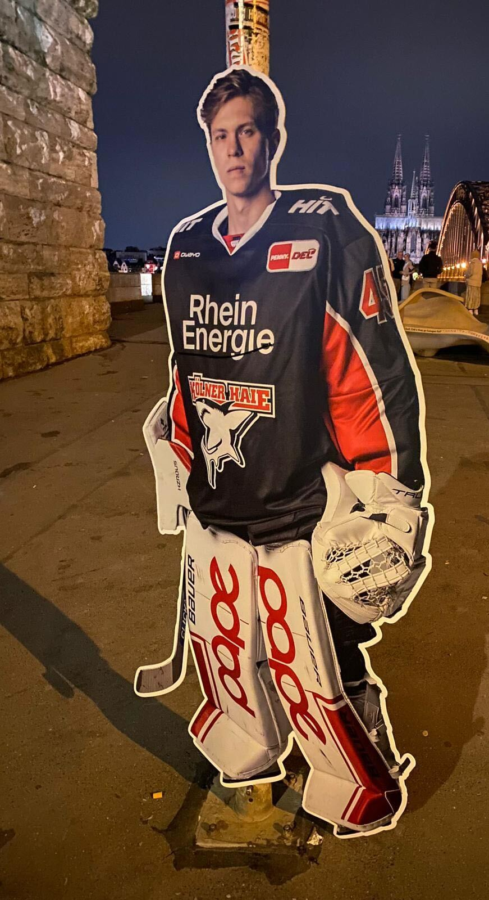
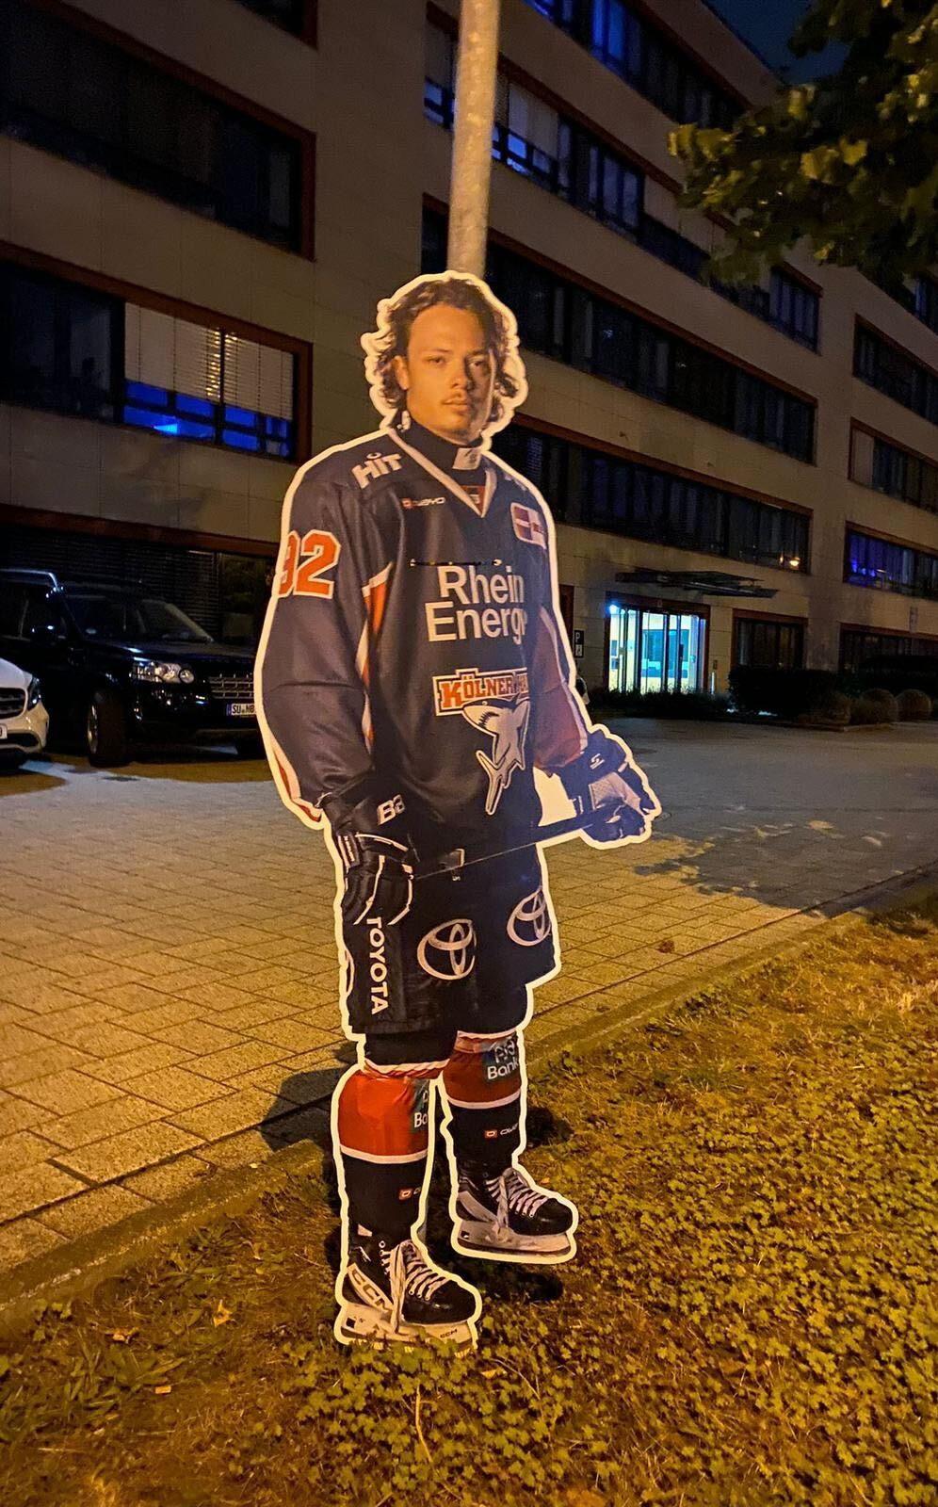

Slide 14
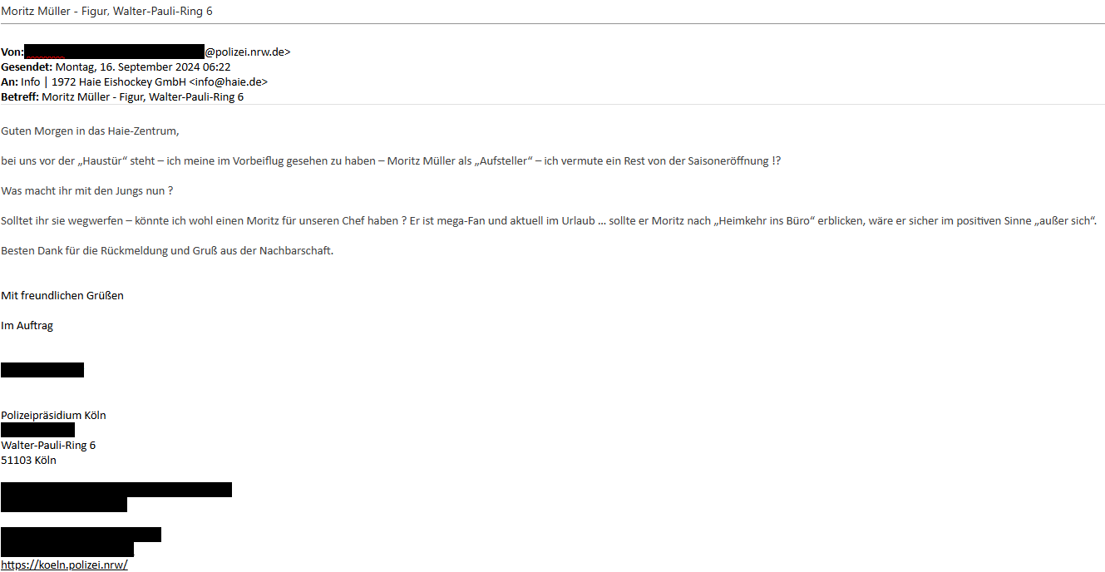

Slide 15
THANK YOU
THANK YOU

