Slide 1
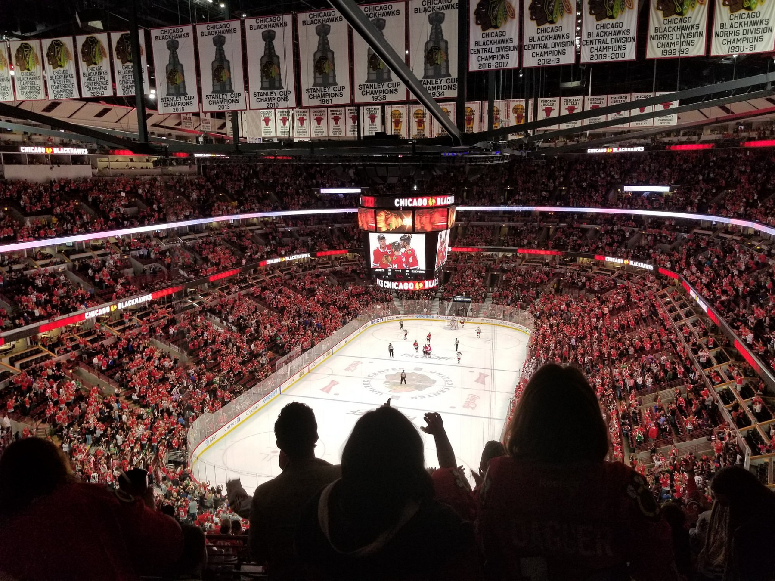
The New High Performance Model
The massive cost of down-prioritizing player sustainability
Kristian Skarphagen, Munich Oct 29

Slide 2
“The most dangerous phrase in the English language is
We have always done it this way”
-Grace Hopper, US Navy
Notes:
“There’s an old saying that is often used in the world of sport performance and strength and conditioning:
How many of you have heard this phrase before?

Slide 3

It doesn’t matter how many tickets you sell
Notes:
It doesn’t matter how many tickets and sponsorships you sell if the sport is bleeding money due to underperforming, expensive or injured players.
Despite all the advancements around us — technical, tactical, leadership, and sports science — many European hockey clubs are still operating in an old-school fashion when it comes to building a high-performance environment off the ice.
It’s very similar to pouring water into a bucket full of holes.
When I look at all of you today, I don’t just see leaders of hockey clubs; I see passionate people who are driven to take their teams to the next level. Like me, you find joy in your work. And, like me, you know that hockey isn’t just about what happens on the ice. It’s about building something bigger—a club, an organisation, a community — that can stand the test of time.
Today, I will guide you through how to utilize the new high performance model, so we can remove those holes in the bucket and channel our time, energy and resources in the right direction to win hockey games and ultimately championships.

Slide 4
Has your club ever signed a player who didn’t reach the level or capacity you were hoping for?

Slide 5
Has your club ever signed a player who didn’t reach the level or capacity you were hoping for?
Have you ever experienced a key player getting injured during a crucial part of the season?

Slide 6
Has your club ever signed a player who didn’t reach the level or capacity you were hoping for?
Have you ever experienced a key player getting injured during a crucial part of the season?
Imagine if you could reduce the risk of injuries of your players, would it make a difference for your club?

Slide 7
Has your club ever signed a player who didn’t reach the level or capacity you were hoping for?
Have you ever experienced a key player getting injured during a crucial part of the season?
Imagine if you could reduce the risk of injuries of your players, would it make a difference for your club?
What would your club look like if you gave yourself better odds of a higher success rate when signing expensive players?

Slide 8
The result:
Notes:
By applying what we cover today, you will not only elevate the club’s performance but also each individual player's level – simply by plugging the leaks that are draining your success.

Slide 9
The result:
Short-term:
  Your investments (i.e. the players) are optimized to perform at their full potential

Slide 10
The result:
Short-term:
  Your investments (i.e. the players) are optimized to perform at their full potential
  Guarantee improved player sustainability and longevity of your investments/recruitments

Slide 11
The result:
Short-term:
  Your investments (i.e. the players) are optimized to perform at their full potential
  Guarantee player sustainability and longevity of your investments/recruitments
  Minimise the risk of injuries and ensure the likelihood of peak performance when it matters the most

Slide 12
The result:
Long-term:
  Building your own talent pipeline that benefits both current players and future prospects

Slide 13
The result:
Long-term:
  Building your own talent pipeline that benefits both current players and future prospects
  Reducing dependency on expensive imports and instead fostering a strong club culture

Slide 14
The result:
Long-term:
  Building your own talent pipeline that benefits both current players and future prospects
  Reducing dependency on expensive imports and instead fostering a strong club culture
  Creating an attractive environment with the right conditions for top performance, where high-end players want to come and play

Slide 15
The result:
Long-term:
  Building your own talent pipeline that benefits both current players and future prospects
  Reducing dependency on expensive imports and instead fostering a strong club culture
  Creating an attractive environment with the right conditions for top performance, where high-end players want to come and play
  More cost-effective by building stability, no need for constantly compensating for underperforming players or having to recruit new ones

Slide 16
The result:
Long-term:
  Building your own talent pipeline that benefits both current players and future prospects
  Reducing dependence on expensive imports and instead fostering a strong club culture
  Creating an attractive environment with the right conditions for top performance, where high-end players want to come and play
  More cost-effective by building stability, no need for constantly compensating for underperforming players or having to recruit new ones
Bonus: One of the similarities between Patrick Kane and Connor Bedard 👀
Notes:
You’ll want to stick around for this one!
Any guesses on what these two franchise players might have in common?

Slide 17
Reality check
The correlation between injured players and wins
Tight margins between success/failure
“Bad luck”
Notes:
Thanks to the data we have today, we know the strong correlation between injured players and the number of wins a team will have during the season, though there's slight differences between sports.
Hockey is so competitive, with incredibly tight margins between avoiding relegation, securing playoff spots, home-ice advantage, and ultimately winning championships.
Teams that continue to blame bad luck for injuries season after season, instead of analyzing their operations, will at best keep leaking money and stagnating, and at worst, get left behind and irrelevant.
I understand you might feel some concern about the challenges affecting your decisions right now. Let’s look at a few of them.

Slide 18
Counterarguments
1. Competition for talent and short-term results
Notes:
1. Competing for talent and short-term results:
It’s natural to feel the pressure to deliver quick results, especially in a competitive environment like elite sports.
But by focusing on developing your own talent and strengthening your internal infrastructure, you can secure both short-term results and create sustainable success in the long run. You won’t be as dependent on expensive new recruits and can instead build a club with a strong and unique identity.

Slide 19
Counterarguments
1. Competition for talent and short-term results
2. Limited financial resources
Notes:
2. Limited financial resources:
I know financial resources can be tight, but this is where we need to think strategically.
By investing in long-term development and more effective training methods, you can maximize returns and ensure every penny spent is worth it. Investing in talent development also reduces the need for expensive imports, freeing up resources over time. Shift from the mindset of “we can’t afford it” to “how can we prioritise and afford it?”

Slide 20
Counterarguments
1. Competition for talent and short-term results
2. Limited financial resources
3. No guarantees (in a contact sport)
Notes:
3. No guarantees:
In a contact sport like hockey, injuries are inevitable. But with conscious choices, smart planning and a solid communication between your coaching staff, performance staff and medical staff alongside with proper load management, high days and low days, exercise selection, weekly and monthly planning—we can reduce injury risks and build bulletproof athletes who can better withstand the demands of the world’s fastest sport.

Slide 21
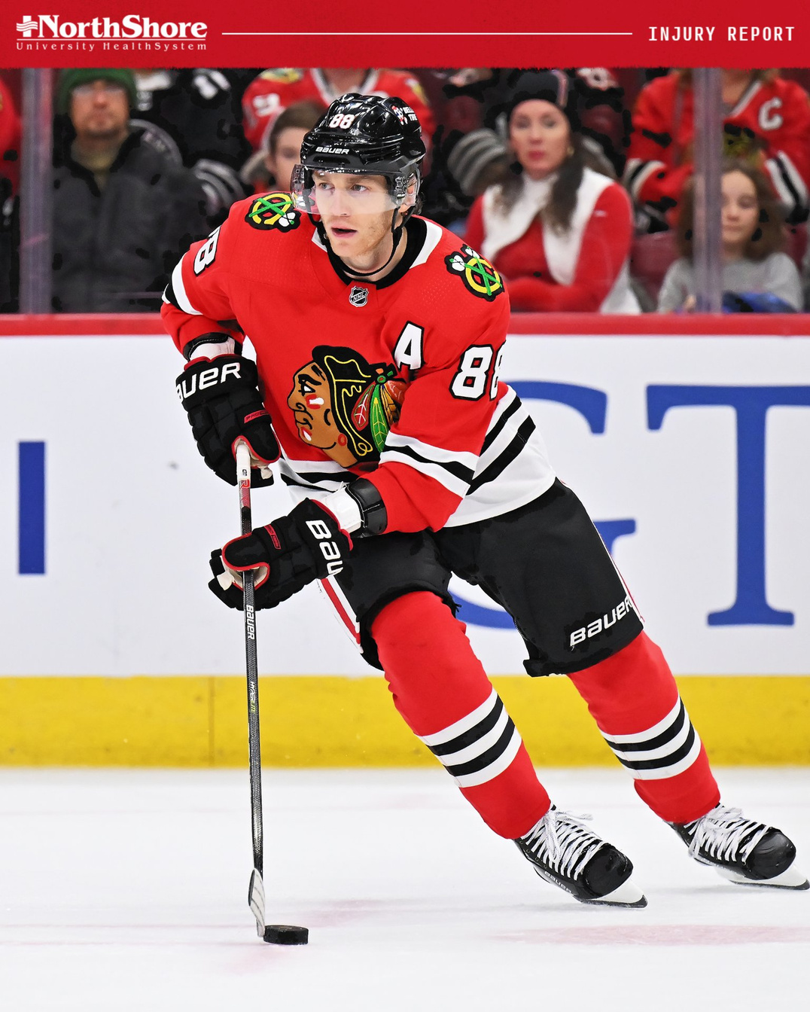
Notes:
Before I start, let me share a quick story about this guy.
How many of you know who this is?

Slide 22
Patrick Kane
3 Stanley Cup
1 WC Bronze Medal
1 Olympic Silver
1 Conn Smyth Trophy
1 Ted Lindsay Award
1 Art Ross Trophy
1 Hart Trophy
1 Calder Trophy
Etc.
Notes:
The first time I met Patrick Kane in 2018 - he told me that the reason he was among the best in the world was because he never got bored with the basics.
By this point, he had just been named MVP of the World Championship the past spring, leading the USA to a bronze medal. A few years prior, he’d been MVP when he won his third Stanley Cup with the Blackhawks. There was no doubt he was still one of the best players in the world.
The Blackhawks just flew me over for the NHL season, and this was my first NHL camp as a performance coach, and I was a rookie in this setting.
On the first day of the NHL camp, after he finished all the physical tests, he brought his hockey gloves and went straight across the gym and through a door I hadn’t noticed before. Naturally, I was curious about what he was doing there alone.
The testing for the other players was in full swing, with players and staff everywhere at different stations. I debated with myself for a moment: should I follow him or stay put?
Eventually, I gathered some courage and went over, put my hand on the door handle. My heart raced, sweating on my back, and my hand trembled.
Would you have opened the door?
I did. Inside was a shooting room with plastic ice covering the floor, a few different nets, and tons of pucks. He looked up, a little surprised, and I quickly asked, “Is it okay if I just observe you for a bit?” I think he was so surprised he just said yes.
I stood there silently for about 10 minutes, watching him work with laser focus, execution and precision. I was blown away, both by the level of focus and execution, but also since I’ve seen, practicing kids in Sweden, Finland, Czech Republic, Russia, and the U.S., do the exact same drills.
The next day, I ran into him in the gym just before the day’s workouts began. I thanked him for yesterday, and my curiosity got the better of me: “I’m curious, you can do whatever you want with a stick and puck, and yet you focused on such basic and fundamental things in there. Why?” He looked up from under his cap, smiled, and said, “What do you think makes me the best in the world?”
Patrick Kane, undeniably one of the world’s best hockey players at the time, understood that to stay at the top of his game, even by the time when he had all the success he had had, he still needed to master the basics.
Who do you think, out of the 65 players we had at that camp, was in the shooting room every day of that NHL camp?

Slide 23

Change your perspective
Notes:
So, what’s my point?
What I learned from Patrick Kane — one of the world’s best hockey players and the brightest star among those 65 players in that camp, definitely the one who needed to be in that shooting room the least — was that you never skip the basics.
You and I both know there’s a reason why some players succeed, and others don’t. It’s not about talent, luck or bad luck. The same goes for coaches, GMs, CEOs, and teams.
Mastering the basics as a player looks one way; mastering them as a leader or an organization looks a bit different.
But if Patrick Kane focuses on the fundamentals, I’m pretty sure that applies to you and me too.
And that’s the lens through which I’ll present today.
I’ve been fortunate to be working behind the scenes internationally in multiple different continents, countries and leagues for the past 13 years, I’ve seen most of it - the good, the bad and the ugly. I’ve seen what works, what doesn’t work and a lot of different nuances in different teams and cultures.
My focus throughout my full journey in the world of hockey has been the off-ice portion as a sports performance coach; to be working and educating players behind the scenes on how to become a high performer and to stay at that level or to reach their next level.
Today I’m fortunate to be entering my fourth year working with a great performance and development staff with one of the biggest hockey franchises in the world, Chicago Blackhawks.
So let’s dive right in, no time to waste:

Slide 24
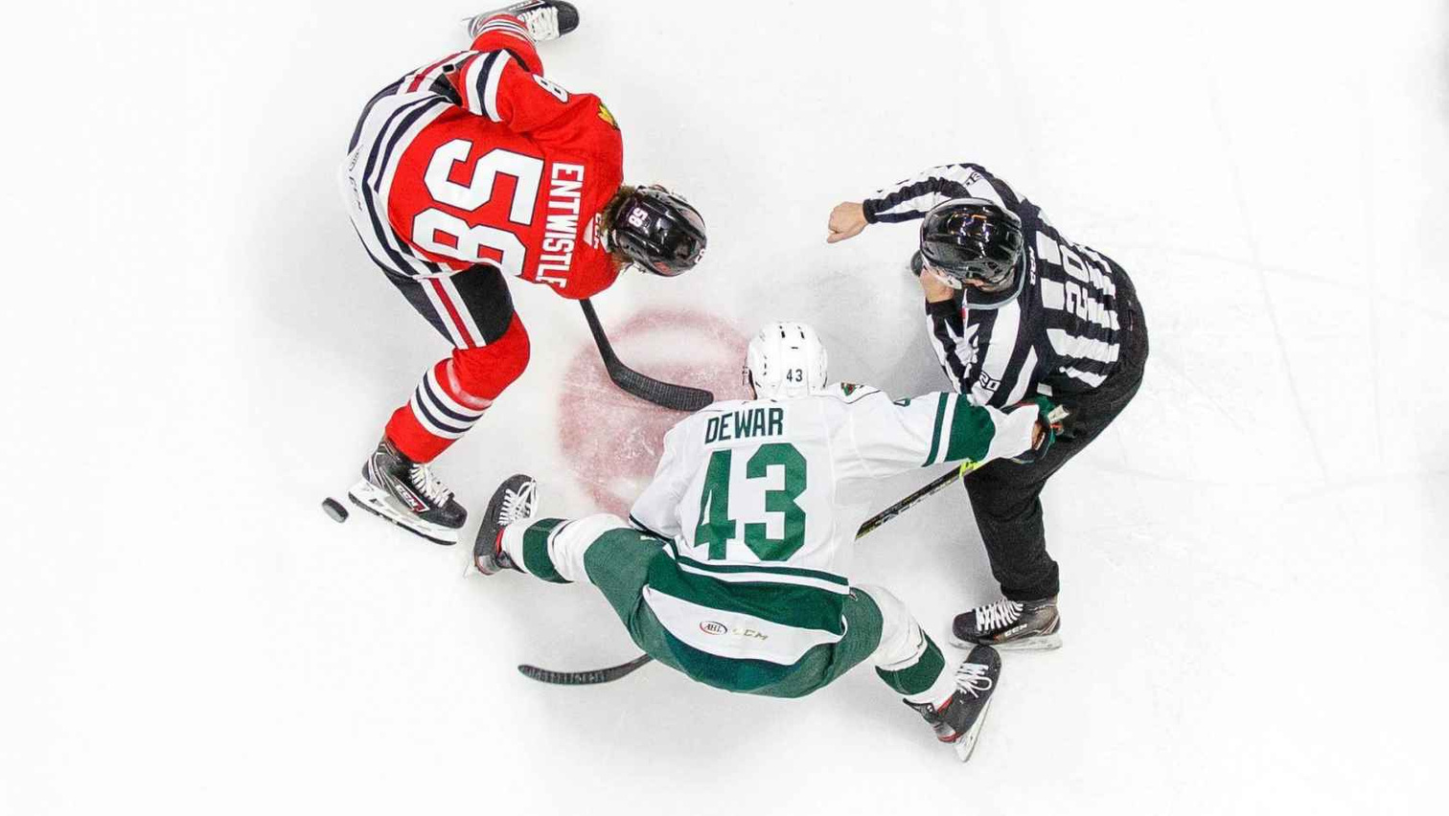
What’s the cost of an injured player?
Notes:
What’s the cost of an injured player? Does anyone know?
The biggest cost for European hockey organizations is the player budget, where large sums are often invested in players, especially imports. But how many clubs have a strategy in place to ensure their players' physical condition? Without a strong infrastructure to support and maintain players performance, these investments are at risk of being wasted. It’s short-term thinking that can lead to long-term issues like injuries and underperformance.
What does it really cost when a player gets injured? Beyond the salary expenses, you’re looking at lost performance, potentially reduced media coverage, fan criticism, and opportunity costs where you could have signed a better option.
On top of that, there are additional costs like insurance, cars, flights, equipment and housing. An injury can also disrupt the internal dynamics of the team, putting extra pressure on other players, which increases the risk of further injuries. This highlights the importance of focusing on prevention and investing in infrastructure to minimize these risks.

Slide 25
Examples when injured
Average SHL salary; €13,000 per month
Total cost: €16,000 per month
Day 1-14; €550 per day
=
€7,500
Notes:
Genomsnittlig lön: 140k/mån
Inkl. soc.avgift: 184k/mån
Dag 1-14: 6500kr = 84,500kr
Dag 15-90: 4300kr/dag
Därefter tar FK 80%
Över medel: 200k/mån
Dag 1-14: 8640kr = 120,960kr
Dag 15-90: 6661kr/dag
Topp-lön: 300k/mån
Dag 1-14: 12962kr = 181,468kr
Dag 15-90: 10550kr/dag

Slide 26
Examples when injured
Above average SHL salary;
€17,500 per month
Total cost: €23,000 per month
Day 1-14: €750 per day
=
€10,500
Notes:
Genomsnittlig lön: 140k/mån
Soc.avgift: 184k/mån
Dag 1-14: 6500kr = 84,500kr
Dag 15-90: 4300kr/dag
Därefter tar FK 80%
Över medel: 200k/mån
Dag 1-14: 8640kr = 120,960kr
Dag 15-90: 6661kr/dag
Topp-lön: 300k/mån
Dag 1-14: 12962kr = 181,468kr
Dag 15-90: 10550kr/dag

Slide 27
Examples when injured
Top SHL salary; €26,500 per month
Total cost: €35,000 per month
Day 1-14: €1150 per day
=
€16,000
Notes:
Genomsnittlig lön: 140k/mån
Soc.avgift: 184k/mån
Dag 1-14: 6500kr = 84,500kr
Dag 15-90: 4300kr/dag
Därefter tar FK 80%
Över medel: 200k/mån
Dag 1-14: 8640kr = 120,960kr
Dag 15-90: 6661kr/dag
Topp-lön: 300k/mån
Dag 1-14: 12962kr = 181,468kr
Dag 15-90: 10550kr/dag

Slide 28
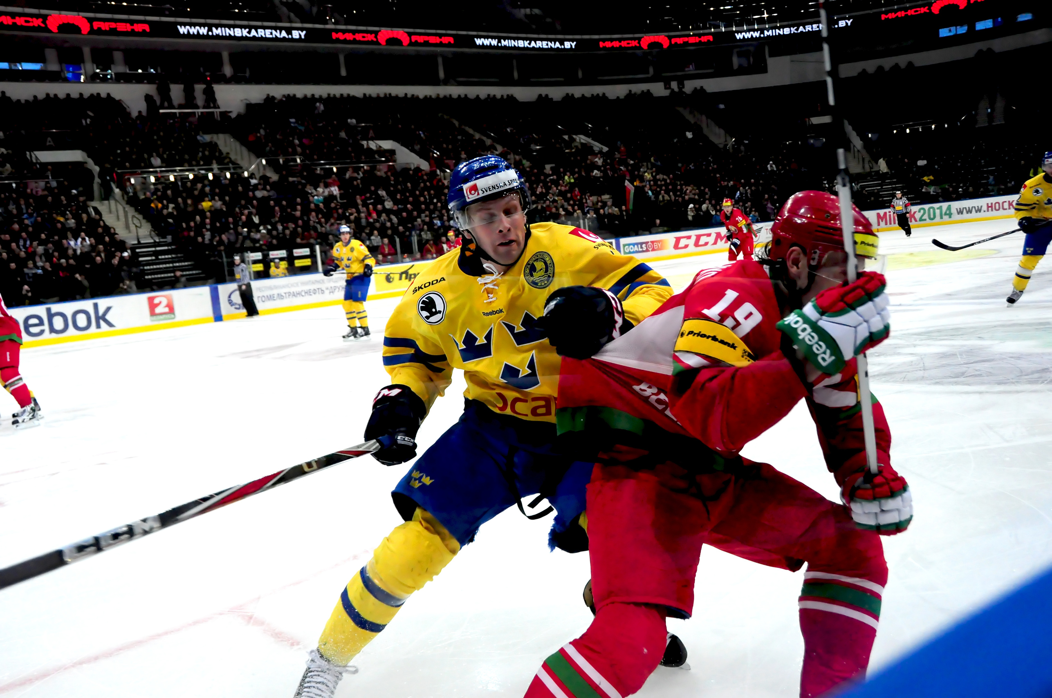
What’s the cost of a star player who doesn't reach their full potential?
Notes:
What’s the cost of each game, each point, if your most expensive players are underperforming?
If they’re not living up to their full potential, it’s not just tickets and sponsorships on the line — it could be the future of the entire club.
Can we really afford players who don’t deliver?
When a club invests big money in a star player, the expectation is obviously that they will perform on the ice. If that player doesn’t reach their full capacity — maybe due to a lack of support from the performance or medical teams — then every lost game and missed point is a direct financial loss for the club. This doesn’t just affect the team’s results in the league but also impacts the long-term financial health and reputation of the club. Teams need to ask themselves if they can afford to have players underperforming, and if that’s a result of their own lack of support and infrastructure.

Slide 29
Examples when under-performing
Top SHL salary; €26,500 per month
Total cost: €35,000 per month
52 games / 8 games per month
= €4,375 per point
Notes:
Vad kostar en spelare som underpresterar?
300k
52 matcher / 8 matcher per månad
300k / 8 ‎ = 37,5 K

Slide 30
“A cheap player who is often injured is not a cheap player.”
Notes:
Brilliant quote, right?
This is credited to a friend and former client of mine.

Slide 31
How to build a high performance model
Notes:
If there’s anything that I really want you to take home from today, it is this part.
To make this as valuable and clear as possible, let me start by saying that you will get the full presentation together with a FREE workbook that’s both actionable and easy to follow for building a sustainable high-performance model and environment.
This guide not only gives you a competitive edge but also provides a long-term framework that can be adapted to future needs.
I’ve identified 6 key steps to create a sustainable high-performance environment, which you’ll get access to by the end of this presentation.
Like I previously said, time is not a luxury we have today so we won’t have time to cover all of them today, but I’ll share 3 critical points on how I see future high-performance teams and clubs evolving.

Slide 32

Step 1
Invest in a solid infrastructure – build a high-performance team.
Notes:
A solid internal infrastructure is the foundation for future clubs. By having a competent high-performance team and medical staff working toward the same goals and in constant dialogue with the coaching staff, your club can create the best conditions for player performance.
Close collaboration between these teams also reduces the risk of injuries through continuous monitoring and individualized adjustments. This ensures that players can perform at their peak over time, while the club maximizes its investment.
Now, when we’re talking about reducing injuries and optimizing performance, let me emphasize the value of these changes. By building a strong internal infrastructure and working strategically on player development, you’re not just creating a more competitive club. You’re saving money in the long run, reducing dependence on expensive imports, and building a long-lasting culture where top players want to stay.
This isn’t just about short-term success—these are investments that will pay off repeatedly, both financially and in performance.

Slide 33
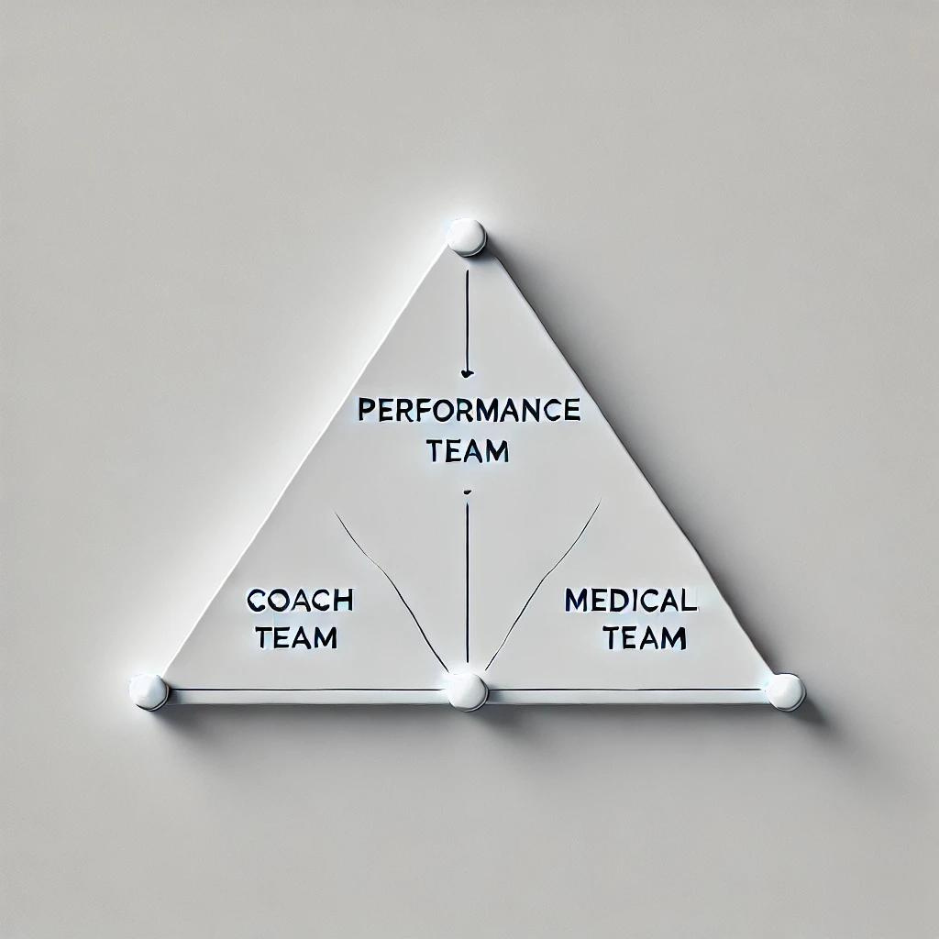

Slide 34
Step 2
Due diligence pre-signing
(utilize the high-performance team)
Notes:
Future clubs need to be proactive by conducting thorough screenings of players before signings. By working closely with the GM, high-performance team, and medical staff, the club can create clear clauses around injury history and the player’s physical condition. This reduces the risk of future problems and ensures players are ready to perform from day one.
Not leaving this aspect to chance and using the expertise of have on your team will save you money and make the team feel more involved in the decision-making process (though, of course, you have the final say).

Slide 35
Step 3
Mindset: The greatest ability is availability
Notes:
For a team to succeed, players need to be healthy and available. We need to remind ourselves that it’s not a pissing game of who can train the most or the hardest of the ice. We must be smarter than that. Keeping players injury-free is THE top priority — performance is built on availability.
We already know the correlation between injured players and wins. By maintaining a balance between training, recovery, and careful monitoring, your club can avoid long-term injuries and maximize wins. A healthy team is a winning team.

Slide 36
Summary
Step 1
Invest in a solid infrastructure – build a high-performance team.
Step 2
Due diligence pre-signing (+utilize the high-performance team)
Step 3
Mindset: The greatest ability is availability
Notes:
I again want to emphasize that this is just the beginning. After the presentation, go and grab the full list with all 6 key steps and a detailed workbook to help you implement these insights immediately. For free.
It’s time to take control of your teams and create an environment where both performance and longevity goes hand in hand.

Slide 37
What’s the short-term win?
01
You ensure results and optimize the performance of your investments (i.e., the players). Do not leave it to chance.
02
Maximize the chances of performing at their best when it matters most (play-out, play-in, playoff).
03
Reducing the risk of injuries will help your team to win more games.
04
Higher likelihood of everyone gets to keep their job 😎

Slide 38
What’s the long-term win?
01
Your own talent pipeline that benefit both current players and future prospects
02
Reduced dependency on expensive imports and instead built a stronger club culture that grows and thrives over time
03
A place where top players want to come to play, and where they feel motivated to perform at their highest level.
04
More cost-effective by building stability, and not constantly compensating for underperforming players or spending time and energy on new recruitments.

Slide 39
Win!
Win!
Win!
Lower risk of injuries
Higher winning percentage
Higher likelihood of keeping jobs
Notes:
So, what’s the key takeaway from today?
It’s not just about avoiding injuries or optimizing our investment in players – it’s about building a long-term strategy that creates sustainable results and a winning culture.
Think about the fundamental principles we’ve discussed and how they can make a difference for both your club and your players.

Slide 40
Not reinventing the wheel
Master The Basics
Notes:
Why should you act now? Because your competitors are. The clubs that don’t act quickly will fall behind, both in performance and financially.
If you want to be on top in 1, 3, or 5 years, that journey starts today.
Success isn’t about following the same old path as everyone else. It’s about taking control, challenging yourself, and stepping out of your comfort zone.
If you truly want to create a high-performance club, the journey starts here.

Slide 41
#88
Notes:
By the way, do you remember the story about Patrick Kane and the shooting room?
Fast forward to last year's camp (2023), and for the first time in his entire career, Patrick Kane was no longer with the Chicago Blackhawks. There was definitely a void to fill.
But every day after practice, there was a new player in that shooting room for 15, 20, sometimes 30 minutes - per day.

Slide 42
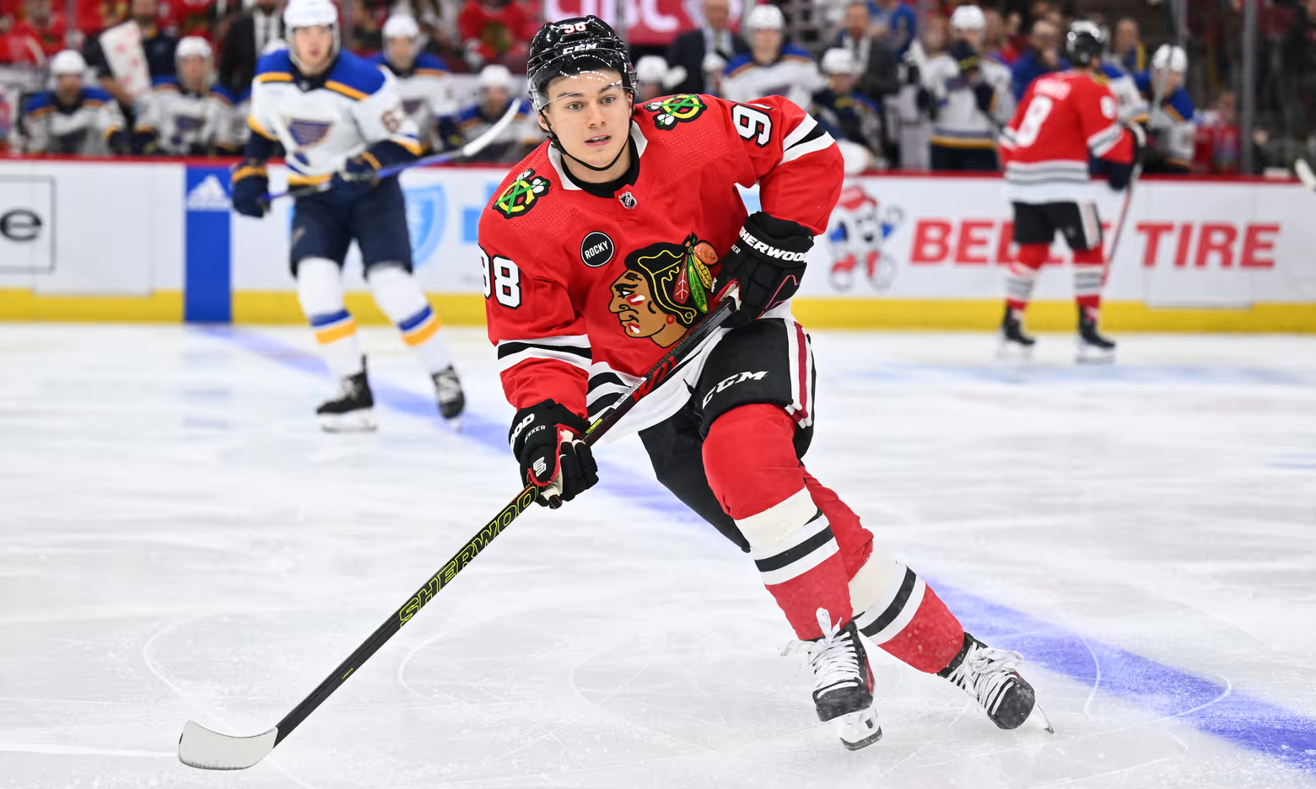
#88
#98
Notes:
It wasn’t number 88 anymore—it was number 98.
It’s about mastering the basics.
In the world of elite sports - taking ownership with this high performance model is mastering the basics.

Slide 43

Scan the QR code:
✅ Full presentation summary
✅ FREE workbook with all 6 action steps, reflective tasks and more
✅ Book a virtual meeting to discuss your situation
✅ Connect on Linkedin etc.
Notes:
Now it's your turn.
Grab your phone, scan the QR code, and access the FULL presentation along with the FREE workbook with all the 6 steps to high performance.
Also, feel free to book time for a virtual meeting, and let's discuss how your organisation can take the next step.
Thank you for your attention!

