Slide 1
Germany has a Vision, and it is not just lip service
Everyone who starts ice hockey and has fun doing it, is a talent

Slide 2
First things first: the focus is always on “The Human Being” – we live athlete-centered coaching

Slide 3
Overview
What we do
What we will do in the near future
Where we want to go
Questions that arise
What we stand for

Slide 4
What we do

Slide 5
We use the “5 Star Program“ to influence the infrastructure and the training Volume And Women's Hockey

Slide 6
Germany-wide uniform training days and club support (coach the Coach) by state and national team coaches

Slide 7
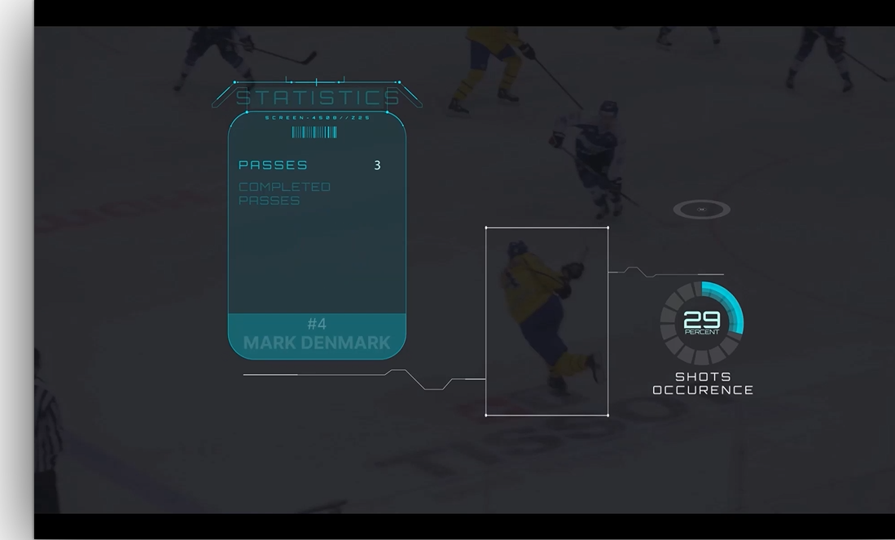
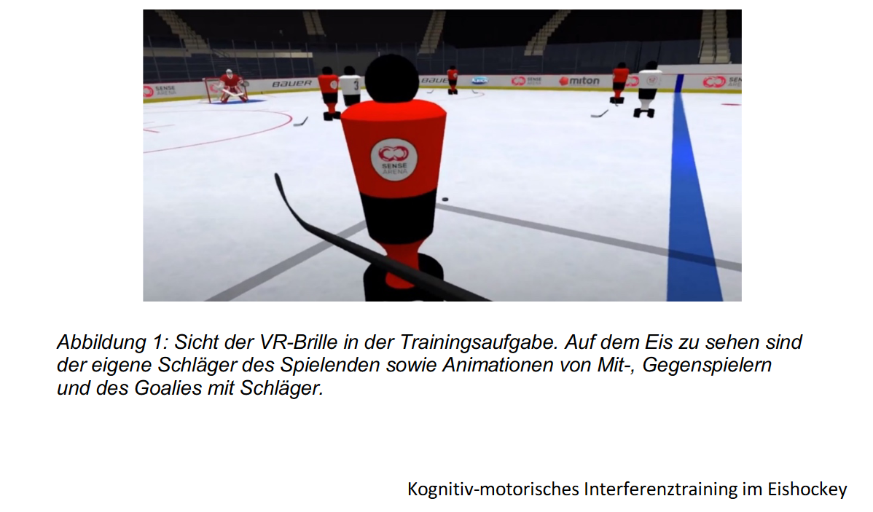
Scientific support: IN:Prove, dual Task-costs, video tracking with simple video data, The future of ice sports, etc.

Slide 8
Exkurs – IN:PROVE

Slide 9
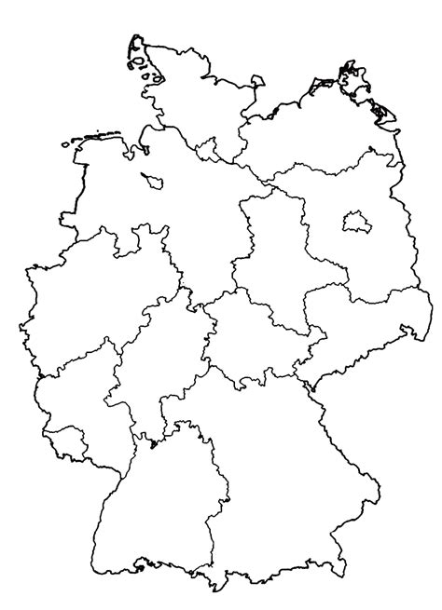
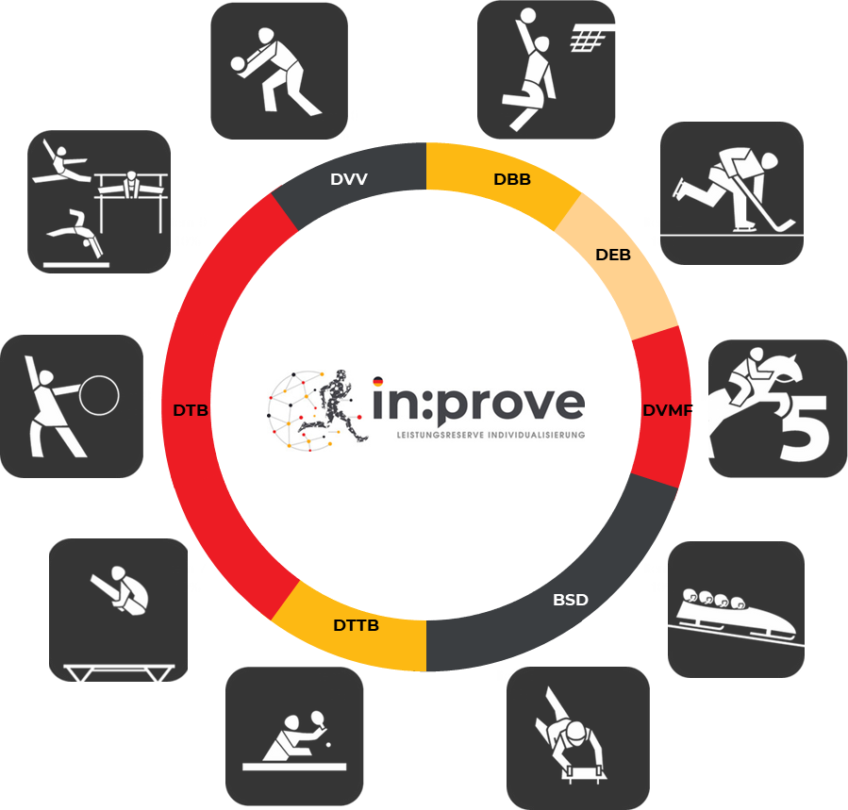
What is “IN:PROVE“
41 measurements
at 13 locations, approx. 20,000 km
Athletes of German national squads only
(NK, PK & OK)
7 federations
10 disciplines
N=550 athletes
Female/male athletes: 50/50
DOSB - Pictograms, 2023
Notes:
Of these avatars: we have now created around 550 at the halfway point of the project.
And only from athletes in the junior squad, perspective squad and Olympic squad7 federations10 disciplinesand a ratio of female to male athletes of 50:50
To achieve this, our team covered 20,000 kilometres last year and carried out measurements at 13 locations.

Slide 10
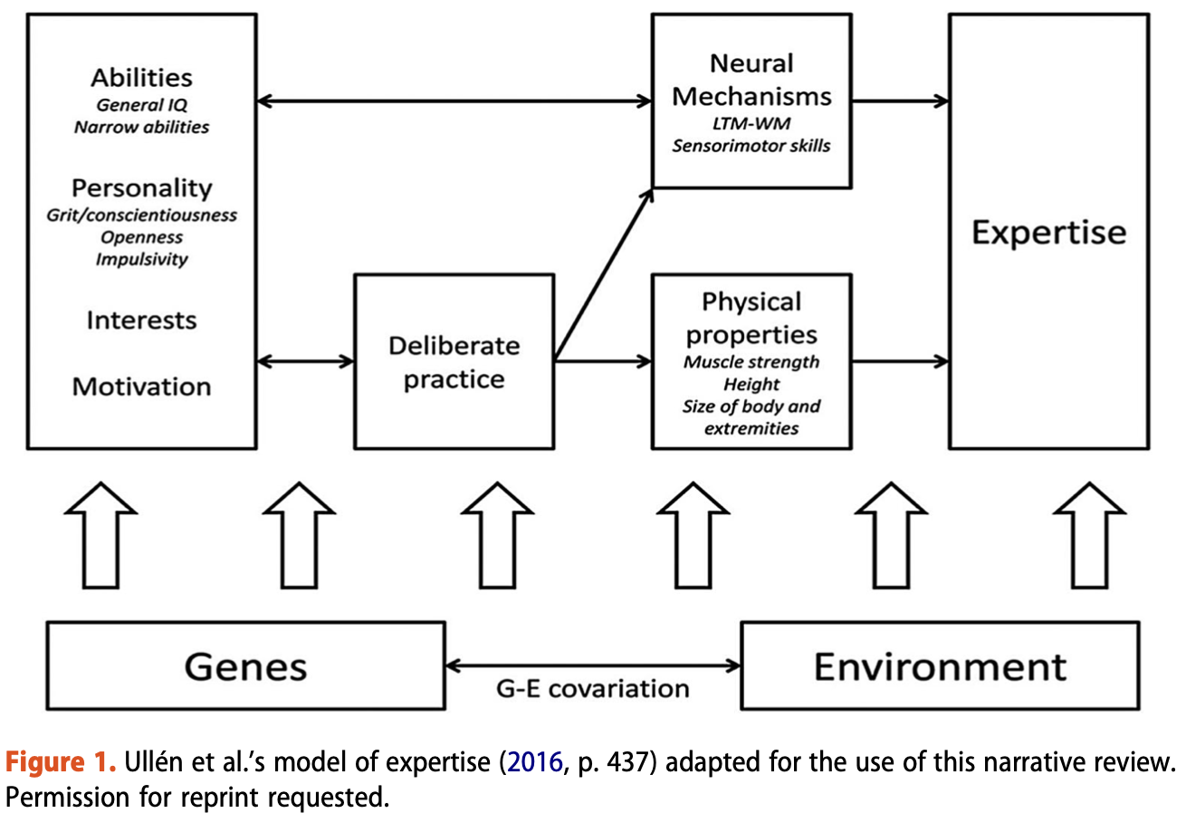
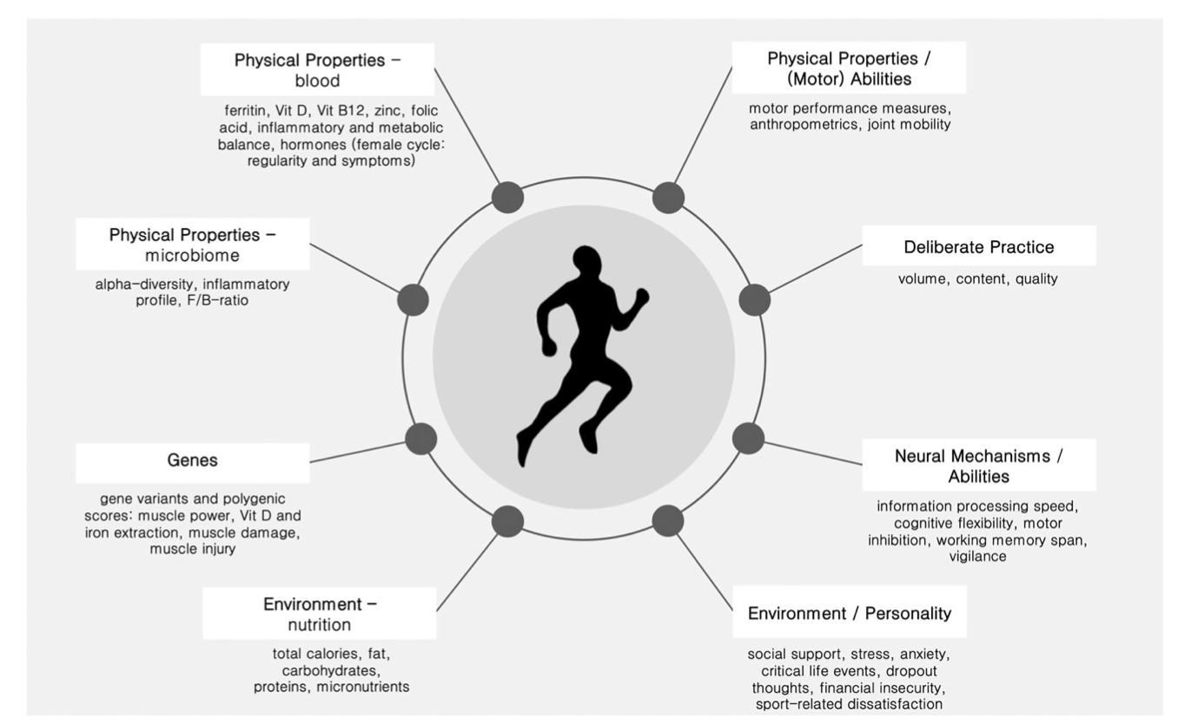
In:prove Diagnostics based on Ulléns Expertise-Model
Notes:
work package III diagnostics and decision on intervemtions run for the cpmplete project duration

Slide 11
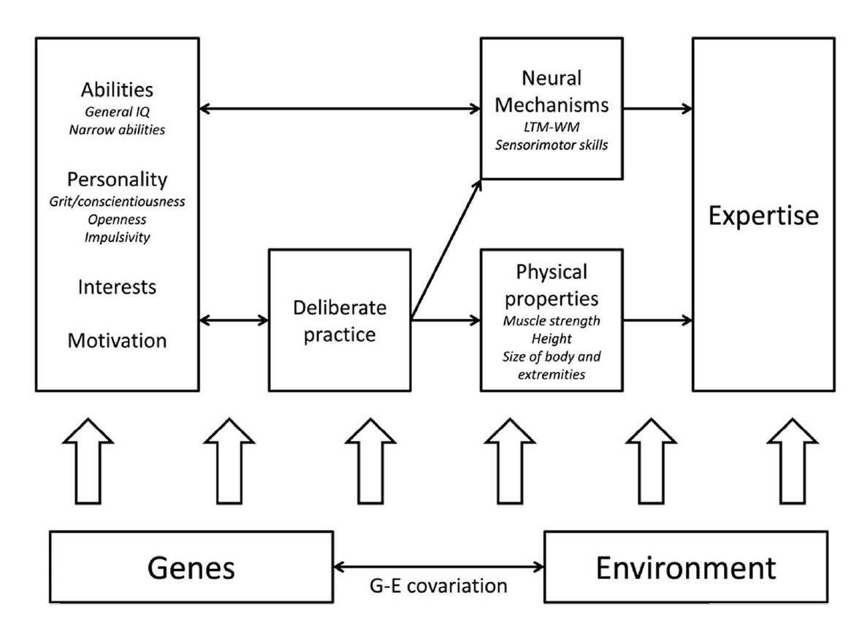
In:prove Diagnostics based on Ulléns Expertise-Model
?

Slide 12
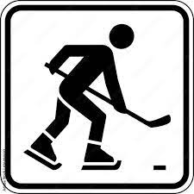
Kognition
1
Trainereinschätzung
Athlete Avatar
Blutanalyse
Zahlenverbindungstest (PR) | 54
Kognitive Flexibilität [ms] | -115
d2-R Konzentrationstest (PR) | 42,1
Arbeitsgedächtnisleistung | 54
Leistungsstand | Leistungsentwicklung | Wettkampfpotential
Anthropometrie
1
Körpergröße [cm] | 181,1
Körpergewicht [kg] | 79,6
Armspannweite [cm] | 188,8
Sitzhöhe [cm] | 90,7
BMI [kg/m²] | 24,3
Legende Blut/Mikrobiom/Ernährung
Grün = im Normbereich
Gelb = suboptimal
Rot = auffällig
Blau = erhöht
Legende Genetik (Skala von 0-100)
0 = weniger „optimale“ Ausprägung
100 = „optimale“ Ausprägung
Legende psychosoziale Aspekte
Grün = unauffällig
Gelb = leicht auffällig
Rot = auffällig
Legende Motorik & Kognition
Grün = überdurchschnittlich
Gelb = durchschnittlich
Rot = unterdurchschnittlich
Grau = Ergebnis liegt noch nicht vor/keine Teilnahme
Mikrobiom
1
A-Diversität
SCFA
Anti inflam
Genetik
Motorik
1
Power Score | Muscle Damage | Muscle Injury | Vit D Aufn. | Eisen Aufn.
58 | 33 | 50 | 50 | 50
Off-Ice Stationen
Countermovement Jump [cm] | 44,9
Drop Jump (RSI beidbeinig) [m/s] | 1,44
Sprint (5/10/30m) [s] | 1,09/1,85/4,29
Griffkraft relativ (links/rechts) [N/kg] | 3,99/4,15
Psychosoziale Aspekte
1
Ernährung
1
Stress
Angst
Drop-Out-Gedanken
Kritische Lebensereignisse
Soziale Unterstützung
Sportbezogene Unzufriedenheit
Finanzielle Unsicherheit
On-Ice Stationen
Sprint (5/30m) [s] | 1,00/4,27
HAST [s] | 8,99
Transition Agility / motorische Kosten [s] | 14,45/0,77
Lateral Shuttle / motorische Kosten [s] | 1,46/0,12
Kohlenhydrate | 62
Fette | 59
Proteine | 209
Ballaststoffe | 38
Gesamt Kalorien | 71
Protokoll Qual. | mittel

Slide 13
Formulation of the Decision trees – DEB79
HAST
Motorik
Ja
Sportbezogener Stress
Ja
Drop-Out-Gedanken
Fehlende soziale Unterstützung im Sport
Sportbezogene Unzufriedenheit
Keine Angaben
Finanzielle Unsicherheit
ZVT
D2R
Kognition
B12
Vit D
Blut
Shannon 6,92
FB/R 2,2
Microbiom
E 41,67
P 75,00
Genetik
Während: Bauch-/ Unterleibsschmerzen, Müde/ Schwäche, verminderte Leistungsfähigkeit (subjektiv)
Zyklus
Regelmäßigkeit
13
Keine Intervention benötigt
Notes:
Entscheidung im Kompetenzteam – was zu tun ist – die Wissenschaft ist eine Erweiterung des Trainerteams

Slide 14
Outcomes

Slide 15
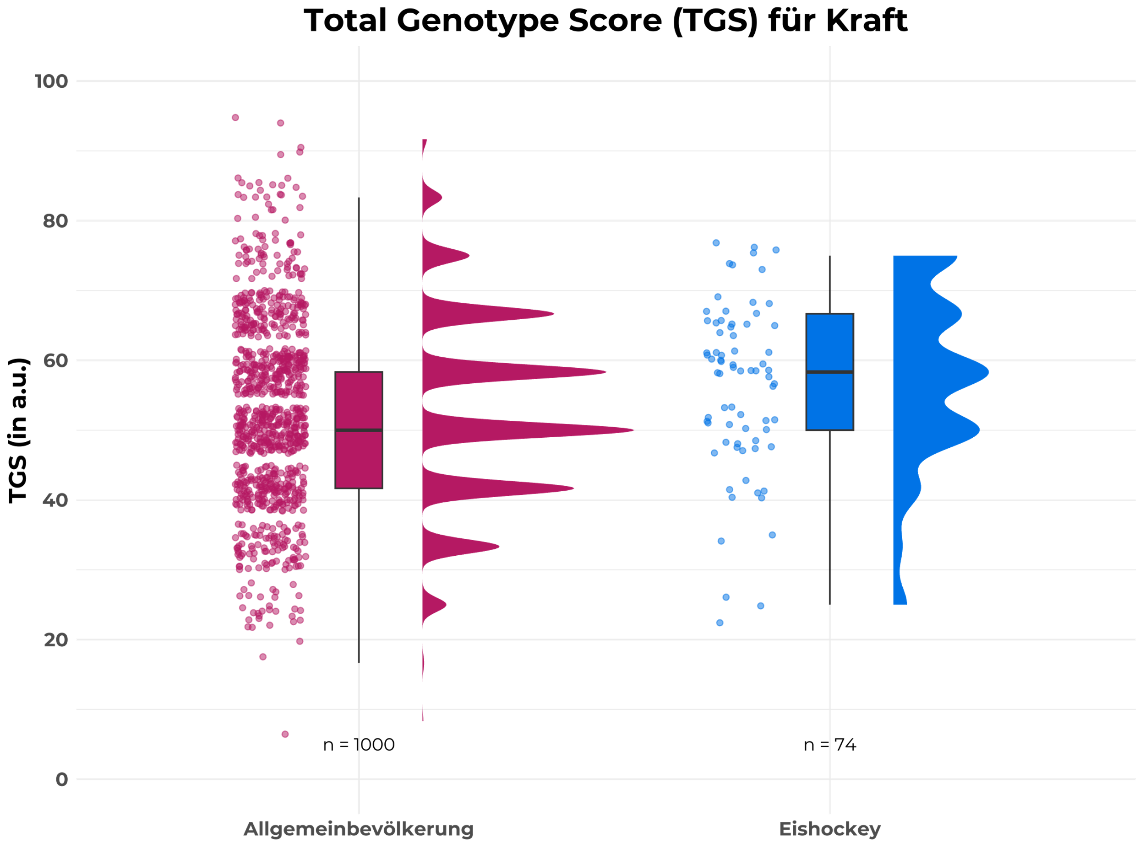
Genetic aspects using the example of strength/speed
The "power" score (muscular abilities for strength/speed) is slightly higher than that of the general population, but spreads widely.
Notes:
Gute Nachricht – sehr viele Kompensationsmöglichkeiten durch andere Fertigkeiten…

Slide 16
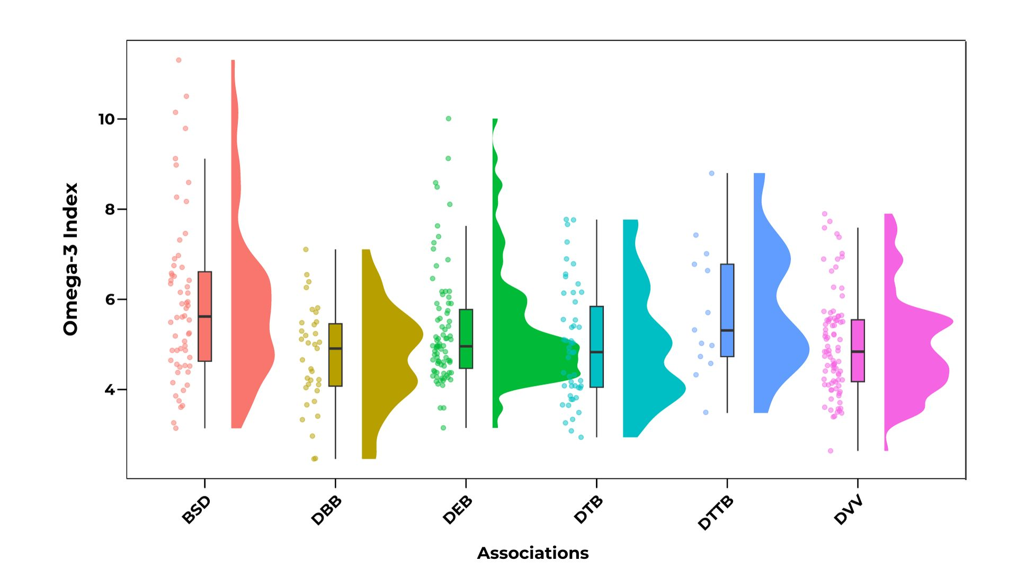
HS Omega-3 Index in Comparison of Disciplines
With a targeted index of 8-12, the supply of DEB athletes with omega-3 fatty acids is rather low as it is in the lower third of the sports recorded in in:prove.
1

Slide 17
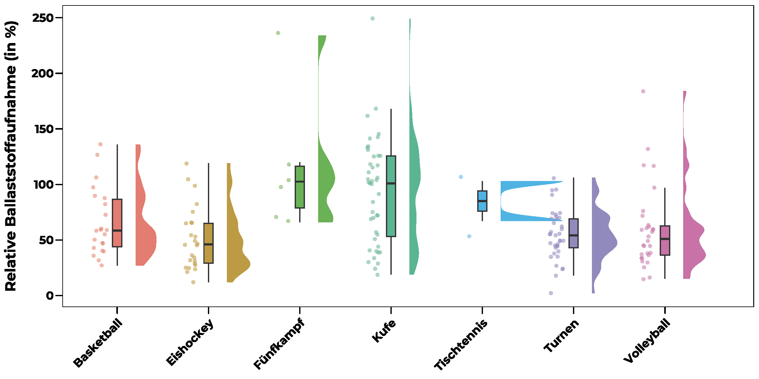
Fiber intake and alpha diversity
α-diversity - (Shannon index)
Relative dietary fibre intake in (%)
Many DEB athletes consume too little fiber, which in turn is associated with the diversity of the gut microbiome.

Slide 18
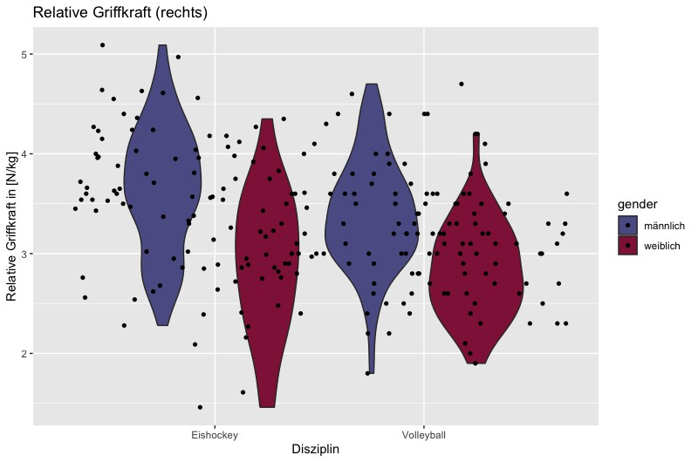
Notes:
Die Griffkraft ist bei allen High Performern bei allen Sportarten erhöht – es gibt eine gewisse Korrelation – keine Kausalität

Slide 19
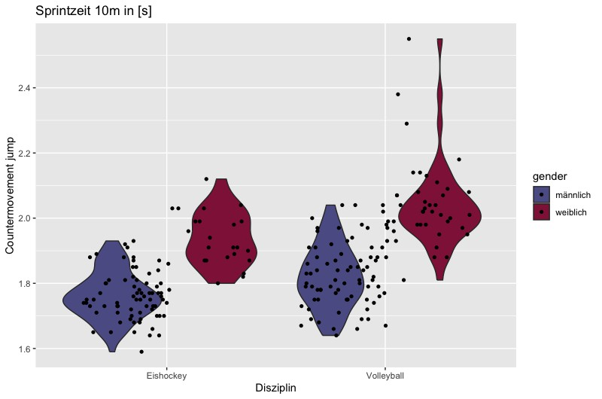
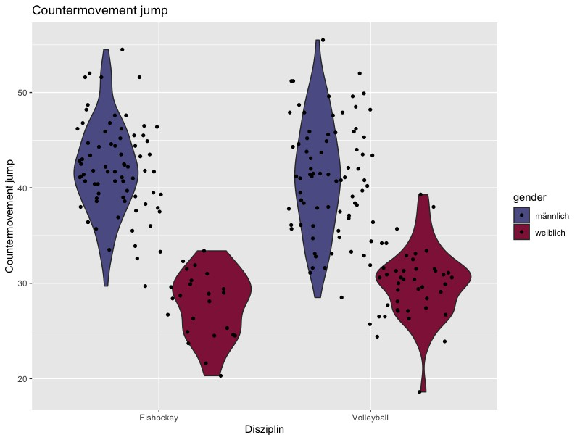
Countermovement Jump in [cm]
Sprint 10m [s]
Countermovement Jump [cm]
Notes:
Es ist trivial, das Männer höher Springen, als Frauen, etc. aber hier geht es darum, dass wir individuell und kontextualisiert (Torhüter, etc.) auf die Spieler*innen eingehen können und sie dann auch so begleiten…

Slide 21
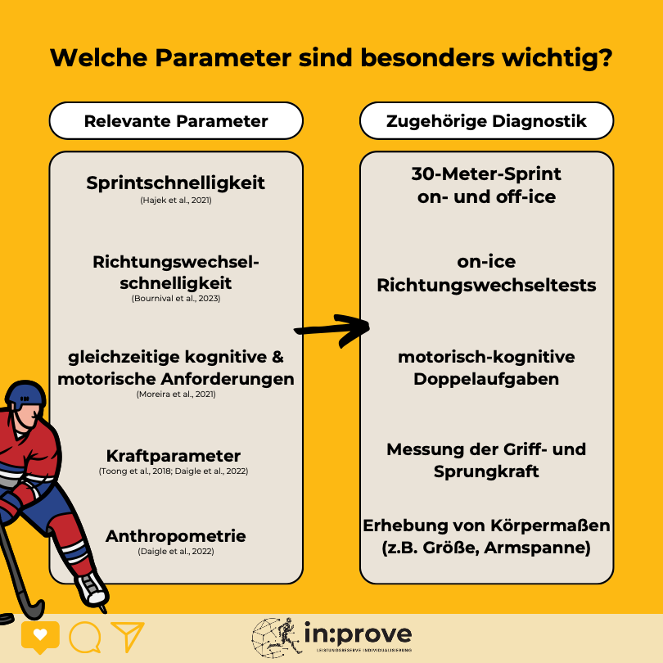

Slide 25
Performance diagnostics

Slide 26
Performance diagnostics

Slide 27
Performance diagnostics

Slide 28
Performance diagnostics

Slide 29
Completely digital Training Framework (RTK) with instructional videos

Slide 30
Cooperation with the “Zeitakademie“

Slide 31
“Coach the Coach“ Podcast

Slide 32
Restructuring of trainer education: competence-oriented teaching and testing – ALSO REALLY IMPORTANT: REFEREE EDUCATION

Slide 33
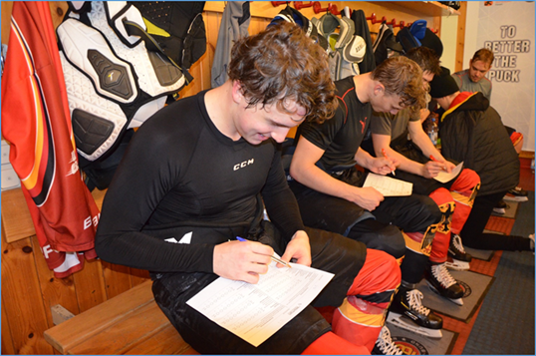
Testing: from the state squad to the Olympic squad - collection of objective and subjective data

Slide 34
Making Rules to Help young Players to establish themselves in professional Hockey

Slide 35
Number of players with their respective nationality (DEL)
DEL-Season 23/24

Slide 36
Trend of U23 Players on the game roster
DEL

Slide 37
What we will do in the near future

Slide 38
VR for Performance and Rehabilitation

Slide 39
Trial balloon for league classification according to biological age (Bio Banding)

Slide 40
Even more club support: “Coach the Coach”

Slide 41
Where we want to go

Slide 42
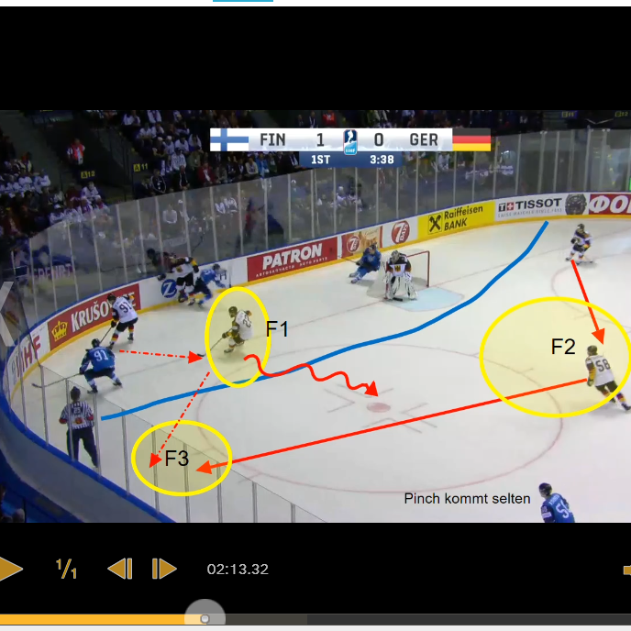
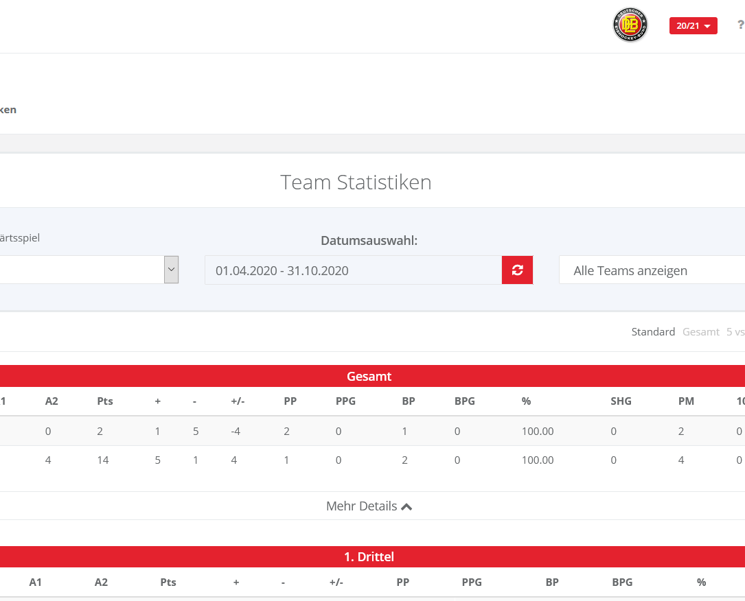
Better KPIs for talent identification

Slide 43
To have so many talents (whatever that means) that "Bio Banding" works throughout Germany

Slide 44
To be among the world's best in the long term

Slide 45
Questions that arise
What is talent? How early should we start selecting? Are we really looking at the right aspects in the selection process? How important is strength and conditioning in youth player development? Don't we leave out the social component far too often? What role does society play?

Slide 46
What we stand for
Never lose sight of the “human being" – every person is a talent We can't really select at the DEB – so we develop Constantly try to break up “encrusted structures” and implement new ones (e.g. Bio Banding) Don't forget the social component – the athlete is not an island Hard work (however that is defined) cannot be replaced by anything

Slide 47
Everybody is a genius.
But if you judge a fish by its ability to climb a tree, it will live its whole live believing that it is stupid.

Slide 48
Literatur
Andersen LL, Aagaard P. Influence of maximal muscle strength and intrinsic muscle contractile properties on contractile rate of force development. Eur J Appl Physiol 2006;96:46-52.
Barnickel, L. (2009). Gewaltprävention durch Kampfsport. Theorie, Einflussfaktoren und praktische Anwendung. München: Martin Meidenbauer.
Beudels, W. & Anders, W. (2006). Wo rohe Kräfte sinnvoll walten. Handbuch zum Ringen, Rangeln und Raufen in Pädagogik und Therapie (2. Aufl.). Dortmund: borgmann publishing.
Binder, B. (2007). Psychosocial Benefits of the Martial Arts: Myth or Reality? A Literature Review. Zugriff am 25.09.2012 unter http://www.fearknot-martialarts.com/Potentials/PsychosocialBenefitsoftheMartialArts.pdf
Biomechanische Überlegungen zu Impaktkräften beim Laufen, Prof. Dr.sc.nat., Dr.h.c. mult. Benno m. nigg.
Bompa, T. O., & Haff, G. G. (2009). Periodization: Theory and Methodology of Training.
Brauner, S., Hartmann, S., Hündersen, S. & Müller, K. (2010). Ordnung Taekwondo als Schulsport. Deutsche Taekwondo Jugend.
Daoud, A.I., Geissler, G., Wang, F., Saretsky, J., Daoud, Y. and Liebermann, D.E. Foot strike and injury rates in endurance runners: a retrospective study. Medicine & Science in Sports & Exercise, Preprint, 2012.
Delecluse C. Influence of strength training on sprint running performance. Current findings and implications for training. Sports Med 1997;24:147-56.

Slide 49
Literatur
Ericsson, K. A., Krampe, R. T., & Tesch-Römer, C. (1993). The role of deliberate practice in the acquisition of expert performance.
Faigenbaum AD, Kraemer WJ, Blimkie CJ, Jeffreys I, Micheli LJ, Nitka M, Rowland TW. Youth resistance training: updated position statement paper from the national strength and conditioning association. J Strength Cond Res. 2009 Aug;23(5 Suppl):S60-79. https://doi.org/10.1519/jsc.0b013e31819df407
Faigenbaum AD, Myer GD. Resistance training among young athletes: safety, efficacy and injury prevention effects. Br J Sports Med 2010;44:56-63.
Faigenbaum, A. D., Myer, G. D., & Lloyd, R. S. (2013). Youth resistance training: past practices, new perspectives, and future directions.
Faigenbaum, Avery D. EdD, FACSM, FNSCA1; MacDonald, James P. MD, MPH, FACSM2; Haff, G. Gregory PhD, FNSCA3 Are Young Athletes Strong Enough for Sport? DREAM On, Current Sports Medicine Reports: January 2019 - Volume 18 - Issue 1 - p 6-8 doi: 10.1249/JSR.0000000000000554 https://journals.lww.com/acsm-csmr/Fulltext/2019/01000/Are_Young_Athletes_Strong_Enough_for_Sport__DREAM.4.aspx
Falk, B. & Mohr, G. (1996). The effects of resistance and martial arts training in 6- to 8-year-old boys. In: Pediatric exercise science. Jahrgang: 8, (1996), Heftnummer: 1, S. 48-56, Lit.

Slide 50
Literatur
Granacher, U., Lesinski, M., Büsch, D., Muehlbauer, T., Prieske, O., Behm, D. G., & Baumeister, J. (2016). Effects of resistance training in youth athletes on muscular fitness and athletic performance.
Hartnack, F. & Diekmann, T. (2011). Taekwondo und kooperative Körperkontaktspiele als gewaltpräventive Maßnahmen in der Schule. Aachen: Shaker.
IN.Prove Study: Sports Medicine - Open (2022). The Impact of Sleep Interventions on Athletic Performance.
Jouck, S. (2008). Dordel-Koch-Test (DKT). Ein Test zur Erfassung der motorischen Leistungsfähigkeit im Kindes- und Jugendalter. Dissertation, Köln.
Kellmann, M., & Kallus, K. W. (2001). Recovery-stress questionnaire for athletes: User manual. Human Kinetics.
Kings Study: PLOS ONE (2021). Effect of core training on athletic and skill performance.
Liebl, S. (2011). Macht Judo Kinder stark? In: P. Kuhn, H. Lange,T. Leffler & S. Liebl (Hrsg.), Kampfkunst und Kampfsport in Forschung und Lehre 2011. 1. Internationales Symposium »Kampfkunst & Kampfsport« vom 6.-7. April 2011 in Bayreuth. (Schriften der Deutschen Vereinigung für Sportwissenschaft, 220, S.139-150). Hamburg: Czwalina.
Myer, G. D., Faigenbaum, A. D., Ford, K. R., Best, T. M., Bergeron, M. F., & Hewett, T. E. (2011). When to initiate integrative neuromuscular training to reduce sports-related injuries and enhance health in youth?.
Ritz, C. (2011). Socius Projekt: Für eine gewaltfreie Stadt Würzburg. In: P. Kuhn, H. Lange, T. Leffler & S. Liebl (Hrsg.), Kampfkunst und Kampfsport in Forschung und Lehre 2011. 1. Internationales Symposium »Kampfkunst & Kampfsport« vom 6.-7. April 2011 in Bayreuth. (Schriften der Deutschen Vereinigung für Sportwissenschaft, 220, S.167-174). Hamburg: Czwalina.
Selye, H. (1956). The Stress of Life.

Slide 51
Literatur
Smith, D. J. (2003). A framework for understanding the training process leading to elite performance.
Stanford Medicine (2011). Snooze you win? It's true for achieving hoop dreams.
Suchomel TJ, Nimphius S, Stone MH. The Importance of Muscular Strength in Athletic Performance. Sports Med. 2016 Oct;46(10):1419-49. doi: 10.1007/s40279-016-0486-0.
Testungen im Eishockey: Eine Übersicht aus 20 Jahren Forschung (2023).
The Relative Age Effect in Ice Hockey: Analysis of Its Presence, Its Fading, and of a Reversal Effect (2023).
The physiology of ice hockey performance: An update (2023).
WANC 30.04.09/Quelle: Sportwissenschaftliches Institut der Universität des Saarlandes, "Kraft und Krafttraining bei Kindern und Jugendlichen" - Tectum-Verlag.
Weyand PG, Sternlight DB, Bellizzi MJ, Wright S. Faster top running speeds are achieved with greater ground forces not more rapid leg movements. J Appl Physiol (1985) 2000;89:1991-9.

Slide 52
Literatur
Wilmore, J. H., & Costill, D. L. (2004). Physiology of Sport and Exercise.
Wolters, J.-M. (1992). Kampfkunst als Therapie. Die sozialpädagogische Relevanz asiatischer Kampfsportarten. Aufgezeigt am Beispiel des sporttherapeutischen »Shorinji-Ryu« (-Karate-do) zum Abbau der Gewaltbereitschaft und Aggressivität bei inhaftierten Jugendlichen. Frankfurt am Main: Peter Lang.
Zajonc, O. (2011). Bedingungen des Kämpfens als Mittel zur Gewaltprävention. In: P. Kuhn, H. Lange, T. Leffler & S. Liebl (Hrsg.), Kampfkunst und Kampfsport in Forschung und Lehre 2011. 1. Internationales Symposium »Kampfkunst & Kampfsport« vom 6.-7. April 2011 in Bayreuth. (Schriften der Deutschen Vereinigung für Sportwissenschaft, 220, S.175-187). Hamburg: Czwalina.
Zawieja, M. & Oltmanns, K. (2011). Kinder lernen Krafttraining. Münster: Philippka.
Zentgraf, K., & Raab, M. (2023). Excellence and expert performance in sports: what do we know and where are we going? International Journal of Sport and Exercise Psychology.
Zentgraf, K., Munzert, J., Bischoff, M., & Newman-Norlund, R. (2011). Simulation during observation of human movements.
Söhnlein, Schwarzenbrunner, DEB Meisterlehre
Bilder: © DEB, © unsplash

