Slide 1
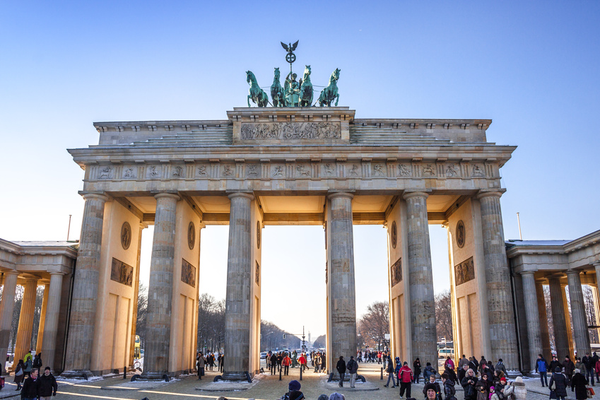
„Open this gate. [..]Tear down this wall.“ European Court of Justice Superleague Game Changer
Munich 2024, Mark-E. Orth

Slide 2
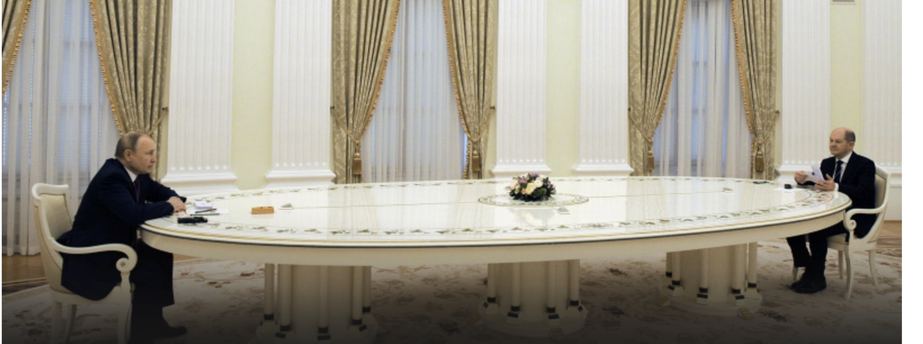
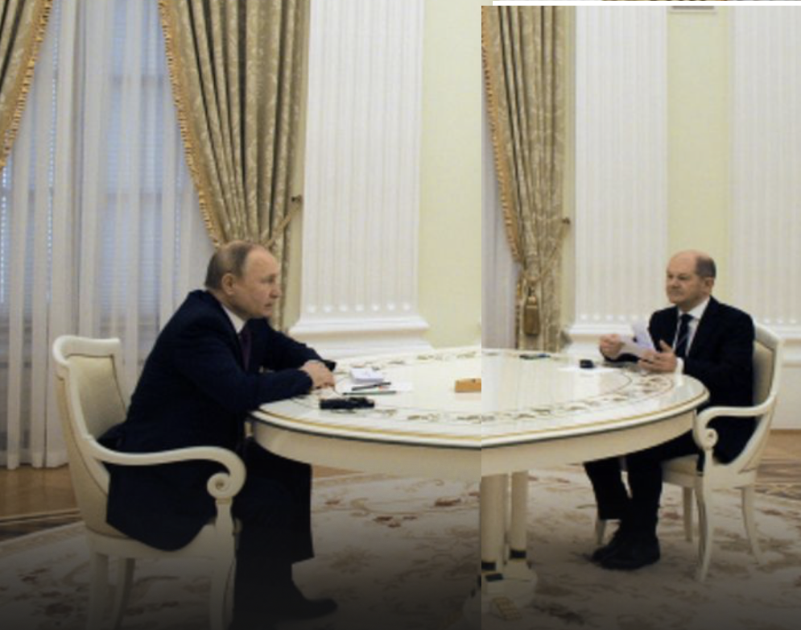
European Competition law applied
by ECJ in Superleague

Slide 3
European Super League Project (adaption in time)
Guided by the principle of self government
12 clubs as founders (Spain, Italy, England)
Semi closed league (later abandoned)
Projected recognition by UEFA and FIFA
Substantial loan to ensure viability and trust with clubs
More exciting games, more money for the clubs and more solidarity payments

Slide 4
European Superleague two main obstacles
UEFA Statute Art. 49 (1):
(1) UEFA shall have the sole jurisdiction to organise [..] international competitions in Europe in [..]
(3) International matches, competitions or tournaments which are not organised by UEFA [..] shall require the prior approval of FIFA and/or UEFA and/or the relevant Member Associations [..]
FIFA Statute Art. 67(1) and 68 (1):
FIFA, its member associations and the confederations are the original owners of all of the rights emanating from competitions[..]

Slide 5
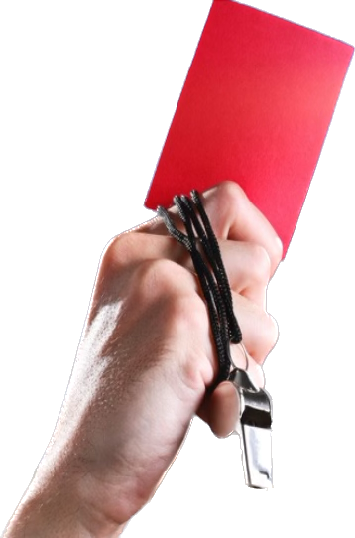
European Super League Court procedure (ongoing)
20.04.21 Interim injunction juzgado mercantil Madrid
13.05.21 preliminary question to European Court of Justice (ECJ)
21.12.23 ECJ judgement
13.05.24 juzgado mercantil Madrid using the ECJ answers

Slide 6
European Superleague ECJ judgement (I)
Sanctions for clubs and players for participating in non-prior approved games dependent on
Detailed procedural rules
Exhaustive list of substantive criteria,
Which are transparent, objective and non discriminatory

Slide 7
European Superleague ECJ judgement (II)
Joint selling of club media rights is contrary to European competition law
Efficiences to be proven by UEFA and FIFA (until now: (-))

Slide 8
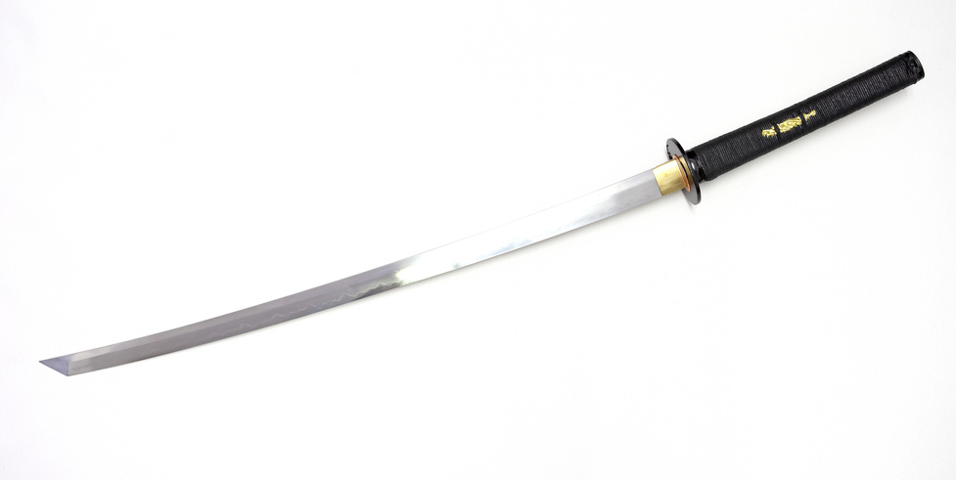
UEFA reaction amendments to CL
(project Gandalf MPI 98‘)
More highlevel games guaranteed for clubs
More money for the clubs
Improved competition
Not reaching the numbers promised by MPI

Slide 9
European Superleague Quo vadis ?
Damage claims Proceed

Slide 10
Comparable developments and further consequences
German wrestling league
German motorsport Rallye (damages paid)
Bundesliga joint selling of media rights
DSV v. FIS (LG Munich)
Diarra
Complaint and court procedure FIFA match calendar

Slide 11
Consequence of your 10.000 USD olympic
Player remuneration ?

Slide 12
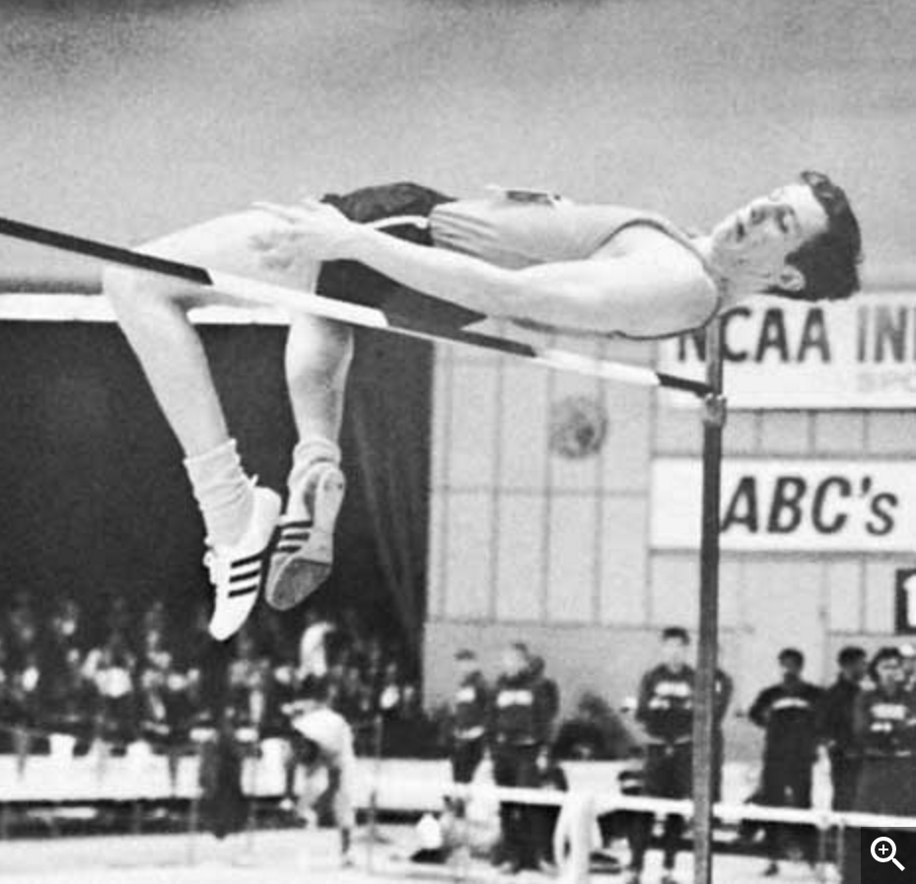
If you want to jump higher, change your technique

Slide 13
Thank you for your attention

