Slide 1
EHC Hockey Business Forum ECA and its role in football… …and what Hockey can learn
Munich, 30 October 2024
Notes:
Kick off time: 09h30

Slide 2
2

Slide 3
ECA’s creation story
2008
2002
2000
Before
2000
ECA started with 137 Members from 52 European countries

Slide 4
ECA today
ECA is the sole independent body directly representing football clubs at European level and recognised by UEFA and FIFA
ECA exists to place the voice of Clubs at the Heart of Football
Beyond 700
ECA Member Clubs from 55 National Associations across Europe
Notes:
How many members

Slide 5
ECA in a nutshell
IMC
Laws of the Game
RSTP
1
Legal Advice
Commercial
Finance
Football Operations
Youth
Women’s
Sustainability
Representing European Clubs with Governing Bodies / Public Authorities
3
700+
EUROPEAN CLUBS
2
Services provision across all club functions areas
International Club Competitions Access, Format and Revenue Distribution
Regulations
Joint Ventures For commercial matters
Joint engagement with UEFA / FIFA in managing CCs framework
Notes:
550+ ECA Clubs from 55 National Associations across Europe, started in 2008/2009 with 137 members
ECA is the sole independent body directly representing football clubs at European level and recognised by UEFA and FIFA
ECA exists to place the voice of Clubs at the Heart of Football

Slide 6
With such a broad range of club perspectives, balancing “consensus with compromise” is vital
Club Unity
Commercial Power
M € of annual revenues
Uniting ECA Members makes ECA stronger
ECA Members
Source: Estimates based on UEFA, ECA and Deloitte
Notes:
10:26:00 - 10:39:00

Slide 7
ECA’s Overall Governance Structure
General Assembly – i.e., our Members!
Board
Executive Committee
Workstreams
1 x ExCo
1 x ExCo
1 x ExCo
1 x ExCo
1 x ExCo
1 x ExCo
1 x ExCo
1 x ExCo
1 x ExCo
Men’s Football
Women’s Football
Youth Football
Commercial & Innovation
Finance
Legal & Regulatory
Sustainability
ECA Governance & Development
Fans
Working Groups / Bureaus / Panels / Task Forces / Committees – many hundreds of clubs!
7
New workstream from this season

Slide 8
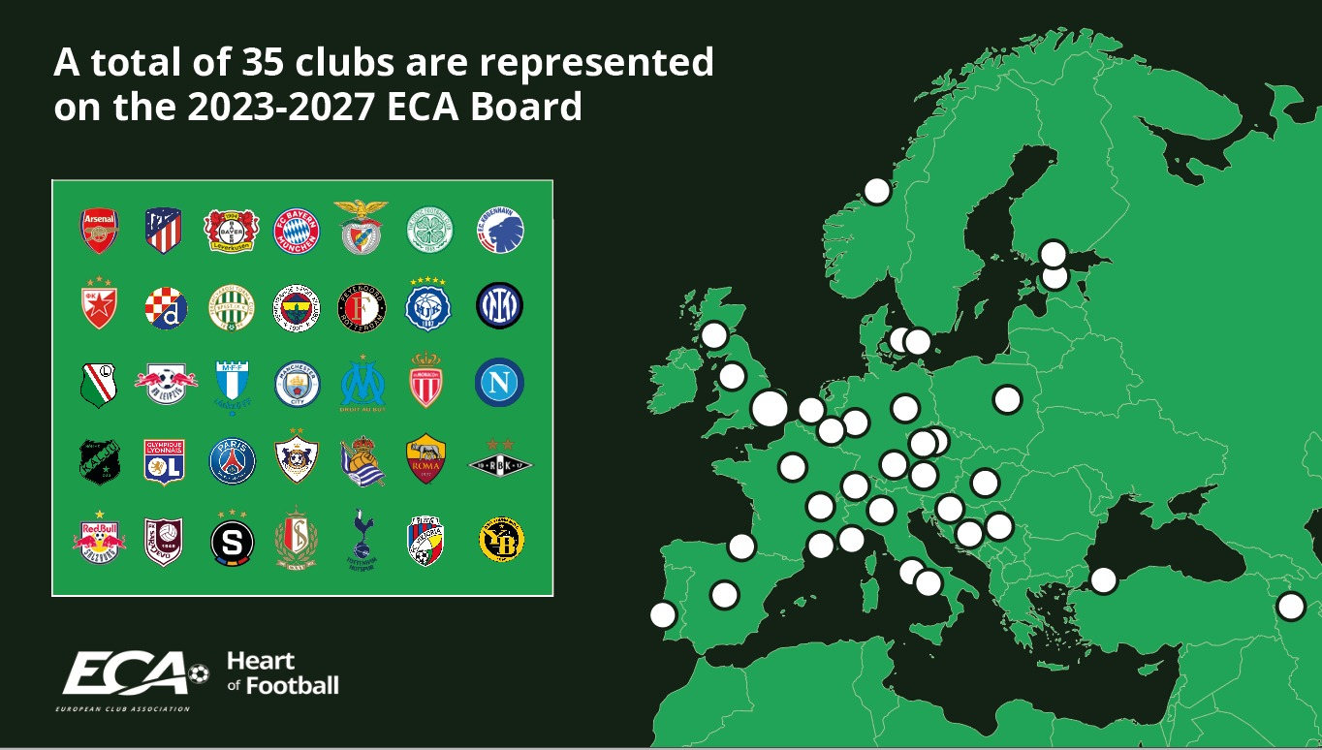
Notes:
Ordinary: Ararat-Armenia
Associated: Alashkert, Urartu, FC Ararat, Pyunik, Noah

Slide 10
ECA’s Overall Governance Structure
Priority Topics
General Assembly
Board
ExCo
Decide
Calendar
Joint Ventures
ECA Foundation
UEFA & FIFA Club Competitions Format
External Bodies
Internal Bodies
Player Transfer System
UEFA and FIFA Committees
ECA Working Groups, Panels & Task Forces
Recommend
Financial Model Mechanism
ECA Administration
Implement
Notes:
17:05:00 - 17:15:00

Slide 11
ECA and Stakeholder Organs and Bodies
General Assembly
Joint Venture
UEFA
ExCo
CCC
Marketing Advisory
Club Licensing
Board
PSTA
Media
Stadium & Security
Women’s Football
Executive Committee
Medical
Youth
UEFA Events
Devt. &
Tech. Assist.
Working Groups
Football
FFSR
Foundation*
UEFA Events SA*
Men’s Football
Women’s Football
Youth Football
Commercial & Innovation
Legal
National Associations*
Finance
Legal & Regulatory
Sustainability
Governance & Development
Joint Venture
FIFA
Club World Cup Committees*
Stakeholders
Cttee*
IMC Committees*
Bureaux / Panels / Task Forces / Committees /
Advisory Groups
Other
ECA Foundation
IFAB*
* Yet to be appointed
Notes:
29 ECA representatives were appointed at UEFA – 10 of them participated to the first UEFA Committees from the new cycle and key takeways were made available as part of the ECA binder.

Slide 12
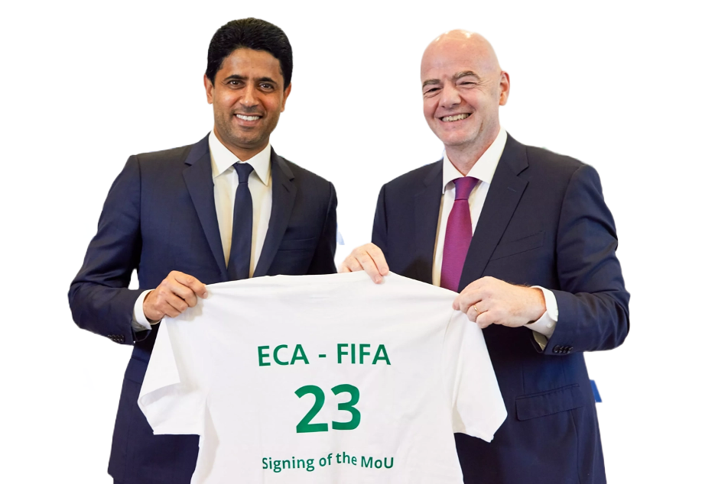
Strengthening the FIFA and ECA Partnership
Partnership formally renewed through new MOU to 2030
Club Benefits $355m (from 40 m. in South Africa)
Renewed Club Protection Programme
International Match Calendar
Revamped FIFA Club World Cup incl. Route to Joint Venture
Services provision across all club functions areas
Mutual Recognition at Global and European level
Club National Teams collaboration globally
MEN’s & WOMEN’s FOOTBALL
12

Slide 13
FIFA Club Benefits Programme
2022 FIFA Qatar World Cup
As per:
FIFA / ECA MOU
$209m. total
Amount per player per game
$10,950
$209m
444 clubs from 50 NAs have released players
Total amount to be paid
Payments to your National Associations
Notes:
209 m (Qatar)
40m (Afrique Sud)

Slide 14
2026 FIFA World Cup Benefits Programme (CBP)
New concept to enable thousands of clubs worldwide to benefit from ECA-FIFA MOU
$355m
+70% vs FIFA World Cup Qatar 2022
Min. increase of 350% of clubs to benefits vs FIFA World Cup Qatar 2022
Qualification phase: $100m
Final Tournament: $250m
Fixed amount per player per WC qualification game
~$2'350 per player per game
(all players on match sheet)
Fixed amount per player per day to clubs releasing players to WC
Est. amount per player per day: $6'600 (26 players per squad). 23 players: $7'500
Split between qualification phase and final tournament
(+ $5m as buffer for club-related projects / operational costs)
Notes:
Top-5 benefiting clubs
Man Utd $4,089m
Man City $4,015m
Paris St-Germain $3,649m
Real Madrid $3,529m
Arsenal $3,382m
(simulation – final tourn. only)

Slide 15
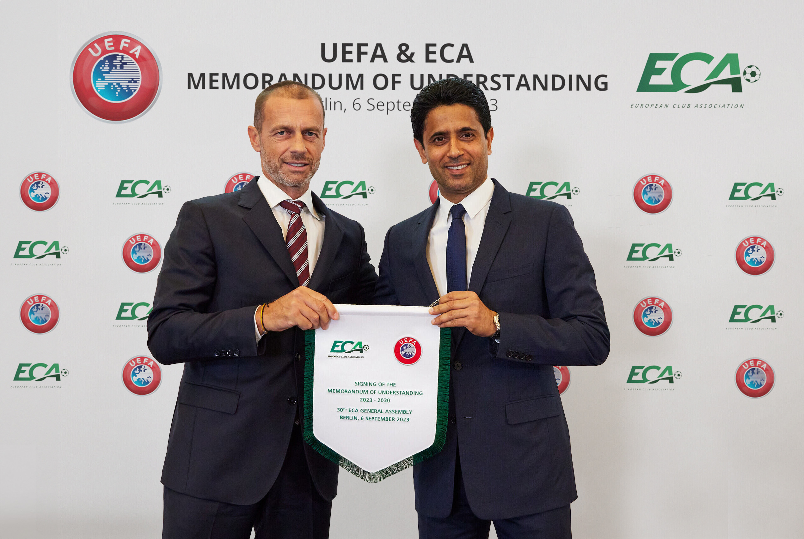
Strengthening the UEFA and ECA Partnership
Partnership formally renewed through new MOU to 2033
Mutual recognition at European level – ECA sole body representing clubs
Protection of the European Sports Model governed by UEFA
Representation of ECA in UEFA bodies
UCC Format, Access, Distribution
Financial Sustainability Rules
Joint Venture for business matters
Clubs and National Teams Collaboration with club Benefits and Protection
Notes:
ECA sole body representing clubs
European Sport Model opposed to American system (closed league)
2 places de l’ECA à l’Exco UEFA, 16 rep de clubs à UCC committee
ECA involved from start to finish in new FSR

Slide 16
UEFA Club Benefits Programme
UEFA Nations League 2021 + 2022/23 editions + EURO 2024
EUR
3.6k
AS PER
Amount per player per game
for UNL and EURO 2024 qualifiers
UEFA/ECA MOU
€240m total/cycle
Total amount to be paid for UNL and EURO qualifiers
EUR
100m
EUR
140m
Total amount to be paid to clubs releasing players to EURO 2024 final tournament
Latest payments to your National Associations performed on 4th April 2024 (cf. next slide)

Slide 17
Overview of ECA Membership Services
Expert Advisory
Education & Knowledge
Research & Insights
Pillars
ECA's in-house experts are available for clubs to consult on a wide range of issues, where you can get bespoke, individual advice in a conﬁdential and professional way, usually for free.
ECA facilitates and ampliﬁes the sharing of tangible knowledge, expertise and insights on how best to manage and develop clubs of all sizes.
ECA collaborates with industry leaders, academics and consultancies to analyse
the European football industry and provide unique perspectives on how best to operate a club in fast moving and volatile times.
Legal
Finance
Commercial
Sustainability
Topics
Competitions & operations
Women’s football
Youth football
Club Management
Case studies
Helpdesk
Publications
Courses
Webinars
Newsletters
Road shows
Workshops
Product

