Slide 1
Recognizing biological maturation & avoiding early selection failures
John Lind, Director Education & Research
john.lind@swehockey.se

Slide 2
The margins in elite sports
Notes:
Vann 54,1% av bollarna under sin karriär Vi har inte råd att ta fel beslut.

Slide 3
The art of talent identification

Slide 4
How accurate are the NHL-scouts?
This study evaluated the accuracy of all seven draft rounds, as well as between lottery and non-lottery picks in the first round. NHL performance data were collected for all forwards (N = 956) and defensemen (N = 558) drafted between 2007-2014.
Predicting future performance was only accurate for defensemen selected in the first round and for forwards selected in the first and second rounds.
The results show significant uncertainty in the NHL draft, especially after the first two rounds.
Last season, 15,7% of the NHL players were undrafted
Farah, Lou & Baker, Joe. (2020). Accuracy from the slot: Evaluating draft selections in the National Hockey League. Scandinavian Journal of Medicine & Science in Sports. 31. 10.1111/sms.13874.
Notes:
https://www.researchgate.net/publication/346910672_Accuracy_from_the_slot_Evaluating_draft_selections_in_the_National_Hockey_League Sju faktorer som proxy Ändå ska ideella klarar det – med Bias som förädrar, dessutom tidigare?!

Slide 5
Performance or potential?
Successful juniors and successful seniors are largely two disparate populations.
International-level U17/18 juniors and international-level seniors were 7.2% identical and 92.8% disparate.
Junior performance has little, if any, predictive validity regarding senior performance
The finding is robust across different populations (e.g., types of sports, sexes, geographical regions)
Early participation in talent development programs is positively correlated with short-term junior performance but negatively correlated with long-term senior performance. Making a late debut correlates with senior performance.

Slide 6
Typically, talent identification and selection usually begin around puberty or younger – an age range where research shows that youth and junior performance are uncorrelated or even negatively correlated with later senior performance
Notes:
Summering

Slide 7
We mistake present performance, driven by temporary physical advantages for being talent or potential

Slide 8
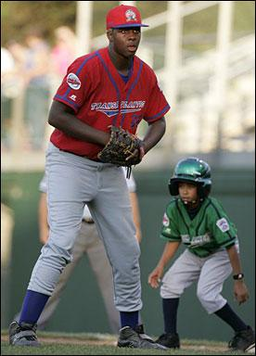
Somatic maturity and the timing of puberty
Children enter puberty at different ages (early, on-time, late)
Timing is mainly genetic
Impacts physical and athletic performance
Team selection in ice hockey?

Slide 9
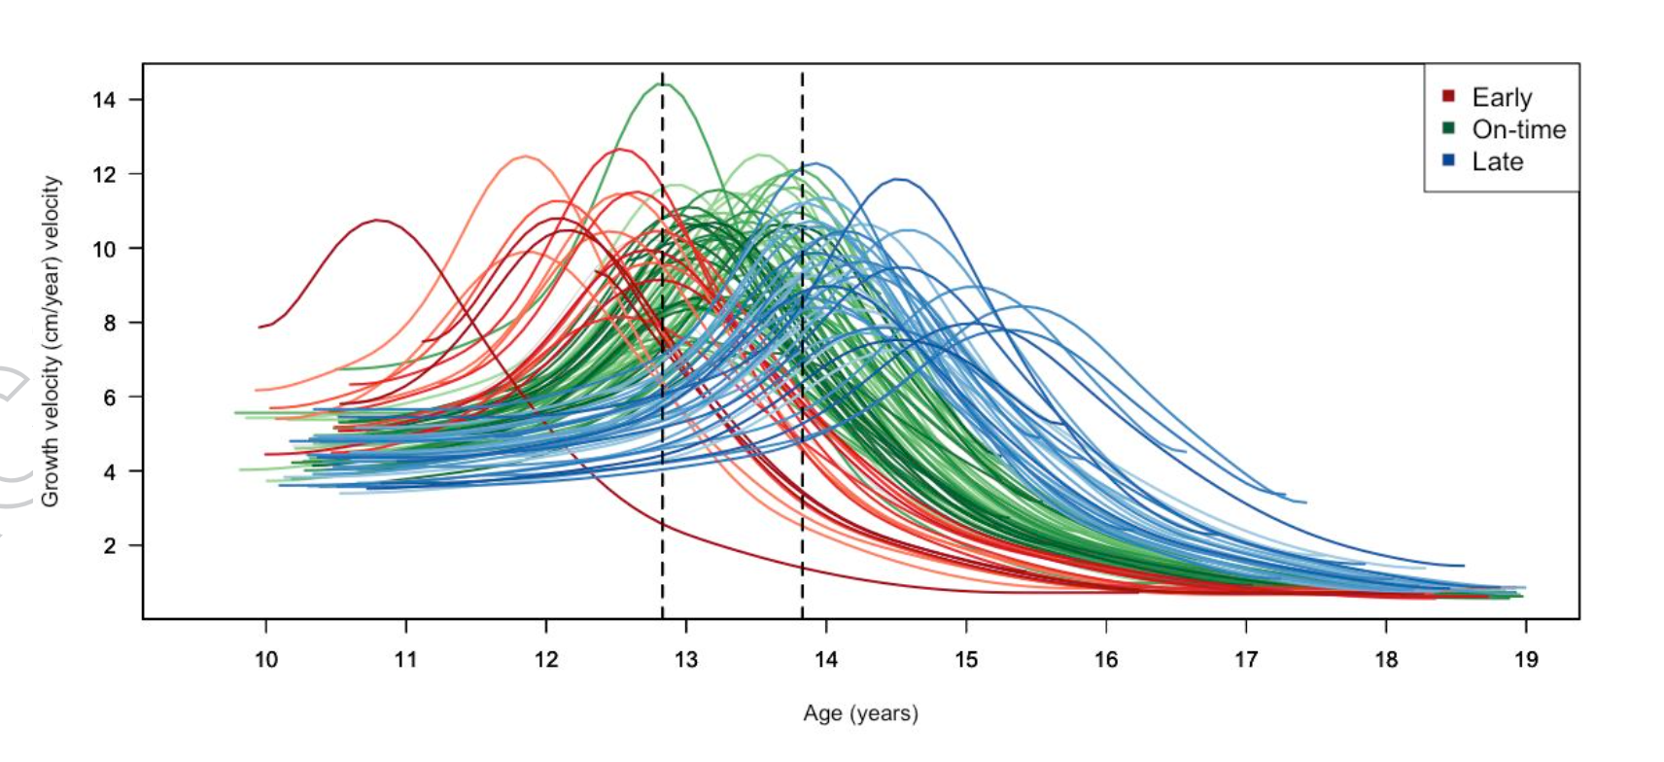
Individual variation in the growth spurt
5 year variation
Late
On-time
Early
Xabier Monasterio et al. 2021

Slide 10
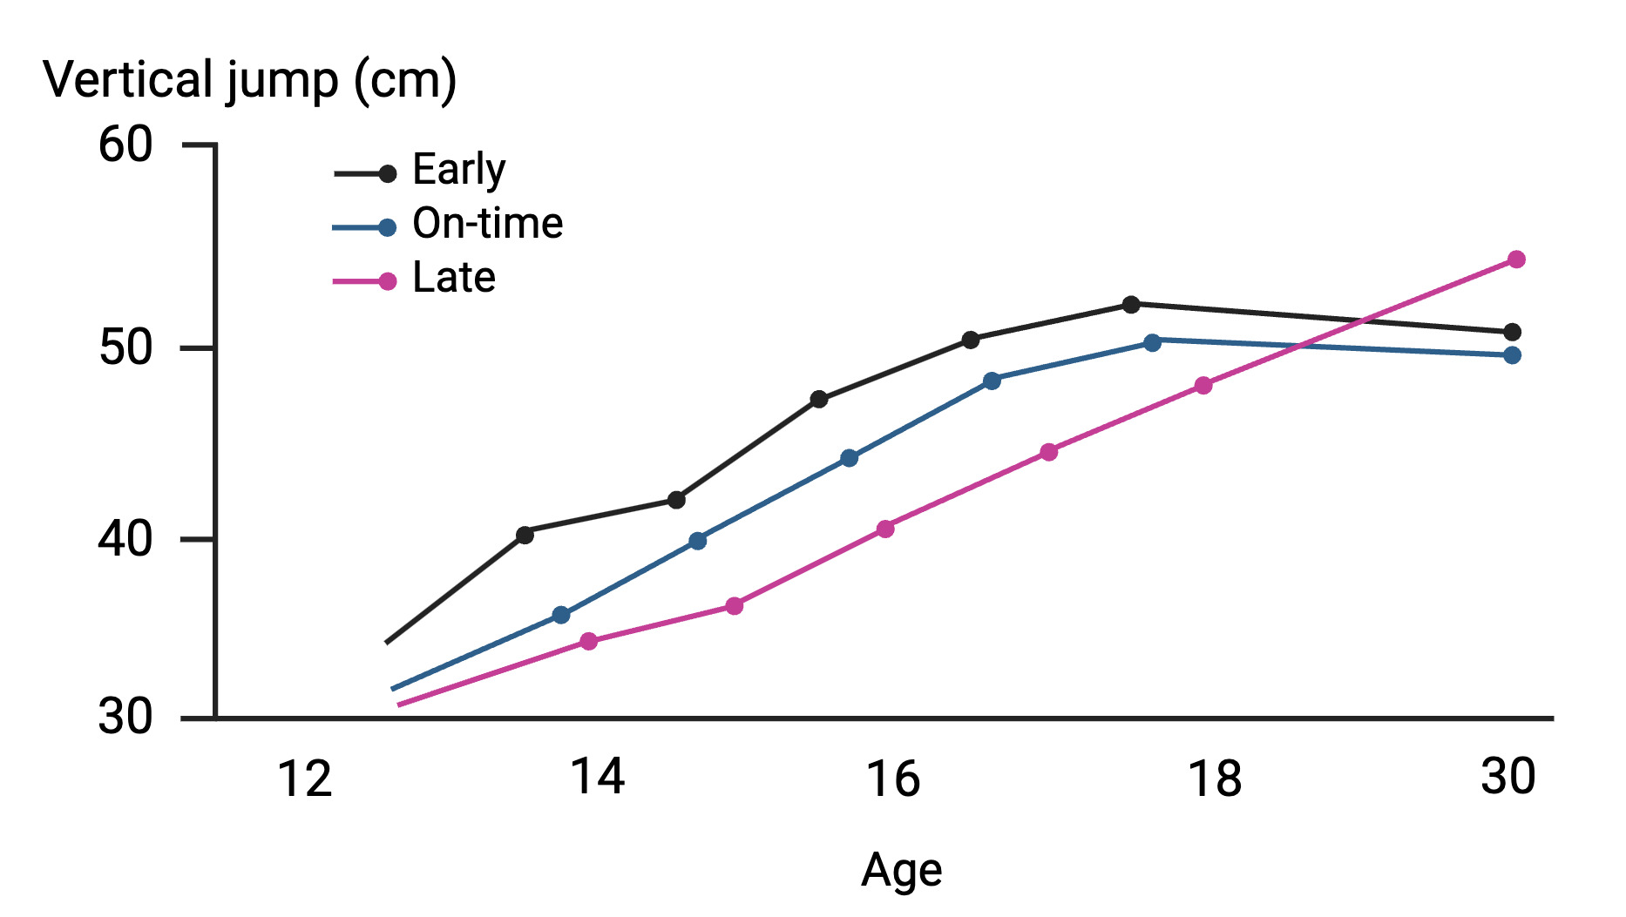
Maturity timing and performance
Strength and power
Aerobic capacity
Speed
Intermittent sports performance (more shots, more high-speed running, more points)
Lefevre et al. Ann Hum Biol. 1990

Slide 11
What does maturity timing say about future potential?

Slide 12
Overview of the issue
Attention
Training/coaching
Selection
Matches
Potential
Opportunities
Early
On-time
Late
Youths

Slide 13
How do we assess maturity?

Slide 14
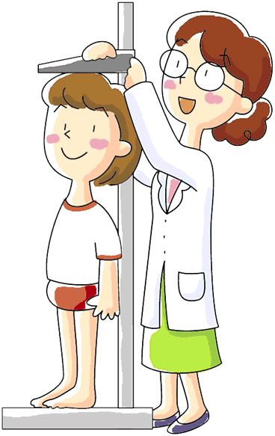
The Khamis Roche method to estimate maturity
% of predicted adult height= Current maturity status
Compared to reference population = Maturity timing
What is needed?
Birth date
Test date
Parental height
Player height and weight

Slide 15
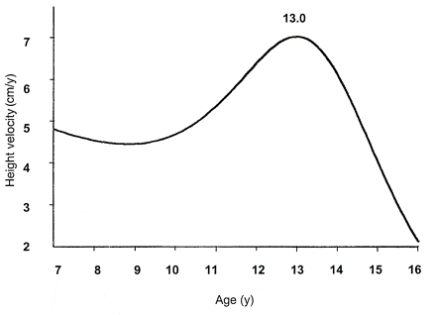
Determining maturation status from %PAH
Age 15: 93% (Late)
Pubertal Growth Spurt
Age 15: 98% (Early)
70%
Pre-pubertal
85%
Circum-pubertal
96%
Post-pubertal
100%
Cumming, Lloyd, Oliver, Eisenmann, Malina (2017) Str Cond J

Slide 16
Biological maturity in ice hockey

Slide 17
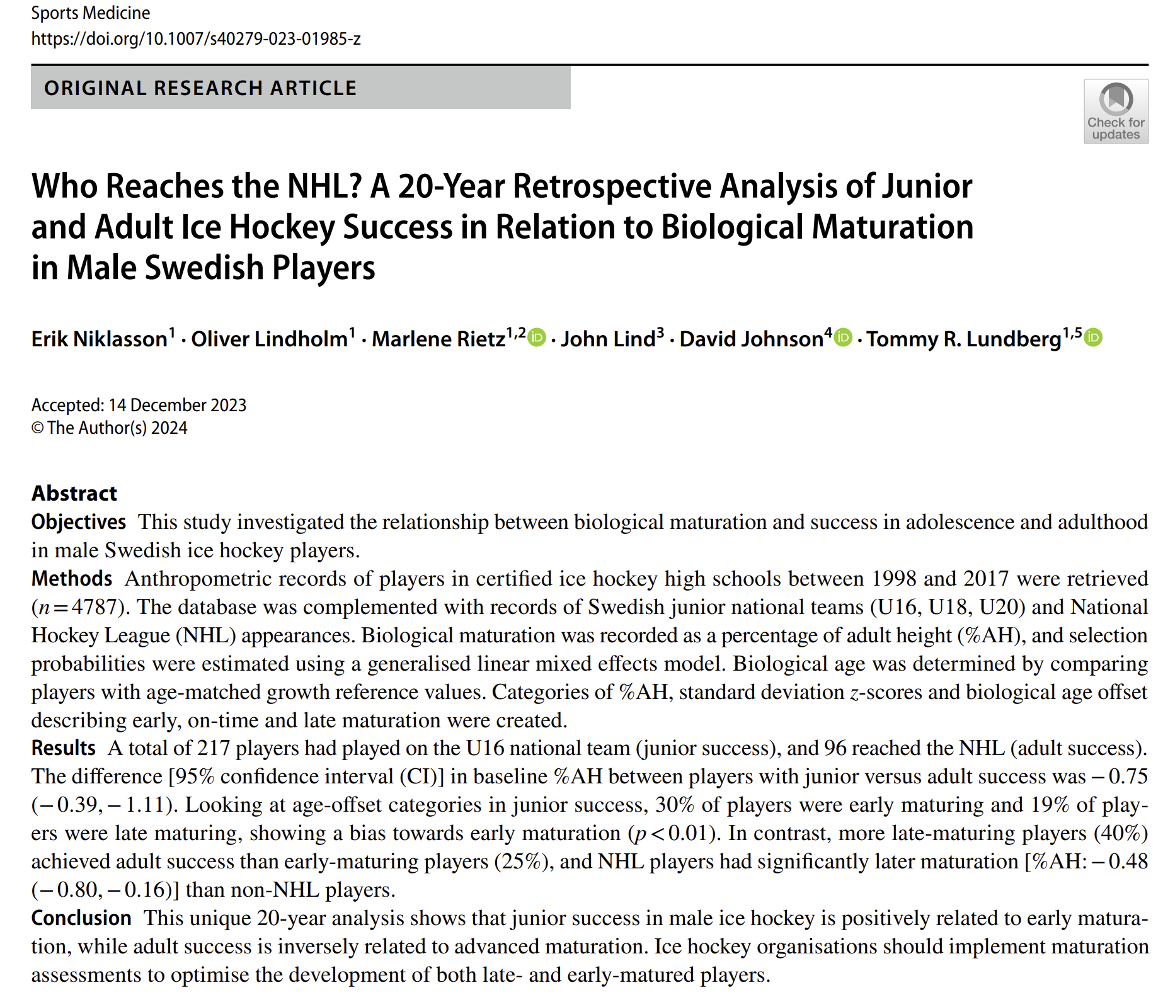

Slide 18
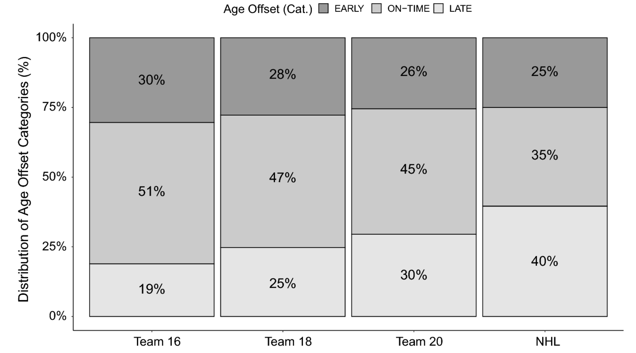

Slide 19
Tools and possible solutions

Slide 20
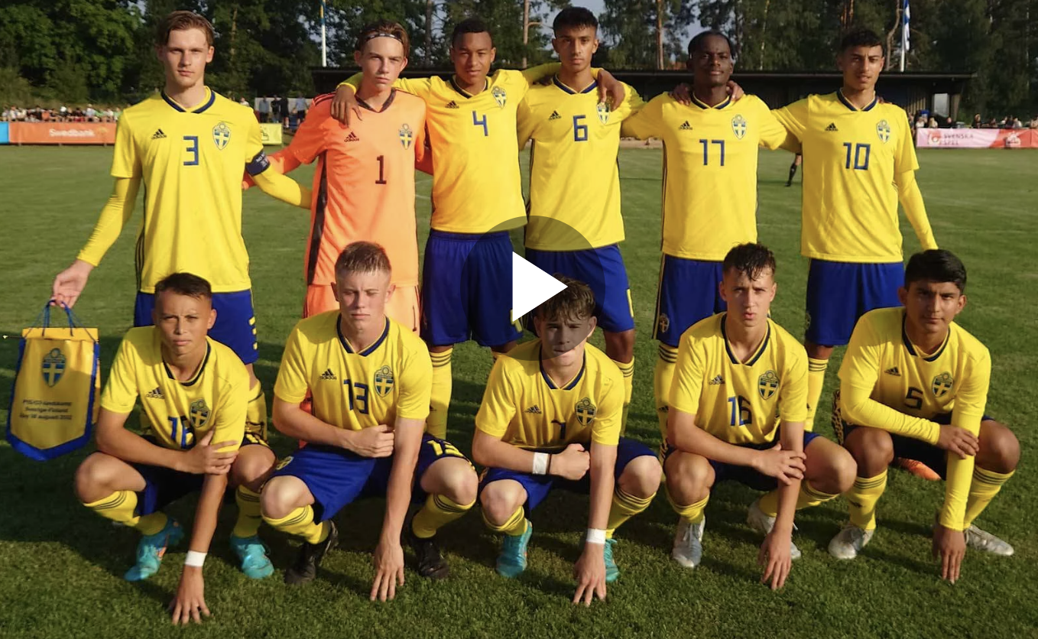
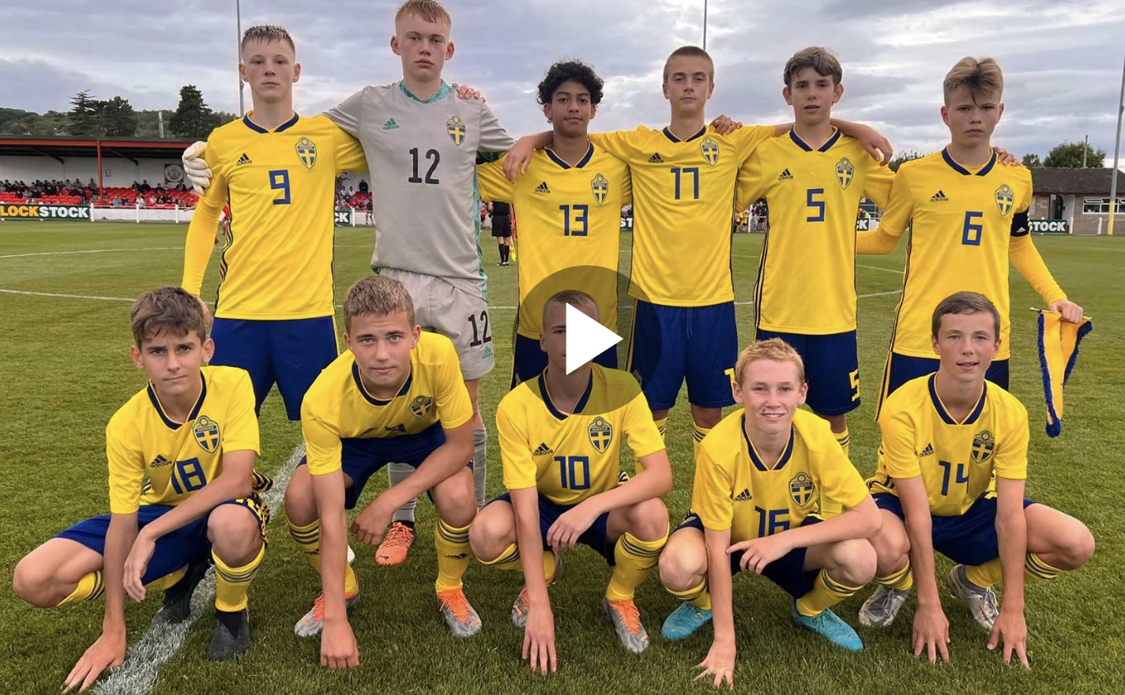
The Future Team concept
P15 National team, Aug 2022
P15 Future team, Aug 2022
Age 15.1
Bio age 15.7
178.8 cm
66.1 kg
Age 15.0
Bio age 14.6
166.8 cm
54.6 kg

Slide 21
Bio-banding
Bio-banding is a concept where you group players based on there biological age instead of chronological age.
The results showed, among other things, that bio-banding can provide late biological maturity players with more opportunities to make their mark in the game, while early developers have more room to improve their tactical and technical skills.
Bio-banding can be an effective tool to provide new types of challenges that players do not encounter as often in the age groups. It helps to broaden the physical and technical challenges, benefiting both early and late physical developers.

Slide 22
Bio-banding – more to come
Data collected in USA
New data collected in Sweden
NHL Edge och Sportlogiq

Slide 23
Other benfits of following maturity status
Adapt traning to maximize response
Avoid growth related injurys
Coaches and managers gets new prepectives on players

Slide 24
Thank you!
john.lind@swehockey.se

Slide 25
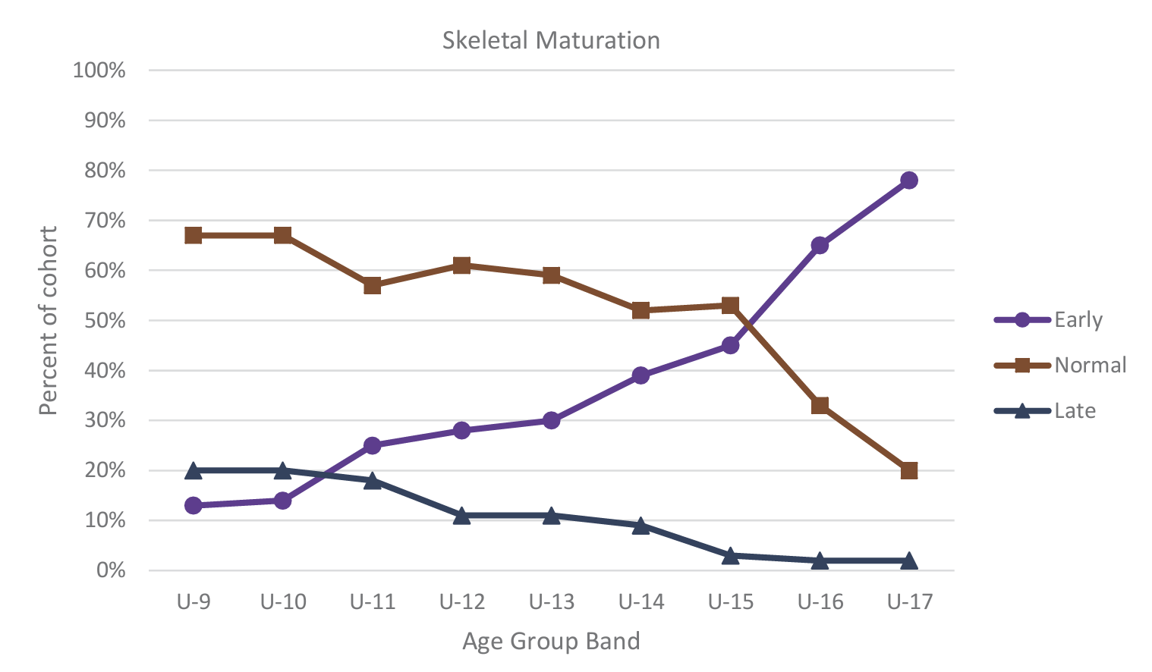
Man United soccer academy – skeletal maturity bias increase with age
Johnson et al. 2017. Science and Medicine in Football,1(2).pp.157-163

