Slide 1
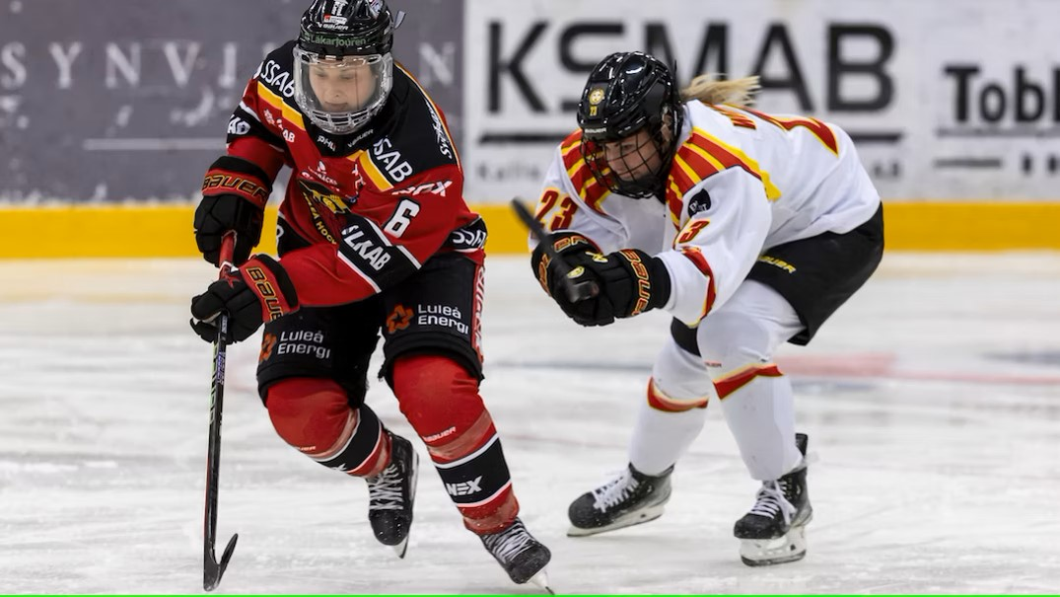
HOW TO CLOSE THE GAP
European women's ice hockey -
Quo Vadis? (where are you going)

Slide 2
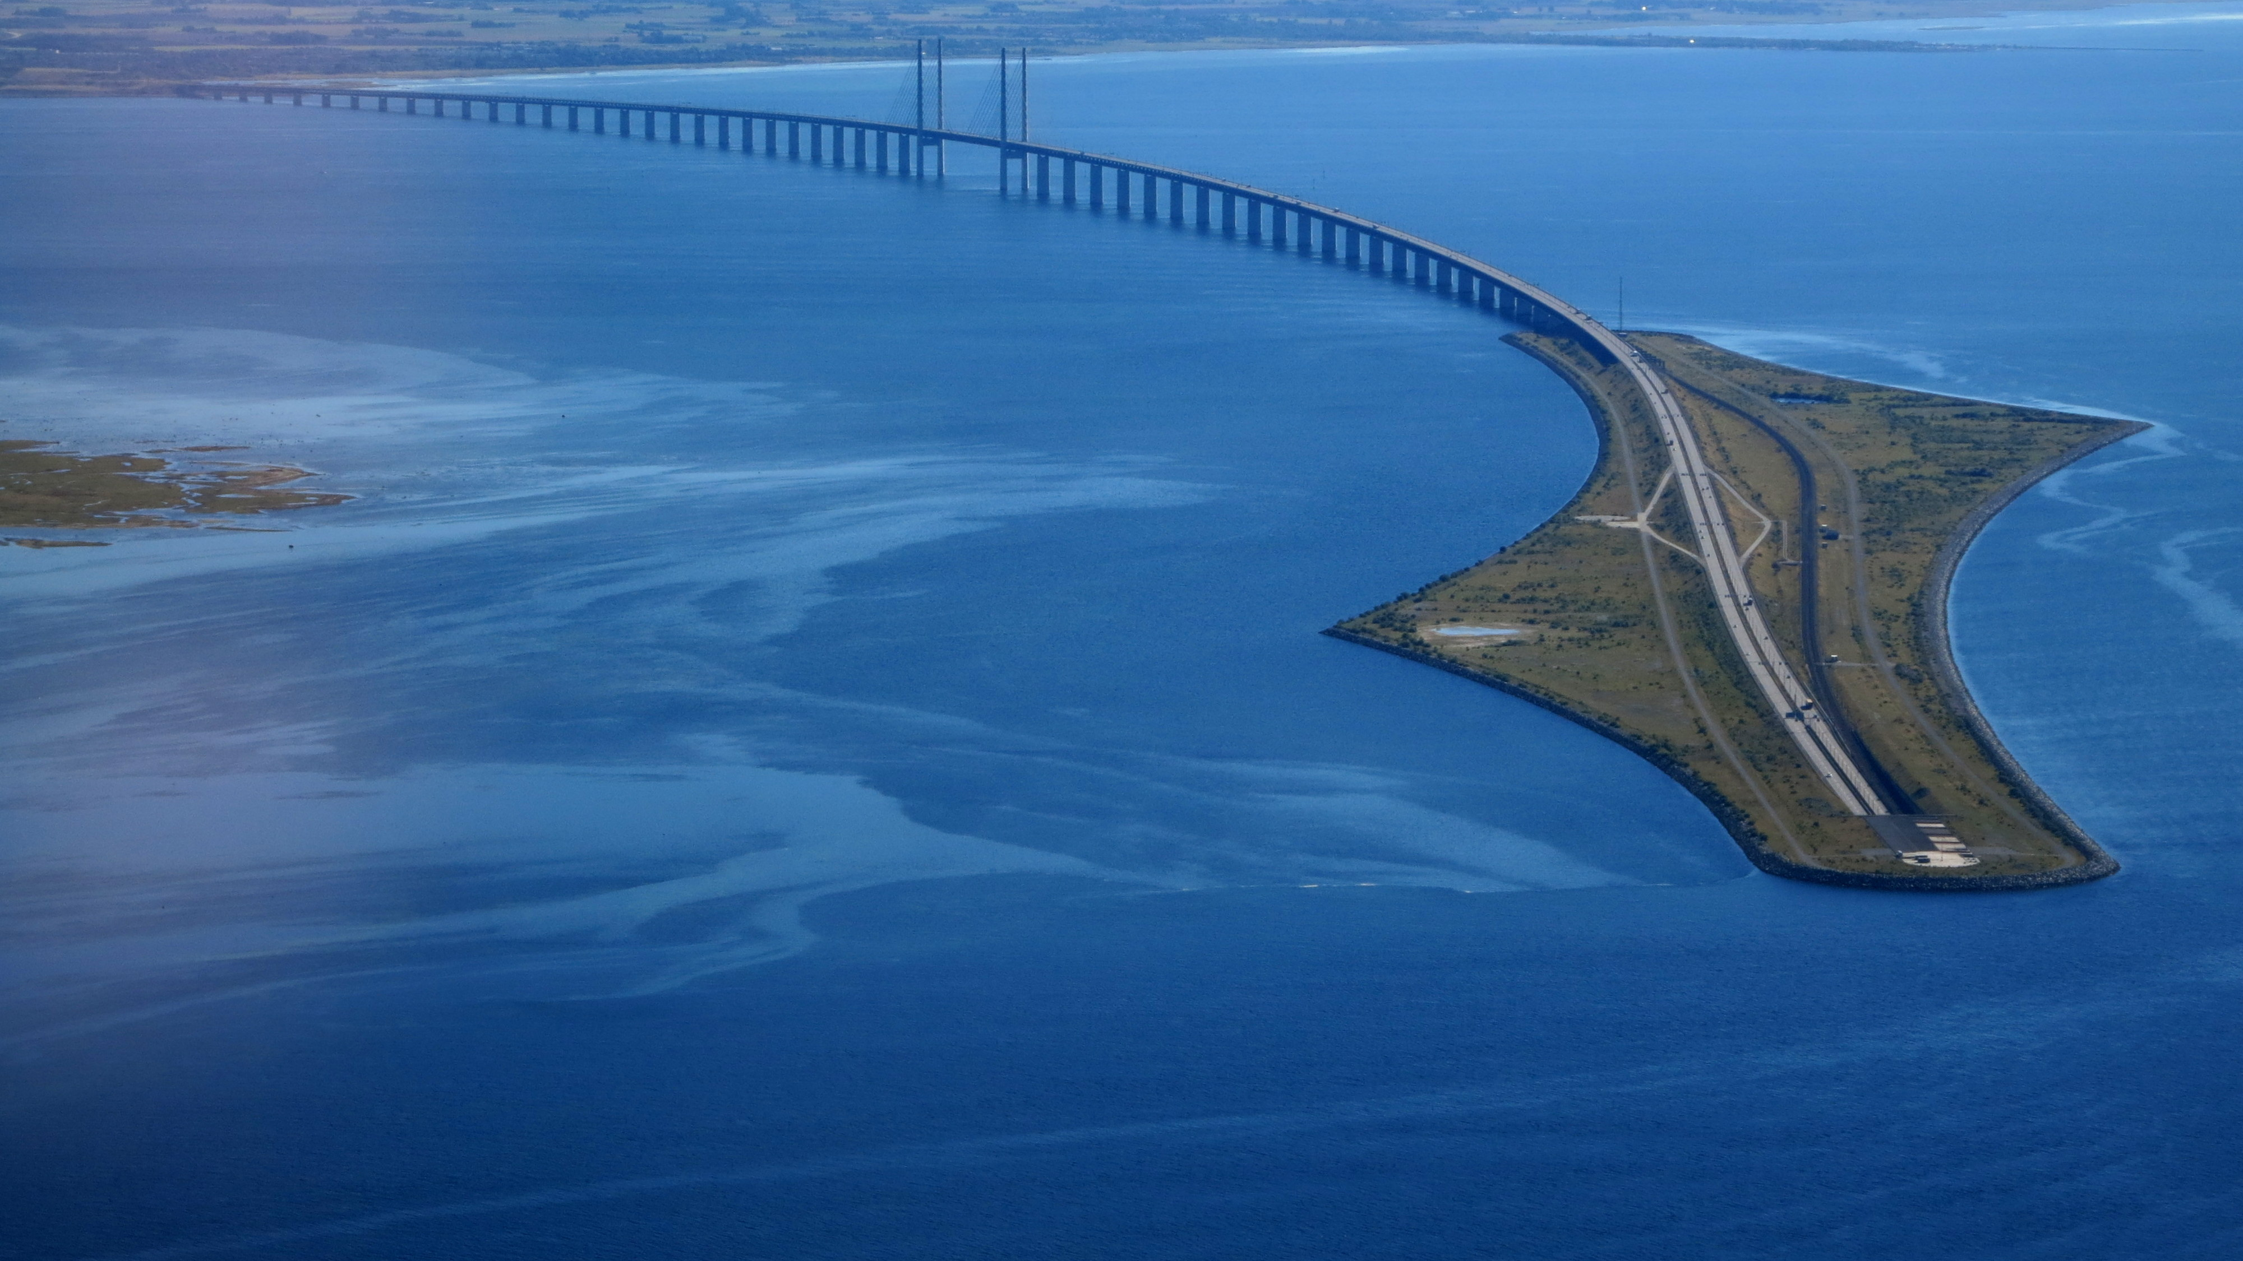
THERE ARE MANY WAYS TO BRIDGE A GAP

Slide 3
The three parties involved
IIHF / National Federations / European Clubs
NCAA Division I Colleges (USA)
Professional Women’s Hockey League (PWHL)

Slide 4
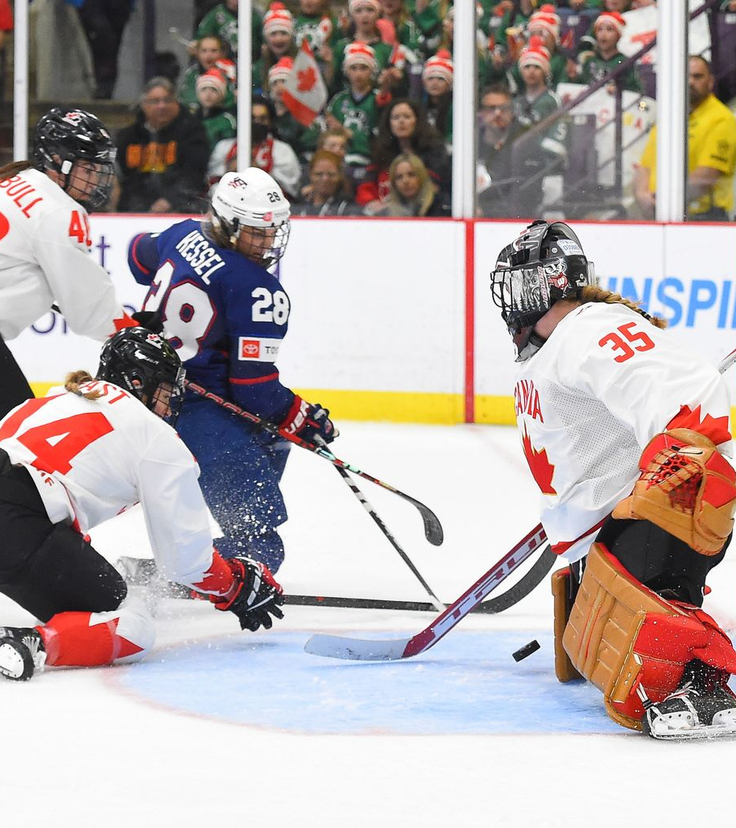
Reality check 1 – Where are we now?
From 1990:
23 final games in IIHF World Women’s
7 final games in Olympics
16 final games in U18 World Women’s
A total of 92 final teams
5 teams – (5,4%) were other nations than USA or Canada

Slide 5
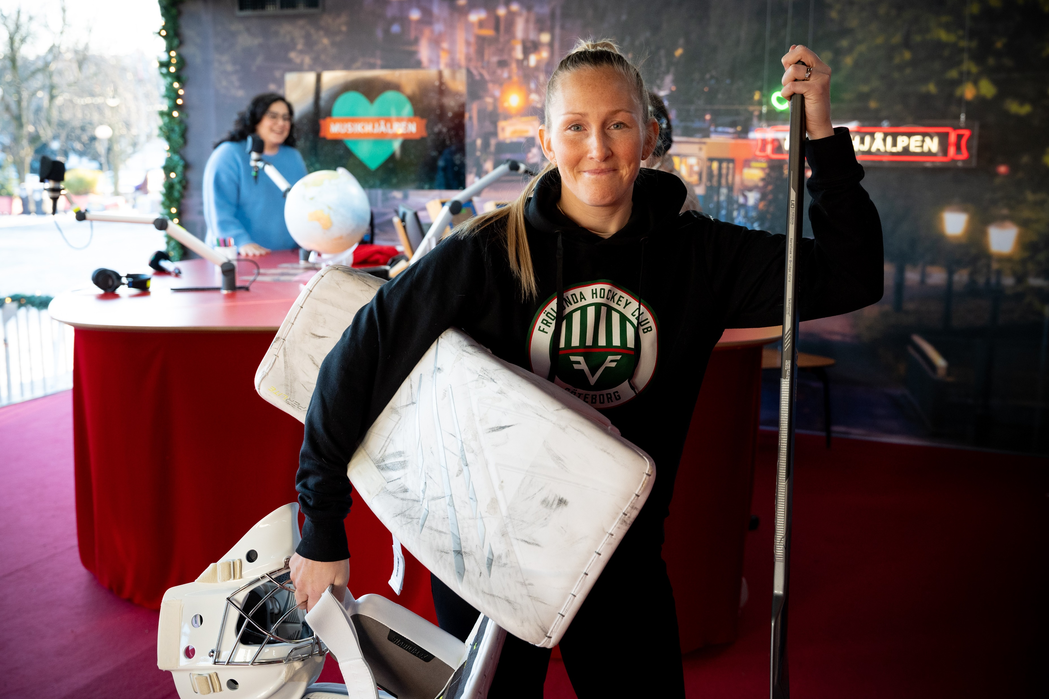
Reality check - 2
110 European players (Snow leopards – few & they disappear fast)
Major reason behind the semifinal wins were goaltenders for those 5 teams (SWE 2006, SWE 2018, FIN 2019, SWE 2023, CZE 2024)

Slide 6
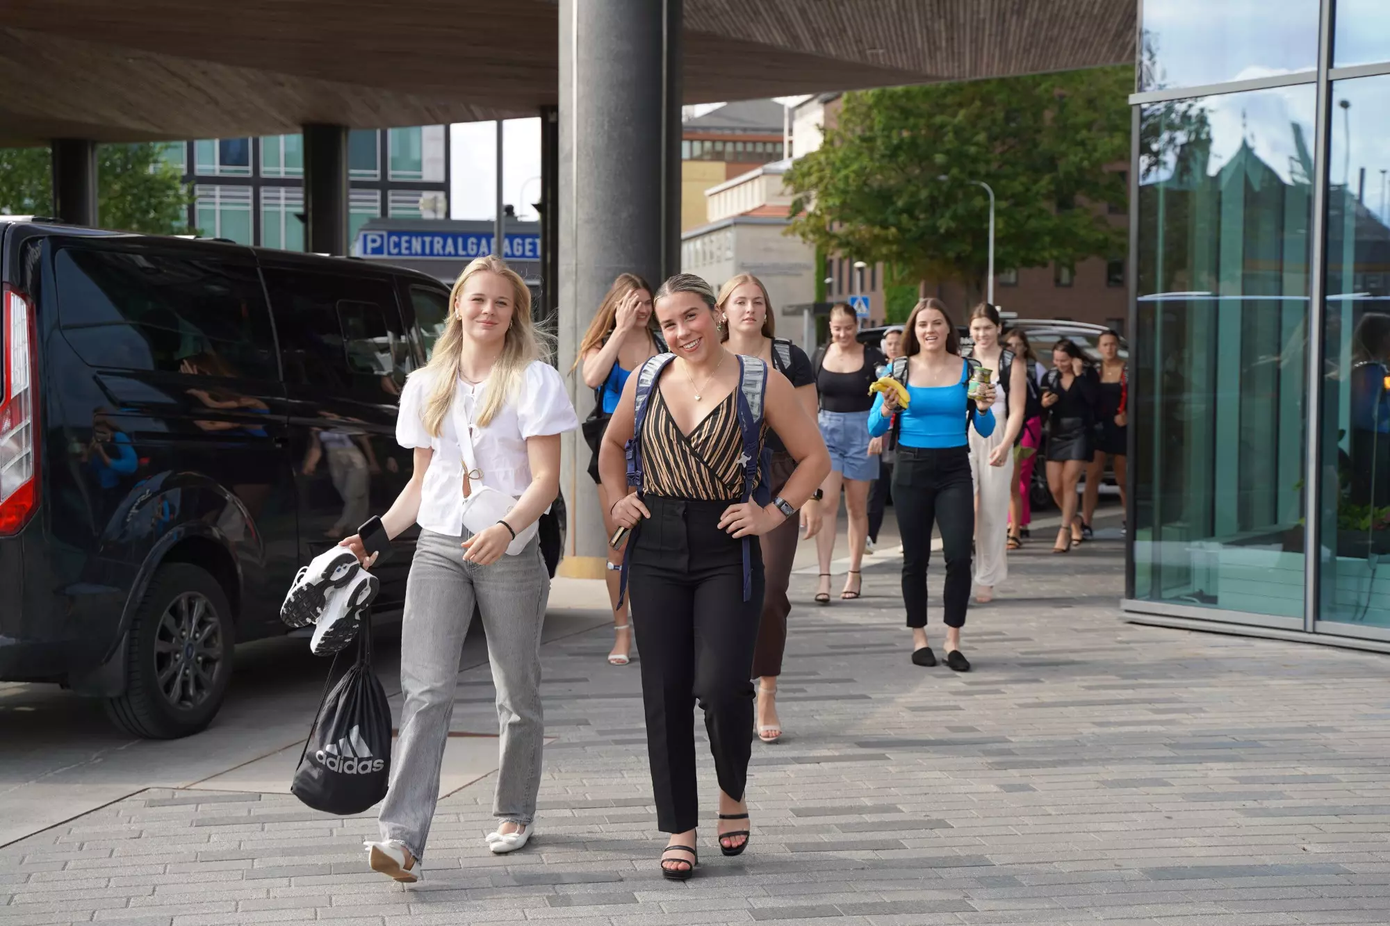
Reality check - 3
In late July 2024, Sweden played vs Ohio State NCAA Div I Champions
Sweden won one game (Shootout), but lost 2 games and total shots in 3 games were 45-146, Ohio had 1 USA National team player!

Slide 7
Observations at the moment
In Sweden this summer, a few coaches from SDHL visited these high-end games. Missed opportunity
During U18 Worlds you see more NCAA coaches than Euro club coaches
At WW, very few observers from European clubs, many more from NCAA
No Female Hockey development clinics neither at WW or at U18WW
The clubs have to lead the ELITE development, with federations’ support
How big is the will from Europe to learn from and adapt to CAN/USA?

Slide 8
The Bridge
Difference in participation numbers must be reduced
USA 92 000, Canada 96 000 female players – Total: 188 000
CZE,FIN,FRA,HUN,DEN,NOR,SWE,SUI together 30 000 female players
Numbers not everything but a big piece – Reach a critical mass
Coach level for players in age group 6-14. Must increase QUALITY
Skill coaches for women groups, to do more than others
The Gender trap – go for competence!
The Age trap. “Young and hungry” = Very little experience
Players spend 80+% of the time with their clubs! What do the clubs do?

Slide 9
How to create a WORLD CLASS (P.E.A.K) performer
PASSION ”Do what you love - love what you do” Life-long passion, where does it come from
ELITE Is an attitude ”Maybe tired but never lazy” one repetition more Never see sacrifices in life as sacrifices
ACCESS Needs infrastructure, opportunities and equipment all year around
KNOWLEDGE A professor with deep knowledge in the specific area and experience, passion to develop

Slide 10
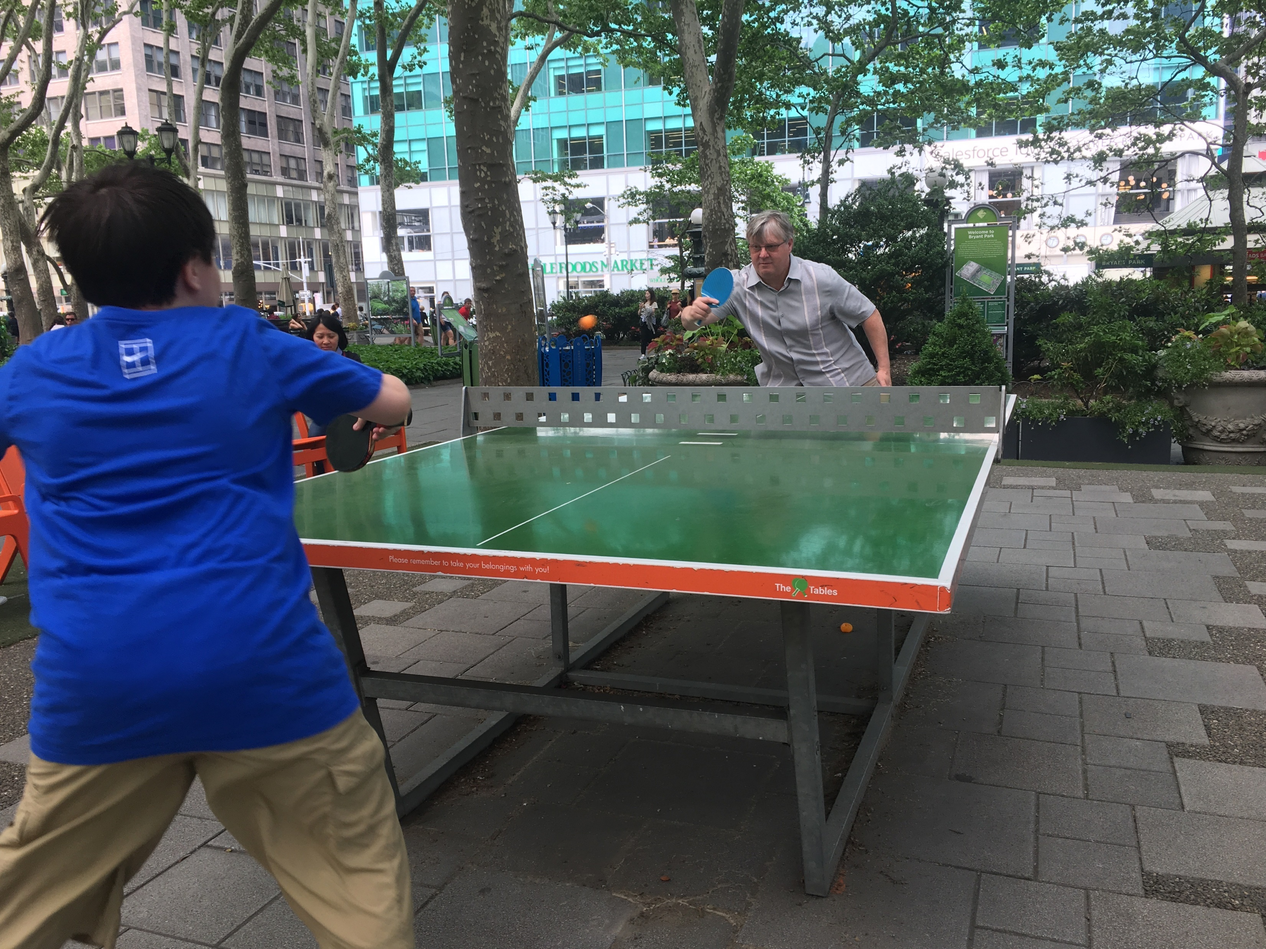
Numbers its not everything! PEAK performance HOT BEDS are key
Table tennis - China 30.000.000 players
Downhill skiing – Austria
Floorball – Sweden
Badminton – Denmark
Football/Soccer – Germany
Basketball - Serbia
Baseball - USA
Nordic skiing - Norway
Hockey - ????

Slide 11
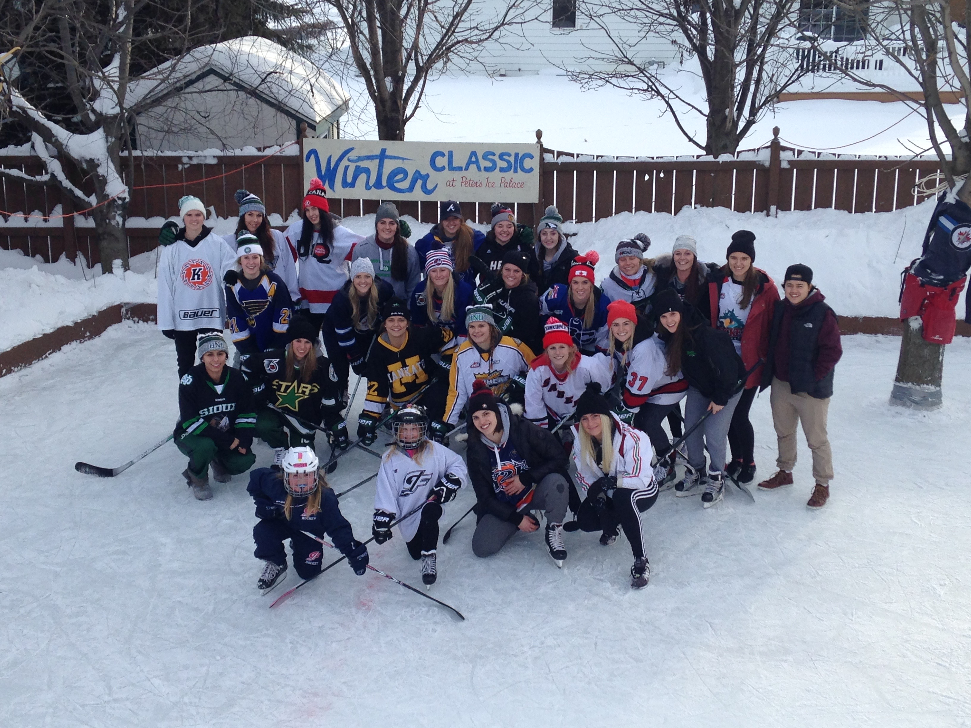
What is really a HOT BED Can you create a HOT BED?
Passion for the sport
Knowledge of the sport ”How to do things”
Culture
Longtime experience
People’s favorite sport ”This is what we do here”
Practice quality ”If you going to do something, do it well”
Practice quantity ”The more I practice, the luckier I get” - I. Stenmark
Your club is or will become a HOT BED for women’s elite hockey

Slide 12
THE ISLAND Age 15-23 The critical Elite development years
The P.E.A.K. for women icehockey players
Passion for the game itself, hockey is much more complicated now, so stamina and long-term passion is needed
Elite attitude is to handle setbacks as learning opportunities, focused practices, compete level, No alcohol use, sleep, over-training
Access, to Gym with an educated S/C coach, video, recovery, extra ice and coaches for individual development .
Knowledge, Women’s hockey experience on a high level, too many weak coaches from the men’s side, with no experience or knowledge of women’s game is supposed to lead, thinking they know more because the men’s side is ranked higher. Gender trap, age trap. Knowledge superior to other factors

Slide 13
ELITE DEVELOPMENT in North America
100% of USA and Canada’s senior National Team players are coming from NCAA Div I environment and from the top 12 of 45 programs
50% of Europe’s Top 50 players are coming from NCAA Div I Programs, mostly from second-tier level
NCAA have 45 Div I programs for players aged 18-24
The top 20 programs have a set up with 4/5 fulltime ice coaches, support staff, full time s/c, trainer, video coach, equipment manager, media officer, extended recovery resources, travel day prior to road games, hotel, meals etc. highest quality.
Combination of academics and sport working hand in hand

Slide 14
ELITE DEVELOPMENT in Europe
Combine full-time, or part-time work outside of hockey
Studies not integrated with hockey
Limitations in coaches and support staff compared with Top NCAA programs
Still, some of world class Europe only developed players is there, how is their journey looking. Why is there not more?
European coaches’ practices differ. Skill, skill, skill vs N.A. compete, systems and game speed
Europe S/C focus much more on cardio, N.A. on explosive movement
Europe focuses on making practice fun. NA practices are much tougher than games - not afraid of conditioning, skating
N.A. all drills with resistance, compete level, long practices, game studies with video 5 times a week, mandatory recovery, healthy lifestyle.
Europe?

Slide 15
The TUNNEL age 24-34 To perfect the game and make a world-wide competitive sport
PWHL is not the solution, it is an inspiration and supporter. PWHL has 6 teams, only 150 roster spots,100% of USA and Canadian national team players will play in that daily environment every day, at most 33% of the other national teams’ players will be in that environment
PWHL puts an effective stop for Canada and USA Olympic season centralization, which has widened the gap every 4th year
PWHL creates dreams and goals for already good players to reach the next level
If max. 25% of Europe’s top players play in the PWHL – what can WE do for the other 75% of the players in our national teams to keep up?

Slide 16
To get out of the Tunnel!
European players, clubs, national teams need to play many more games against USA and Canada-based teams already from 14/15 years of age
Create a ”Women’s World Cup” Ex: Host Zug (SUI), Luleå (SWE), IFK Helsinki (FIN), Minnesota Frost (PWHL-USA), Ottawa Chargers (CAN-PWHL)
Every time USA or Canada are in Europe for WW or U18 WW play more games against them
Invite Top NCAA teams for games in Europe
Send your junior teams to high end tournaments in North America.
Bring back Women’s Pan-European Club competition “Champions League”
Give your players the same conditions as the top NCAA programs.
Perspective European women’s soccer championship in England spectacular quality raise.
Let your men’s team’s infrastructure in facilities and support-staff be fully shared with your women’s team.

Slide 17
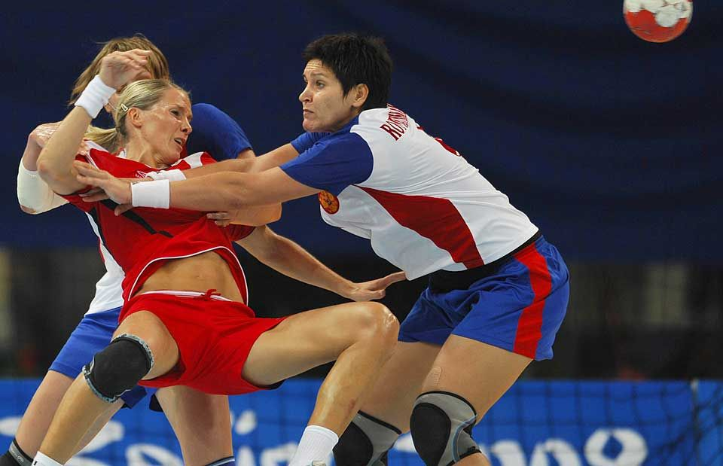
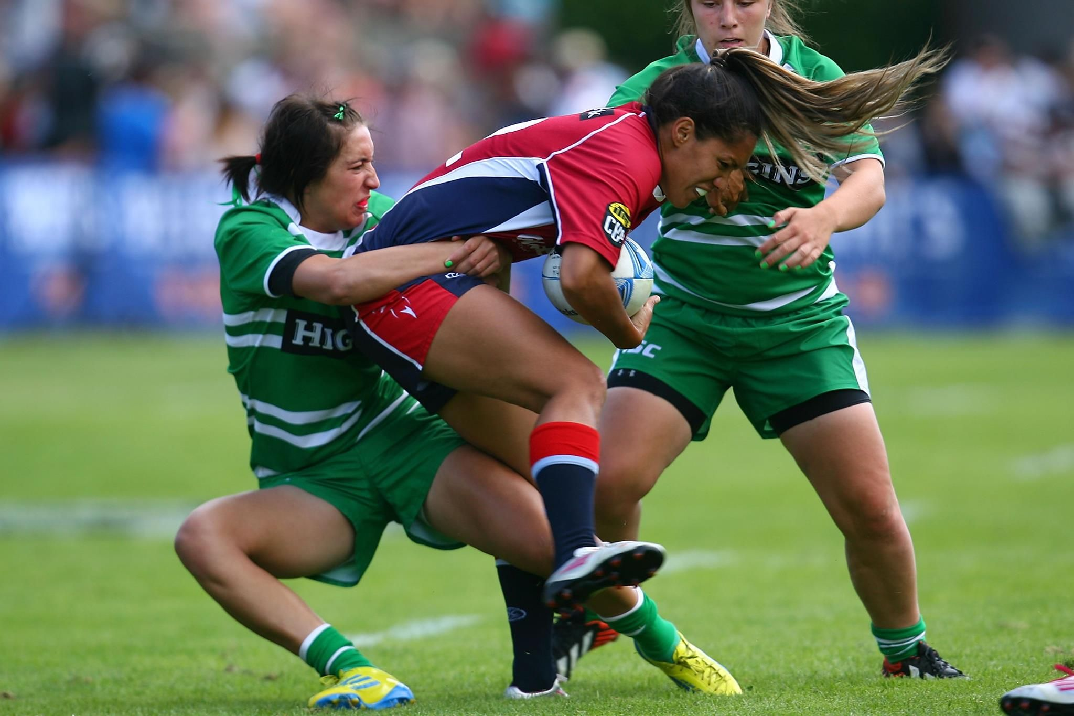
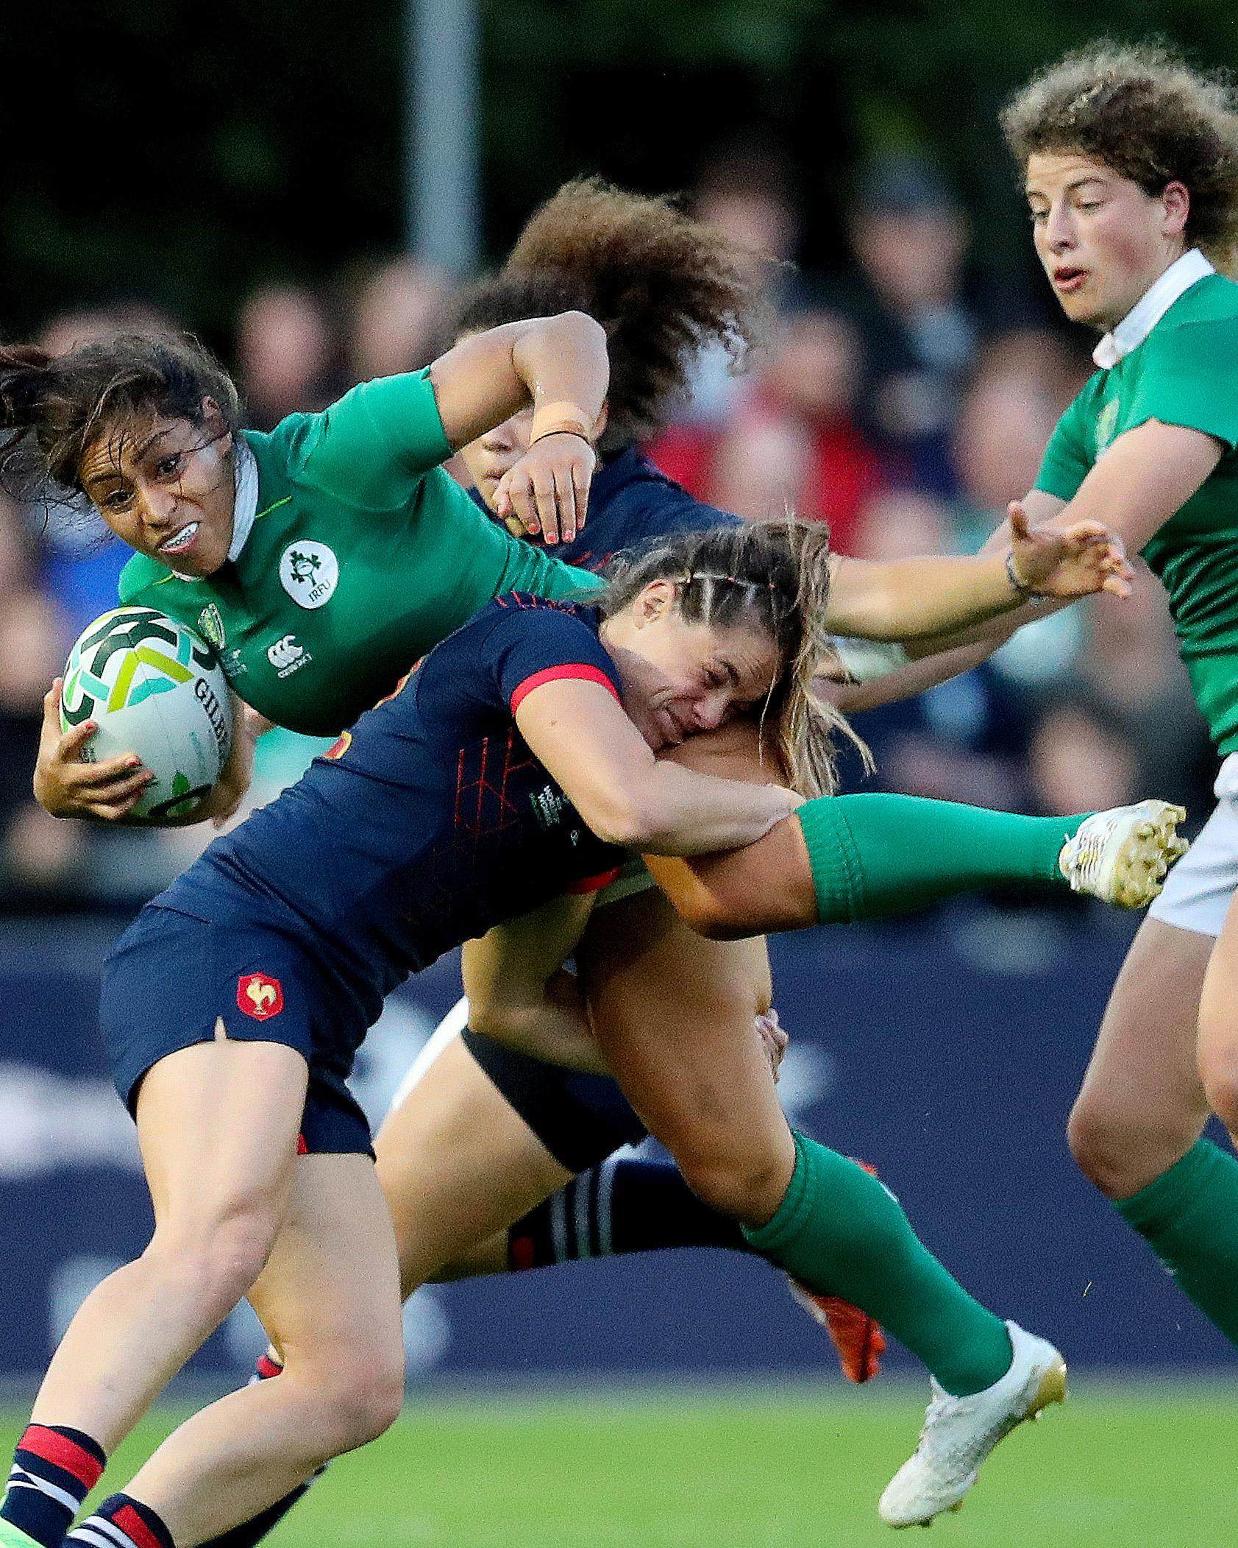
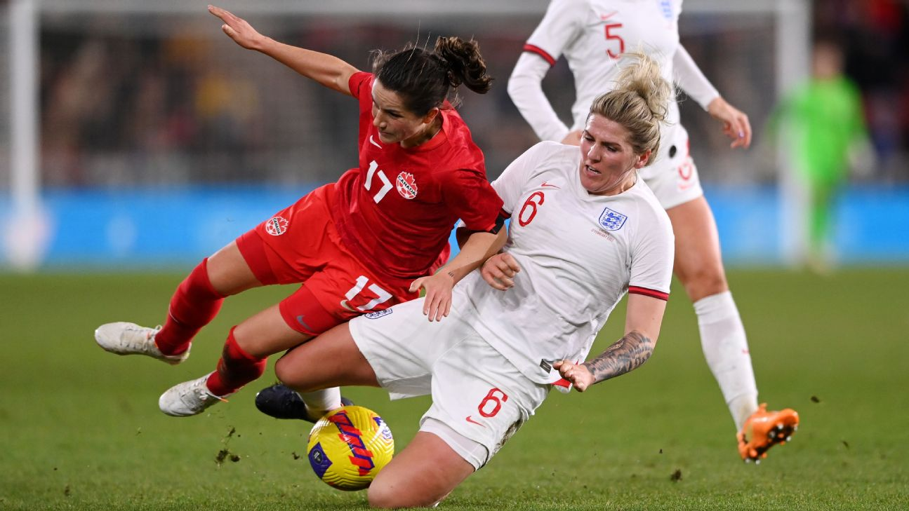
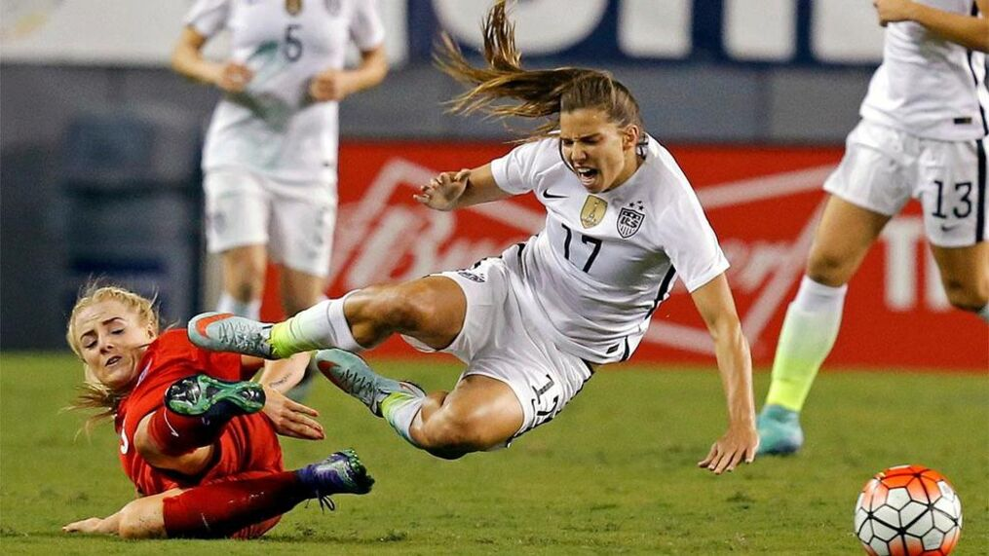
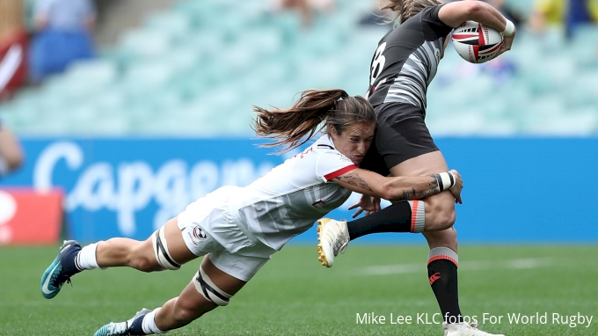
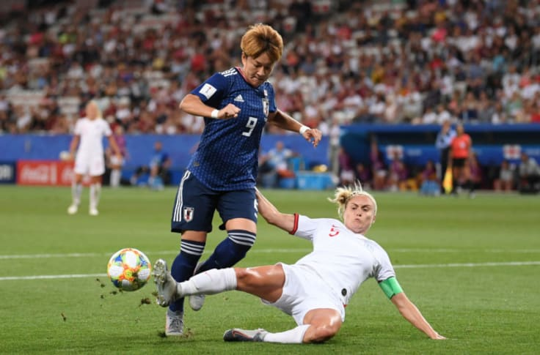
Why different rules in women’s ice hockey?
Handball
Rugby
Football

Slide 18
YOU ARE NOW READY TO FLY 2030! Future Discussions
What Rule book should women play after, we have now 3 versions. IIHF, SDHL, PWHL. We need 1!
Why must women wear fully protected face shields, but a boy older than 18 years can choose? What is the reason?
Rink size: Women’s hockey is a much better product on NHL-sized rinks. Who will be first in Europe to build an NHL-sized arena for their Women’s pro team

Slide 19
”The opinion of 10.000 men is of no value if none of them knows anything about the subject” – Marcus Aurelius, Roman Empire
Thank you for listening Peter Elander

