Slide 1









Notes:
1.7.2013
‹#›

Slide 2



Slide 3
PWHL LEADERSHIP
Mark and Kimbra Walter
Business and philanthropic leaders
Stan Kasten
Los Angeles Dodgers President
Billie Jean King
Sports icon and Advisory Board member
Royce Cohen
Los Angeles Dodgers SVP of Business Strategy
Ilana Kloss
Sports executive
WHAT WE STAND FOR
Professionalism
Gender Equality
Empowerment
Growing the Game
Player-Fan Engagement
Notes:
1.7.2013
‹#›

Slide 4



PWHL PLAYERS
156
53
12
8 YEAR
COLLECTIVE BARGAINING AGREEMENT
PLAYERS
OLYMPIANS
COUNTRIES
The PWHL features the best
women’s ice hockey players in
the world, competing annually for The Walter Cup.
At the league’s foundation is a historic 8-year agreement (CBA) between the PWHL and PWHLPA.
Notes:
1.7.2013
‹#›

Slide 5

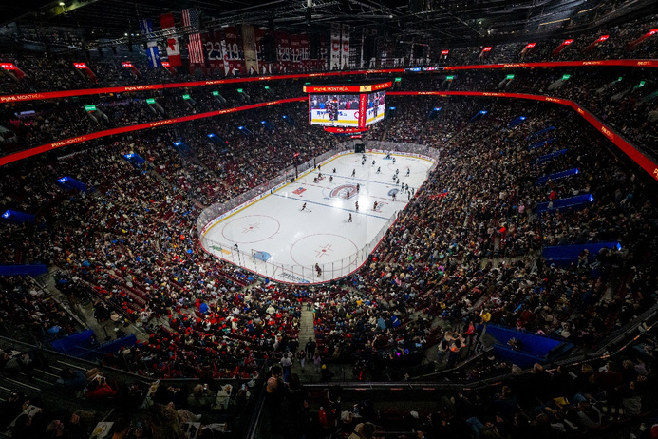
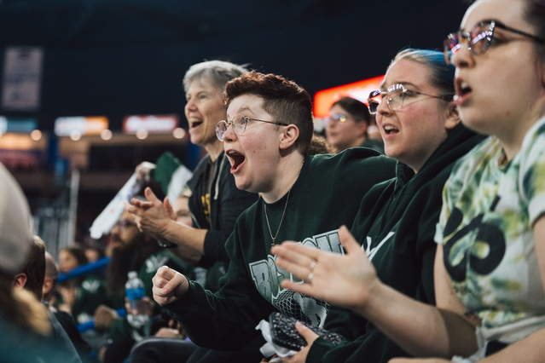








INAUGURAL SEASON MILESTONES
21,105
483,530
13,736
Record-Breaking Professional Women’s Hockey Game Attendance
People attended games during the 2024 season
Neutral site games in Detroit (13,736) and Pittsburgh (8,850) saw extremely strong attendance
Corporate Partners
Notes:
1.7.2013
‹#›

Slide 6
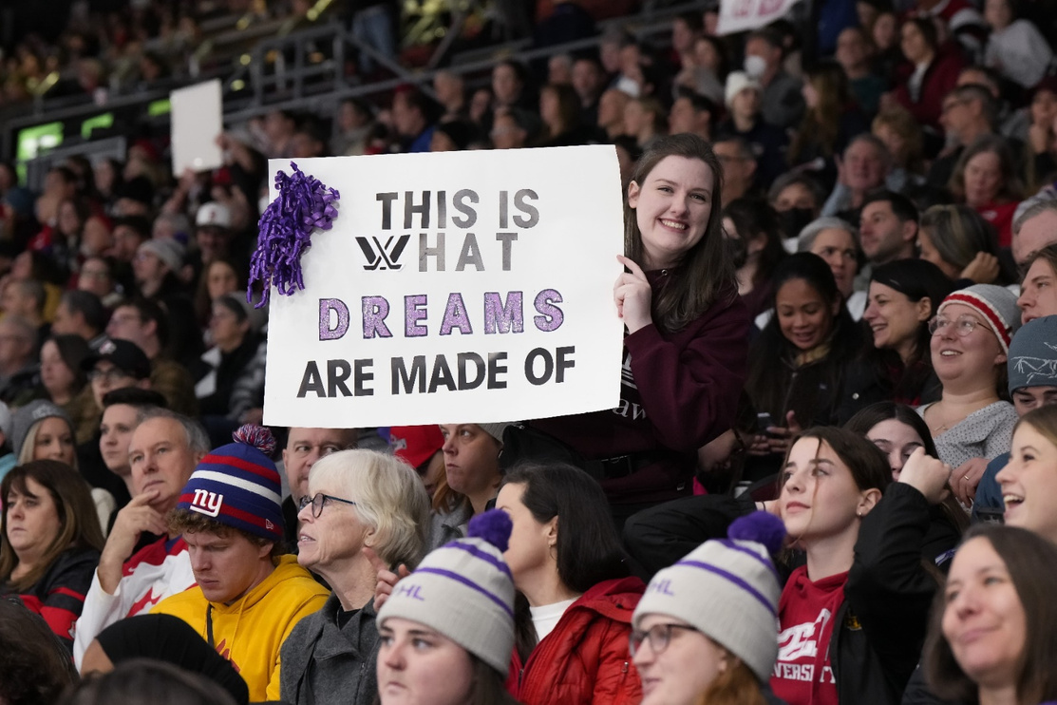
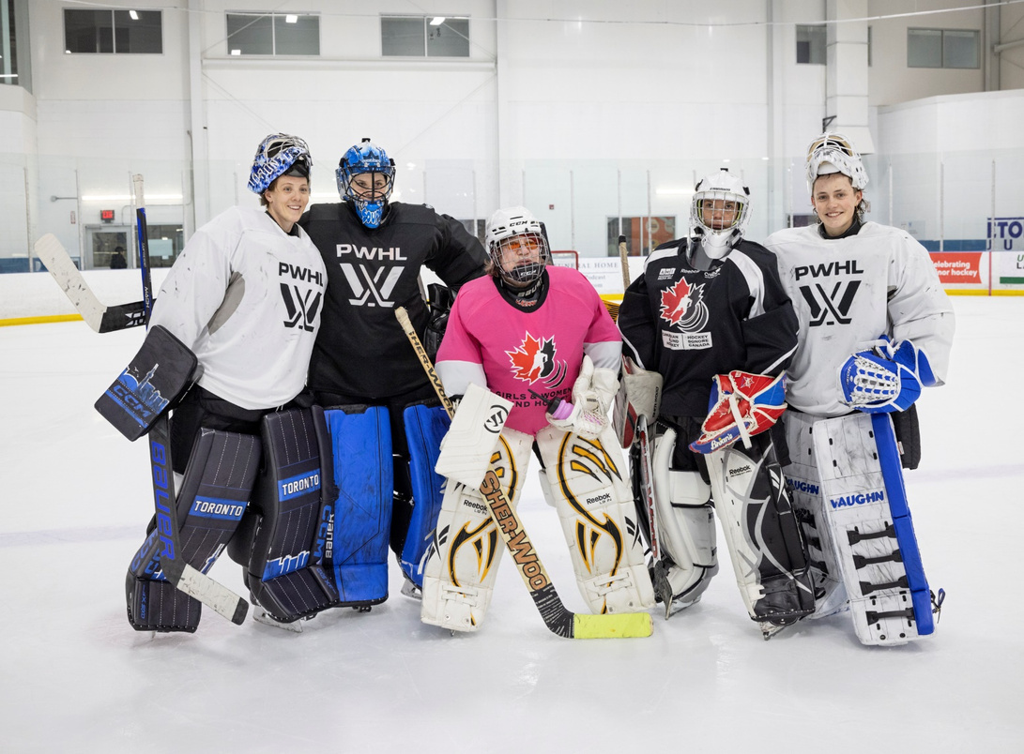
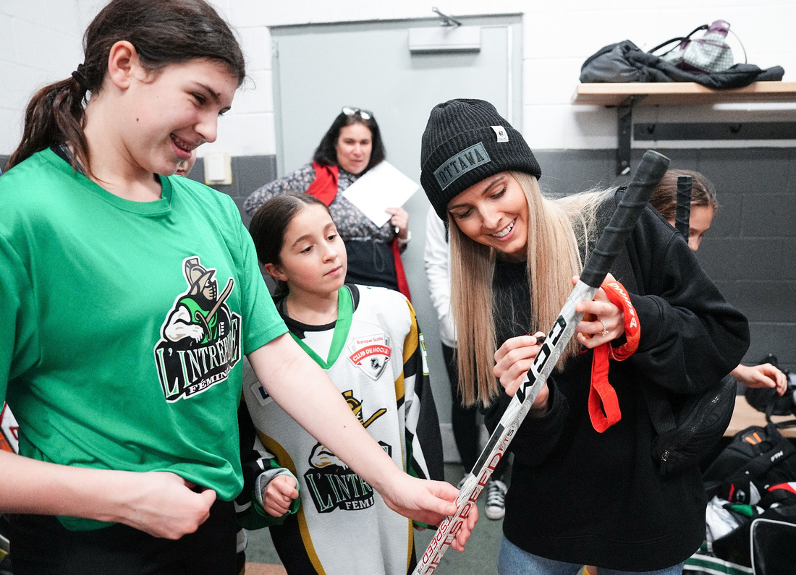
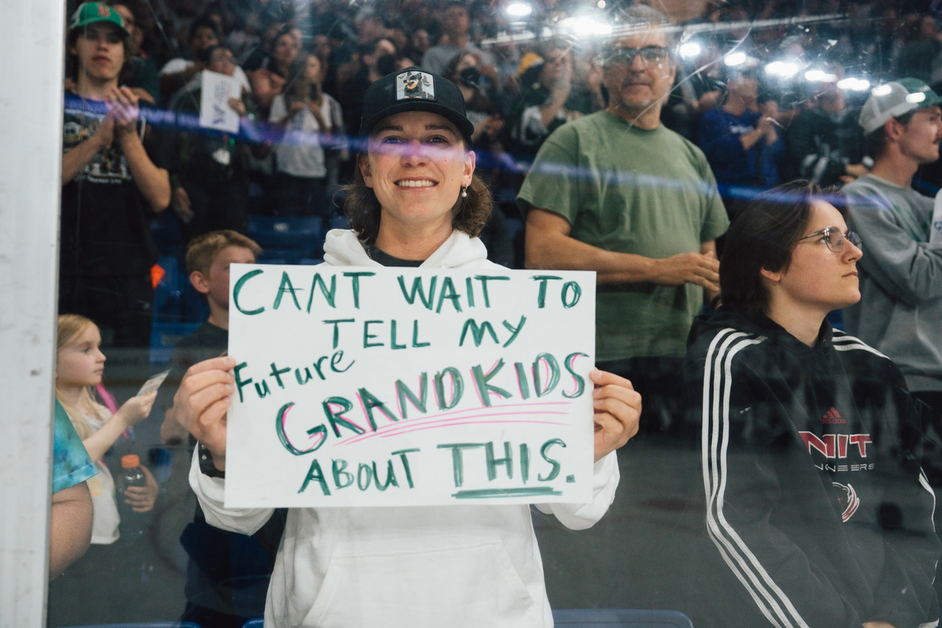
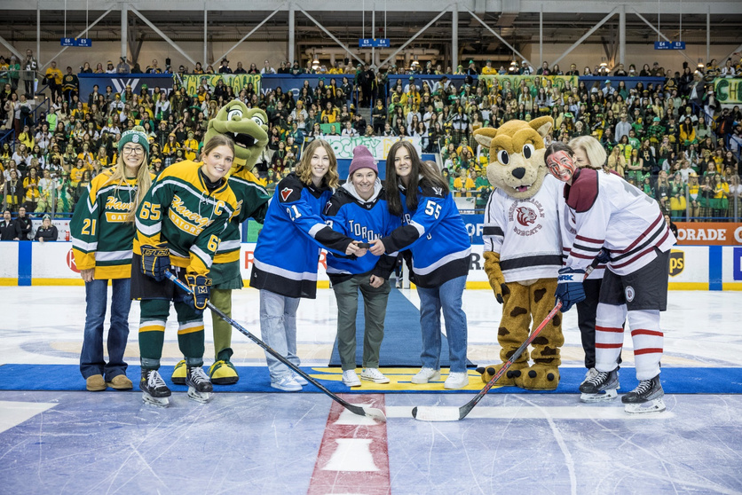
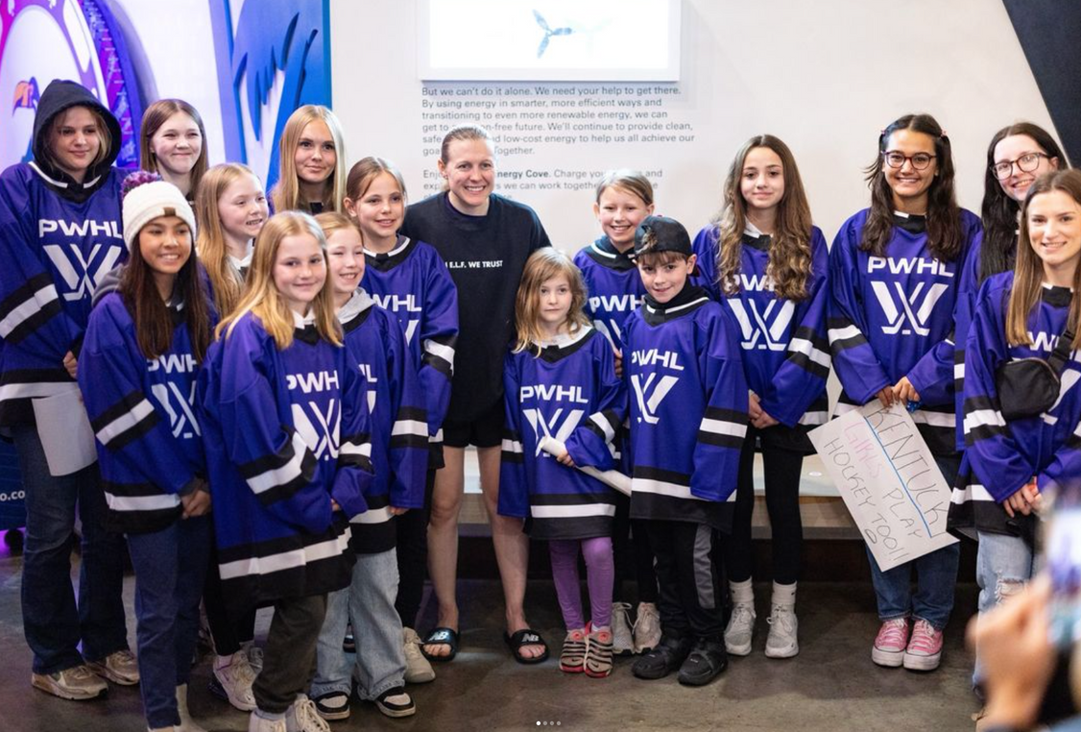
OUR COMMUNITY IMPACT
The PWHL aims to galvanize its communities by supporting local organizations and fostering meaningful connections. Through our initiatives, we support diverse community groups and inspire the next generation of fans, cultivating an engaged population who shares our passion for the game and social impact.​
Notes:
1.7.2013
‹#›

Slide 7

COMMUNITY IMPACT
“The PWHL has been instrumental in keeping girls in Nunavut in hockey. The PWHL players showed our girls that success is possible despite obstacles.”​
“What an experience you are giving our kids. This league is so much more than what happens on the ice. We will be cheering from Newfoundland.”
Iqaluit Blizzards​
Newfoundland Hockey Club​
“I love the way the team is trying to get involved with the community... When you capture New Yorker's hearts, they tend to stick around.”
“The girls could not stop talking about how cool it was to see their idols up close and how the experience was the best thing ever so thank you for making their day (and probably their year).”​
NYC Women's Hockey League​
Ottawa Guides
“We asked one of our newer U8 Girls for her uniform number choice. She selected #30 in celebration of Cami Kronish who you all sent over to work with our girls last year. Your players made such an impression on our players.”
Cambridge Youth Hockey​
Notes:
1.7.2013
‹#›

Slide 8
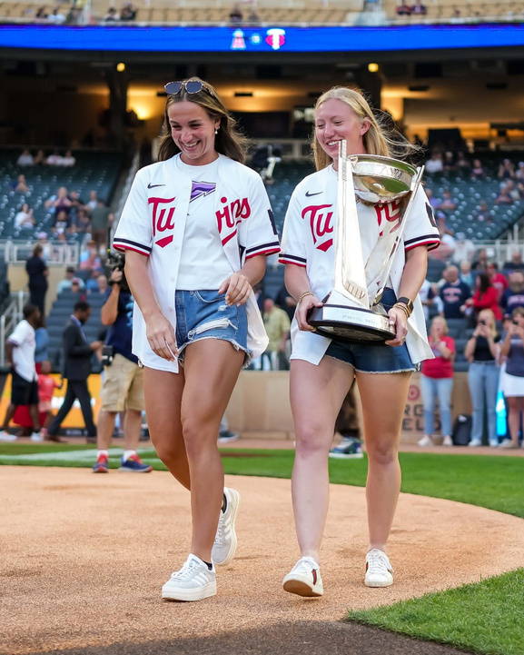
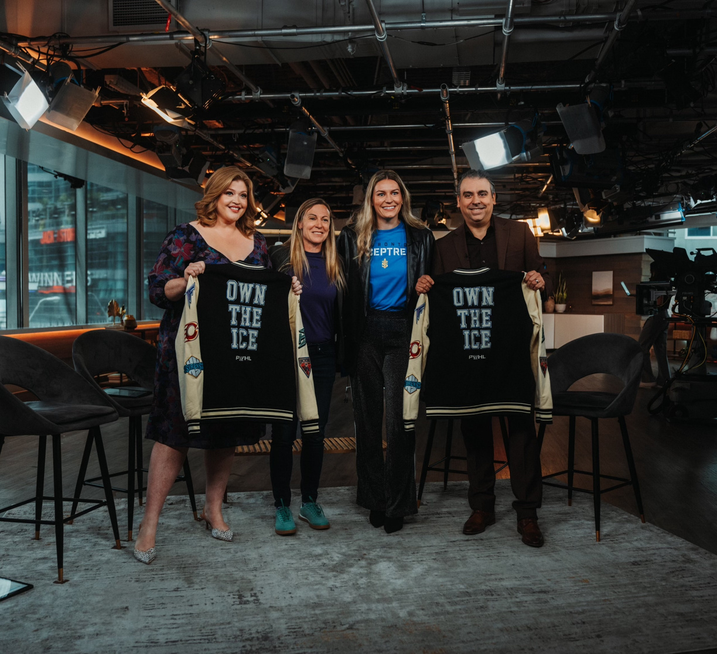
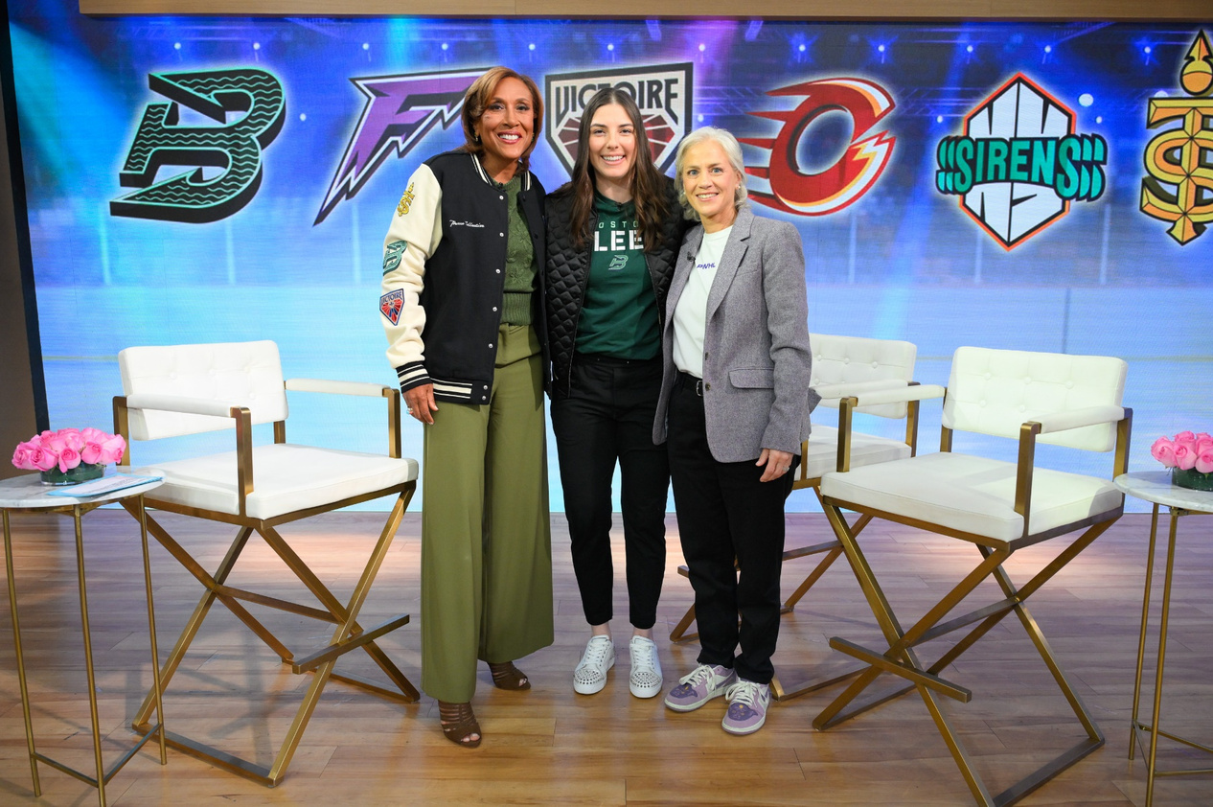
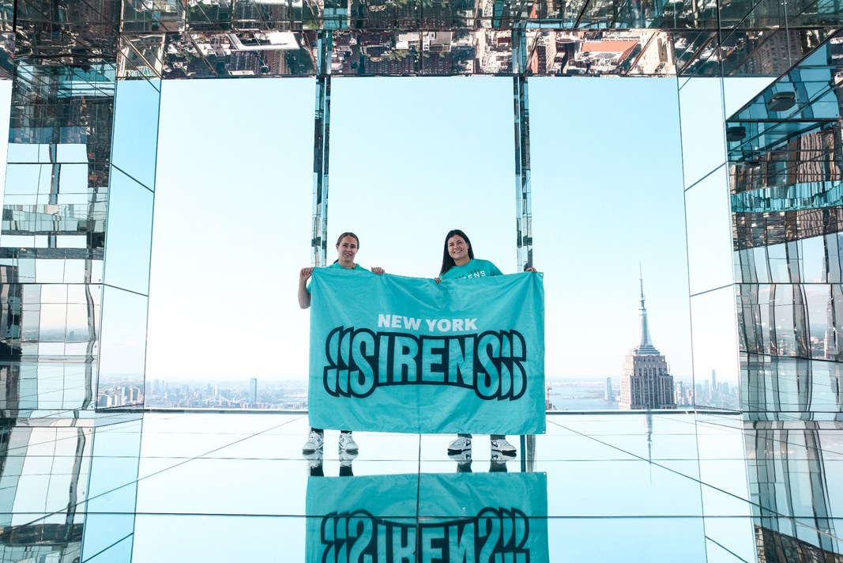
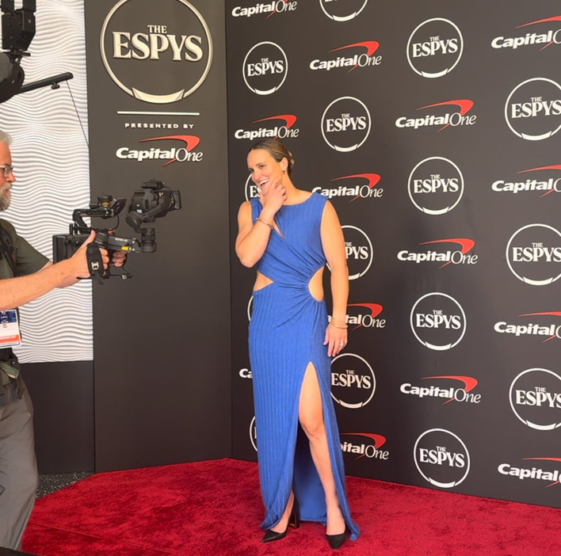
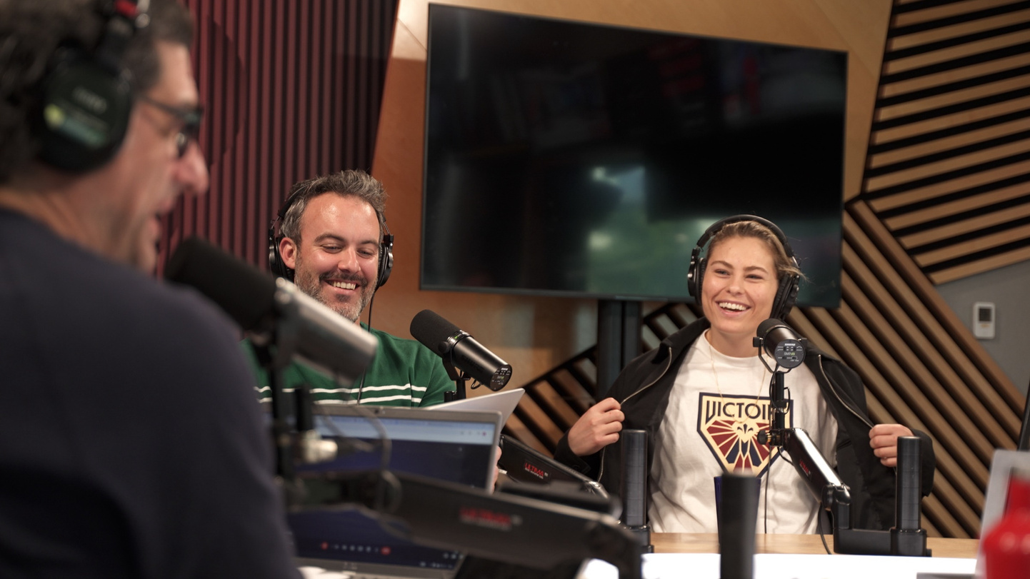
WHAT’S AHEAD
Our inaugural season didn't raise a bar, it established a baseline for what we expect of ourselves. In Season 2, our focus is on building upon that momentum by bringing our new team identities to life, playing in larger primary venues, and strengthening our connection with an ever-growing community of fans and partners. Here are some key growth highlights as we look ahead:
  Significantly increasing neutral site games, expanding our
presence across both the United States and Canada.
  Season ticket memberships have surged, growing by at least
50% in every market.
  New grassroots hockey programs aimed to increase participation and attract new fans
  Upcoming announcement with leading broadcast and streaming networks that will make PWHL games accessible to millions of viewers across the globe.
  The PWHL continues to gain relevance in mainstream culture by participating in high-profile events across music, sports, and fashion, showcasing the league's growing impact beyond the hockey world.
Notes:
1.7.2013
‹#›

Slide 9
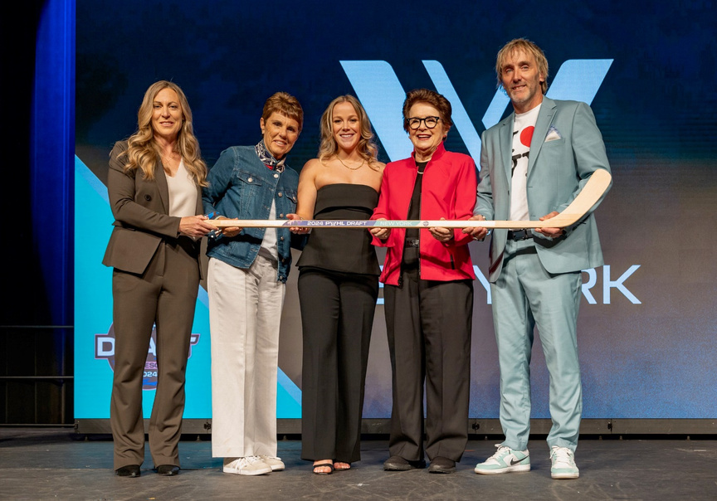
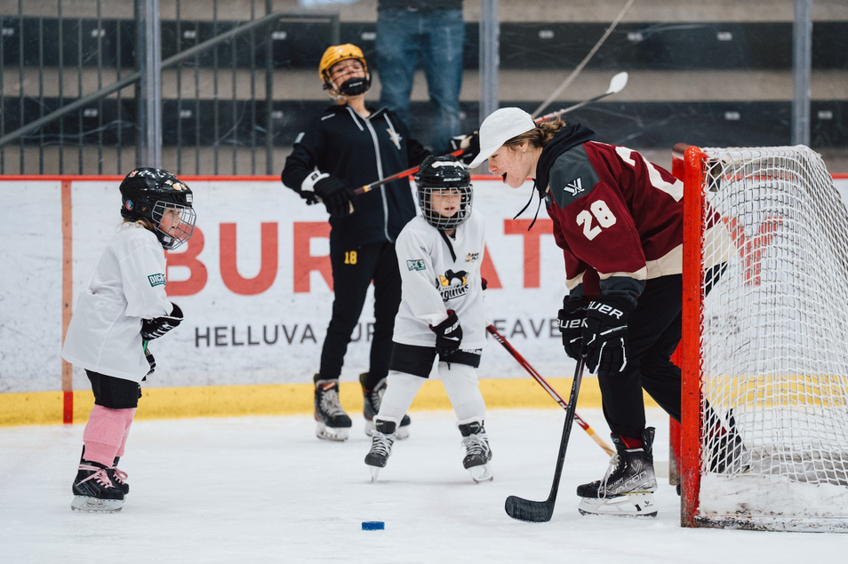
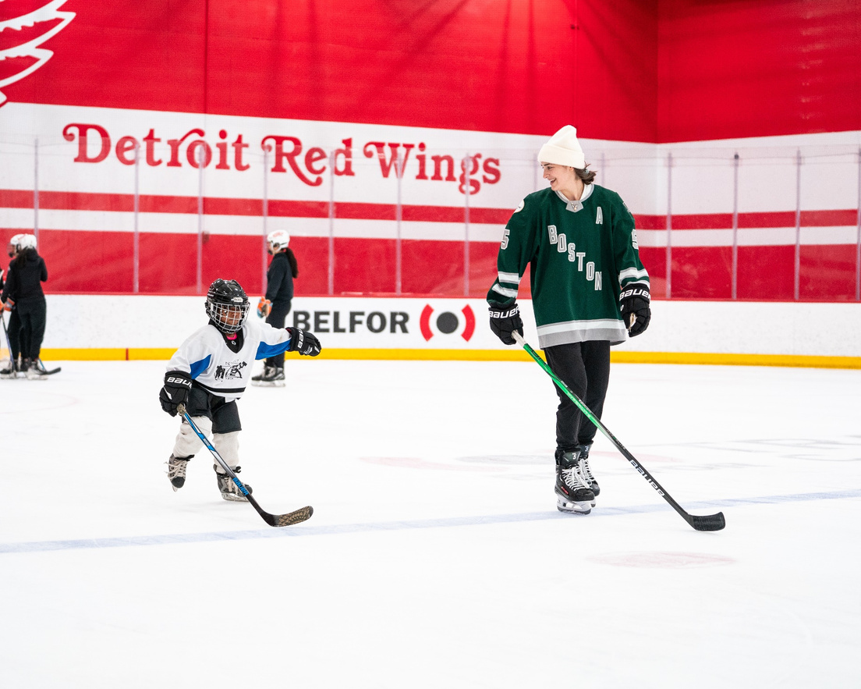
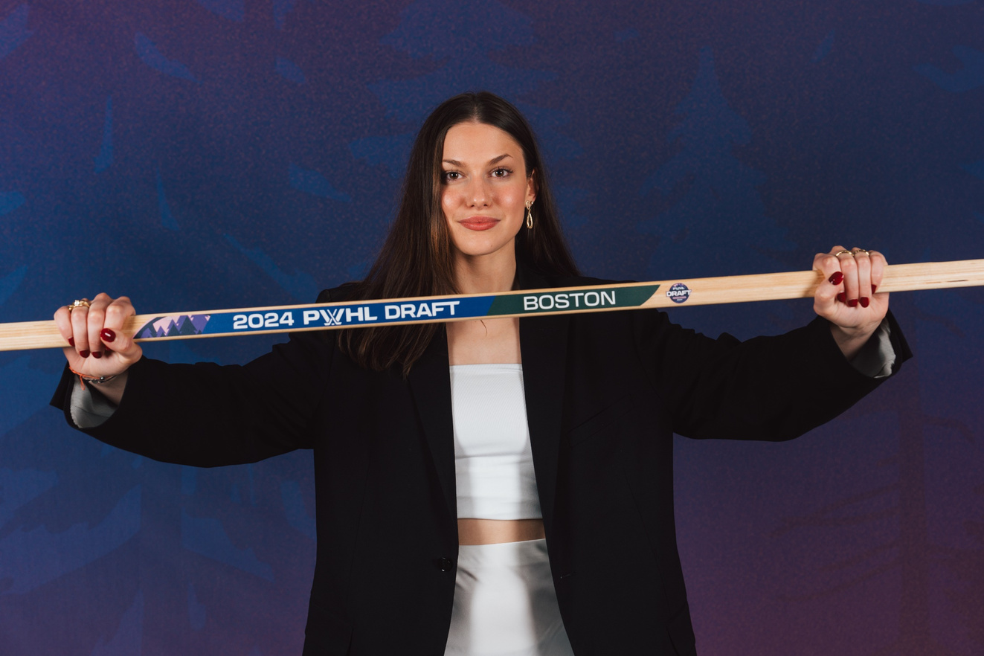
THE BIG PICTURE
Expanding the talent pool for girls’ and women’s hockey
  In 2024, the PWHL Draft saw more entrants than total players in the league, highlighting rapid growth in the talent pipeline
  The extra year of COVID-19 eligibility means more student-athletes will complete their collegiate careers this season, boosting the talent and depth of the next draft class.
  Girls’ hockey is among the fastest-growing youth sports in North America. Registrations continue to increase year-over-year and more girls than ever are taking the ice.
Notes:
1.7.2013
‹#›

Slide 10

THANK YOU
Notes:
1.7.2013
‹#›

