Slide 1

…and how ice hockey can capitalize on it

Slide 2



The growth of women’s sport, backed up by numbers and facts
Growth drivers and trends in women’s sport
Examples of how rightsholders capitalize on it

Slide 3
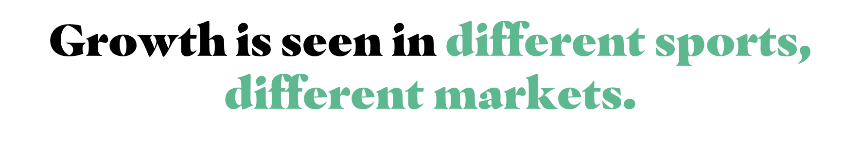





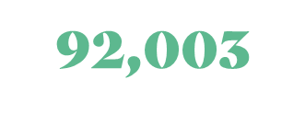
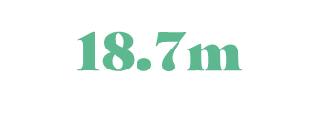
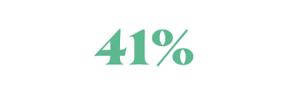

2023-24 Records
70%
Attendees for NCAA Volleyball in Nebraska
viewers of women’s college basketball final on ESPN
(+90% YOY)
Increase in attendance for Women’s Super League (927k)
Increase in match attendance for Women’s Six Nations 2023
TV viewers for the Women’s Ashes

Slide 4










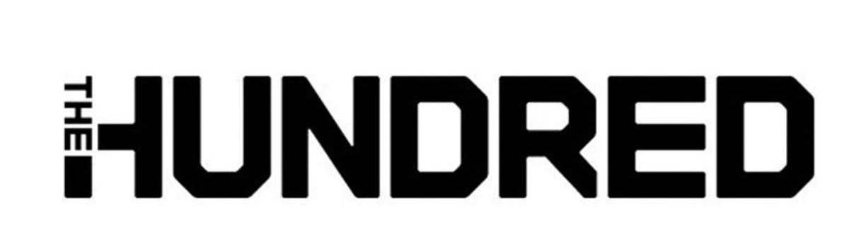






















We have significant experience working in women’s sport across a range of different areas
INCREASING COMMERCIAL VALUE
CREATING NEW FORMATS
GROWING AUDIENCES
GROWING PARTICIPATION
MAXIMISING ATTENDANCES
DELIVERING QUALITY CONTENT

Slide 5

WOMENS SPORT IS ON THE RISE
We see growth happening in different markets, different sports.
VISILIBILTY IS KEY
Women’s sport has been underrepresented in the media in the past – this is changing rapidly with increased reach
OPPORTUNITIES ARE ARISING FOR BIG & SMALL
Any rightsholder has the power to positively impact or even introduce change
WOMENS SPORT IS AN INTERESTING PROPERTY FOR BRANDS
New audiences, the accessibility of great personalities and the opportunity to shape the journey are drivers of that interest
COLLABORATION MEANS AMPLIFICATION
It needs pioneers to get all stakeholder of the eco-system to work together towards a common vision and goal

Slide 6
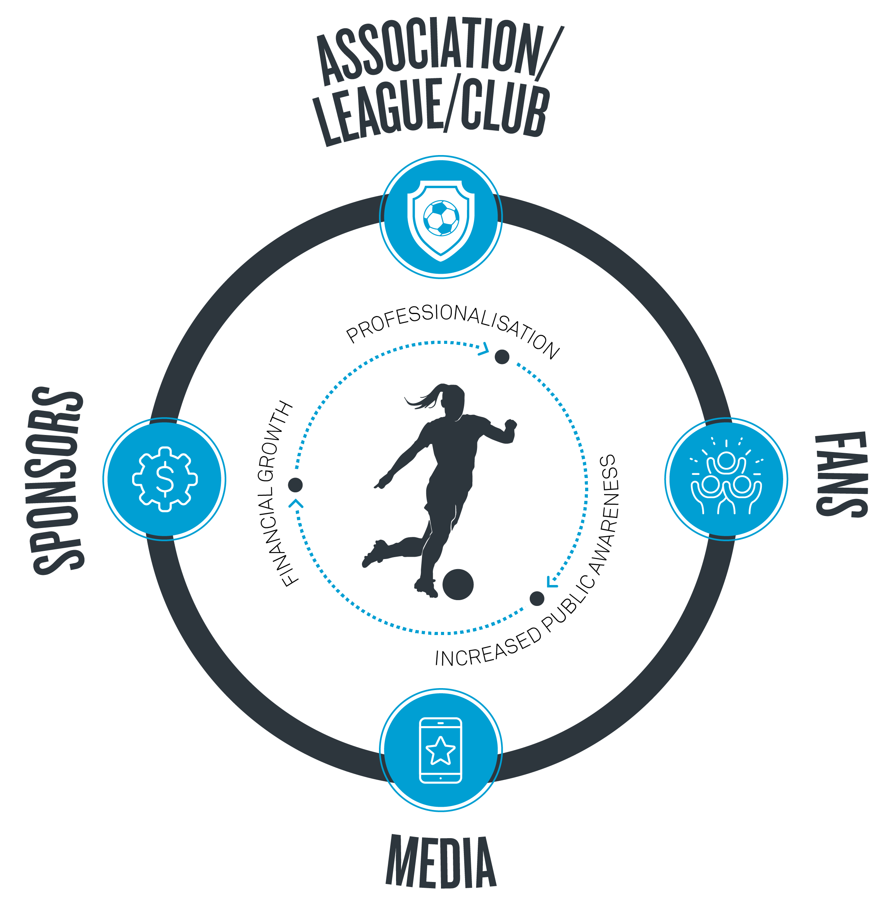

In Women’s Sport

Slide 7

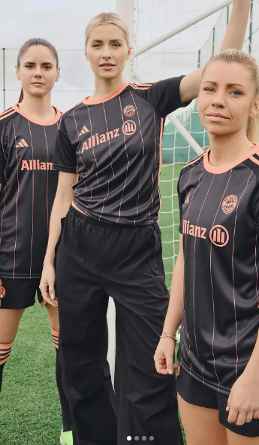
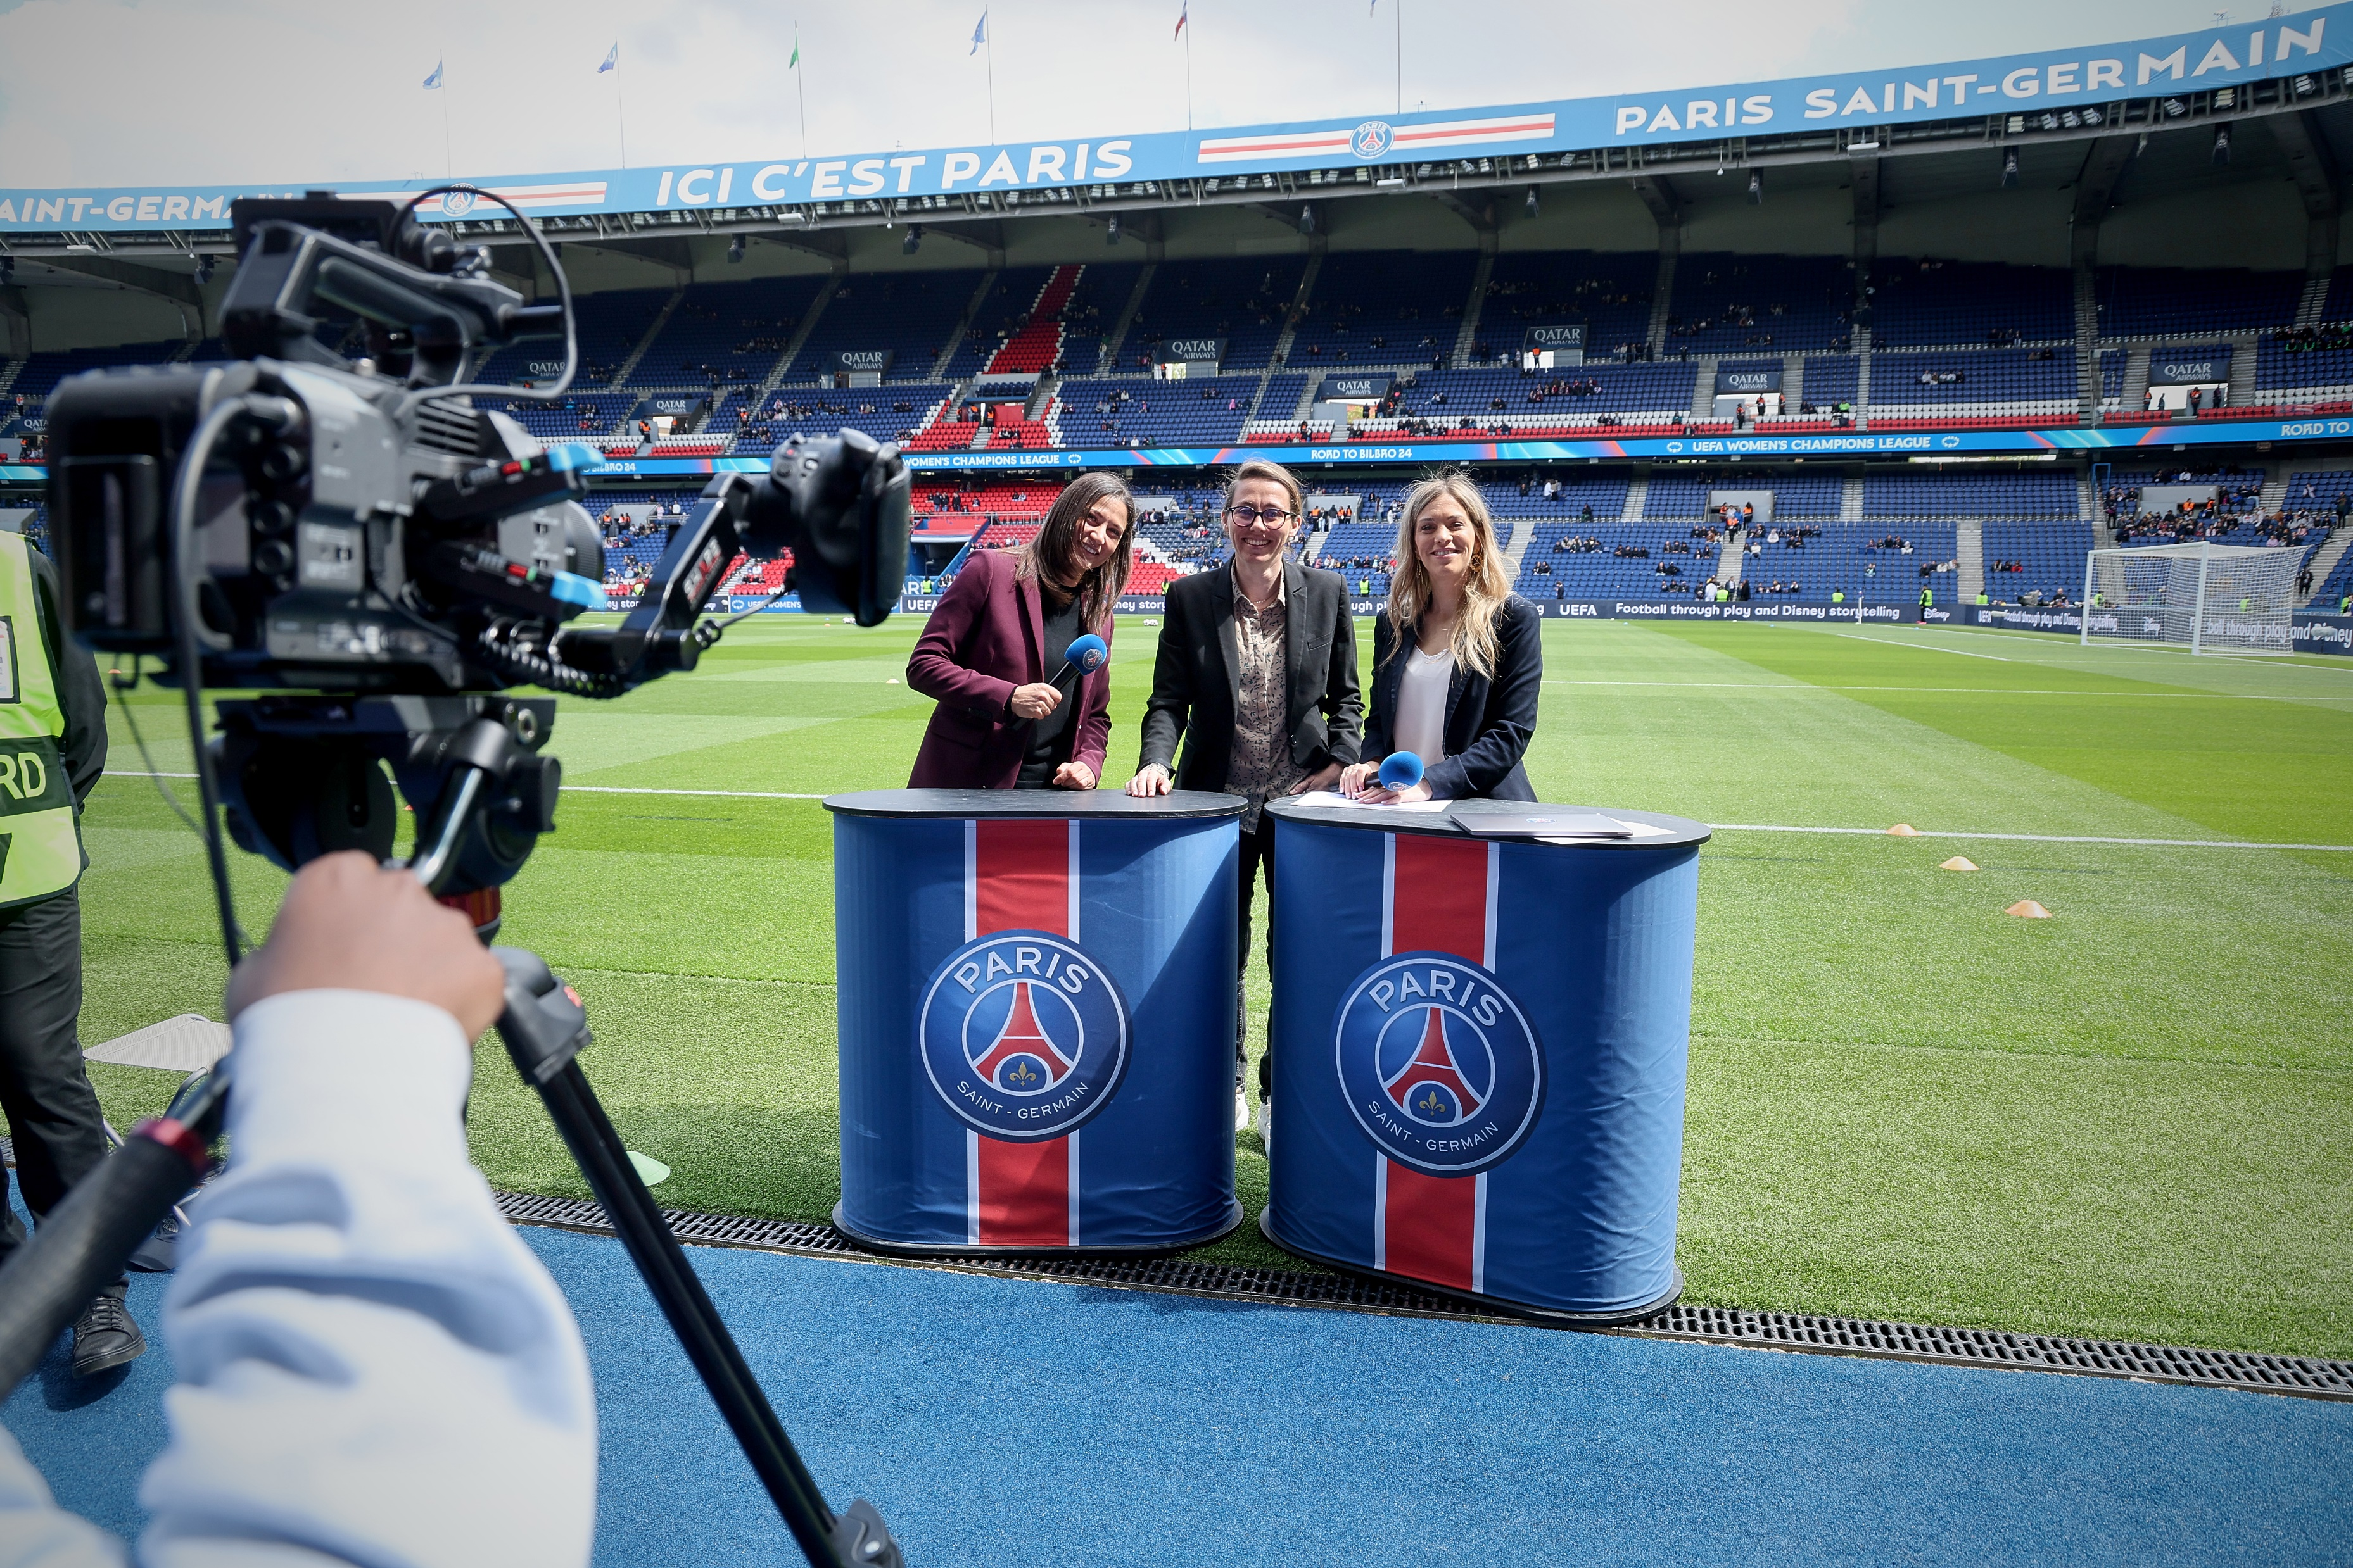
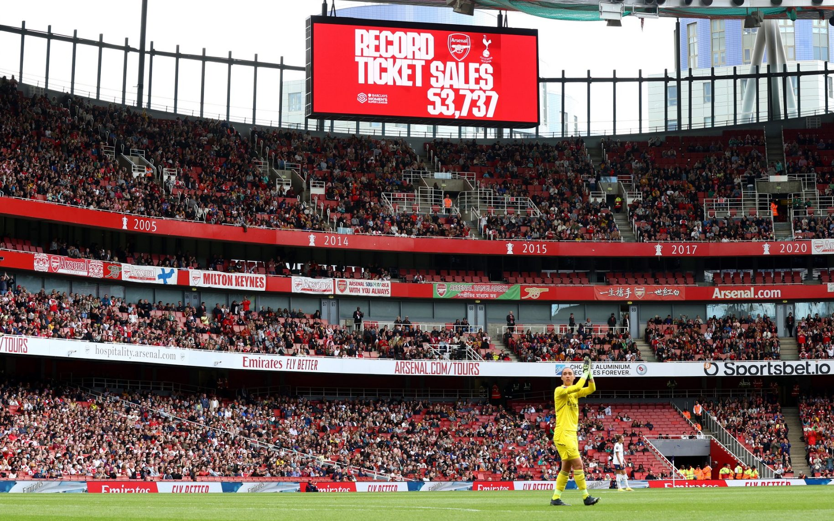





’
Notes:
Although there are many ways that you can view women’s sport, we tend to apply a threefold commercial lens.
On-Pitch, the players – continuing to build a fantastic product to buy into. This starts at a grassroots level, all the way through to the elite game. This starts by ensuring access to the game, and ultimately making women’s football the most played game by girls both in Europe and globally…The game cannot commercialise if the product is not right!
Sponsorship – the most traditional and biggest revenue driver for women’s football. Ensuring that we increase the VOLUME and value of sponsorship and media rights.
Fandom – growing the game… reaching new fans, exciting existing fans, filling stadiums, smashing viewership. Without fans the game doesn’t exist. But also fandom drives revenues – be that indirectly through sponsorship, or directly through ticketing, merch etc…

Slide 8
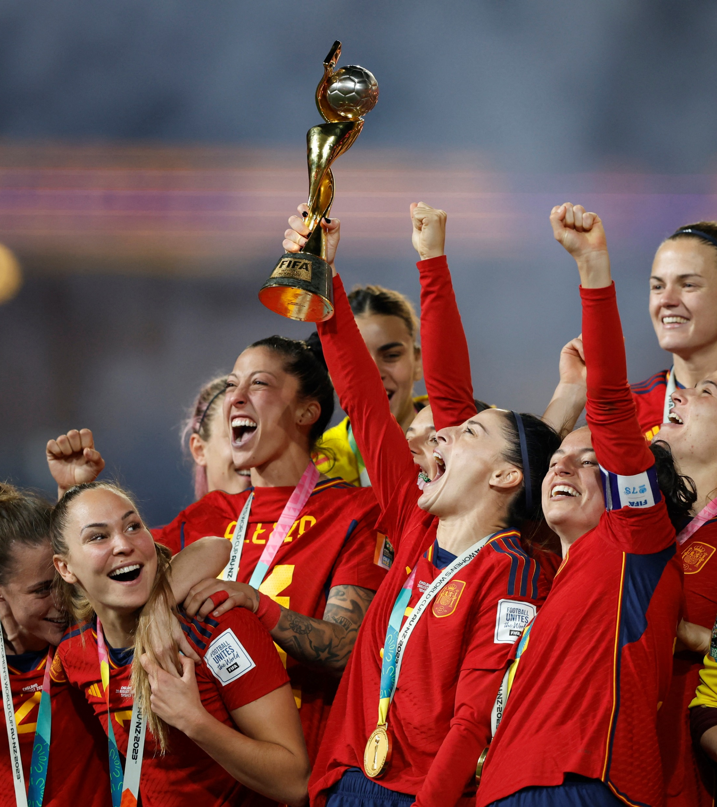
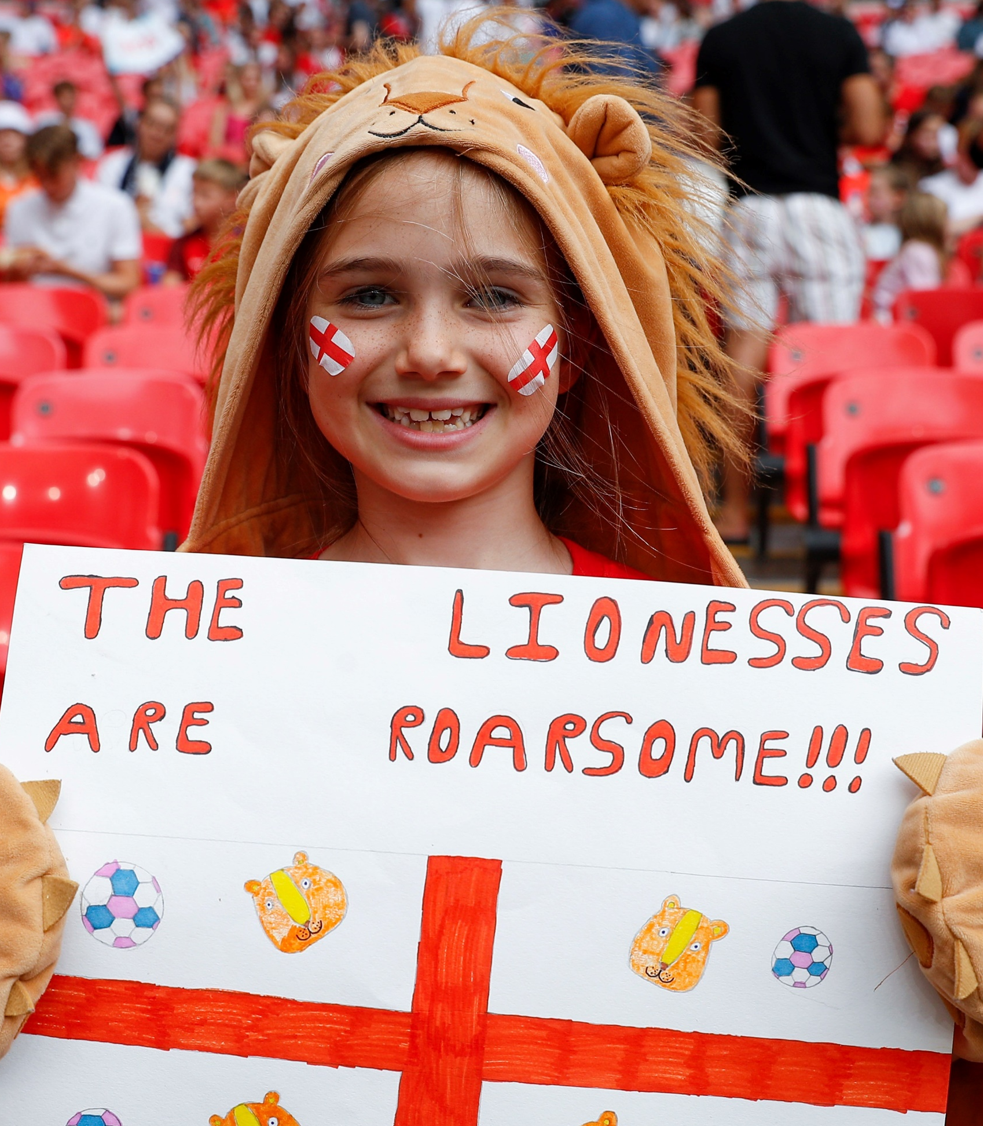
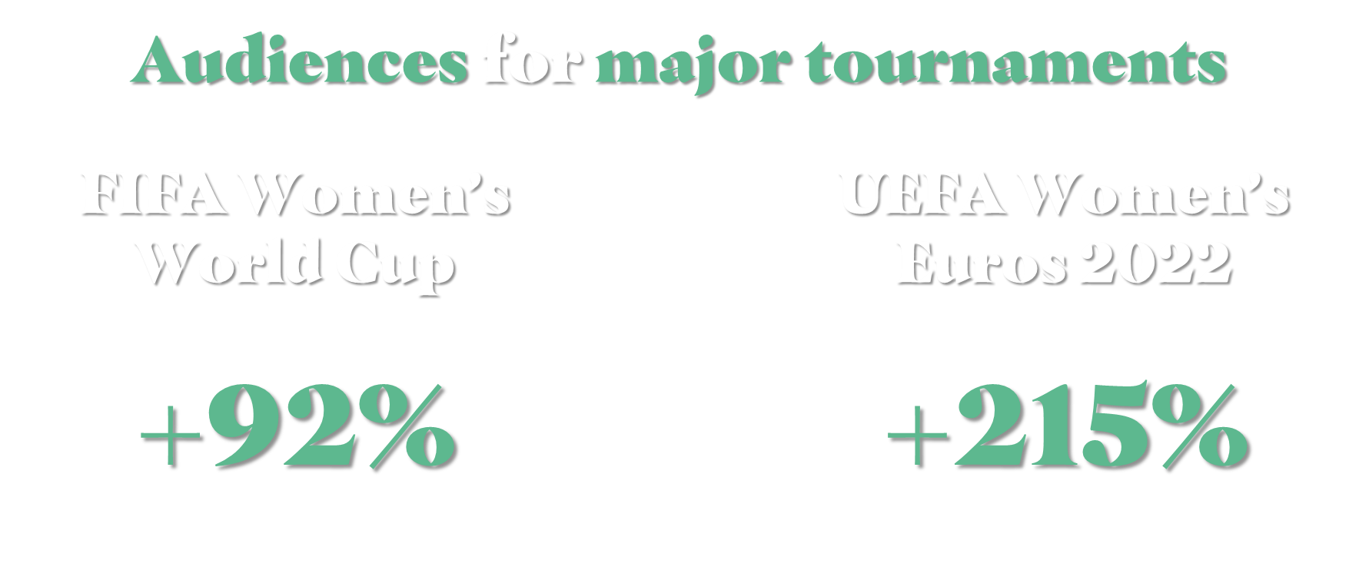
cumulated audience compared to
2015 FIFA Women’s World Cup
cumulated audience compared to
2013 UEFA Women’s Euros

Slide 9






Average audiences per match | 21/22 – 23/24 seasons
+33%
+57%
+41%
+172%
+6%
+221%
+11%
+124%
+38%
+42%
21
22
23
21/22
22/23
23/24
21/22
22/23
23/24
21/22
22/23
23/24
21/22
22/23
23/24
NWSL
WOMEN'S SUPER LEAGUE
FRAUEN-BUNDESLIGA
LIGA F
D1 FÉMININE
Sources: publicly accessible information

Slide 10

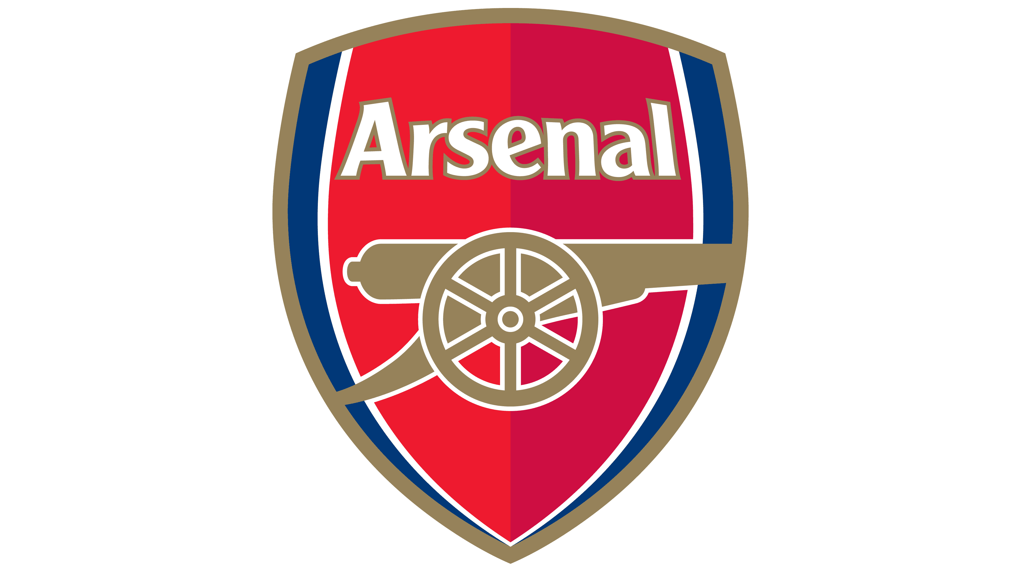


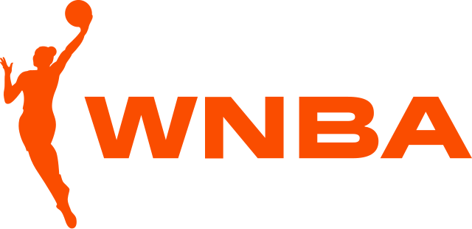
Rightsholders have continued to focus marketing efforts on key games, relocating matches to bigger or ‘main’ stadiums to allow for increased sales and more diverse audiences.
Arsenal Women have committed to playing a minimum of 11 games at the Emirates this season after record-breaking ticket sales last season.
The CPKC stadium became the first purpose built professional women’s football stadium and will be home to the Kansas City Current in the NWSL.
England & Wales Women’s rugby teams hosted standalone Six Nations games at Twickenham and the Principality, stadiums typically reserved for men’s internationals.
LA Sparks, Washington Mystics, Las Vegas Aces and Atlanta Dream will all host a select number of WNBA fixtures at marquee venues.
Notes:
EVZ
All game in Bossard Arena
Berlin Doppelspiel
Eisbären Juniors – Frauenteam Doppelspiel mit U20
→ Bettina

Slide 11
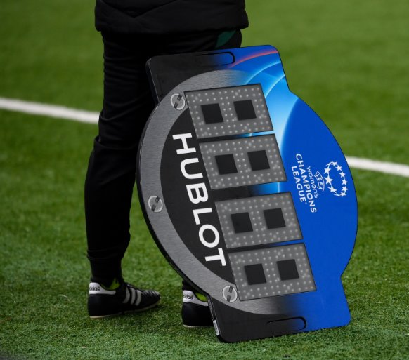


155
$90m
From 2022-2024 there were 155 new deals valued over $0.5 million in women’s sport, a 97% increase from the previous period.
2023 was a record year for sports sponsorship in women’s sport, with $90 million in total spend. 2024 is on pace to surpass that total.
50+
So far in 2024, over 50 individual brands have sponsored properties in women’s sport, already more than the whole of 2023. ​
There has been a continuous increase in the number of brands sponsoring women’s sport every year since 2019. ​

Slide 12
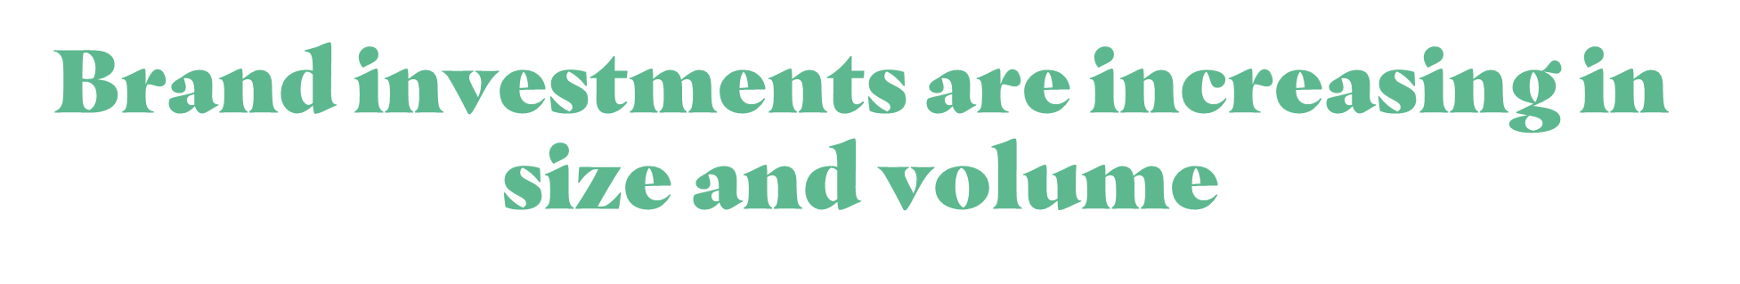
Number of deals per year in women’s sport over time
$1m+ p/a
>$3m p/a
Sources: Global Data, Two Circles
Includes: UEFA, WTA, Billie Jean King Cup (ITF), LPGA, Ladies European Tour, FIFA (not including WWC deals), FA WSL, Damallsvenskan, Liga F, Division 1 Féminine, Frauen-Bundesliga, NWSL, World Rugby, W Series, Tour de France Femmes
Data accurate as of June 2024
Brand investments are increasing in size and volume
Notes:
Notes - across comparable rightsholders: UEFA, WTA, Billie Jean King Cup (ITF), LPGA, Ladies European Tour, FIFA (not including local), FA WSL, Damallsvenskan, Liga F, Division 1 Féminine, Frauen-Bundesliga, NWSL, World Rugby, W Series, Tour de France Femmes (ASO)
As a result of that, sponsorship deals are increasing in volume and size.
This graph shows the how the number of deals above 1m and 3m in women’s sport have developem over the last +10y
You can clearly see that we have entered a new era in women’s sport… it’s not just a hype!

Slide 13
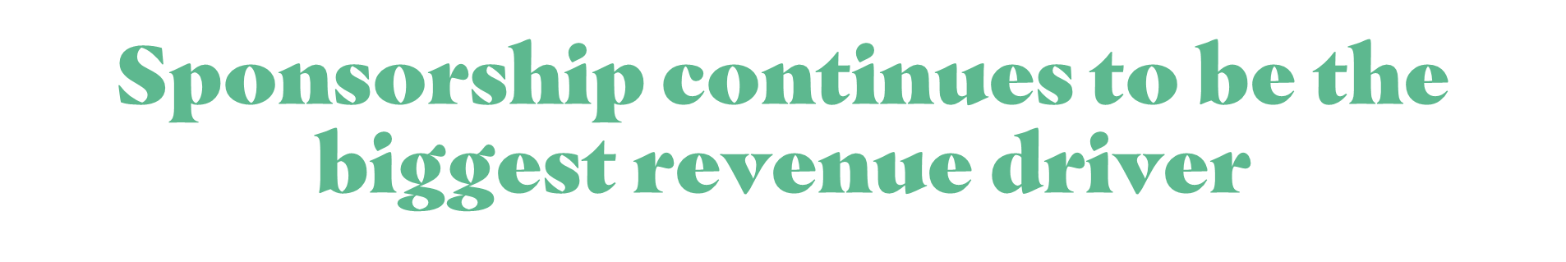
Revenue Split Men’s vs. Women’s Football
Men’s
Football
Properties (aggregate)
Women’s Football Properties (aggregate)
% Annualized Revenue
Sponsorship
Media
Match Day
Data accurate as of June 2024
Sponsorship continues to be the biggest revenue driver
Notes:
Notes - across comparable rightsholders: UEFA, WTA, Billie Jean King Cup (ITF), LPGA, Ladies European Tour, FIFA (not including local), FA WSL, Damallsvenskan, Liga F, Division 1 Féminine, Frauen-Bundesliga, NWSL, World Rugby, W Series, Tour de France Femmes (ASO)
As a result of that, sponsorship deals are increasing in volume and size.
This graph shows the how the number of deals above 1m and 3m in women’s sport have developem over the last +10y
You can clearly see that we have entered a new era in women’s sport… it’s not just a hype!

Slide 14

47m
20m
47m viewers of women’s sport in the UK alone in 2023, averaging a viewing time of just over 10 hours per person (WST)
The 2023 Tour de France Femmes attracted a total of nearly 20 million viewers on public service broadcaster France Télévisions
#1
+51%
2023 WNBA viewership was up 21% whilst an NCAA Women’s Final Four game became the most viewed college basketball game ever
The Frauen Bundesliga in Germany saw a 51% increase in live match viewership YOY
Notes:
FC Copenhagen attracts over 5K to their first home game of the season – setting new attendance record for a women’s game in Denmark by more than doubling previous record
FC Copenhagen Women: New team 'allowing girls to be stars' - BBC Sport
Swedish Damallsvenskan:
The average attendance per game has increased by about 22% from 2022-2023
Publiksnittet ökar i OBOS Damallsvenskan | OBOS Damallsvenskan
WTA achieved a new global audience record of more than 1 billion, during the 2023 season (47).
https://www.sportspromedia.com/news/solheim-cup-2023-sky-sports-ratings-viewership-figures/

Slide 15

Compared to big men‘s sport where media reach and other classical benefits rule surpreme
Power of Personality
New
Audiences
The Opportunity to shape the Journey

Slide 16

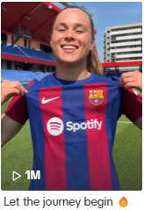
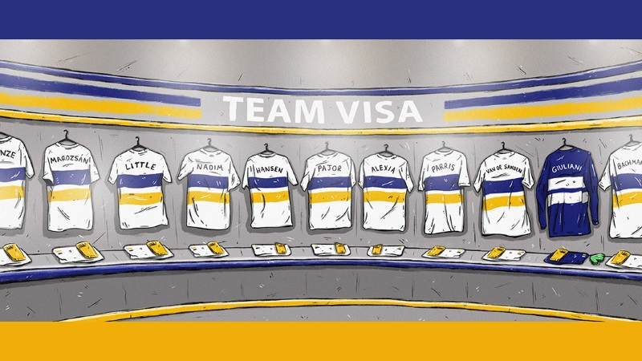
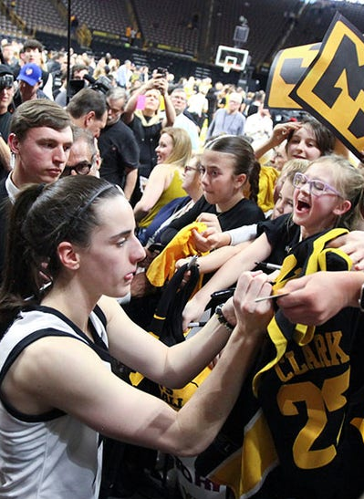
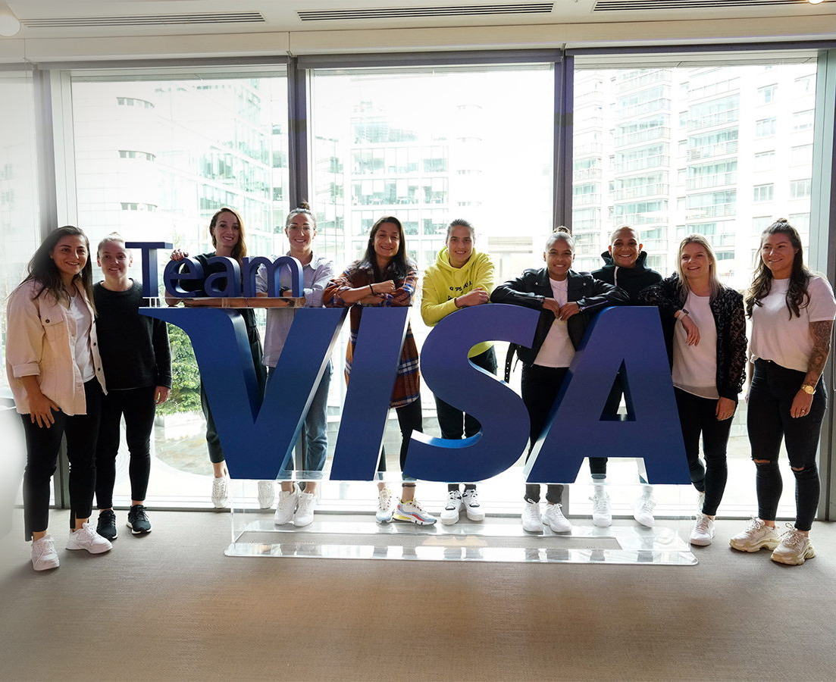
72% of women’s sports fans are interested in athletes ‘off the field’
Social media offers a great opportunity for female teams, leagues and athletes to tell stories.
Female athletes tend to be more accessible and more open to involvement.
Rightsholders and brands are amplifying individual athletes, turning them into stars.
Storytelling
Accessibility
Amplification
Notes:
WF offers more than just brand sentiment, the power of personality, is relatively untapped in women’s football but holds a real potential.
Fans care about the athletes, and there is a real chance to get to know them on a deeper level in many ways than with male athletes.
FC Barcelona TikTok saw a near 4fold increase in TikTok views this season through culturally relevant content, female athletes tend to run their own channels, more authentic, whilst WNBA saw 60m views in May 2024. Social media, in particular TikTok, lends itself to women’s sport in a way that it doesn’t to mens. We also know TikTok is the only social platform that leans more female than male. We are seeing more and more branded content on TikTok performing well.
This links into the accessibility point. At this stage – women’s athletes are more accessible. They are more likely to run their own social accounts. They are more likely to understand AND enjoy the value of social. This accessibility and authenticity improves the brand prop.
Final point is interest. I think the jury is slightly out on this one. The WNBA have undoubtedly leveraged the star power of Caitlin Clark exceptionally well, as has someone like Emma Raducanu and more recently US Gymnastics with Simone Biles drawing record viewership last weekend at their US Olympic Trials. We know that there is huge interest around the women’s players, but there is certainly still work to do for clubs and leagues to leverage this, let alone brands.

Slide 17

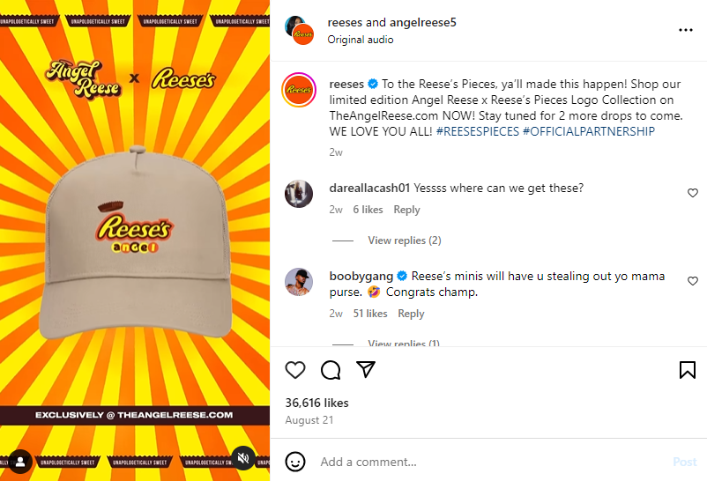
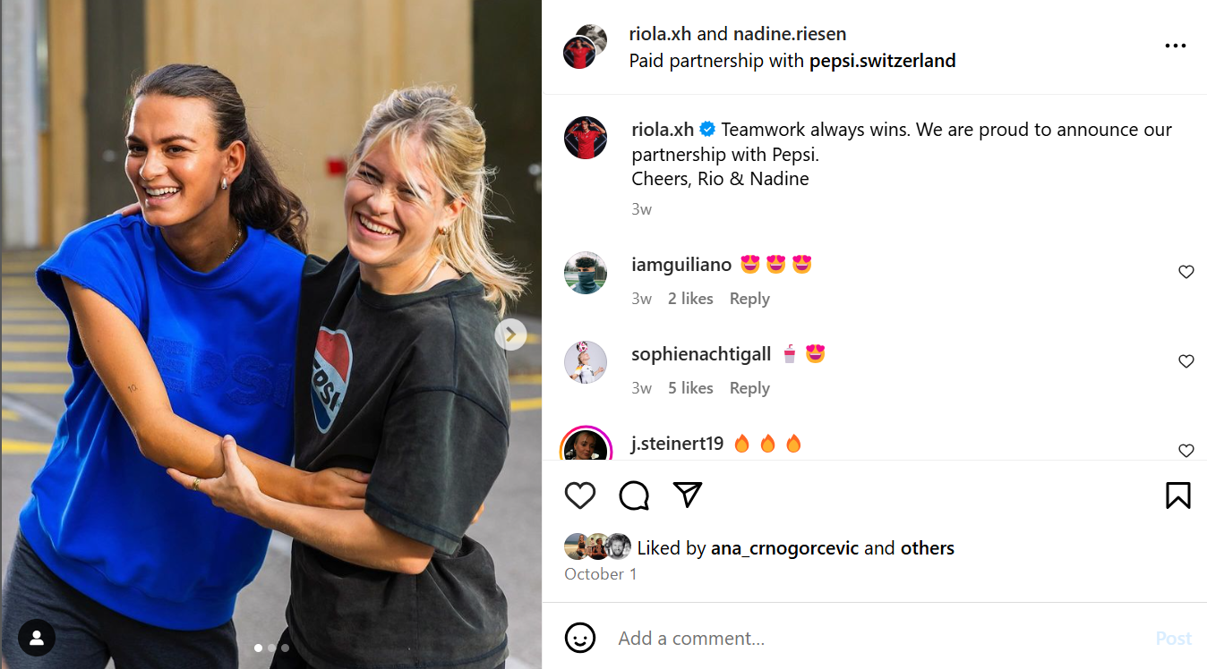
Collaborating with Partners
Angel Reese, Basketball: One of the highest profile college recruits into the WNBA. Utilises social media presence for high profile collaborations and promotion of partnerships with select brands.
Pepsi x Swiss Female Football Players
Pepsi and Swiss Women’s Football Player: Pepsi announced a collaboration with “Swiss women’s Football” and sponsors on various levels, not only investing in clubs and but individual athletes playing in Switzerland and abroad.
Brands are leveraging
athlete star power

Slide 18

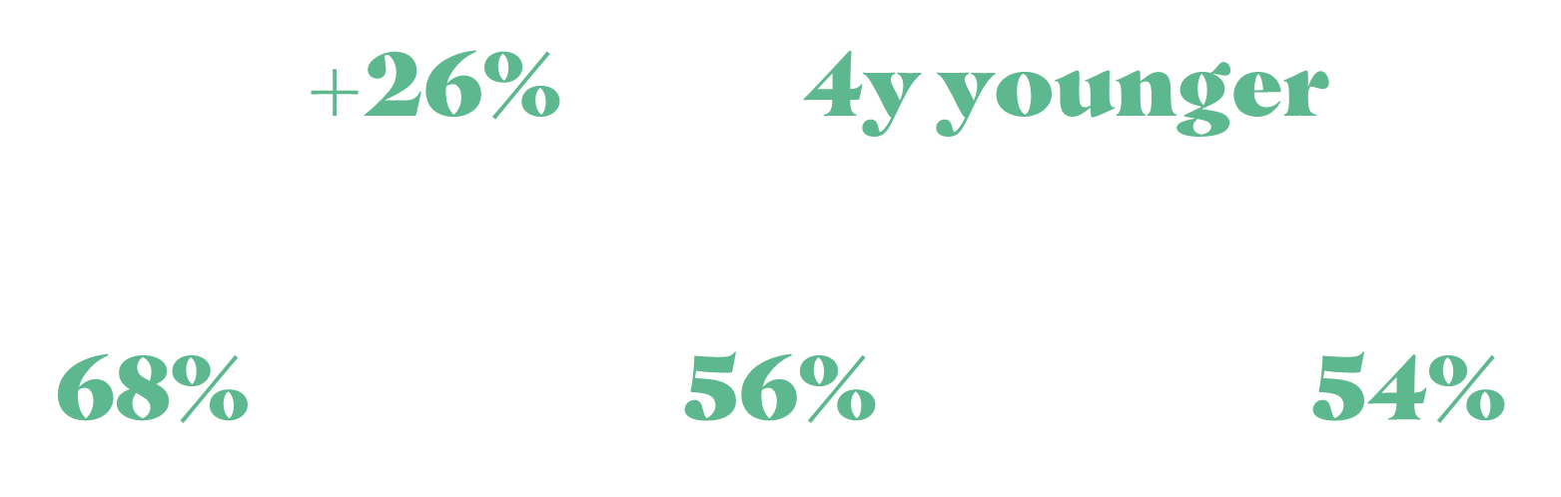
More females engaged in women’s football
(57% female vs 31% male)
On average
(35, while a men’s football fan on average is 39)
Of women’s sports fans are more likely to purchase sponsor products
(vs.48% of fans of men’s sports)
Of women’s football fans would be more likely to engage with the brand on social media sponsoring an athlete
(vs.29% of fans of men’s sports)
Women’s sports fans are 54% more aware of sponsors
(vs. fans of men’s sports)
Brands can reach new and hard to target audiences
Notes:
For me, this perhaps the most key thing to get right when valuing the game. Demonstrate a unique audience.
This goes back to the point around big brands, sponsoring multiple products, they need to understand that the audience they are reaching is unique… AND IT IS.
It is there!
They look different
They engage differently

Slide 19
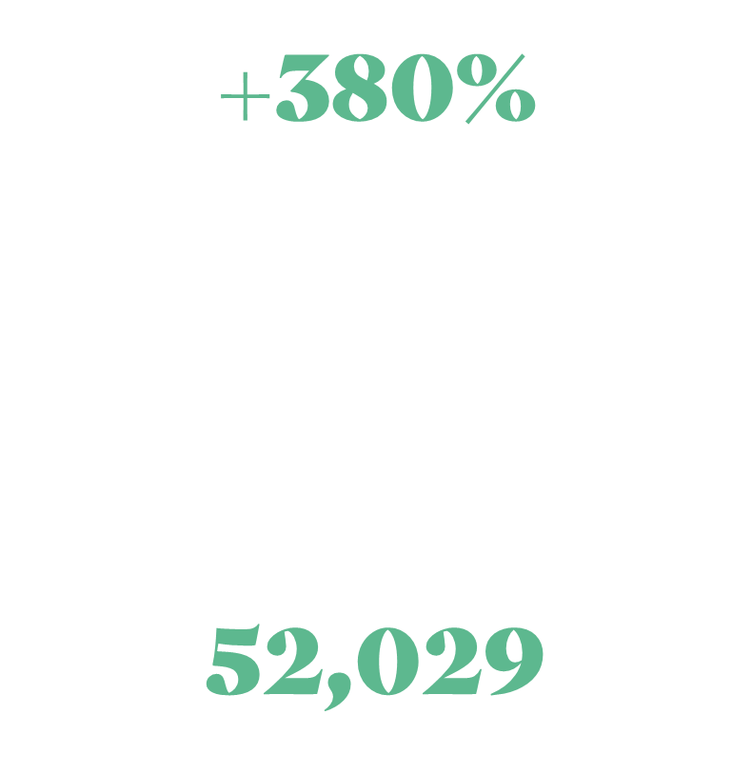
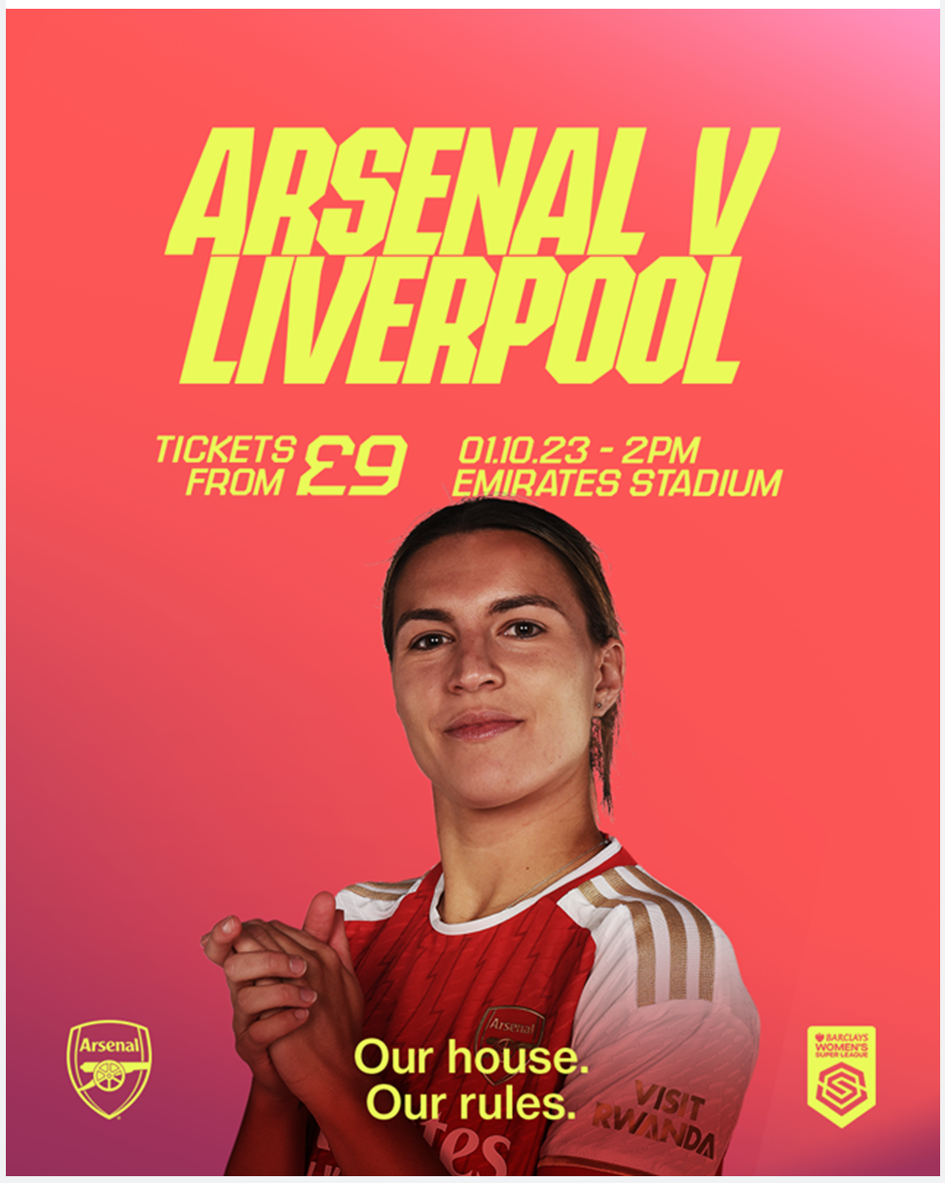

YoY increase on their average audience
Audience Profiling
Women’s Loyalists
Arsenal Supporter
Family
Big Eventer
Average attendance at the Emirates

Slide 20

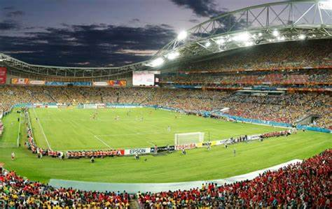
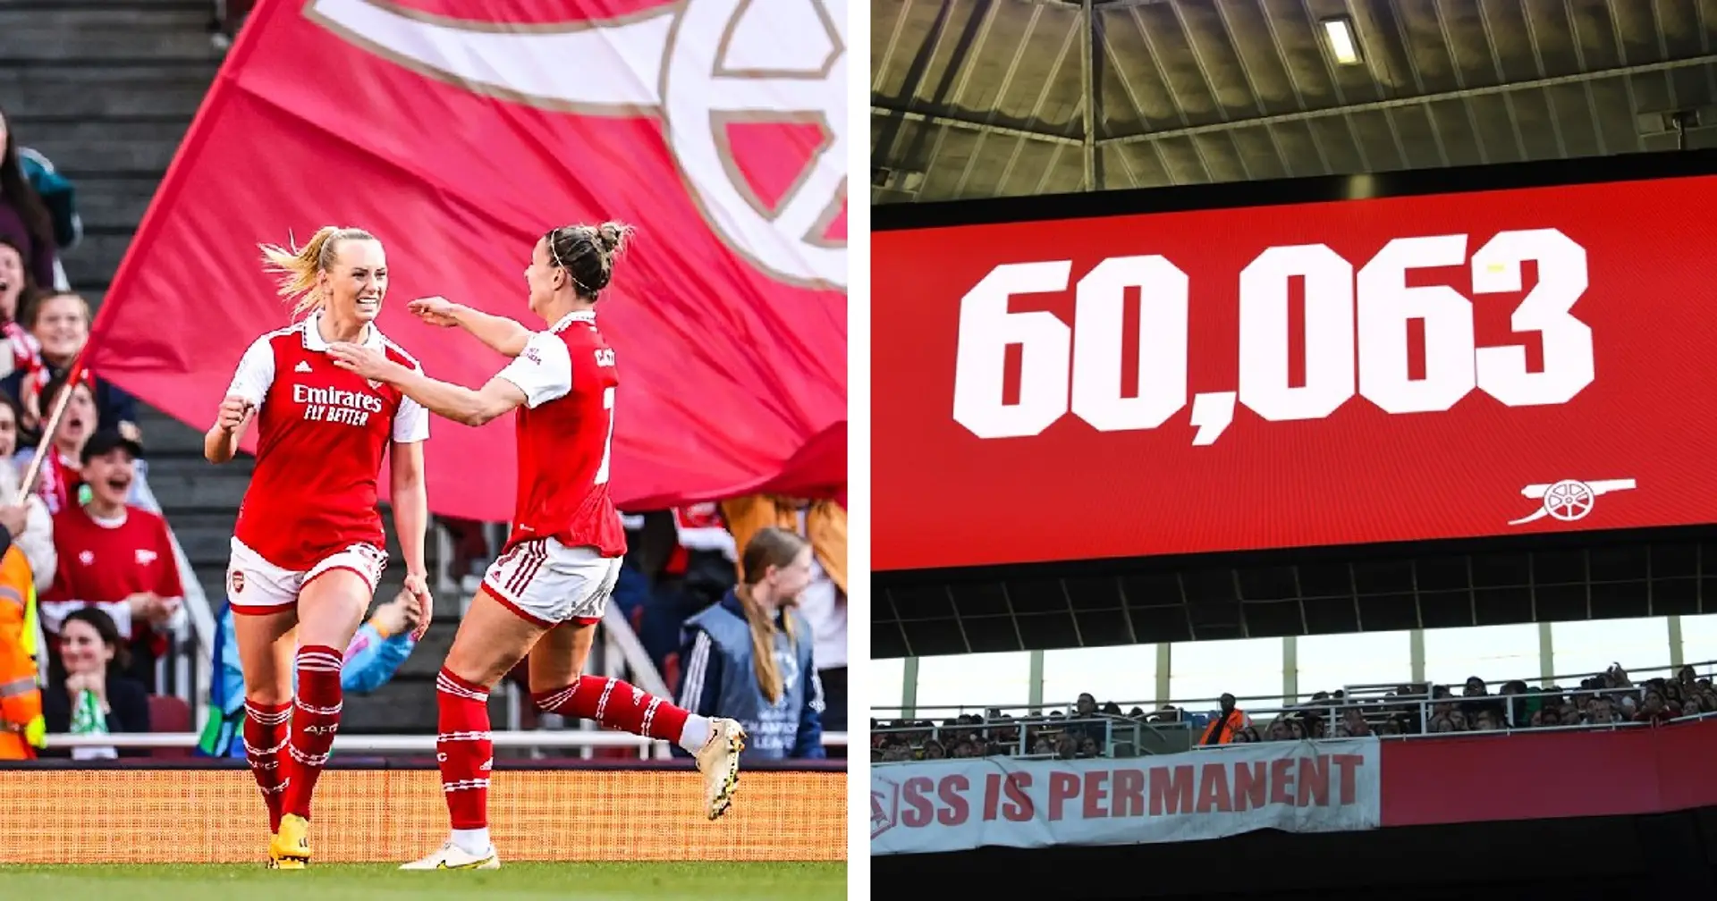
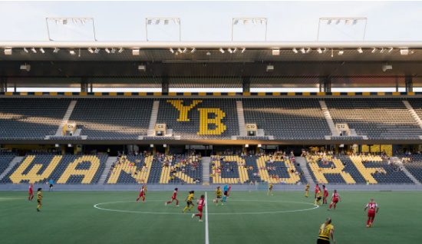
?
Notes:
When we think of men’s football, not much will change between now and 2030, but with WF, we don’t know where it will be in 2030. There is a real opportunity to make a TANGIBLE difference.
The opportunity with women’s sport is unique, a real chance to make a difference. Funding makes a tangible difference to areas such as:
Attendance
Professionalisation
More female coaches, referees, administrators, players etc…
Grassroots
Perceptions

Slide 21
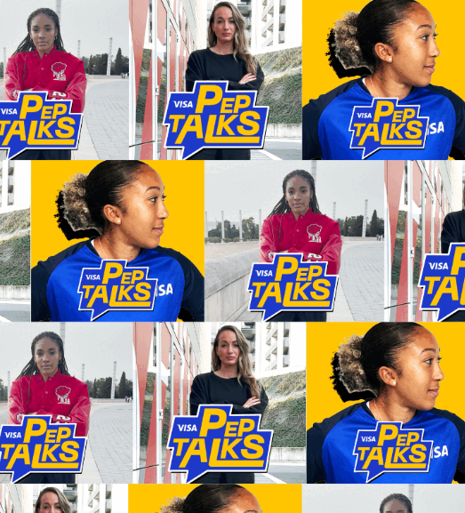
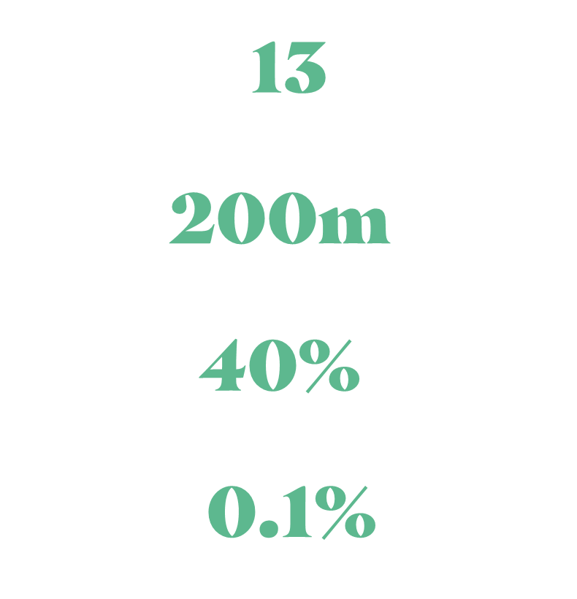
Visa Pep Talks
UEFA Women’s Champions League
DAZN
Games
Impressions
Participation Rate
Negative Conversation
Notes:
https://www.visa.co.uk/about-visa/newsroom/press-releases.3317931.html

Slide 22
WOMENS SPORT IS ON THE RISE
We see growth happening in different markets, different sports.
VISILIBILTY IS KEY
Women’s sport has been underrepresented in the media in the past – this is changing rapidly with increased reach
OPPORTUNITIES ARE ARISING FOR BIG & SMALL
Any rightsholder has the power to positively impact or even introduce change
WOMENS SPORT IS AN INTERESTING PROPERTY FOR BRANDS
New audiences, the accessibility of great personalities and the opportunity to shape the journey are drivers of that interest
COLLABORATION MEANS AMPLIFICATION
It needs pioneers to get all stakeholder of the eco-system to work together towards a common vision and goal

Slide 23

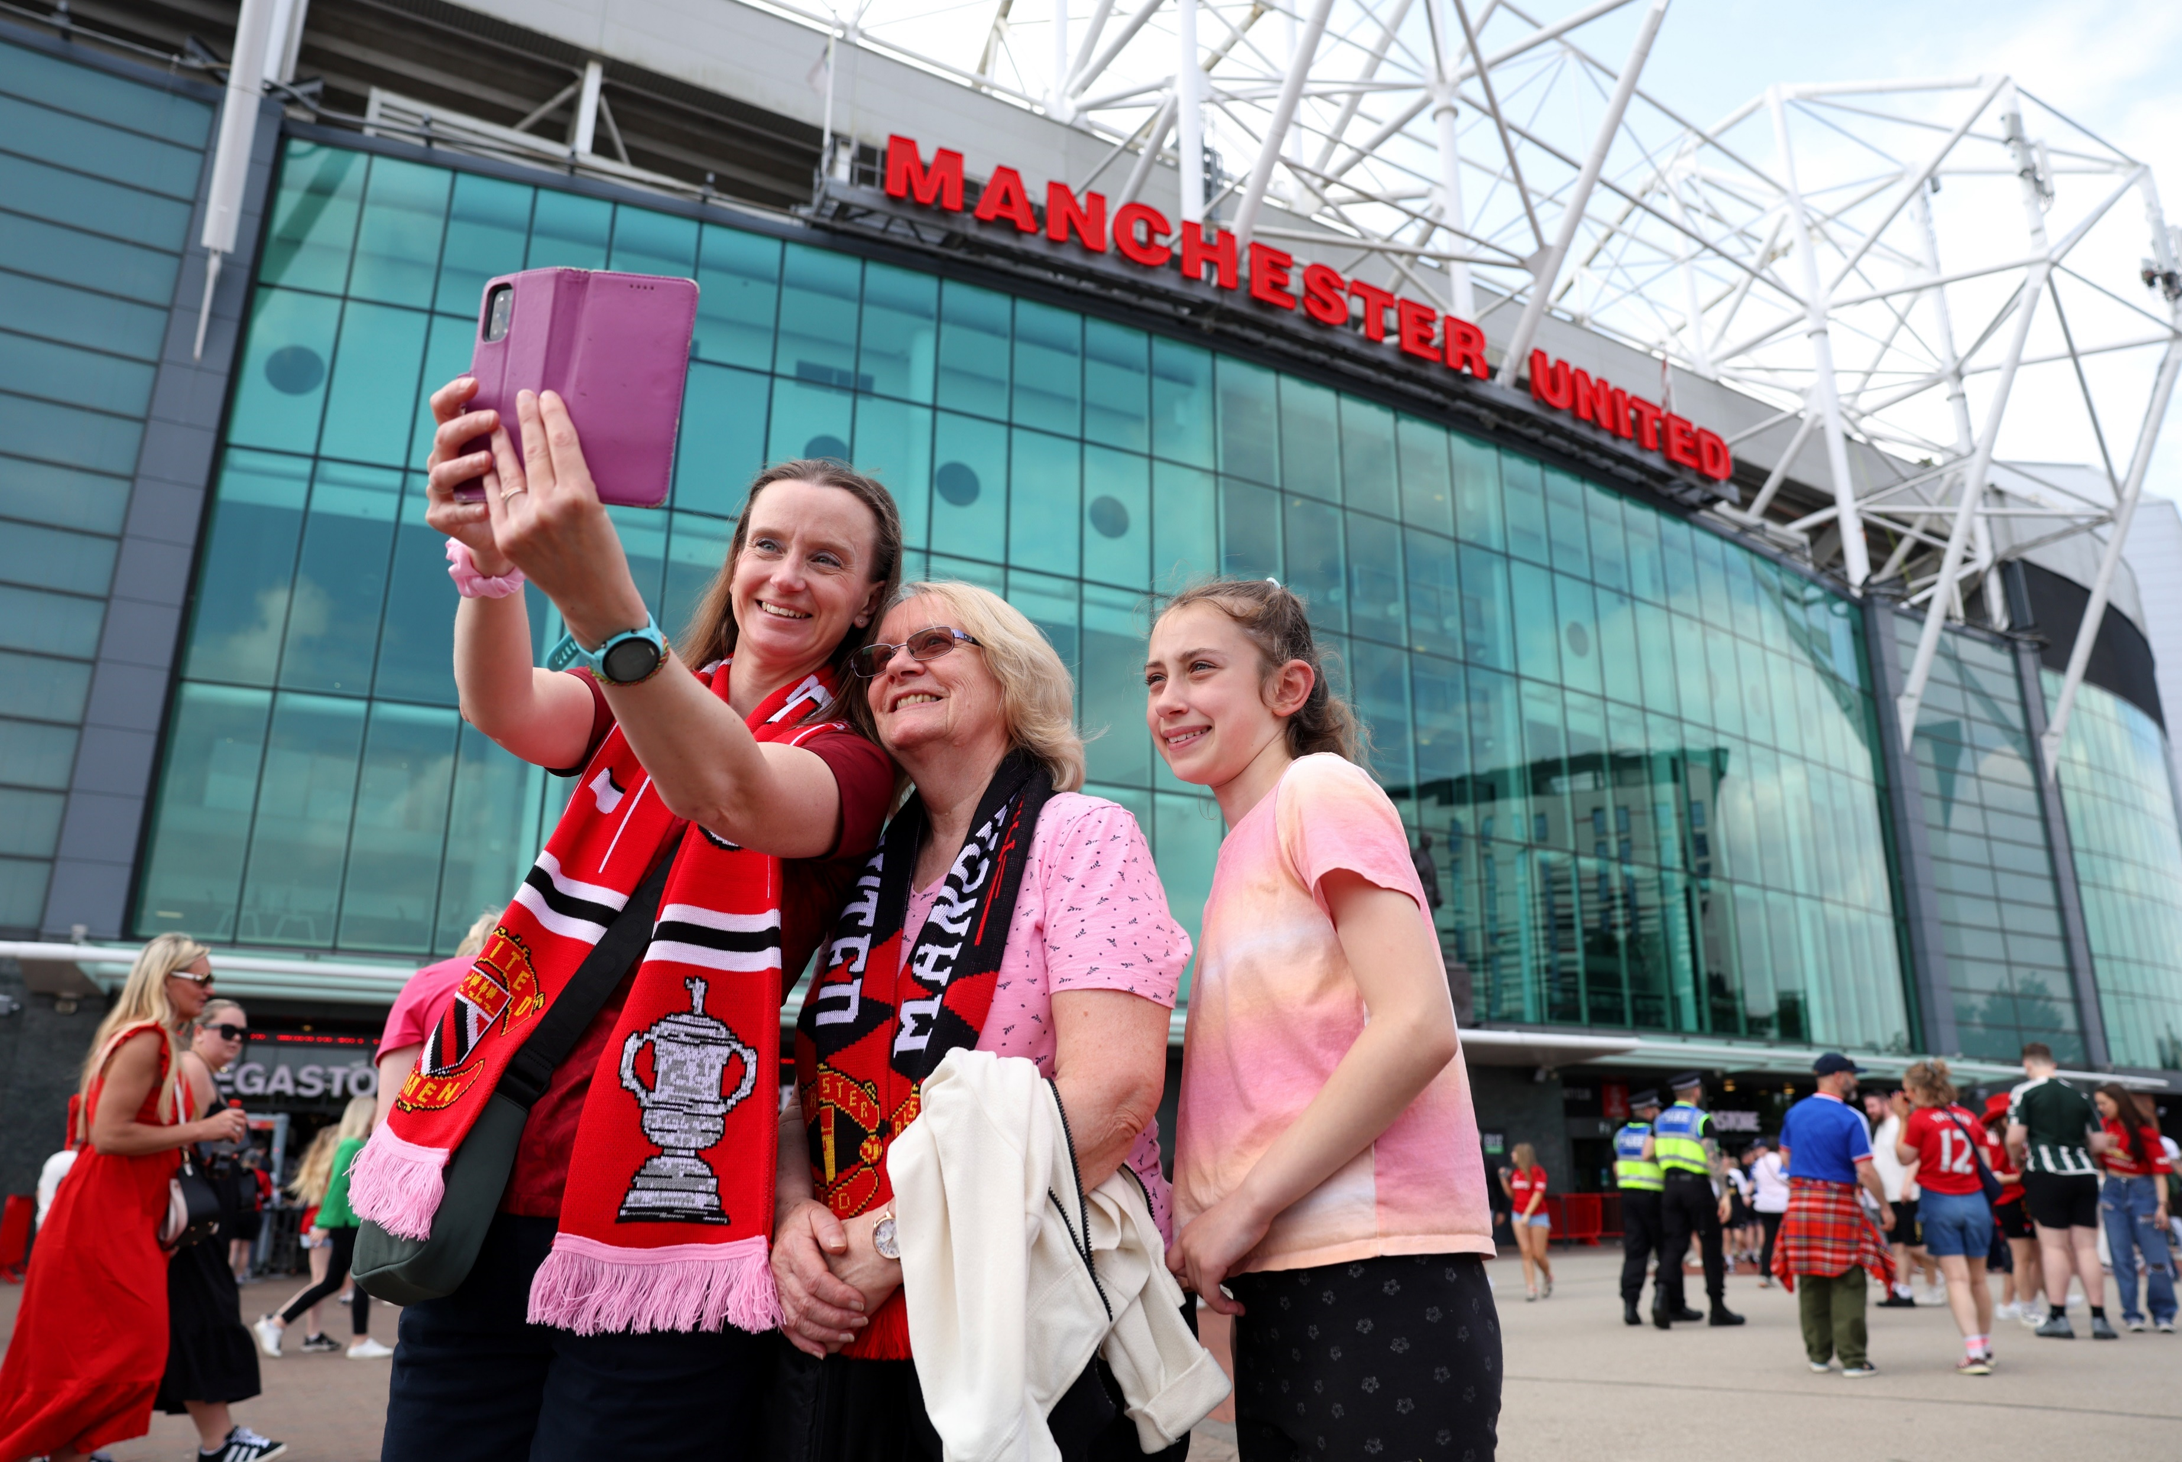
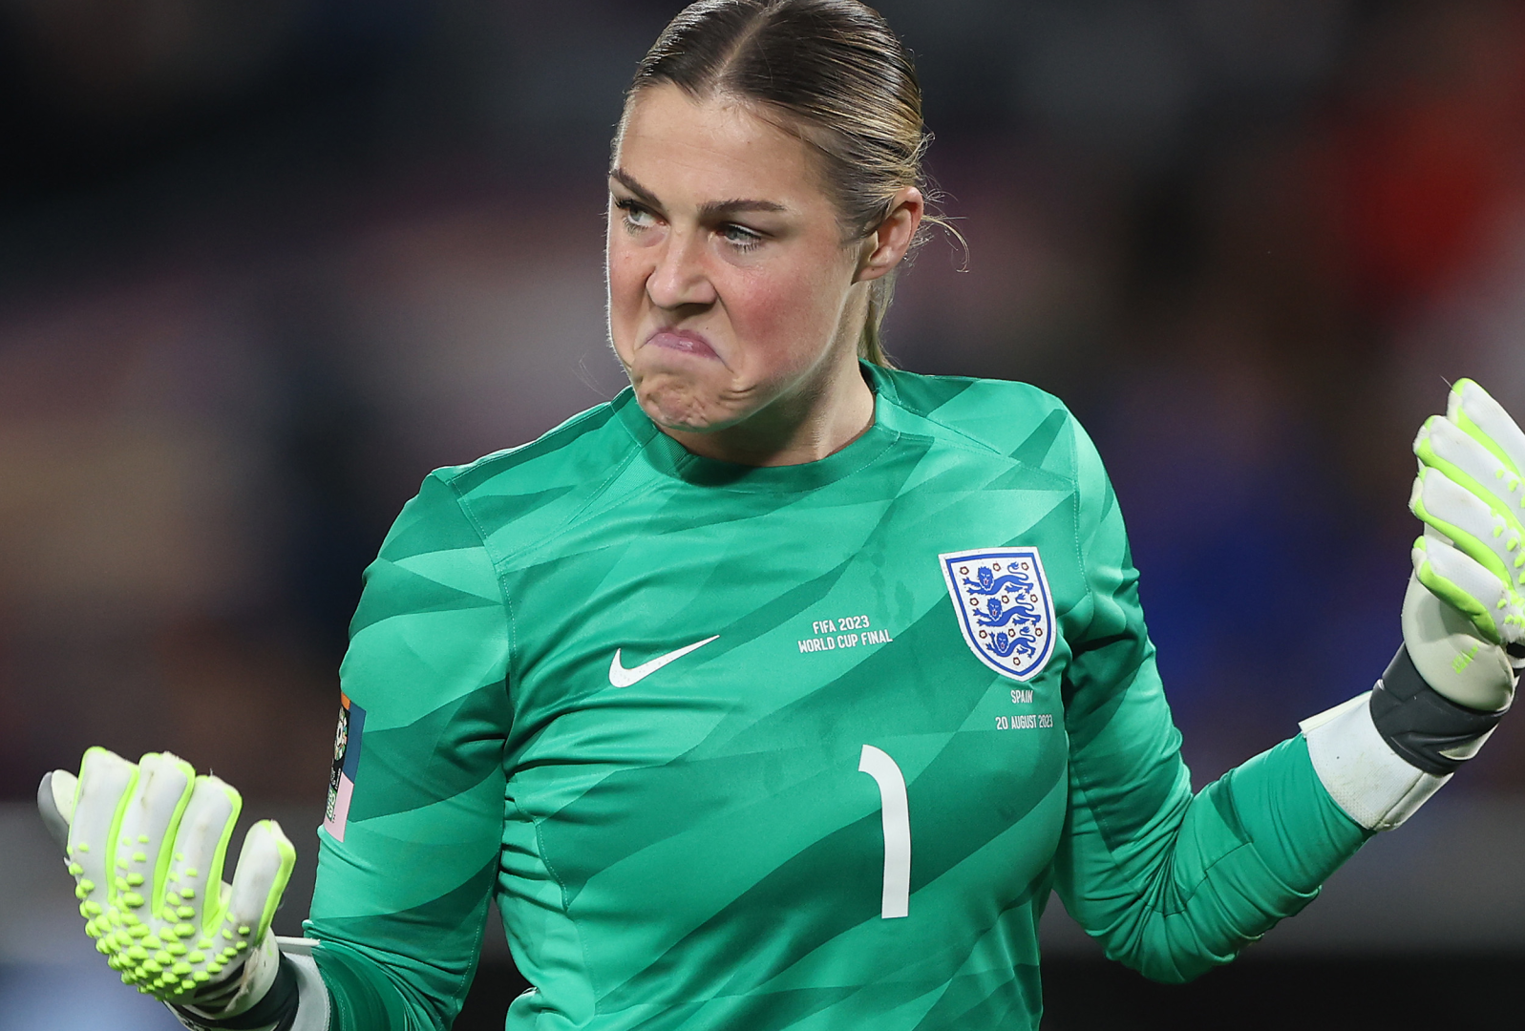
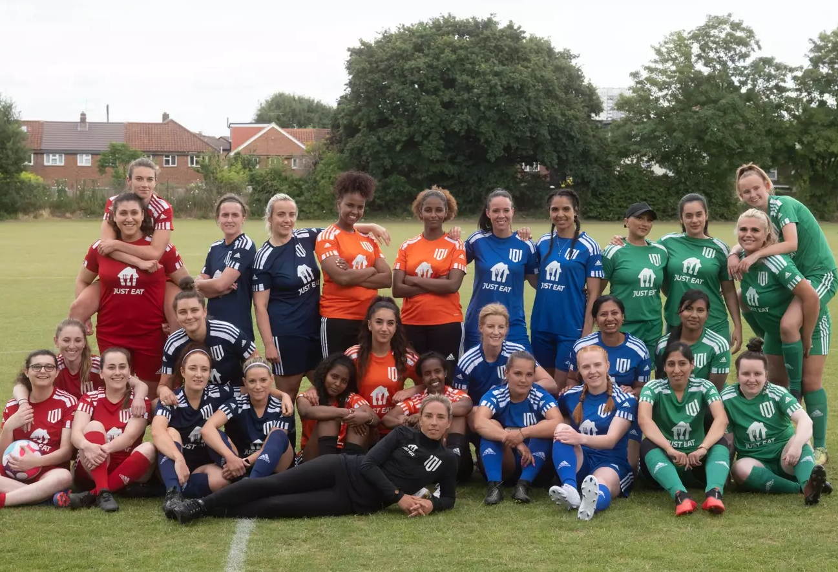
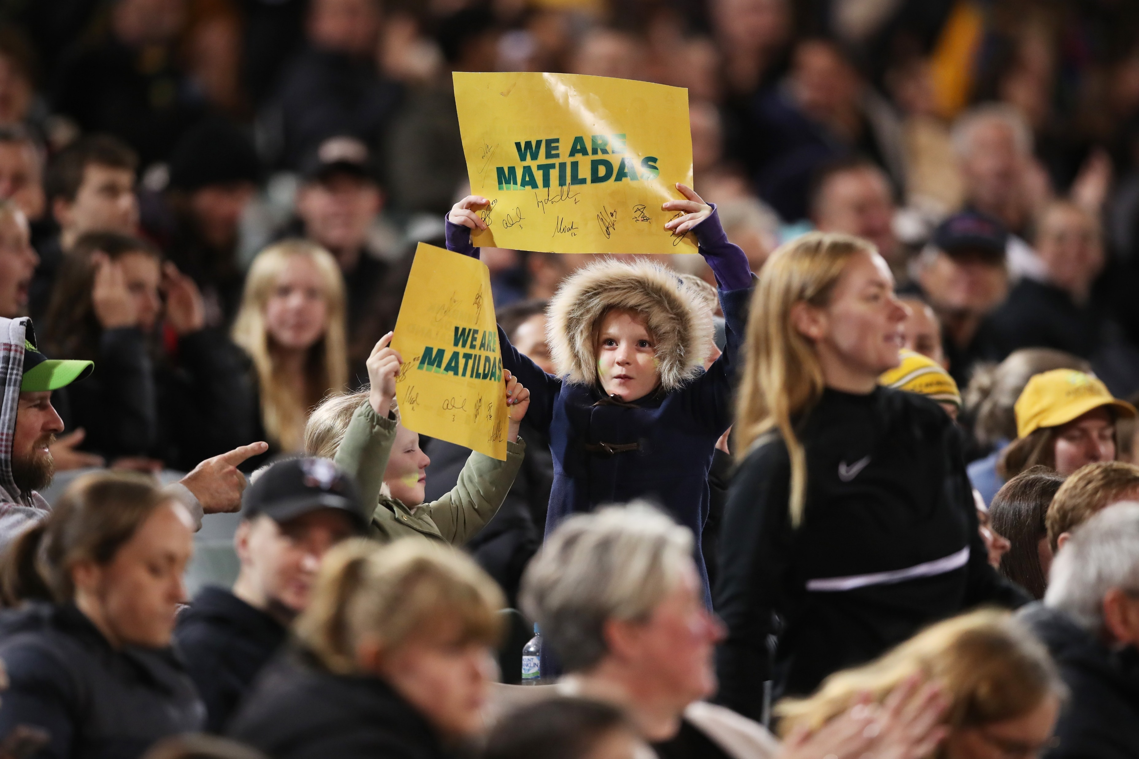
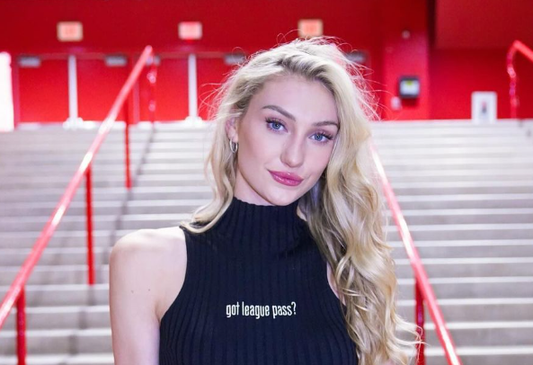
Key challenges and practices to be aware of when articulating value.
Demonstrating unique audience is not easy
Continue to put athletes first
Maintain ‘key values’
Attract new fans
Be flexible & innovative
GRASSROOTS
PLAYERS
GRASSROOTS
PLAYERS
GRASSROOTS
PLAYERS
GRASSROOTS
PLAYERS
The key point of differentiation is often in attendees and followers
They are critical to success, and harder to leverage as popularity grows
Whilst still being able to commercialize and develop
Without alienating the existing, loyal fans
There is more scope to ‘do things differently’ vs established men’s products
Notes:
The key is to show where your unique audiences sit… often found in attendee make-up vs broadcast audience
As athlete and sport popularity grows, how do you continue to access athlete power and harness it
Innovation, do things differently!
Keep reaching new fans and growing, whilst serving key fans
Values that are core to women’s football – inclusivity, equality, empowerment, fun – whilst also being able to commercialise, where is the line?

Slide 24


Slide 25
15-20 Slides
20min
Standard Font
Introduction – who am I, what is Two Circles and what do we do
Women’s Sport is growing – it’s not just a hype!
Today I will cover what is happening (backed up by data) – why and the wider context of the movement – and how; provide market examples we’re seeing
5 Key facts that I want you to take away
Data & Facts; Split by fans/ticketing/Attendance, sponsorship, media
Ticketing
  Big events – massive growth for football tournaments
  Big football leagues – audience growth across the board
  Big games – key approach to grow and diversify women’s audiences
Sponsorship
  Market headlines – steady increase in revenues alongside audience growth
  Market trends - a new era in women’s sport… it’s not just a hype
Broadcasting
  Market headlines – increasing viewership across different women’s sports
  Women’s sports tends to forgo short-term media revenue in order to increase audiences (and sponsorship revenues)
How can rightsholders capitalize on this? → Value drivers are different in women’s sport!
  Power of Personality
  New Audiences
  A Chance to shape the journey
Moving Forward – What are key challenges and practices to be aware of when articulating value?
It’s a new era in women’s sport
accelerated by visibility, investments and fan interest

Slide 26
OPPORTUNITIES
Whilst there are many exciting opportunities across the whole range of UEFA WF, we have picked out a couple below.
Capitalise: Whilst the women’s sport market has been on the rise for many years, recently, the levels of interest are currently spiking. There is a real opportunity to continue to be visible, and cement UEFA WF position as a market leader, to draw in more eyeballs and make the most of the interest spike.
1.
2.
Collaborate: It is worth exploring collaborating with the major names within women’s football, but also exploring collabs more broadly in women’s sport. Chelsea and Arsenal have collaborated with the WNBA whilst US Athletics sent female athletes to create content with WNBA players. How could cross sport collaboration be utlised to bring new audiences to UEFA WF?
3.
Star Power: We are seeing a shift in female athlete followership on social media, especially TikTok. Athlete strategy should be prioritised, i.e. athlete partnership marketing, ambassador offerings, collaborations and athlete social media education offerings.
4.
Creator Value: With increased athlete popularity, comes increased fees. Creators / influencers could and should be utilised to deliver and drive value both where athletes can’t, but also to reach different audiences. Could be especially beneficial for WEURO awareness.
5.
Knowing your fans: If you know who your fans are, you can grow your fanbase. Arsenal have exemplified this through their ticketing strategies. There are many more opportunities to get under the skin of the UEFA WF fan, who they are, what they like, don’t like, what they want and don’t want, in order to improve their experiences and attract new fans.
6.
Creativity: Women’s sport campaigns and initiatives tend to cut through when they are creative and done differently from the men’s side of things. Don’t be afraid to try new things, test and learn and launch new ideas that wouldn’t necessarily work for the men’s product i.e. new fantasy games, athlete collaborations, purpose-led campaigns.

Slide 27
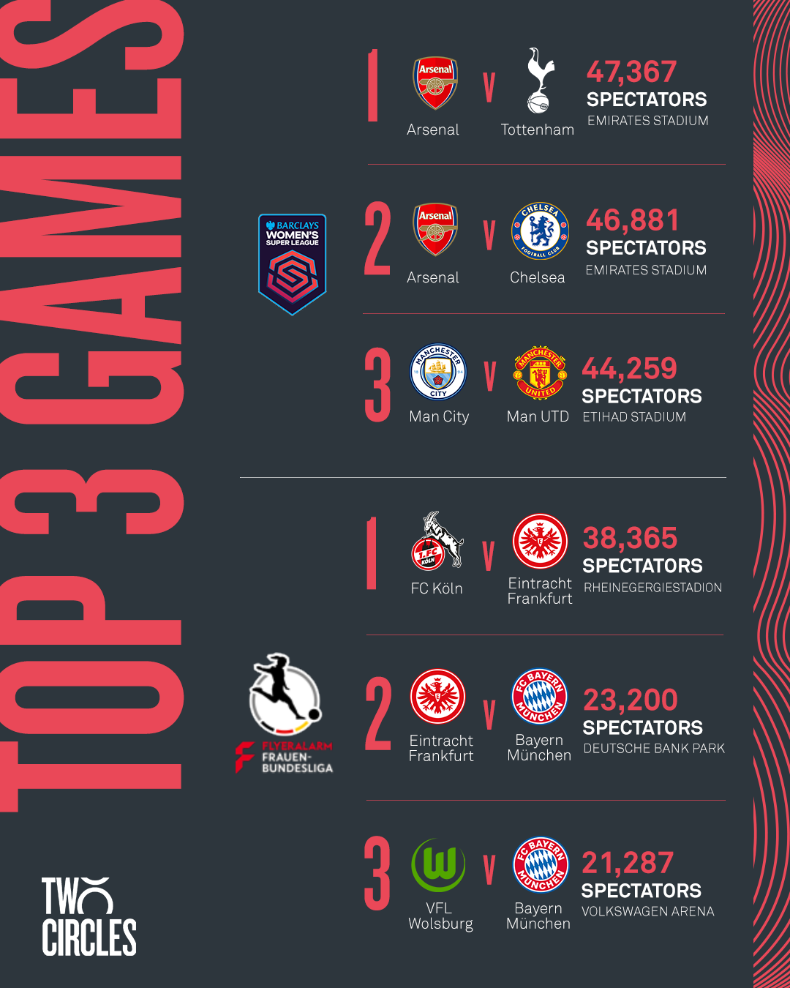
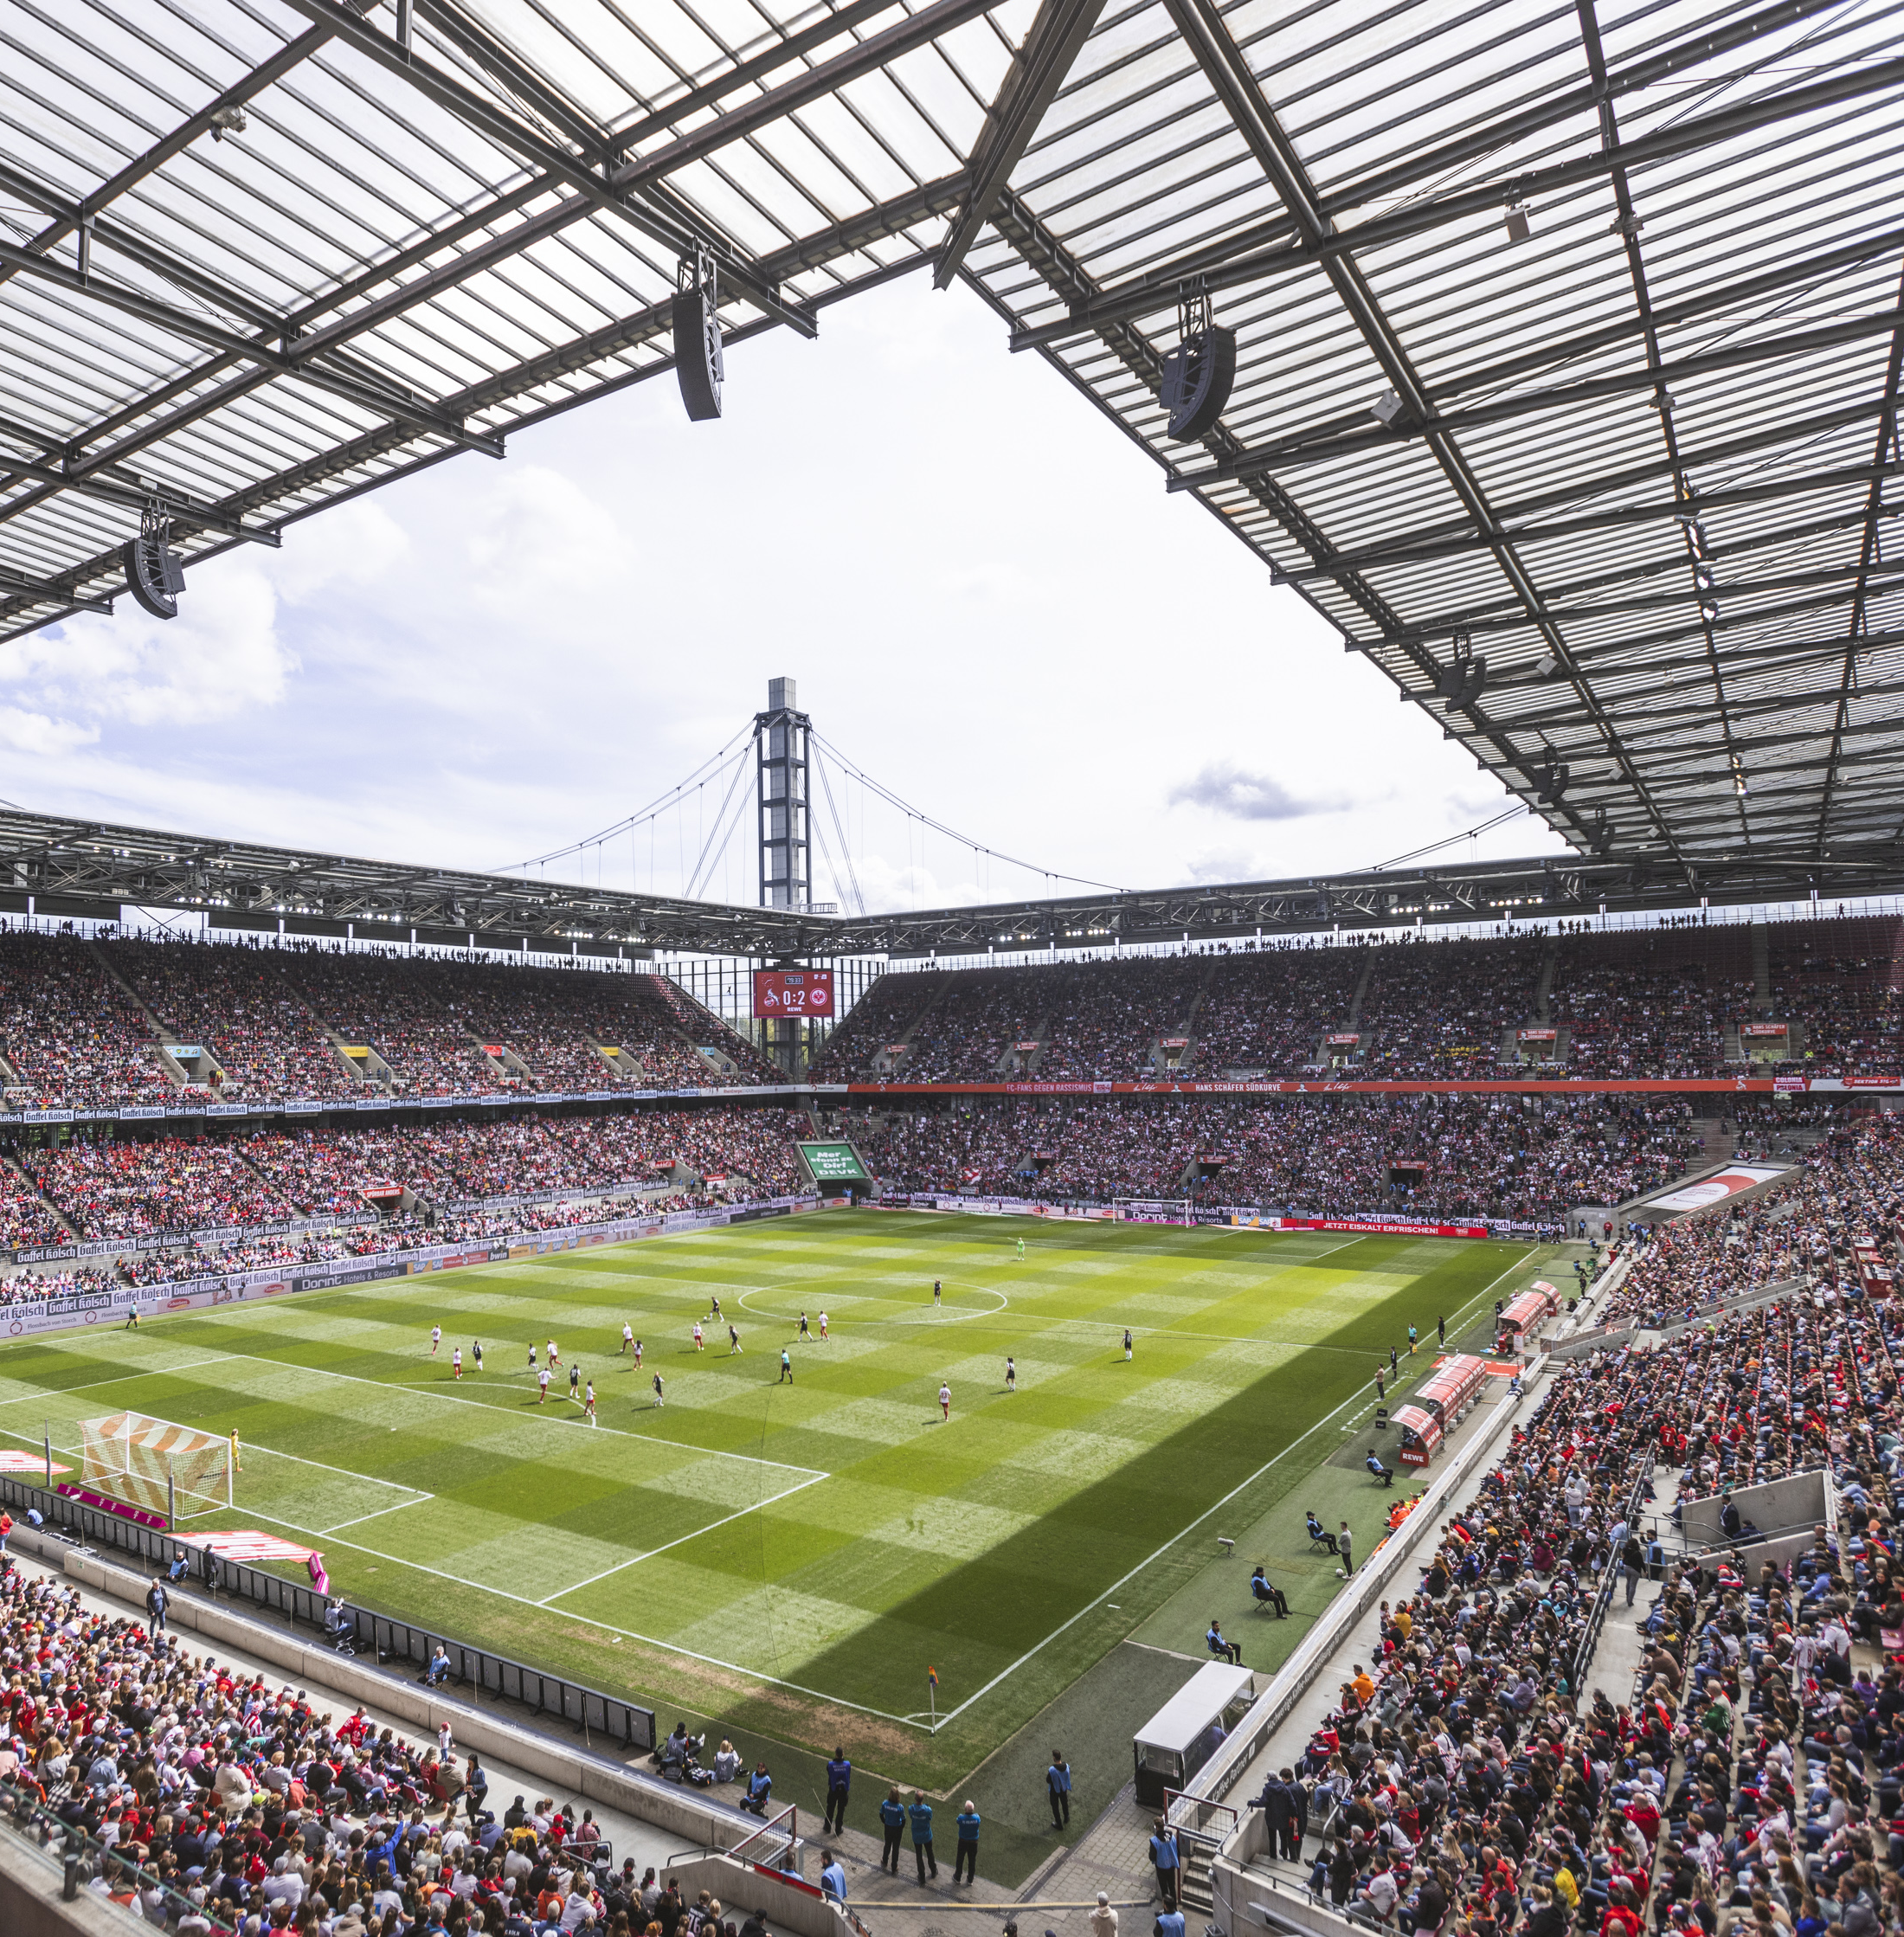
‘Big Games’ strategy underlines commercial growth potential for clubs and leagues across Europe

Slide 28
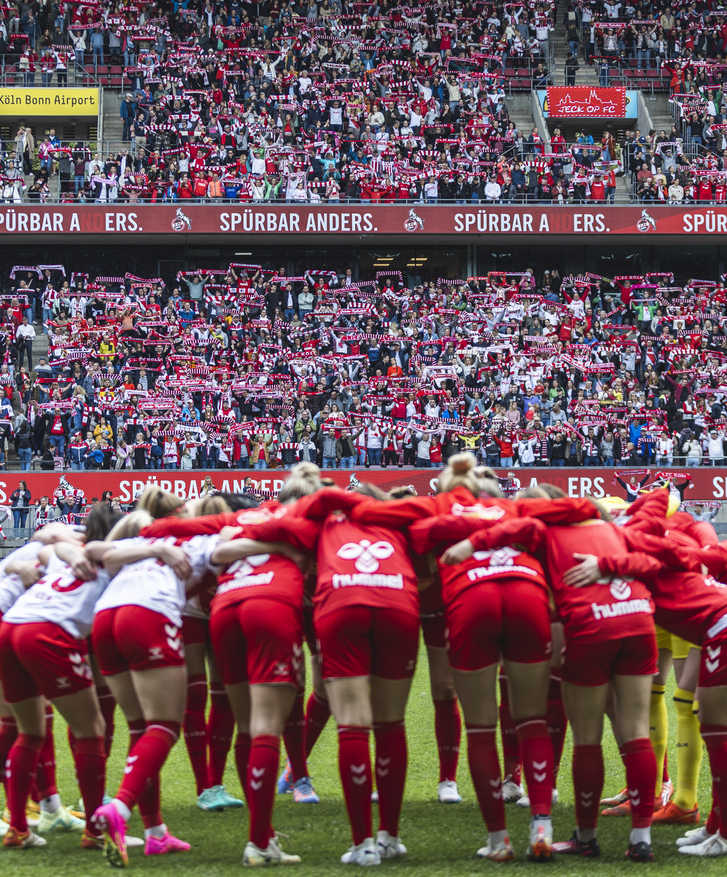
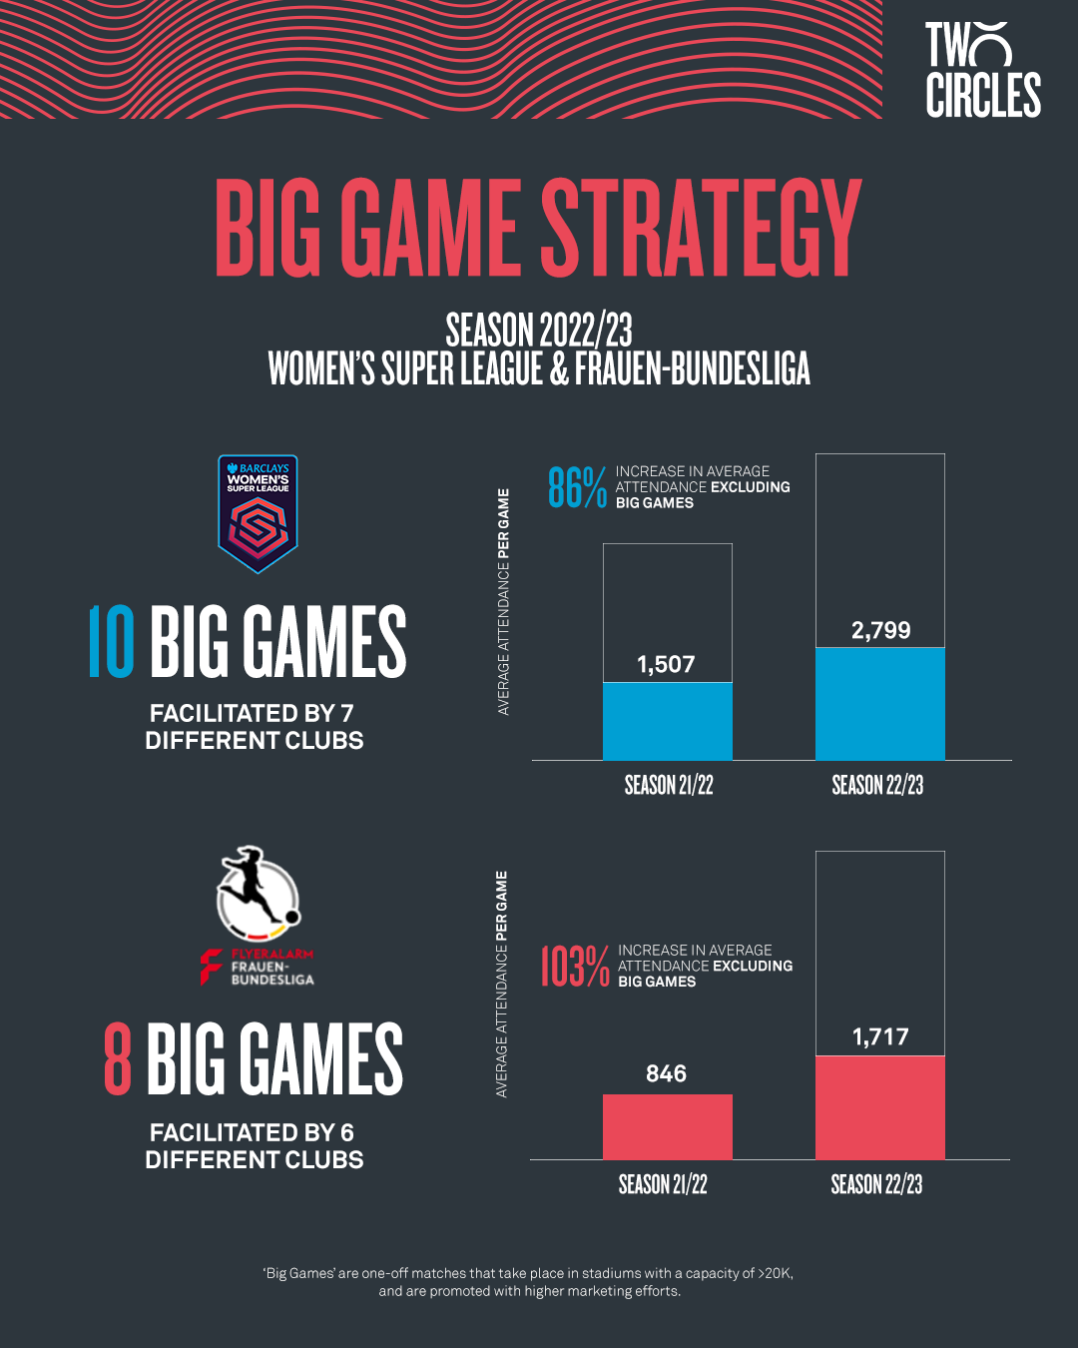

Slide 29

Road To Emirates
Arsenal Women’s FC

Slide 30
240’000 Tickets
sold in season 2022/23
Audience Profiling
Women’s Loyalists
Arsenal Supporter
Family
Big Eventer

Slide 31
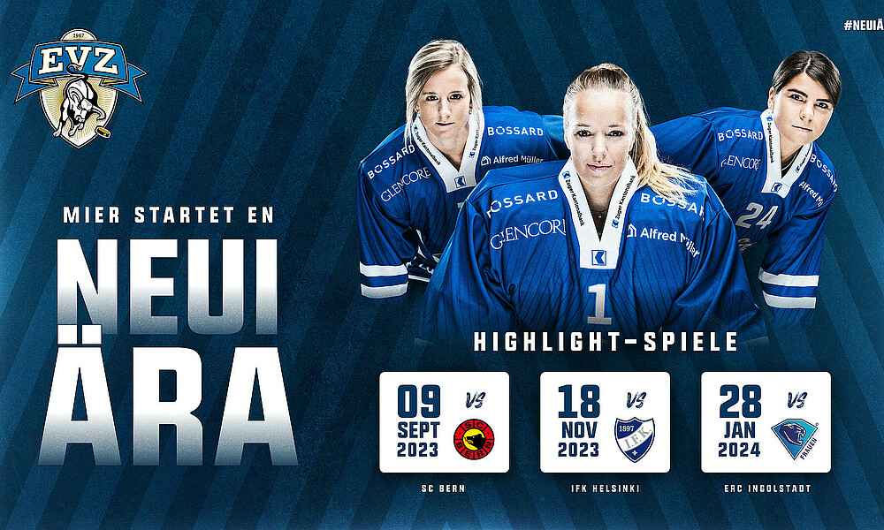
All In or Not At All
EVZ Case Study

Slide 32

All In or Not At All
EV Zug disrupting Swiss women’s ice hockey
FULL INTEGRATION
STRONG NARRATIVE
PLAYER
PERSONALITIES
MAX
VISIBILTY
PARTNERSHIPS
Full integration in EVZ organisation, sporting infrastructure and dedicated resources
Approaching brands with opportunity to join and shape the journey
Putting personalities in the center of the narrative
Through joint social media accounts and expert content production
Collaboration over purely financial sponsorship to fuel visibility

Slide 33
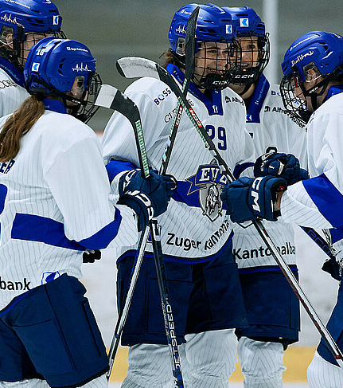

From Zero to…
1’000
Attendance
in first two games
40
Partners
signed
=
CHF 750k
from sponsorship
Notes:
Jan Kovar

Slide 34
Levers for Growth
Collaboration
Visibility
Among rightsholder, brands, media
Through platforms, content and reach
Investment
are initially required to harvest later

Slide 35
1.
WOMENS SPORT IS ON THE RISE
We see growth happening in different markets, different sports.
2.
WOMENS FOOTBALL WILL BE THE FASTEST GROWING SPORT
The sport is and will be able to capitalize on high interest levels globally.
3.
COLLABORATION MEANS AMPLIFICATION
It needs all stakeholder of the eco-system to work together towards a common vision and goal.
4.
VISILIBILTY IS KEY
Women’s sport has been underrepresented in the media in the past – this is changing rapidly with increased reach.
OPPORTUNITIES ARE ARISING FOR BIG & SMALL
5.
Any rightsholder has the power to positively impact or even introduce change.

