Slide 1
Apps as the centre of a smart fan experience
28.9.2023
Notes:
- Good afternoon from my behalf as well
- I am going to be tlaking under this title for the next 20 mins or so but…

Slide 2
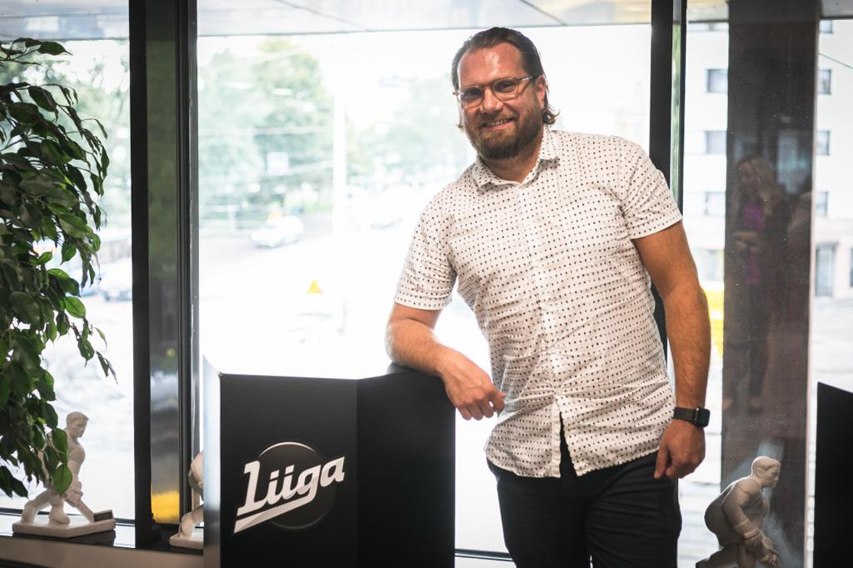
JUKKA SUNDQUIST, CDO
+20 years of experience in digital business development
Last two years with Finnish Hockey League (Liiga)
The whole Liiga community has a strong focus in digitalization
Notes:
- first, just quickly about myself and why I am here talking to you all
- +20years worth of experience within digital business→ I have been running my own company first within data driven marketing and sales and later we also included digital business development to the mix
- You can say that this experience has given me a wide experience on different areas of digital business but I am no expert in any of those → those things I leave to the experts
- For the last two years I ahve been working as the chief digital officer for Finnish Ice hokcey league and we at the whole Liiga community have a strong focus in digitalization
- and now I am going to give a little insight about what we have been planning and building during these two years and what we are planning in the future

Slide 3
MISSION
VISION
MOST SPECTACULAR SPORTING EXPERIENCE IN FINLAND
GROWING & RESPECTIVE FRONTRUNNER IN PRO SPORTS
LIIGA STRATEGY
DRIVING FORCES
STRATEGIC GOALS AND DEVELOPMENT PROGRAMS
FINANCIAL GOALS
CHANGES IN CONSUMER BEHAVIOUR
TRANSFORMATION OF MEDIA
INCREASING PROFESSIONALISM IN SPORT ENTERTAINMENT BUSINESS
COMPETITION OF TOP PLAYERS
INCREASING EXPECTATIONS TOWARDS EVENTS
THE GROWTH OF REGIONAL ECONOMICAL DIFFERENCES
PANDEMIC AND RESTRICTIONS IN SOCIETY
TURNOVER GROWTH 25% DURING STRATEGY SEASON
GOOD PROFITABILITY AT THE END OF STRATEGY SEASON
MOST SIGNIFICANT COMMUNITY IN FINLAND
TOP LEAGUE FROM POINT OF VIEW OF THE GAME AND PLAYER
SUSTAINABLE AND ACCOUNTABLE INFLUENCER
PROFITABLE AND GROWING BUSINESS
CUSTOMER PROFRAM
GAME PRODUCT AND PLAYER DEVELOPMENT PROGRAM
SUSTAINABILITY AND EFFICTIVINESS PROGRAM
PROFITABLE GROWTH PROGRAM
VALUES
COMMUNALITY
COURAGE
SUSTAINABILITY
RESPECTING TRADITIONS
Notes:
- To start things of I want to show a one slider about our strategy
- And don’t worry, I am not gonna go through it all here cause then this presentation would take much more than 20 minutes
- but I do want to show this because when I was in the recruitment process we talked about the strategy that Finnish Ice hockey league had updated quite recently
- I was impressed by it, right kind of drivinf forces were identified, it had enough ambition and most importantly mentioned strategic goals and development programs made sense to me

Slide 4
PICKS FROM PROGRAMS:
Developing sportiness and customer satisfaction of game events
Developing Liiga season schedule, structure and system
Developing the game through wise hockey system
Developing customer experience and sales with things digital
Customer segmentation and customer journey development
Building a common tech & data ecosystem
Developing mobile solutions
Developing customer experience with wise hockey system
Developing arena experience and restaurant & event service concepts
Developing a common objectives and key results structure
Developing and commercializing services and revenue logics with data
Developing pricing structures
Developing a common procurement process
Automating manual internal processes (AI)
Developing strategic and financial operative framework
Strengthening resources and know-how of Liiga office
…
MISSION
VISION
MOST SPECTACULAR SPORTING EXPERIENCE IN FINLAND
GROWING & RESPECTIVE FRONTRUNNER IN PRO SPORTS
LIIGA STRATEGY
DRIVING FORCES
STRATEGIC GOALS AND DEVELOPMENT PROGRAMS
FINANCIAL GOALS
CHANGES IN CONSUMER BEHAVIOUR
TRANSFORMATION OF MEDIA
INCREASING PROFESSIONALISM IN SPORT ENTERTAINMENT BUSINESS
COMPETITION OF TOP PLAYERS
INCREASING EXPECTATIONS TOWARDS EVENTS
THE GROWTH OF REGIONAL ECONOMICAL DIFFERENCES
PANDEMIC AND RESTRICTIONS IN SOCIETY
TURNOVER GROWTH 25% DURING STRATEGY SEASON
GOOD PROFITABILITY AT THE END OF STRATEGY SEASON
MOST SIGNIFICANT COMMUNITY IN FINLAND
TOP LEAGUE FROM POINT OF VIEW OF THE GAME AND PLAYER
SUSTAINABLE AND ACCOUNTABLE INFLUENCER
PROFITABLE AND GROWING BUSINESS
CUSTOMER PROFRAM
GAME PRODUCT AND PLAYER DEVELOPMENT PROGRAM
SUSTAINABILITY AND EFFICTIVINESS PROGRAM
PROFITABLE GROWTH PROGRAM
VALUES
COMMUNALITY
COURAGE
SUSTAINABILITY
RESPECTING TRADITIONS
Notes:
- what I didn’t really understand during my recruitment process was how much things there were in these programs that were related to things digital
- basically digitalization was everywhere in all there programs so it was self-evident that I needed figure out what I should focus on first and what I leave for later

Slide 5
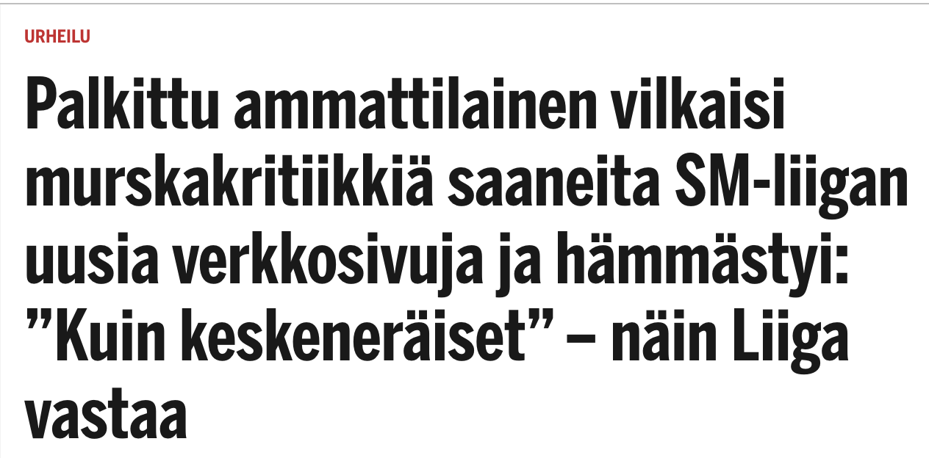
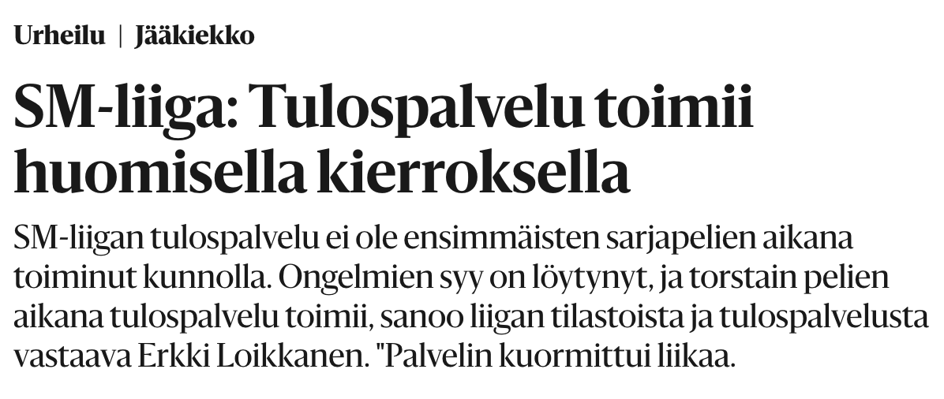
STARTING POINT: SITE RENEWAL PROJECT AND OFFICIAL RESULTS & STATS SERVICE
Iltasanomat: 13.8.2021
Site renewal project finished in spring 2022
Launched site faced a lot of challenges and was transferred to a new tech partner who had also developed our apps
Official results and stats service had been under minimal development for the last ten years → Root cause for many challenges on the site & apps
Helsingin Sanomat: 19.9.2013
Notes:
- also during my recruitment process, it wa mentioned that there had been a bit of trouble with Liiga’s site renewal project
- I started to realize how much trouble juut before I started as this news article from the finnish newspaper on the 13th of August demonstrates → It basically says that nothing works on the just lauched site
- That article was released on Friday and I started on my job on the following Monday so that was kinda of my welcome to the jod present
- Likely something had already been done about this and the site had been transferred from the partner that had renewed the site to a new tech partner who wad also done Liiga’s and most club’s mobile apps
- After a little bit of discussion with the this new tech partner it became evident that I would need to spend more time with the site than I had originally planned and there was also another problem, the official results and stats service had been under minimal development for the last ten years and it was actually the root cause for many problems on the site and on our mobile apps
-After relaizing this I knew that it will be even more important to find out the things to focus on first, together with this burning platform, so I decided to do a farily large questionare to our clubs with a goal to find the right focus from the questinare…

Slide 6
STARTING POINT: FOCUS THROUGH QUESTINARE
ARE YOU CONSIDERING THE IMPLEMENTATION OF A CDP?
CUSTOMER UNDERSTANDING AND PERSONALIZED CONTENT:
One club had a Customer Data Platform (CDP) in use
Different CRM-systems were in use in most clubs
All clubs were considering Customer Data Platforms → Better customer insights and personalized messaging
Yes
No
Don’t know
Something else, what?
Notes:
- Again, don’t worry, I am not going to go through the wholw questinare but I would show a couple of pics from it
- First of all, the questinare told me that better customer understanding based on data was in the focus for all clubs
- Only one club at that point had invested in customer data platform but all were considering it
- For those who ar not familiar what customer data platform is here is a quick definition
- it is basically a platform that collect all your customer data to one platform and makes individual customer profiles based on unifying ID, usually either an e-mail or phone number
- this profiles can tehn used to increasre understanding about your customers but you can also personalize your messaging to different customer groups and send different kinda of e-mails or notifications on your mobile app based on this information

Slide 7
STARTING POINT: FOCUS THROUGH QUESTINARE
HOW SATISFIED ARE YOU IN YOUR MOBILE APP?
DIGITAL HOMEBASE FOR SUPPORTERS:
Ten clubs and Liiga using same app environment
Clubs were fairly satisfied with their app solution
App was seen as the most significant enabler to increase customer experience
Extremely unsatisfied
Unsatisfied
Neither satisfied or unsatisfied
Satisfied
Extremely satisfied
Notes:
- the other thing that I wanted to bring up from this survey was the fact that at this point we already had ten clubs and Finnish Ice Hockey League in the same mobile app environment and clubs were fairly happy with the app
- clubs also saw the mobile app as the most significat enabler to increase customer experience
- As the strategy also stated that one of the strategic goals was to get the whole finnish ice hockey league community under one tech and data ecosystem, I knew I had something to focus on in this mobile app environment…

Slide 8
DEEPENING UNDERSTANDING THROUGH WORKSHOPS
EXAMPLES FROM CUSTOMER EXPERIENCE AND MOBILE APP WORKSHOP.
Goals:
Fan engagement
Identifying customers at the arena
Creating better experiences for different customer personas (other then true fans)
Notes:
- in order to know what we should do with our mobile app development and how to increase our customer experience, we organized a bunch of workshops and tried to get a common understanding about the develoment we wanted to achieve with the clubs
- basically these can be summarized in these goals written here, fan engagement, indetifying customer s and finding new customer groups were the common goals identified

Slide 9
GOAL SETTING: LIIGA COMMUNITY DIGITALIZATION DAY FALL 2022
OBJECTIVE 2027 – 28:
”Digitalization”
KEY RESULT 1
KEY RESULT 2
KEY RESULT 3
SUB OBJECTIVE
Statistics
SUB OBJECTIVE
Digital services
SUB OBJECTIVE
Commercialize digital business.
SUB OBJECTIVE
Optimize processes through automation and AI.
SUB OBJECTIVE
Liiga community known for its high digitalization.
TASKFORCES WITH DEFINED KEY RESULTS FORMED FROM CLUB AND LIIGA EMPLOYEES.
Notes:
- so ok, now at this point I had understood that digitalization was everywhere in the strategy, I had a burning platform with our site and results and stats service and I had been able to find a bit more understanding were focus in our digital development should be through the questinares
- now it was time to have the the first digitalzation day in Finnish Ice Hockey community history, which happend in the fall 2022
- there we decided on our long term objective for digitalization and divided that to smaller sub objectives
- for these sub objectives we formed taskforces from club and Liiga employees with defined key results
- these objectives weer in real life much more specific but unfortuantely I can’t share the exact objectives as those are for internal use only
- one of the largest focuses was on digital services, mobile apps to be exact, and our result and stats services
- Next I will give a bunch of conrete examples about hat we have been able to achieve so far…

Slide 10
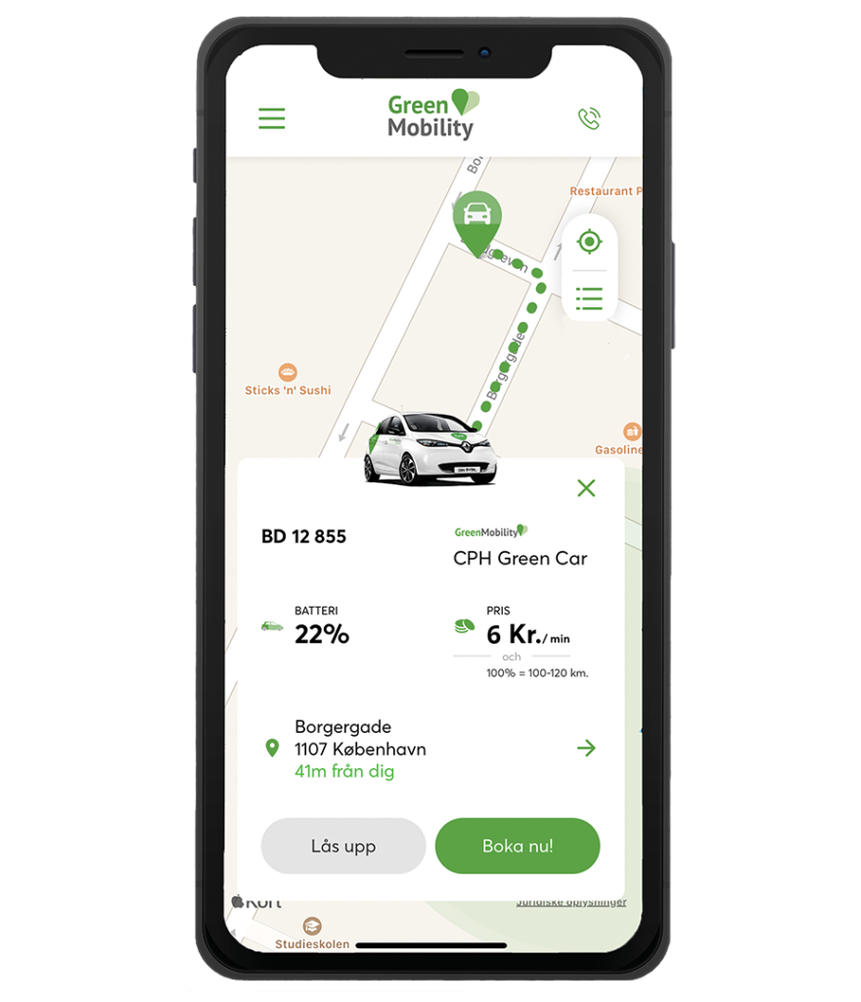
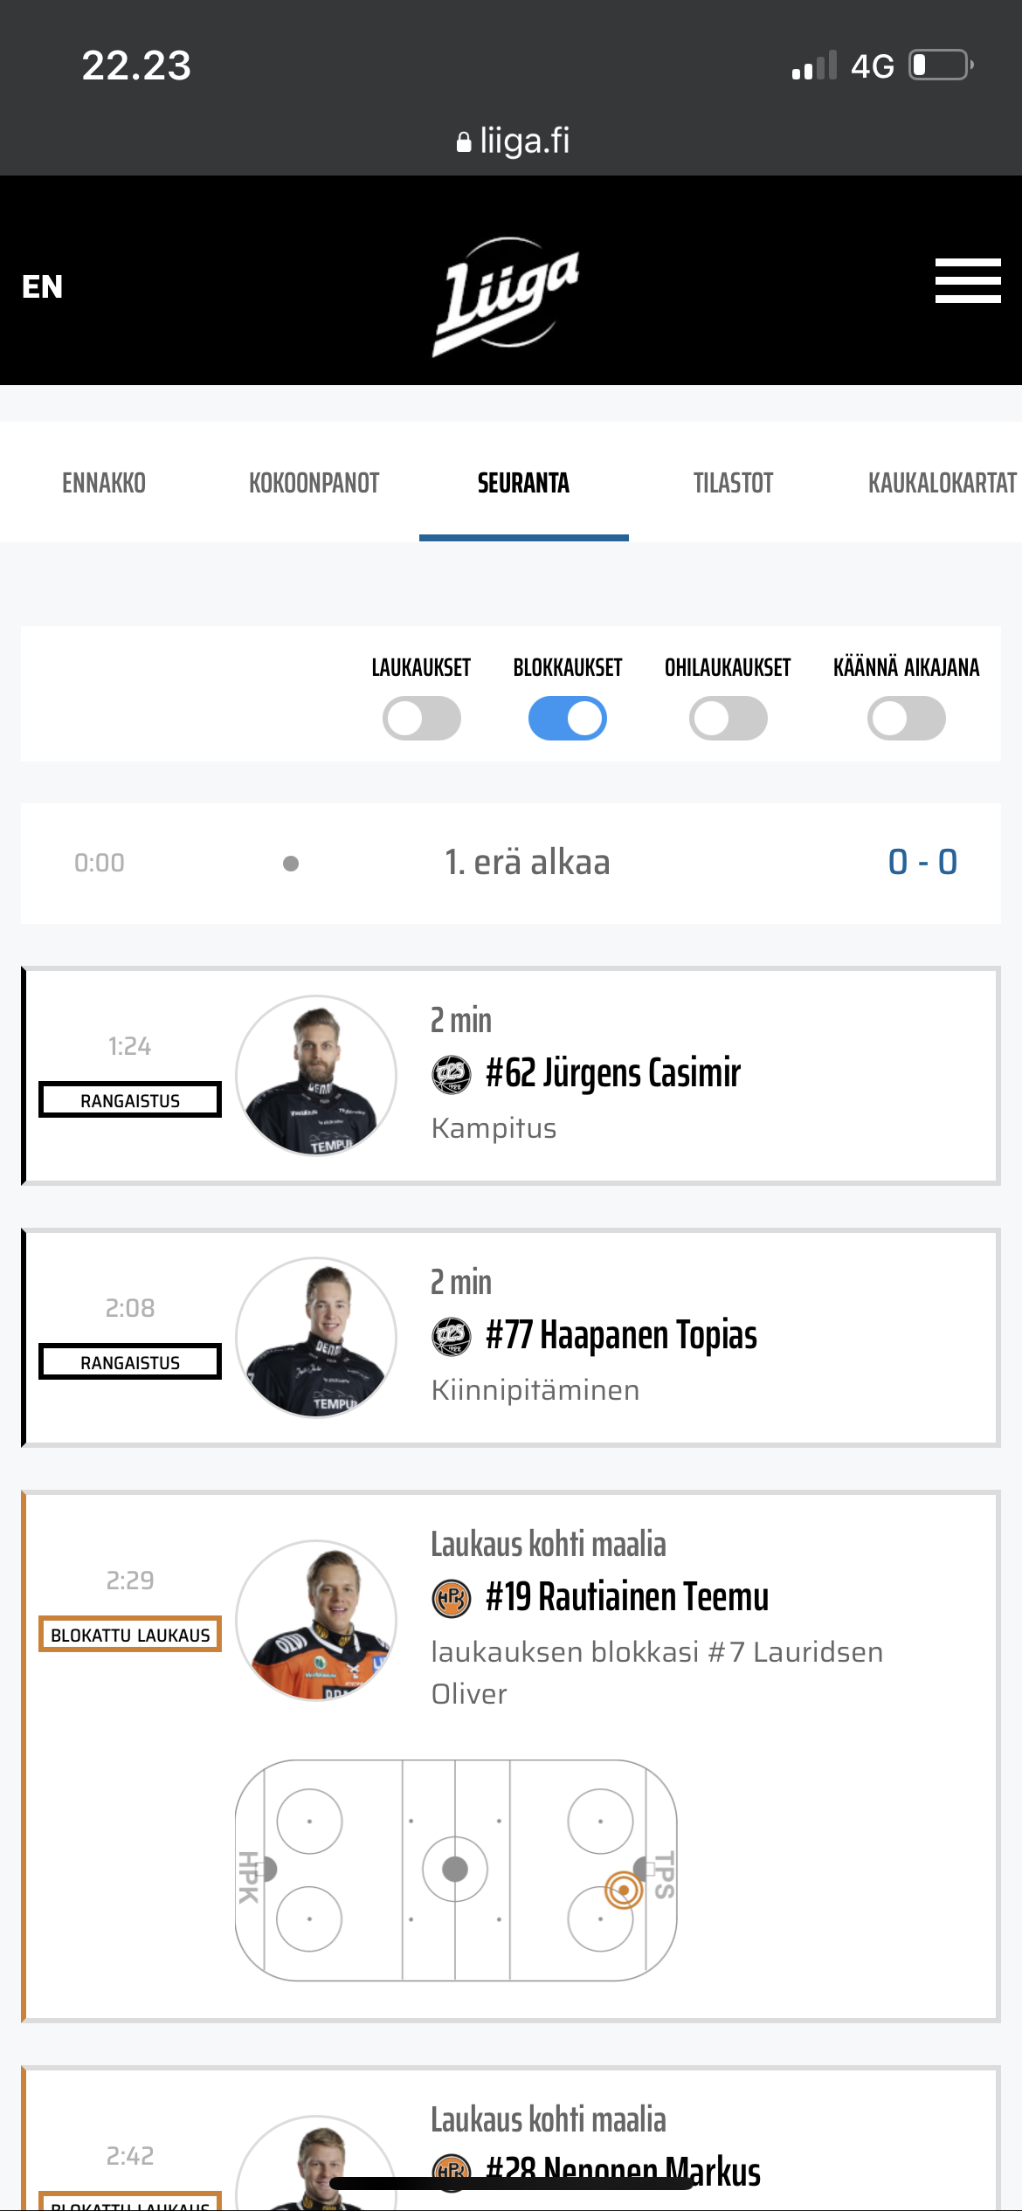
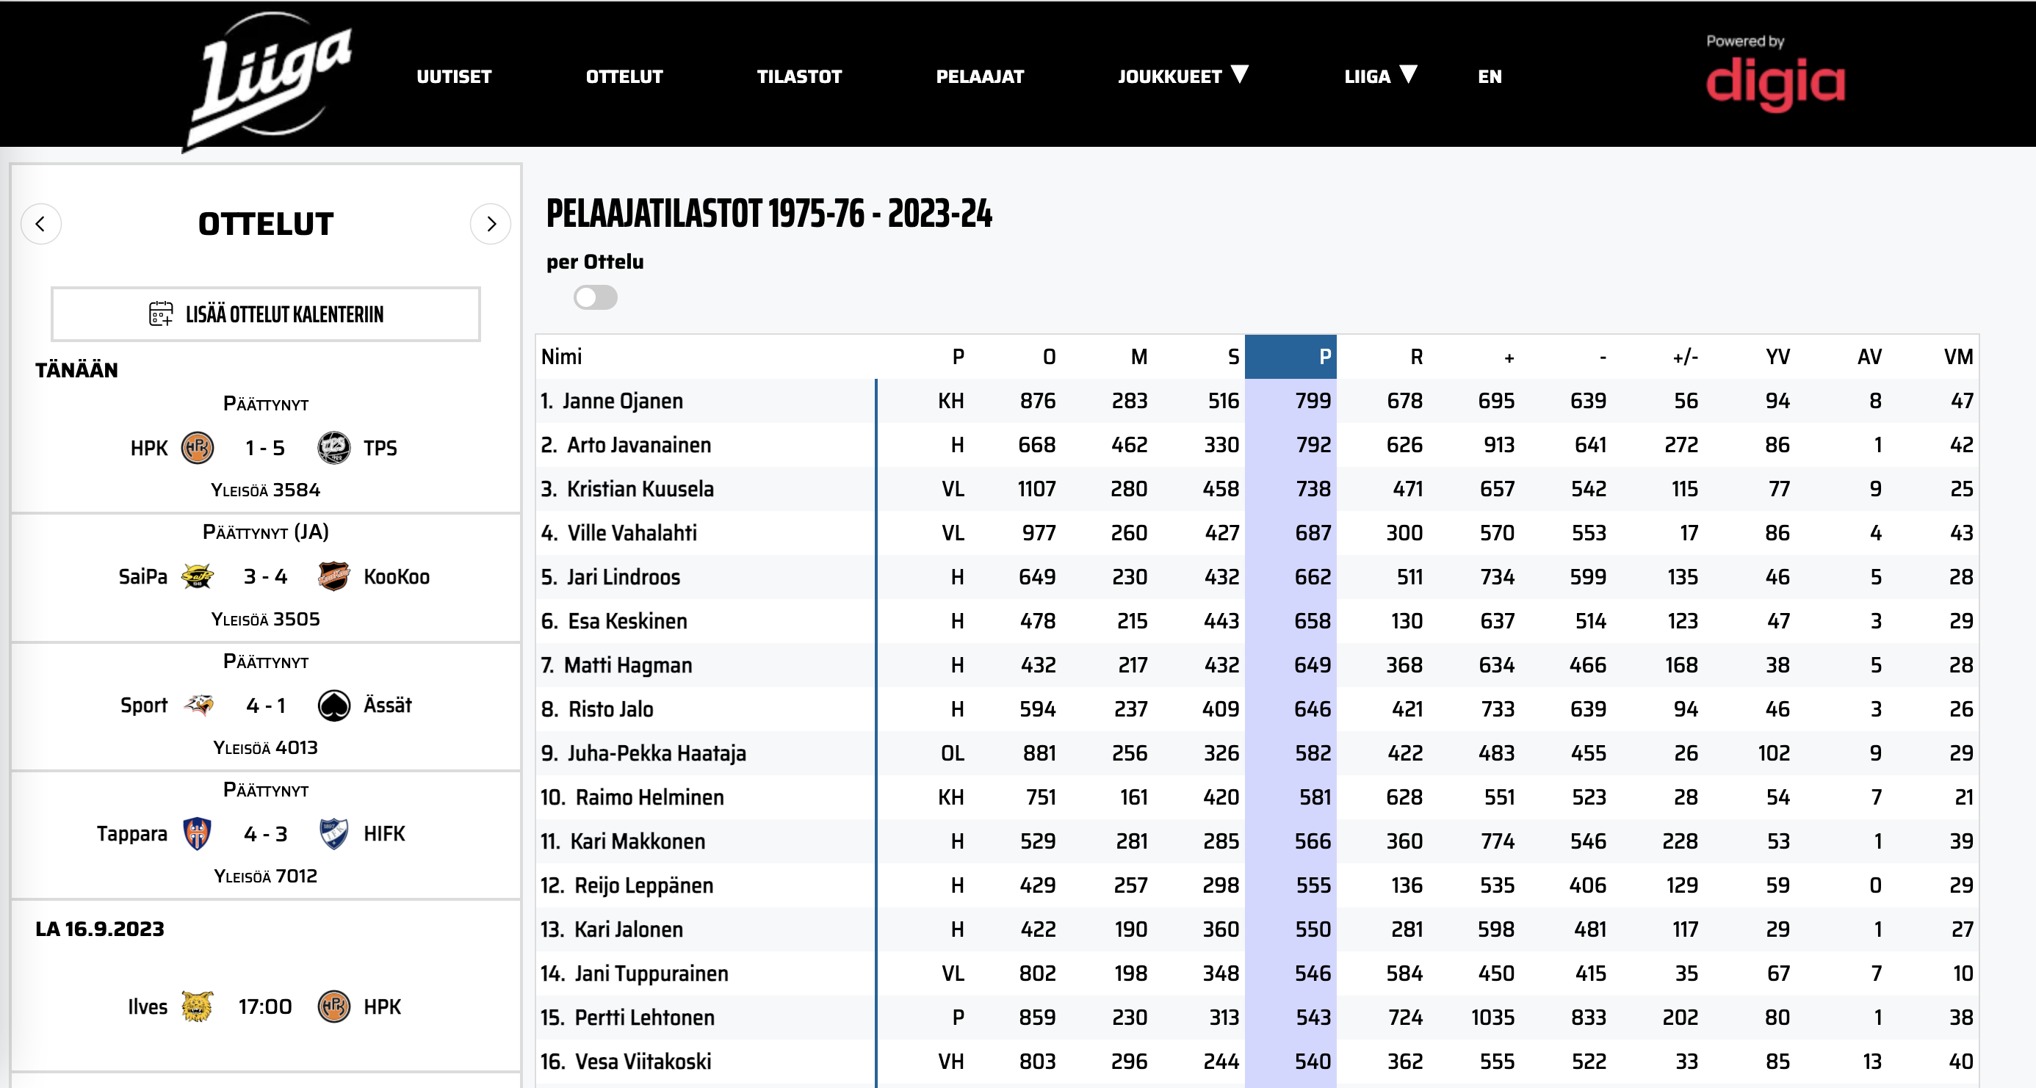
FIXING THE BASICS: RESULTS & STATS SERVICE
DEVELOPING A NEW STATS DATA WAREHOUSE.
Notes:
- Firstly, we have worked on the our site but more imporatantly we have been developing a whole new stats data warehouse that has all our stats from our first season in year 1975 to all the way today
- this database we can use on our site, in our mobile app and in social media with animations as you can see in this example
- we are actually not all the way done with this work but we can already utilize the database for example in these kinds of animiations

Slide 11
MOBILE APPS: REGISTRATION AND PROFILE AS AN ENABLER
DIGITAL HOMEBASE FOR SUPPORTERS STARTS TO TAKE SHAPE WITH OWN SUPPORT PROFILE.
Notes:
- then we have developed a registration and profile for our app environment as can be seen here
- As we wanted to created a digital homebase for our supporters this was basically a must before anything else could be done
- This of course gave us an opportunity to start to collect customer data better as well

Slide 12
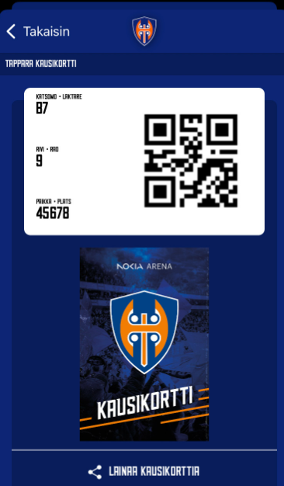
MOBILE APPS: IDENTIFYING CUSTOMERS
SEASON TICKETS ALREADY IN APPS. INDIVIDUAL TICKETS TO FOLLOW.
Notes:
- then we connected this profile to our season tickets as can be seen in this demonstration
- this enables us to indetify our customers better and with the QR-code isntead of a bar code, we can start to have more services behind the same code
- we don’t have individual tickets in our app yet but those will hopefully come soon… depending on how we are able to co-operate with our ticket providers

Slide 13
MOBILE APPS: BUYING PRODUCTS AND SERVICES
GOAL IS TO INCREASE CUSTOMER EXPERIENCE AND INCREASE SALES.
Notes:
- with the customer profile in place, we can start to add payment methods to the app as well
- this is an example of TPS app which is not published yet but wil be during the fall
- witht this solution we are able to enhance the customer experience and increase sales as foods and drinks are being delevered to your seat
- Looking forward to be testing this out in Turku soon

Slide 14
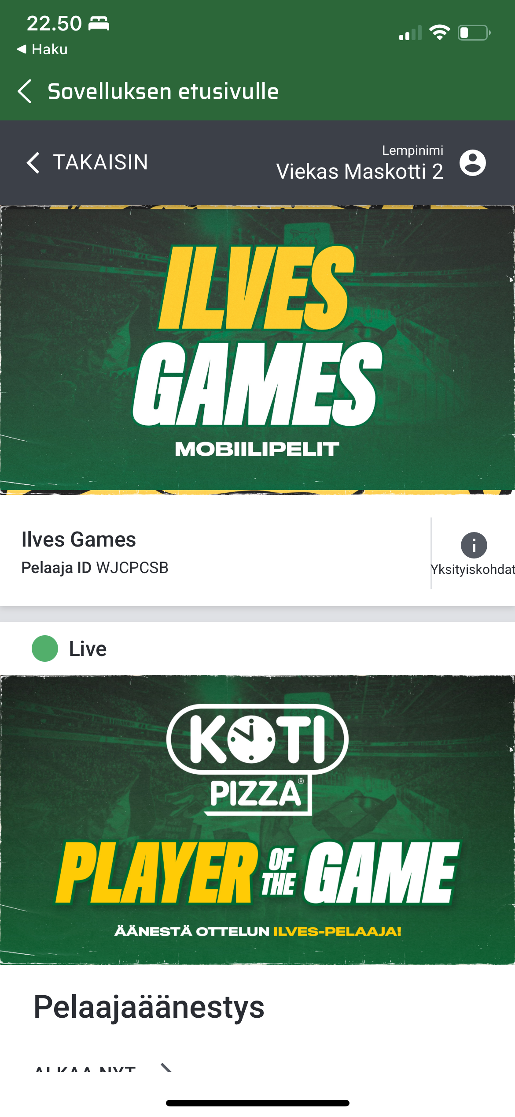
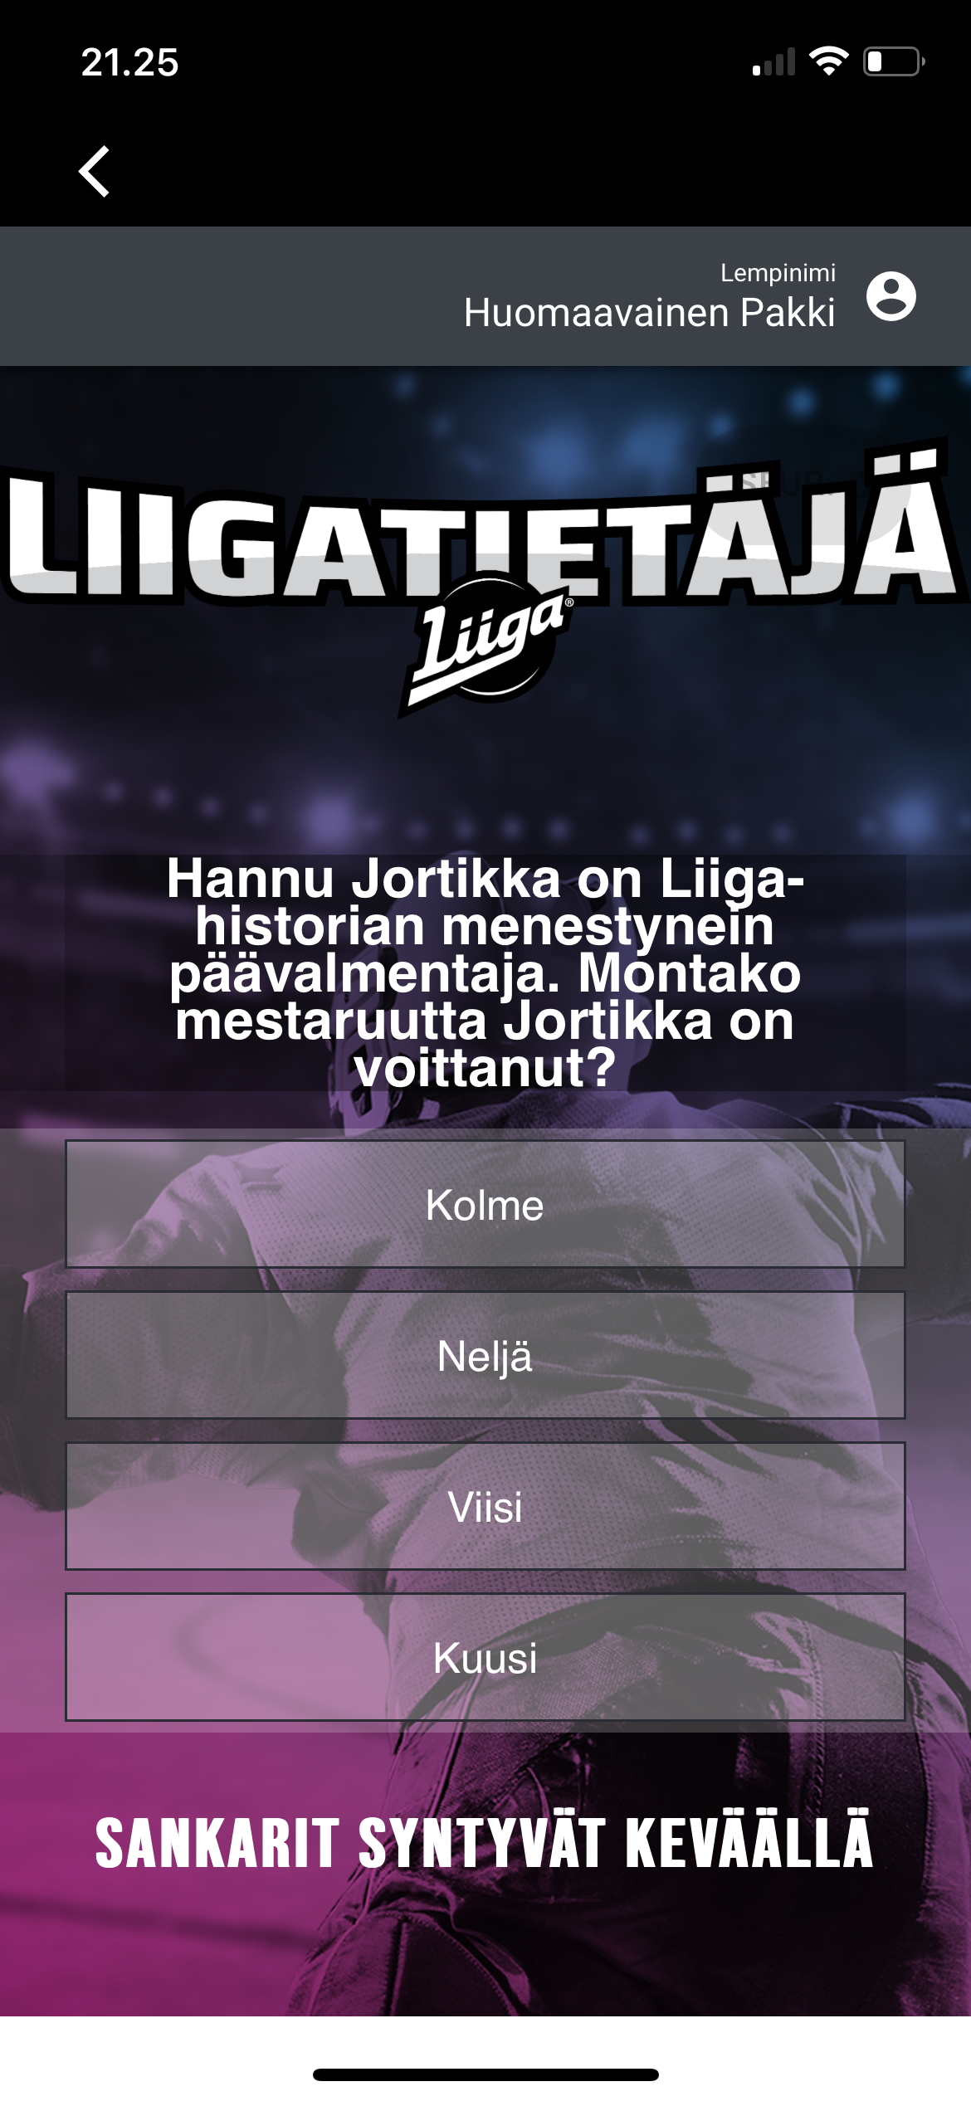
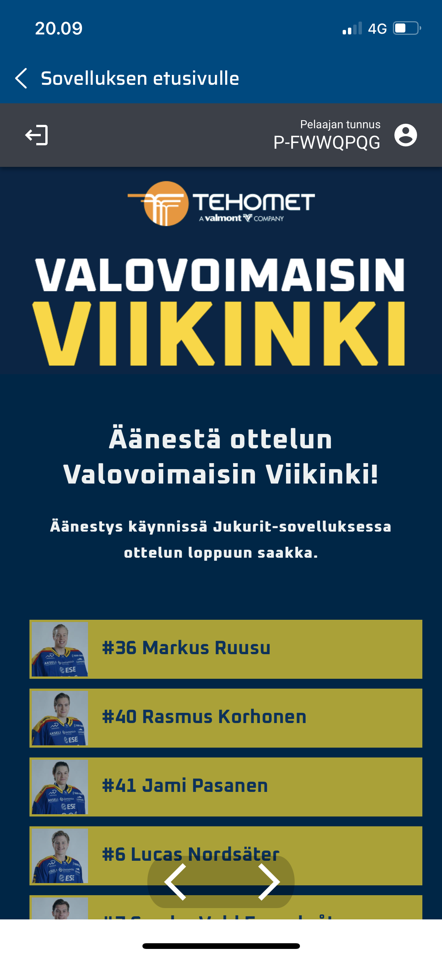
MOBILE APPS: FAN ENGAGEMENT
STARTING FROM THIS SEASON (22 – 23) 8 CLUBS AND LIIGA USE FANNEX FAN ENGAGEMENT PLATFORM.
Notes:
- the the last things is fan engagement
- Starting from thsi season we have eight clubs + Liiga using this Fannex fan engagement platform in our mobile app
- Fannex is platform used by mayb NHL and NFL clubs and it has roughly 15 made games within each platform
– You can theme these games to your own design and utilize these as you see fit
- here you have an example from Ilves and Jukurit who both use the platform to allow customer at the game to vote for the player of the game
- results are then shown on the media screen and winners can be picked
- Lukko even used this platform on theri practice games tournament Pitsi where people at the arena were able to vote whether there will be a shootout or overtime if there was a tie
- Sky is the limit here and it also a good way to get new sponsorship money

Slide 15
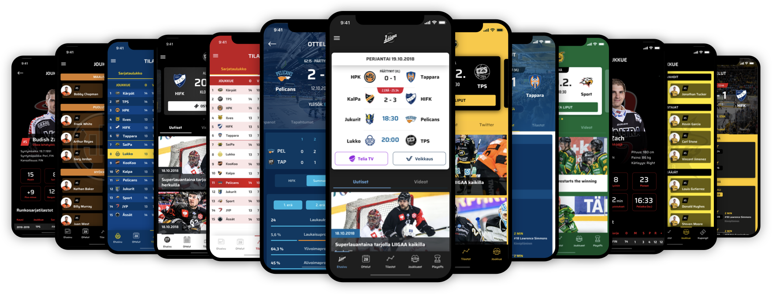
SCALING DEVELOPMENT: LIIGA AND ALL CLUBS IN SAME APP ENVIRONMENT
ALL CLUBS IN THE SAME ENVIRONMENT BY THE END OF THE YEAR.
VISITS THROUGH ALL APPS +20% COMPARED TO PREVIOUS SEASON (21 – 22).
NEW APP LOADS THROUGH ALL APPS +44% COMPARED TO PREVIOUS SEASON.
Notes:
- So where are we now
- Sense we have been able achieve pretty good progress with the app, all the clubs that were not in the same app environment are to follow and we will have all the clubs in the same enviroment by the end of the year
- Last season we were able to increase the visits to all our apps by 20% compared to last season and most importantly app loads to new mobile phones was up by 44% througout these apps compared to previous season
- This hopefully proves that the direction is right
- So what does the future hold…

Slide 16
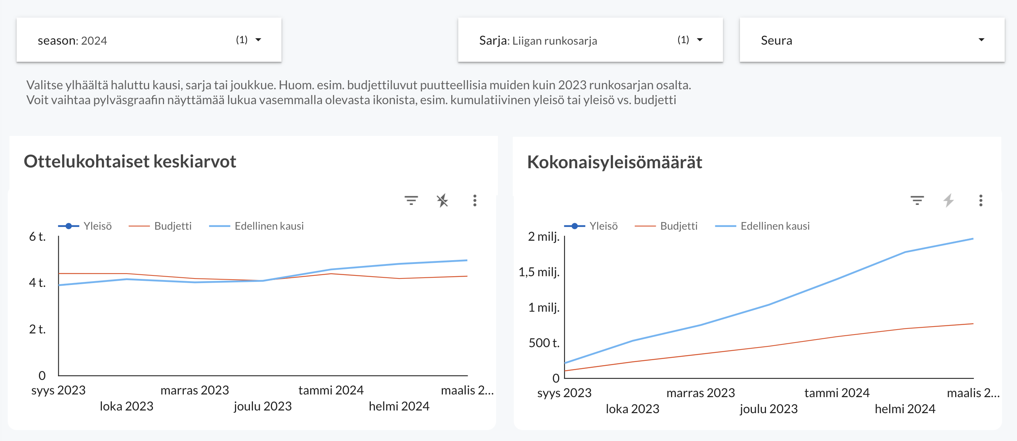
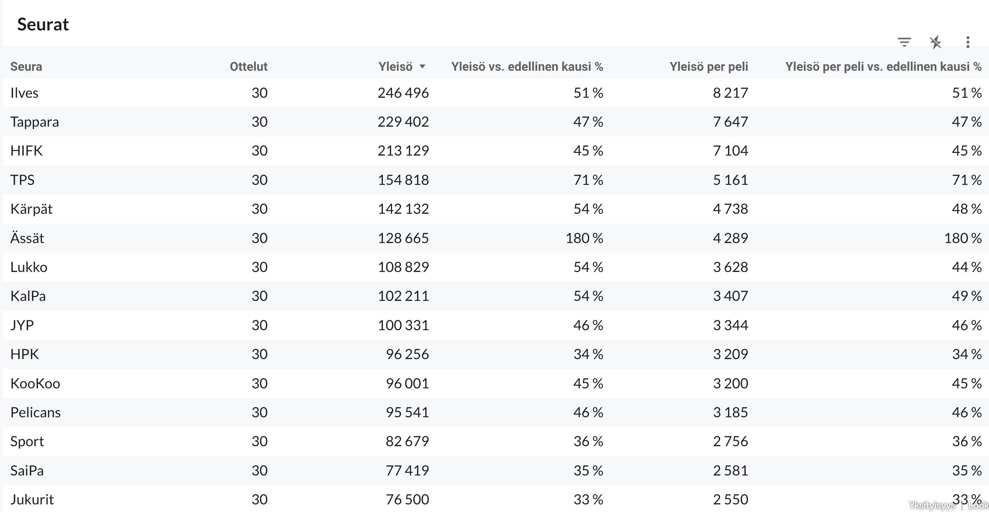
CUSTOMER UNDERSTANDING: CUSTOMER AND SALES DATA
KNOWLEDGE-BASED MANAGEMENT
(CUSTOMER & SALES UNDERSTANDING)
ATTENDANCES
TICKETS
SITES
APPS
WEBSTORES
VISUALIZATION, ANALYSIS
& PREDICTATIONS
DATA SOURCES
TiTu & WH
MACHINE LEARNING
GA
AI
AUTOMA-TION
TICKET
DATA COLLECTION
TAGGING
DATA WAREHOUSE
APP
SOME
CUSTOMER DATA PLATFORM

Slide 17
CUSTOMER UNDERSTANDING: CUSTOMER PERSONAS STUDY
Moms/Dads:
Ages 25 – 44
Under 13-year-old child/children
Has attended max. 5 Liiga games
Teenagers:
Ages 13 – 17
Follows hockey in social media and/or through streaming services
Has attended max. 5 Liiga games
Young adults:
Ages 18 – 24
Follows hockey in social media and/or through streaming services
Has attended max. 5 Liiga games
True fans:
+25-year-old
Follows hockey actively, goes to games and watches games through stream services
Attends at least 5 games per season
Notes:
Buyer personas help you understand your customers (and prospective customers) better. This makes it easier for you to tailor your content, messaging, product development, and services to meet the specific needs, behaviors, and concerns of the members of your target audience.

Slide 18
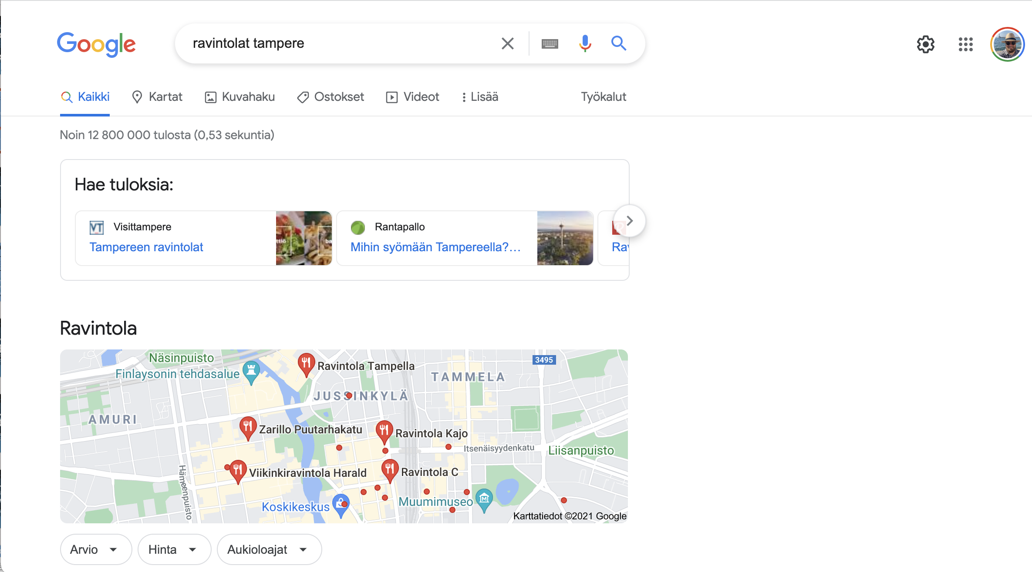
CUSTOMER UNDERSTANDING: CUSTOMER JOURNEY STUDY
”Checks for the next potential game”
”Researches services at the arena”
BUYS FOOD & DRINKS AFTER THE GAME
SHOULD WE GO TO A GAME?
BUYS A BEER DURING THE 1st INTERMISSION
ARRIVES HOME
BUYS TICKET TO A PUBLIC TRANSPORTATION
ARRIVES TO THE ARENA
BUYS A TICKET TO A PUBLIC TRANSPORTATION
VOTES FOR THE BES PLAYER OF THE GAME DURING THE 2nd INTERMISSION
BUYS TICKETS

Slide 19
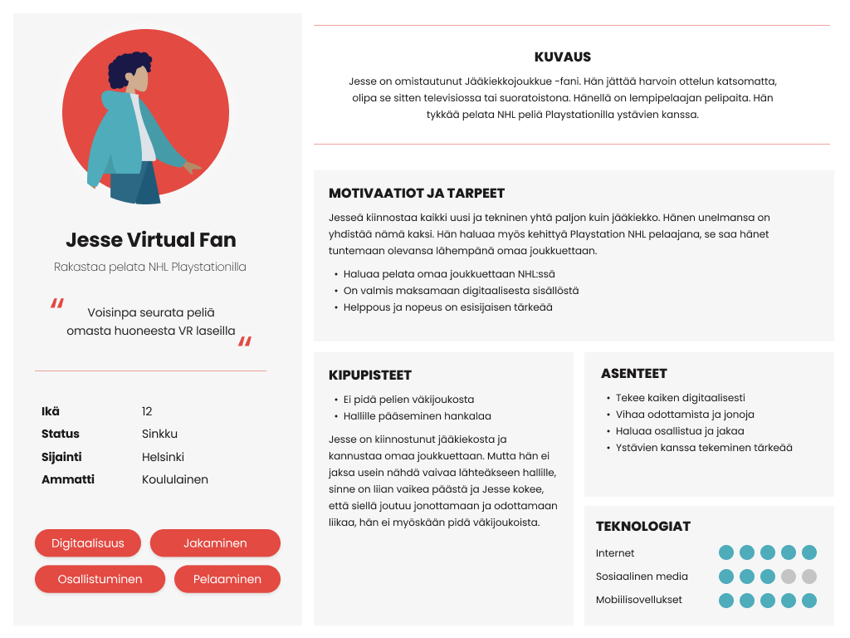
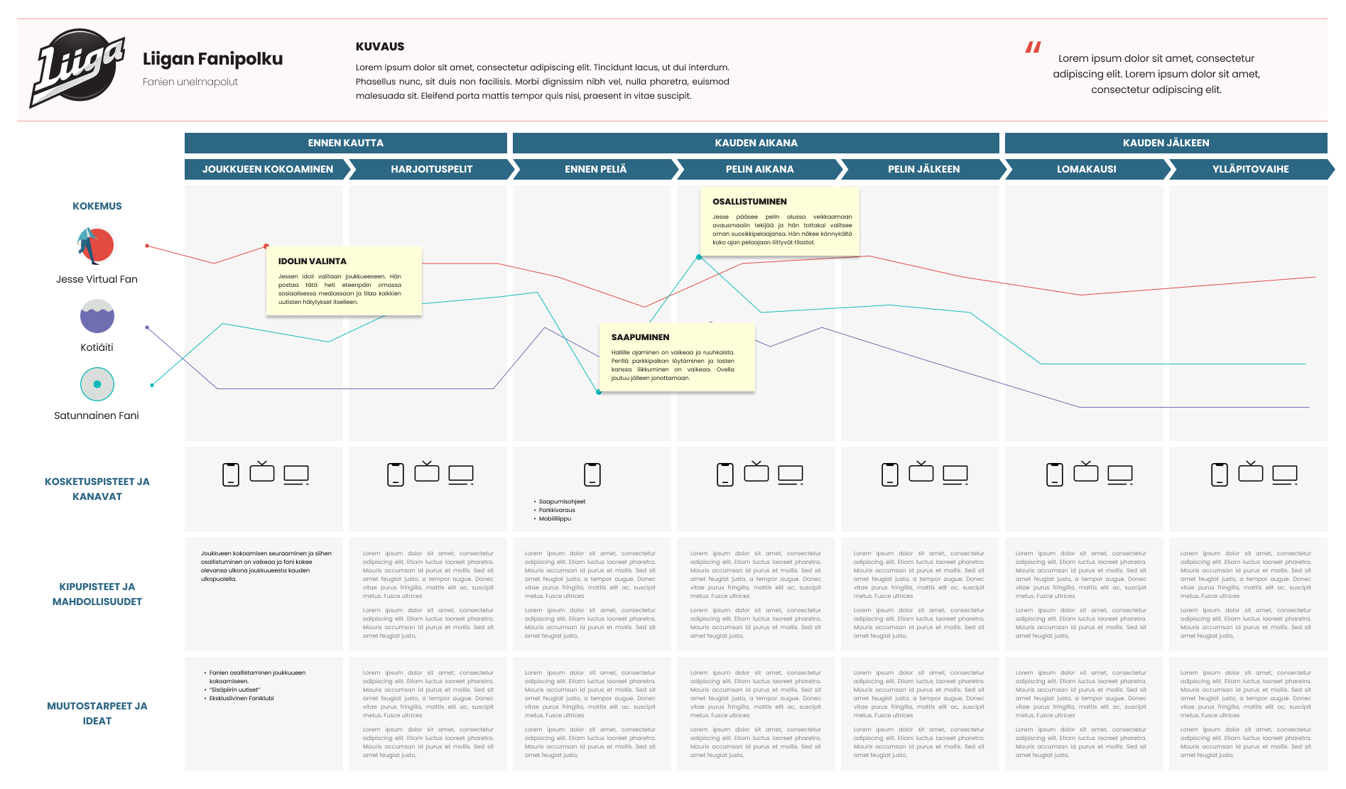
EXAMPLES OF END RESULTS

Slide 20
CUSTOMER UNDERSTANDING AND PERSONALIZED MESSAGING: TECH & DATA ECOSYSTEM VISION
DATA DRIVEN CUSTOMER JOURNEY ORCHESTRATION
(SERVICE DESIGN, PROSESSES, AUTOMATION/AI, CONTENT)
VISUALIZATION, ANALYSIS
& PREDICTATIONS
AI
CONTENT MANAGEMENT AND DISTRIBUTION
MULTI-CHANNEL CUSTOMER PROGRAMS
DATA SOURCES
TiTu & WH
MACHINE LEARNING
PICTURES
TEXT
VIDEOS
APP & ARENA
AUTOMA-TION
E-MAIL
GA
AI
AUTOMA-TION
AI
AUTOMA-TION
IDENTIFYING CUSTOMER PERSONA AND POINT IN CUSTOMER JOURNEY IN REAL-TIME
TICKET
CUSTOMER PERSONAS AND CUSTOMER JOURNEY UNDERSTANDING
RIGHT CONTENT TO THE RIGHT PERSONA IN THE RIGHT CHANNEL AT THE RIGHT TIME
DATA COLLECTION
AI
CUSTOMER UNDERSTANDING DASHBOARDS
SOME
TAGGING
DATA WAREHOUSE
MOM
TRUE FAN
YOUNG ADULT
APP
SEASON TICKET
SMS & WHATSAPP
1st GAME TICKET
5th GAME TICKET
SOME
CUSTOMER DATA PLATFORM
AUTOMA-TION
BEFORE THE GAME
DURING THE GAME
AFTER THE GAME
1:1 CUSTOMER EXPERIENCE

