Slide 1
MAXIMIZING
SUCCESS
E.H.C. Business Forum September 28, 2023
*Confidential

Slide 2
SPRINT AI IS A SPORTS DATA COMPANY
Harnessing the power of data and artificial intelligence to maximize success for teams & individuals and generate new revenue streams.
*Confidential
2

Slide 3
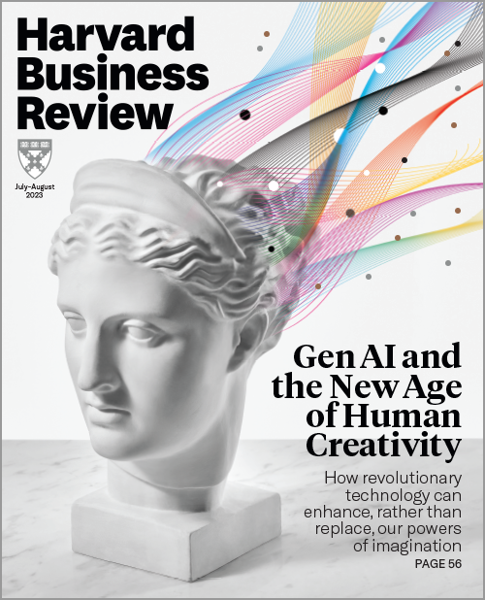
AI IS CHANGING EVERYTHING
*Confidential
3

Slide 4
DATA HAS FUNDAMENTALLY TRANSFORMED OTHER INDUSTRIES
UBER
AIRBNB
ALIBABA
META
The world’s largest taxi company owns no vehicles.
The largest accomodation provider owns no real estate
The world’s largest retailer has no inventory
The world’s most popular media creates no content
DATA IS THE MOST VALUABLE ASSET
*Confidential
4

Slide 5
HOCKEY HAS FALLEN BEHIND OTHER SPORTS
5
Cycling
4
Soccer
Technology adoption
3
Am. football
Baseball
2
Basketball
Ice hockey
1
1
2
3
4
5
Transformation intensity
*Confidential
5

Slide 6
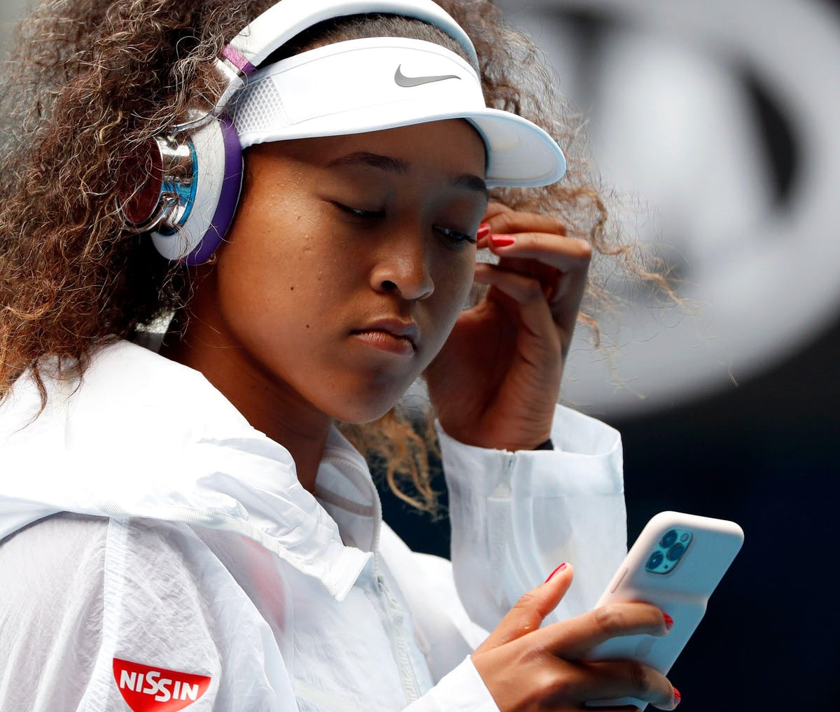
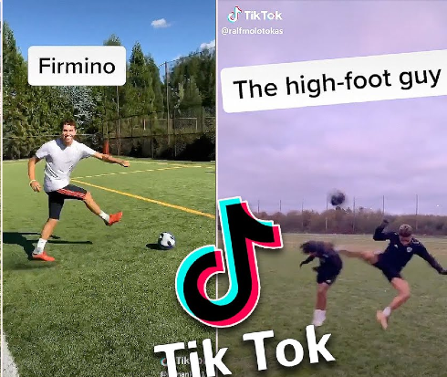
NEW SPORTS CONSUMER
Mobile-first
Personality-driven
New influences
New platforms
Generation Z has very different expectations for sports but at the same time are willing to spend more than any other consumer group.
*Confidential
6

Slide 7
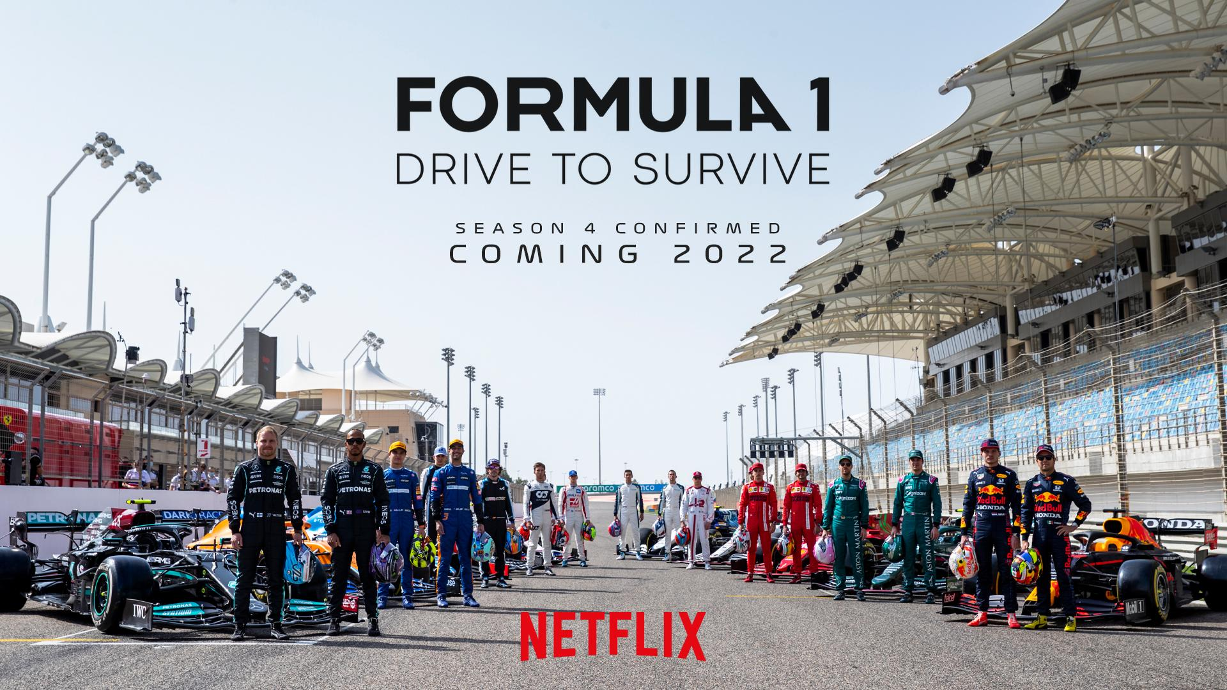
MEDIA DISRUPTION OPENS NEW OPPORTUNITIES FOR TEAMS
Formula 1
Kings League
Overtime Elite
50% of new fans are under 35 years old. 49% of fans visited their first race last year
Over 2 millions viewers online and 92,000 audience for debut season finale.
Content with 425 million views across all platforms during inaugural season.
*Confidential
7

Slide 8
NEW TYPES OF OWNERS
Arctos Partners
Blueco
777 Partners
Redbird Capital
MSP Sports Capital
Blueco
*Confidential
8

Slide 9
AMOUNT OF ATHLETE DATA GROWING EXPONENTIALLY
Today
In 3 years
9,000%+
Increase in data points per athlete
2.5 million data points per athlete per year
230 million data points per athlete per year
*Confidential
9

Slide 10
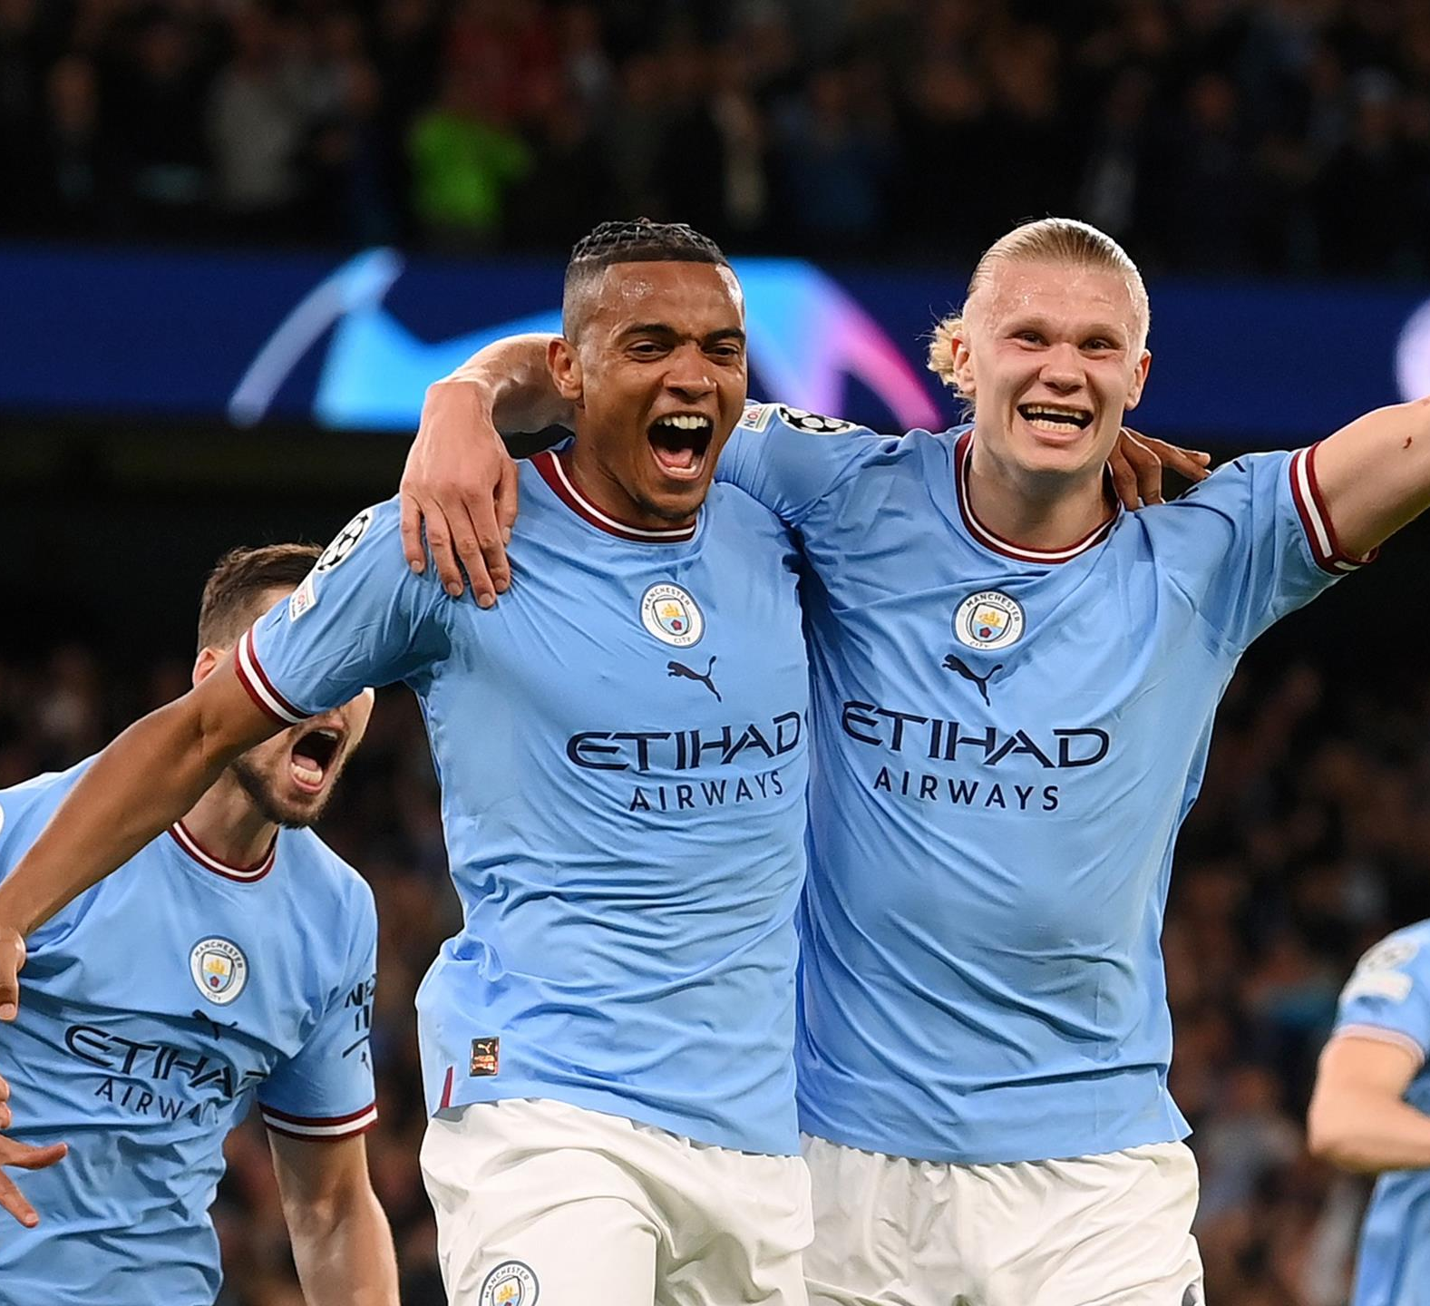
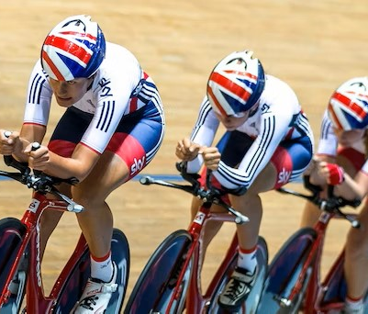
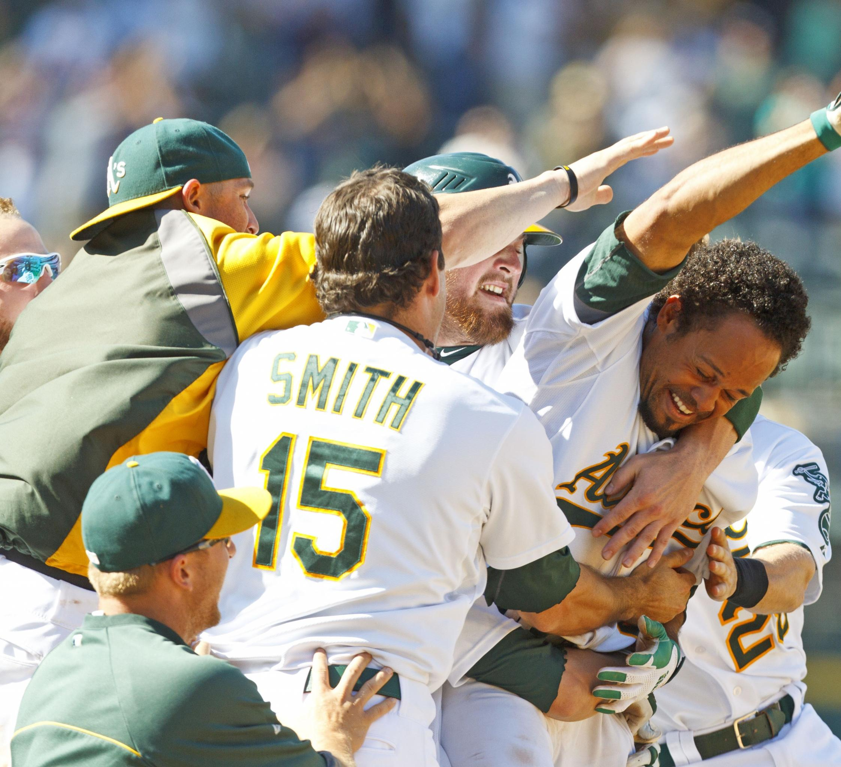
AI IS THE NEW GAME-CHANGER
4. Artificial intelligence
3. Data analytics
2. Marginal gains
1. Moneyball era
Now
• Able to handle complex analyses
• Complete view of an athlete
• Forward-looking predictions and insights
• Continuously learns from coaches creating a foundational data layer
2017
Data scientists become key influencers in sports club decision-making
2010
Manual approach to optimize athlete performance in races
2001
Data-driven approach to player contract evaluation
*Confidential
10

Slide 11
UNLOCK A NEW WAVE OF CAPABILITIES
Athlete performance optimization
Accelerated player development
Insights
Talent and future potential identification at scale
Injury risk detection and prevention
Pen & paper
Spreadsheets
AMS
AI
AI delivers an unprecedented level of insights and precision.
*Confidential
11

Slide 12
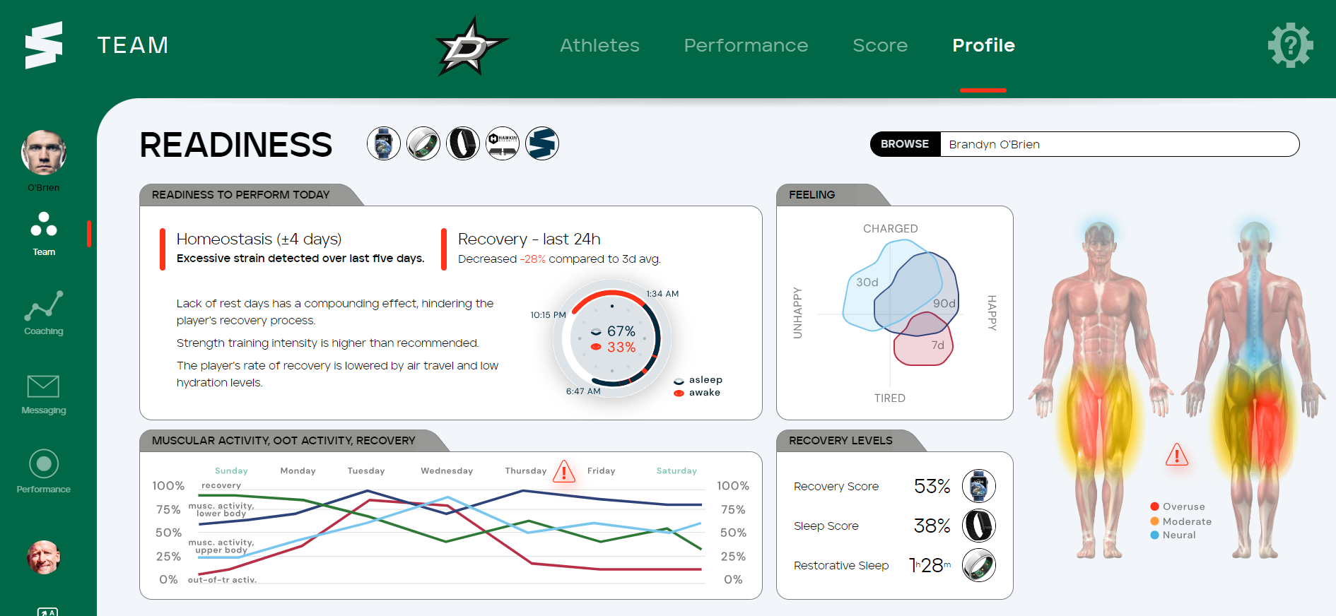
OPTIMIZING ON-ICE PERFORMANCE
*Confidential
12

Slide 13
AI CAN SAVE MILLIONS LOST TODAY ON INJURIES
Salaries of injured players during
2022-23 season
$400M
Source: Toronto Sun
*Confidential
13

Slide 14
DATA & AI IMPACT EVERY ASPECT OF HOCKEY CLUB OPERATIONS
Player performance
Player health & medical
Team game strategy
Sponsorships & new revenue
Player scouting & recruitment
Fan engagement
Salary cap management
Community relations
Digital media & content
In-stadium experience
*Confidential
14

Slide 15
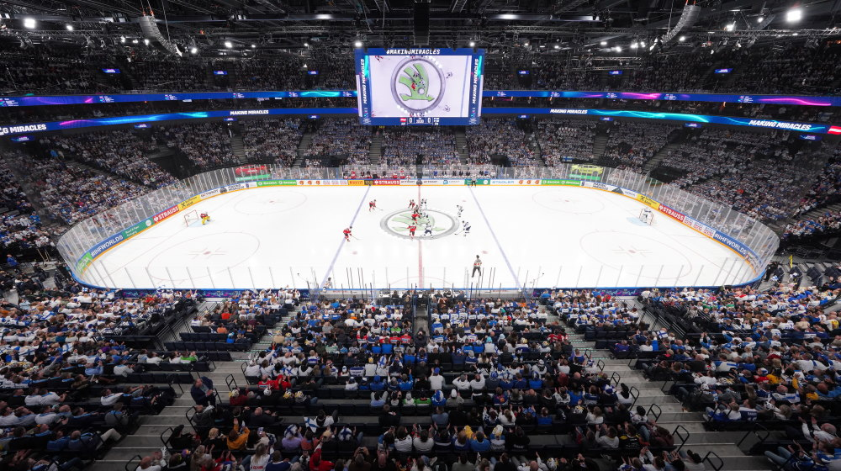
DATA AT CENTER OF ALL NEW BUSINESS OPPORTUNITIES
Traditional business
Digital business
Data
Broadcast rights
Ticketing
Stadium revenue
Concessions & parking
Sponsor brand visibility
Digital content & media
Data-driven sponsorship models
Data licensing
Name, Image, Likeness
Virtual experiences
Digital merchandise
Source: McKinsey
*Confidential
15

Slide 16
BUILD FOUNDATION FOR OPERATIONAL EXCELLENCE
Revenue growth
Competitive advantage
Time savings
Cost reduction
Long-term sustainability
*Confidential
16

Slide 17
DATA IS AT THE CORE OF NEW WAY OF WORKING
OLD WAY
TODAY
Backwards-looking
Human bias
Spot checking
Segment-based
Manual
Time-consuming
Siloed
Reactive
Static
Local
Predictive
Objective and impartial
Continuous monitoring
Holistic and integrated
Automated
Efficient and real-time
Holistic
Proactive
Agile
Global
Bring your business practices to the next level with future-proof technology
*Confidential
17

Slide 18
ROADMAP TO SUCCESS
New business around data
Predictive artificial intelligence
Quick wins
Foundational data layer
*Confidential
18

Slide 19
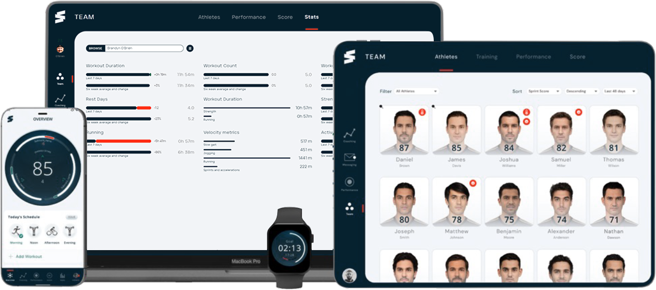
NEW OPERATING SYSTEM OF SPORTS
Forward-looking AI insights
Actionable recommendations
Custom KPIs & diagnostics
Device & data source agnostic
Real-time holistic
athlete status
Best-in-class
coaching tools
SprintAI applies proprietary artificial intelligence to your data and turns it into actionable insights that maximize your success.
*Confidential
19

Slide 20
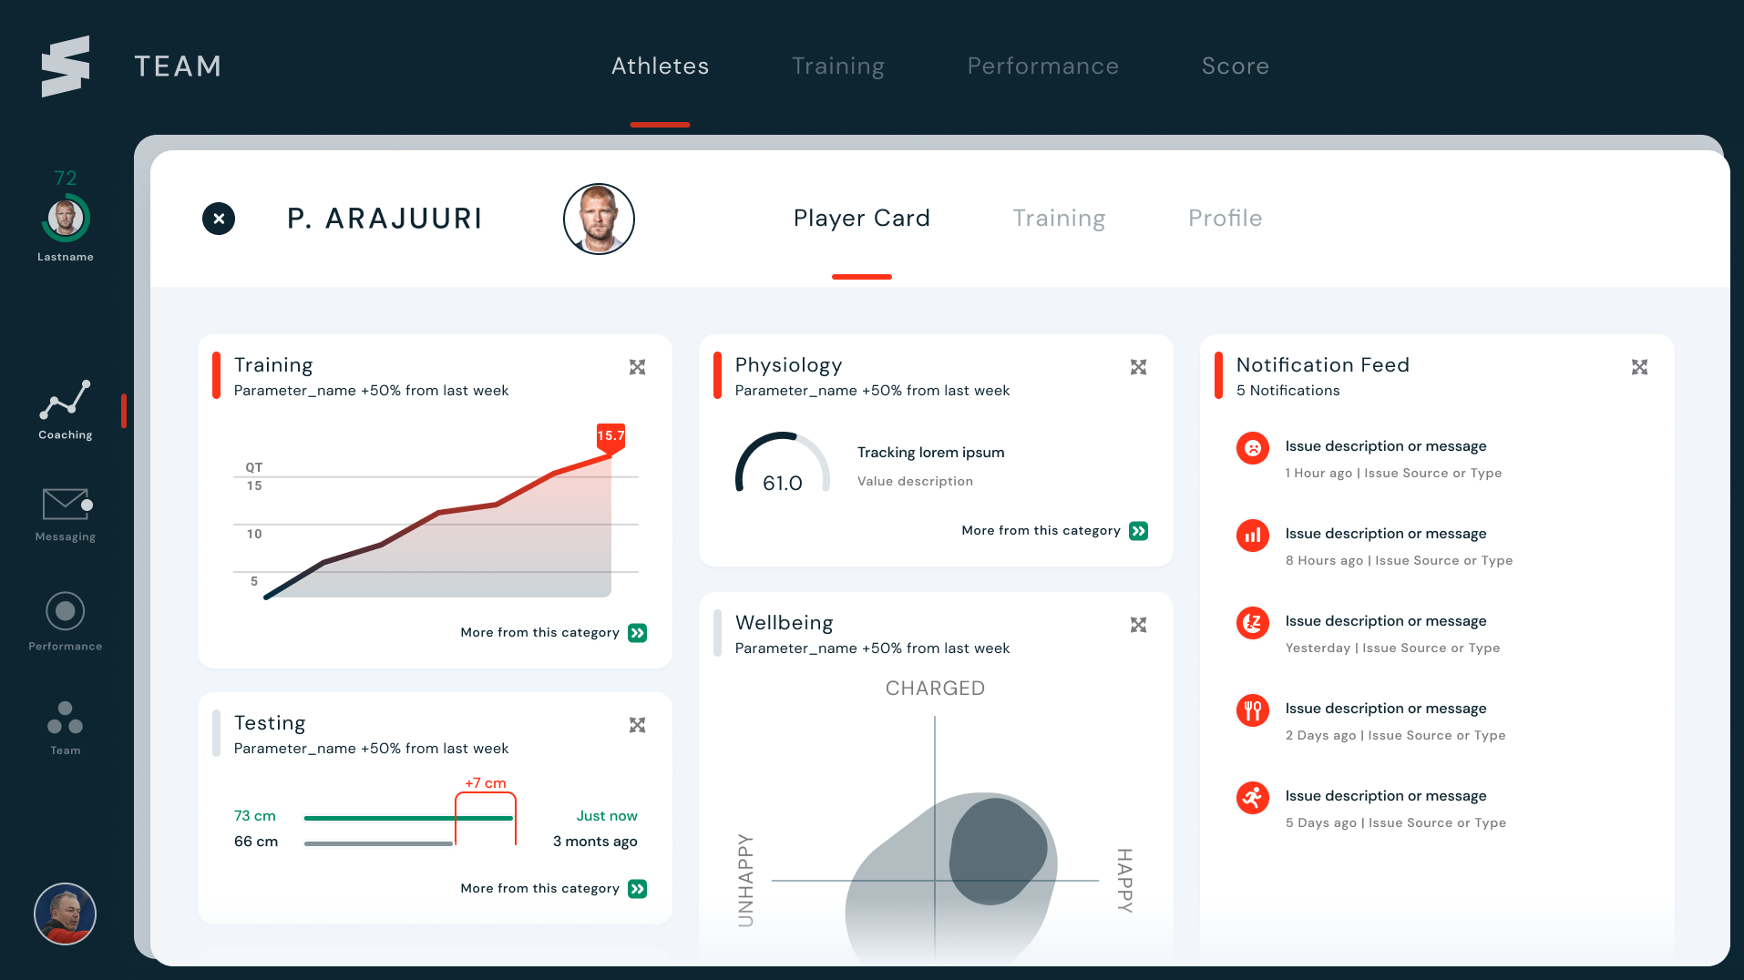
VISION FOR E.H.C. SPORTS DATA HUB
Centralized data hub to collectively create competitive advantage and position European ice hockey for future success
*Confidential
20

Slide 21
AI FOR SPORTS IS AT A TIPPING POINT
ORGANIZATION SUCCESS
NEW MODEL
Adopt AI
New growth
Deny change
Slowly slide into irrelevance
Strategic turning point
OLD MODEL
Every hockey team will be impacted by AI. It is time to adapt now or get left behind.
*Confidential
21

Slide 22
IMPOSSIBLE TO IGNORE
IMPACT OF ARTIFICIAL INTELLIGENCE
“Every product of every company will be impacted by the quick development of AI… it’s not for the company to decide.”
Sundar Pichai
CEO of Google
*Confidential
22

Slide 23
Mikko Simon
Co-founder
mikko.simon@sprint.ai
+358 407578552
www.sprint.ai
Bulevardi 6D 00100 Helsinki FINLAND
*Confidential

