Slide 1
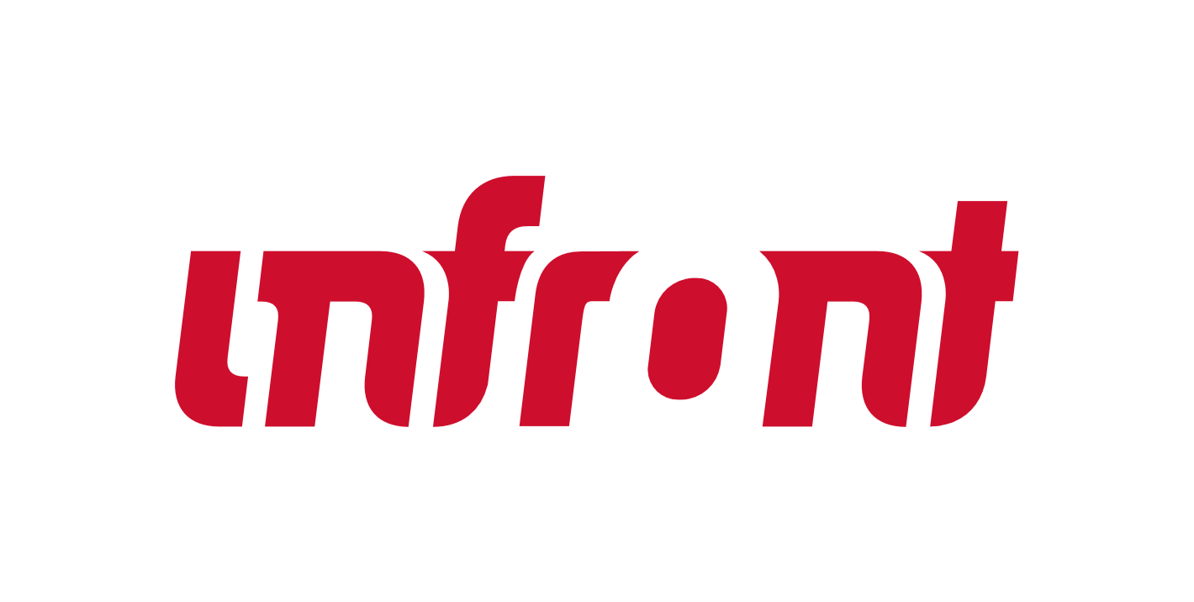
THE ULTIMATE WIN-WIN
HOW MAXIMISING DATA BENEFITS YOUR CLUB - AND YOUR FANS
Notes:
How maximizing data benefits your club and your fans

Slide 2
LET’S TALK ABOUT DATA

Slide 3
TODAY’S FANS ARE BEING PULLED IN EVERY DIRECTION
By using data and tech we CAN
capture their attention at every touchpoint
Improve the fan experience and
maximise monetisation opportunities

Slide 4
CREATING ENGAGED ECOSYSTEMS
BY GETTING TO KNOW FANS

Slide 5
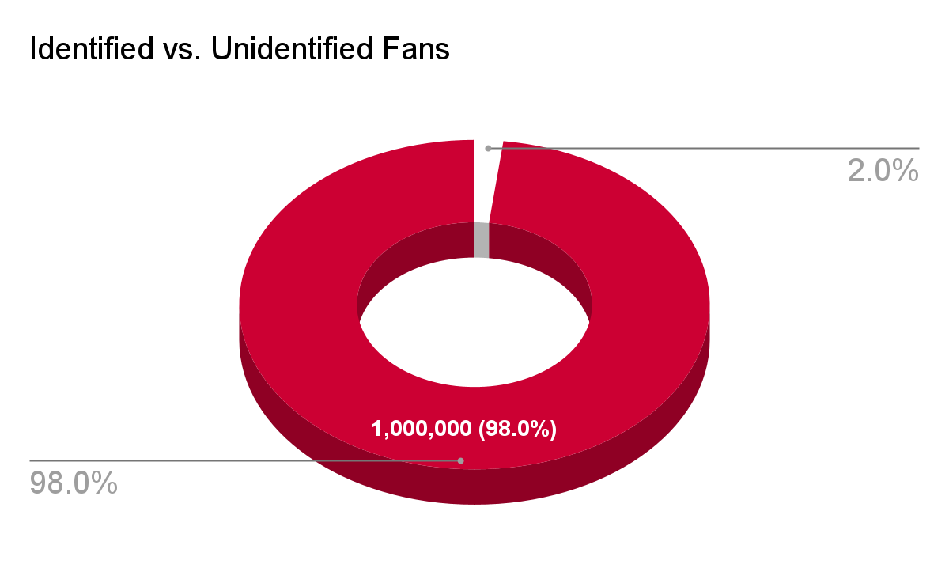
IDENTIFIED VS. UNIDENTIFIED FANS
98%
of fans remain unknown

Slide 6
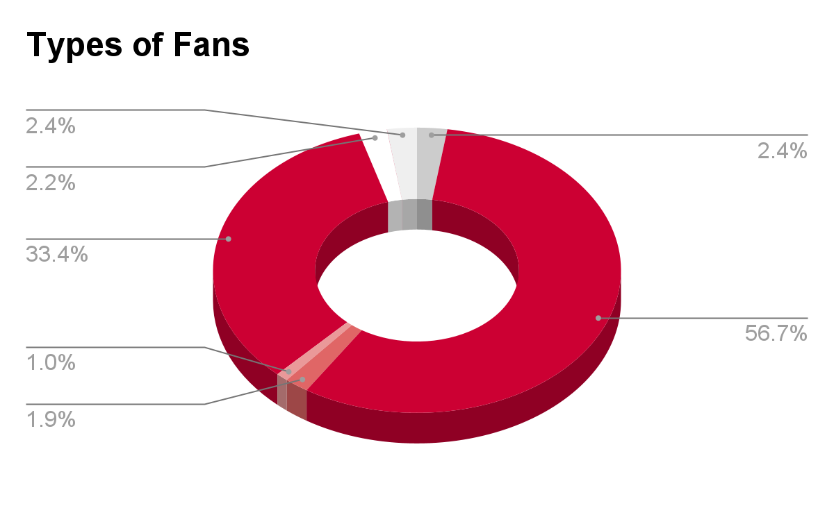
TYPES OF FANS
Notes:
Meg to insert groups of fans for

Slide 7
THE FAN JOURNEY
LET’S TAKE A STROLL

Slide 8
THE FAN JOURNEY MAP
Notes:
The journey changes - our parents had different journeys than we have, our journey has changed over the years, and our children will have different journeys than ours. but as eras and times change it’s up to sports organizations to help fans navigate the journey. We of course take inspiration from fan preferences - what they want to watch and where we should share content, but it’s our responsibility walk them through. From social media, search, ads and the first touch points you see on tehleft, to our owend and operated platforms, in all their variations, to the events themselves and eventually to creating an engaged, converted, community of super fans. And the journey never ends.

Slide 9
CRAFTING THE JOURNEY
TO IMPROVE EXPERIENCES & MONETISATION

Slide 10
#AllAboutSports
ANONYMOUS GLOBAL FANS
Notes:
Touch point #1
Activation on social media / website
1/ Name
2/ Email
3/ Where are you based?
Global fan-clubs
Targeted information re: viewing possibilities, ticketing for local games, etc’
Timed newsletters…

Slide 11
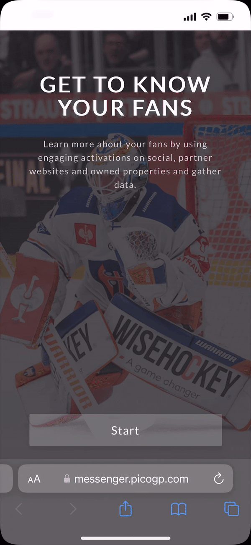
GATHERING 0-PARTY & 1-PARTY DATA
Engaging activations
Engage fans on social, partner websites and owned properties while gathering data.
Name
Email
When is your birthday?
Who is your favorite player?

Slide 12
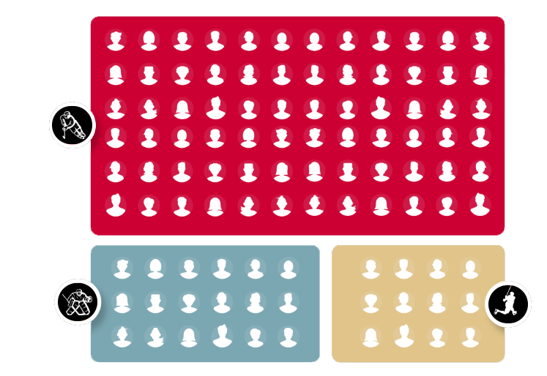
#AllAboutSports
GETTING TO KNOW THE FANS
- PERSONALISED FANDOM
FANS
DATA
Notes:
Touch point #1
Activation on social media / website
1/ Name
2/ Email
3/ Where are you based?
Global fan-clubs
Targeted information re: viewing possibilities, ticketing for local games, etc’
Timed newsletters…

Slide 13
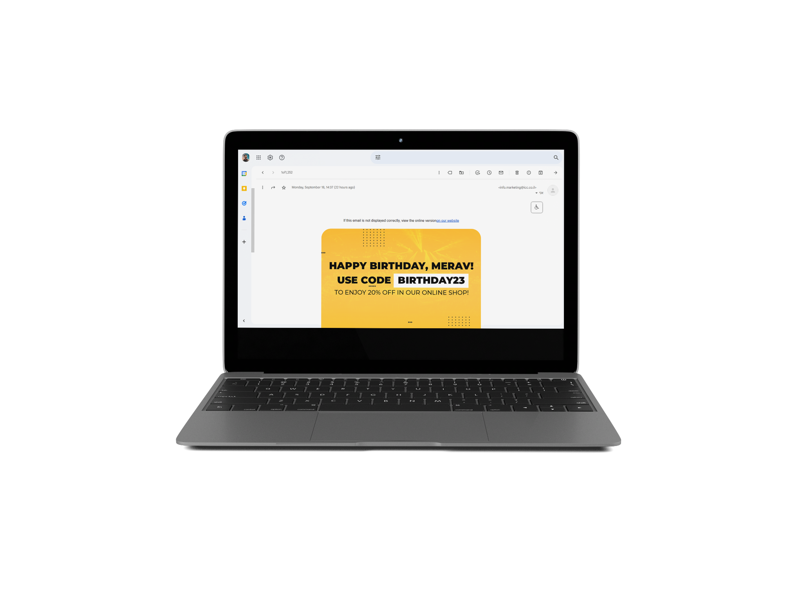
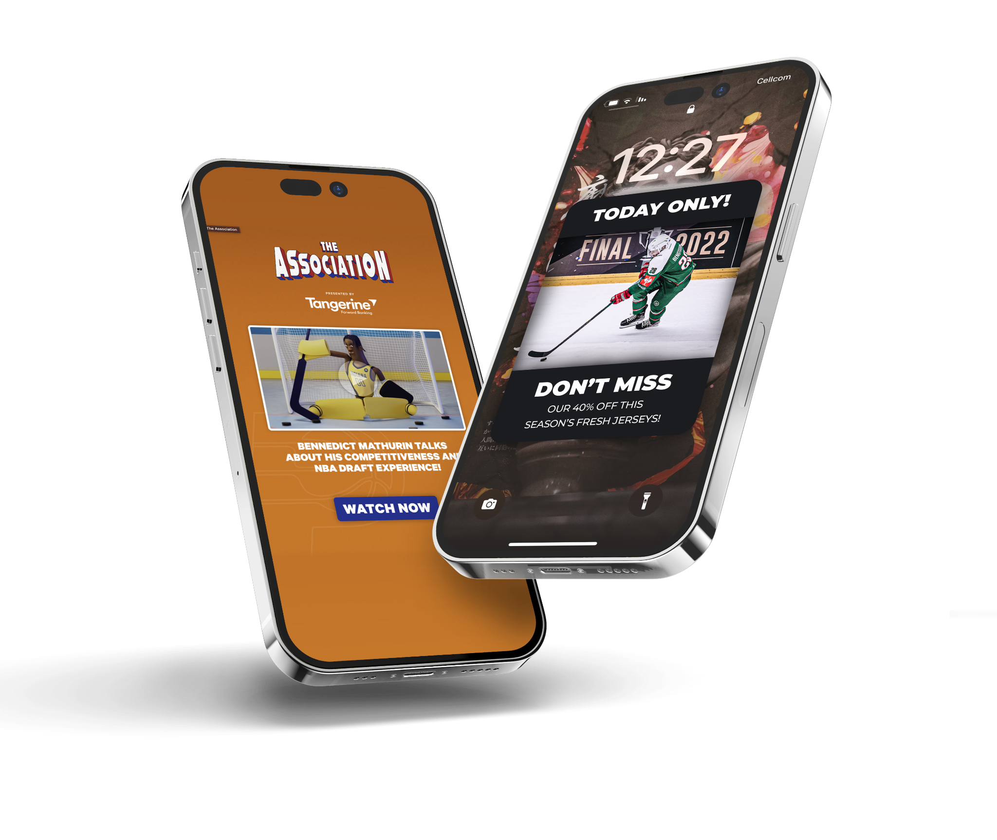
IMPROVED EXPERIENCES
& OPTIMISED MONETISATION
Notes:
Improved experiences: getting the right content to the fans where they are watching it; putting players at the forefront for fan experiences, player-based content; affinity to players
optimised monetisation: sponsored content on the right channels, betting, targeted e-commerce;

Slide 14
HORIZONTAL & VERTICAL DATA COLLECTION
Continuous data collection
Continuing to learn about existing and new fans with questions that enable us to get to know fans on a personal level.
Are you a season ticket holder?
How do you consume content?
What’s your favorite game-time snack?
Notes:
WHO’S YOUR FAVORITE PLAYER

Slide 15
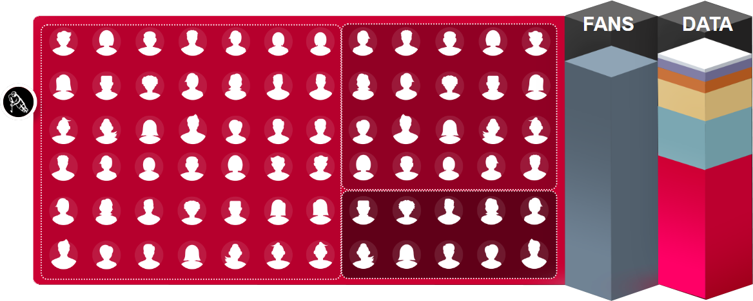
#AllAboutSports
GETTING TO KNOW THE FANS
- VIEWING
1,338
NEW FANS ADDED TO THE CRM
3
NEW DATA POINTS COLLECTED
Notes:
Touch point #1
Activation on social media / website
1/ Name
2/ Email
3/ Where are you based?
Global fan-clubs
Targeted information re: viewing possibilities, ticketing for local games, etc’
Timed newsletters…

Slide 16
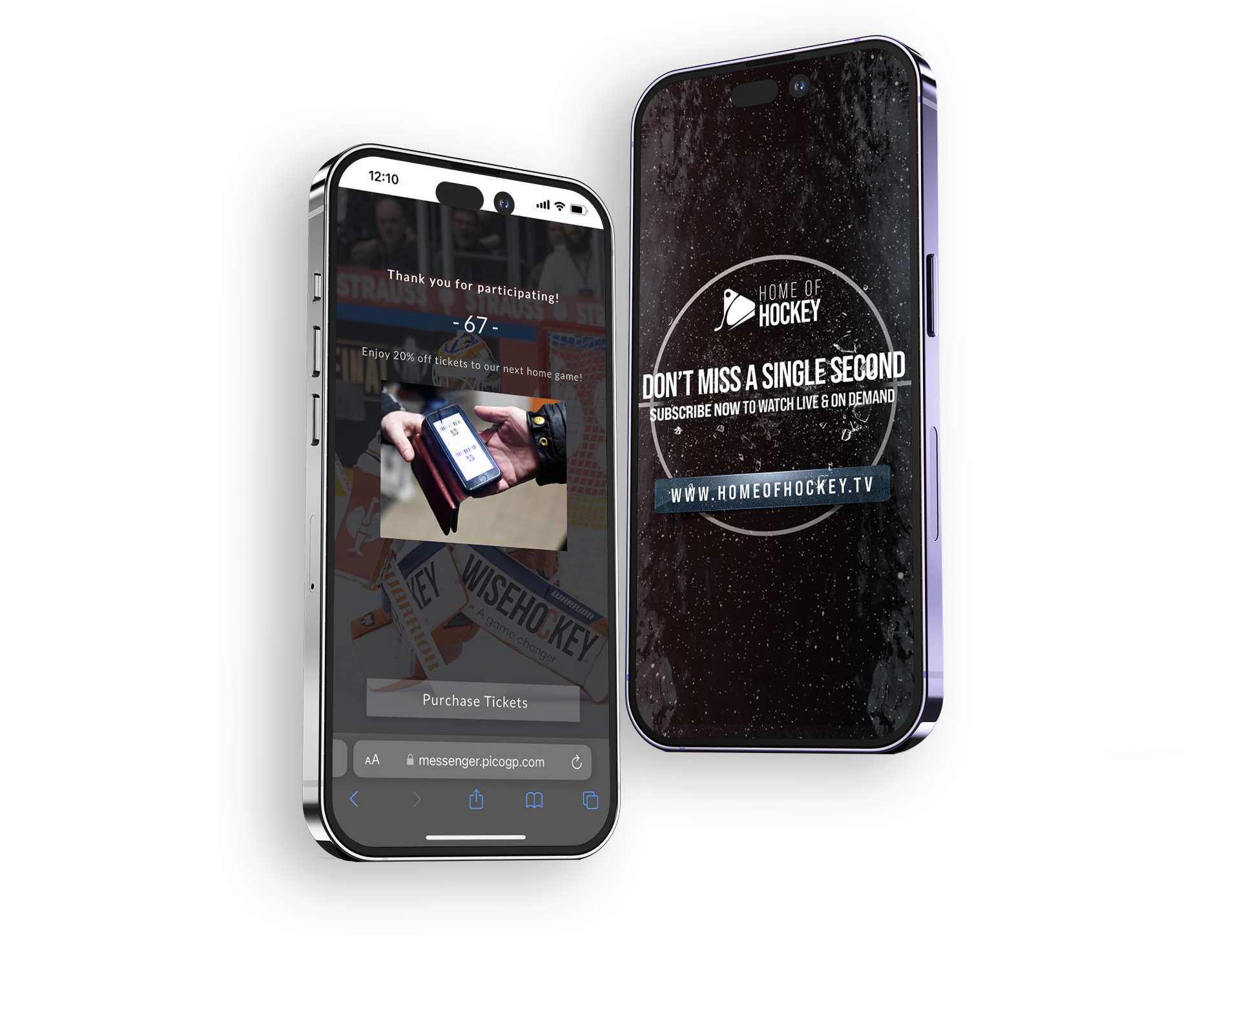
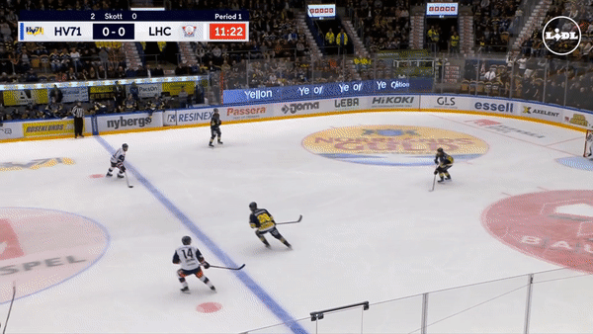
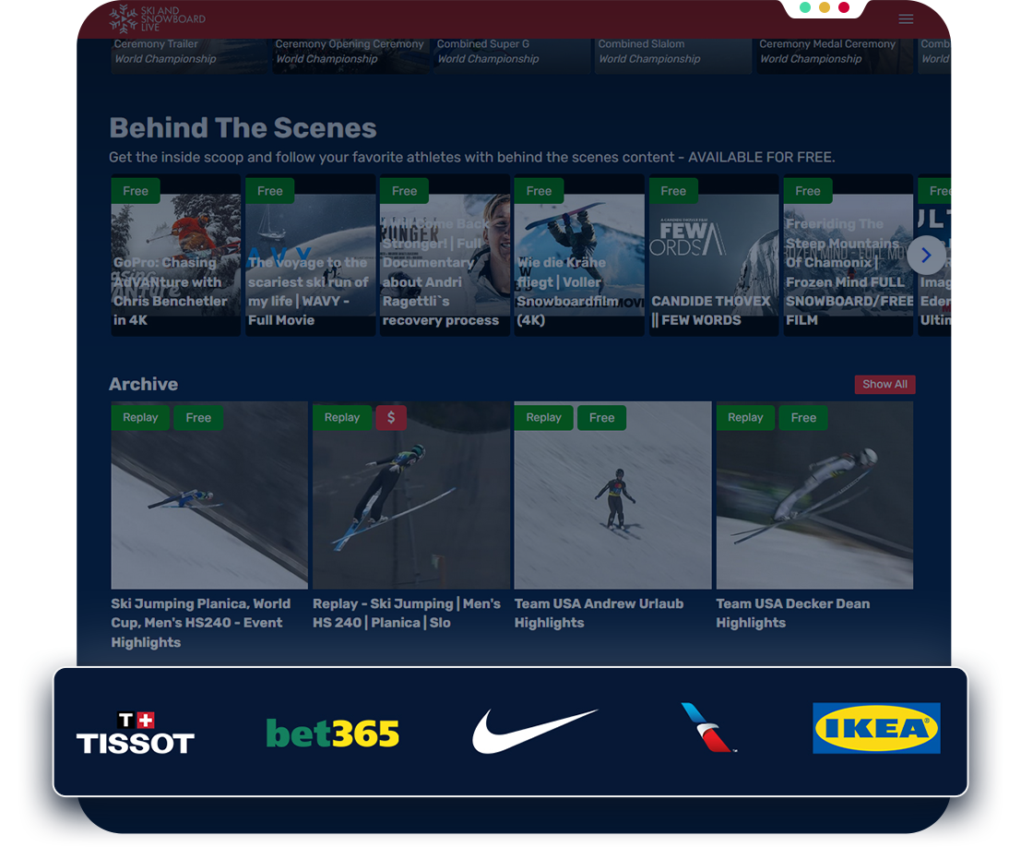
IMPROVED EXPERIENCES
& OPTIMISED MONETISATION
Notes:
Improved experiences: getting the right content to the fans where they are watching it; putting players at the forefront for fan experiences, player-based content; affinity to players
optimised monetisation: sponsored content on the right channels, betting, targeted e-commerce;

Slide 17
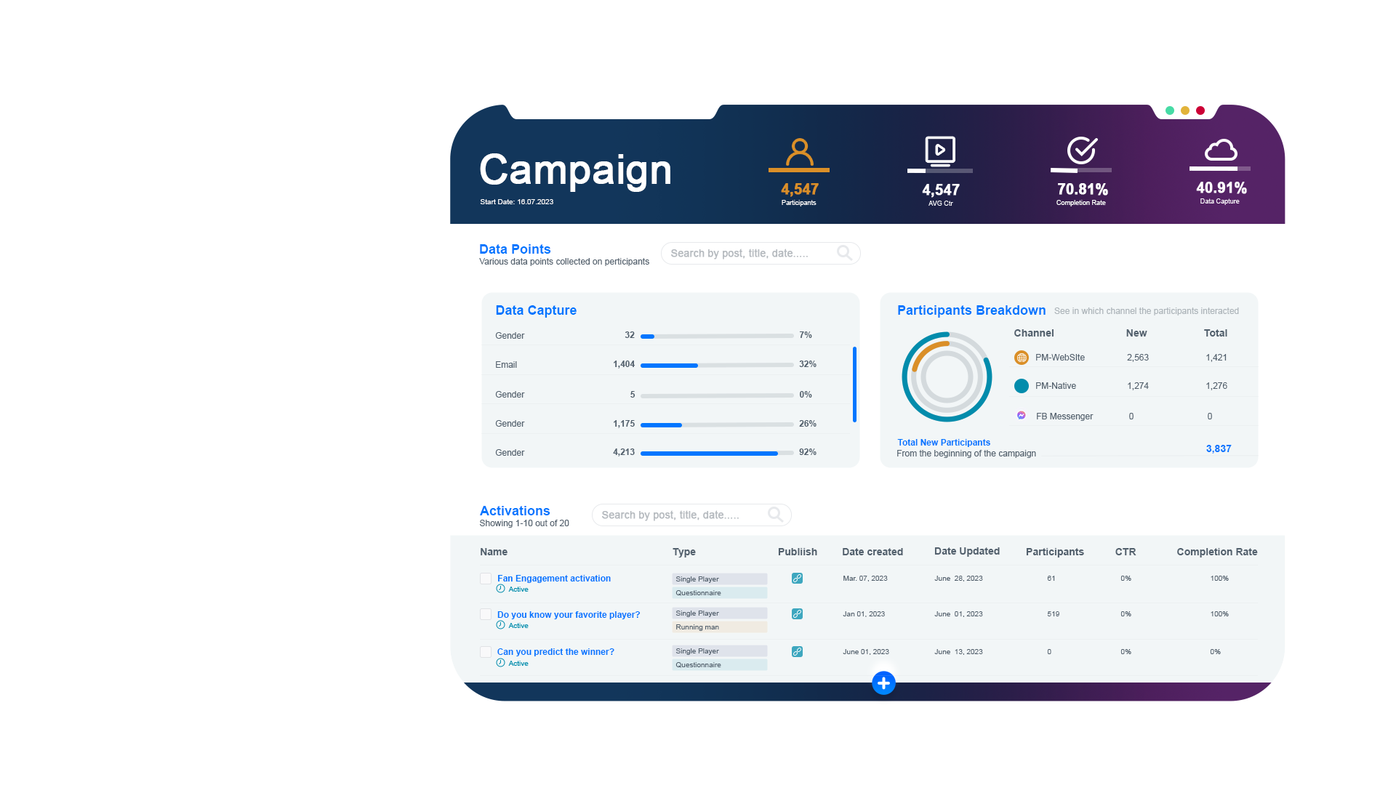
DATA-DRIVEN

Slide 18
LEVERAGING DATA
THE NIKE EXAMPLE

Slide 19
FROM SNEAKERS
TO DATA LEADERS

Slide 20
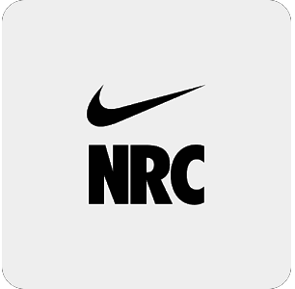
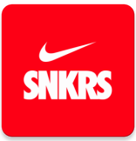
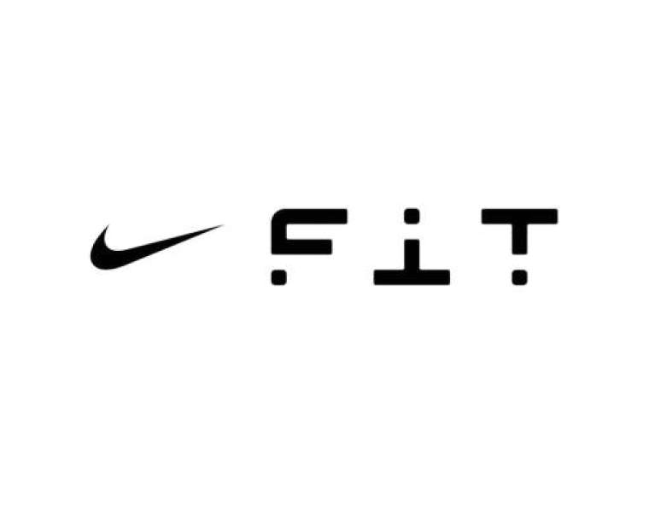
500M users
COLLECTION
ANALYSIS
NIKE Direct revenues were $21.3 billion, up 14 percent on a reported basis, led by NIKE Brand Digital growth of 24 percent
RESULTS
Our investment in innovation and our digital leadership are fueling broad-based growth across our portfolio of brands, as we create value by serving the future of sport.”
John Donahoe, President & CEO, NIKE, Inc. | June, 2023
Notes:
In order to better use the data collected through its apps, Nike made two key acquisitions in the past years. In 2018, Nike bought Zodiac, a marketing-focused tool that allows it to analyze the data it collects from its various apps to better understand customer habits and predict purchasing decisions.[i] Nike has incorporated Zodiac into its app to facilitate personalized product recommendations and content. In addition, in 2019, Nike bought Celect, a demand-sensing analytics platform that “provides proprietary insights that allow retailers to optimize inventory across an omnichannel environment through hyper-local demand predictions.” Through this inventory management platform Nike is able to more effectively decide what products to produce and where to sell them.[ii] Furthermore, Nike has put together a formidable enterprise analytics foundation across its operations, from finance to marketing, which links its recent data analysis asset acquisitions with its apps data and the company as a whole.

Slide 21
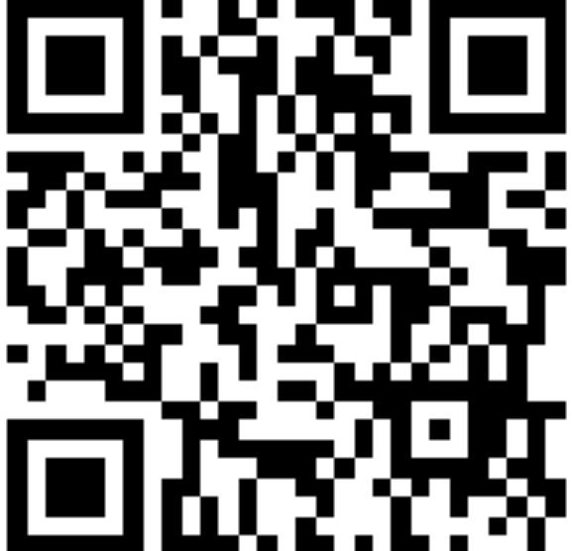
CONTACT US
WANT TO LEARN MORE
ABOUT YOUR FANS?
21

