Slide 1

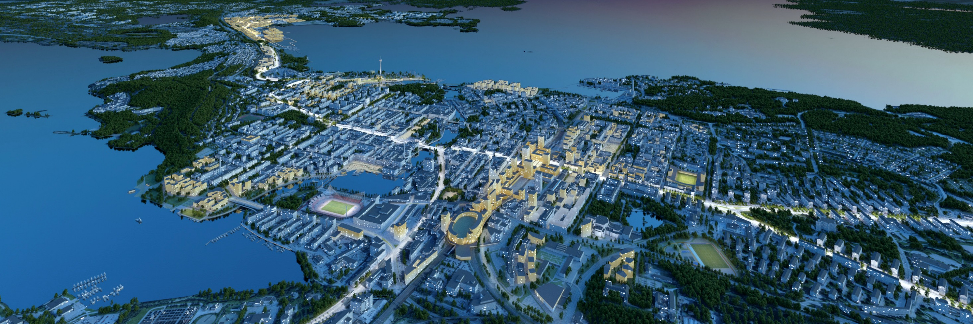

How Tampere became high level sport city?

Slide 2
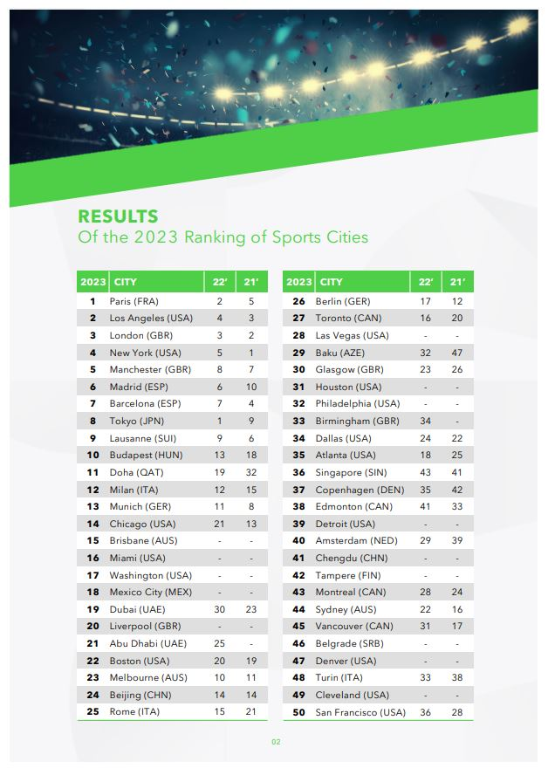
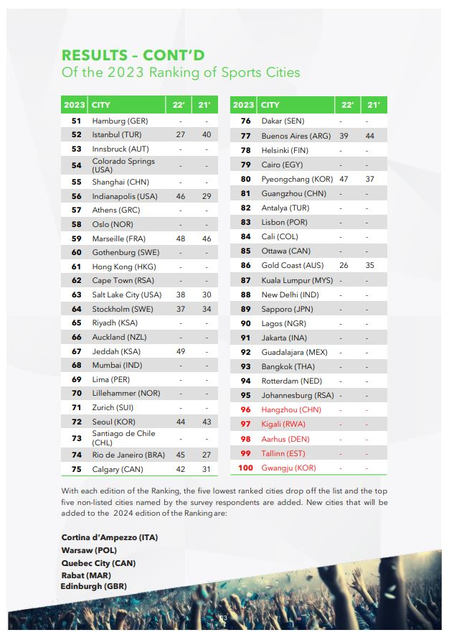

Slide 3
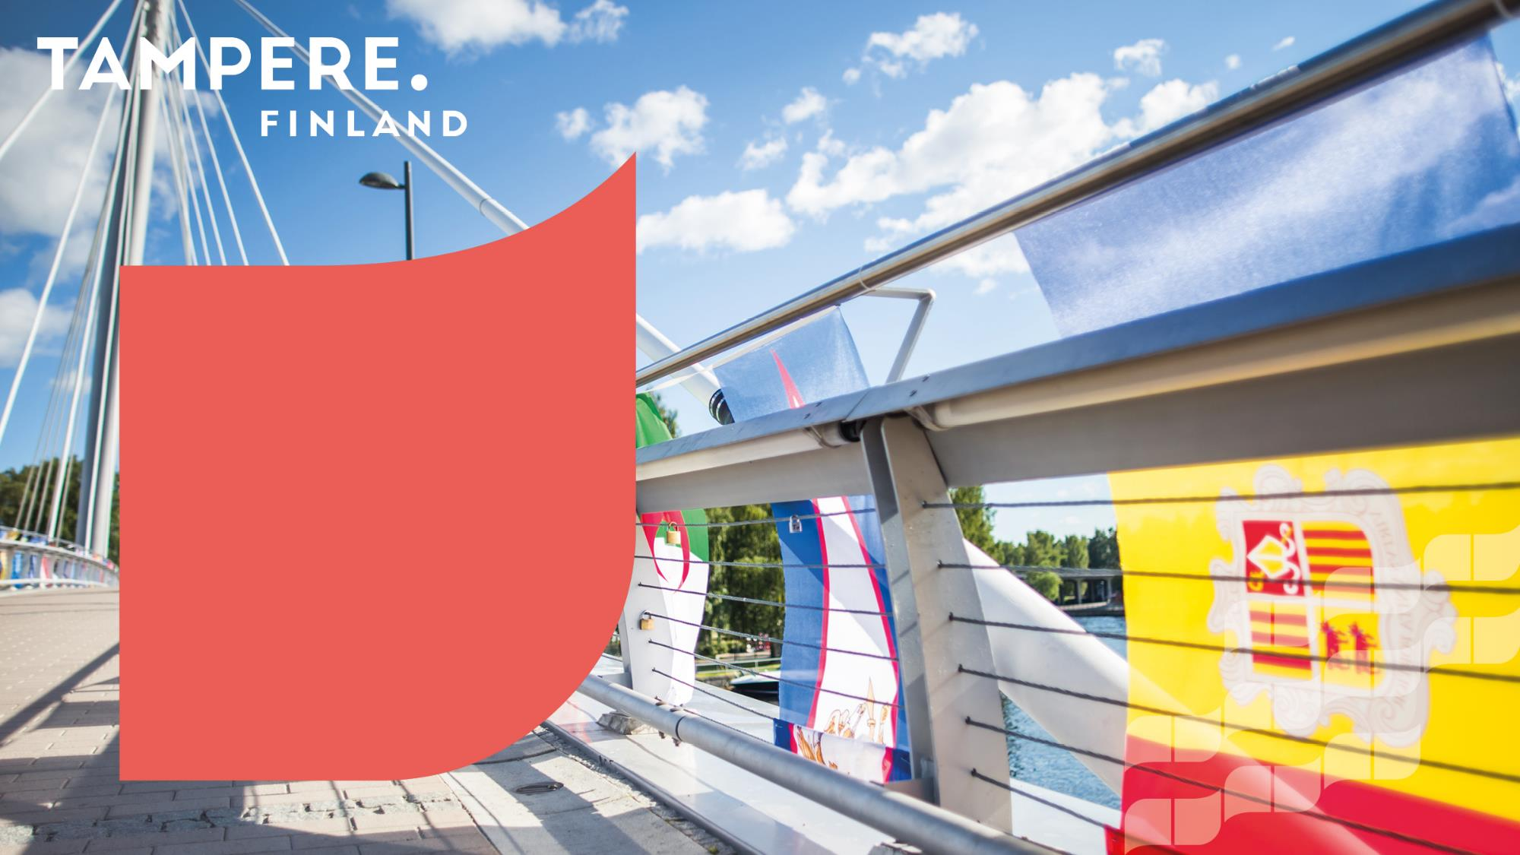
Finland
- Population 5,6 M
- EU membership: joined in 1995.
- Currency: euro
- Land area: 338,424 km²
Ten percent of the Finnish land area (338,424 km²) is water and 76% is forest
“The Happiest Country of the World”

Slide 4
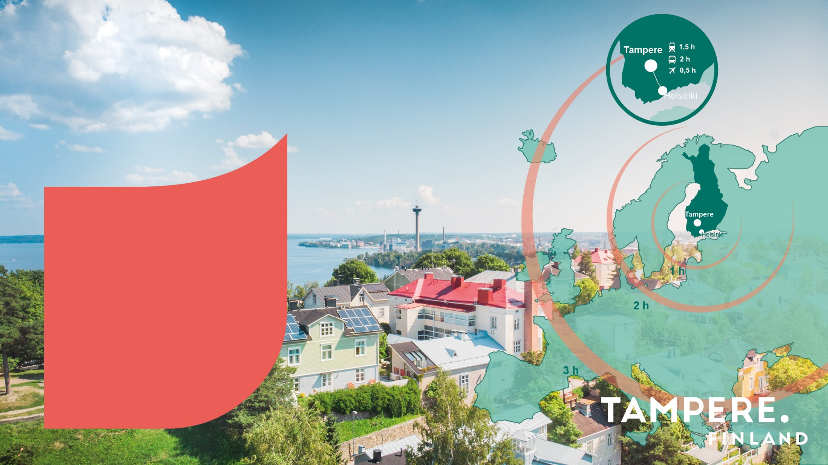
Tampere. Finland
Population 251,000, Tampere Region: 525,000
Tampere International Airport
Central location - 175 km from Helsinki
Located between two scenic lakes
Popular sport city
Vivid culture, safe environment
Compact city centre

Slide 5
Tampere is developing more than ever… right now
Notes:
No näyttää siltä, että on tehty jo nyt paljon hallitun kasvun ja kilpailukyvyn eteen, mihin..
Toki on useita isoja teemoja, joista on pidettävä huolta. Peruspalveluiden, kuten tasokkaan koulutuksen ja terveyden huollon korkea taso ovat ihan peruspilareita tulevaisuuden kasvulle ja kilpailukyvylle, mutta nosta yhden keskeisen teeman tässä esille, joka on tavoitellun kasvun edellytyksenä kriittinen ja ajankohtainen.

Slide 6
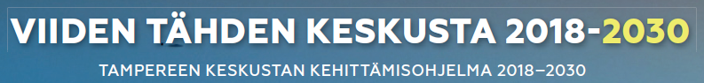

Slide 7
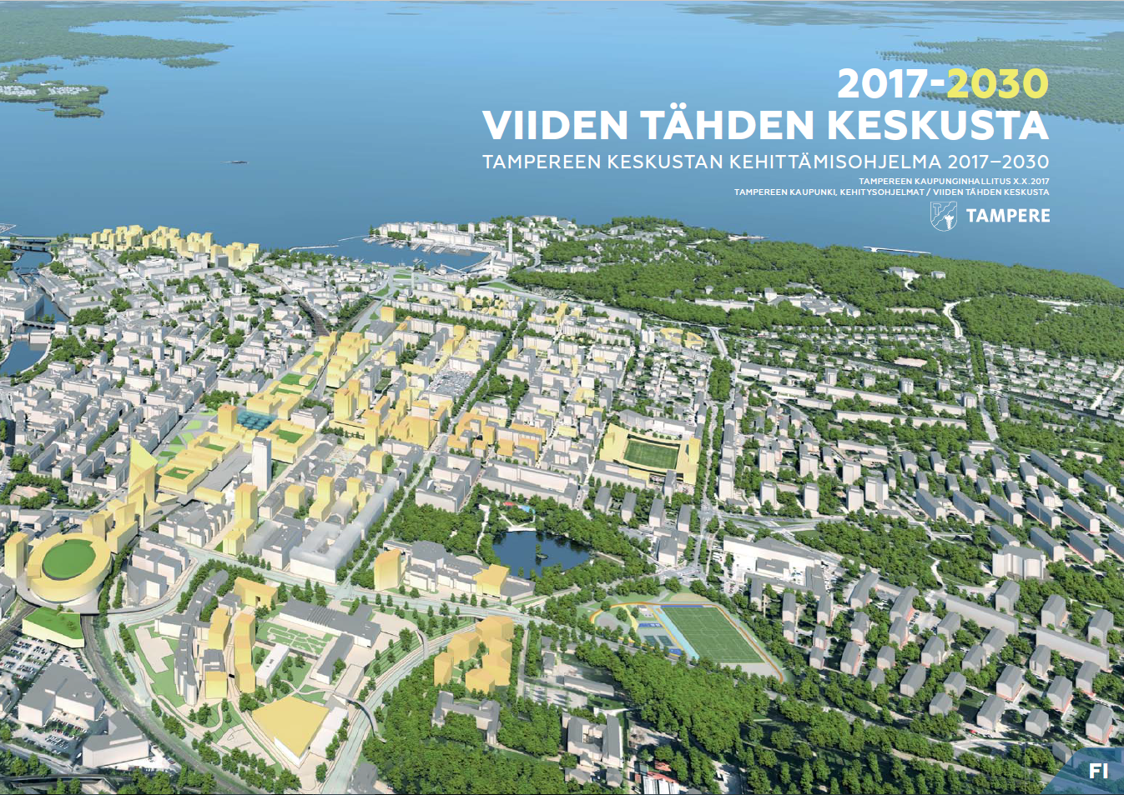
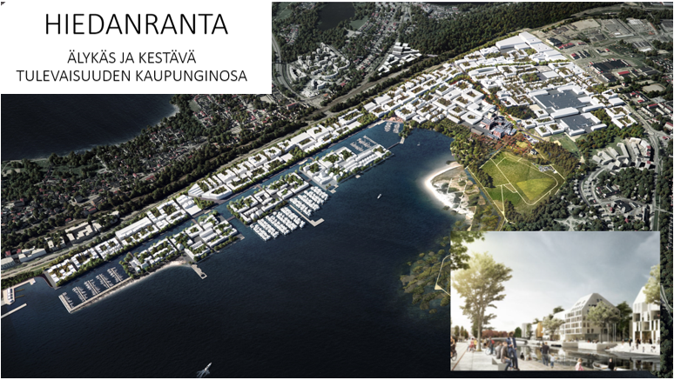
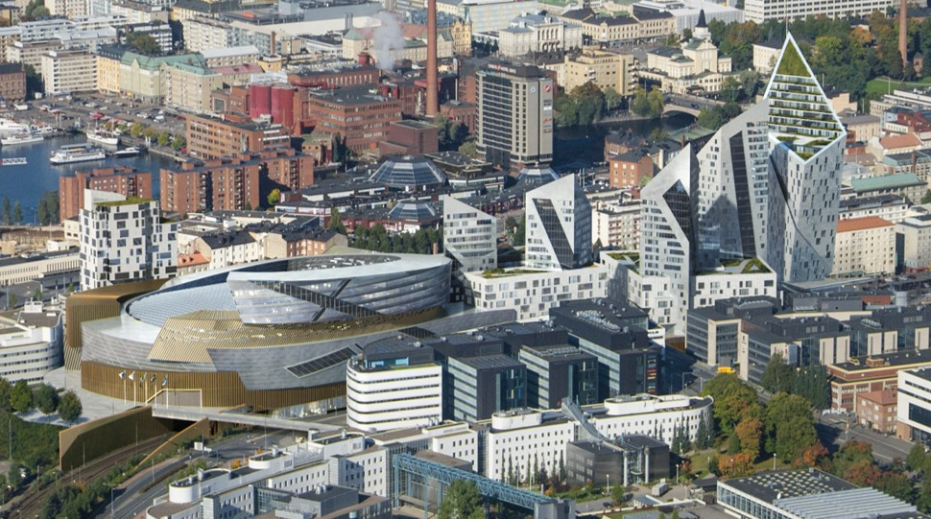
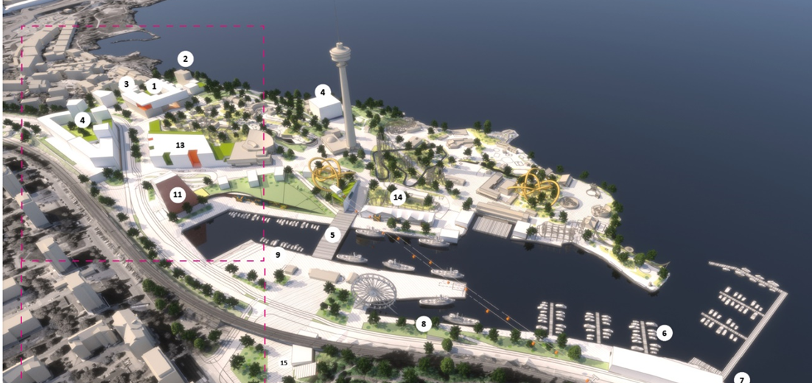


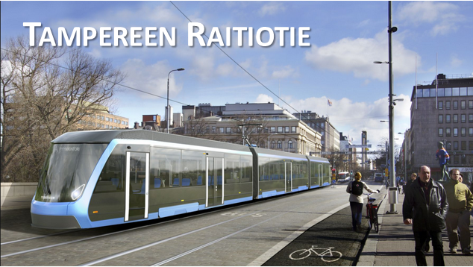

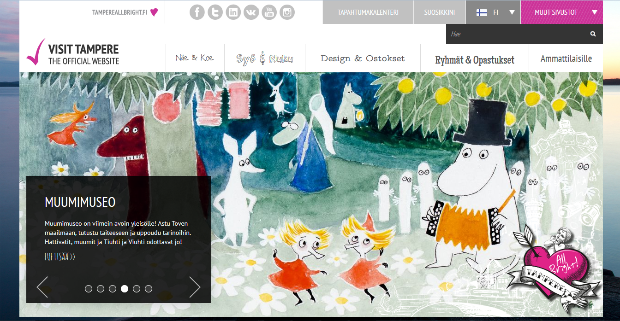
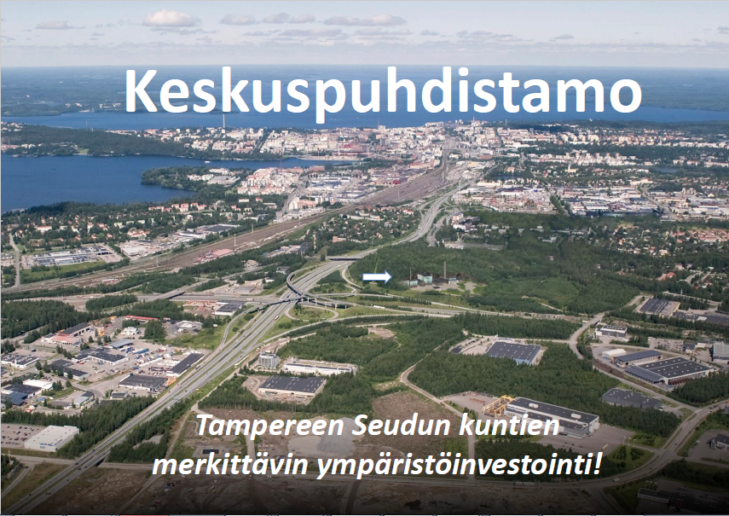
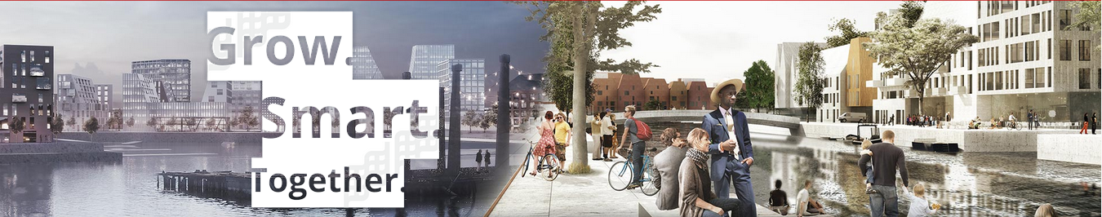

Slide 8
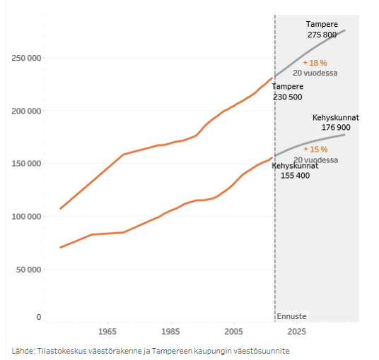

City grows
We are growing even faster that we thought in 2015…

Slide 9

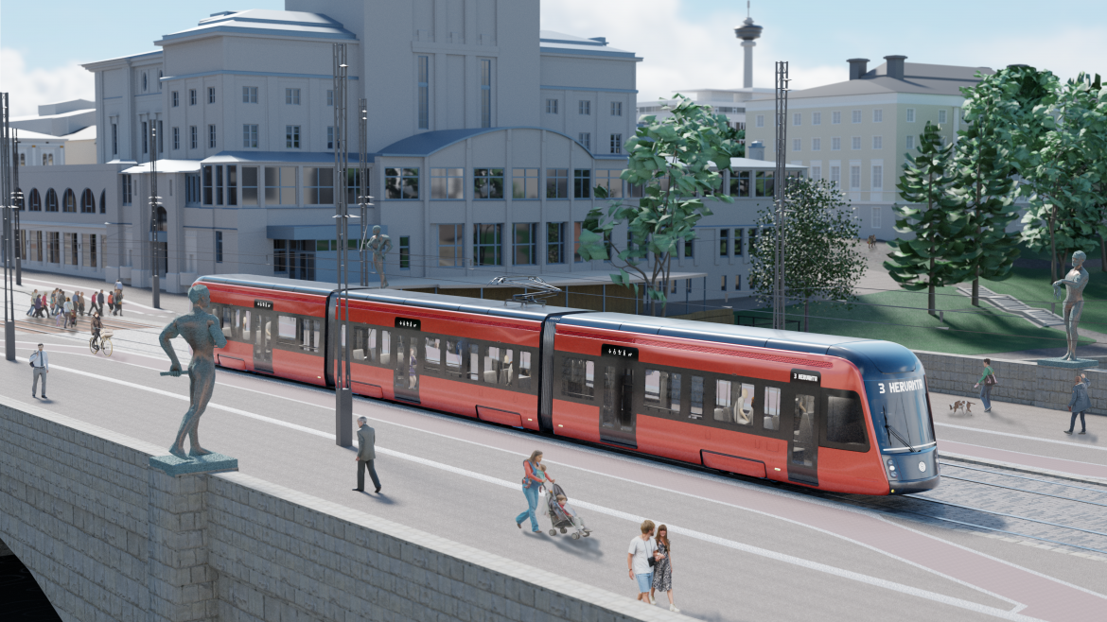

Tampere Tram

Slide 10
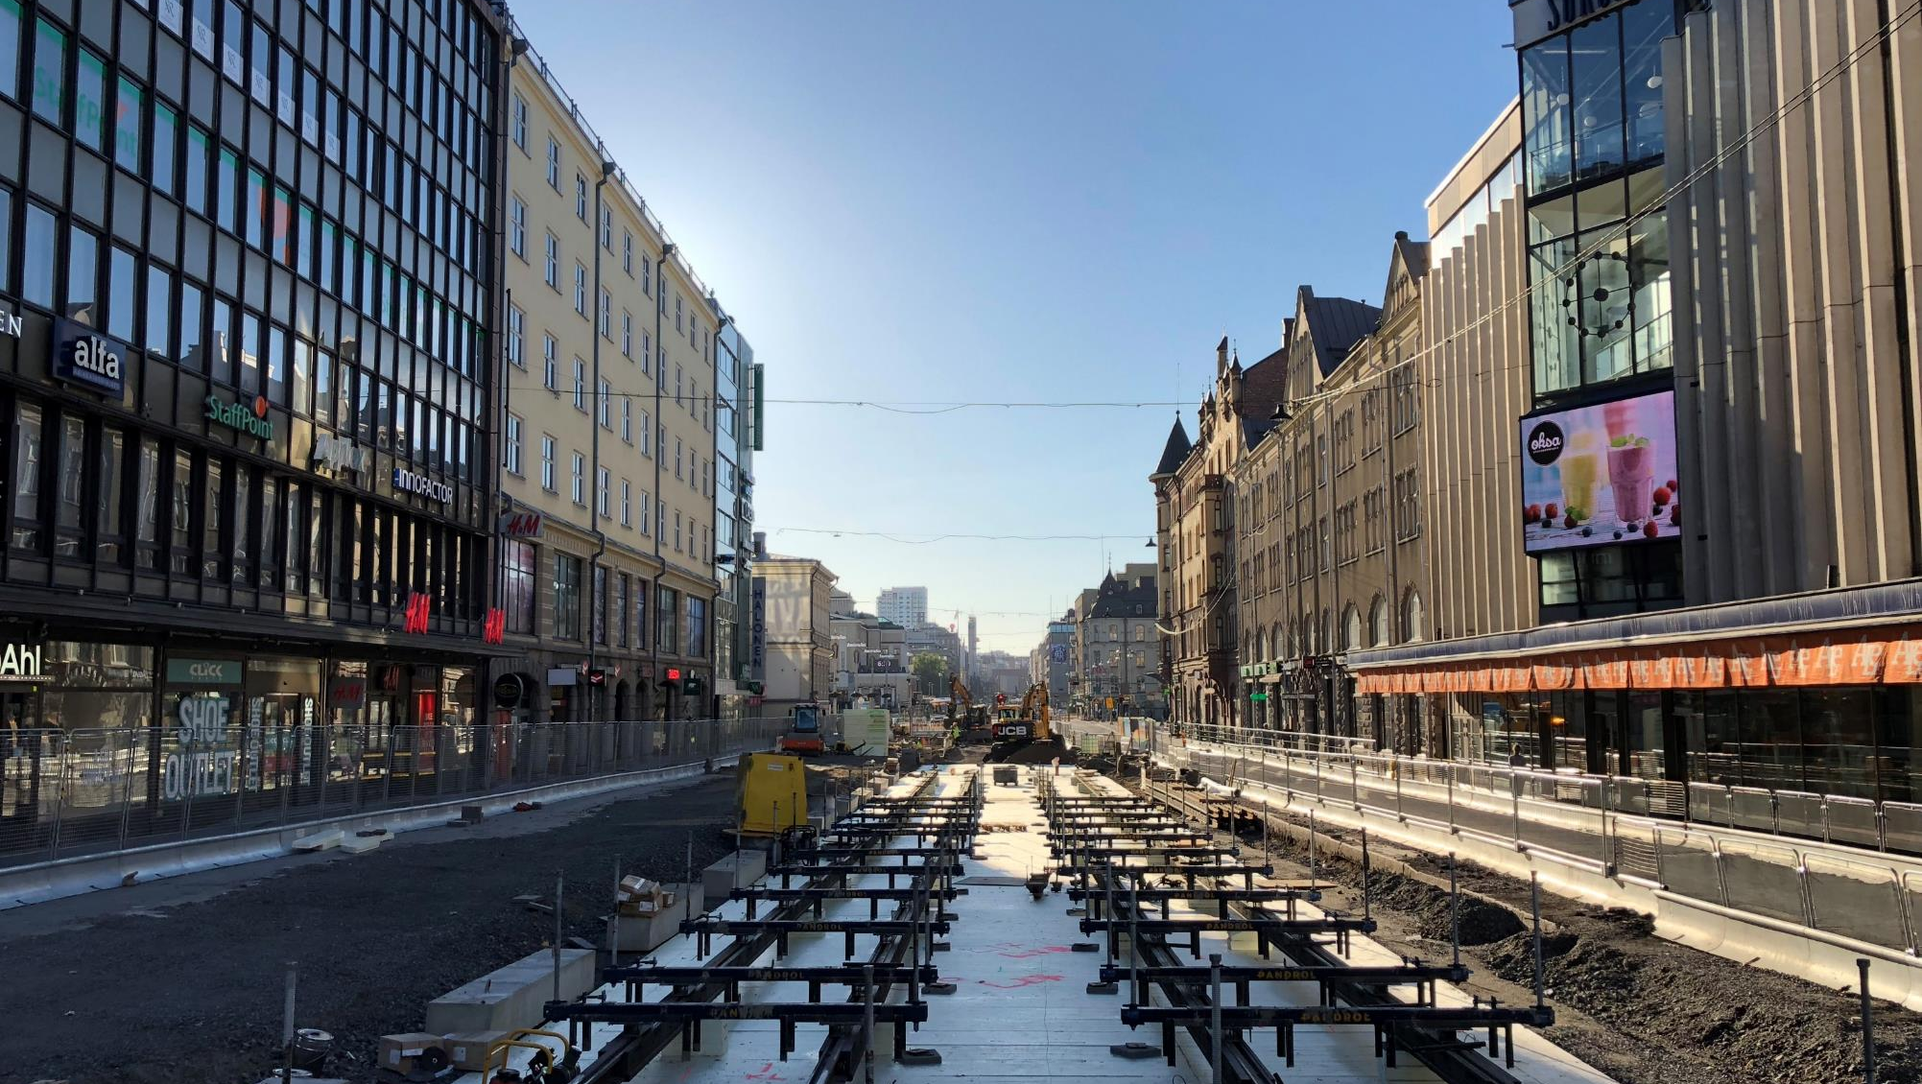
Tram project
Hämeenkatu 7.8.2018

Slide 11
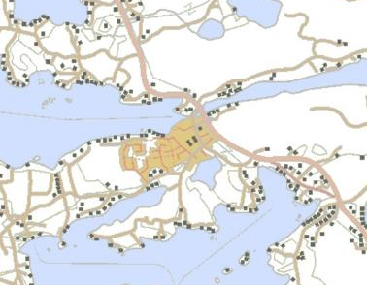
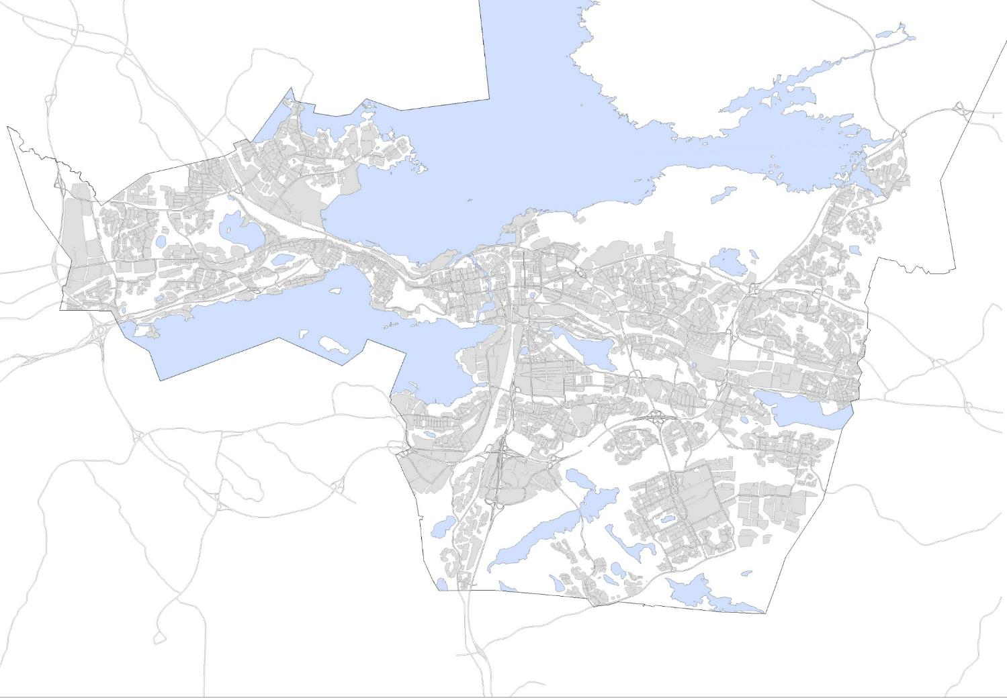
Palm – residential construction 2017 – 2040
Kämmenniemi
Nurmi-Sorila
16 000
88 000
Lielahti-Niemenranta
173 000
Ojala
403 000
Ranta-
Tampella
Haukiluoma-Tesoma
Hiedanranta
Santalahti
249 000
176 000
119 000
188 000
Muu
keskusta
Kaleva-Hakametsä
326 000
223 000
Koilliskeskus- Pappila
121 000
84 000
Eteläpuisto
Härmälä
Turtola
Kaukajärvi-Annala
179 000
82 000
107 000
Tampere 4 447 000 k-m²
(4,4 k-m²)
Lakalaiva-Peltolammi
Hervanta
132 000
172 000
Vuores - Västinginmäki
425 000
Hervantajärvi-Lintuhytti
189 000

Slide 12

HIEDANRANTA
SÄRKÄNNIEMI ADVENTURE AREA
SANTALAHTI
RANTA-TAMPELLA
NEW SARA HILDÉN ART MUSEUM
TAMMELA INFILL DEVELOPMENT
TAMPERE ART MUSEUM EXTENSION
TRAMWAY
TAMMELA STADIUM
TRAVEL AND SERVICE CENTRE
TULLI AREA
DECK AND ARENA
HOTEL FOR
TAMPERE HALL
RATINA AREA
SORI AREA
UNIVERSITY CAMPUS
VIINIKANLAHTI
VIINIKANOJA
Notes:
This image showcases our city centre and yellow colour shows you all the areas we are developing.
Here you can see what we already have done
And what development is under construction or soon to begin
And as you can see from the picture, the Deck district is the largest area we are developing and it´s located in the heart of the city.

Slide 13
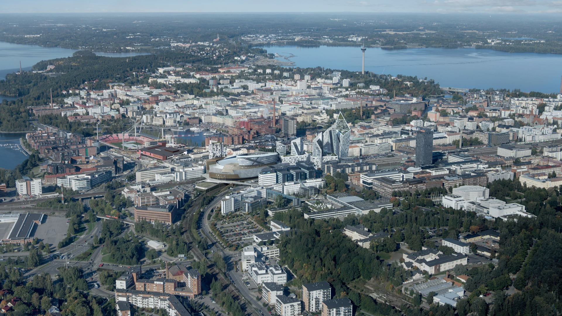
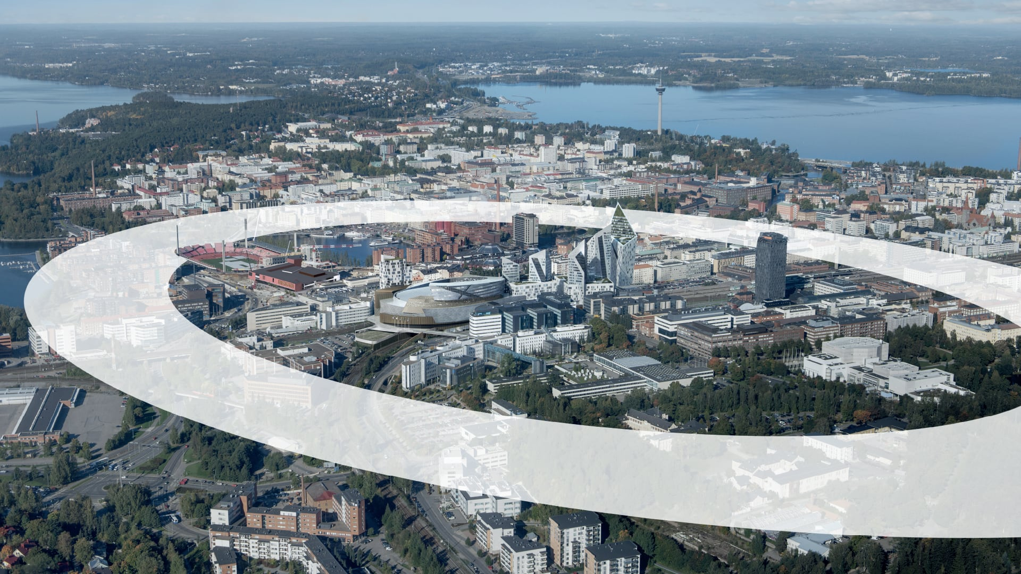
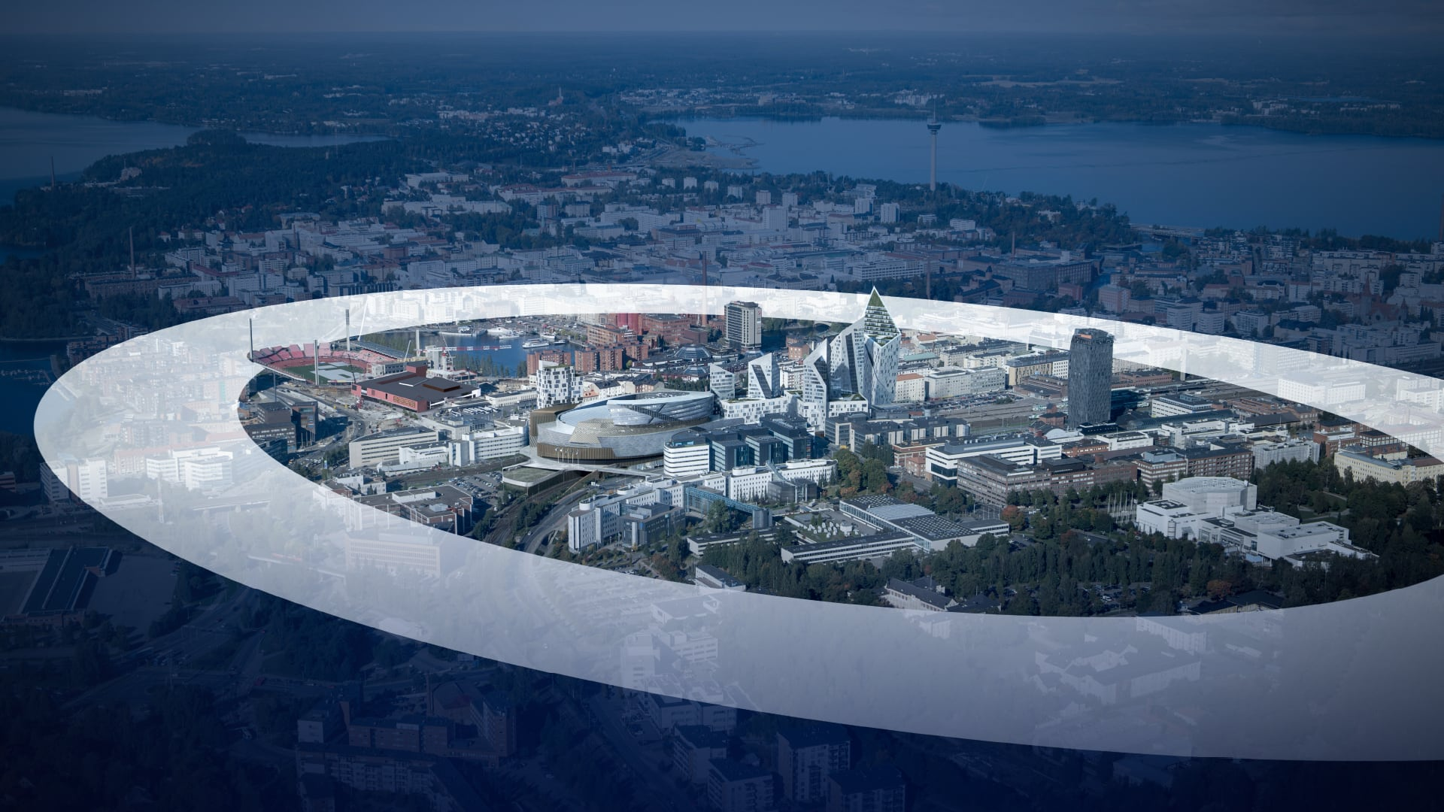


Image © SRV/ Credit Tomorrow AB / Studio Libeskind

Slide 14
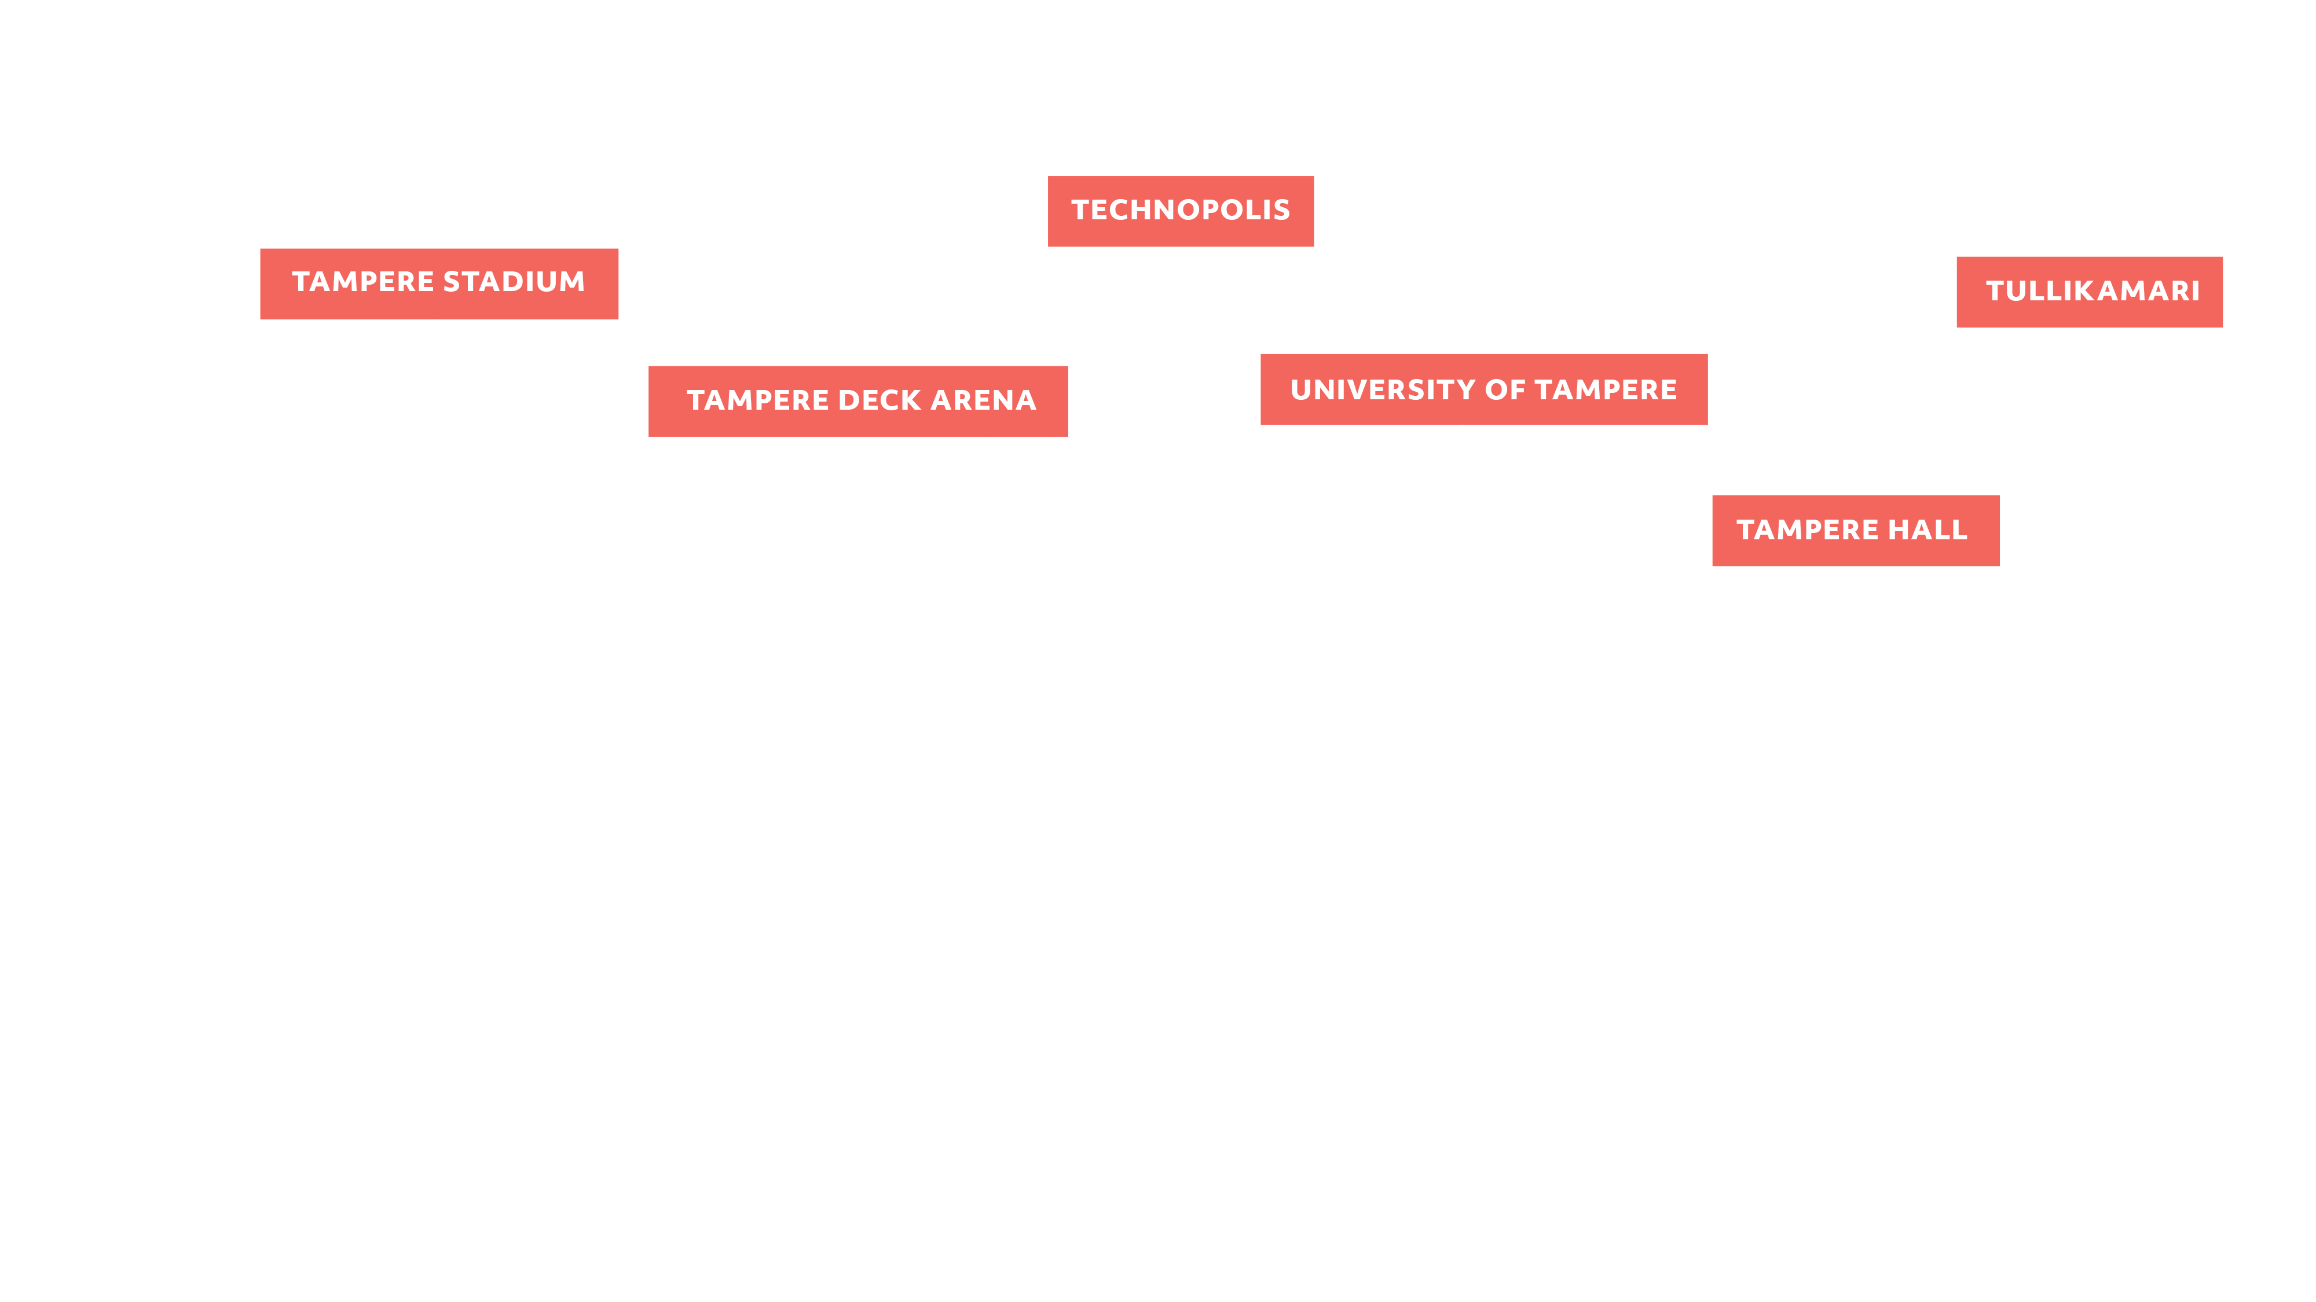

A unique cluster of facilities and professionals within a 10-minute radius
Image © SRV/ Credit Tomorrow AB / Studio Libeskind

Slide 15
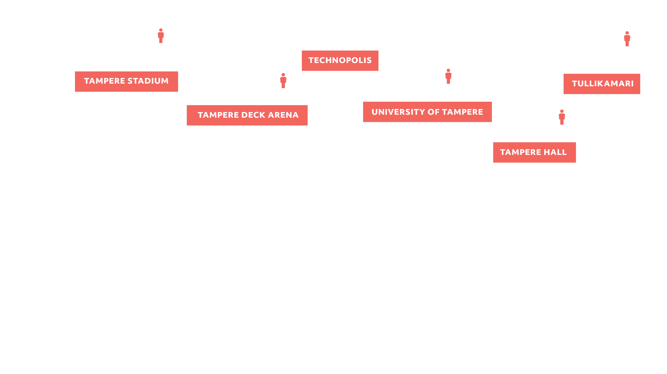
Capacity for major events
Image © SRV/ Credit Tomorrow AB / Studio Libeskind

Slide 16
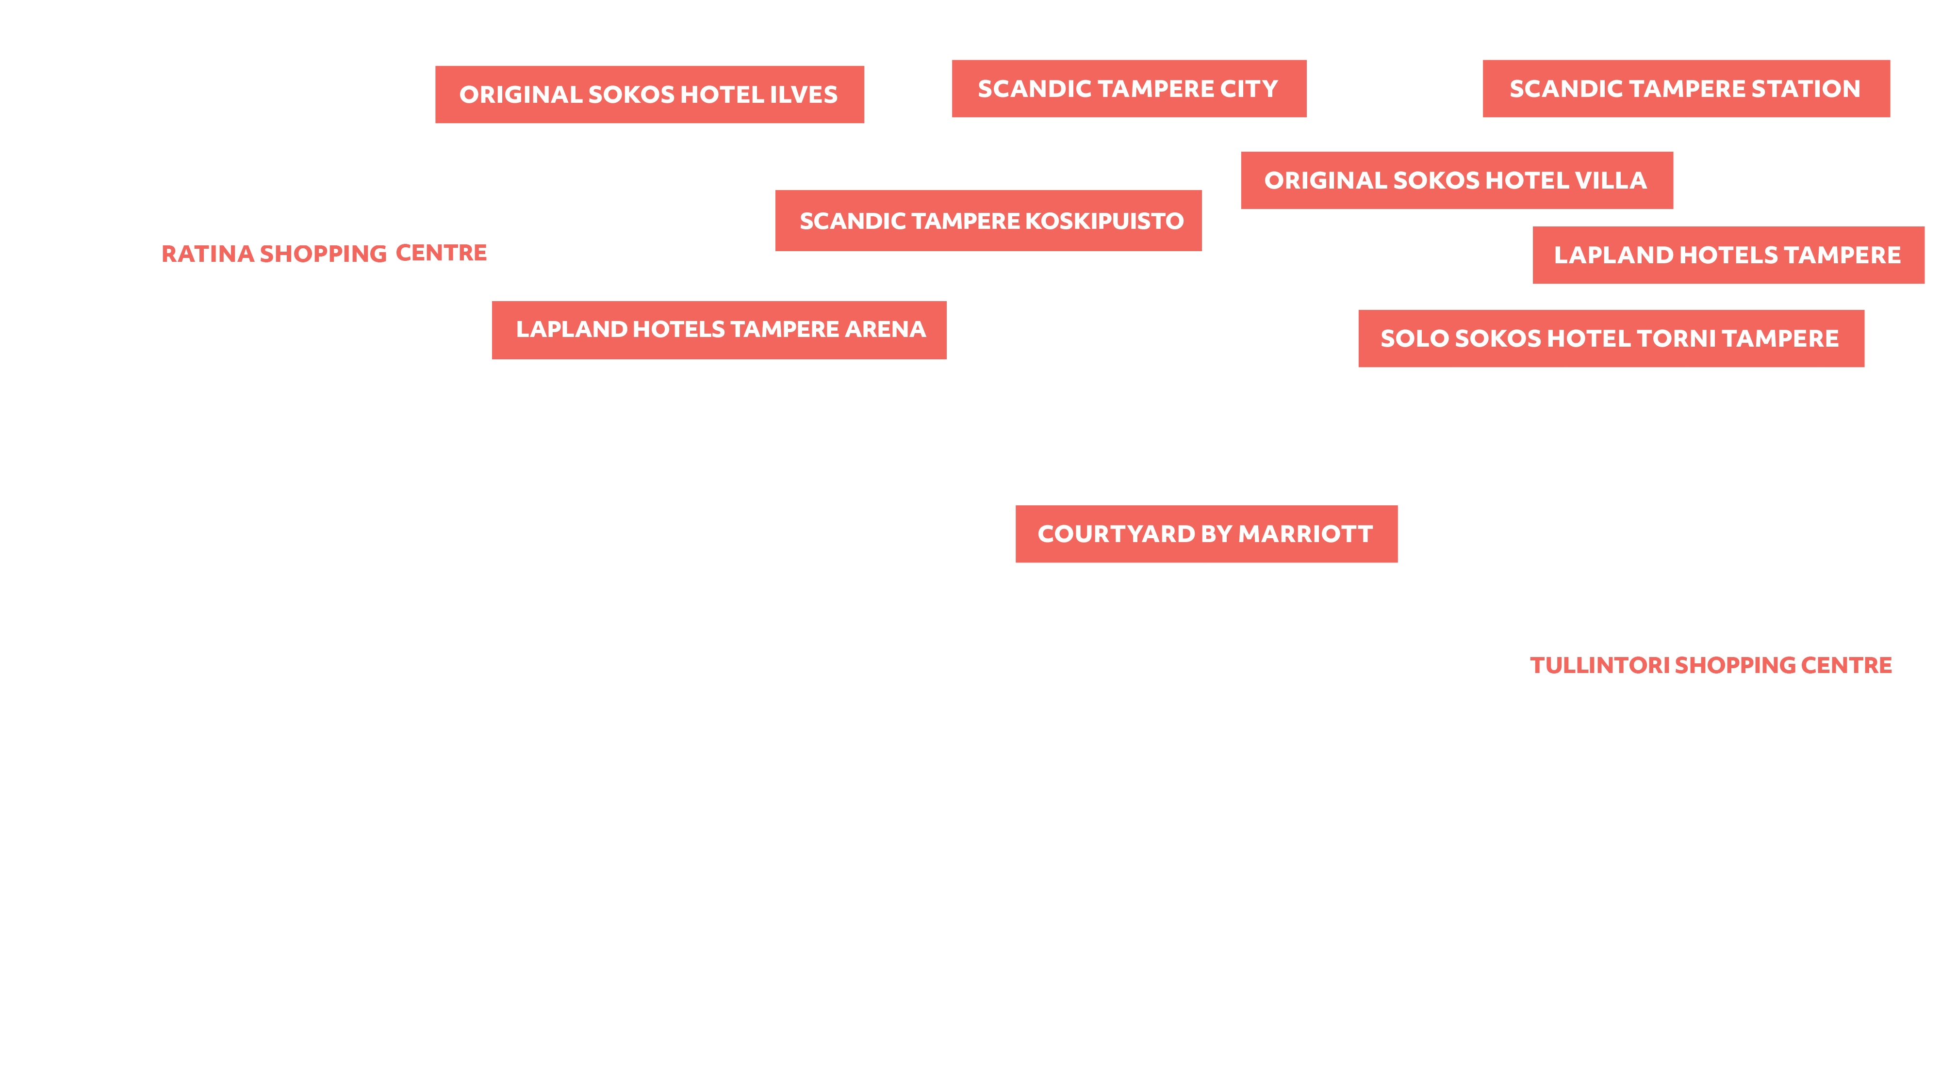
Several hotels and shopping centres
Image © SRV/ Credit Tomorrow AB / Studio Libeskind

Slide 17
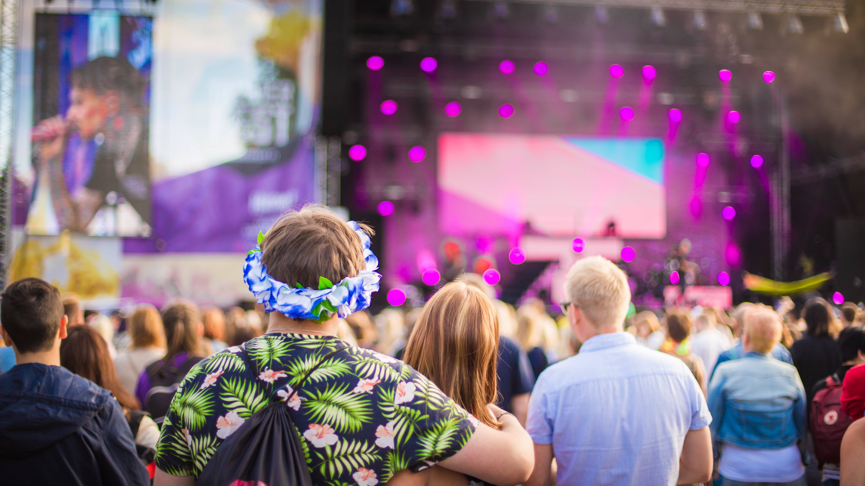

Eventful Tampere
Guidelines
Photo: Visit Tampere / Laura Vanzo

Slide 18
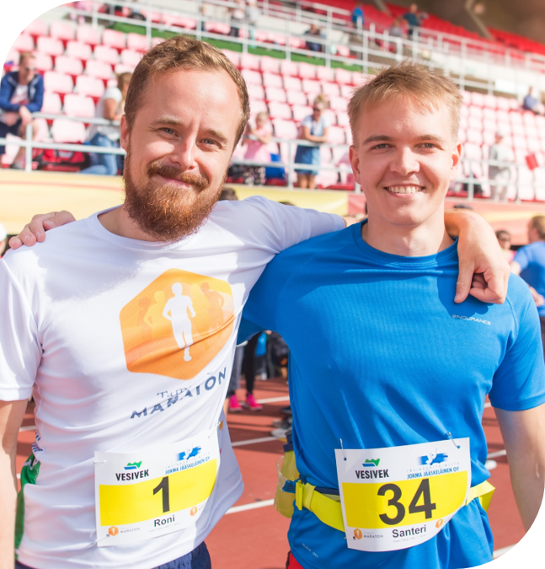
Events in Tampere City Strategy and Mayor’s programme
Foundations
Tampere City Strategy 2023: City of Action
  We are a home for creative people. Tampere is known as a cluster for international events and culture.
  We attract people to experiences all year round.
  We strengthen the operating conditions of associations and organizations. We offer opportunities for independent and voluntary activities.
Mayor’s programme by Anna-Kaisa Ikonen People’s Tampere– City of Opportunities
  Tampere strengthens its appeal as a city of events and a cluster for creative industries.
  Study opportunities and development in the creative fields must be maintained.
  A development program focusing on experience economy will be launched. The program develops Tampere’s audiovisual industry ecosystem and Tampere as a destination for congresses, events and audiovisual productions.
Kuva: Visit Tampere/Laura Vanzo

Slide 19







Event Classification
Event Info
Size Categories
Types of Events
Minor Event
e.g. city district events
Arts, culture, entertainment and exhibitions
Sports events
Local Event
e.g. city event
Fairs and markets
Conferences, congresses and corporate events
Main Event
e.g. significant exhibition or congress, main festival
Educational and scientific events
Major Event
e.g. major concert, international sports event
Political events
Devotional and spiritual events
Mega Event
e.g. major championships event, Ice Hockey World Championships
Recreational and community events
Private events
Global Event
major global event, e.g. the Olympic Games
Events without an official organizer, ”unauthorized” events
Flagship or signature events that profile the city nationally

Slide 20



Desired Impacts of Events
Event Info
The desired impacts of events are improved quality of life, community building, positive publicity and growth in event-related businesses and local economy.
A balanced overall impact can only be achieved when each event category is proportionately represented in Tampere’s event scene.
Image and Publicity
Business and Economy
Community and Wellbeing

Slide 21
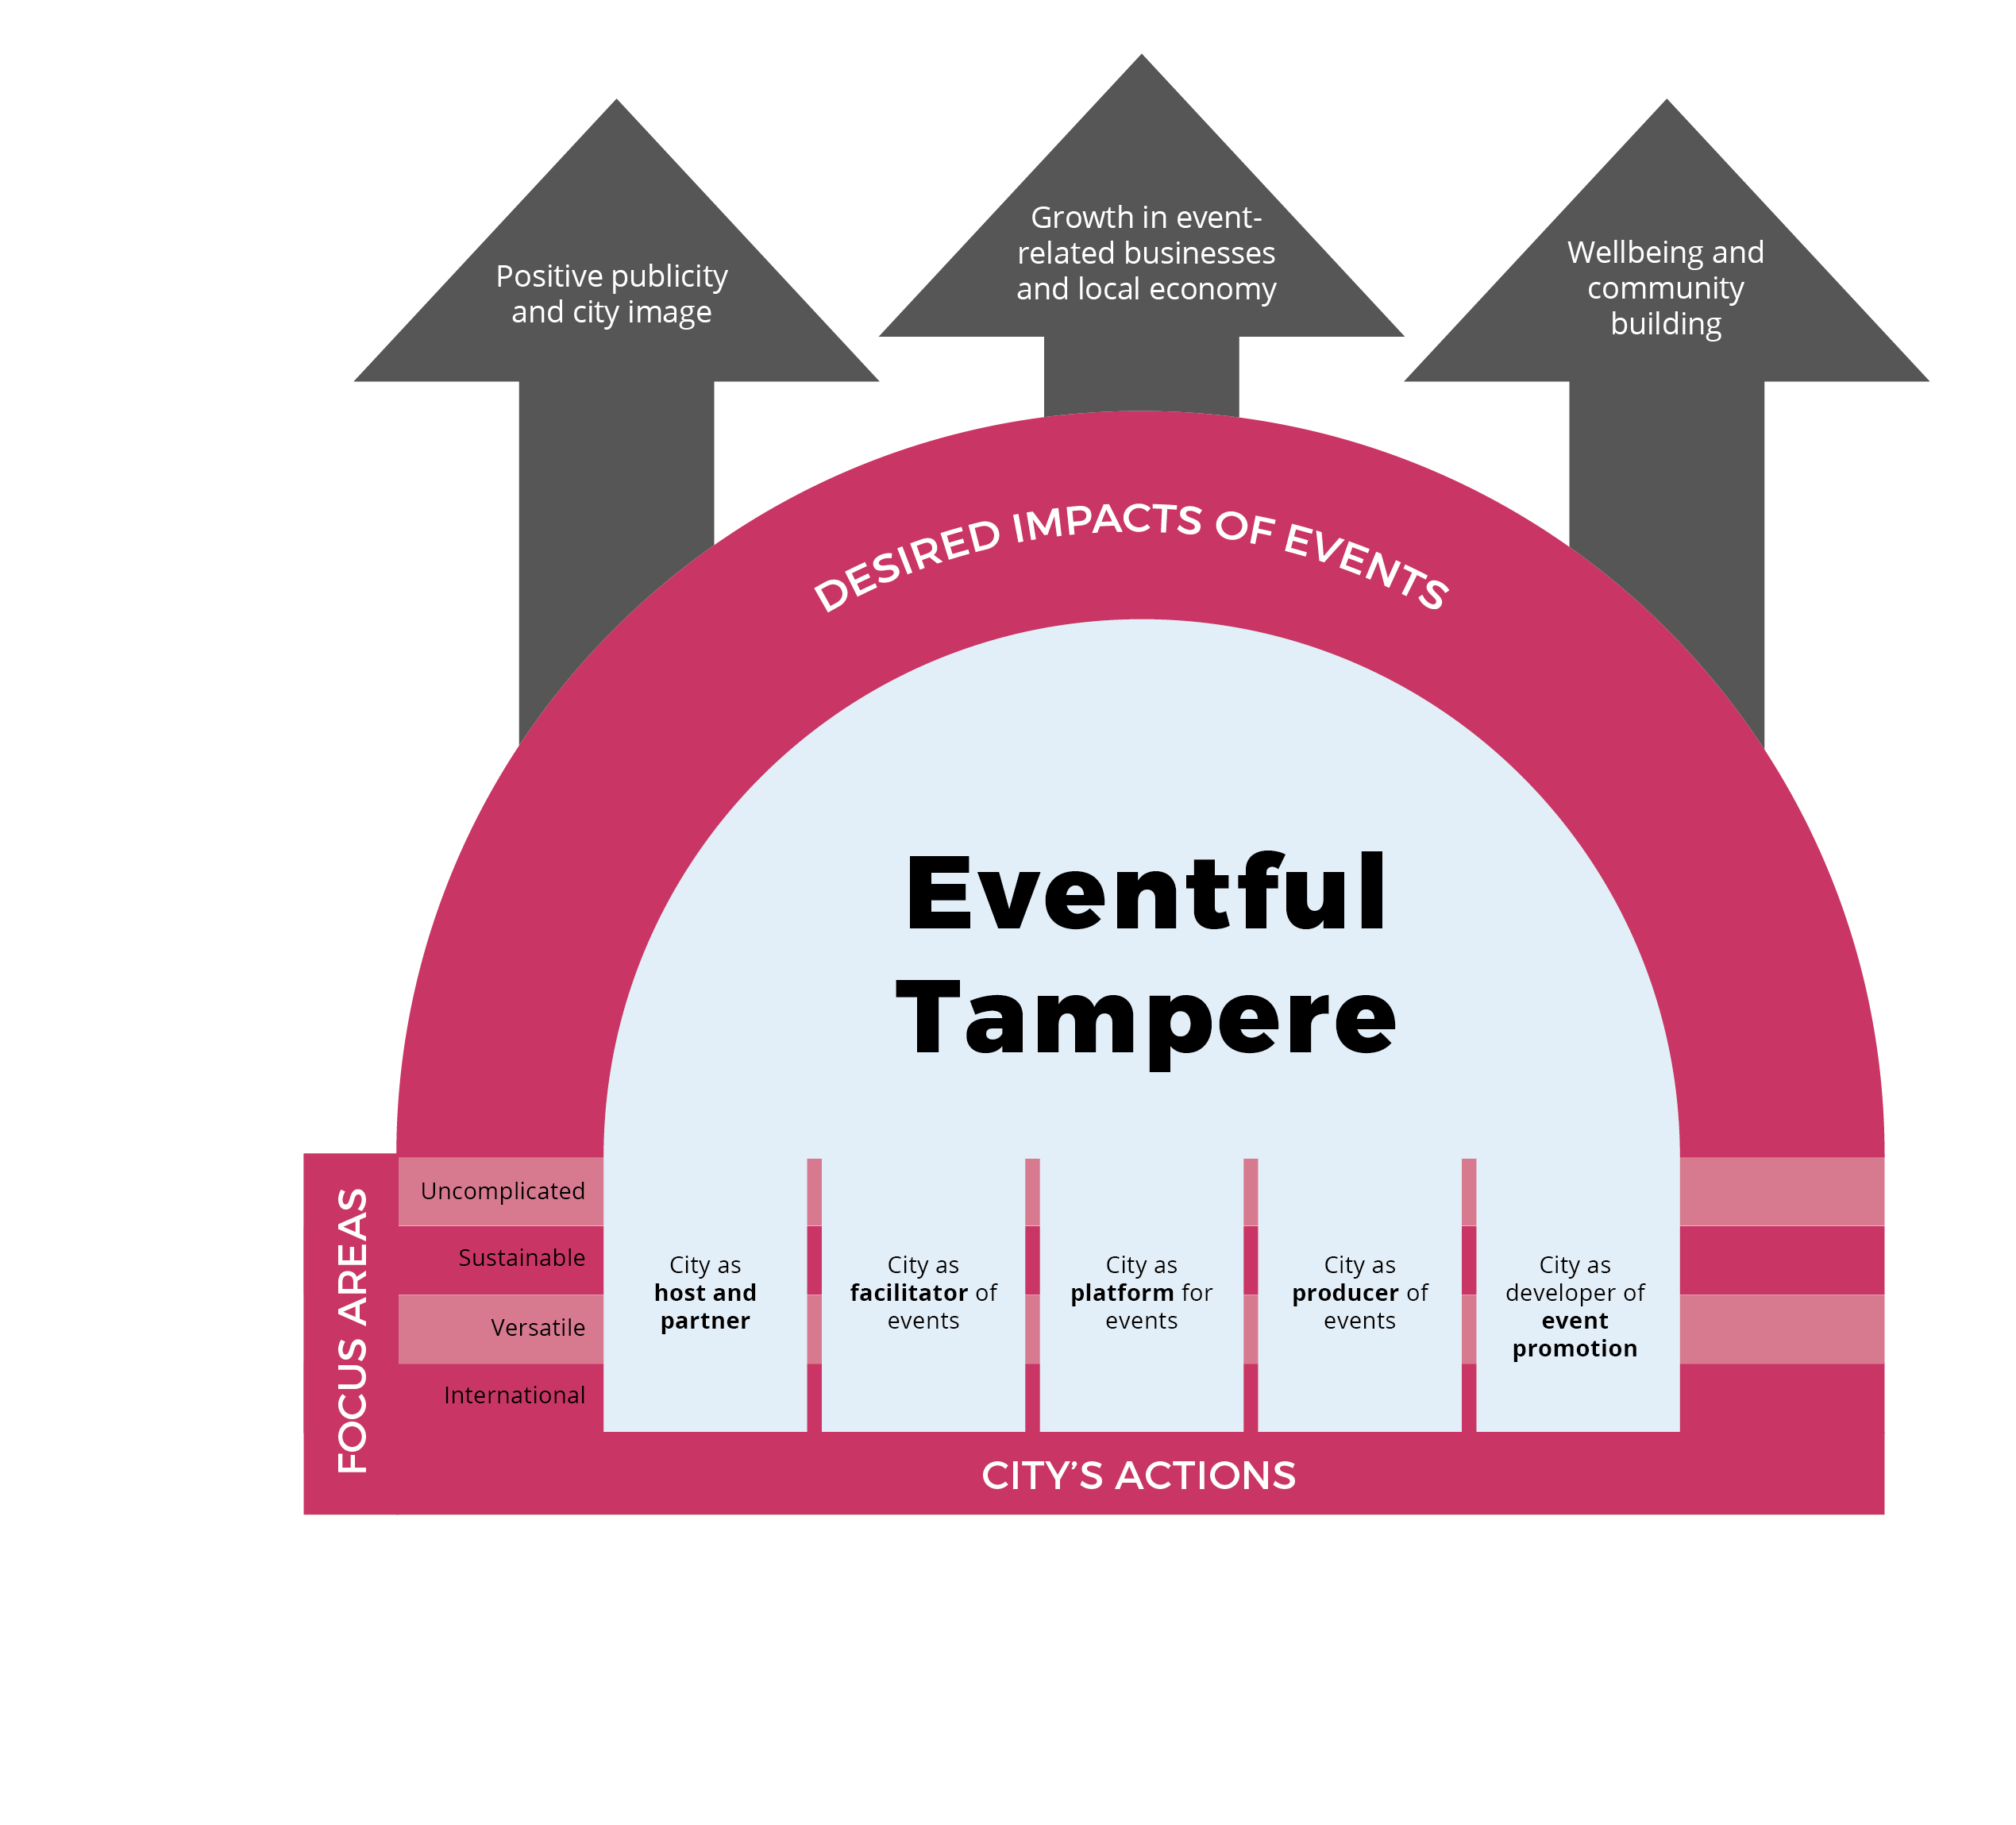
Summary
Through its various roles, the city develops and supports Tampere as an event city and uses events as a tool for city development
The city’s actions emphasize smooth and uncomplicated services, sustainability, versatility as well as international appeal.
The desired impacts of events are improved quality of life, community building, positive publicity and growth in event-related businesses and local economy.

Slide 22
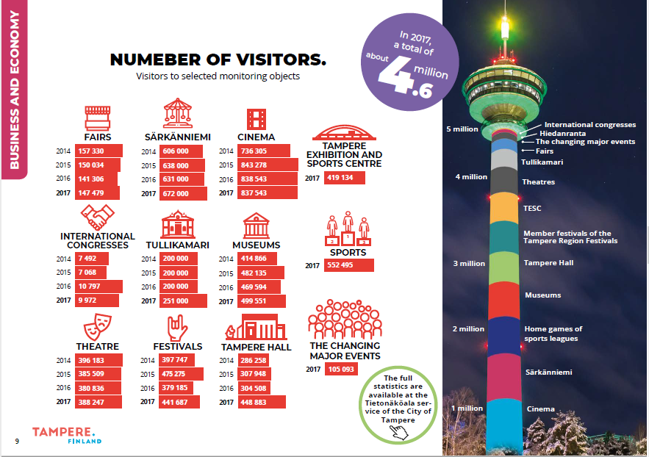

Slide 23
International Sports Events in Tampere
World U23 Wrestling Championships 2023
ITF Taekwon-do World Championships 2023
IMGA European Masters Games 2023
IIHF Ice Hockey World Championships 2023
Pool EPBF Men, Women & Wheelchair Dynamic Billiard European Championships 2023
2023 FIFA Women's World Cup qualifier: Finland – Sweden 2022
FIBA Basketball World Cup 2023 European Qualifiers Finland-Israel 2022
World Masters Athletics Championships 2022
IIHF Ice Hockey World Championships 2022
48th EKF Junior & Cadet U21 European Karate Championships 2021
Men’s European Volleyball Championship 2021
Taido European Championships 2019
European Open, Junior & Master Equipped Bench Press Championships 2019
Tampere 2019 PDS International Competition & Suomi Open 2019
5th IAADS Open European Athletics Championships & 2nd ITTADS Open European Table Tennis Championships 2019
UEFA European Qualifiers: Finland-Bosnia and Herzegovina, Italy, Greece 2019
ECCC Track & Field Senior Group B 2019
EDSO 5th European Futsal Championships 2018
IAAF World U20 Championships 2018
LEN European Junior Swimming Championships 2018
IFPA European Pinball Championships 2018
Finland – Belarus International Friendly Football Match 2018
UEFA Nations League Finland – Greece, Hungary 2018
ECCC Track and Field Senior Group B 2018
UWW Junior Wrestling World Championships 2017
IOF Junior World Orienteering Championships & Fin5 2017
Athletics Nordic Indoor Championship 2017
WPA 9-Ball Wheelchair World Championships 2017
FIFA World Cup Qualifier: Finland-Croatia 2016
AETF Taekwon-Do European Championships 2016
Finland-Sweden Athletics International 2016, 2018 and 2020
SELL Student Games 2016

Slide 24

Major Events 2023
Ice Hockey World Championships
Pool billiards Euros
European Masters Games
Wrestling U23 World Championships -cancelled
ITF Taekwon-do World Cup

Slide 25
Future
Basketball U18 EC 2024
Basketball Euros 2025
European Athletics U20 2025
Floorball M WC 2026

Slide 26
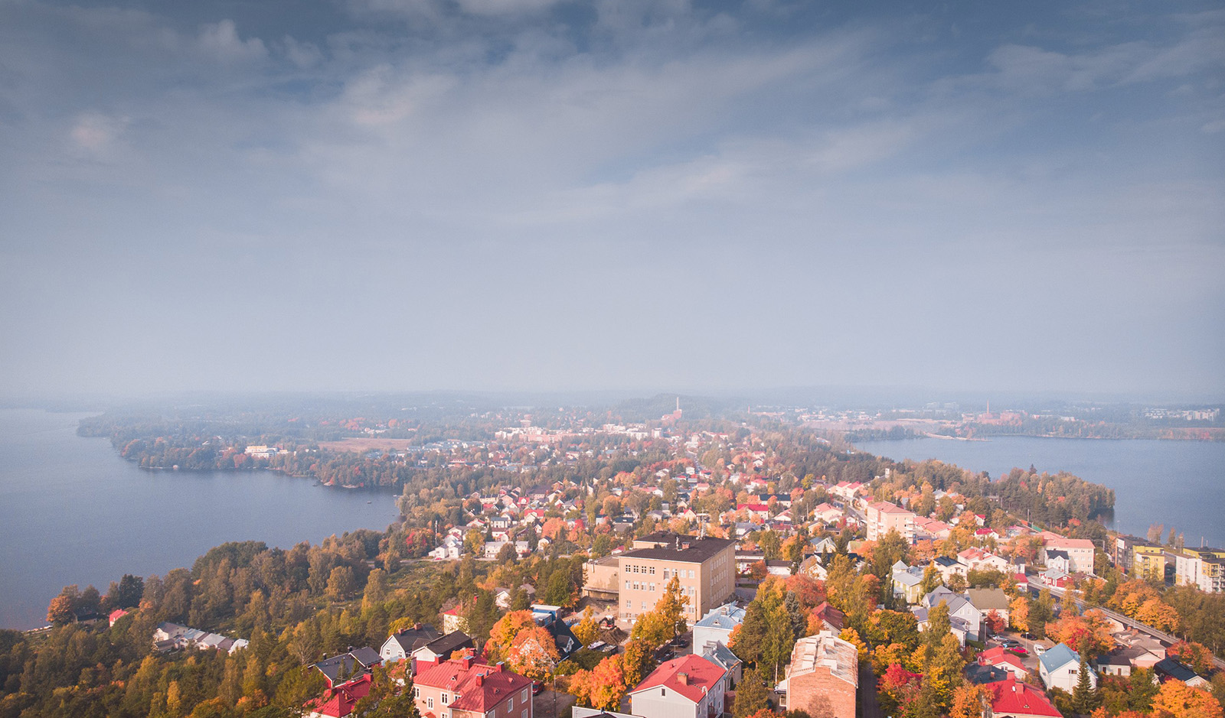
THANK YOU
Photo: Visit Tampere / Laura Vanzo

