Slide 1

BE
MORE
ILVES
EHC Hockey Business Forum 2023 Tampere
Sep 28th, 2023
Mikko Mattila
Ilves-Hockey Oy

Slide 2
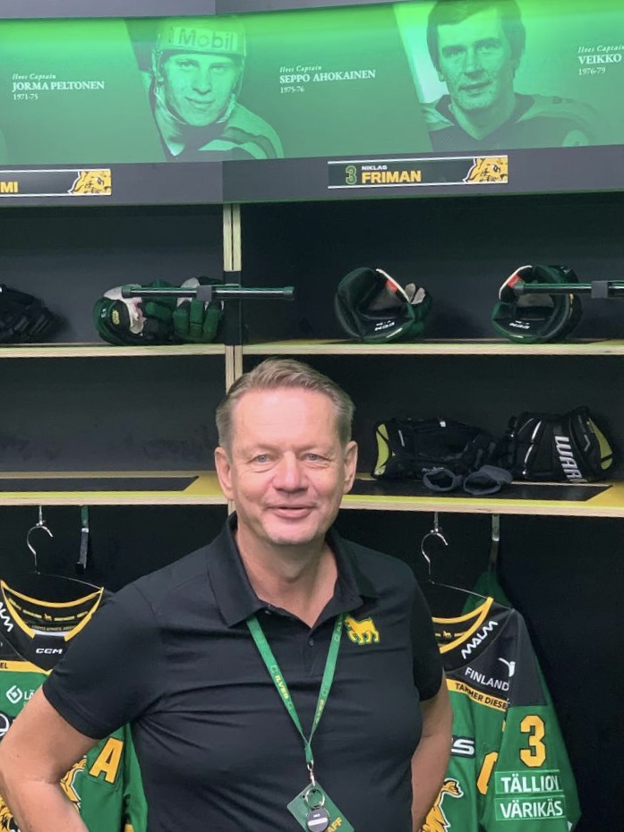
Ilves, Living up its Glorious past
Ilves history
  Glory days
  Last 50 years
Ilves-hockey oy (LTD)
  2000 – 2016
  2017 – 2024
  The Change
Revenue breakdown & supporting tools
Nokia arena
Ilves+
Vision
Mikko Mattila
Director
Ilves Hockey
mikko.mattila@ilves.com

Slide 3
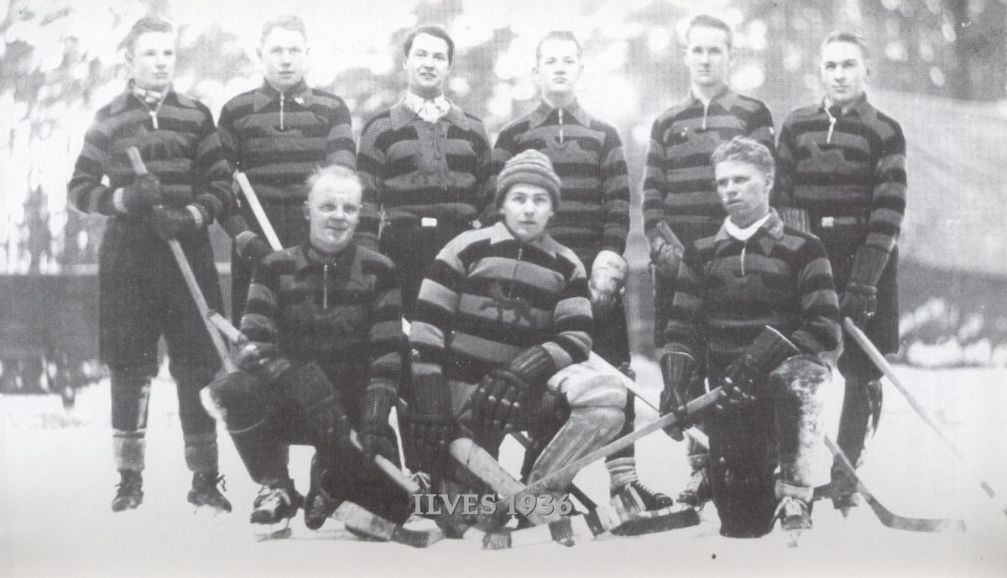
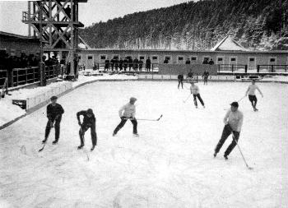
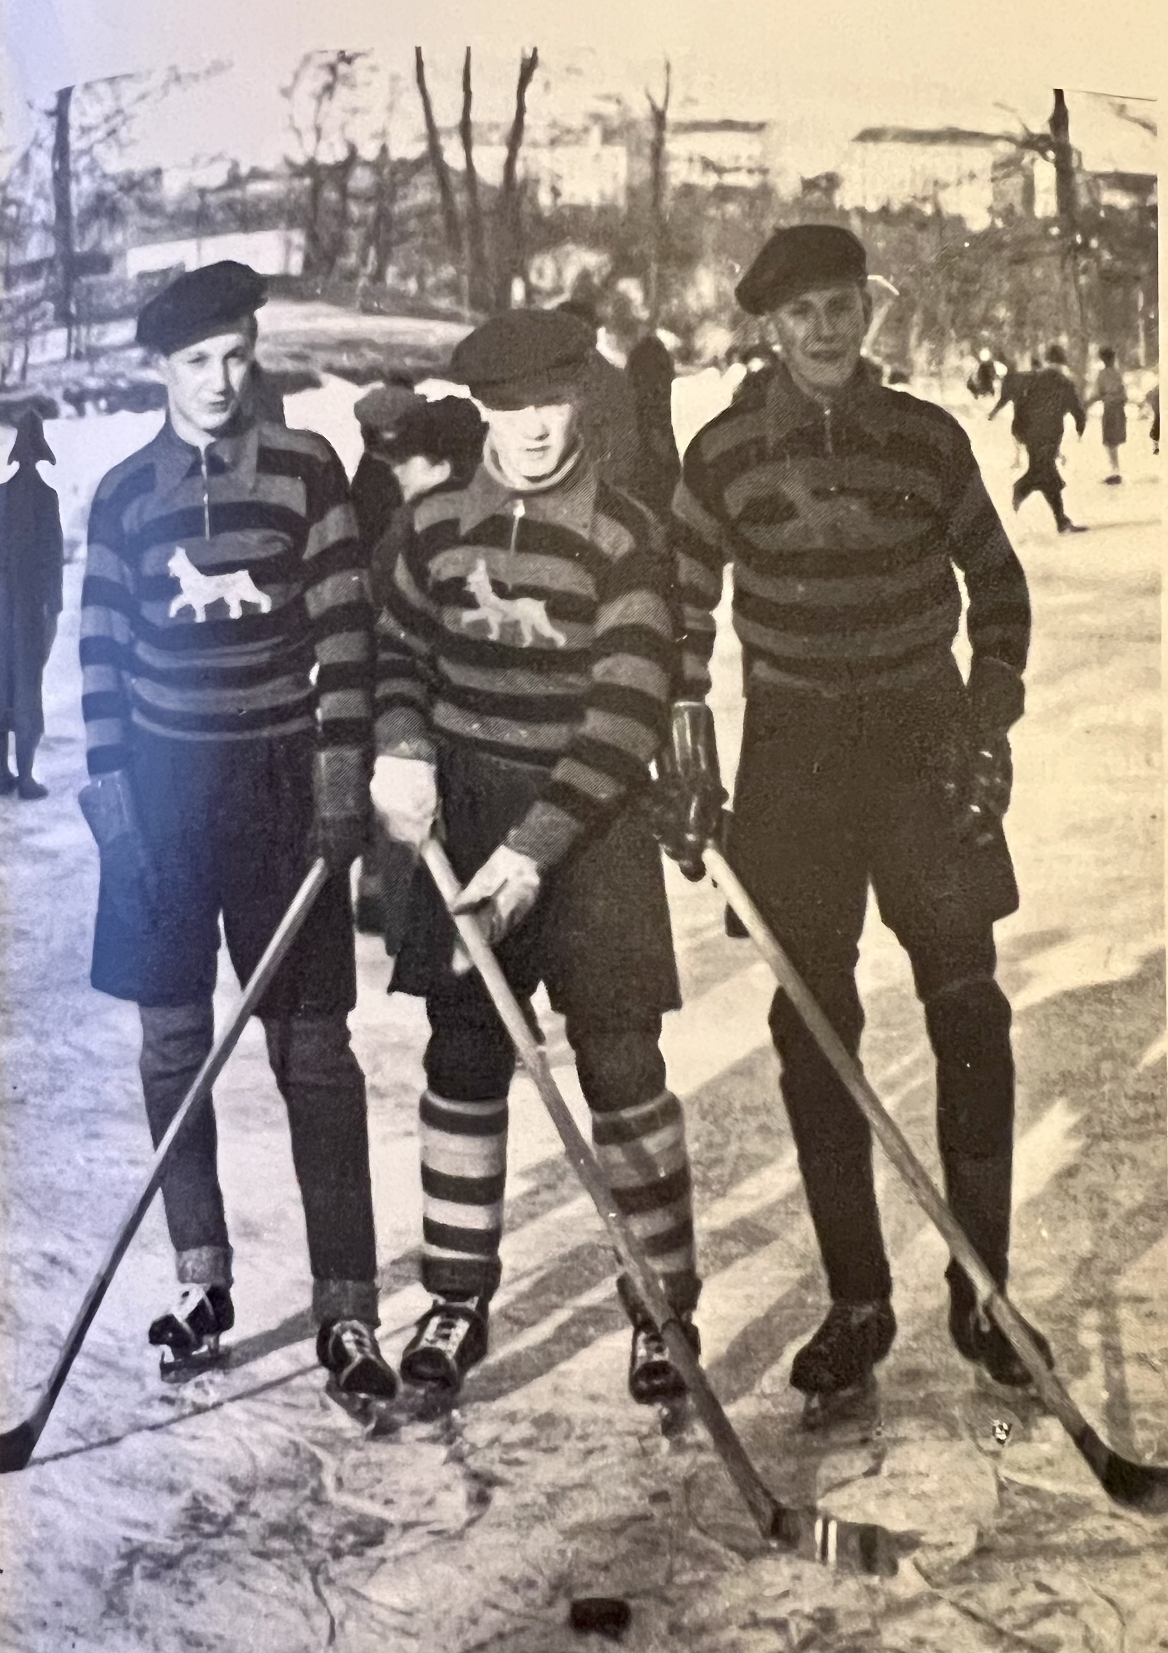
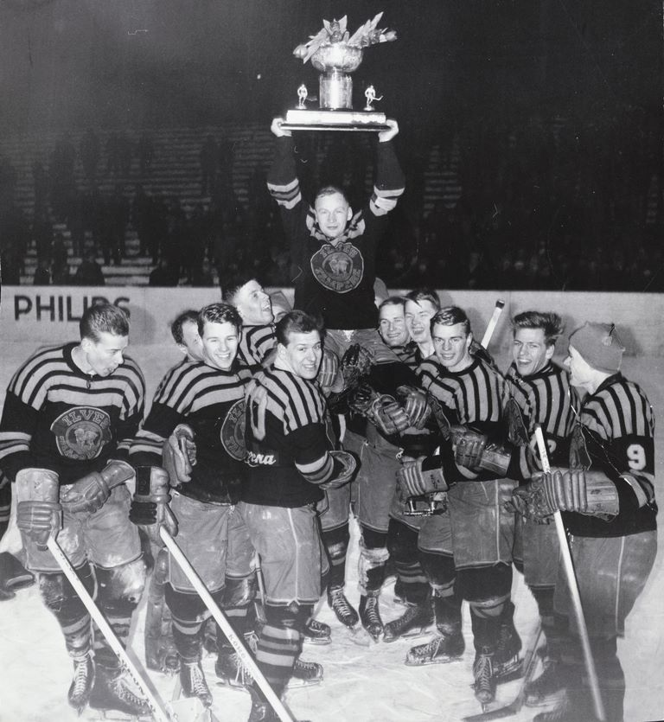
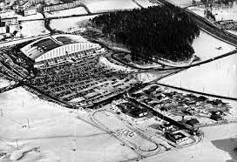
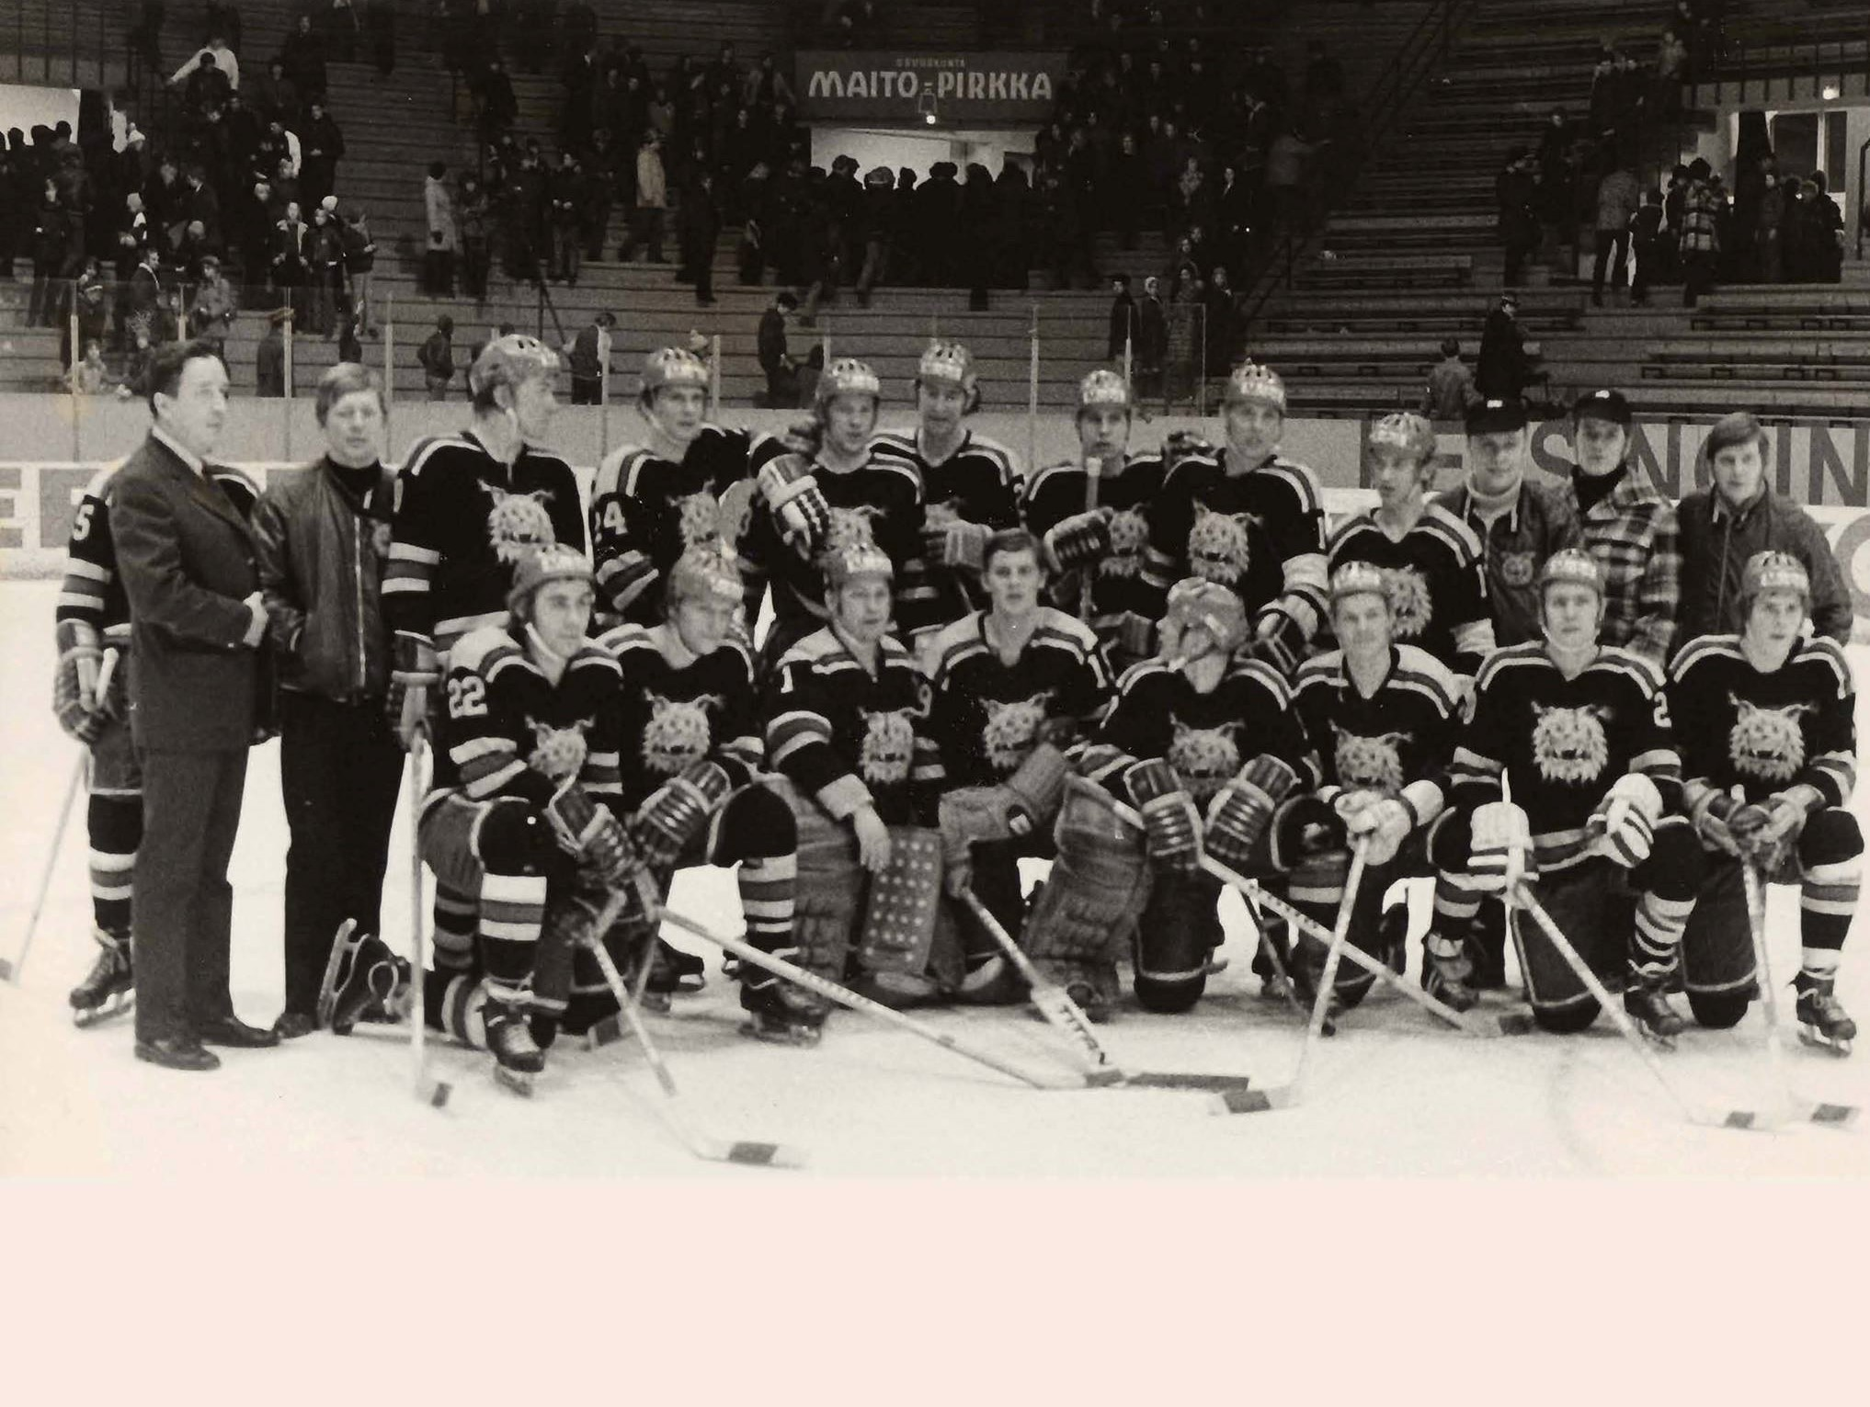
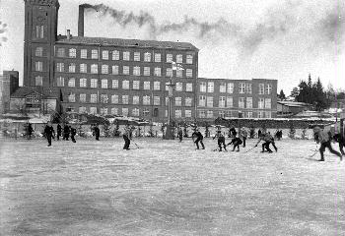
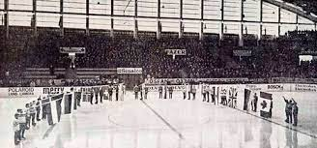
Ilves History
glory days – 40 years, 15 titles
1931
1932
1936
1945
1962
1965
1972
APRIL
10th
JANUARY
24TH
FEBRUARY
23RD
December
14TH
FEBRUARY
26TH
JANUARY
29TH
MARCH
16TH
Foundation of Ilves.
1st Game
Ilves vs. Tampereen Palloilijat 1-2
14 Spectators
1st National Championship
First formal size ice rink opened in Tampere
13th National Championship
Finland’s first indoor ice-hockey arena opened in Tampere.
15th National Championship
just within 40 years since foundation.

Slide 4

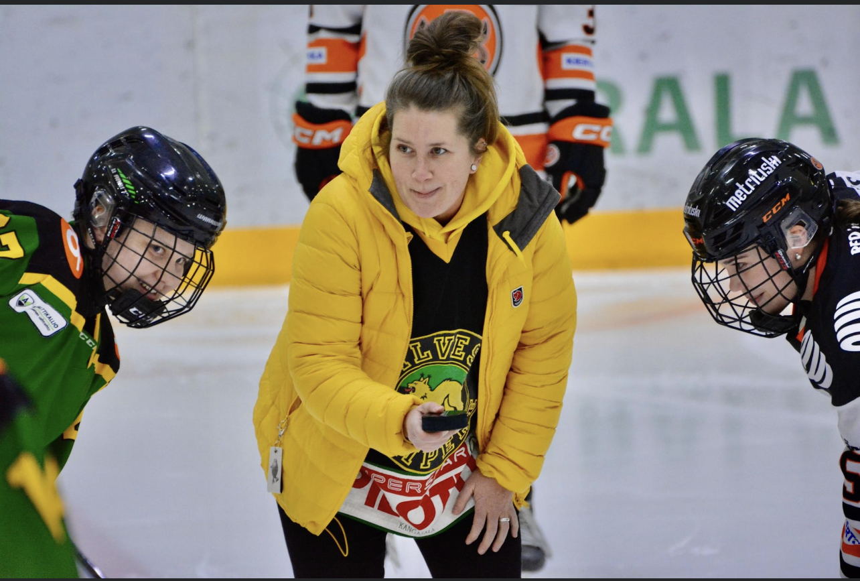
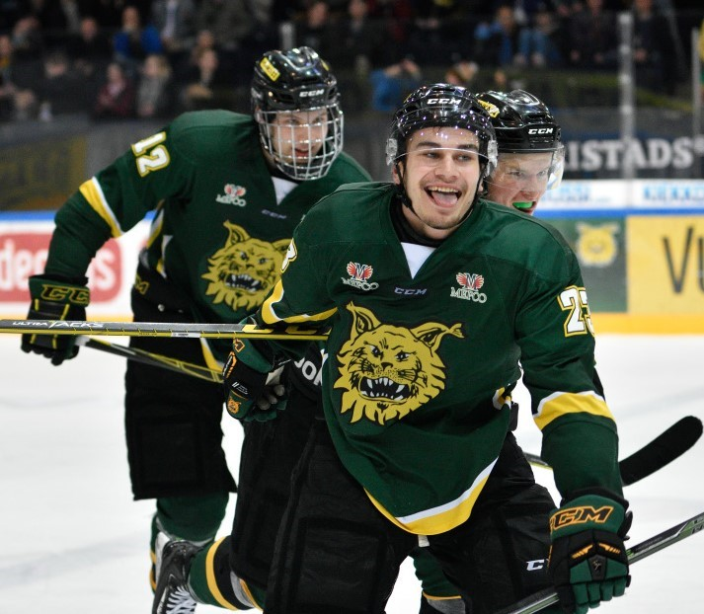
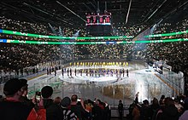
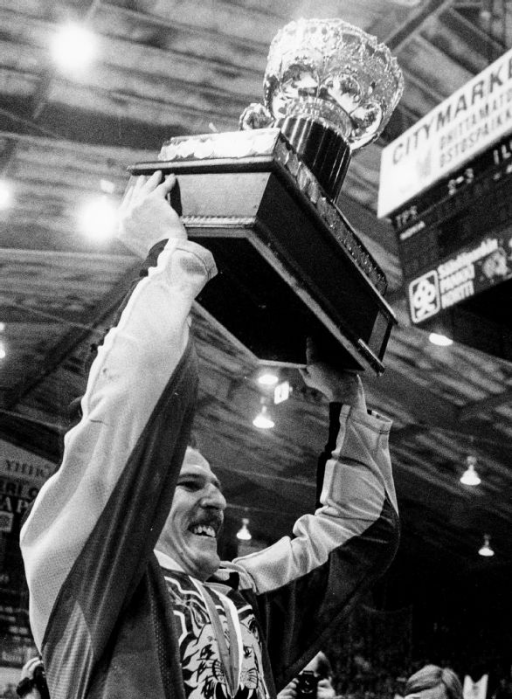

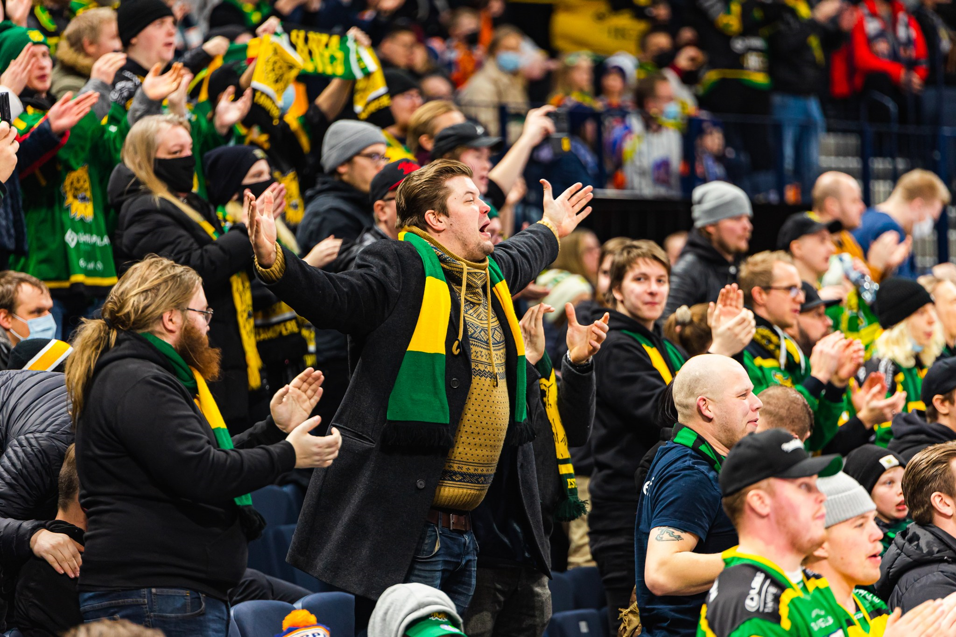


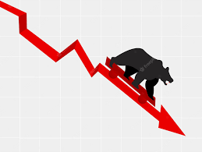
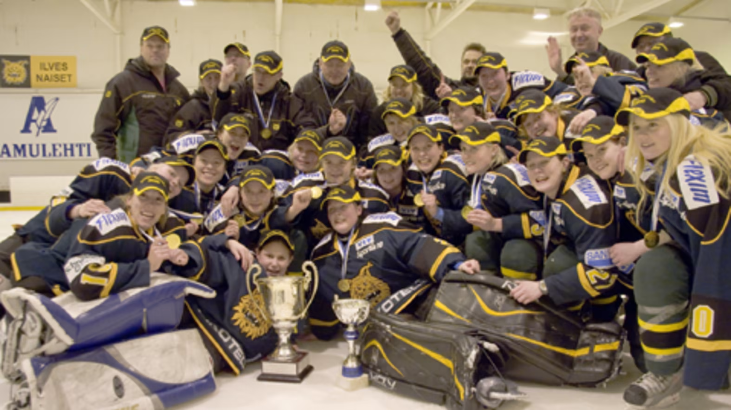
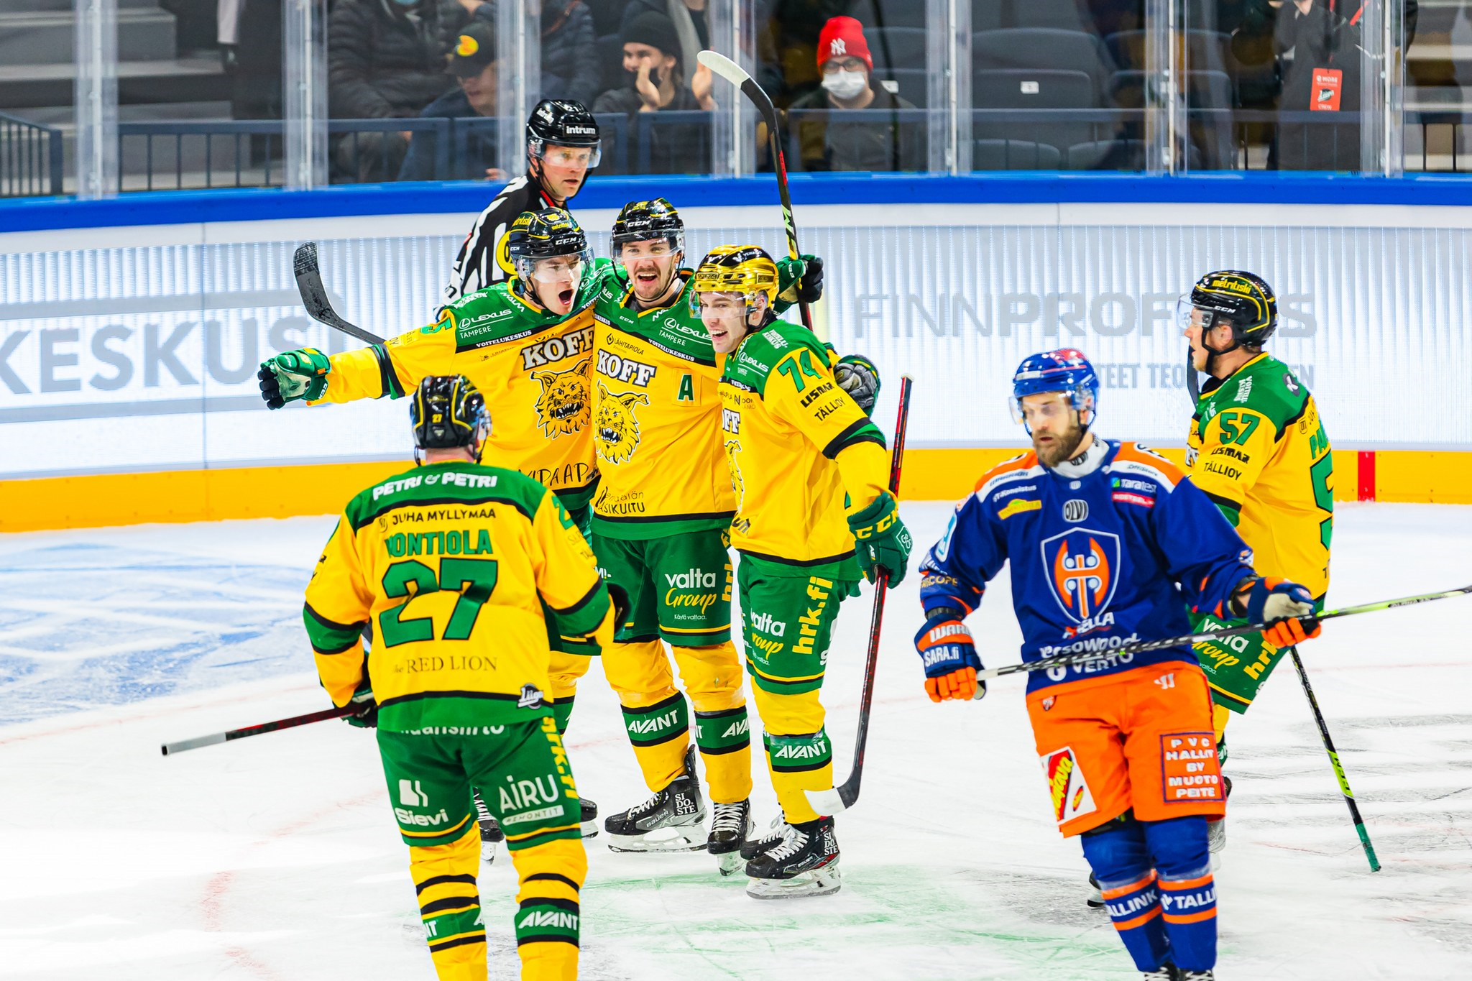
Ilves History
LAST 50 YEARS – 1 title
1975
1985
2000-02
2008-2013
2010-11
2016
2021
MARCH 26TH
Ilves faced qualifications
three times within five seasons.
Escaped relegation every time by winning
series 4-1.
DECEMBER 3RD
Finnish National Liiga established
16th National Championship title.
1st National Championship for women’s team
Ilves-Hockey Oy (Ltd) founded June 2000.
Finnish National Liiga’s operator,
Jääkiekon SM-Liiga Oy (Ltd) established
10th National Championship for women’s team.
1st European Cup title for women’s team in 2011.
22nd National Championship for
U20 team
Relocation into a new multifunctional
Nokia Arena.
Ilves won Tappara in the opening game 6-3. Full house, 13,000.

Slide 5

Ilves Hockey Oy (Ltd) – 2000 - 2016
Performance on the ice
Regular Season points vs. max, (unit %)
Financial
Performance
May 1st to Apr 30th
Unit: 1,000e
Revenue
+
-
Fiscal
Year
result

Slide 6

Ilves Hockey Oy (Ltd) – 2017 - 2024
Performance on
the ice
Regular Season points vs. max, (unit %)
Financial
Performance
May 1st to Apr 30th
Unit: 1,000e
Covid-19
Revenue
+
-
Fiscal
Year
result
Target setting

Slide 7
THE CHANGE
Financial Discipline
        Regular Season financial planning & monitoring
          Regular Season 16/17 revenue income 4,40ke, Operative result -1,570ke
        8th share issuance brought in the new board & management → External image improved
        Cost cutting; Player Budget, Office relocation
        Supplier contracts reviewed, terminated & opened for bidding to improve the contracts
        17/18 Ilves didn’t qualify into Playoffs, but Financials were back in black!
          Regular Season 17/18 revenue income 5,40ke (+23%) and
          operative result positive +159ke

Slide 8

THE CHANGE
Strategy
PLANNING & EXECUTION
          Brand refreshment. Ilves Hockey Brand Book version 06/20
          published after 9 months development work.
          Ilves-Hockey Strategy review, latest version 09/21 published. Focus in execution.
          Digitalisation & Cloud Services to increase productivity.

Slide 9
THE CHANGE
Sports Development
Creating the sports strategy; from coach centrix to club centrix
Focus into Players development projection / Scouting
  Investments into junior path from kids’ hockey schools to U18 –level.
      Strategic Collaboration; U20 – KooVee – Ilves
16-17 | 17-18 | 18-19 | 19-20 | 20-21 | 21-22 | 22-23 | 23-24 | Ilves Players | Total (vat-0)
0 | 291,986€ | 477,736€ | 475,298€ | 366,332€ | 827,052€ | 227,561€ | 950,000€ | NHL Compensations | 3,615,965€
1 | 3 | 4 | 4 | 2 | 5 | 7 |  | in Men’s National teams | 26
6 | 5 | 3 | 6 | 3 | 5 | 6 |  | in U20 National teams | 34
Covid-19

Slide 10
Revenue Breakdown
Ilves-Hockey Oy
1.5.22- 30.4.23
14,7me
+32%
3rd Party
2,0me
YoY -13%
Liiga Oy contributions
Event Sales
6,0me
YoY +55%
Single tickets 3,35me +27%
Season Sales
6,6me
YoY +35%
B2B order intake 4,10me +43%
RS & PO Season tickets 1,85me +43%
Merchandise sales 1,57me +71%
CHL price money
NHL –compensations
VIP –tickets; Skyboxes, Stefans restaurant
Food & Beverage commission
                Regular Season outcome known Oct/Nov.
                Forecast based on Year-on-Year monthly benchmark
                Revenue forecast very accurate by August.
                Separate internal tool to forecast game day additional revenues.

Slide 11
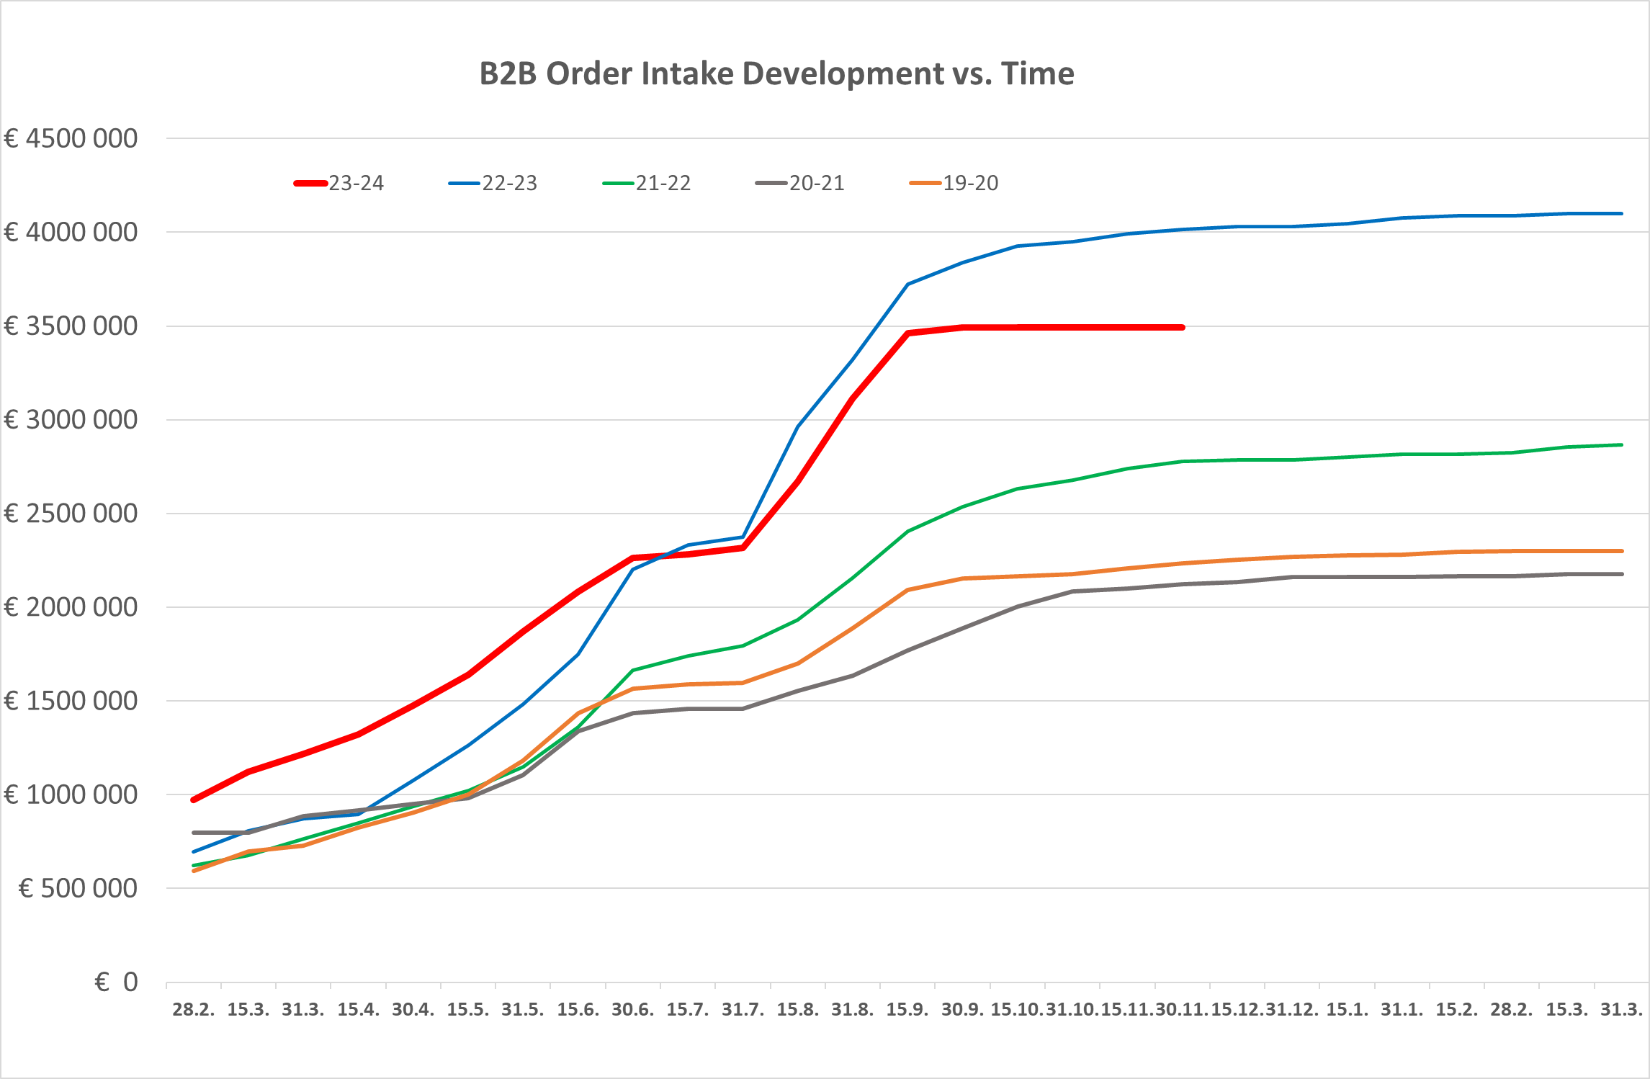
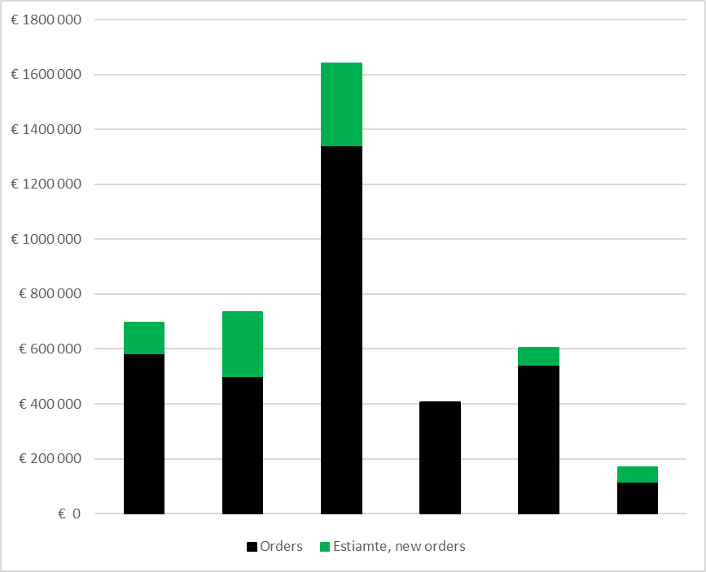
Supporting tools
Monitoring
Sales Persons’ actual orders + estimate for new
B2B Order intake vs.
Previous seasons
F&C Forecasting
Revenue and Cost forecasting covering Regular Season
95%+ accuracy in November vs. final 19-20 result

Slide 12
Nokia Arena impacting revenue streams
Face-off time
Spectators in Nokia Arena (8,217)
grew +46% compared to old Hakametsä (5,637). (22-23 vs. 19-20)
Playoffs audience record high 10,687 (22-23) , 10,625 (21-22). Still room to grow as capacity utilisation is 85%
Food & Beverage sales more than doubled due high variety of services
Spectators arrive earlier into
Nokia Arena
vs. Hakametsä
19 min
Diagram
This data is collected from ticket scanners covering 13
first home games on seasons 22-23 (Nokia Arena) and
21-22 (Hakametsä).
2,000
spectators in

Slide 13
Ilves+
New web-based Media Platform for Game Day content distribution
at ilves.com/plus
PreGame studio broadcast, 60 minutes.
Live audio commentator in all Liiga and
CHL –games away games included.
  Home game audio includes a separate ring side
  commentator and program for period intervals.
Own video production clips.
C MORE clips, goals, game review, post game
media interviews (Liiga’s Mediapartner).
Weekly Podcast (60min).

Slide 14
Our Vision:
TO BE ONE OF THE
MOST SUCCESSFUL CLUBS
IN THE EUROPEAN
ICE-HOCKEY

Slide 15
Vision
Perspective
Sports Operations
Sales & Account Management
Fan Experience
Brand
Development
Administration
& Finance
The adjacent vision perspective defines five critical elements what we continuously develop and measure.
The core of our growth strategy is to see those five vision elements as a one whole entity. All five elements need to develop simultaneously - hand in hand - in order to reach sustainable success in the execution.
VISION
TO BE ONE OF THE
MOST SUCCESSFUL CLUBS
IN THE EUROPEAN
ICE-HOCKEY

Slide 16

THANK YOU

