Slide 1
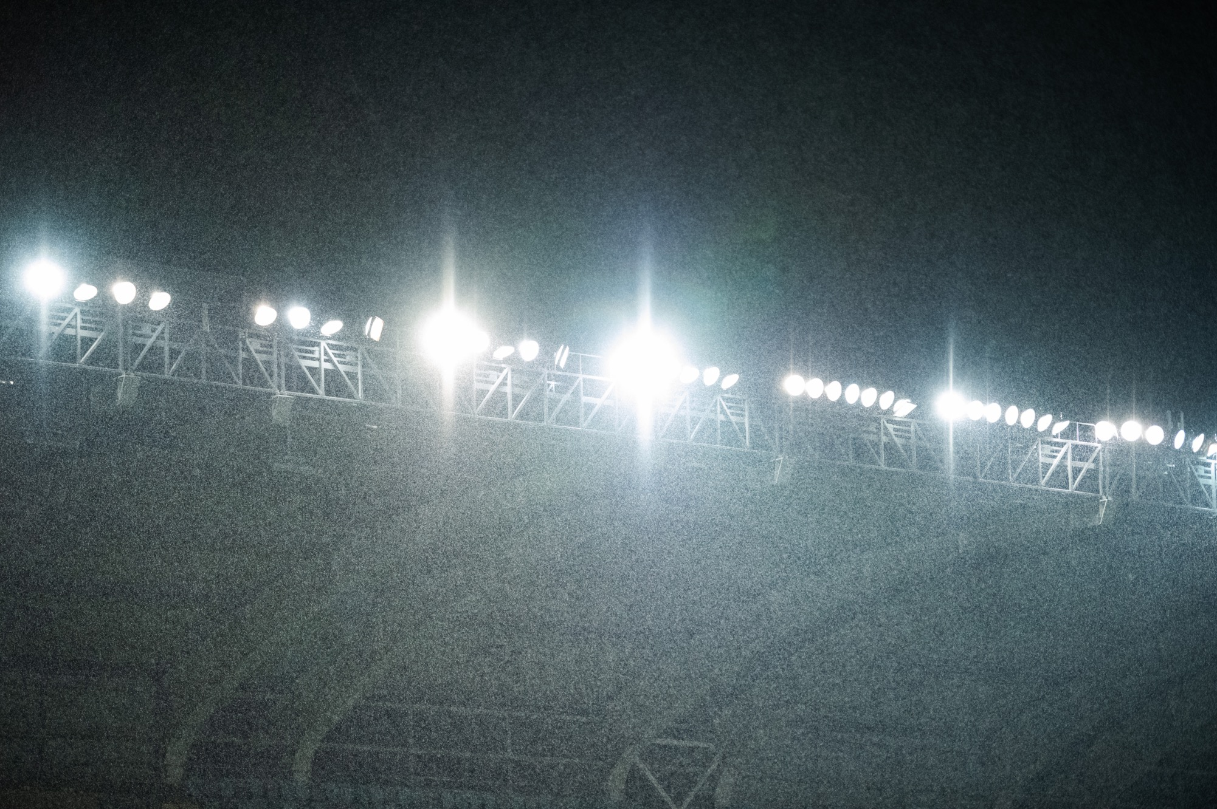

ISP Boost
“If you can’t do the
little things right…..”

Slide 2
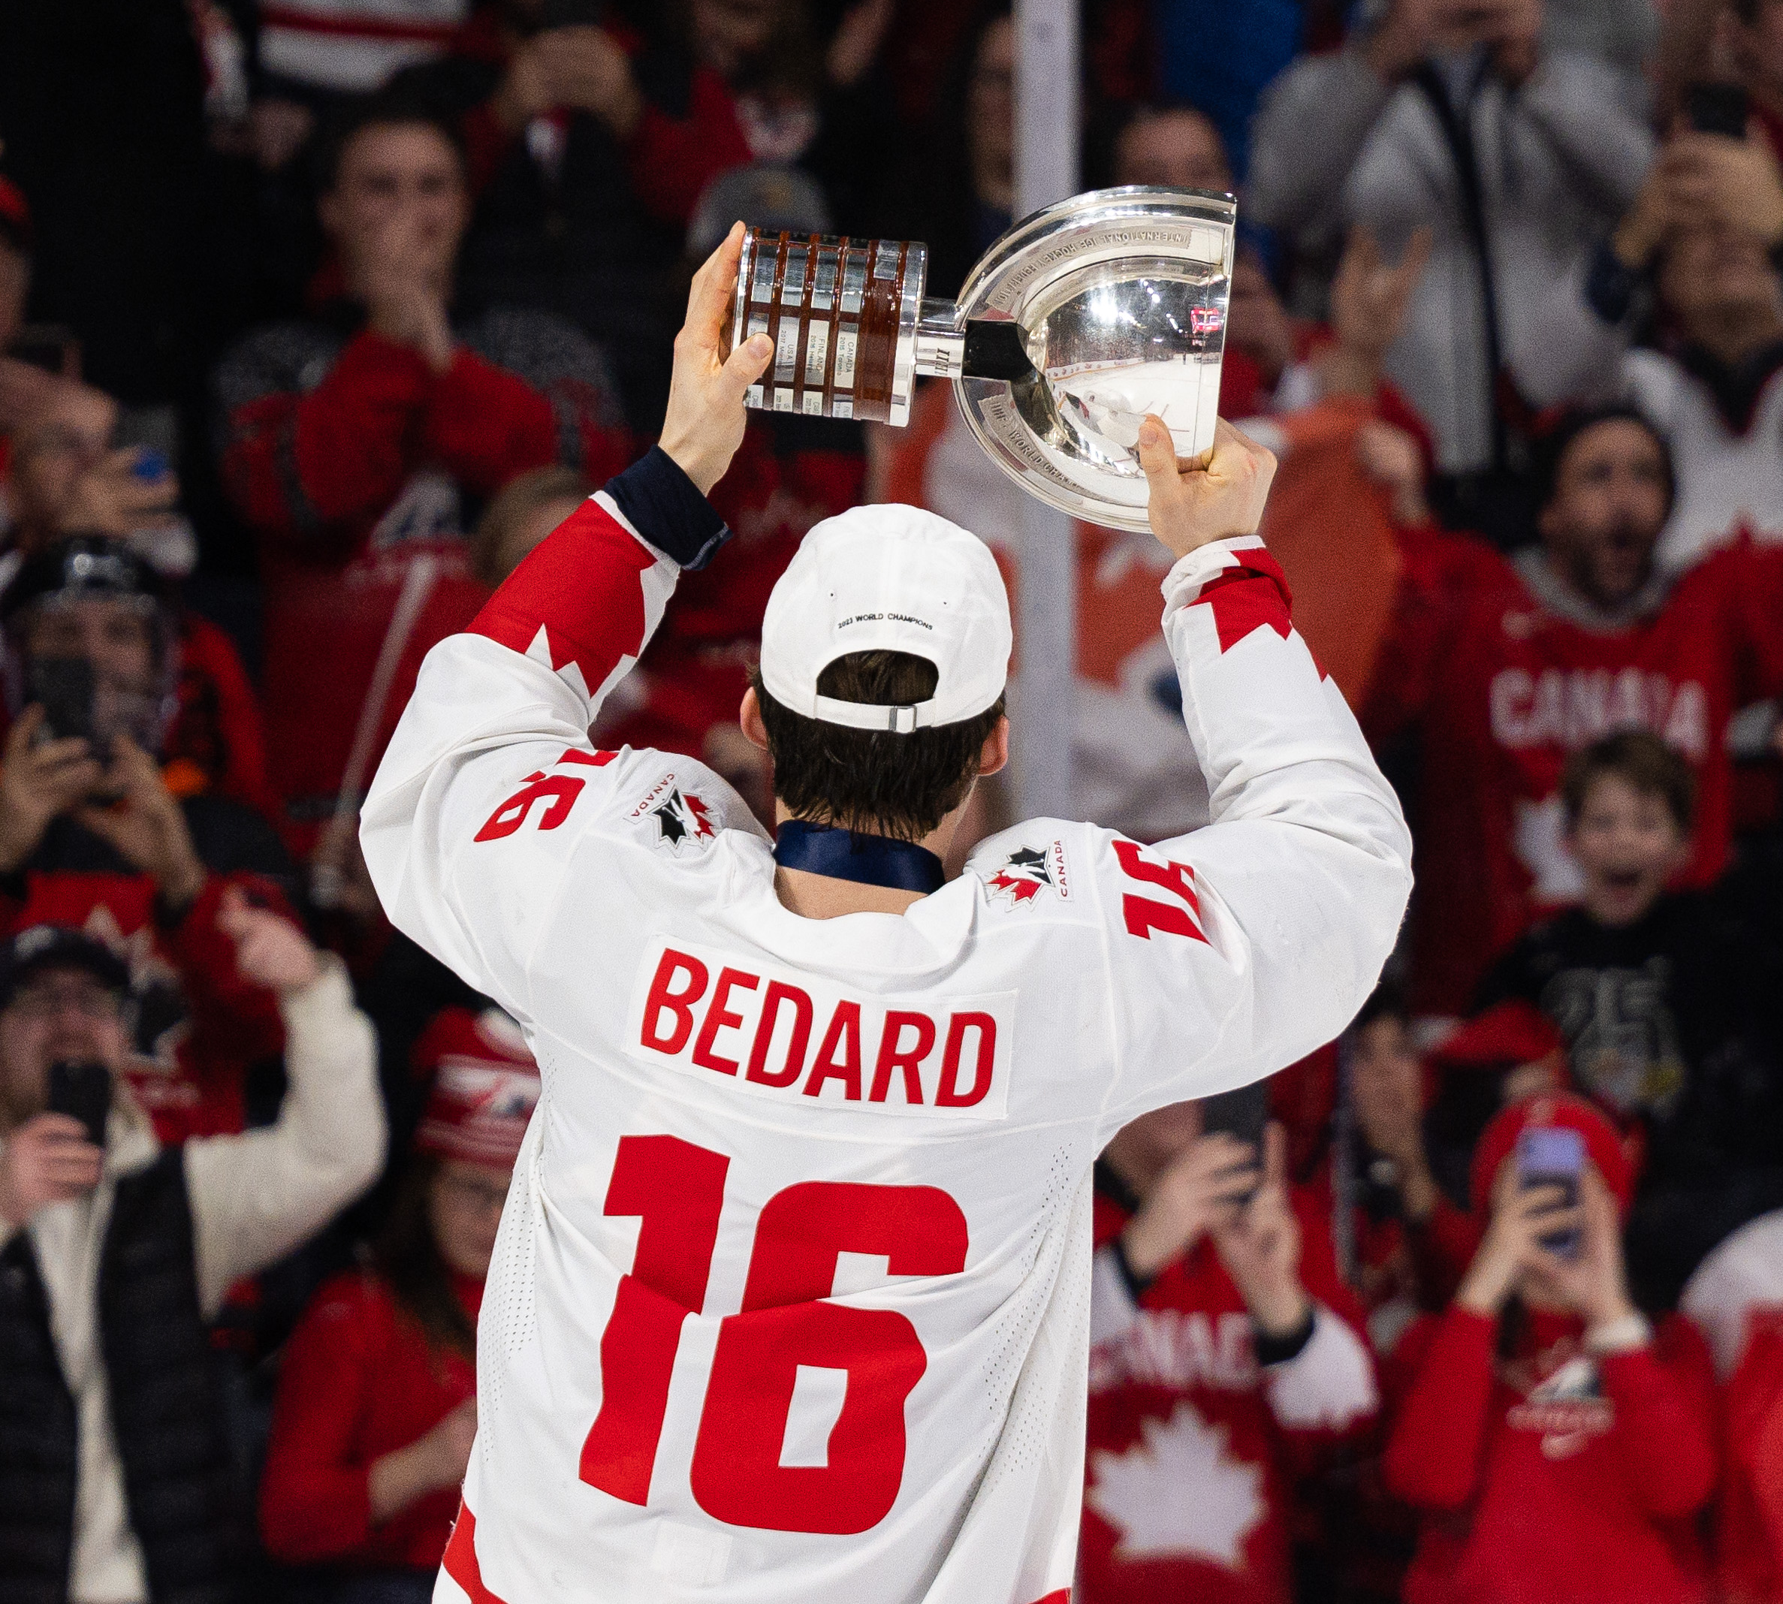
What's your potential?
Have ISP Boost analyze your B2B set-up and get an Optimized Potential Report!
As member/guest at the E.H.C Hockey Business Forum Tammerfors 2023 you have a € 1000 discount for your Optimized Potential Report. Send ”I’m interested in knowing our potential” no later then October 20th.
Normal price is € 3500, your price € 2500.
Use code ”ISP Boost & E.H.C” when emailing robert@isp-sport.se.
(Your investment of 2500 Euro will be deducted if you decide to sign up for ISP Boost Program)

Slide 3
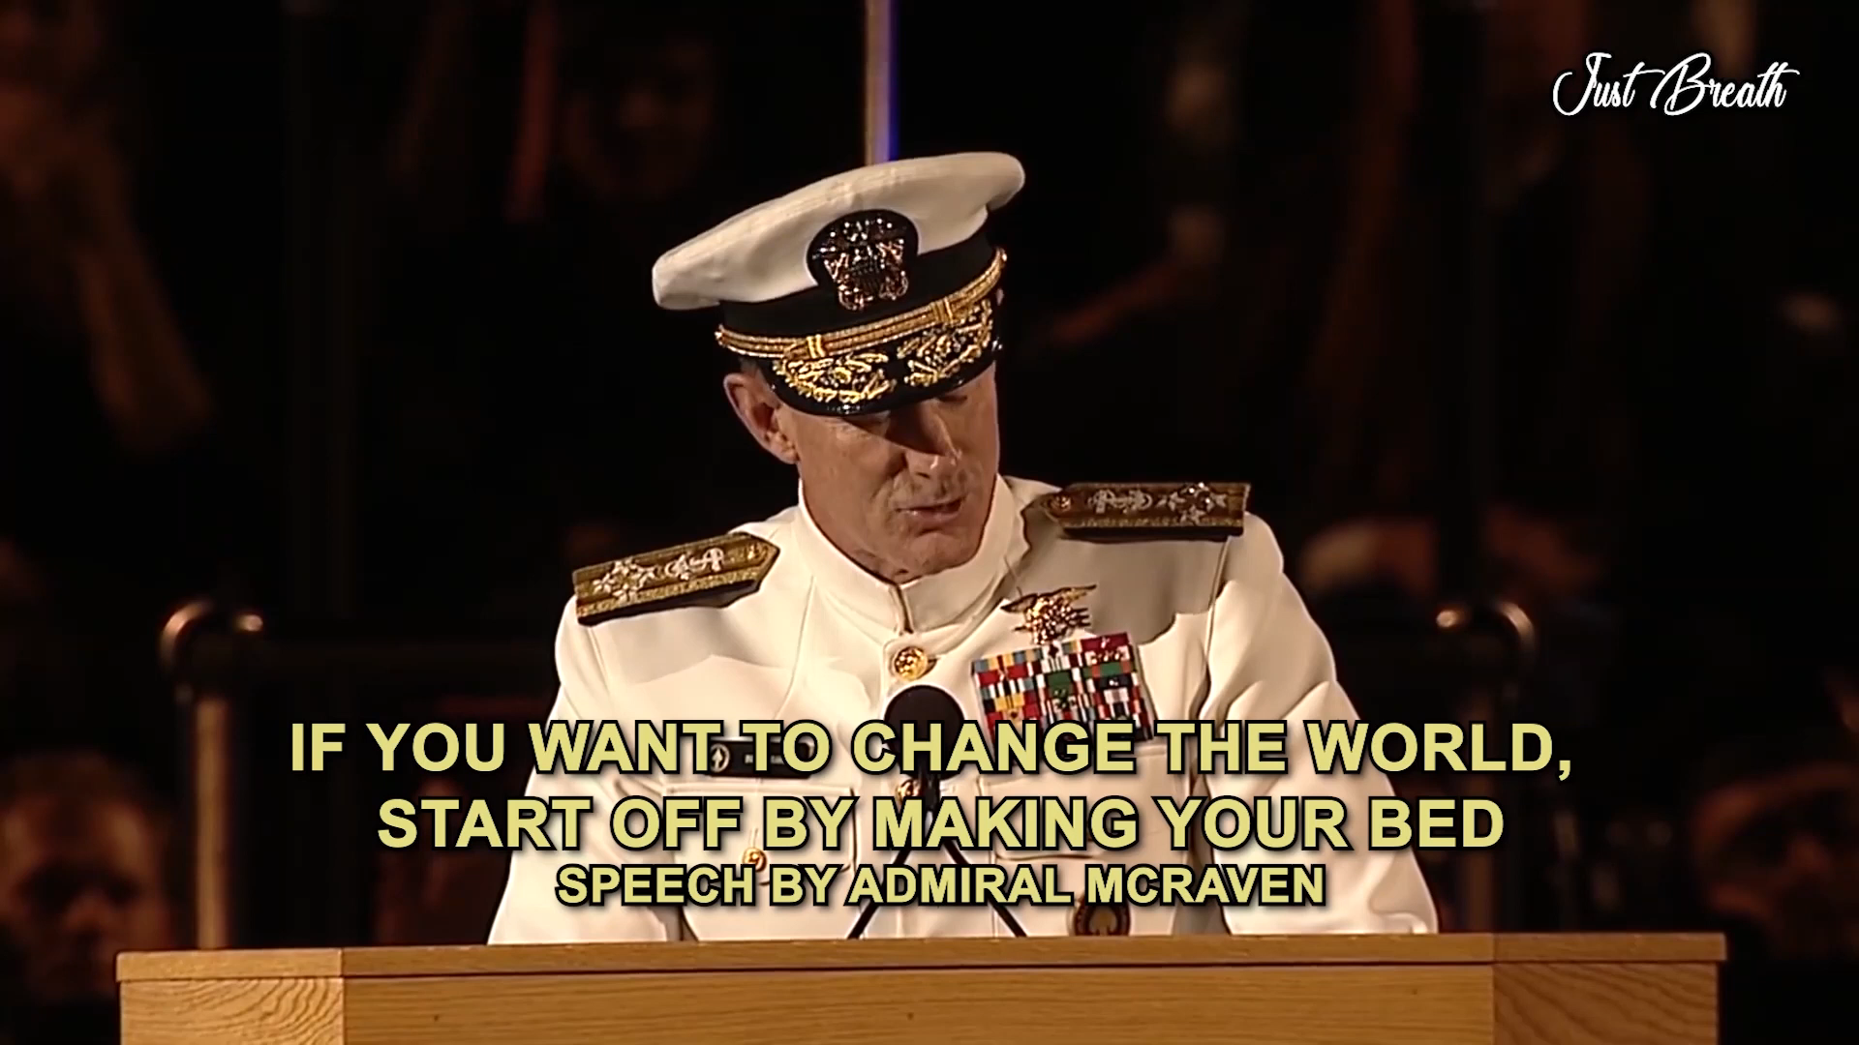

Slide 4

The B2B Challenge
Grow sponsor revenue faster & better than ever before
-> Leave comfort zone doing 40-60% of potential - aim for 80-100%
Significant increase of competence & confidence in Sales Management and Sales
Know the price – Get the price – Dare to say No
“Do the little things right!”

Slide 5
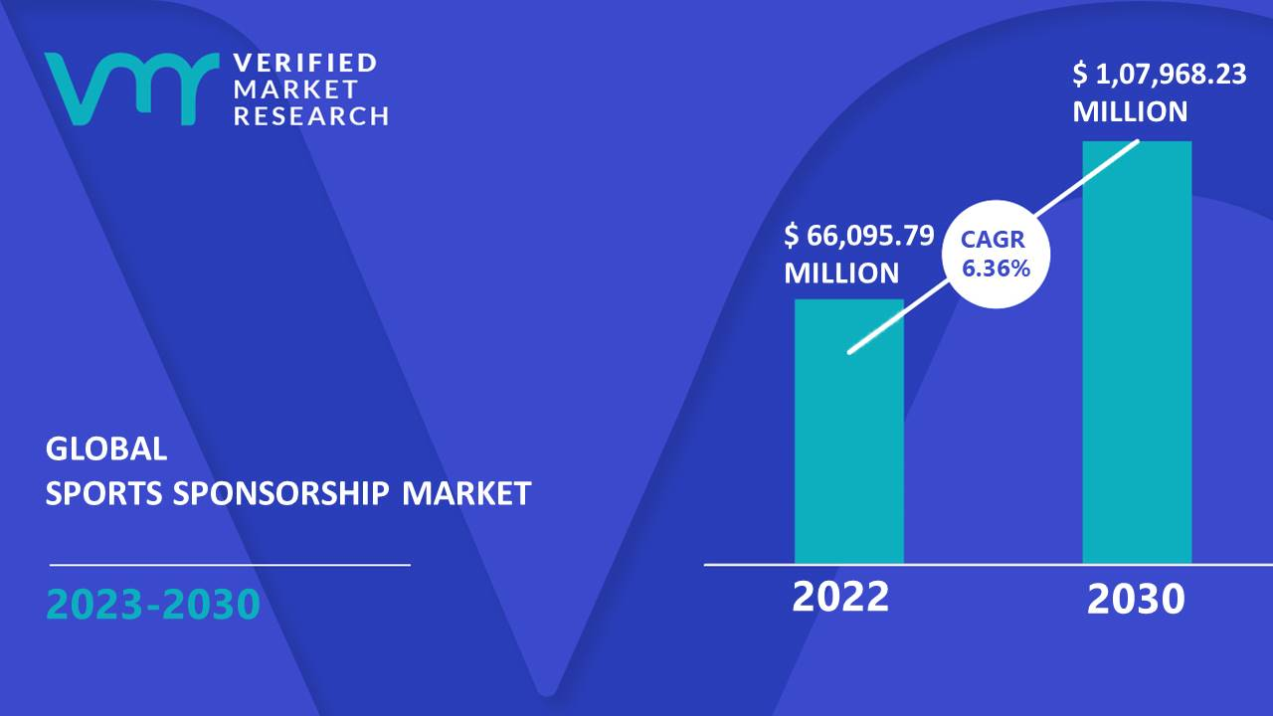
Expected growth
Sports Sponsorship globally
CAGR 2015-2020 3,64%

Slide 6
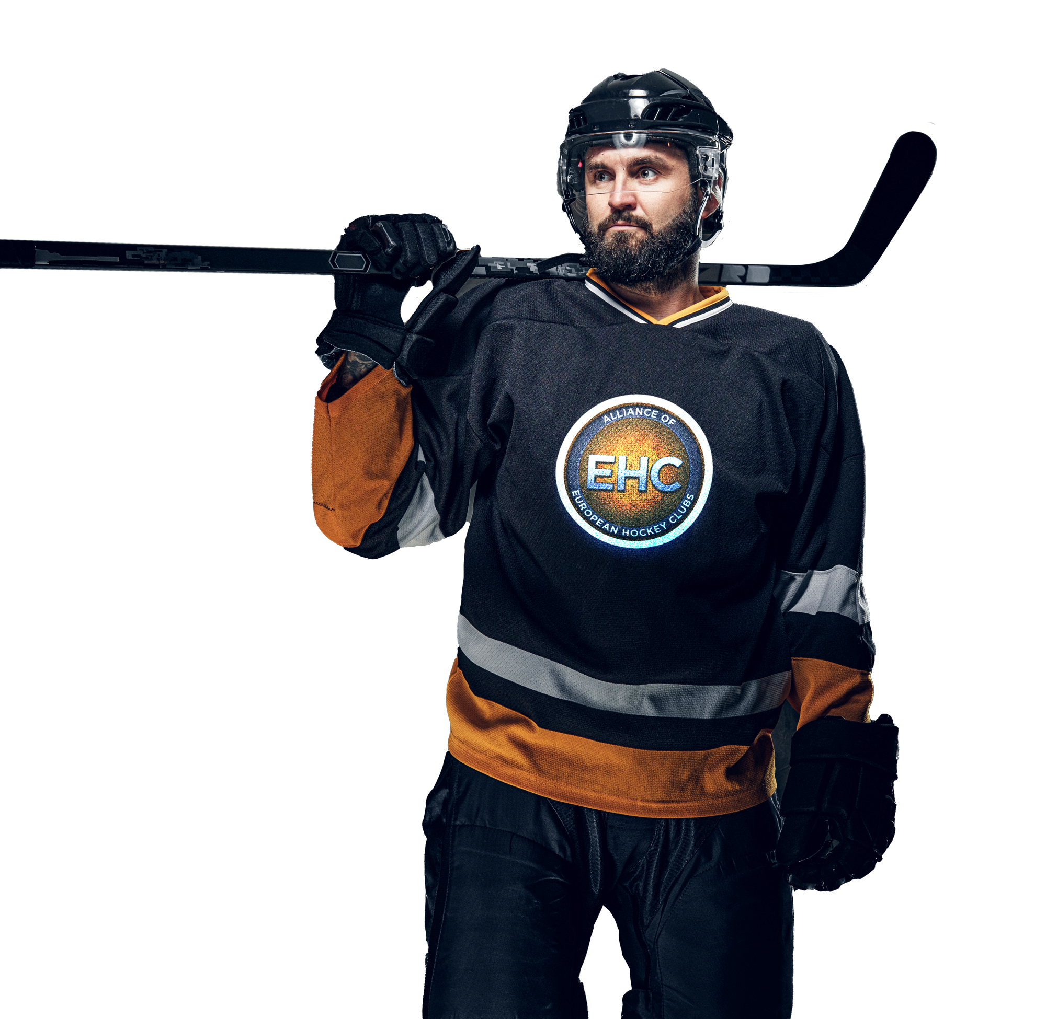
”The little things….”
Pyramids
Content
Sales Management
Pricelist
“The law of Attraction & Resistance”
​

Slide 7

Main Sponsor
Pyramid of Products
– Traditional
Offical Sponsor
Network
Traditional sponsorships –
Base today & base tomorrow
Content & Price
No rocket science
- No revolutionary changes
– Small daily steps of improvement
Keep it clear & simple
Premium Sponsor
Activities
Pyramid of Sponsors
Exposure
What do you sell & What do they buy?
”The law of Attraction & Resistance”
- What do you add? What can’t be bought
Know the Why for every level!
See them! Know them!

Slide 8
Pyramid of Sales Management
Strategic
Who do we sell to?
What do we sell?
How do we sell?
When do we sell?
80/20 -> 20/80?
The 10/10/5 principle!
Relation
Mechanical
1,0 MEUR ->
Pyramid of Investment
Investment per level?
”Attraction & Resistance?
When change & renew?
Compare with best in market?
0,3 – 1,0 MEUR
0,1 – 0,3 MEUR

Slide 9
Pyramids synchronized?

Slide 10

Pricelist vs outtake!
Price per product?
Correct price?
Pricelist in CRM?
Outtake vs listed?
Rebates by habit
vs
Rebates by strategy?

Slide 11
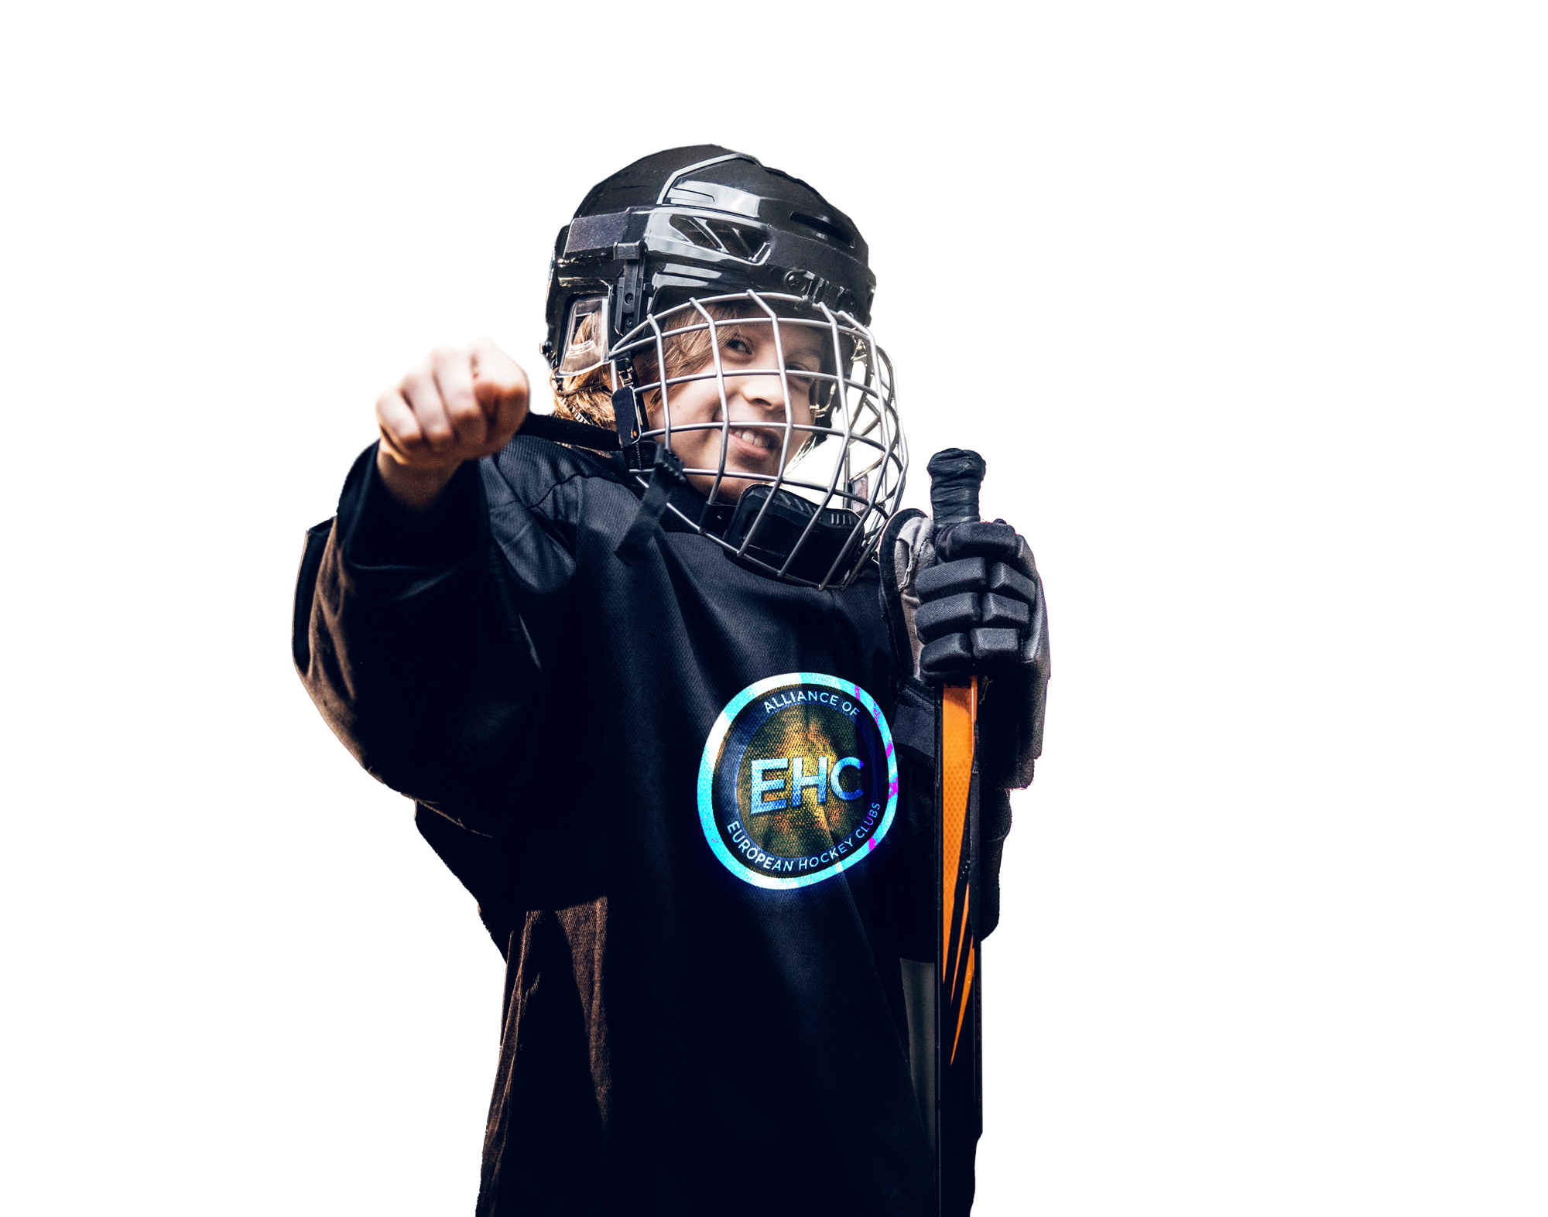




Sustainability
The UN goals! You target……?
Packaged?
Price?
Standalone?

Slide 12
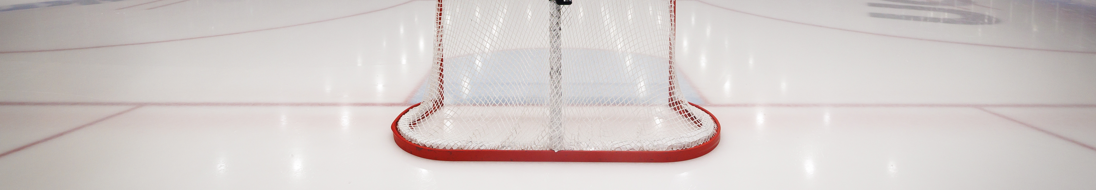
0,1 – 0,4 MEUR/year
Leave the comfort zone!
Aim for next level!
Average increase B2B revenue, on top of regular growth in next 2 years per year
+1 MEUR
Generated increase, on top of regular growth in 3-5 years
+10% Gross Margin
Focus on price, rebates & costs. Increase Gross Margin over 2-4 years
2024
2027

Slide 13
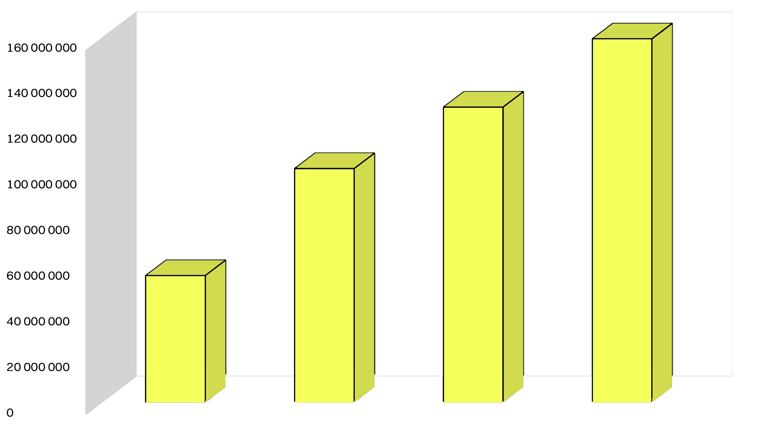




ISP Clubs 2020 - 2023
right
CAGR 2021 –2023 = 20%
things
little
the
2020
2021
2022
2023

Slide 14

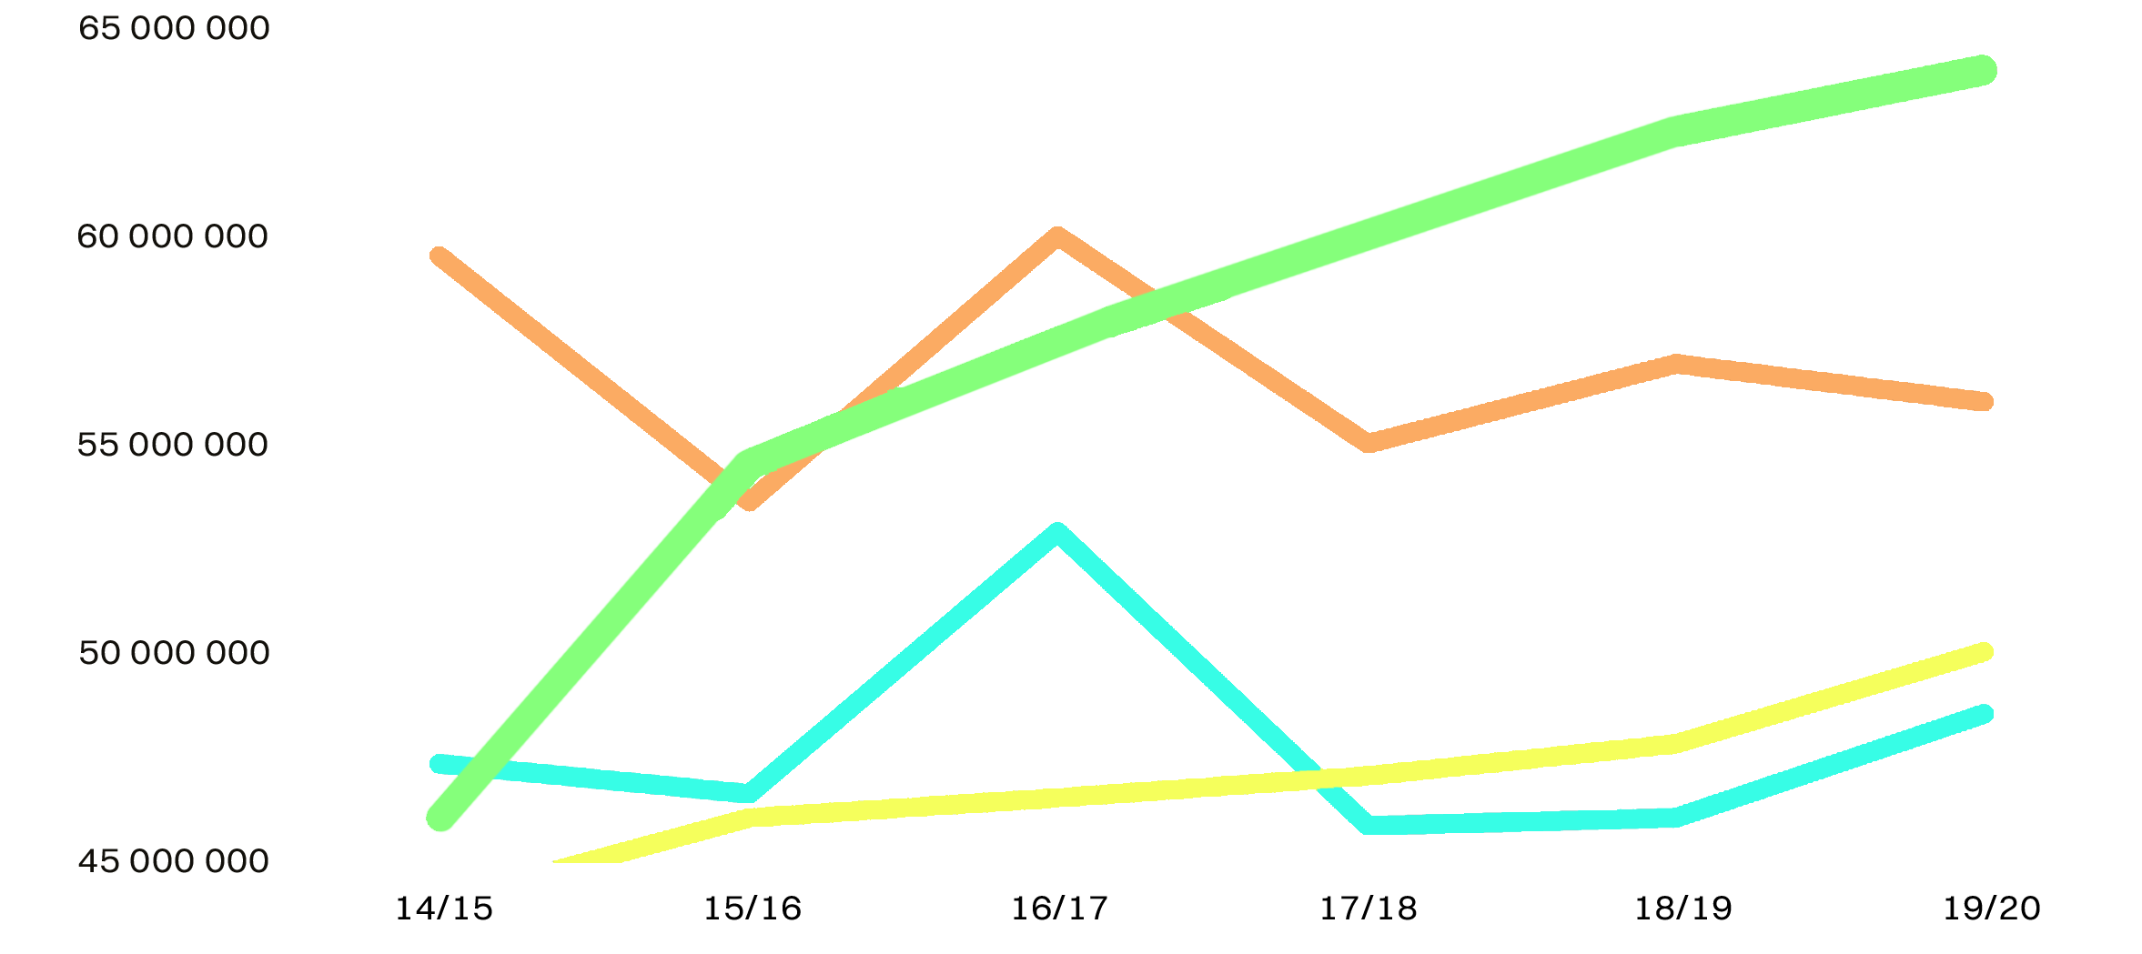
Frölunda HC vs
top competitors 2015 – 2020

Slide 15


















Rights

Slide 16
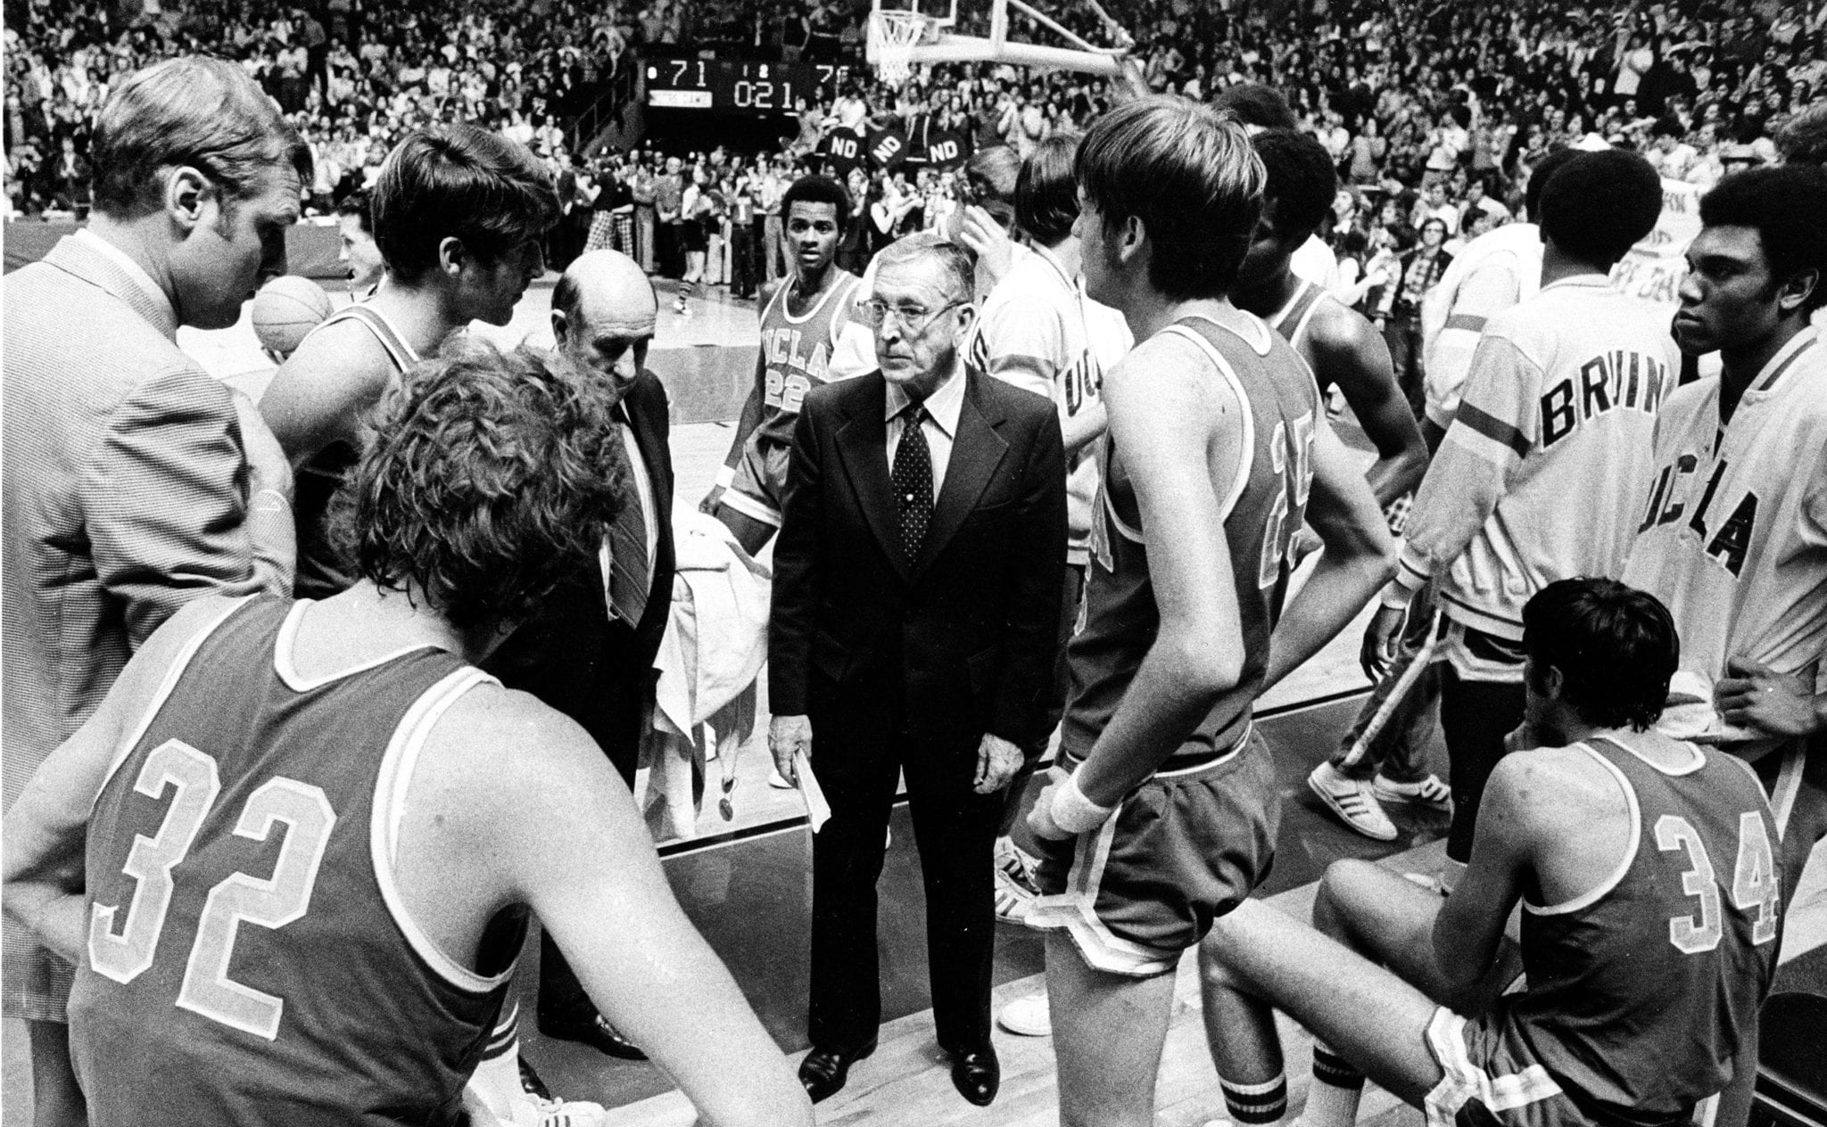
”
It’s the little details that are vital. Little things make big things happen.
John Wooden

Slide 17
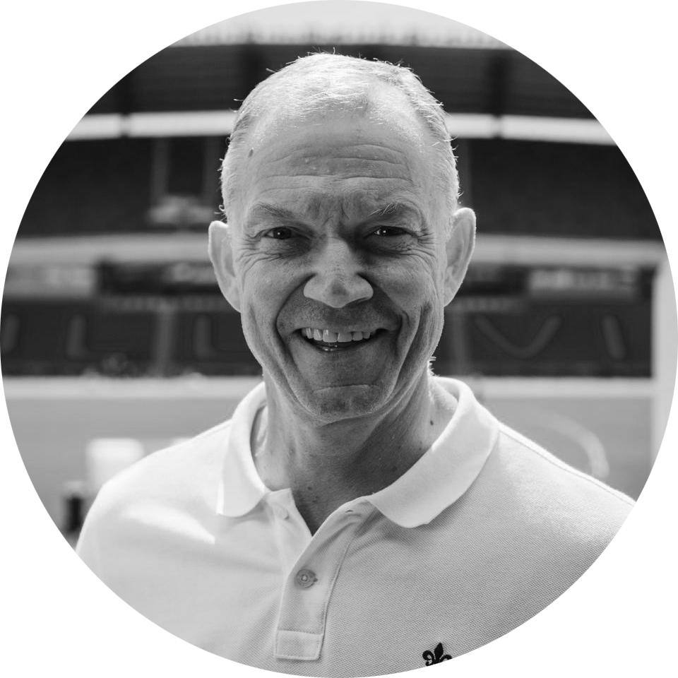
BOOST
Your ”coach” at ISP Boost
27 years of experience corporate top sales management
10 years of experience sports top sales management
Track record ->
Beat competition in growth/effiency/profitabilíty
Sports part of life ->
Player, coach for youths, juniors & elite ice hockey, soccer and floorball, board member
Coach ISP Boost
Robert Jonsson
robert@isp-sport.se

