Slide 1
Aki Hautamäki

Slide 2
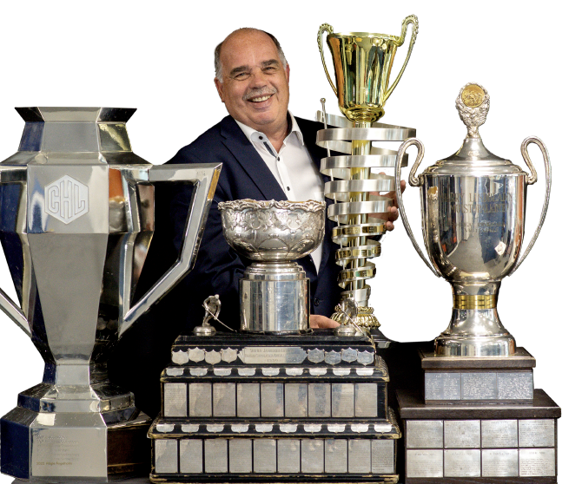
Most Successful YEAR
Liiga Champion 2022 and 2023
Regular season winner 2022 and 2023
U20 Champion 2023
U16 Champion 2023
Best Finnish team award 2023
CHL Champion 2023 (Silver 2022)
EHC Awards: Club of the year 2023
Among TOP 4 in Liiga regular series since 2011-2012

Slide 3
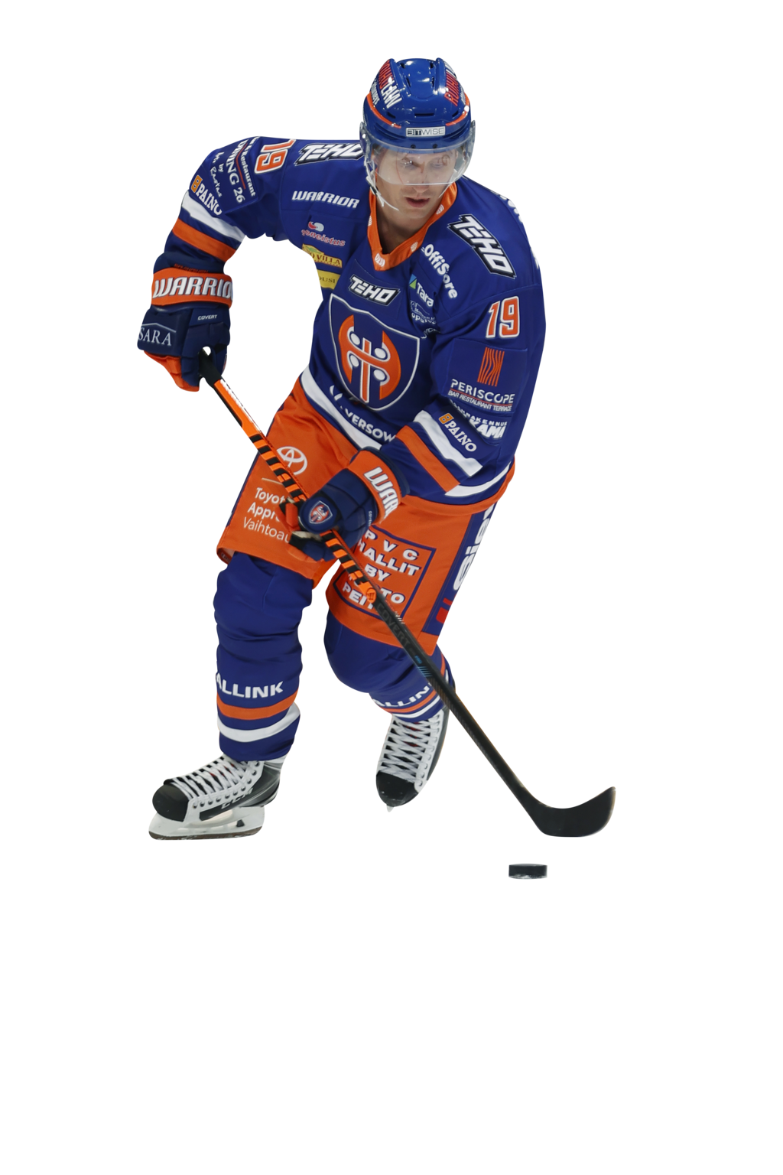
Tappara 2022 - 2023
Founded: 1932 TBK, 1955 Tappara
Turnover: EUR 17,3 million
Profit: EUR 0,3 million
Equity: EUR 5,3 million
Employees: 65
Restaurant operations, security and financial services are outsourced
Business network (partner contracts): + 200
Spectators in home games: 350 000

Slide 4
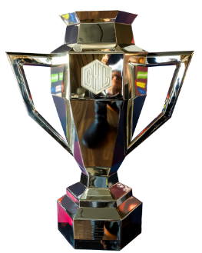
Turnover
12
(3) no playoffs
4

Slide 5
Revenue breakdown
45 %
19 %
15 %
15 %
10 %
9,7 me
17,3 me
Restaurants are run by 3rd party – we receive a provision

Slide 6
BUSINESS CASE – LED BOARDS (RINK)
Total sales with traditional boards: EUR 0,3 million
Old rink (Hakametsä)
52 pc´s x 3 meters
Total sales with LED boards: EUR 0,9 million
4 rotations x 52 pc´s x 3 meters
260 ad´s to sell
Also take over and all actions (Goal, penalty, starting six etc.)

Slide 7
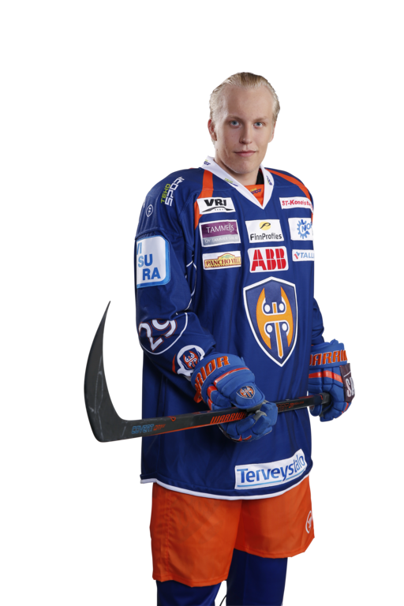
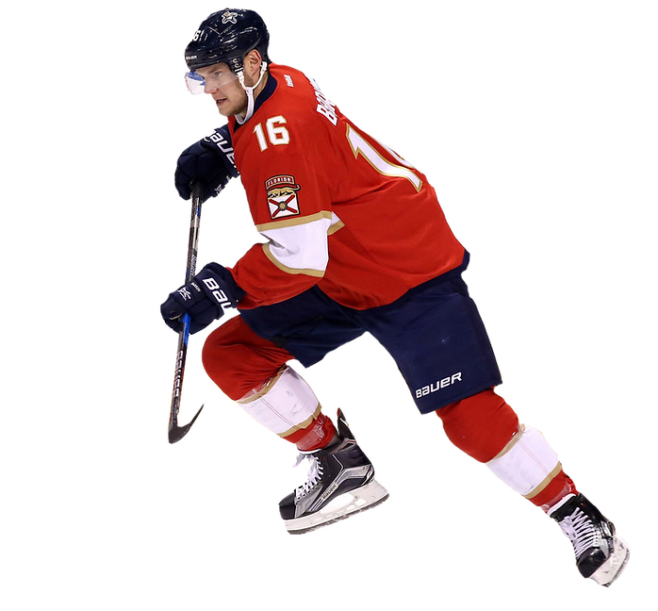
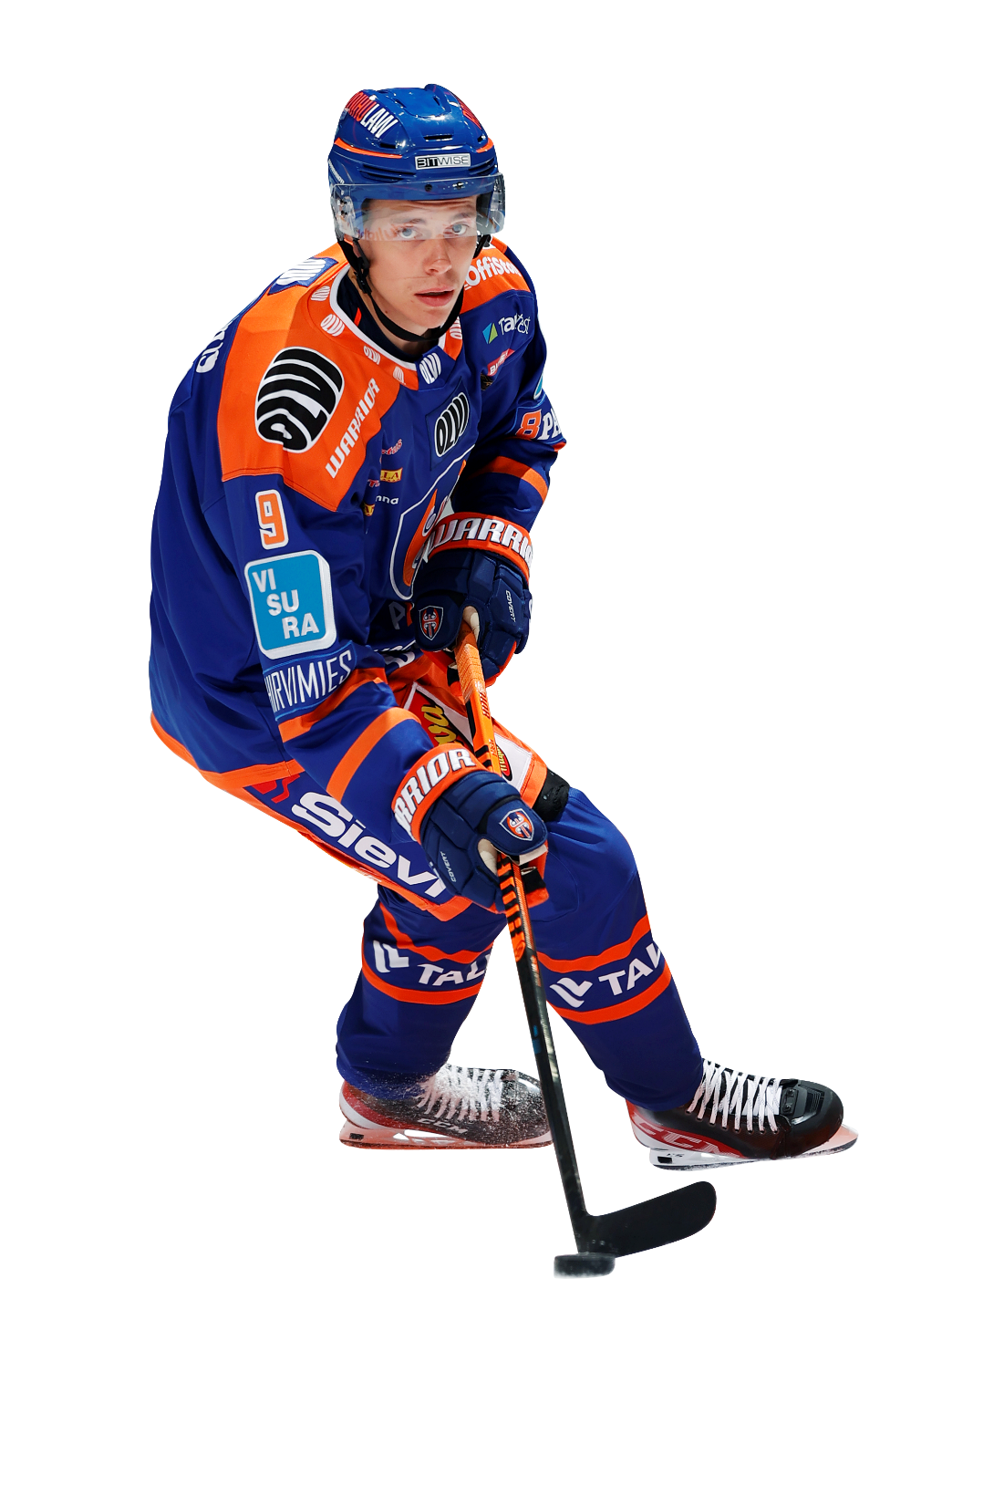
JUNIOR PATH TO THE TOP!
Over the years, Tappara has trained numerous top hockey players, many of which have even reached the international level right up to the big arenas and beyond to the top.
The whole world that follows hockey knows for example, NHL stars Aleksander Barkov and Patrik Laine. Our newest player in the NHL is Waltteri Merelä.

Slide 8
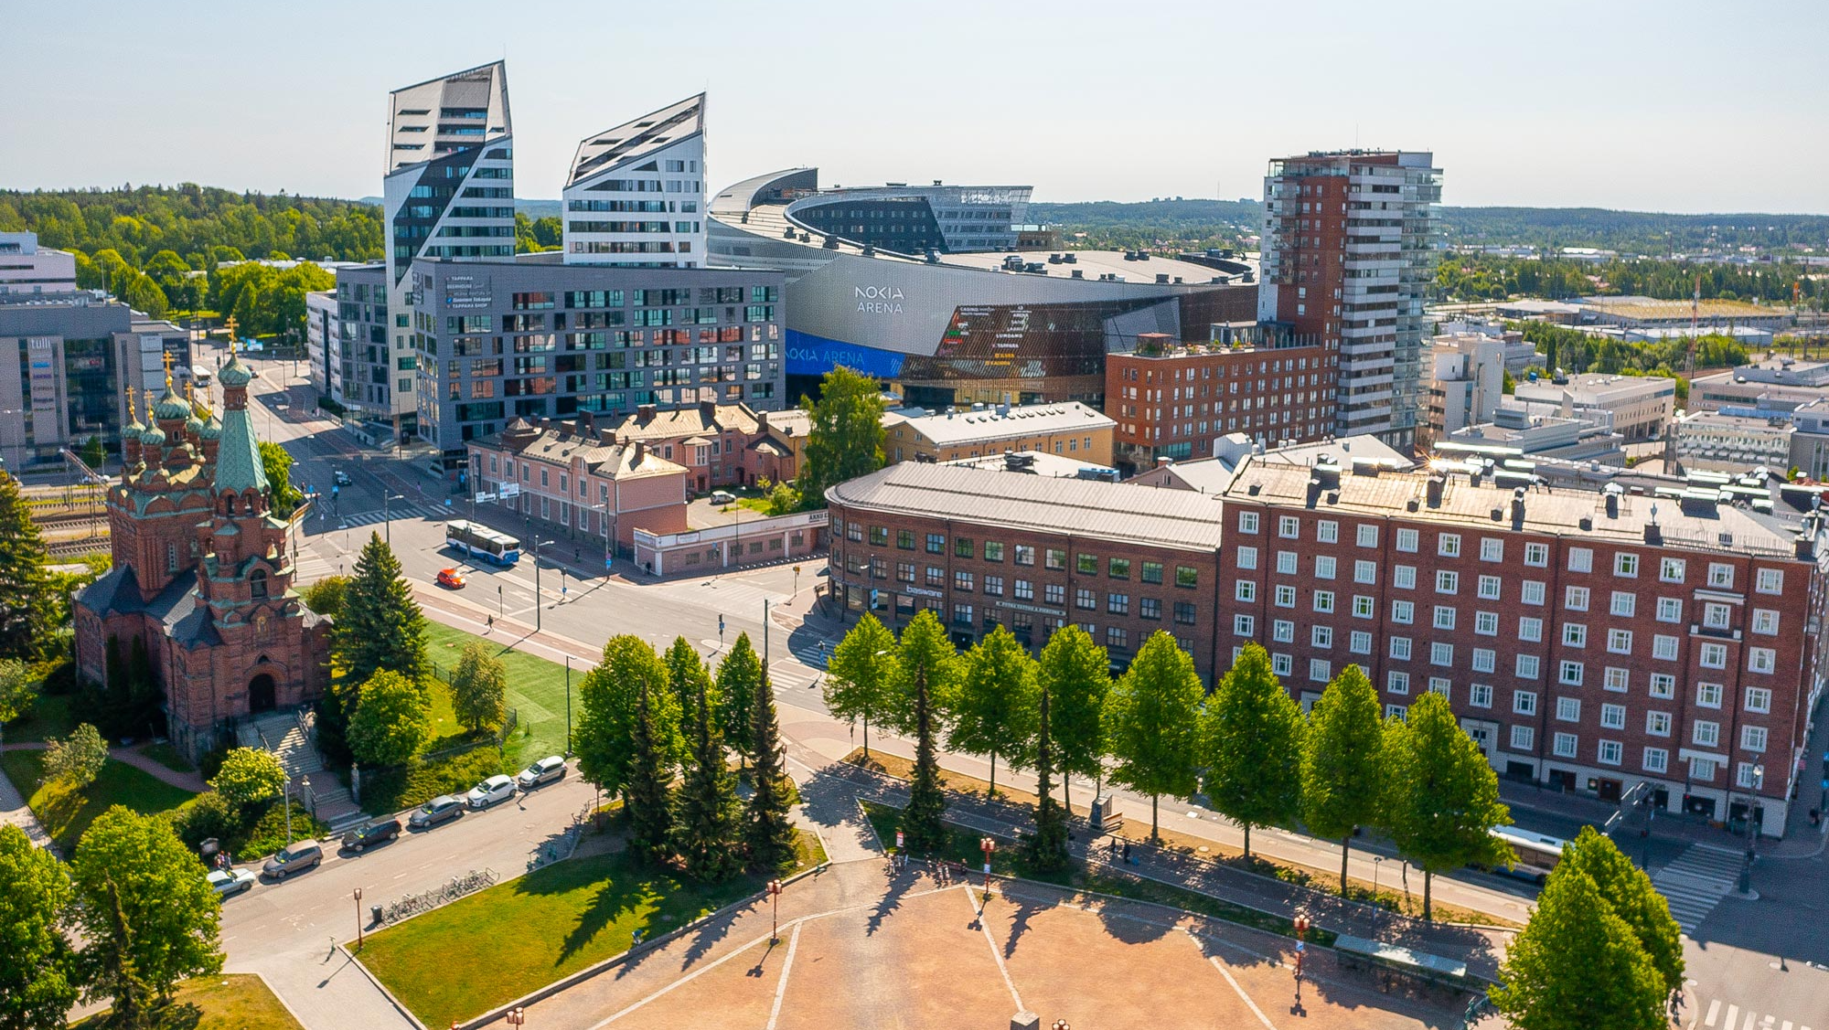

Slide 9
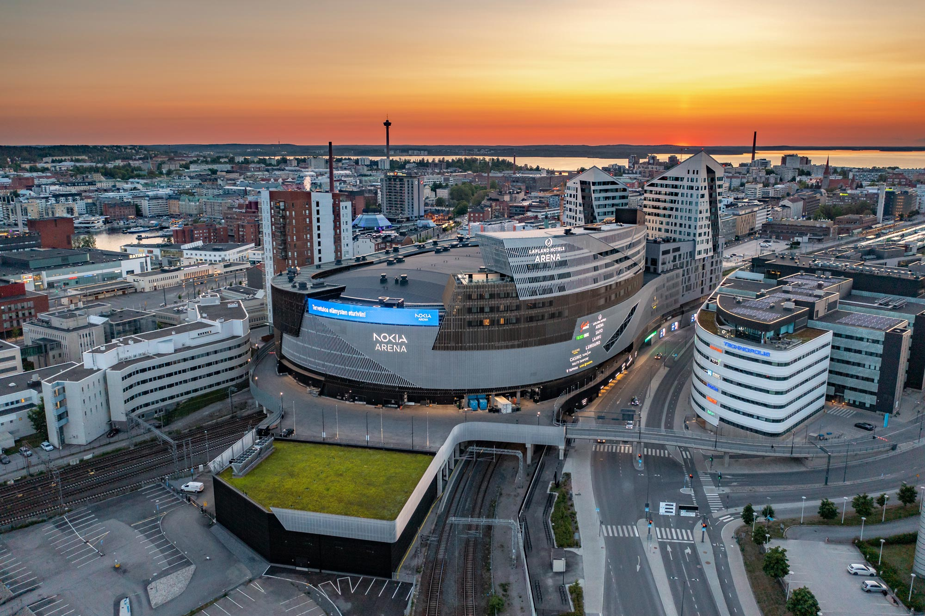

Slide 10
CLUB OF THE YEAR & COACH OF THE YEAR 2022–2023

Slide 11
350 000 spectators at home games in 2022–2023 we played 90 matches, 45 of which were home matches
More spectators than any club team in Finland before – NEW RECORD!

Slide 12
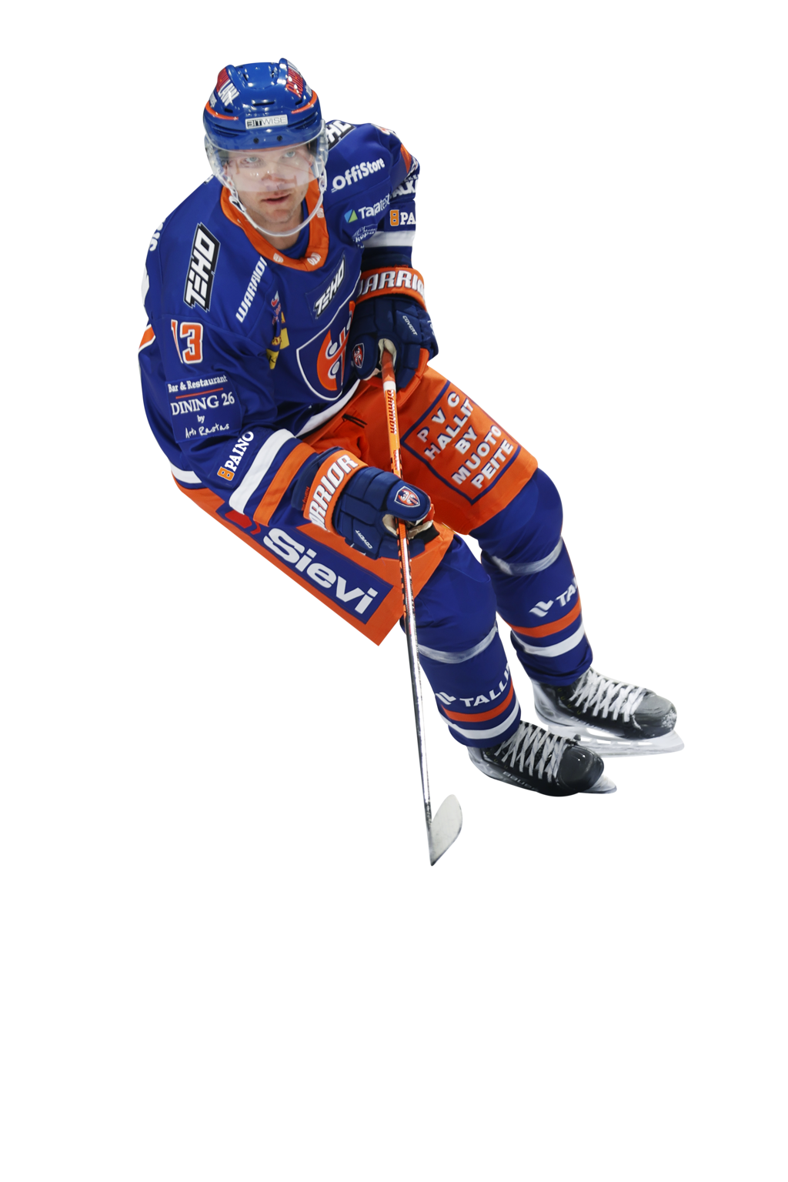
VISION
A successful and respected pioneer of hockey sports
Finland's most valuable, international-level sports entertainment brand

Slide 13
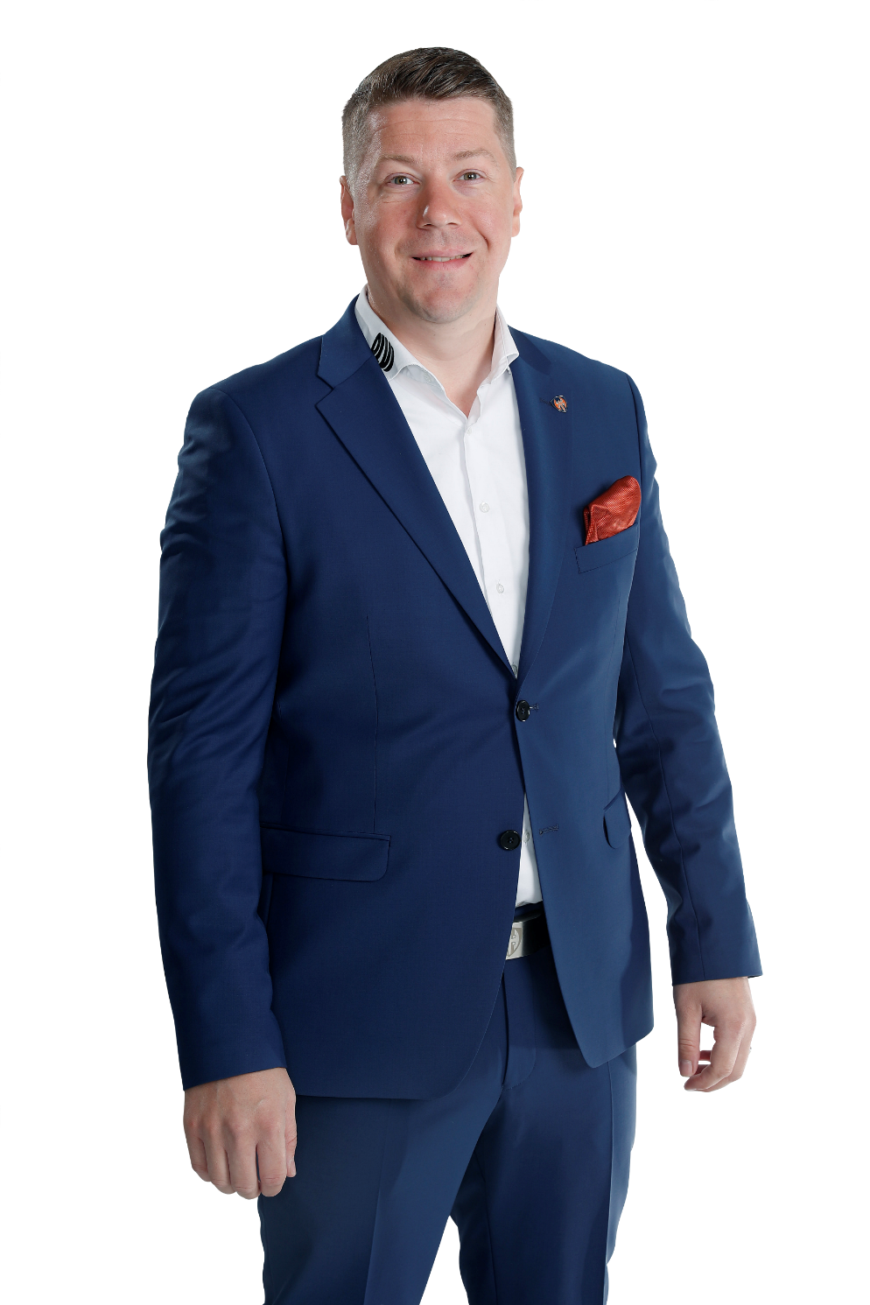
THANK YOU!
Aki Hautamäki Director Of Business Development and Events

Slide 14
See you in the game!

