Slide 1
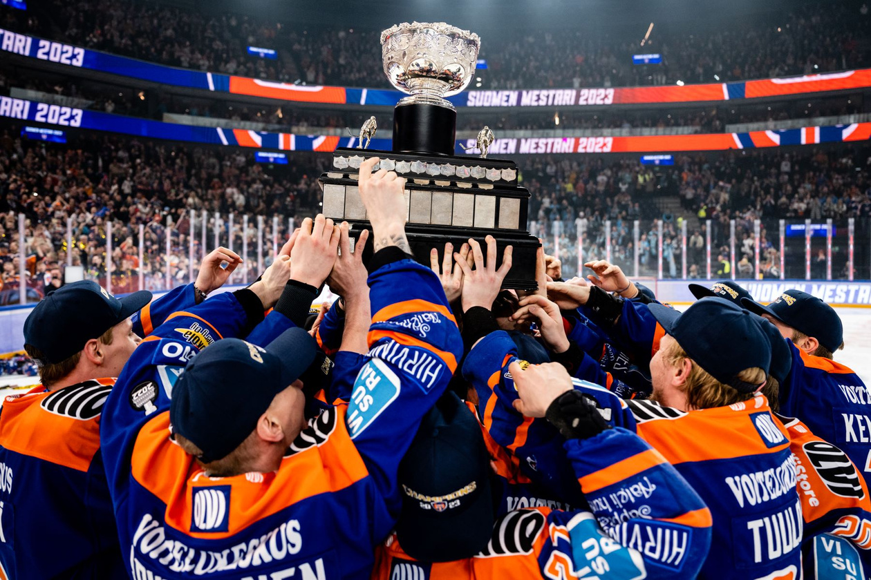

HOW TO RECRUIT THE RIGHT PLAYERS?
And avoid costly mistakes
LEO GIROD
GOTMYTEAM
FOUNDER
Notes:
Hi everyone,
Before I get started with my presentation about player recruitment I would like to highlight all the work done by the EHC staff to make this event happen, since 4 years, it is an highlight for the people working in European hockey.
So please give a round of applause to Caroline, Efraim, Risto & Szymon.

Slide 2
ABOUT ME
Notes:
Now place to the presentation, few words about me…

Slide 3
GM experience
ABOUT ME
Notes:
Before you ask yourself – do I have any GM experience?

Slide 4

GM experience
ABOUT ME
Notes:
Nope.

Slide 5
GM experience
Scouting experience
ABOUT ME
Notes:
Any scouting experience?

Slide 6

GM experience
Scouting experience
ABOUT ME
Notes:
Yes! I have been doing scouting reports for Scandinavian players for some top teams in Europe, in USHL, and also NCAA I.

Slide 7
GM experience
Scouting experience
Coached at the pro level
ABOUT ME
Notes:
Did I coach at the pro level?

Slide 8
GM experience
Scouting experience
Coached at the pro level
ABOUT ME
Notes:
I’m currently a head coach at the U20 level in Stockholm but also served as a video coach in Lausanne and assistant and video coach in Bern two season ago.

Slide 9
GM experience
Scouting experience
Coached at the pro level
gotmyteam
ABOUT ME
Notes:
Gotmyteam…

Slide 10
GM experience
Scouting experience
Coached at the pro level
gotmyteam
ABOUT ME
Notes:
This is the platform that I built 5 years ago helping players, coaches, and agents connect to the right players. So I spend a lot of my time talking to agents or GMs.

Slide 11
Great hockey player
Notes:
Was I a great hockey player?

Slide 12
Great hockey player
Notes:
And the answer is… no!

Slide 13
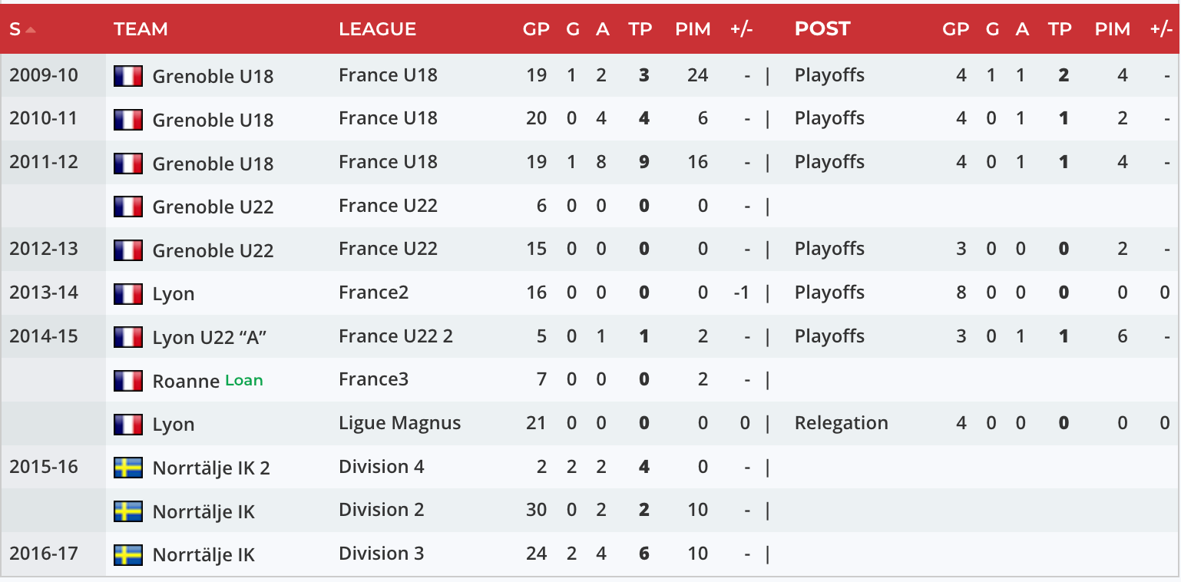
Great hockey player

Slide 14
Great hockey player

Slide 15
AGENDA

Slide 16
1
House building
AGENDA

Slide 17
1
House building
2
Sculpting an identity
AGENDA

Slide 18
1
House building
2
Sculpting an identity
AGENDA
3
Be magnetic

Slide 19
1
House building
2
Sculpting an identity
AGENDA
3
Be magnetic
4
Recruitment strategy

Slide 20
1
House building
2
Sculpting an identity
AGENDA
3
Be magnetic
4
Recruitment strategy
5
The roadmap

Slide 21


2023 E.H.C HOCKEY BUSINESS FORUM
House building
Find the formula to create solid foundations

Slide 22
Which type of architects?

Slide 23
Which type of architects?
01
Presidential
The person at the head of the club is highly involved in the sporting decisions

Slide 24
Which type of architects?
01
02
Presidential
Tandem
The person at the head of the club is highly involved in the sporting decisions
The GM & head coach find and reach out to players together

Slide 25
Which type of architects?
01
02
03
Presidential
Tandem
Split
The person at the head of the club is highly involved in the sporting decisions
The GM & head coach find and reach out to players together
The head coach shapes the profiles and the GM finds the names

Slide 26
Which type of architects?
01
02
03
Presidential
Tandem
Split
The person at the head of the club is highly involved in the sporting decisions
The GM & head coach find and reach out to players together
The head coach shapes the profiles and the GM finds the names

Slide 27
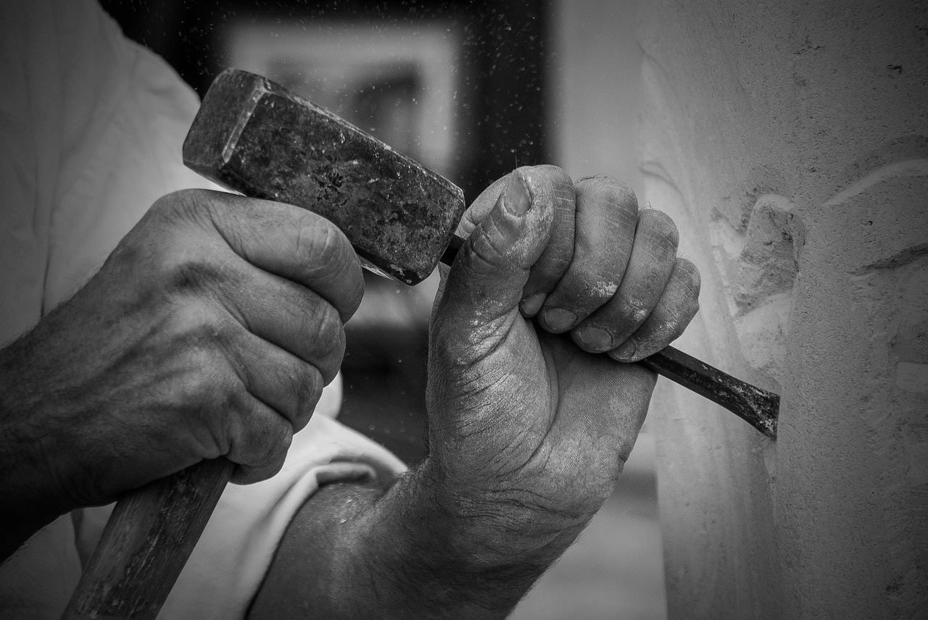
2023 E.H.C HOCKEY BUSINESS FORUM
Sculpting
an identity
Sign who you need by knowing who you are

Slide 28





Playing style

Slide 29
Playing style
City

Slide 30
Playing style
City
Players

Slide 31
Playing style
City
Players
History

Slide 32
Playing style
City
Players
History
Core values

Slide 33

2023 E.H.C HOCKEY BUSINESS FORUM
Be magnetic
Let your identity do the work

Slide 34
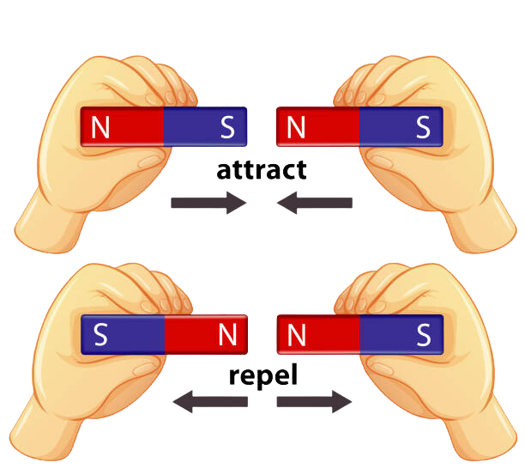

Slide 35
1
Create an
Alumni club
An organization where your former legends can serve as ambassadors of your culture

Slide 36
1
2
Create an
Alumni club
Improve your online presence
An organization where your former legends can serve as ambassadors of your culture
Players, as fans do, check your social networks and can have strong opinion about your club just by scrolling for 10s

Slide 37
1
2
3
Create an
Alumni club
Improve your online presence
Be vocal and loud about your brand
An organization where your former legends can serve as ambassadors of your culture
Players, as fans do, check your social networks and can have strong opinion about your club just by scrolling for 10s
Whenever you have the chance, accentuate what your club stands for and who should be a part of it

Slide 38
4
Be nice to agents
They want the best for their clients, be top of mind when they have someone who could be a good fit for you

Slide 39
4
5
Be nice to agents
And to your former players as well
They want the best for their clients, be top of mind when they have someone who could be a good fit for you
Think about Google Reviews, what do you want the players to say about your club to others?

Slide 40
4
5
6
Be nice to agents
And to your former players
Maximize what you do best
They want the best for their clients, be top of mind when they have someone who could be a good fit for you
Think about Google Reviews, what do you want the players to say about your club to others?
Great facilities? Fans? City? Financial situation? Highlight that and make sure that it is known

Slide 41
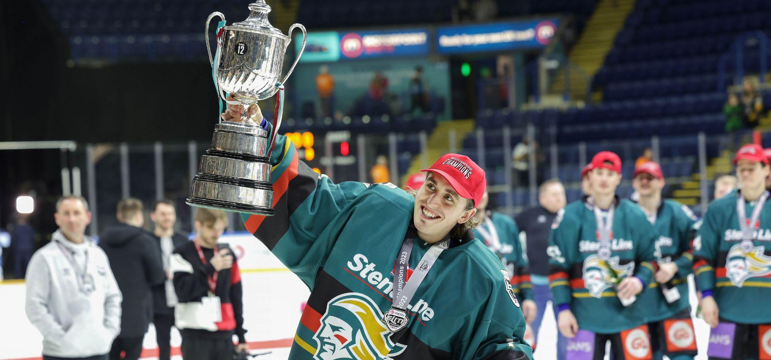
2023 E.H.C HOCKEY BUSINESS FORUM
Recruitment strategy
Find the right bricks

Slide 42

Adaptability

Slide 43

Adaptability
Skill

Slide 44

Adaptability
Skill
Tactical

Slide 45

Adaptability
Skill
Tactical
Mentality

Slide 46

Adaptability
Skill
Tactical
Mentality
Potential

Slide 47

Adaptability
Skill
Tactical
Mentality
Potential
Economics
Notes:
economy plus clair
Obvious but worth remembering

Slide 48

2023 E.H.C HOCKEY BUSINESS FORUM
The roadmap
A plan to execute with confidence

Slide 49
Roadmap for 2024-2025
2023 E.H.C HOCKEY BUSINESS FORUM
June-August
Sep-Nov
Dec-Feb
March-May
Assistant GM
Analyst/Scouts
General Manager

Slide 50
Roadmap for 2024-2025
2023 E.H.C HOCKEY BUSINESS FORUM
June-August
Sep-Nov
Dec-Feb
March-May
Assistant GM
Analyst/Scouts
Wide scouting
Wide scouting
General Manager

Slide 51
Roadmap for 2024-2025
2023 E.H.C HOCKEY BUSINESS FORUM
June-August
Sep-Nov
Dec-Feb
March-May
Assistant GM
Analyst/Scouts
Wide scouting
Wide scouting
Team evaluation
Wide scouting
Wide scouting
General Manager
Contacting agents

Slide 52
Roadmap for 2024-2025
2023 E.H.C HOCKEY BUSINESS FORUM
June-August
Sep-Nov
Dec-Feb
March-May
Assistant GM
Analyst/Scouts
Wide scouting
Wide scouting
Narrow scouting
Team evaluation
Wide scouting
Wide scouting
Final list
General Manager
Contacting agents
Narrow scouting
Negotiations

Slide 53
Roadmap for 2024-2025
2023 E.H.C HOCKEY BUSINESS FORUM
June-August
Sep-Nov
Dec-Feb
March-May
Assistant GM
Analyst/Scouts
Wide scouting
Wide scouting
Narrow scouting
Defining models
Team evaluation
Wide scouting
Wide scouting
Final list
Defining profiles
General Manager
Contacting agents
Narrow scouting
Negotiations

Slide 54
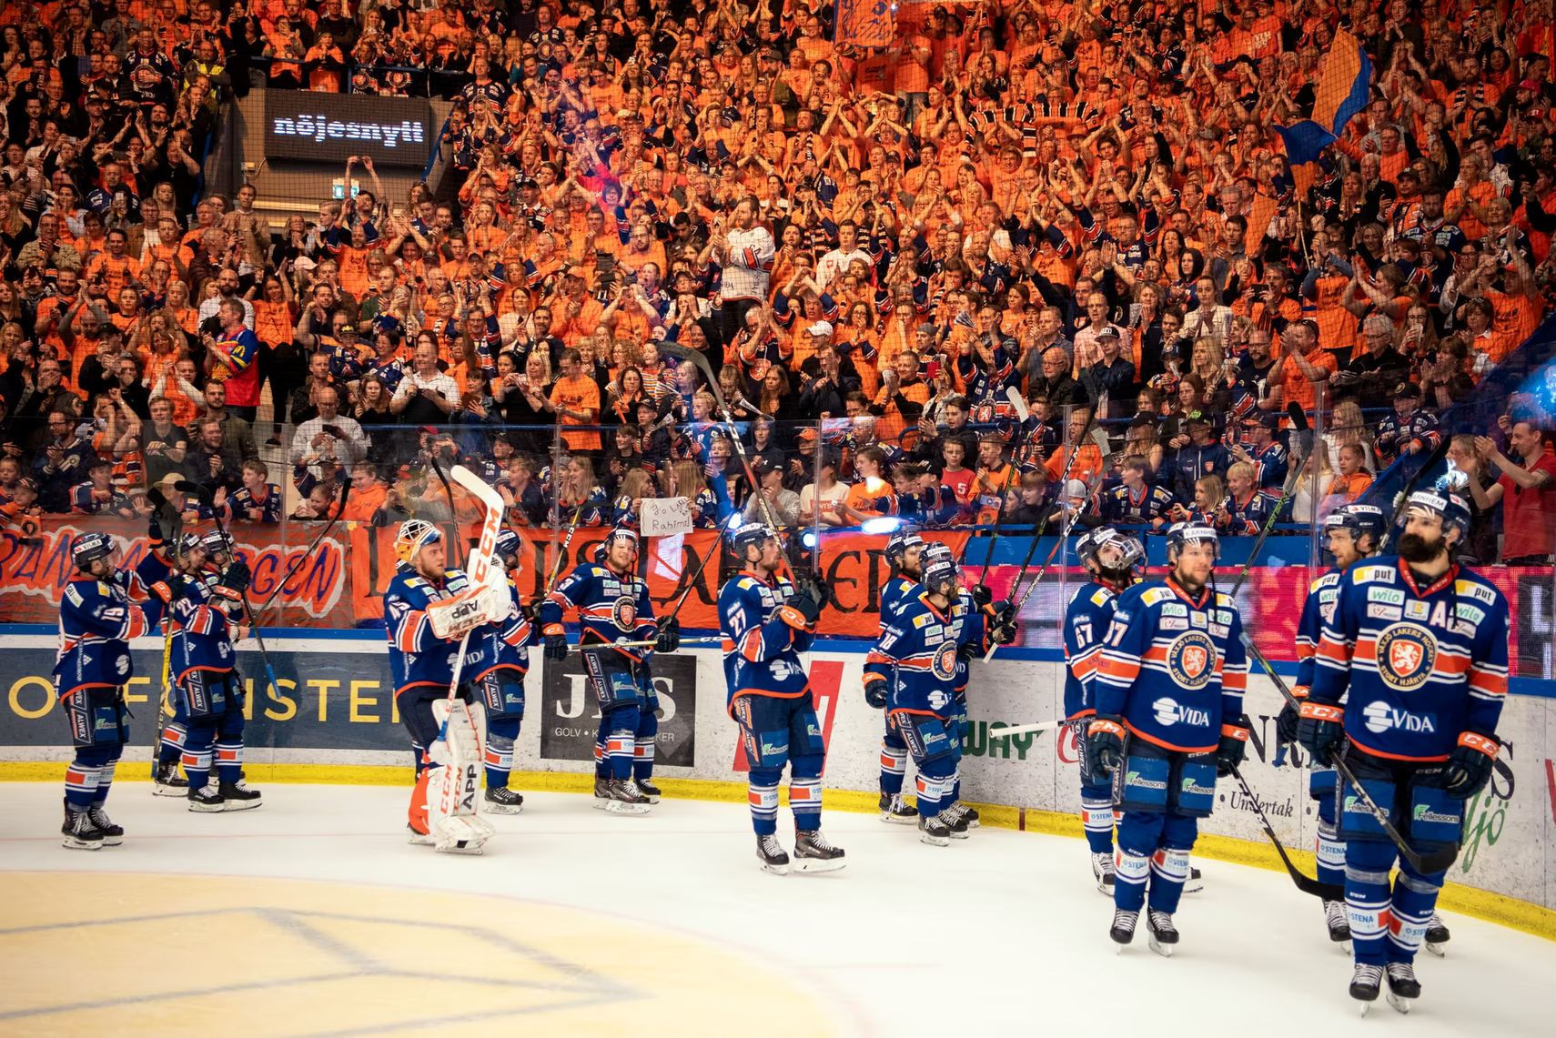
Unity
The key to achieve sporting success, economic stability and growth

Slide 55
  Would you sign for your team?

Slide 56
leo@gotmyteam.com
gotmyteam.com

