Slide 1
Tackling the future of hockey
Escape from Stagnation
Hockey Business Forum, EHC Alliance, Tampere, 23.9.2023
André Noël Chaker
Writer | Speaker | Entrepreneur
Chairman of the Board
MySpeaker

Slide 2
+
DESIRABLE
-
-
DIFFERENT
+
1

Slide 3
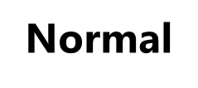
+
DESIRABLE
-
-
DIFFERENT
+
1

Slide 4
+
DESIRABLE
Personal
-
-
DIFFERENT
+
1

Slide 5
+
Perfect
DESIRABLE
Personal
-
-
DIFFERENT
+
1

Slide 6
+
Perfect
DESIRABLE
Normal
Personal
-
-
DIFFERENT
+
1

Slide 7
+
Unique
Perfect
DESIRABLE
Normal
Personal
-
-
DIFFERENT
+
1

Slide 8
+
Unique
Perfect
DESIRABLE
Normal
Personal
-
-
DIFFERENT
+
1

Slide 9
WHO?
5

Slide 10
WHO?
5

Slide 11
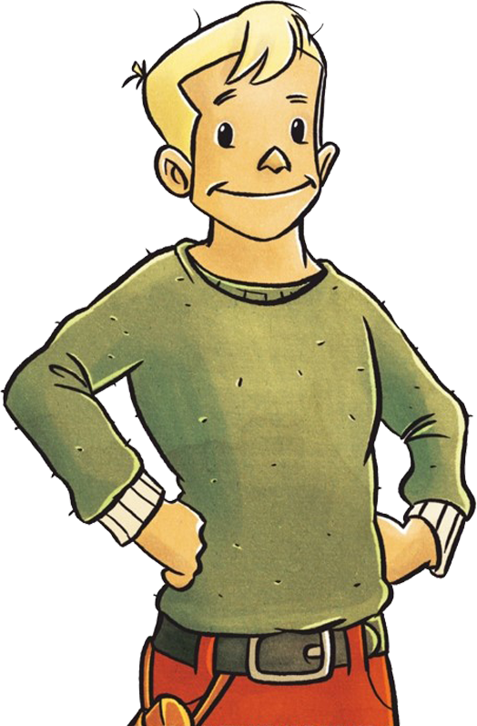
Nicolas Claus
The Little Prince of Finland
6

Slide 12
11

Slide 13
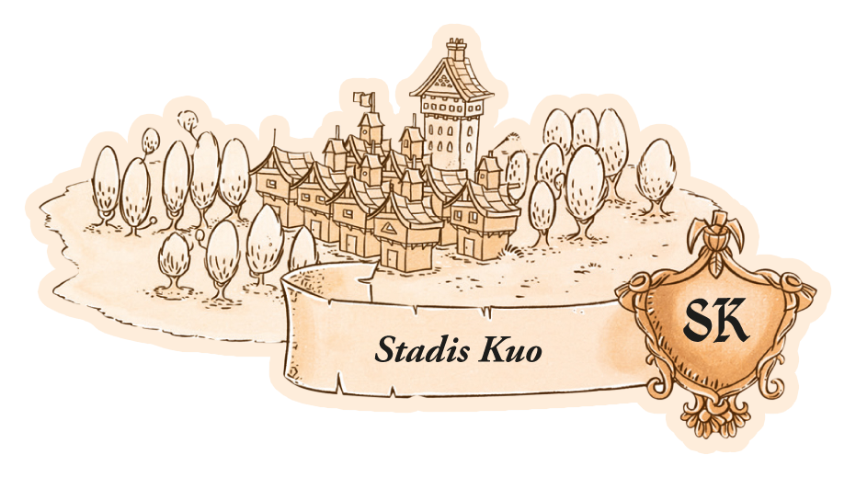
12

Slide 14
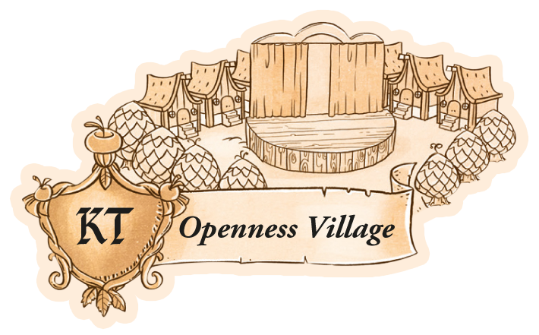
13

Slide 15
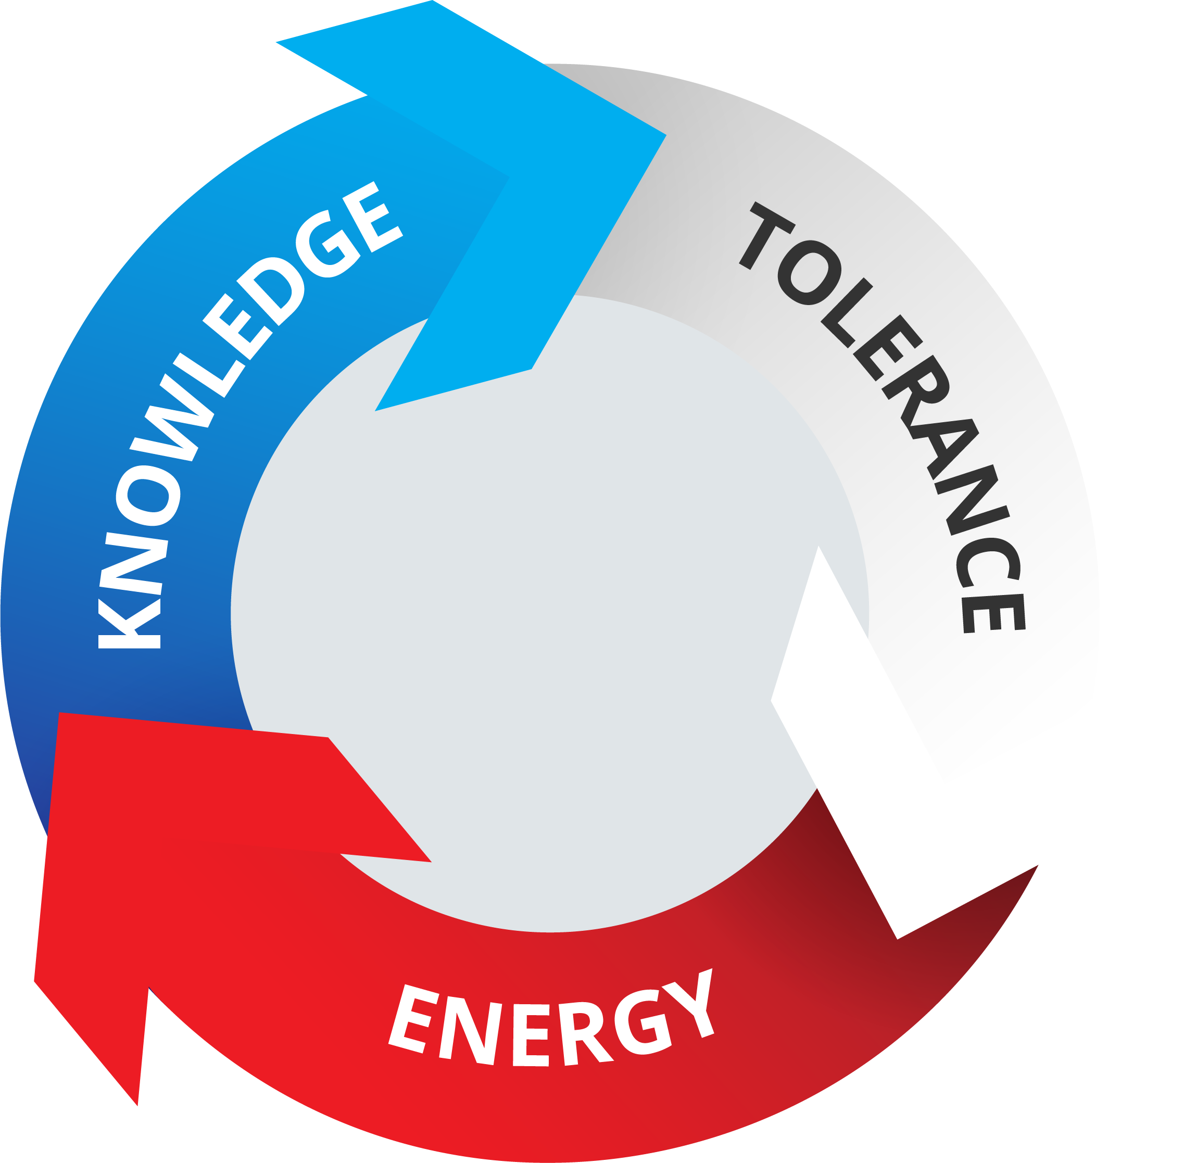
The Virtuous Circle of the open mind
4

Slide 16
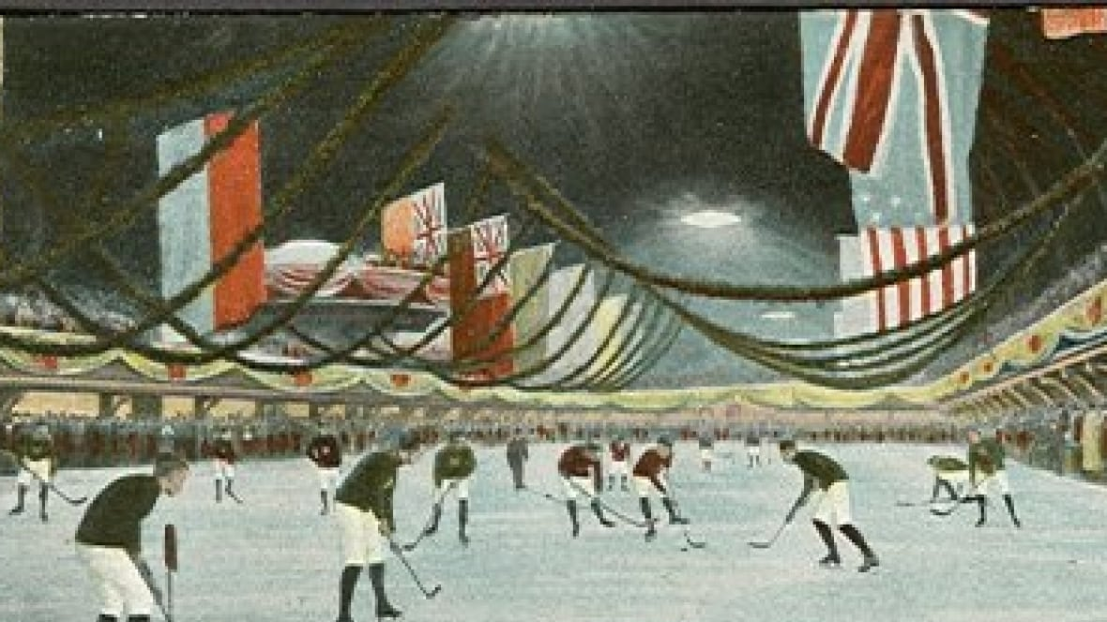

Slide 18
18

Slide 19
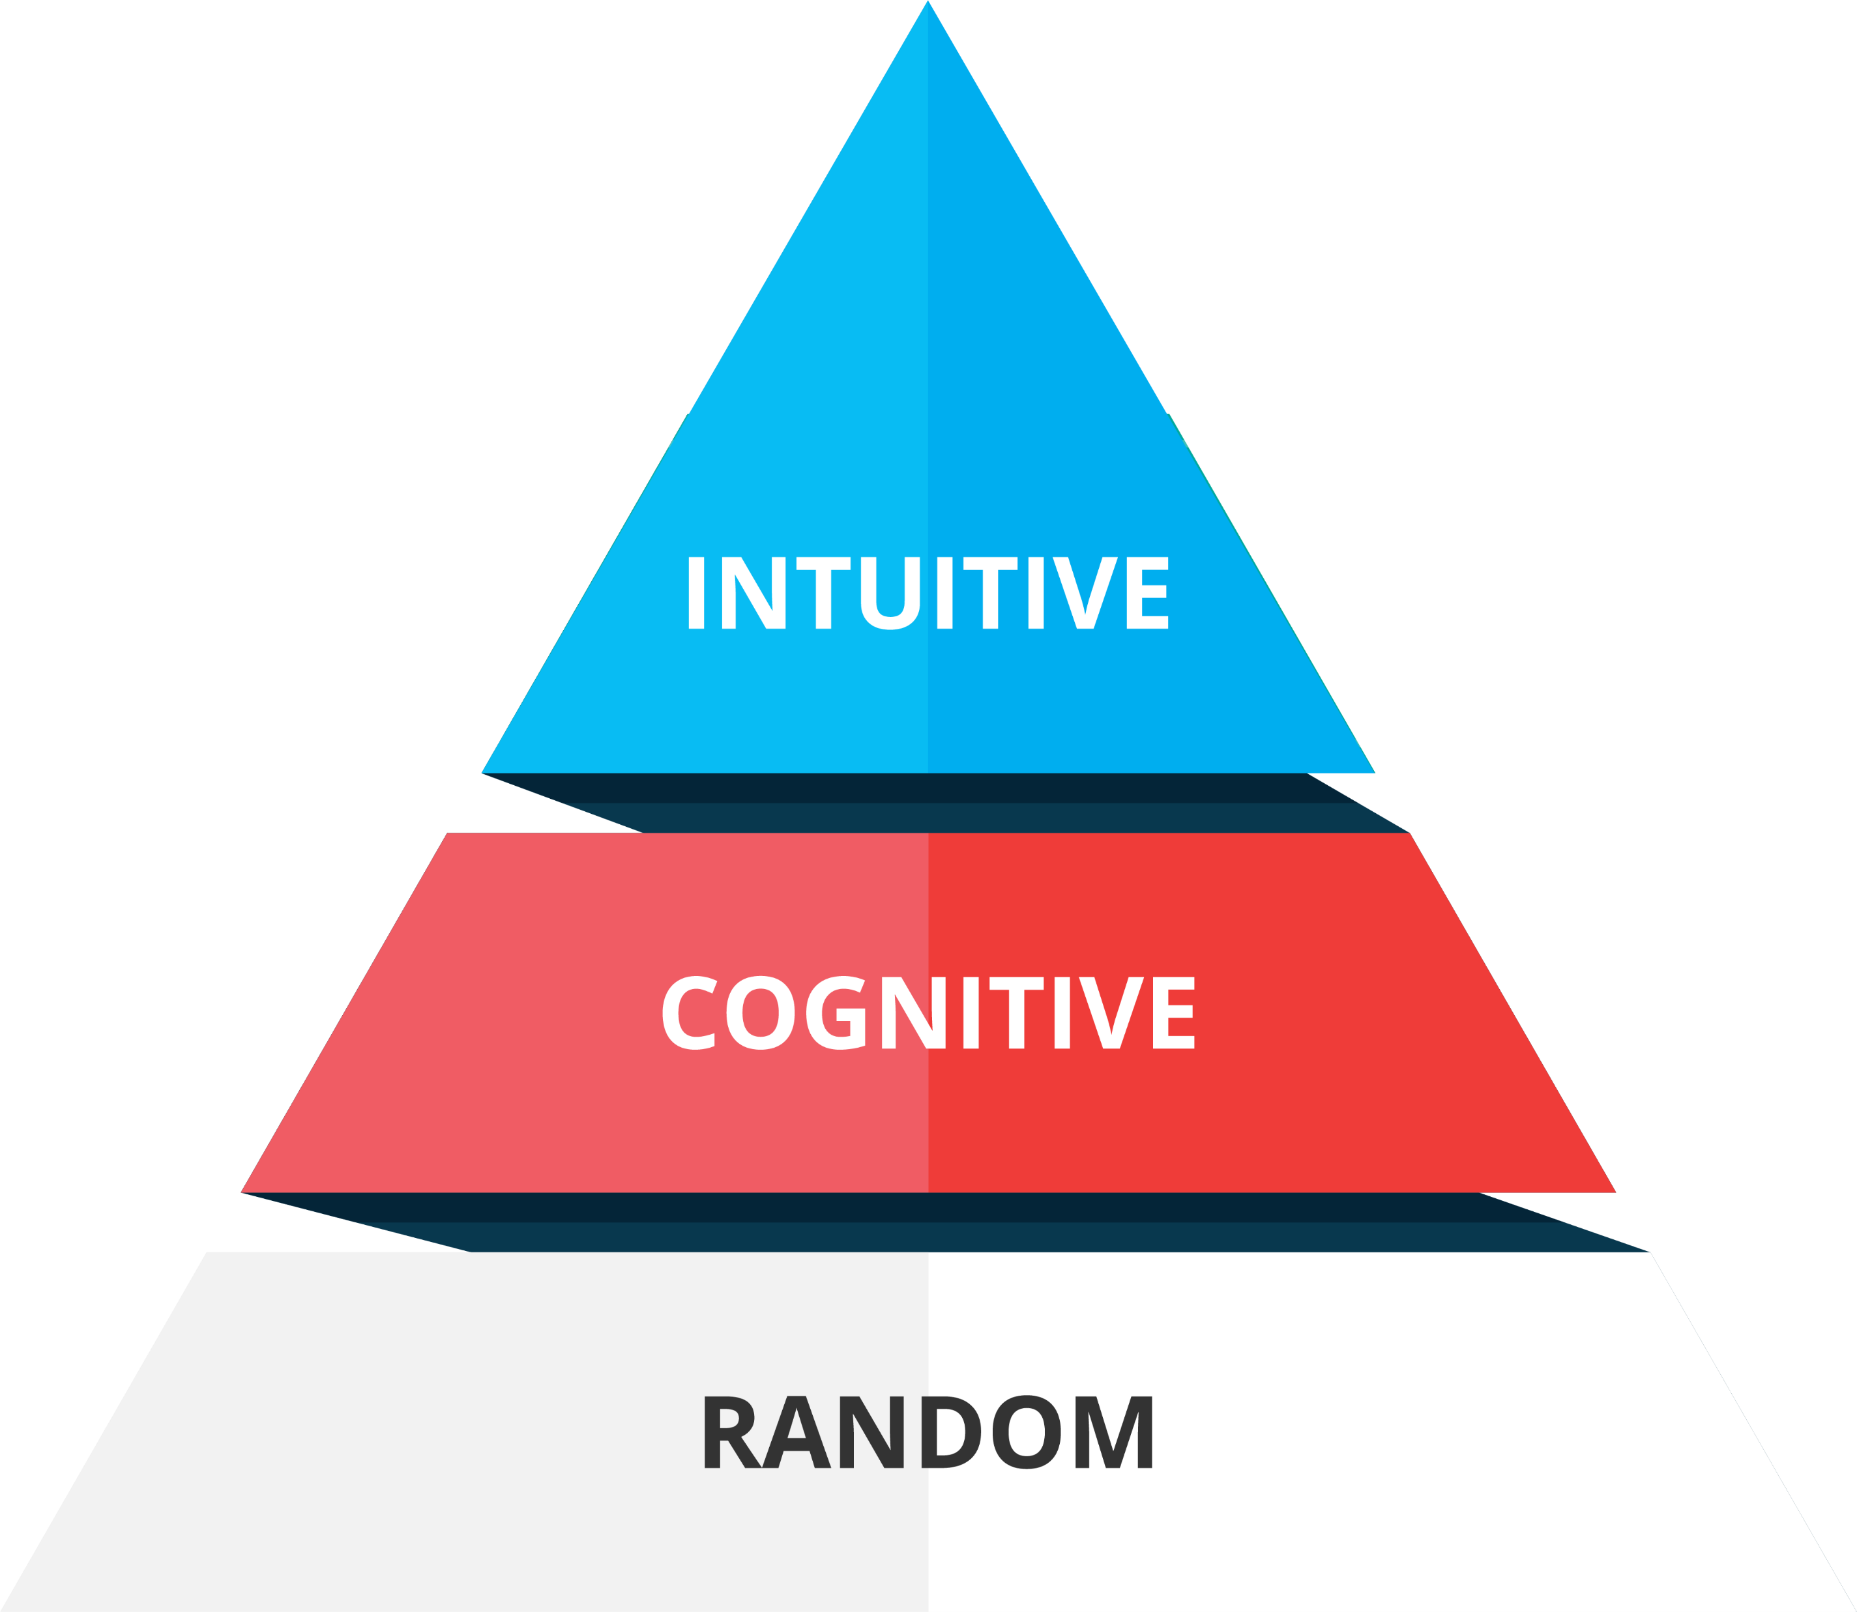
The Hierarchy of Trial and Error
7

Slide 22
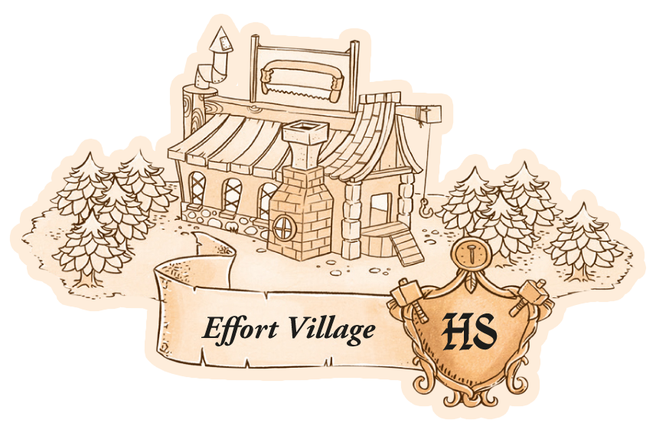
21

Slide 23
HARDER & SMARTER
(Capital +Work) x (Intelligence + Culture)
11

Slide 24
1.COMMUNICATION
11

Slide 26
Words of Speech: Rational & Emotional
Argumentation
Structure
Rational/Logos
Credibility
Thought leadership
Personal/Ethos
Likeability
Stories
Emotional/Pathos
Resonance
Sensation
Notes:
Key Substance Inputs
One Mouth; Two Lips

Slide 27
Words of Speech: Rational & Emotional
Structure
Argumentation
Rational/Logos
Credibility
Thought leadership
Personal/Ethos
Likeability
Stories
Emotional/Pathos
Resonance
Sensation
Notes:
Key Substance Inputs
One Mouth; Two Lips

Slide 28
Credibility
Uskottavuus
Competence Pätevyys
Character Luonne/Maine
Caring Välittäminen

Slide 29
Likeability
Mielyttävyys
Relevance Relevanssi
Empathy Empatia
Authenticity Aitous
Laughter Nauru

Slide 30
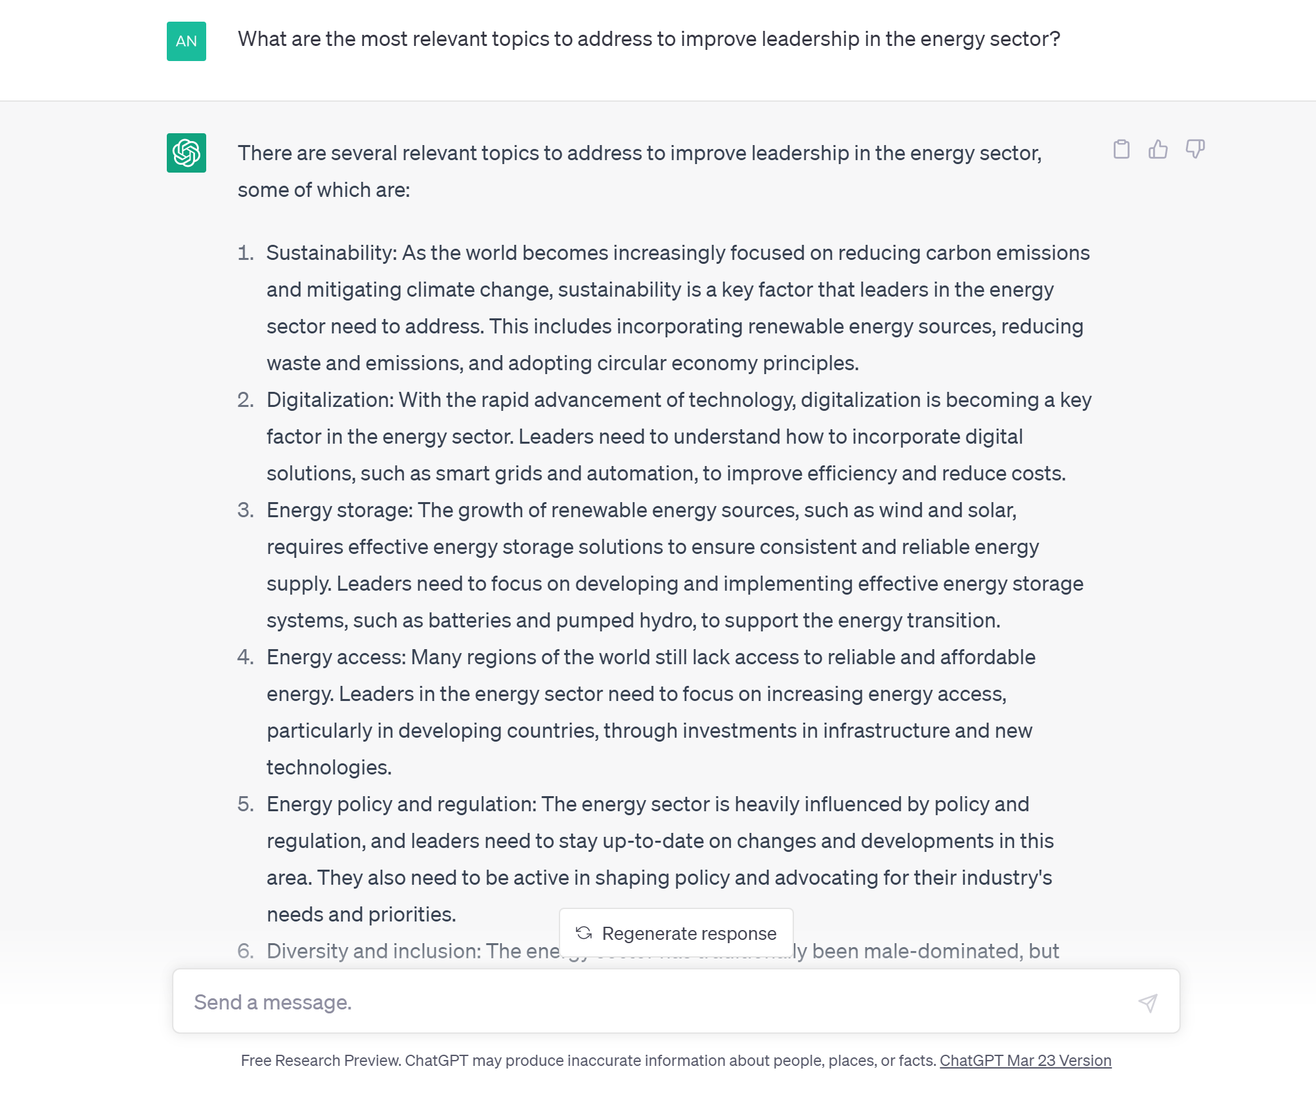
www.myspeaker.fi

Slide 32
About MySpeaker: Background & Story
WHAT?
WHO?
HOW?
WHY?
10,200,000 €
10,2 M€
6,5 M€
EU expansion with AI Innovation
3,4 M€
50 Professionals
2000 Corporate customers
SME’s
Reskilling
Green
Peace
1,3 M€
MySpeaker is on its way to become a major player in the supply and development of speaking and coaching solutions in the world.
Our purpose is to use AI technology to enhance every human’s ability to speak.

Slide 33
2. DIVERSITY
11
Notes:
Jatkuva kehittyminen
Fimlab haluaa tarjota tiedosta hyödyn ja hyödyllisimmän tiedon kaikissa tilanteissa nyt ja tulevaisuudessa.

Slide 34
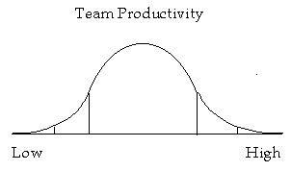
Dynamics of Diversity
Research shows that teams that cultivate and utilize their diversity achieve higher performance and innovation than others.
“Getting to the right side of the curve” requires proactively exploring, understanding and leveraging our differences.
Sameness or
Assimilation
Barrier
Diverse Teams
Diverse Teams
that discourage or devalue differences
that cultivate and utilize differences
Low Performing Teams
High Performing,
Innovative Teams

Slide 35
Relationship between Team Diversity and Performance: Stronger leadership and role clarity required in diverse teams
High
With strong leadership & role clarity
Business Performance
Without strong leadership & role clarity
Low
Low
Team Diversity (Nationalities & Expertise)
High
2015 © John R Childress and The Principia Group

Slide 36
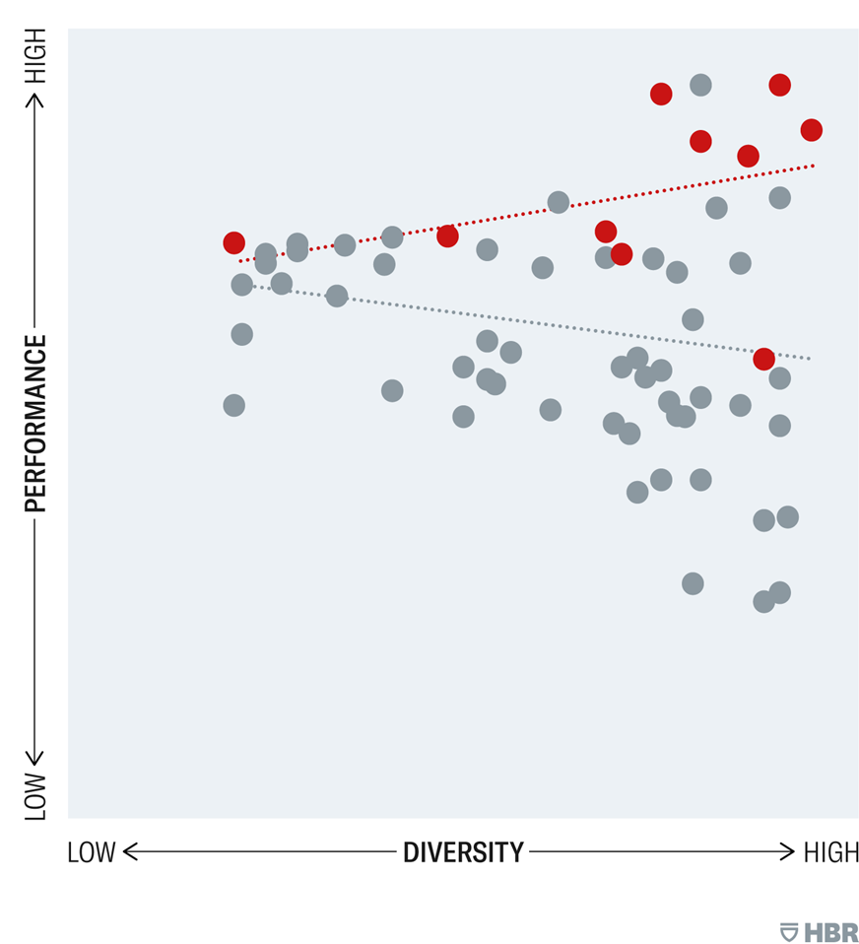
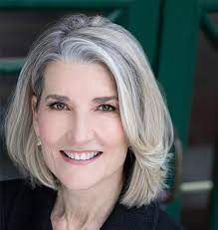

Slide 37
Technological safety

Slide 38
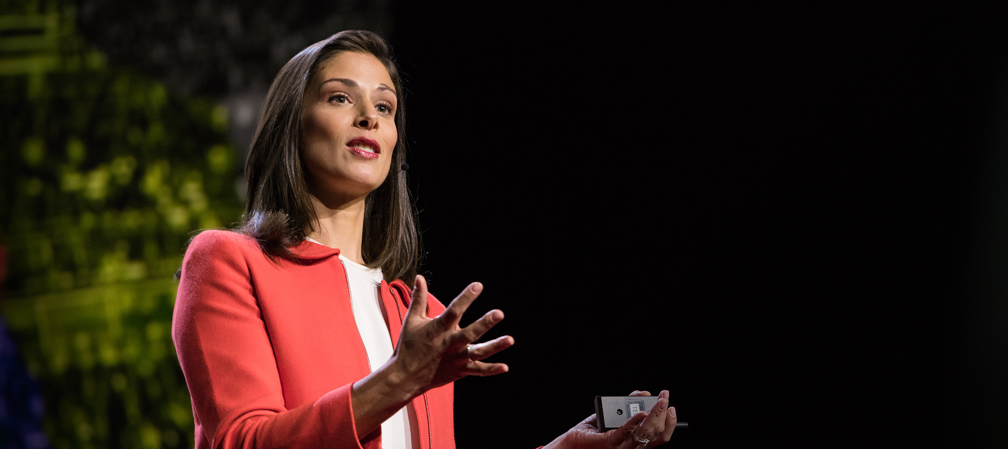
3. TRUST
11

Slide 39
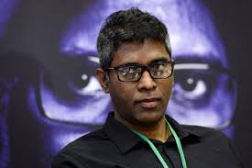

Slide 41
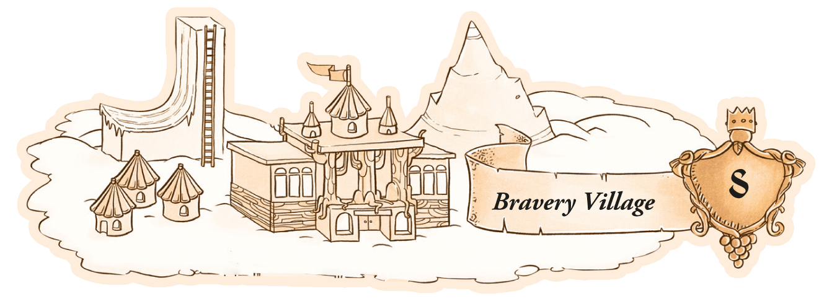
46

Slide 42
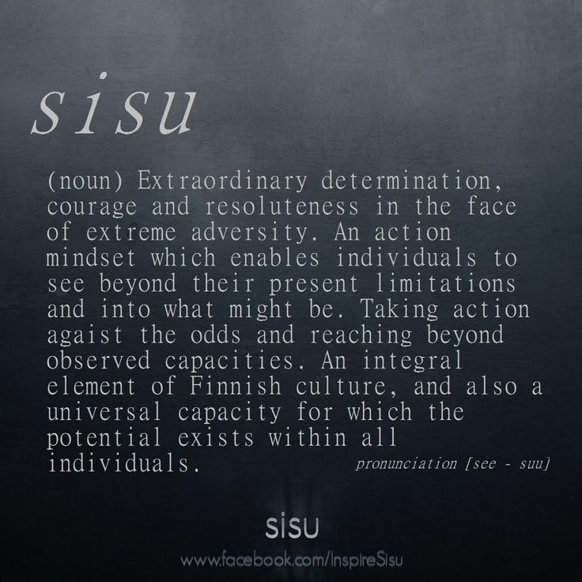

Slide 43
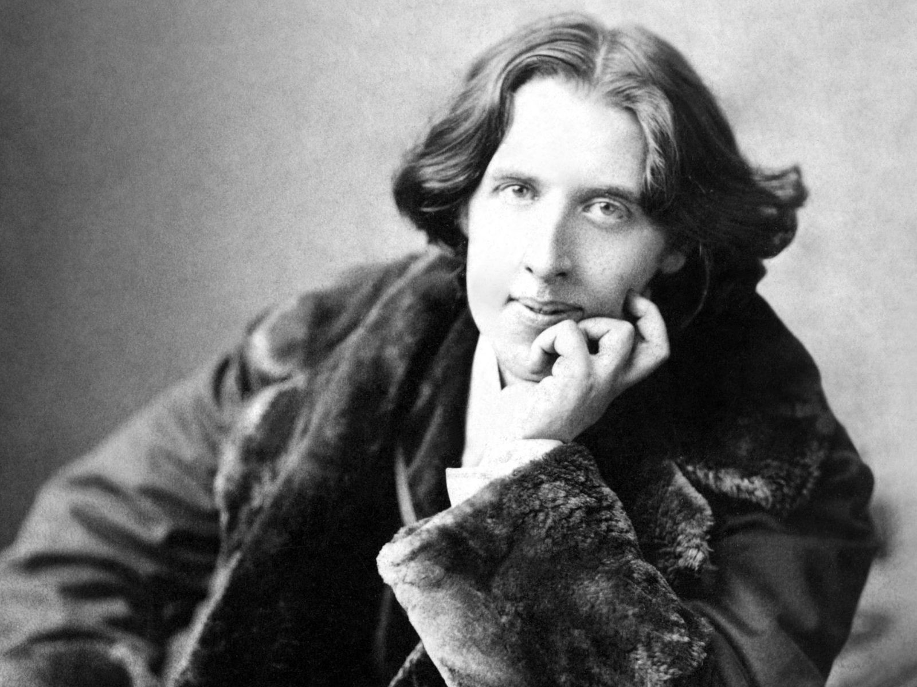

Slide 44
THANK YOU!
André Noël Chaker
MySpeaker
(@anchaker)
Writer | Speaker | Entrepreneur

