Slide 1
How to balance brand-building and the need for short-term revenue
Felix Boronczyk
E.H.C. Hockey Business Forum 2023 28 September 2023

Slide 2
NEED TO MAXIMIZE REVENUE FOR SHORT-TERM SUCCESS AND FINANCIAL VIABILITY
A DILEMMA FOR HOCKEY CLUBS
CLUBS ARE FACING A TRADEOFF BETWEEN LONG-TERM CLUB BRAND BUILDING AND COMMERCIALIZATION FOR IMMEDIATE REVENUES
SEEK TO EXPLOIT ADDRESSABLE AUDIENCES AND UNIQUE CLUB ATTRIBUTES

Slide 3
NEED TO MAXIMIZE REVENUE FOR SHORT-TERM SUCCESS AND FINANCIAL VIABILITY
A DILEMMA FOR HOCKEY CLUBS
HOW CAN PROFESSIONAL HOCKEY CLUBS SOLVE THIS DILEMMA?
SEEK TO EXPLOIT ADDRESSABLE AUDIENCES AND UNIQUE CLUB ATTRIBUTES

Slide 4
Building your own club brand is the foundation for long-term commercial success!
I. Avoid cluttered sponsorship environments!
II. Exploit opportunities arising from technological advances!
III. Be deliberate in your partner selection!
IV. Protect your club brand identity!
Copyright © 2023 The Nielsen Company (US), LLC. Confidential and proprietary. Do not distribute.

Slide 5
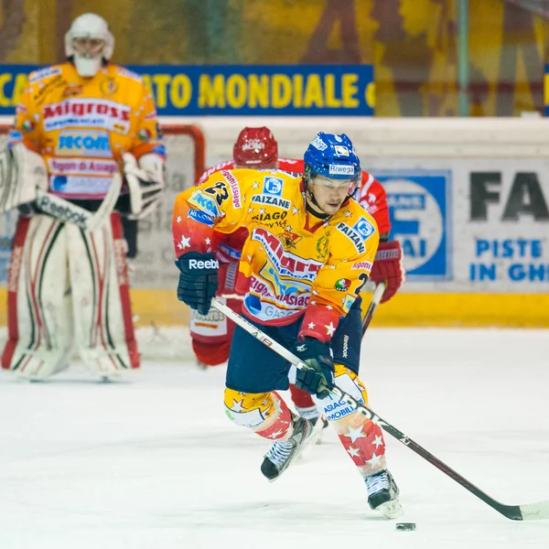
I. Avoid cluttered sponsorship environments
The science and business of visual attention
During 95 % of a sport broadcast viewers DO NOT look at sponsor signage (Breuer & Rumpf, 2012)
Logo clutter further reduces attention to sponsor signage (Breuer & Rumpf, 2012)
Why should sponsor brands pay for ads that fail to attract attention?
Key takeaways for hockey clubs
Viewers‘ attention is scarce and valuable
Less branding can be more effective
Clubs need revenue streams beyond jerseys and on-ice

Slide 6
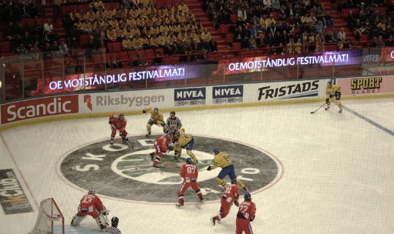
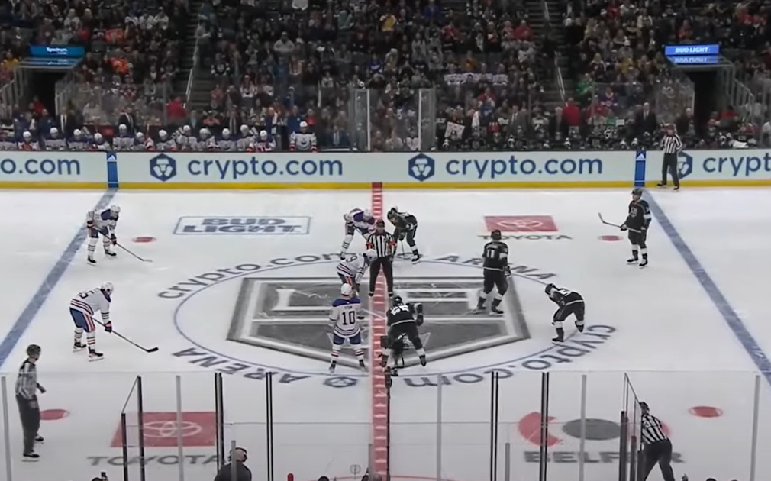
II. Exploit opportunities arising from technological advances
Technological advances in sponsor signage
Dynamic signage provides more flexibility and greater quality of signage than static boards!

Slide 7
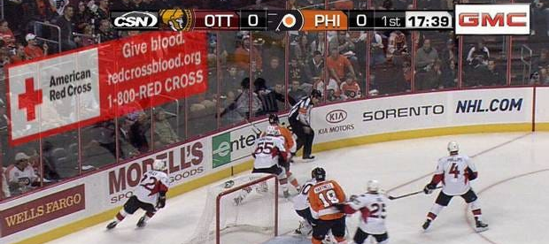
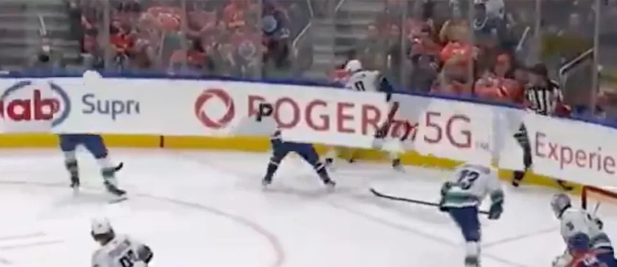
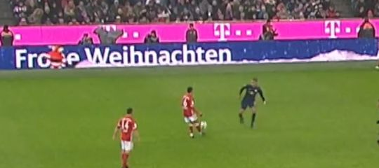
II. Exploit opportunities arising from technological advances
Static boards vs dynamic sponsor signage
Brighter colors and clearer signage increase viewer attention (Breuer & Rumpf, 2015)
Animated signage is very effective in attracting viewers‘ attention (Breuer & Rumpf, 2015)
BUT: animated signage also increases confusion and can cause reactance (Breuer & Rumpf, 2015; Rumpf & Otto)
Key takeaways for hockey clubs
Dynamic signage can increase quality and value of sponsor signage
Animation should be used sparingly – ideally only during breaks
Signage must NOT distract aggressively from the game itself

Slide 8
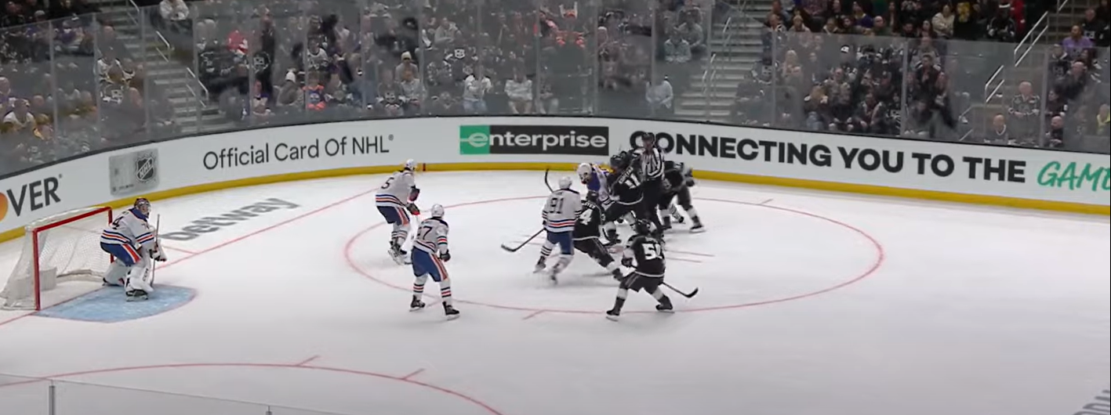
II. Exploit opportunities arising from technological advances
Virtual advertising and message exposure timing
The timing of brand exposure determines signage impact and value
Attention to sponsors depends on the suspense and the timeline of a game (e.g., Lee et al., 2019; Breuer et al., 2021; Boronczyk et al., 2021)
With dynamic signage, clubs can control - and price! – brands’ exposure based on timing (Breuer, Boronczyk & Rumpf, 2021)
Key takeaways for hockey clubs
Pricing and exposure timing should reflect anticipated attention
Premium pricing for exposure in attractive game situations, e.g., before faceoffs
Consider variable component in exposure pricing

Slide 9
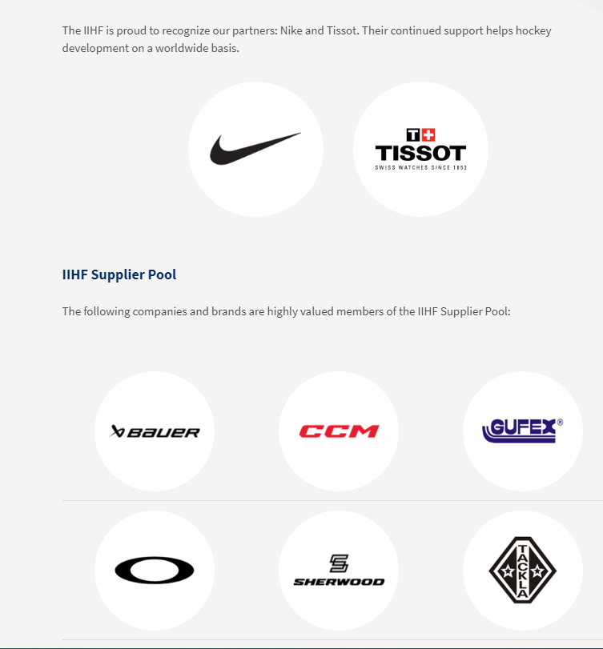
III. Be deliberate in your partner selection
Beware of the company you keep
Images rub off from club to sponsors, from sponsor to clubs – but also between sponsors! (e.g., Boronczyk & Breuer, 2019; Carrillat et al., 2015)
This can generate considerable benefits - but also depreciate the value of a sponsorship – depending on the co-sponsors!
Key takeaways for hockey clubs
Brand alliances between sponsors can be mutually beneficial
Assembling a roster of selected sponsors can create value for all partners
Negative effects for sponsors are also possible and must be avoided

Slide 10
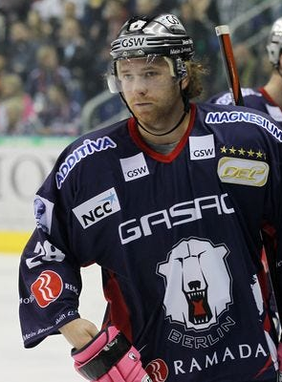
IV. Protect your club brand identity
Commercialization and club brand building
The club brand and how fans perceive it is any clubs’ greatest and most important asset!
Fans are sensitive to commercialization and tend to react with resistance (e.g., Boronczyk & Zarins, 2022; Woisetschläger et al., 2014)
Key takeaways for hockey clubs
Protect assets that are of high symbolic value to fans
Consider the impact of commercialization on fans’ long-term reactions
Weigh short-term revenue against the value of the club brand

Slide 11
Building your own club brand is the foundation for long-term commercial success!
Avoid cluttered sponsorship environments!
Exploit opportunities arising from technological advances!
Be deliberate in your partner selection!
Protect your club brand identity!
Copyright © 2023 The Nielsen Company (US), LLC. Confidential and proprietary. Do not distribute.
Notes:
Avoid cluttered sponsorship environments
No revenue without advertising value - no advertising value without processing - no processing without visual attention
To sponsors, signage that fails to attract viewer attention is virtually worthless!
Exploit opportunities arising from technological advances
Clubs and leagues can increase the quality of partners‘ exposure and make the pricing of their assets more efficient
(ABC)
Be deliberate in your partner selection
Be careful with the company you keep
Both the club and its partners can benefit from a carefully assembled network of partners
Protect your club brand identity
Look at North America: franchises focused on brand-building - dominance of club brands
Commercialization mostly via TV and matchday revenue, jersey and helmet branding introduced only recently
European clubs with unique positioning? (e.g., Belfast Giants, HC Davos, Ambri-Piotta)
Those clubs have identities that can help them attract partners because they have a unique and distinct story to tell and attributes to share

Slide 12
Dr. Felix Boronczyk
Consultant Nielsen Sports
+49 174 1535 138 felix.boronczyk@nielsen.com

