Slide 1

BE
MORE
ILVES
EHC / ILVES

Slide 2

SPEAKING TODAY
Hannu Toivo
Ilves ry
Executive Director, Hockey
Juha Alén
Ilves ry
Head of coaching, Hockey 15U-13U

Slide 3
PLAYERS AND TEAMS 2023-24
”HOCKEY AND SKATING SCHOOLS” – 230 boys and girls
”CHILD HOCKEY 8U – 12U” – 350 players and 35 teams
”ROAD TO COMPETITION 13U – 15U” – 130 players and 11 teams
”COMPETITION HOCKEY U16 – U18 – 110 players and 5 teams
WOMEN – 40 players and 2 teams
Easy Hockey teams for juniors and adults – 100 players
Special Hockey – 25 players
Para Ice Hockey – 15 players
1000 PLAYERS – 170 COACHES – 60 TEAMS – 10 RINKS – 115 HOURS OF ON-ICE EXCERCISE WEEKLY

Slide 4

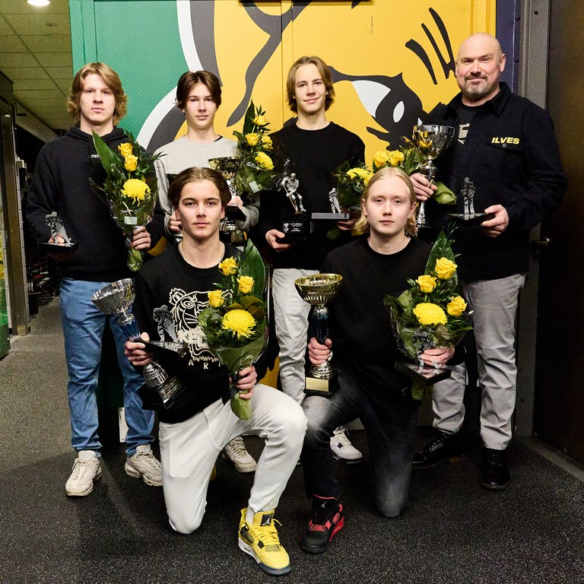
CORE VALUES
JOY
SKILL
OPENNESS
HEALTHY LIFESTYLE
CARING

Slide 5
DARE TO LAUGH AT YOURSELF
BALANCE OF JOY AND DEMAND
EMPHASIZING COMPETITIVENESS
JOY
SMILE
PUSH YOURSELF PHYSICALLY
SHOW YOUR ACHIEVEMENTS AND ENJOY

Slide 6
ENCOURAGING VOLUNTARY SKILL TRAINING
PLANNING AND REACTING = ASSESSMENT
PEDAGOGICAL COMPETENCE AND INTERACTION SKILLS
SKILL
RECOGNIZING DIFFERENT SITUATIONS
HIGHLIGHTING THE IMPORTANCE OF SPECIAL SKILLS
PRACTICE OF VERSATILE SPORTS SKILLS

Slide 7
COMMUNICATION AND INFORMATION
DARE TO BE YOURSELF
TRANSPARENCY OF PLANNING AND DECISION MAKING
OPENNESS
CO-OPERATION OF MANAGEMENT TEAM AND COACHING
COURAGE TO PERFORM AND FAIL
ATMOSPHERE, ASKING, TELLING AND HONESTY

Slide 8
EXEMPLARY IN NUTRITION
NO INTOXICATION
SHOW YOUR MOVES ON EXCERCISE
HEALTHY LIFESTYLE
LIFE MANAGEMENT
PHYSICAL EDUCATION FOR PLAYERS
PHYSICAL EDUCATION FOR KIDS

Slide 9
GOOD MANNERS
PERFORMANCE LEVEL DOES NOT AFFECT ON CARING
THE INTERACTION AND ATMOSPHERE OF THE STAFF
CARING
DAILY INTERACTIONS AND COMMUNICATION
GET TO KNOW YOUR PLAYERS
ENCOURAGEMENT

Slide 10
15U-13U
WHAT WE FOCUS ON?
BASIC HOCKEY SKILLS
ACTIVE HOCKEY
- SHOOTING = SCORING
- SKATING
- PASSING
- CONTACT PLAY
WE PLAY ACTIVE HOCKEY AND WE “DEFEND SKATING FORWARDS”
→ NO TRAP
COMPETITIVENESS
STANDARDS
- DIFFERENT SKILL LEVELS
A-AAA IN GAMES AND PRACTISIES
- WE VALUE WINNING BUT IT DOESN’T DEFINE THE PROGRAM
- BASIC BEHAVIOUR
- TAKE YOUR HATS OFF INSIDE
- SAY HELLO, THANK YOU
- BE ON TIME
- RESPECT OTHERS
- GIVE YOUR BEST
- YOU ARE ALOUD TO MAKE MISTAKES, BUT NEVER GIVE UP

Slide 11


Slide 12

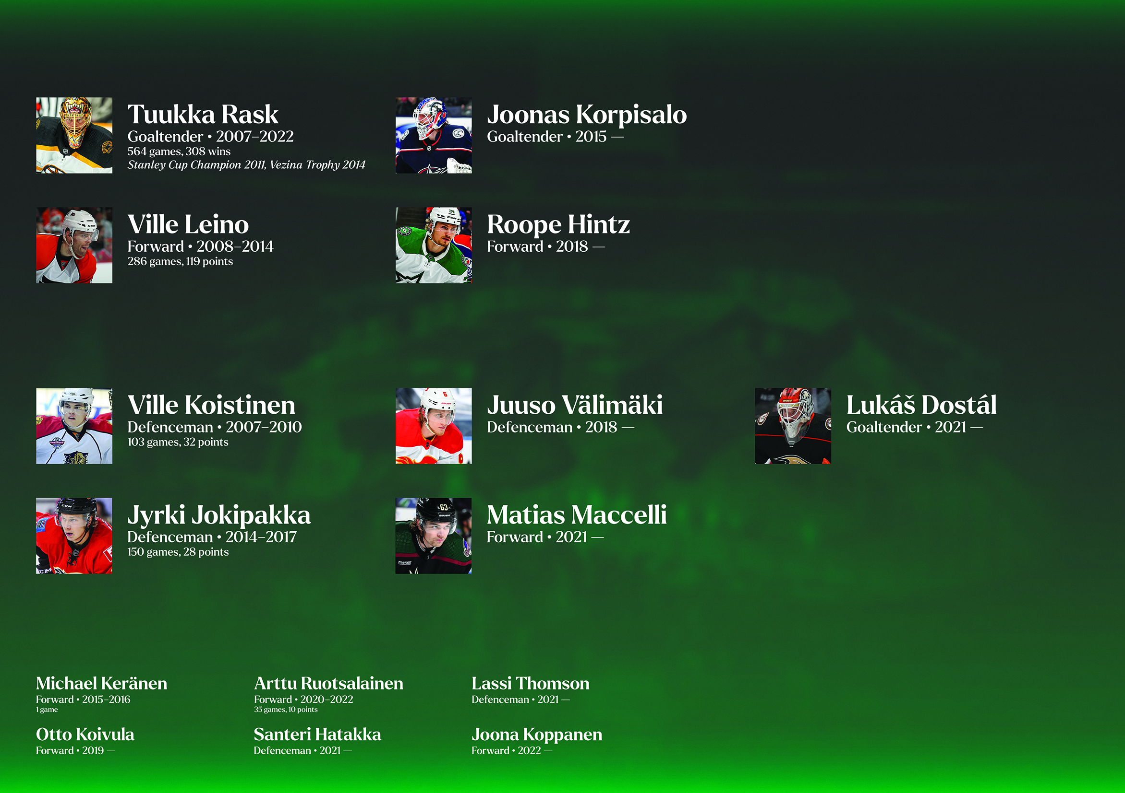

Slide 13


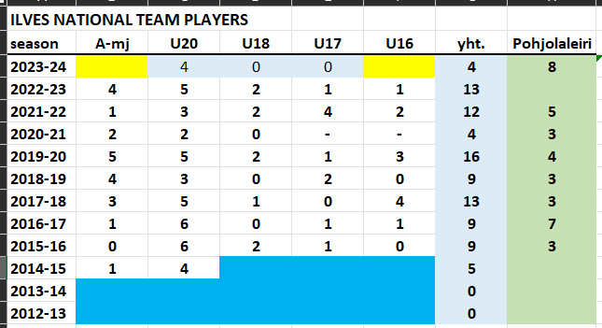
NATIONAL TEAM PLAYERS

Slide 14
THANK YOU!

