Slide 1
Embrace relegation
2022 E.H.C. Hockey Business Forum, Malmö 3 October

Slide 2
Open or closed leagues
Promotion & relegation
”One league – two divisions”
Why relegation could be a good thing for a club
Why a turn-over of teams is healthy

Slide 3
Definition of open leagues:
Where there is an annual opportunity for a team(s) from the 2nd league to be sportively promoted to the top league
And:
Where is an annual risk for a team(s) from the top league to be sportively relegated to the 2nd league.
OPEN: CZE, FRA, GER, SVK, SUI, SWE
CLOSED: AUT, FIN, GBR, HUN-ROU, RUS

Slide 4
Notes:
No, they didn’t close the league, it was never open. There are no AHL-teams or clubs dreaming about promotion to the NHL.

Slide 5
Is there a good reason for a European league to be closed?
”Long-term stability”
”The clubs are shareholders in the league”
”We must make sure to keep the big brands in the league”
”New times, too much money at stake, too much too lose”
Comfortable for the league and the clubs
Play safe – no risk
Selling off players when missed playoffs. League integrity?

Slide 6
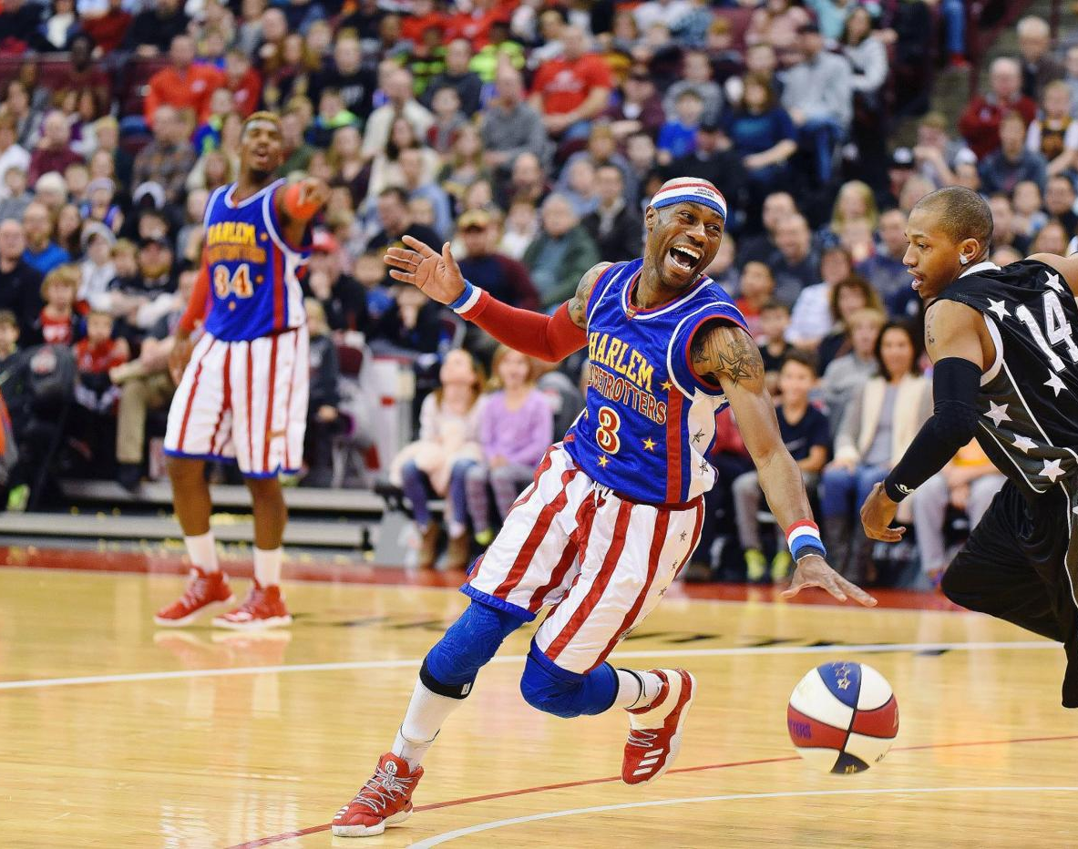
Competitive sports is about winning and losing
It’s about joy and despair.
If you take away losing and despair you take away one basic element.

Slide 7
”A few years ago I was a big supporter of closing the Swedish league; to have stability, for the clubs to invest without fearing risk of relegation and to make sure that clubs from the big cities remain in the top league.”
”I have changed my mind – creativity and ambition are created if you have a dream. Closed leagues are taking away that dream. Creativity comes from living on the edge.”

Slide 9
”If we are relegated it will be a financial disaster, which could kill the club and we may never be back.”
If your club is not good enough to get back to the top league, you are not good enough.
If relegation becomes a financial disaster which may kill the club, the club’s leadership should consider if the club really has elite potential.

Slide 13
“This is not a funeral”

Slide 14
OPPORTUNITY FOR A NEW START
Rebuild a demoralized team, slash the worst contracts
Bring in the juniors you didn’t dare to bring in last season
Make front office changes, slim the organization
Make an honest assessment of where you are (sports & €€)
Communicate honestly to fans, partners and media
Be humble in your new environment (reason why you are here)
Make a credible plan for the club’s return
Do you have conditions to be an elite club?

Slide 17
One league – two divisions
ADVANTAGE:
Joint office, officiating, situation-room, competition rules, etc.
Marketing, look & feel, sale media & marketing, communication.
Probably more money if sold as ”national pro-hockey package”
2nd league clubs more happy > healthier pro league sector
Probable proportions from central marketing: 80/20. (90/10)
Relegation feels less like a disaster
DISADVANTAGE:
Top-league clubs will get less from central marketing
2nd league must give up certain self-promotion
”Sweden’s most entertaining hockey league”

Slide 18
Guiding principle in promotion/relegation:
Team from 2nd league must beat the team from the top league
Annual opportunity – promotion / relegation NOT guaranteed
1.44
BEST-OF-SEVEN
BEST-OF-SEVEN

Slide 19
1

Slide 20
For the first time since 1922 – no top league team in Stockholm
10 out of 14 teams in HA have played in top league; 392 seasons
Teams in HA have together won 33 Swedish titles
CLUB | TITLES | TOP SEASONS
DJURGÅRDEN | 16 | 81
SÖDERTÄLJE | 7 | 74
AIK | 7 | 70
MODO | 2 | 55
BJÖRKLÖVEN | 1 | 26
VÄSTERÅS | 0 | 35
MORA | 0 | 27
KARLSKOGA | 0 | 16
TINGSRYD | 0 | 7

Slide 21
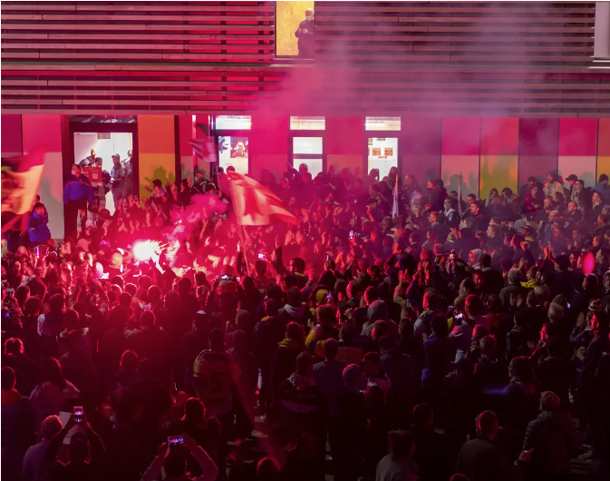
Don’t kill dreams
Promotion & relegation
But not guaranteed
Healthy turnover, healthy hockey
”One league – two divisions”
Relegation can be a good thing

