Slide 1
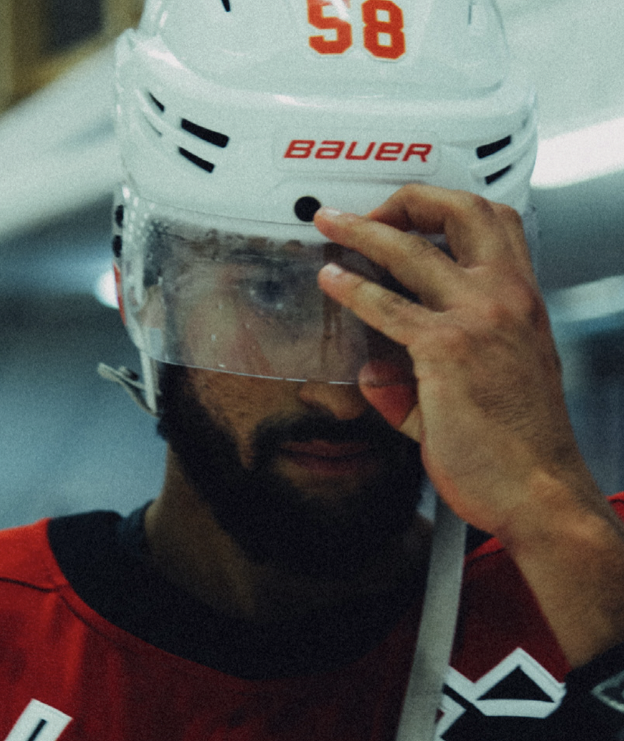
Hockey 2.0

Slide 2
The idea
What if growth lies outside of our comfort zone?

Slide 3
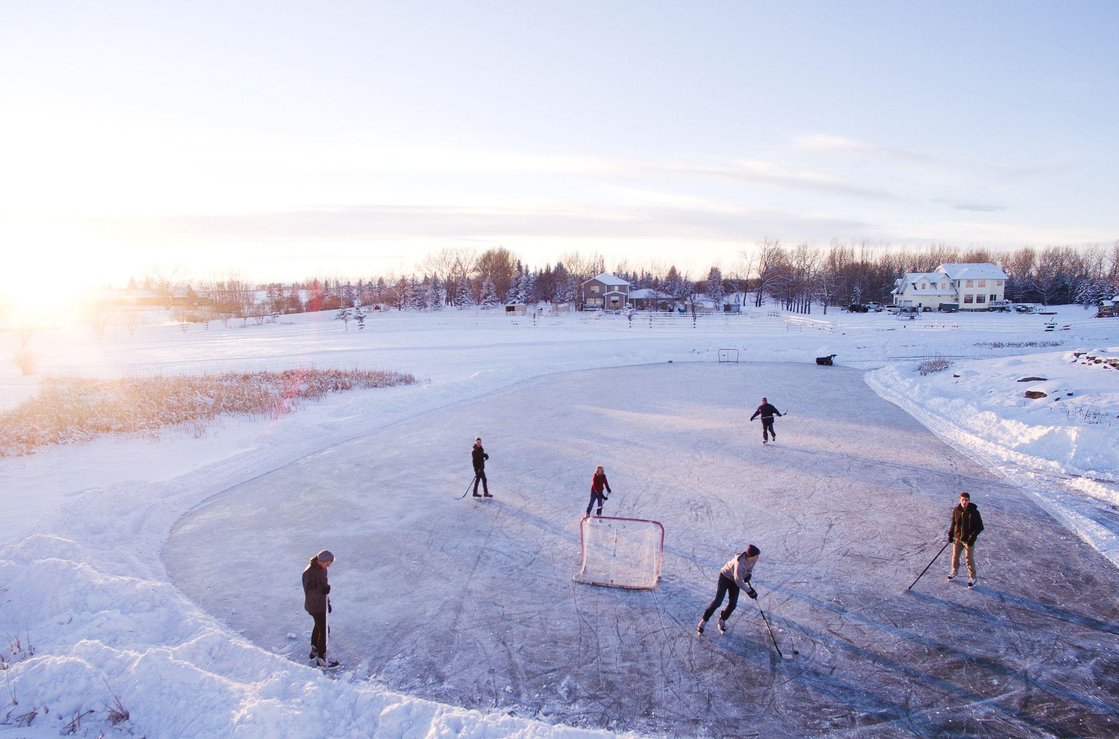
Notes:
Challenge of sign ups and competition of other sports and social media/gaming
Situation in Stockholm with no capital city team in the highest league
What will be the local and national consequence of it in the future?

Slide 4
“Society is changing, Canada is changing. You can name any options that people have these days. It’s not like in the past when hockey could just put an ad in the paper and people would sign up. This is the first time hockey has had to market itself, that’s where we’re at.”
Ontario Minor Hockey Association

Slide 5
The organization’s registration has declined in recent years.
The numbers were at 92,650 in 2015 and 89,400 in 2019.
Ontario Minor Hockey Association

Slide 6
“Even before the pandemic, we recognized that it’s not an automatic that, because we’re in Canada, people will sign their kids up for hockey,”
Ontario Minor Hockey Association

Slide 7
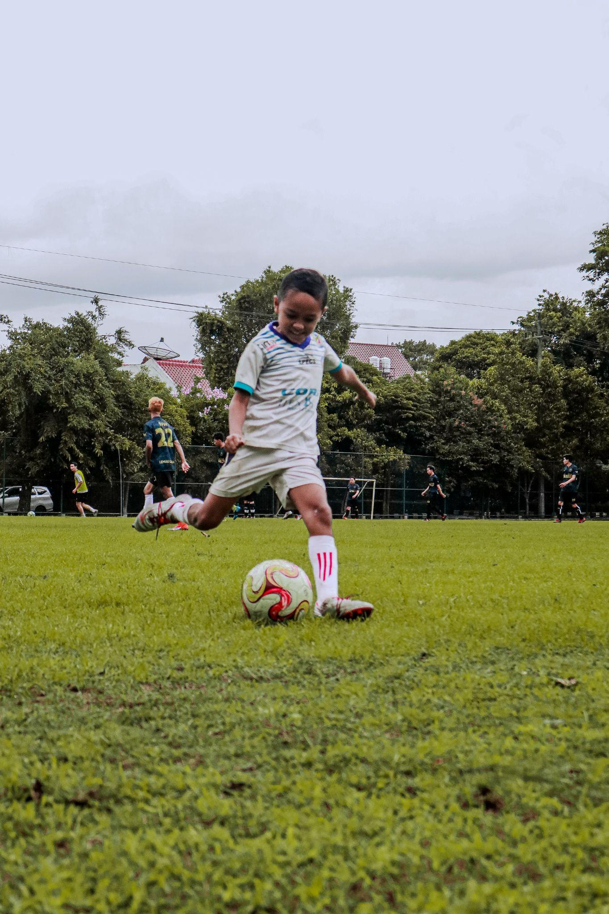
culture or capital?

Slide 8
Who are we talking about?
Notes:
++ Pratar vi framförallt om breda invandrargrupper (nysvenskar) från länder där hockeyn praktiskt taget existerar?

Slide 9
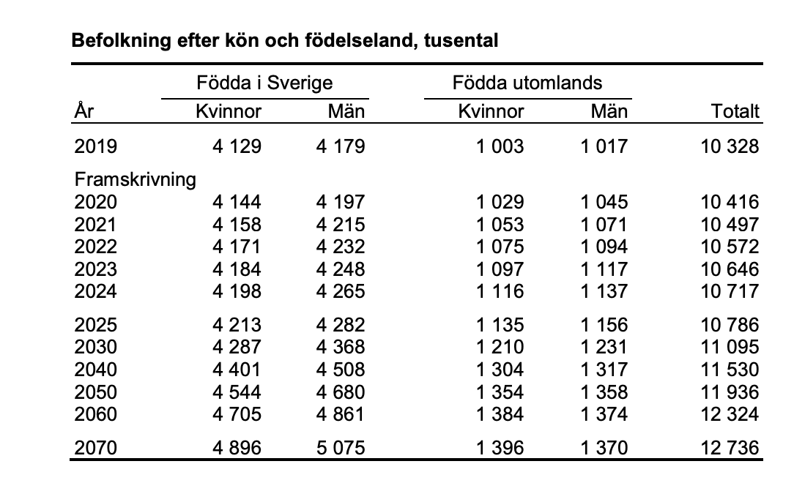
According to the SCB Sweden will hold a steady state of around 25% of its population being born outside of the country up until 2070.

Slide 10
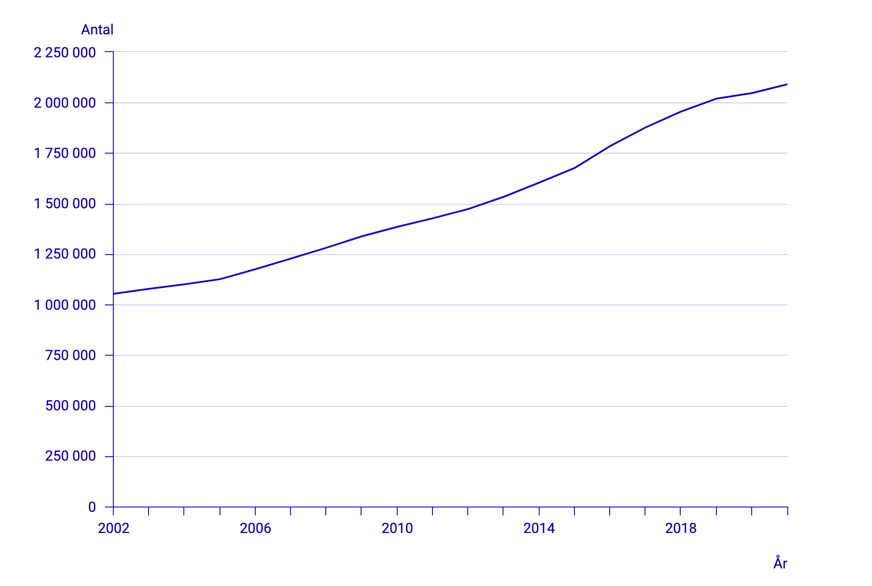
Rate of imigration Sweden

Slide 11
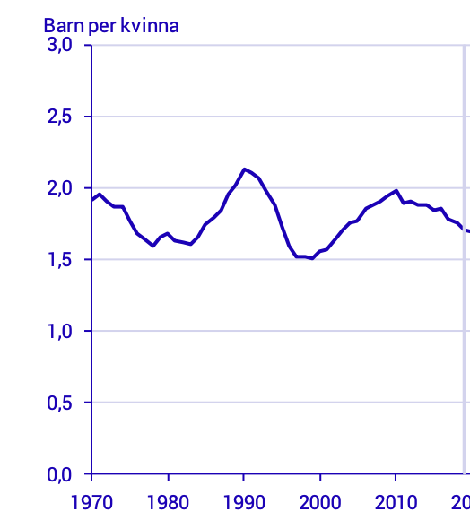
Notes:
Barn per kvinna i Sverige
Not a question about imigration but integration and sports and activities is the best way

Slide 12
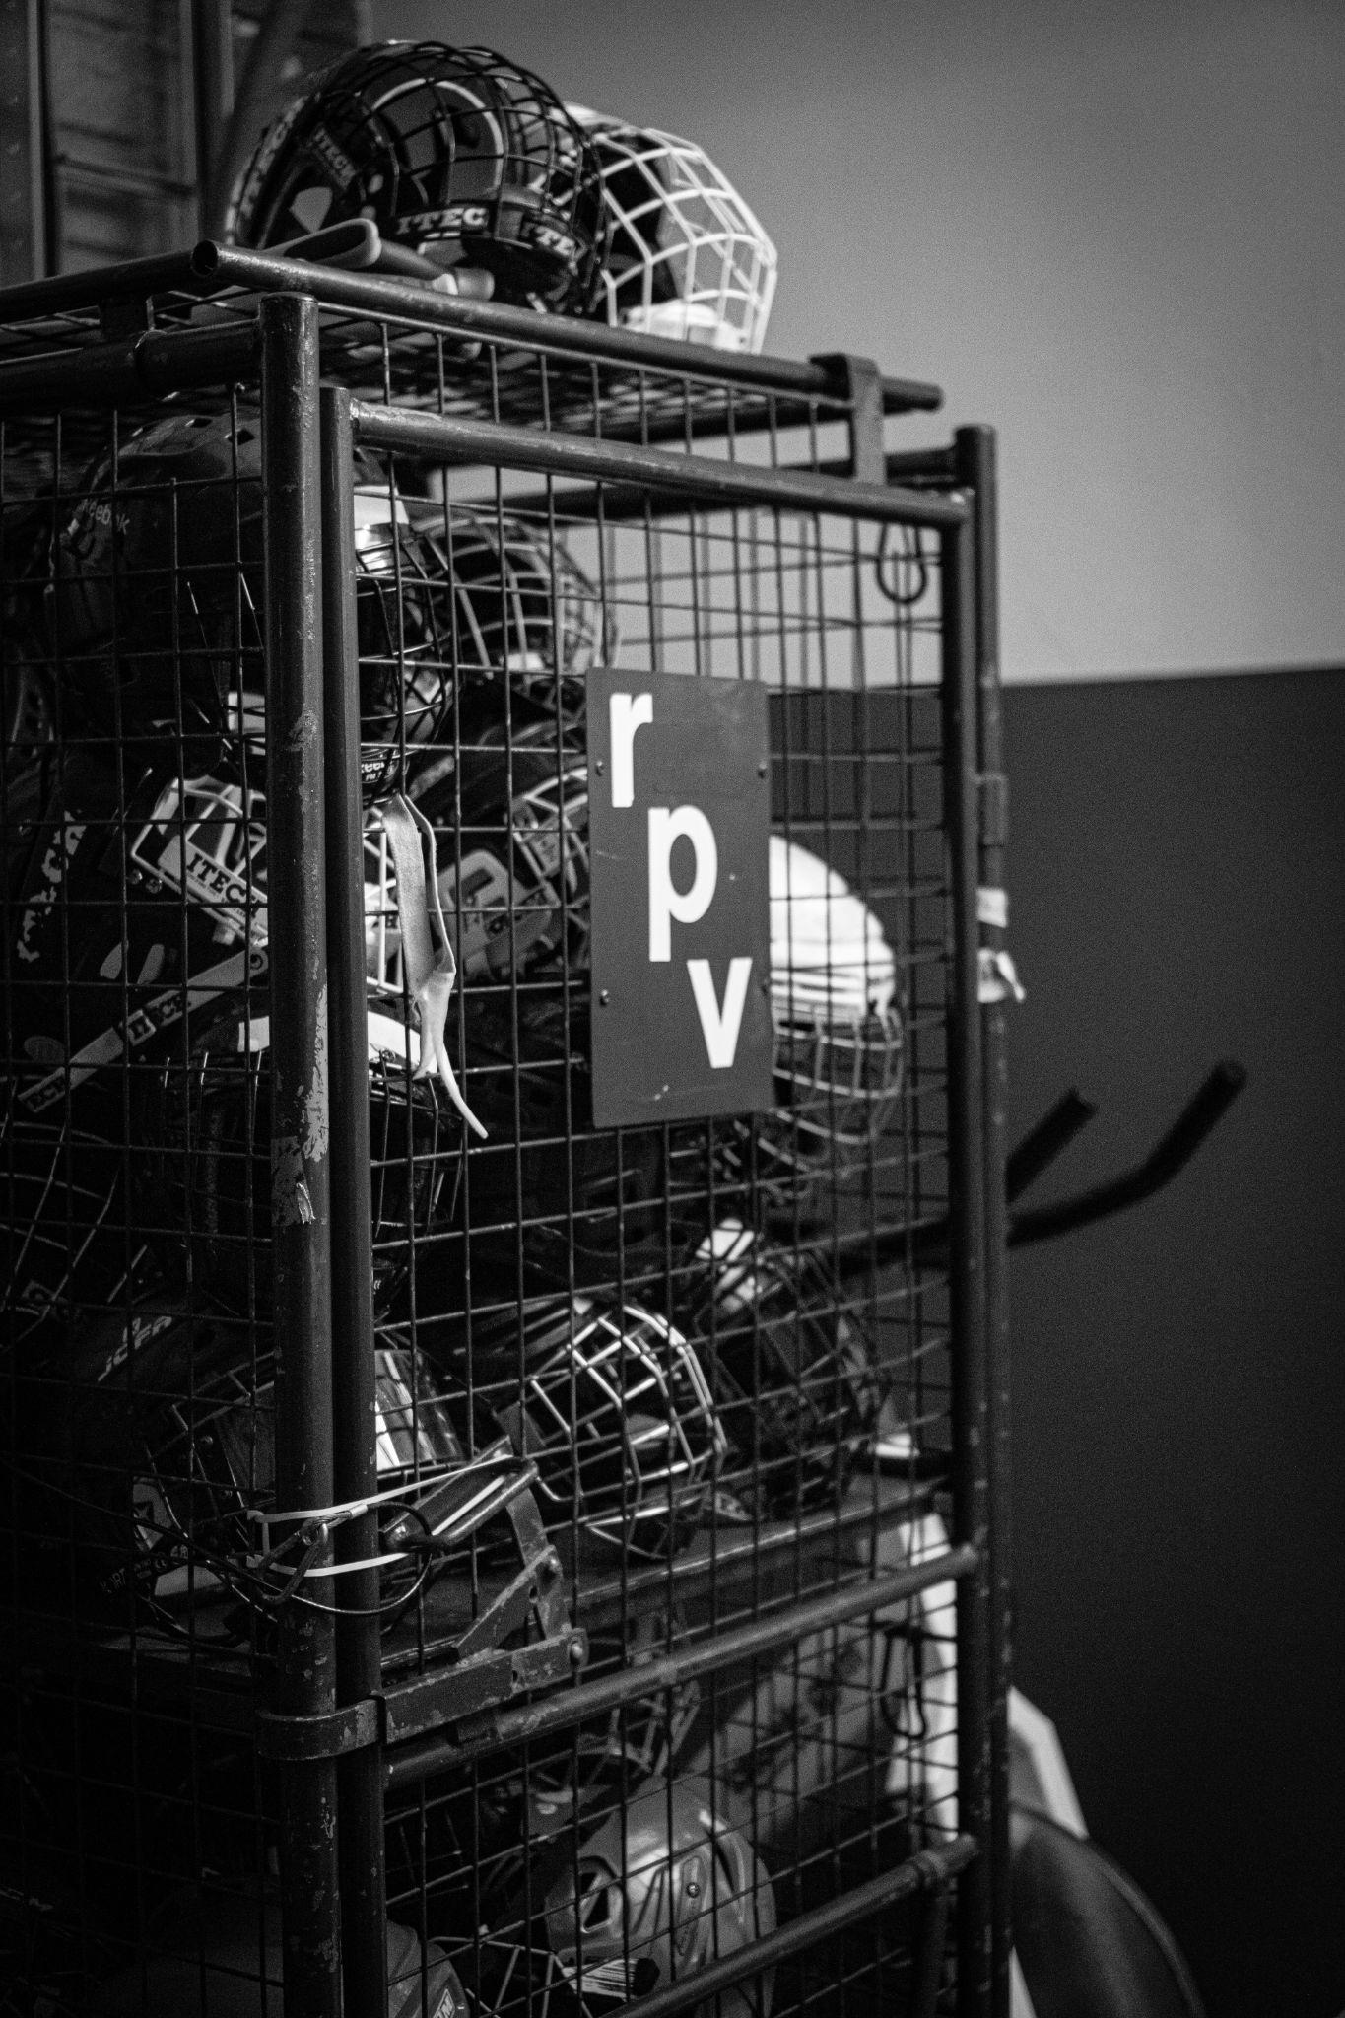
What needs to change for the games development?

Slide 13
Rise of women's hockey
Source: IIHF

Slide 14
Womens hockey in Sweden
2003 2019
2194 5341 active players
Notes:
We actively put focus and effort in developing women's hockey!

Slide 15
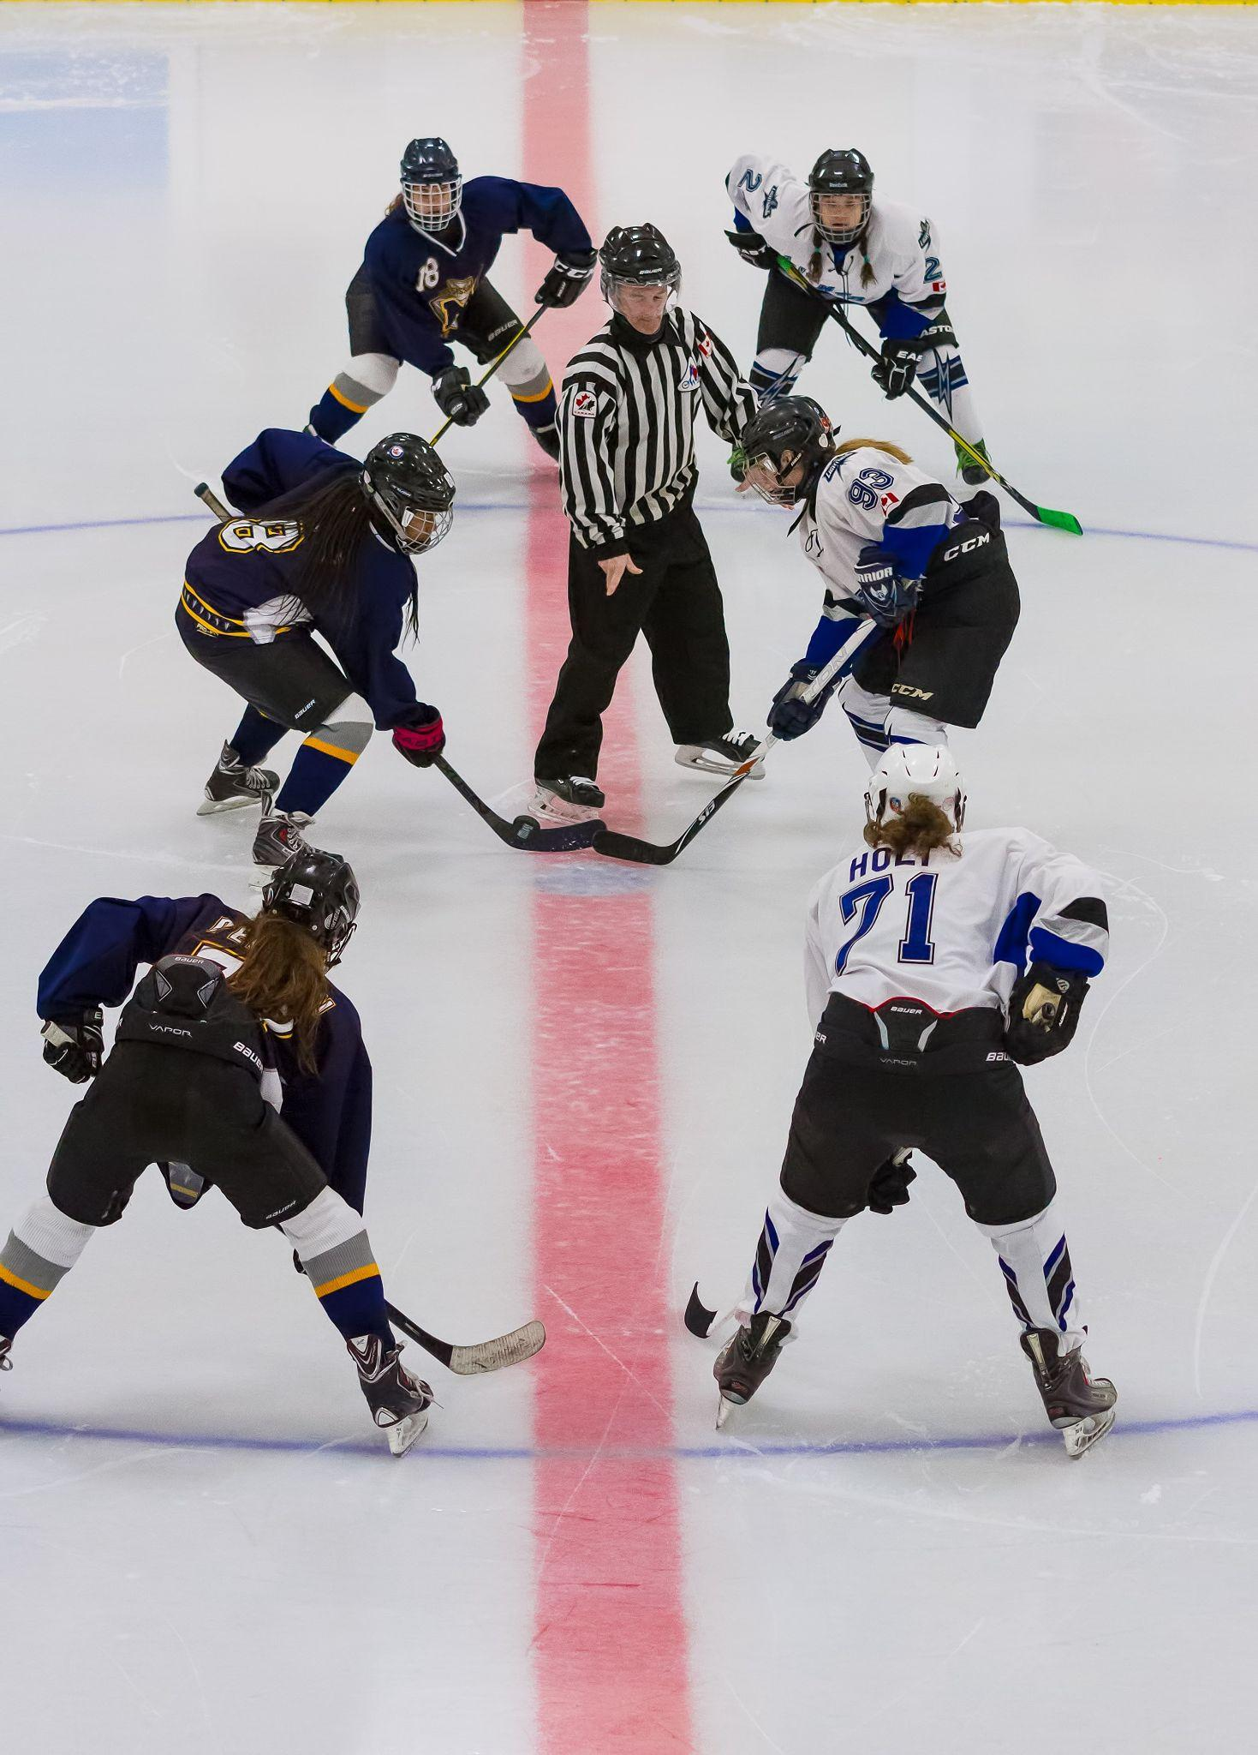
So what did we do?
Notes:
We actively put focus and effort in developing women's hockey!

Slide 16
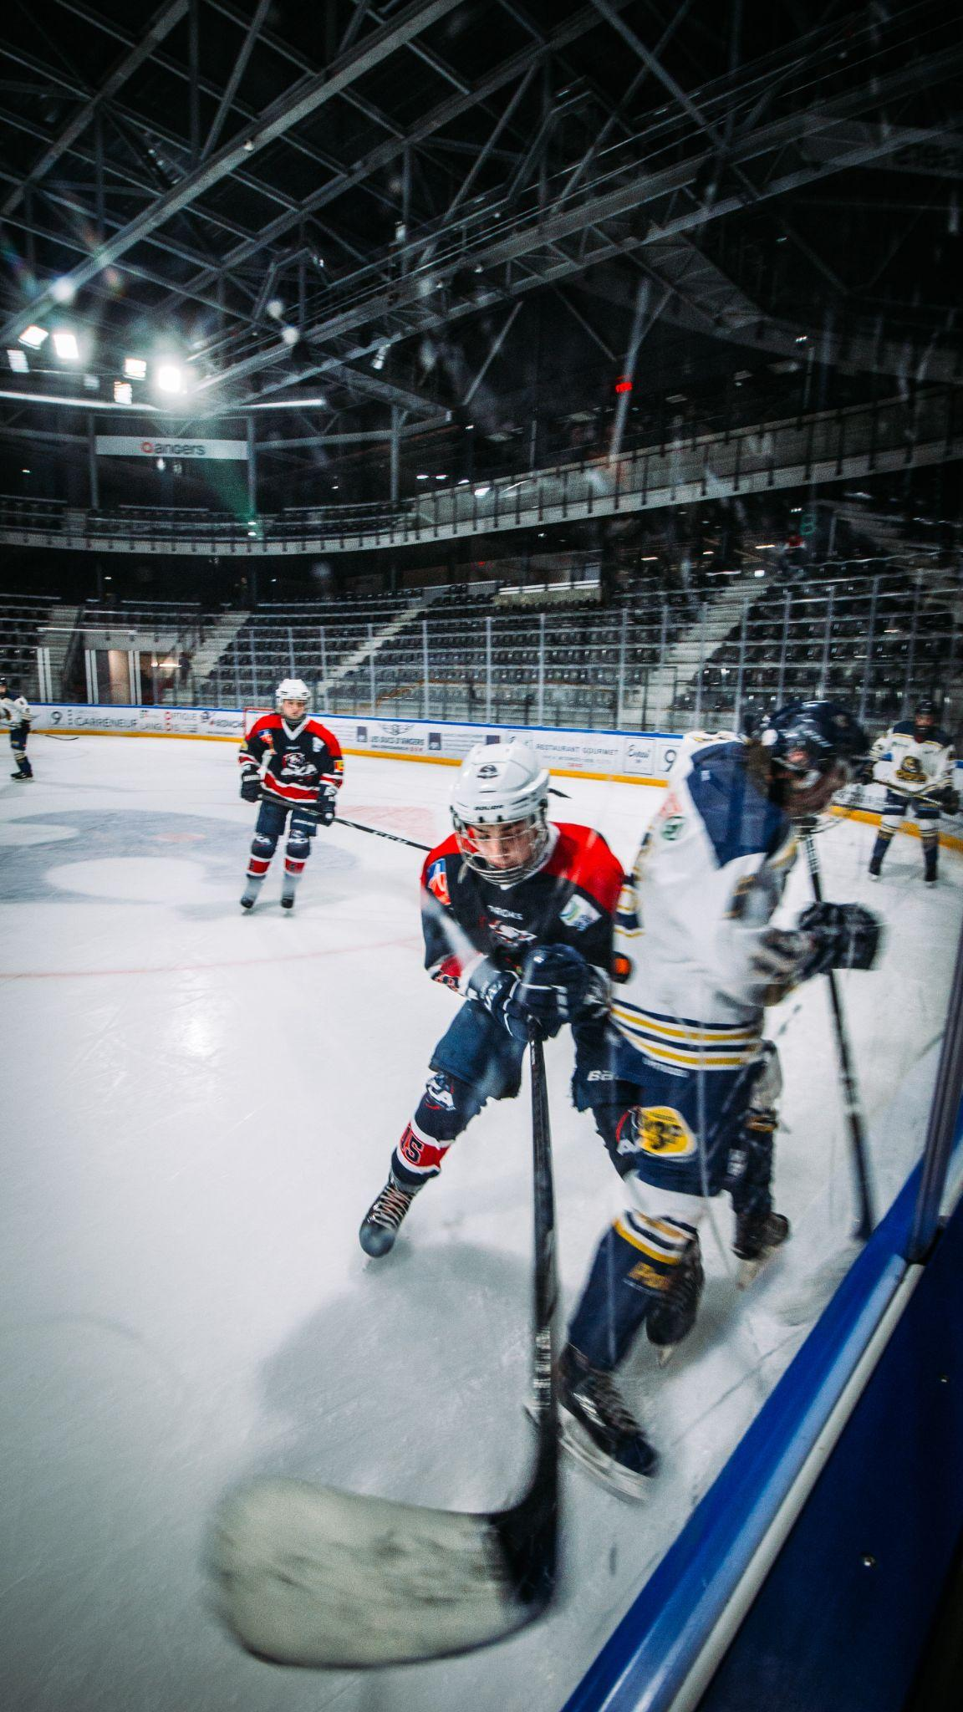
the way forward
Notes:
Leadership and responsibility for development

Slide 17
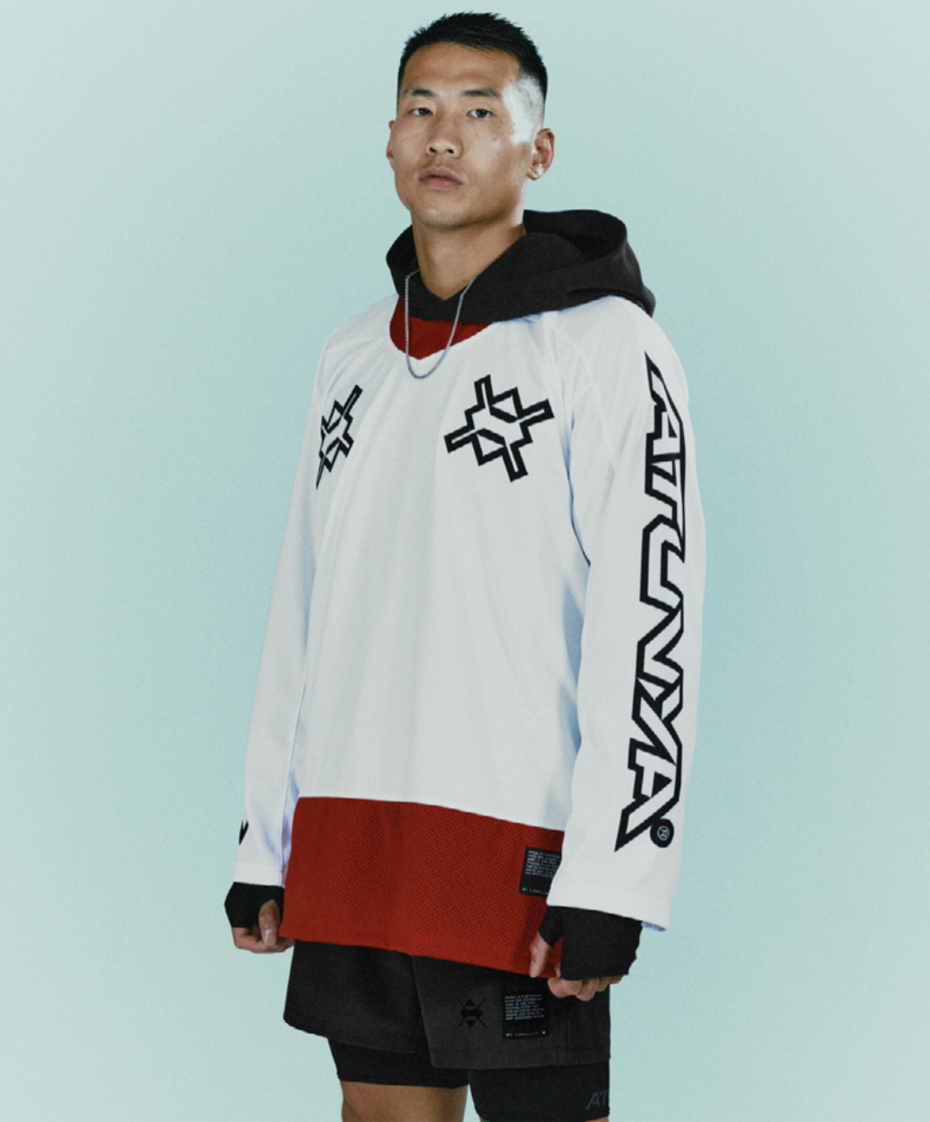
How will we reach other demographic groups?
Notes:
New rinks and areas to skate - 2006 last built rink in the city
What hockey looks like needs to change
How we speak and act needs to develop
Upside of strong capital incentive to become a professional like in soccer
Find a local role model

Slide 18
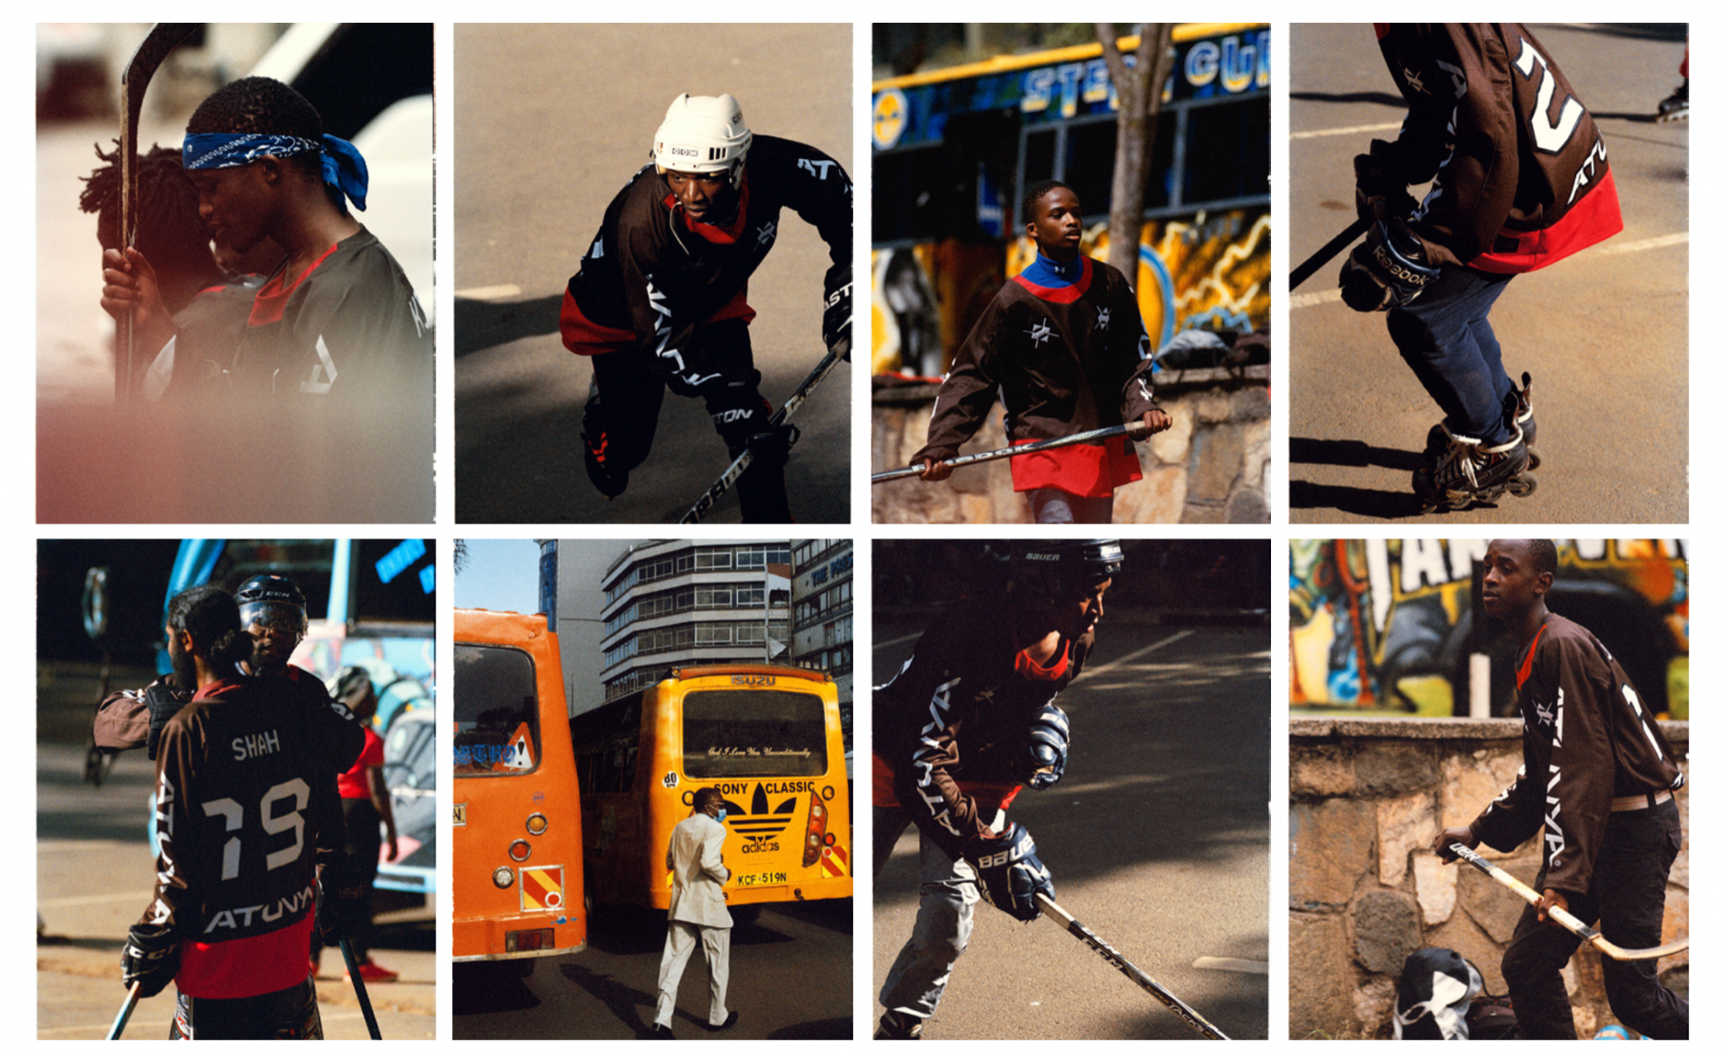
Notes:
What it looks look needs to change

Slide 19
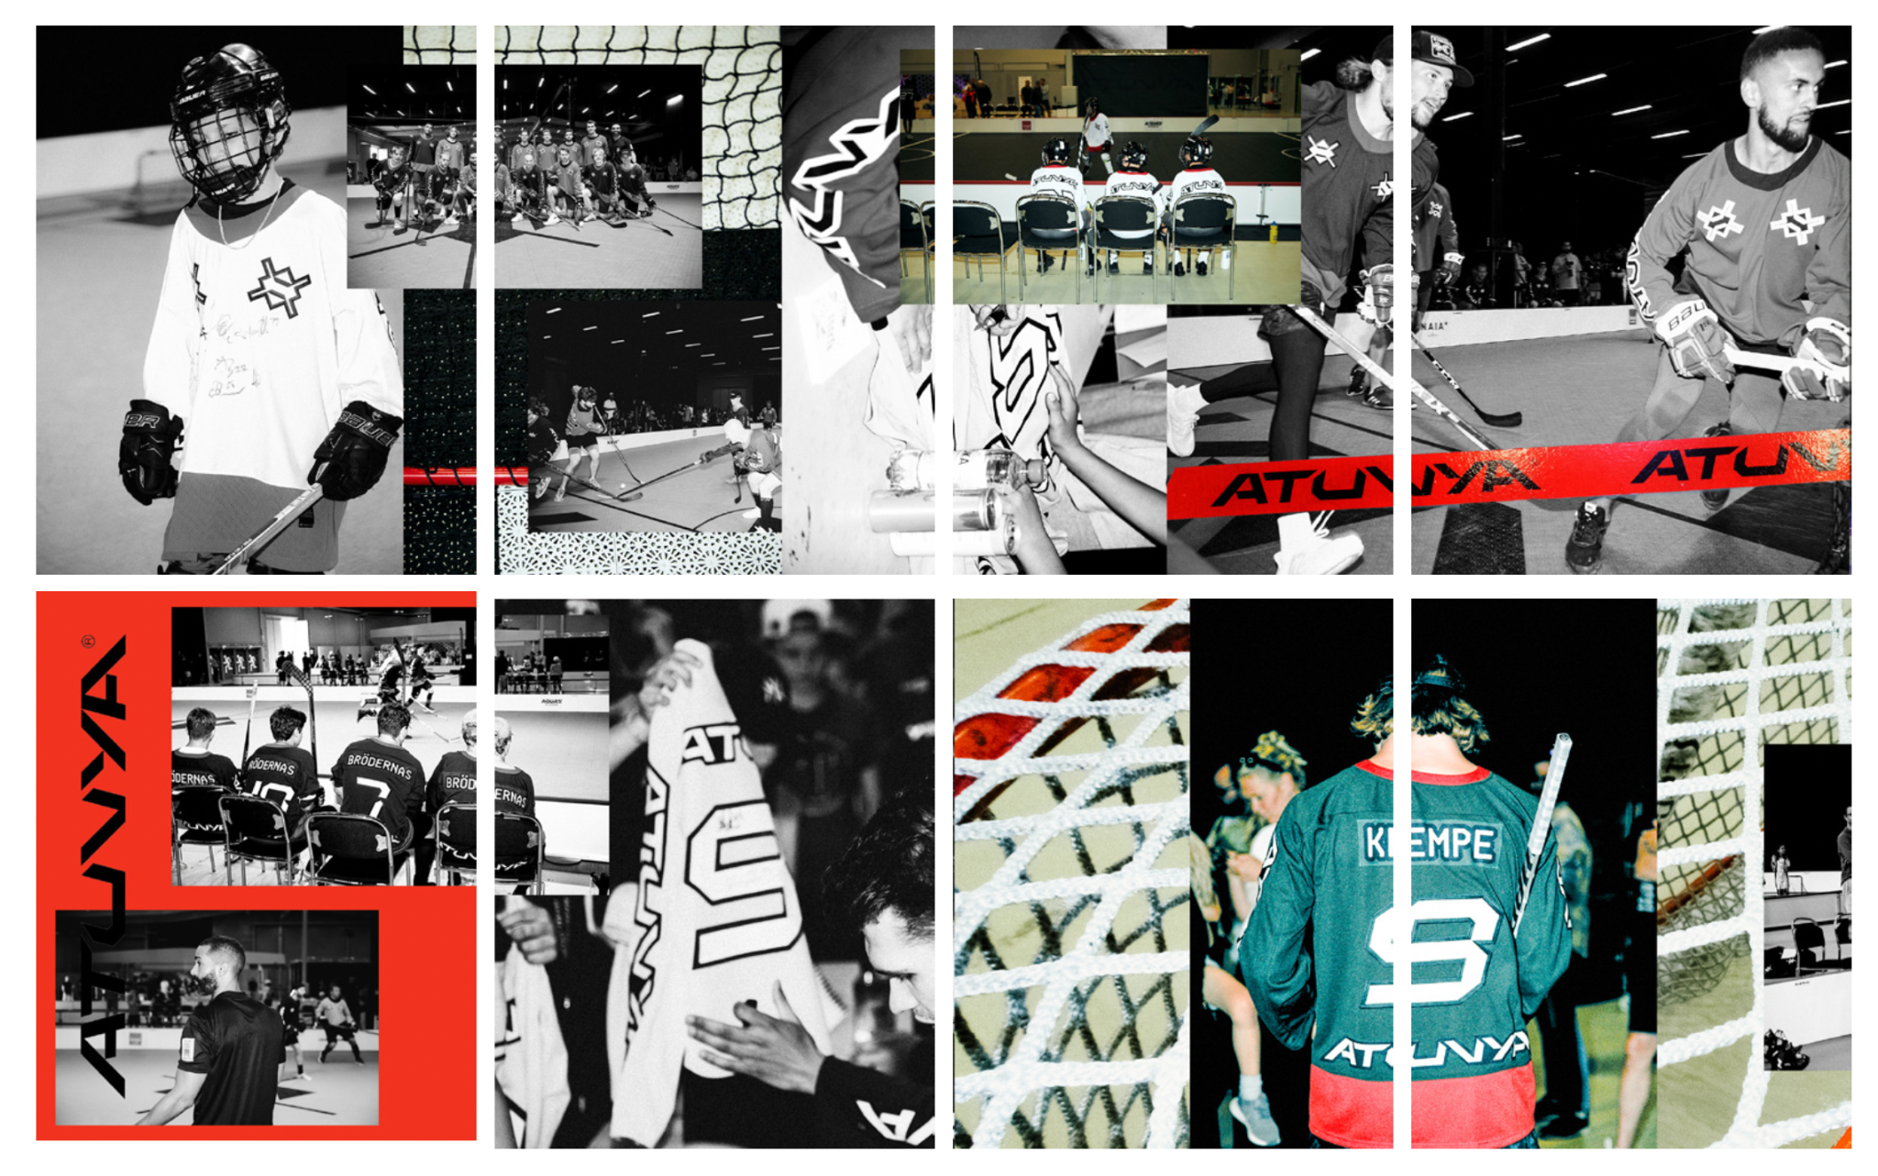
Notes:
Create a easy way into the sport

Slide 20
Notes:
Find transition collaborators to support the journey into hockey

Slide 21
Notes:
We need partners that can support young players with gear

Slide 22
Notes:
Clubs to allocate icetime and equipment service along with parent information

Slide 23
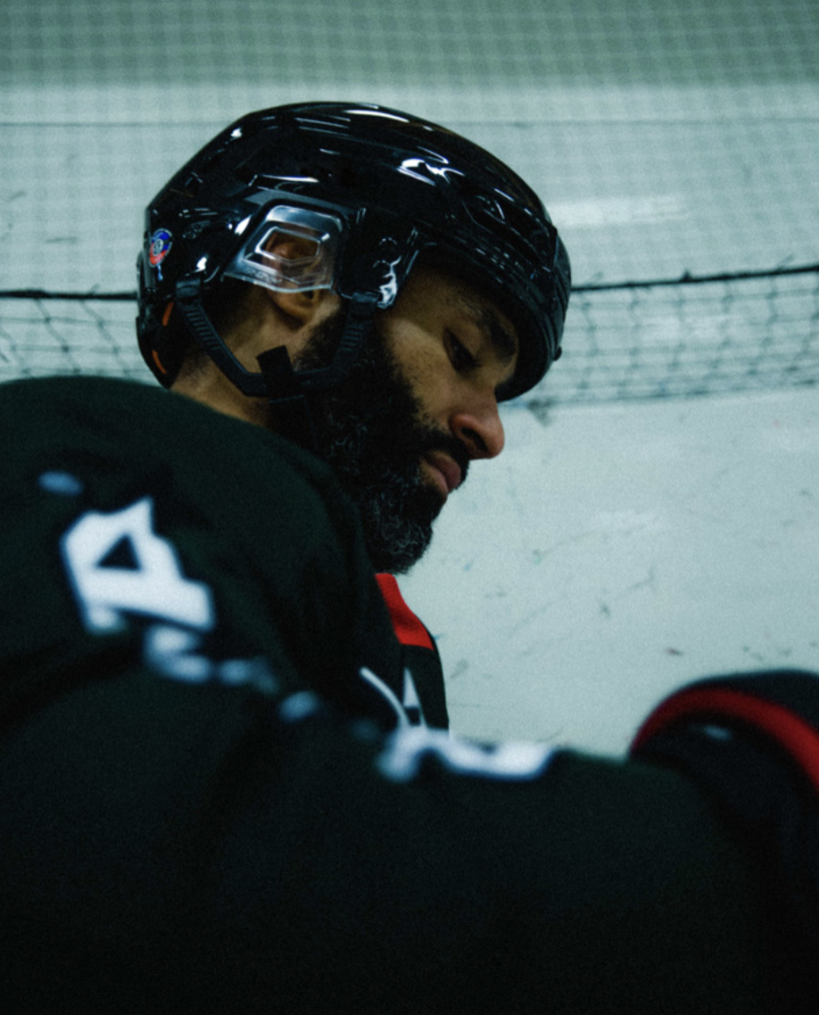
How we display & communicate hockey
Support organisations
Partnering companies
Clubs and organisations
Notes:
Can we see it as an development of the brand hockey and its business model?

Slide 24
Zlatan as a hockey player

