Slide 1
BEYOND THE BUZZ
Growing Women‘s Sports
Prague, April 2025
1
Notes:
Hello and good morning from my side, too.

Slide 2
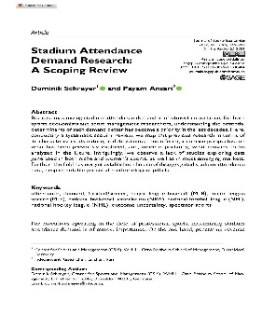
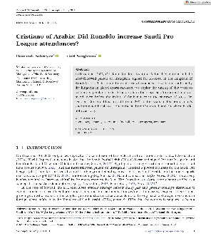
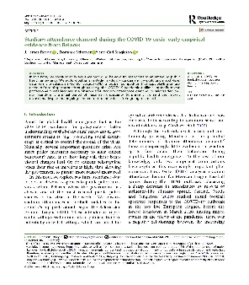
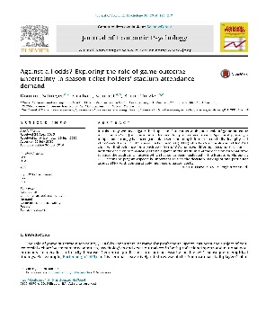
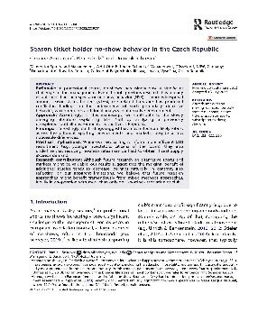
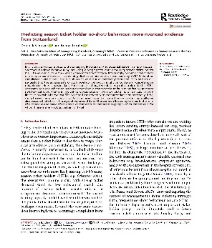
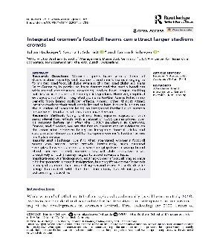
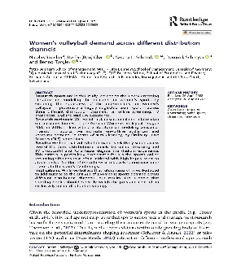
Who‘s speaking
Professor of Sports Economics (WHU), practice-oriented research with a focus on stadium economics and spectator behavior, including women’s sports
Attendance demand¹
No-show behavior¹
…
Women‘s sports¹
Partner²
Abbreviations, notes, and sources:¹ Selection of published research articles in international, peer-reviewed journals (a total of 42 articles, in addition to numerous book chapters and practice-oriented reports) ² Past research and cooperation partners in the field of stadium economics.
apl. Prof. Dr. Dominik Schreyer | WHU | Center for Sports and Management (CSM)
2
Notes:
For those of you who are wondering, “Who’s that guy on stage?”
My name is Dominik Schreyer, and I’m a Professor of Sports Economics at WHU…
… and Director of the Center for Sports and Management.
At our Center, what we typically do is help executives in professional sports prepare for a future where tech-savviness is crucial for success.
For instance, right now we’re running a series of what we call Future Workshops with Borussia Dortmund. We also supported Fortuna Düsseldorf in developing their Fortuna for Everyone campaign.
So, I’d say we’re really applied, rather than just working in an ivory tower.
Importantly, whether we’re teaching or consulting within the sports business, everything we do is grounded in empirical research.
My own research, in particular, focuses on all things stadium economics.
In practice, I model sports demand — mostly attendance demand — and I’m especially interested in no-shows.
Lately, I’ve also done more work on women’s sports, which I find to be a fascinating field of research.
Because, quite frankly, in my niche, not many people seem to care about what actually drives demand for women’s sports.
Well, I do.

Slide 3
Women‘s
sports
apl. Prof. Dr. Dominik Schreyer | WHU | Center for Sports and Management (CSM)
3
Notes:
And, today, I want to talk about how we — or you — could grow women’s sports.
And quite frankly, I think that very sentence is illustrative of everything that’s currently going wrong.
So, let me say it again: Today, I want to talk about how we could grow women’s sports.
Not sports. Not men’s sports.
Nobody ever feels the need to say that. But when it comes to women’s sports, we always have to specify.
And I really think that’s a problem.

Slide 4
Language matters: Perception shapes value
Women‘s
sports
apl. Prof. Dr. Dominik Schreyer | WHU | Center for Sports and Management (CSM)
4
Notes:
Just think about this for a moment.
The seemingly simple label “women’s” is anything but neutral.
I mean — what’s the purpose of that qualifier? It implies difference — and, more often than not, inferiority.
When we say “women’s sports,” do we actually mean “lesser sports”?
This isn’t just a matter of semantics.
It points to something much deeper:
A lack of control,
Poor positioning,
And weak branding.
Am I right?

Slide 5
A boom is happening
91.6k
60.7k
91.5k
60.2k
77.4k
60.1k
72.3k
60.1k
Abbreviations, notes, and sources: Most in-demand women’s (club) football matches by stadium attendance (Wikipedia, as of April 11, 2025)
apl. Prof. Dr. Dominik Schreyer | WHU | Center for Sports and Management (CSM)
5
Notes:
But why should we care?
I mean, wherever you look these days — there’s a new record.
What you see here on the slide — and yes, I apologize that it’s all about football — are the eight most-attended matches in European women’s club football.
These are seriously impressive numbers.
Barcelona Femení’s positioning is, without a doubt, world-class.
Arsenal is making a real push — they’ve moved most of their women’s matches to the Emirates Stadium.
And in the background, you can see the women’s team from Hamburger SV, currently playing in Germany’s second division — and yet they recently attracted 57,000 fans to a cup match at Volksparkstadion.
I mean, wow. That’s wild, right?
These matches clearly show that when the conditions are right, there’s massive demand for women’s sports.
And guess what? Now, all the clubs, agencies, and marketers are jumping on the bandwagon, using these moments to craft a narrative: “Women’s sports are booming.”
Right?

Slide 6
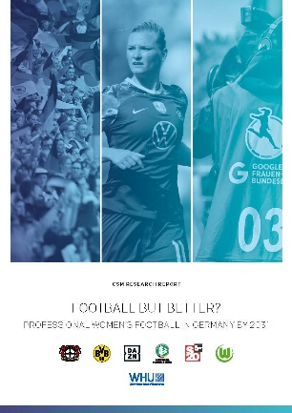
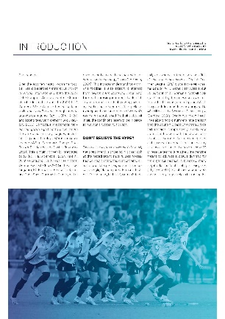
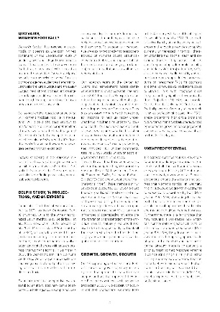
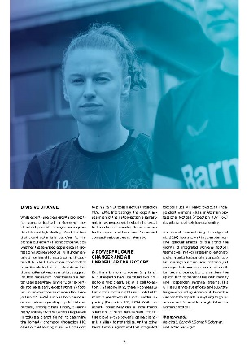
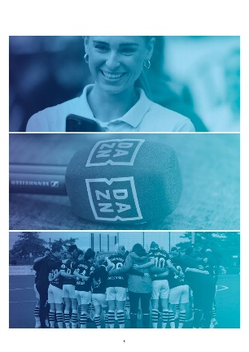
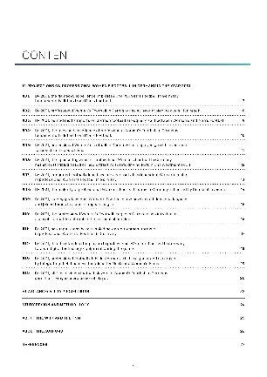
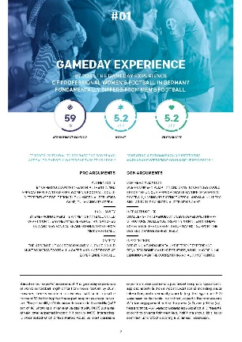
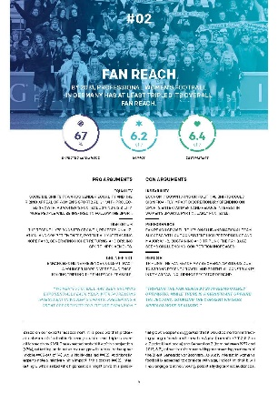
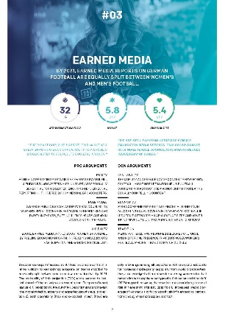
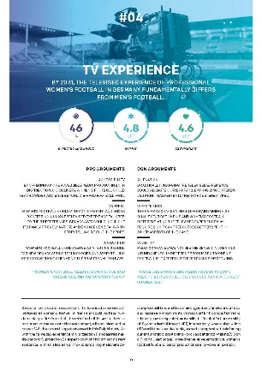
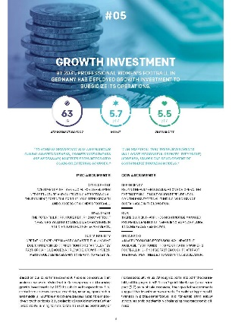
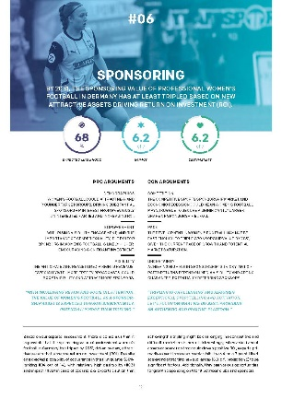
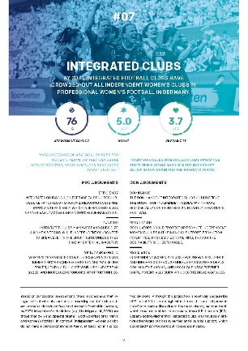
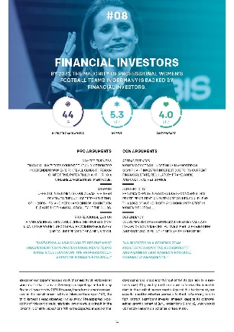
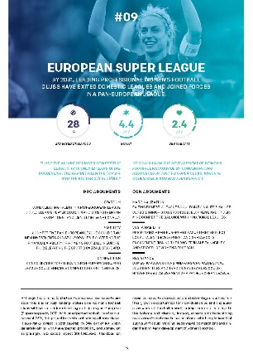
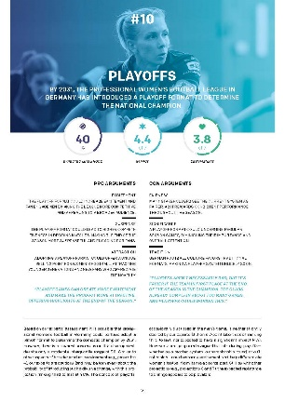
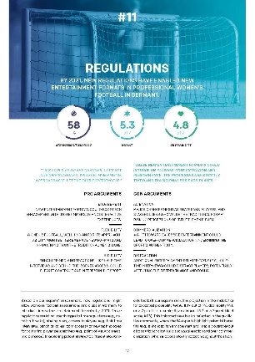
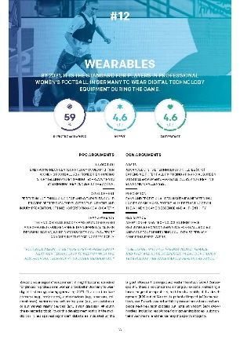
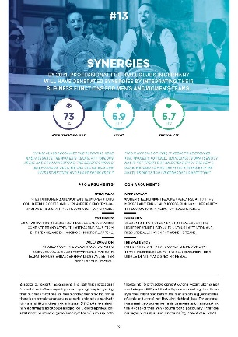
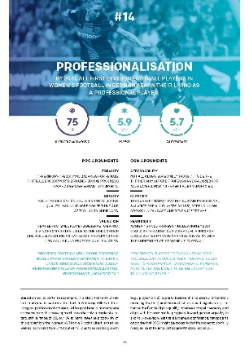
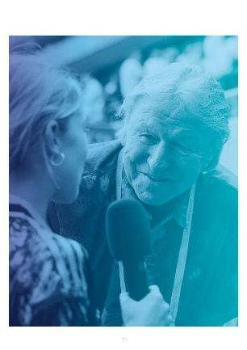
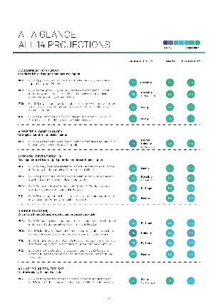
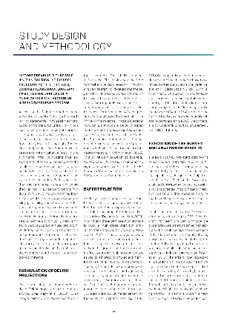
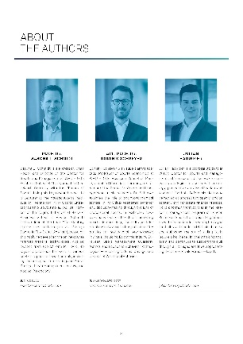
We’re all part of the story
“Fan reach and sponsorship value in professional women’s football in Germany could triple by 2031, new WHU Delphi study finds”
apl. Prof. Dr. Dominik Schreyer | WHU | Center for Sports and Management (CSM)
6
Notes:
And even I’m part of this story.
Last year, we published a Delphi study on the future of German women’s football.
In this kind of study, we ask a panel of experts to assess a number of projections about the future.
And one of the key findings — which the media happily picked up — was that fan reach could triple by 2031.
I mean, if you’re an agency or a marketer, that’s exactly the kind of data you want to fuel your narrative.
That’s great news, right?

Slide 7
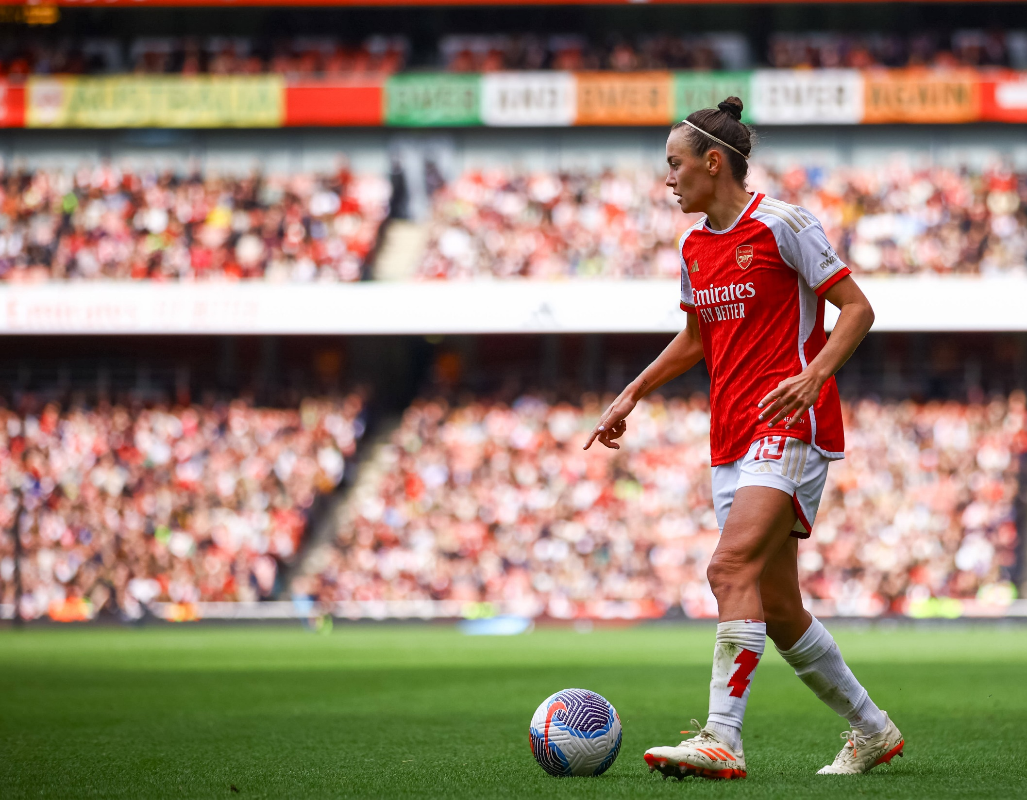
Yes—but…
Yes, demand might triple by 2031— but it’ll still trail men’s 3. Liga
Yes, Arsenal’s Women attract large crowds to the Emirates— but they’re an outlier¹
Yes, there’s considerable hype—but demand in both Women’s Super League and Frauen-Bundesliga seems to have plateaued
Abbreviations, notes, and sources: ¹ As are Barcelona Femini. For instance, in the current 2024–25 season, Arsenal distributed approximately 38% of all WSL tickets. As such, Arsenal—averaging around 29.4k tickets distributed per match—boosted the league’s average demand from about 4.4k to 6.4k. However, this is still lower than last season’s average.
apl. Prof. Dr. Dominik Schreyer | WHU | Center for Sports and Management (CSM)
7
Notes:
Still, it’s important to put things into perspective.
And to emphasize that — no matter the hype — growth is not guaranteed. It’s not automatic.
Yes, demand might triple by 2031. But even if it does, average attendances would still be lower than what we see today in Germany’s third league.
Yes, Arsenal Women attract impressive crowds. But they’re a clear outlier — accounting for nearly 40% of all ticket sales in the league.
And yes, the hype is real. But if you actually look at the attendance data, you’ll see that this year, there’s no real growth. In both the WSL and the Frauen-Bundesliga, demand is plateauing at best — and it’s largely driven by a few highlight matches.
But as I said at the beginning — today, we want to talk about how women’s sports could grow.
And in my research, I’ve identified three things that I think are worth sharing.

Slide 8
If They Can’t Find It, They Won’t Watch It
Distribute
apl. Prof. Dr. Dominik Schreyer | WHU | Center for Sports and Management (CSM)
8
Notes:
The first path to growth is relatively simple.
And while the word on my slide says “Distribute,” what I really mean is accessibility.
A few years ago, my team and I explored women’s volleyball data.
Specifically, we wanted to know: Are the factors that drive demand the same across different distribution channels?
So we looked at TV, streaming, and — of course — in-stadium attendance.
At the time, women’s volleyball had moved from being shown on public TV, via a dedicated sports channel, to being available via online streaming. Both were free. But the demand for streaming was significantly lower than for traditional broadcasts.
Put simply: People were happy to watch volleyball when it was part of their usual TV sports routine. But they didn’t follow the sport when it moved to a different platform.
They were watching sports — not specifically volleyball.
It seems like a no-brainer, but clearly it’s not: Go where your potential audiences already are.
And this is critical to understand: To grow demand, you don’t just need to activate your existing fans —You need to reach new audiences. New customers.

Slide 9
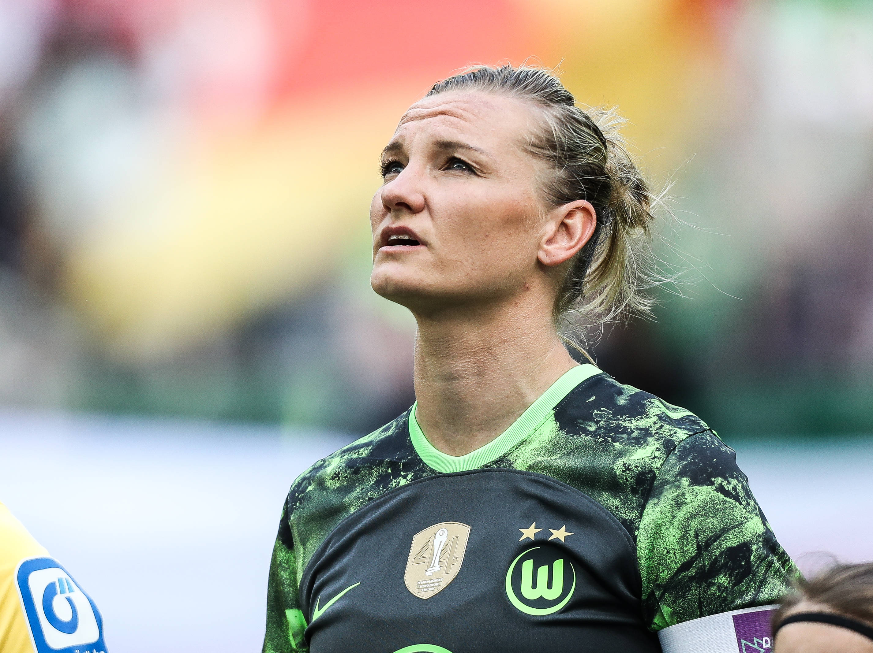
Clubs need a platform to stand on
Scale
apl. Prof. Dr. Dominik Schreyer | WHU | Center for Sports and Management (CSM)
9
Notes:
The second path to growth is closely related: Scale. Though, honestly, I could’ve just called it Cooperate.
When I say “Scale!”, what I really mean is:
Find a partner who
A) already has access to large, relevant audiences, and — even more importantly —
B) is willing to champion you.
And that’s crucial.
Last year, we published a study on the effects of integrated clubs on stadium attendance demand.
So, in men’s football, there’s this trend to integrate women’s teams — often as part of a diversification strategy.
And the assumption is: for women’s clubs, that’s a good thing.
Because, well, men’s clubs tend to have:
bigger audiences,
larger stadiums,
more resources,
more networks,
more expertise.
So we looked at the data — several years’ worth. Several markets.
And guess what we found?
Nothing. No significant effect. We were puzzled.
Why is that?
So, we dug deeper into how these integrations are actually managed — and we found something interesting:
Highlight matches — games played in the men’s stadium, with real promotion behind them — did significantly boost demand.
And that might not surprise you. But it tells us something important:
If you’re going to partner, do it with someone who wants you to grow. Who actually champions your success — not someone who’s just using your sponsorship revenue to buy a new left back for the men’s team.

Slide 10
Solving the Innovator’s Dilemma
Dare
apl. Prof. Dr. Dominik Schreyer | WHU | Center for Sports and Management (CSM)
10
Notes:
Dare.
This brings us full circle, if you will.
As I said at the beginning, women’s sports are often perceived as something less.
And one reason for that is simple: It’s often just more of the same.
It’s Hockey. But now Women’s play it.
And, don’t get me wrong, that’s great. And fair, even, if we want to go down that road.
But is it a better product? Is it one that will sell?
To truly differentiate, I believe women’s sports executives need to leave the trodden path.
And let’s be honest: There’s a lack of ambition out there. A lack of fresh takes.
And, speaking about integration, that’s a missed opportunity.
Because by becoming bolder, women’s sports could actually solve a problem for integrated clubs — all of which are facing the classic innovator’s dilemma.
Let me explain.
The clubs I showed you earlier — they’re already in high demand.
And when you’re successful, it’s hard to change.
To stay competitive, they have to keep catering to the needs of their core clientele.
And those fans? They’re resistant to innovation.
A few weeks ago, I asked ticketing managers for an EVENTIM workshop about the likelihood of several ticketing innovations becoming mainstream: Blockchain tickets, dynamic pricing, virtual experiences, biometric access—you name it.
And the answer was almost always the same: “Our fans don’t want that.”
But here’s the thing: Those fans are aging.
And the next generation — Gen Z — wants something different.
They’re looking for:
Experiences, not just 90 minutes.
Stars, not just teams.
Highlights, not full matches.
And here’s a striking data point: In the U.S., every second Gen Z person has never attended a live sporting event. Never.
But they’re somewhere — on TikTok, on YouTube, on whatever comes next. And you need to be there.
Tackle them. Do it differently.
So that one day, it’s not the women’s teams learning from the men — but the men’s teams learning from you.

Slide 11
Dare. Distribute. Scale.
apl. Prof. Dr. Dominik Schreyer | WHU | Center for Sports and Management (CSM)
11
Notes:
And that’s already everything I wanted to share.

Slide 12
Language matters: Perception shapes value
Women‘s
sports
apl. Prof. Dr. Dominik Schreyer | WHU | Center for Sports and Management (CSM)
12
Notes:
And I hope, that someday, women’s sports is a positive association.
Let’s see what the future holds.

Slide 13
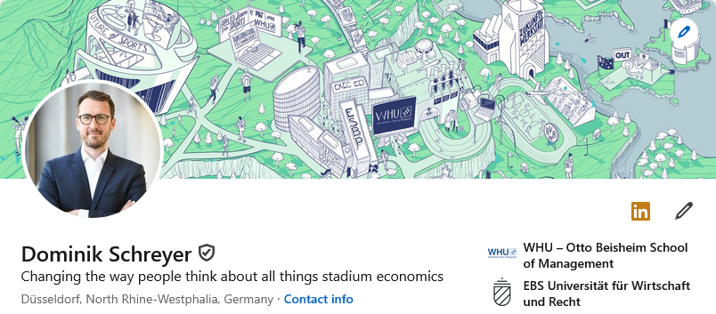
Thank you
apl. Prof. Dr. Dominik Schreyer | WHU | Center for Sports and Management (CSM)
13
Notes:
Thank you
And if you want to keep up to date with all things stadium economics, including eomne‘s sports, please feelf ree to follow me on LinkedIn and join the conversation.
That‘s it.
Again. Thanks for having me.

