Slide 1
E.H.C Professional Women’s Seminar
Marin Hickox
Vice President, Women’s & Girls Hockey

Slide 2
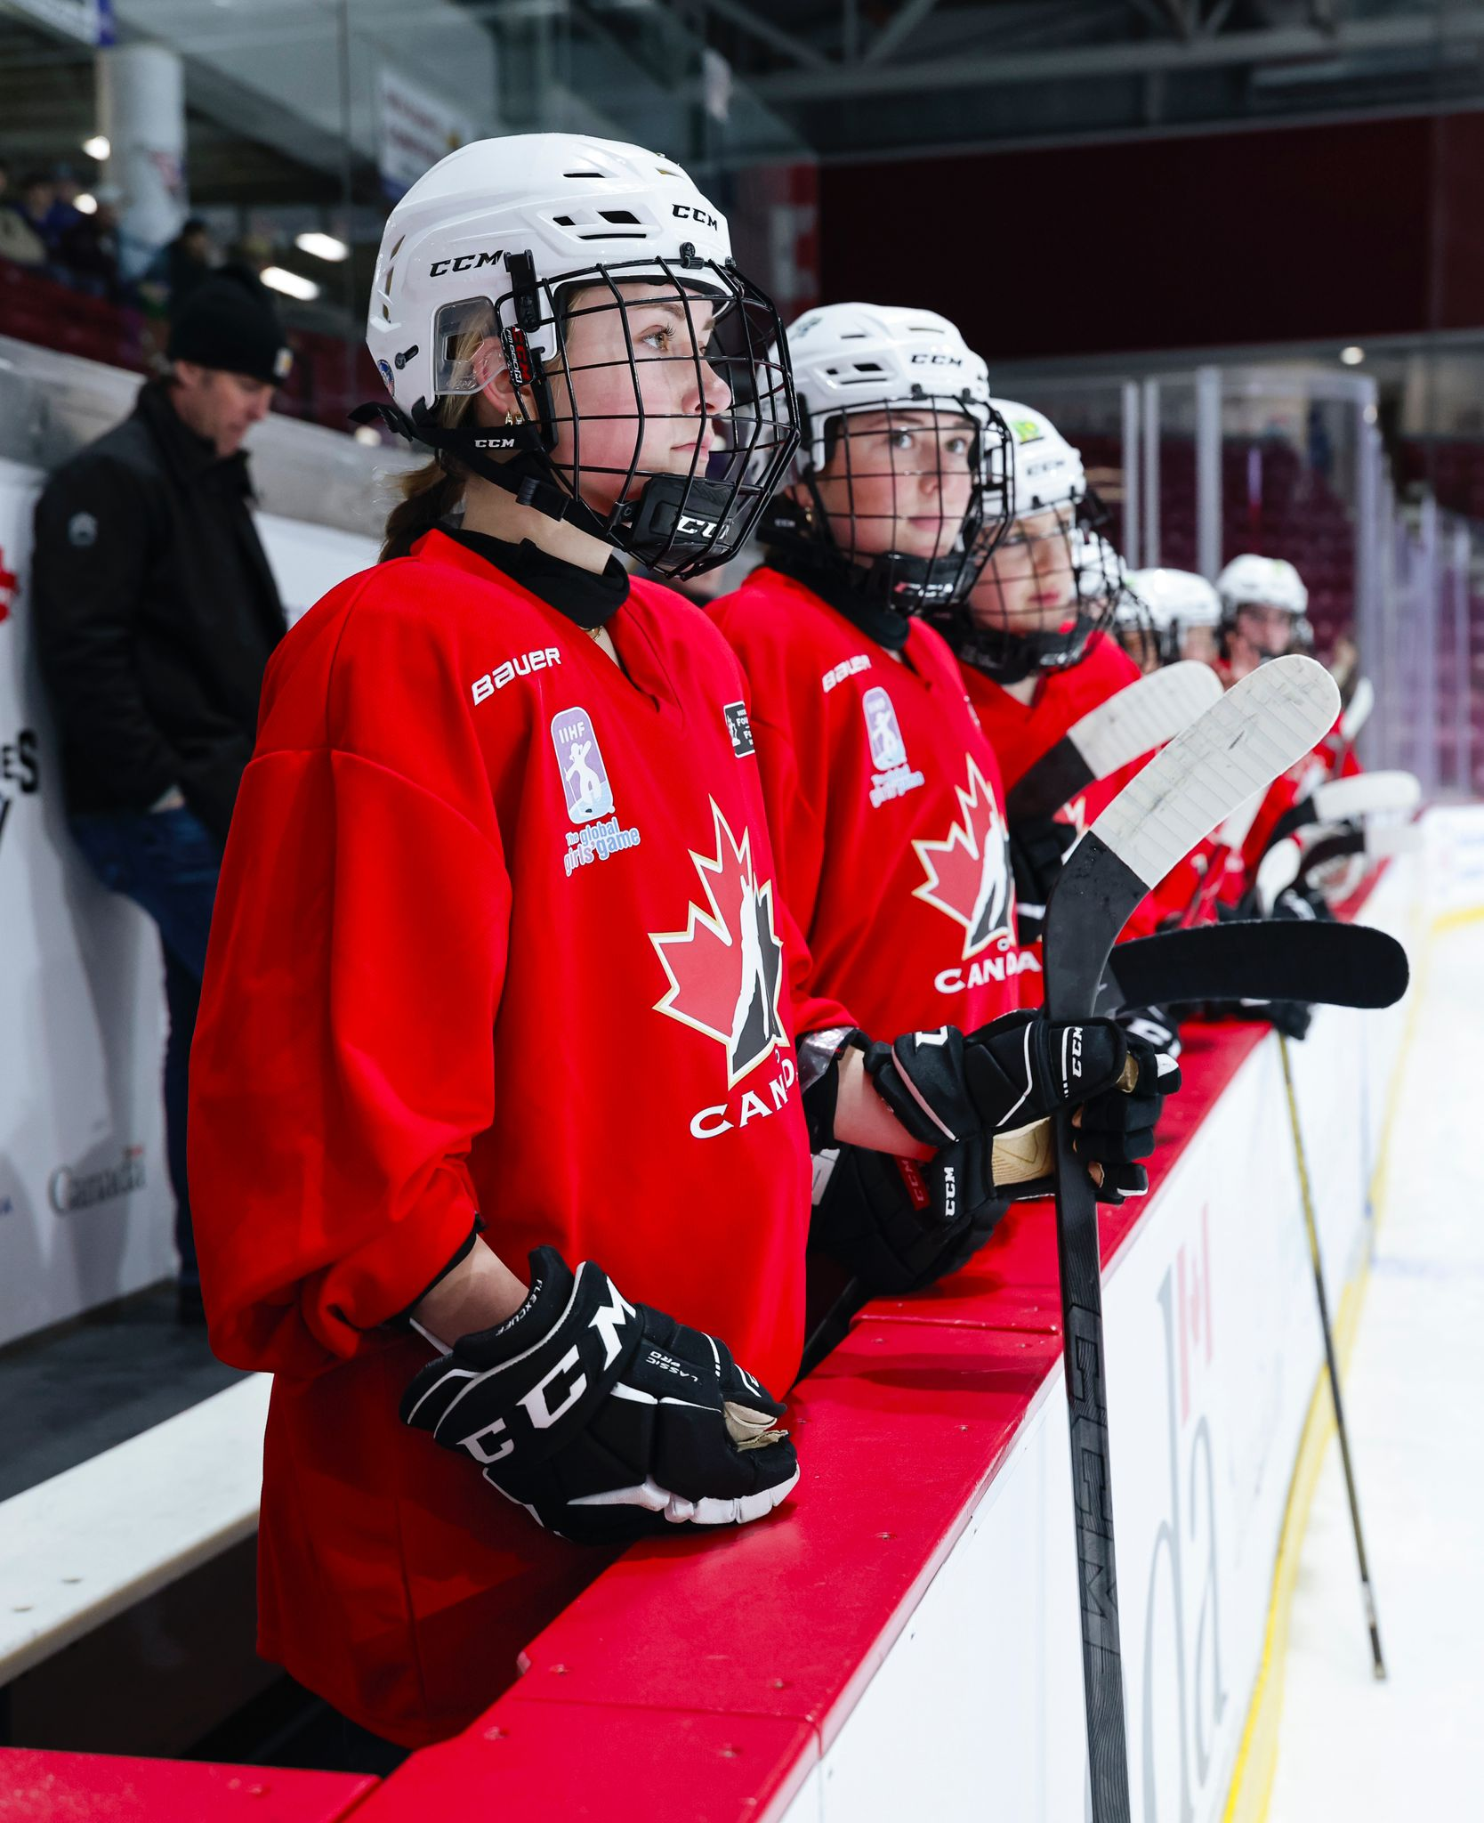
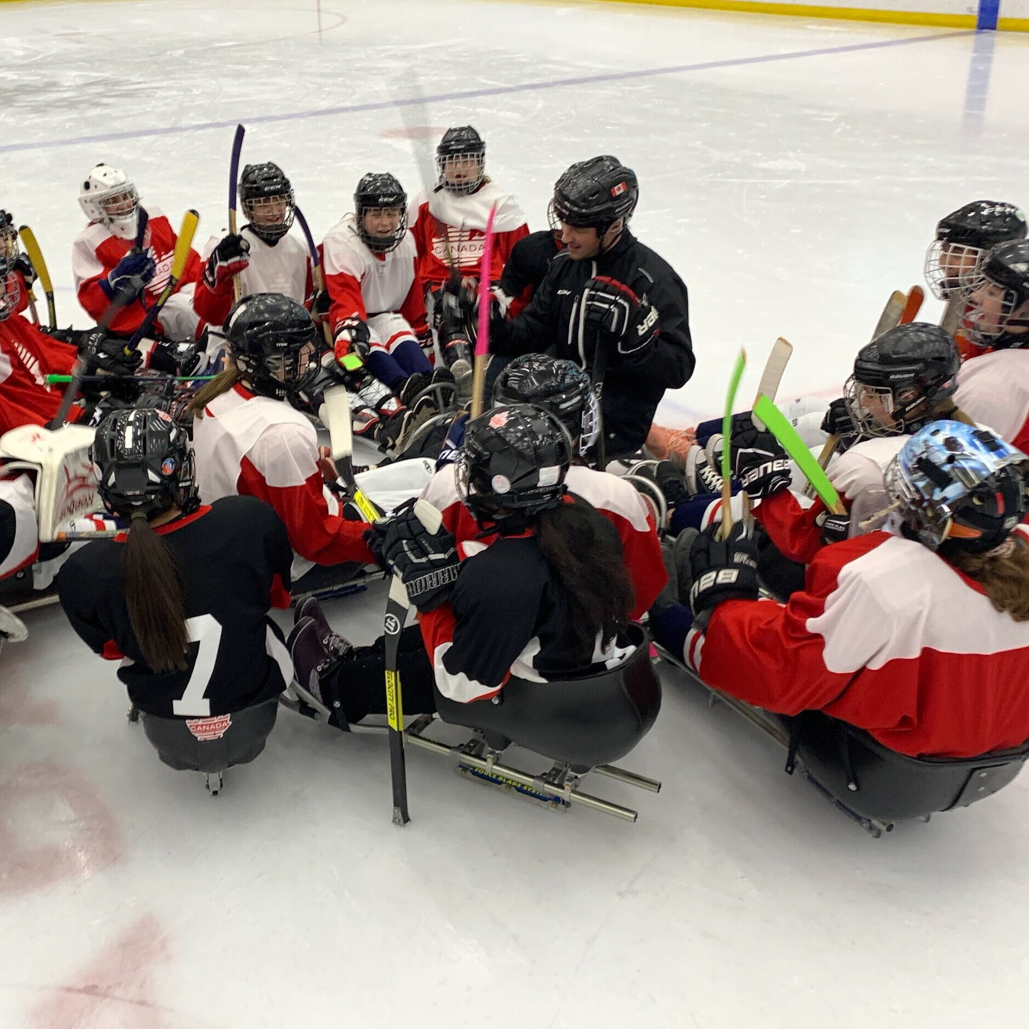
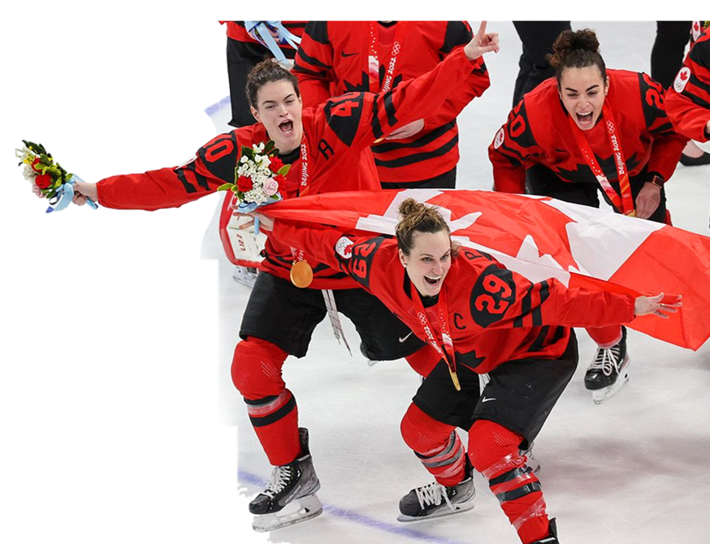
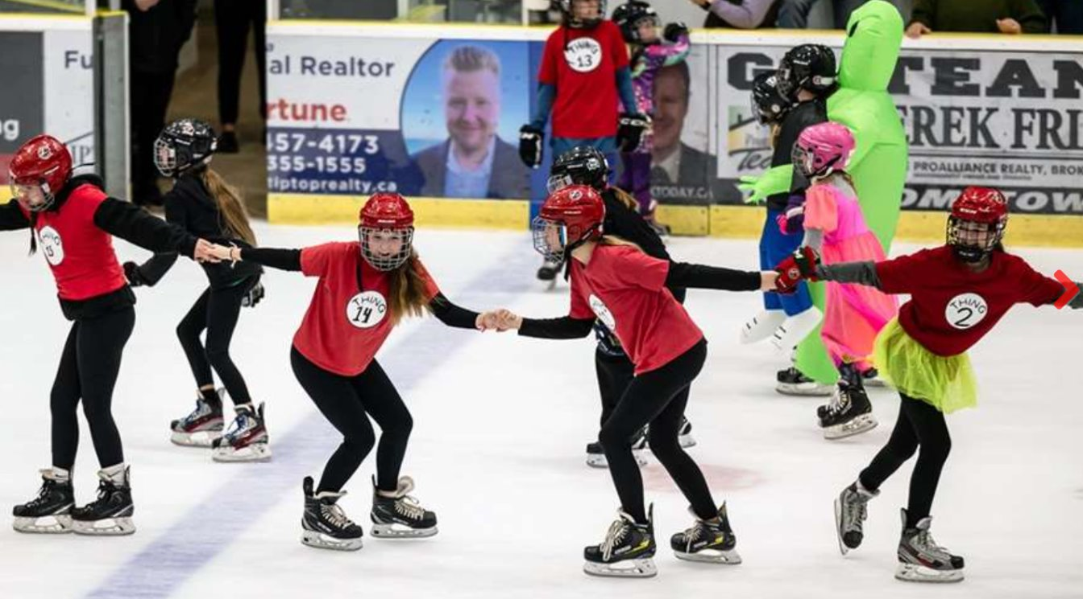
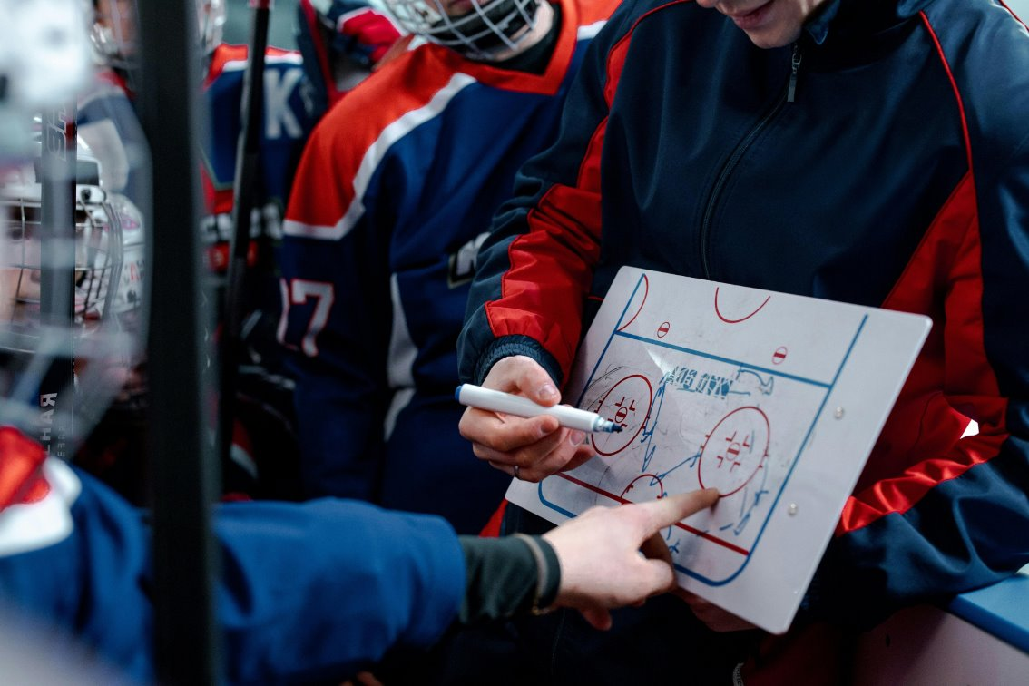
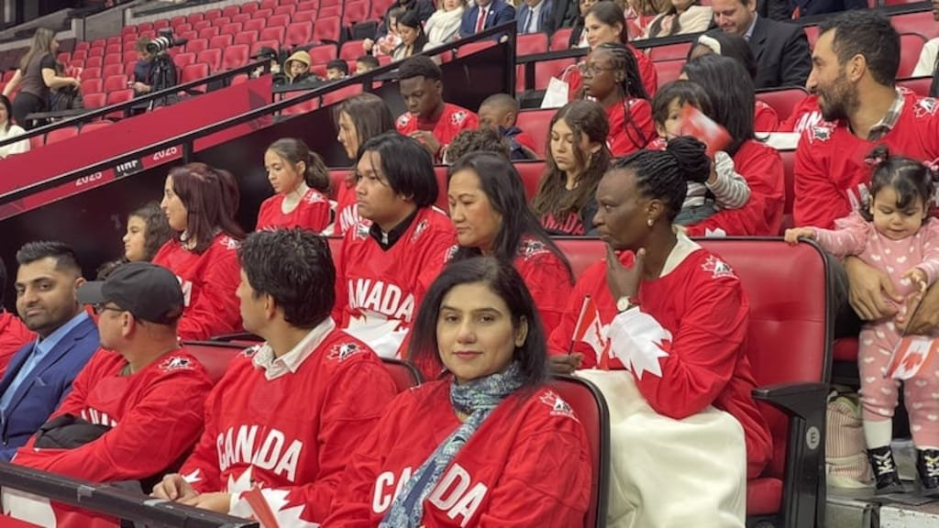
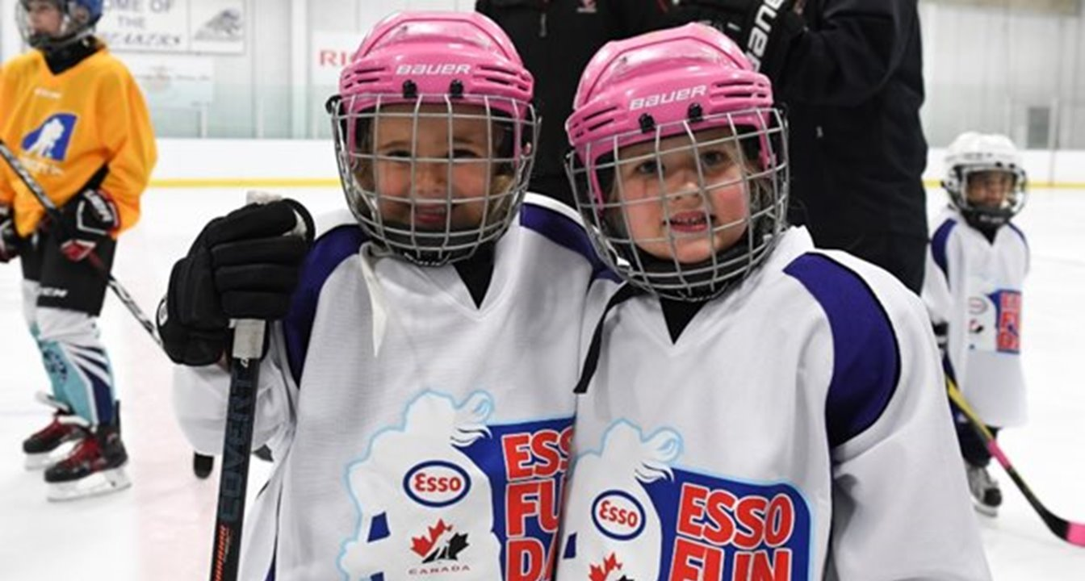
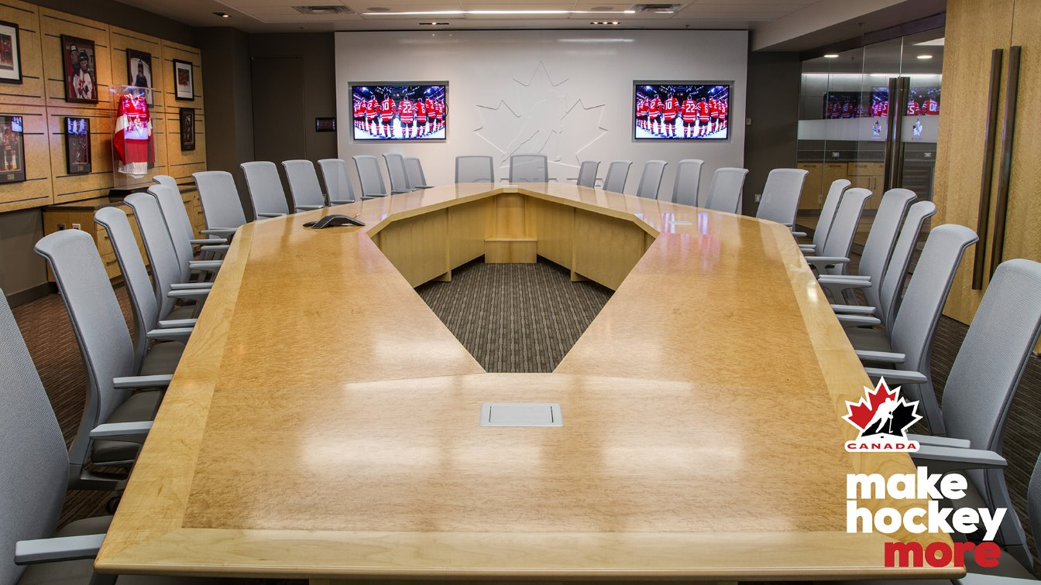
Notes:
Take a step back. 2022. New position.

Slide 3
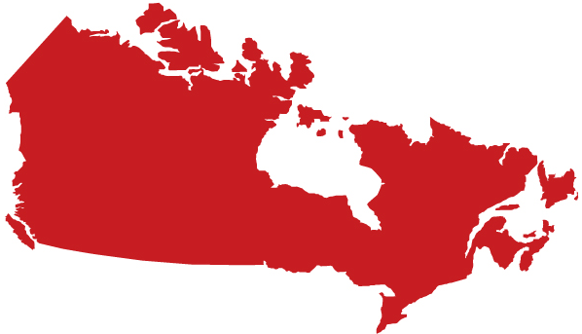
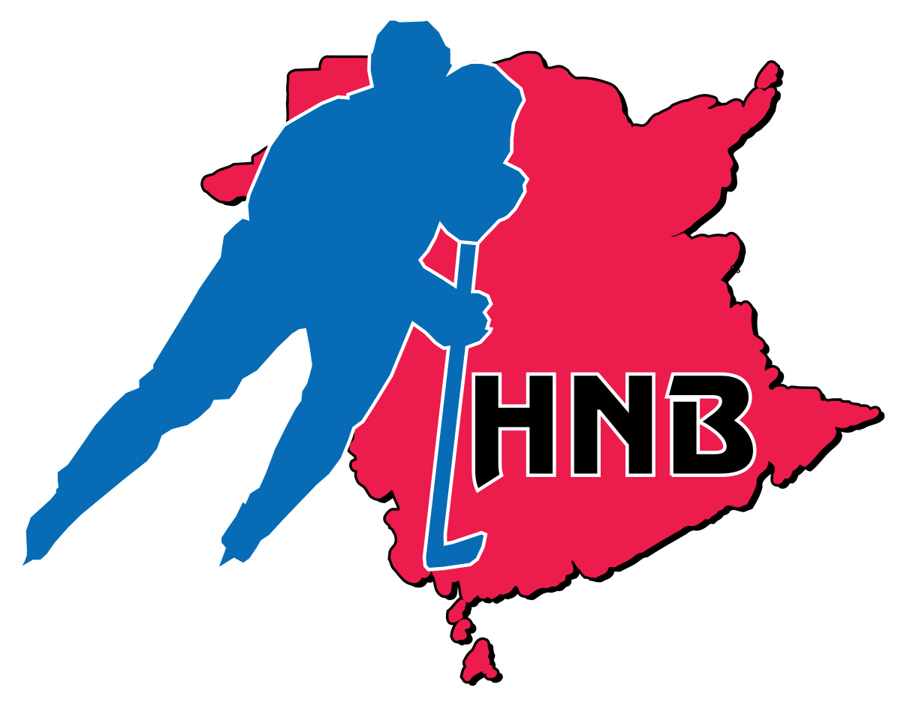
HOCKEY CANADA’S MEMBERS
Notes:
11 Provinces = Canada

Slide 4
MARIN’s MANDATE
Champion the long-term growth and sustainability of Women & Girls hockey ecosystem, identifying opportunities for continued advancement, development, investment and equity.
Support the national collective of Members and Member identified women & girls leads (28) to ensure a unified, consistent and strategic approach to the delivery of programs and services.
Set annual, national priorities utilizing the Women & Girls Game Plan as a blueprint, driving accountability and alignment across all stakeholders: Members and HC Departments.
Advocate and representative of HC Women & Girls initiatives, including leadership voice at Executive Table, external committees (IIHF, NHL/NHLPA, PWHL, Canadian Olympic Committee, Canadian Women & Sport) and beyond.
Collaborate across all Hockey Canada business units (ie: Growth & Retention, Hockey Ops, Safe Sport, Marketing, Revenue & Partnerships) to make data driven and informed business decisions.

Slide 5
GUIDING PRINCIPLES
Develop messaging and education opportunities for leaders and executives of Provincial, Territorial Hockey Associations that creates buy-in and prepares them to support and enable the women’s and girls’ hockey leads within their jurisdictions.
Facilitate the connection and network of Women & Girls hockey leads across Canada, cultivating a platform and cadence for best practice sharing, collaboration and alignment for the future (monthly calls, annual meeting, innovation exchange).
Develop and maximize two-way learning, incorporating presentations by Hockey Canada subject matter experts and external representatives (ie: Canadian Women & Sport) to drive feedback, action and the foundation of the Women & Girls hockey strategy.
Ensure Members and stakeholders feel aligned with Hockey Canada direction and feel empowered to contribute to the sustainable growth and long-term development of women’s hockey.
Ensure increased learning opportunities & touchpoints across the country that support empowerment, growth and positive change.
Prioritize connection and conversations with other HC department leads to discuss continuous alignment.
Notes:
Boiling the ocean.

Slide 6
CURRENT STATE
Canada saw highest registration numbers ever in 24-25 for Women & Girls
PLAYERS = < 100,000 – a 13% increase from 22-23 (but still only 20% of total players registered…)
COACHES = 6,045 – a 16% increase from 22-23
OFFICIALS = 4,045 – a 24% increase from 22-23
We’re at a tipping point for Women’s Sport
This societal shift has NEVER happened before.
Incredible momentum in Hockey. Registration. PWHL. 5x World Championships. A passionate ecosystem.
Immense popularity in women’s sports: NCAA Women’s basketball, Northern Super League Soccer (Spring 2025). WNBA - Toronto Tempo (Summer 2026).
How do we harness the momentum and excitement to drive Pond-to-Podium-to-Professional?
Building the Future of Women’s & Girls’ Hockey in Canada
Foundational knowledge is strong, but now we have extensive research to back our insights.
Time to chart forward to ensure we have a sport structure and system that holds {ourselves} accountable to the incredible opportunity of serving women and girls through hockey, for the sustainable future.
Notes:
TOTAL PLAYERS = 500,000
W&G PLAYERS = < 100,000 – a 13% increase from 22-23 (20%) **AREA OF OPPORTUNITY to grow – not important about the #, it’s the ratio/percentage
W&G COACHES = 6,045 – a 16% increase from 22-23
W&G OFFICIALS = 4,045 – a 24% increase from 22-23
45% of girls come from OWHA / 50 years
Poland = ~ 4,000 total players (22-23) – similar size to # of girls in Nova Scotia
Poland = ~500 girls players (2024)

Slide 7
VISION 2030

Slide 8
GAME PLAN
CONNECTION
Member Listening & Learning (annual summit, Member & HC Meetings)
Consistent national communication structure
Best in Class programs & initiatives – knowledge sharing (NSOs, CWS, Members, IIHF ++)
Increased learning opportunities & touchpoints across the country → leaning into empowerment & change
CREATION
Calendar of priorities – 12 month +
Resource creation (player, coaching, officiating pathways & building volunteer capacity)
Policy & governance review of PSOs, equity in resource allocation and overall structure
Alignment with gender expression & EDI, terminology review, gender policy implementation
COMMUNITY
HC Program and community touchpoint collaboration (IIHF programs, Rivalry Series, WWC +++)
Community support of underserved and under-represented markets
Outreach and association with external Hockey Canada groups (PWHL, USports, NCAA)
See It, Be It. Increased strategy surrounding NWT (past and present) Community Appearances, Alumni Ambassador Program
STRUCTURE OF WOMEN & GIRLS HOCKEY
EDUCATION & TRAINING
VISIBILITY & CELEBRATION

Slide 9
KEY TAKEAWAYS
Who’s on your team? – build your bench.
Identify the problem – are you boiling the ocean?
Set Clear Objectives – what’s your vision 2030?
Share. Learn. Collaborate. Repeat. - We vs Me.
It's foot on the gas, and driving for more;
more opportunities, more growth, more optimism and exposure.
When you can See it, you can Be it.

Slide 10
HOCKEY CANADA’S WOMEN’S & GIRLS HOCKEY STRATEGY
3 C’s
Barriers?
BODY COPY V2

