Slide 1
IIHF Women’s Ice Hockey –
Facts and figures
E.H.C. Professional Womens Seminar, April 13, 2025

Slide 2
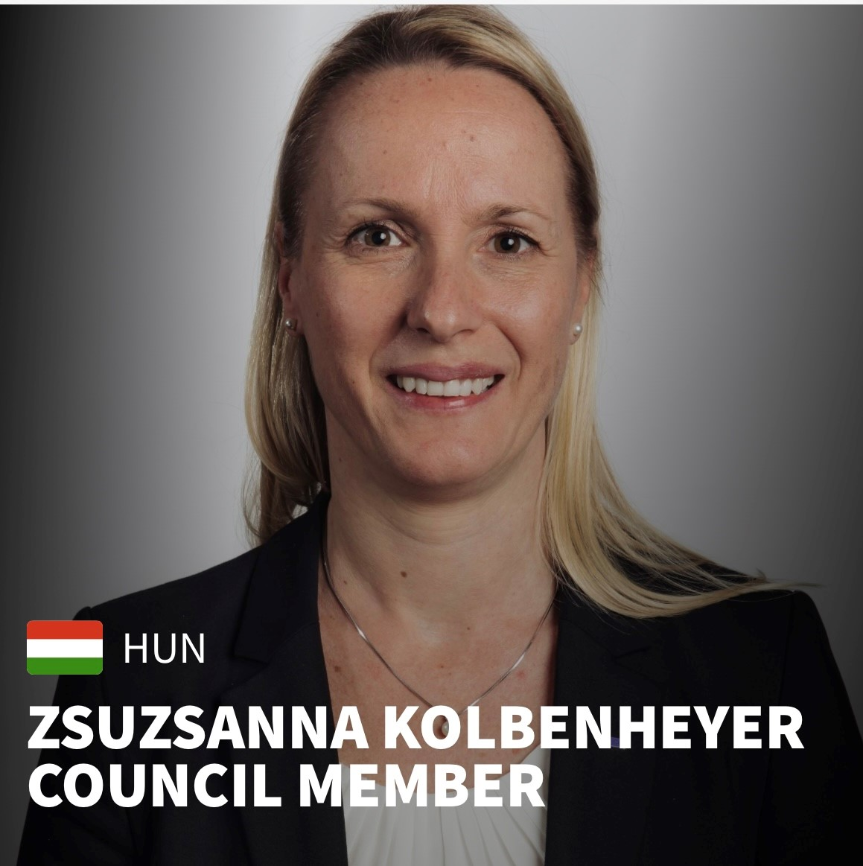
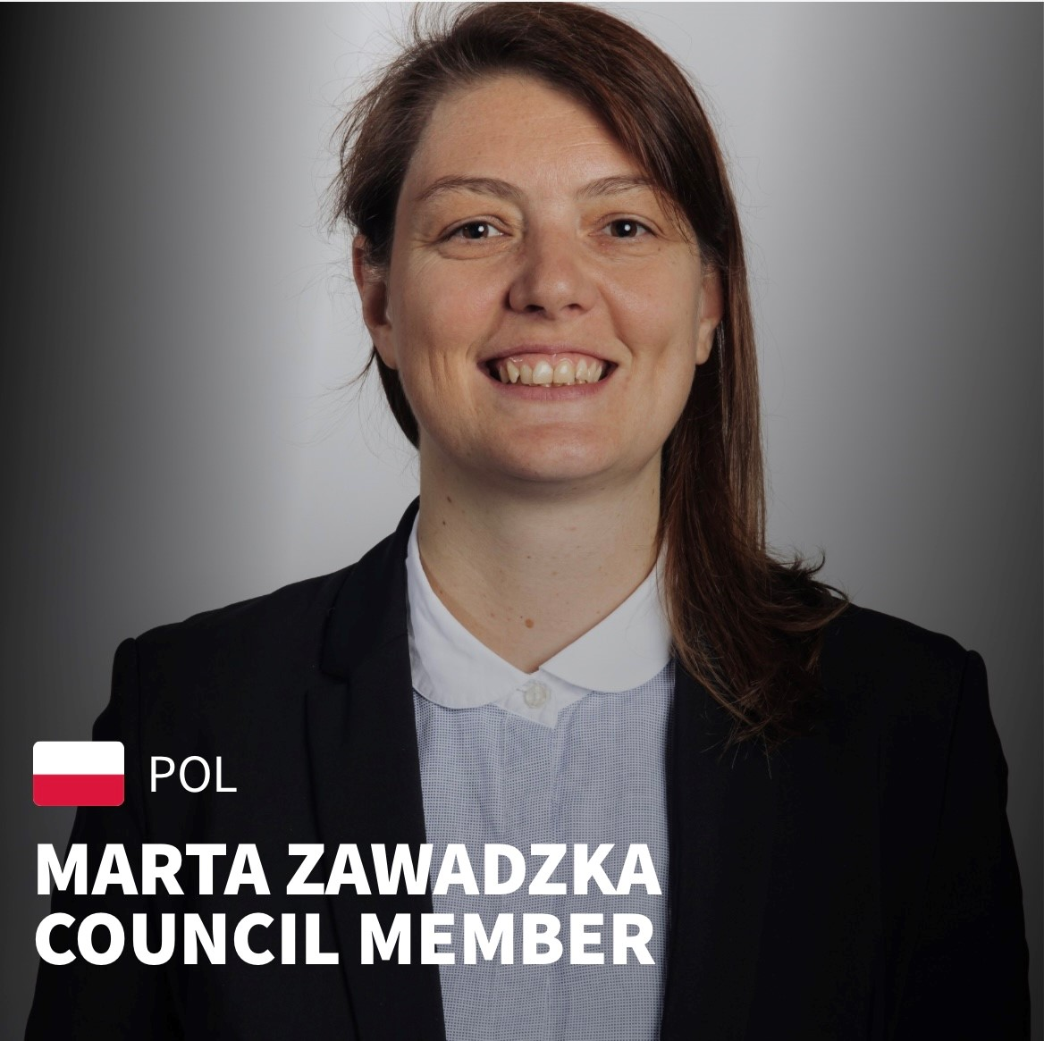
IIHF leadership
IIHF council – two female council members, Zsuzsanna Kolbenheyer and Marta Zawadzka
IIHF committees – out of 18 committees 11 have female members and 4 are chaired by females (Legal, Officiating, Sustainability and Women’s Committees)

Slide 3
IIHF Women’s Committee
Zsuzsanna Kolbenheyer, Committee Chair
Mel Davidson, Canada
Gina Kingsbury, Canada
Martin Kogler, Austria
Katie Million, USA
Tereza Sadilova, Czechia
Viktoriya Sazonova, Kazakhstan
Emma Terho, Finland
Blanka Elekes Szentagotai, IIHF Women’s Program Manager and Committee Secretary
Malin Andersson, link to IIHF Development Committee
Continuous co-operation with all relevant IIHF committees – CoCoCom, Event, Coaching, Development, Medical, etc.

Slide 4
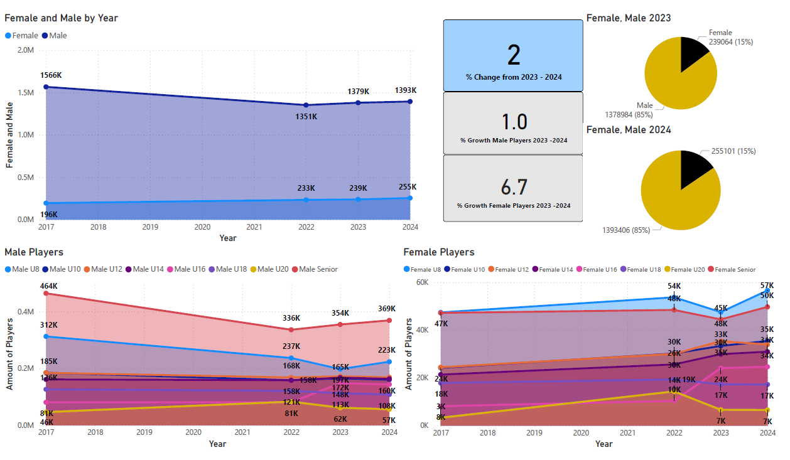
Notes:
Various MNAs did not report accurate breakdown of age groups (or have
different age categories) creating a difference between totals and players age
breakdown - These trends are still the most accurate representation of player
growth
• IIHF is missing 13 MNAs data and using the registration numbers from the
2023 survey to create the most accurate representation of the global outlook
• From 2017 - 2022 Czechia cleared entire player history creating a decrease of
close to 80K players
• Canada U16 reporting was not available for 2017 and 2022 surveys
• 2 new MNAs in 2023 - PUR and TUN
• Reporting time periods are different for MNAs - numbers may change
throughout the year

Slide 5
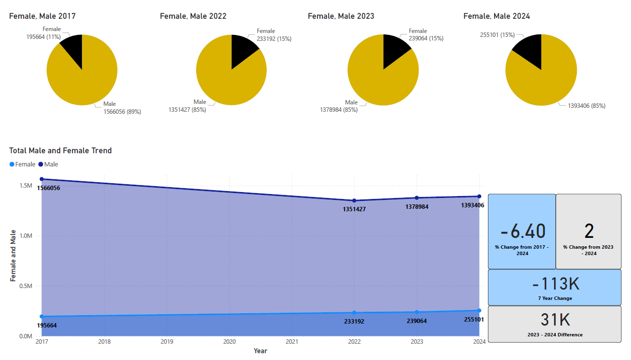

Slide 6
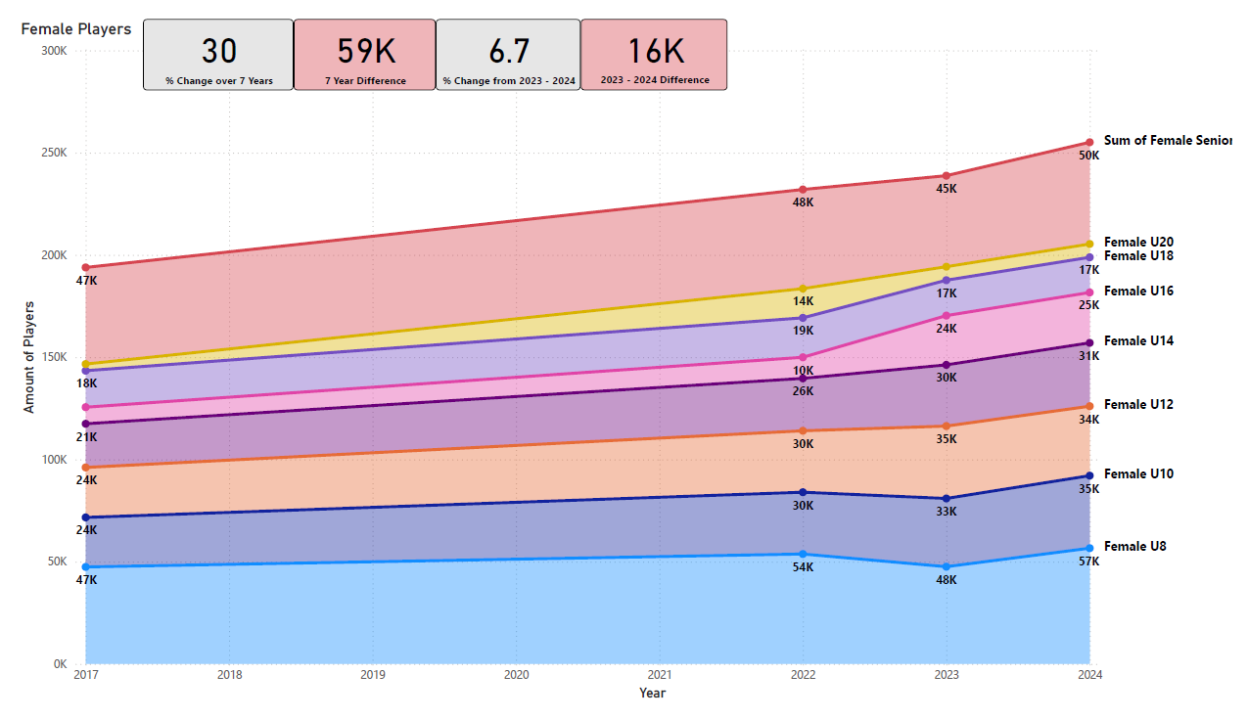

Slide 7
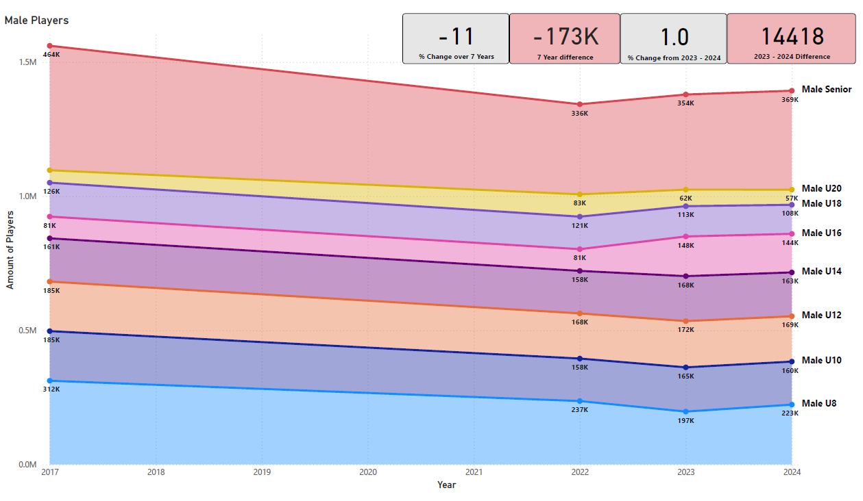

Slide 8
IIHF Championship Program 2024/2025
45 MNA participate in Women’s Senior Category
35 MNAs participate in Women’s U18 Category
58 MNA participate in Men’s Senior Category
44 MNAs participate in Men’s U20 Category
46 MNAs participate in Men’s U18 Category

Slide 9
MISSION
To work with all stakeholders to make ice hockey an available, attractive and competitive sport and to generate added value for our members.
VISION
Global leader in winter sports.
VALUES
INTEGRITY
RESPECT
PASSION
COMMUNITY
ICE26
GOALS & KEY INITIATIVES
COLLABORATE
Develop an annual global ice hockey forum
Increase collaboration with Olympic stakeholders
Analyze use of international breaks
Strengthen commercial partnerships
INNOVATE
Undertake a digital transformation program
Drive new sustainable initiatives
Refresh the World Championship structure
Strengthen IIHF’s global presence
EXPAND
Build a targeted development program
Create engaging promotional campaigns
Develop a fresh women’s hockey concept
Establish a new 3-on-3 discipline
Notes:
Henrik
So here it is all together; our new mission, vision, values and our new strategy, ICE26.
There are many different approaches we could have taken to developing an IIHF strategy.
We decided to focus on choosing a framework that put focus on these 12 key areas where there is very strong potential for progress in our sport.
We would do just fine if we didn’t focus on these areas and continued as we are doing.
But, In order to realise this potential, we need to give extra attention to these 12 areas while we also continue to work hard on other activities that we are doing.
All of this will take some effort, but it is achievable – and it starts today!
To begin to frame the issues, we will dive into each of these initiatives in workshops.
I invite Matti to explain what will happen this afternoon. these workshops.
I hope you will wear your new hat and enjoy a daily coffee thinking about ICE26.
Thank you everyone.
Now,’Let’s Hit the Ice!’
Matti…

Slide 10
Our IIHF Values
INTEGRITY
RESPECT
PASSION
COMMUNITY
The IIHF is fully committed to protecting ice hockey, its players, coaches, officials and fans against any form of cheating or abuse. In addition, it is the IIHF’s top priority to strengthen the ethics in the sport and to tackle any ethical misconduct.
The IIHF together with its Member National Associations must strive to develop not just good hockey players but also good people. Through IIHF competitions, IIHF camps, and coaching seminars we aim to instill values of fair play and respect at all levels of the game.
Through inclusivity and promotion of the game, the IIHF aims to instill a passion for ice hockey among all players, coaches, administrators, and fans, that will carry over across generations and grow the game.
The strength of our sport comes from our unity, the international ice hockey family is a real and tangible resource for our game, allowing our Member National Associations not just to compete together but also to support, share knowledge with, and assist each other with the development of the sport.

Slide 11
ICE 26 - Develop a fresh women’s hockey concept
LEADERSHIP IS KEY
The three main areas identified for leader development
Management – development of MNA leaders
Coaching – increasing the number of female coaches worldwide working in all areas of ice hockey
Players – identifying and developing the next generation

Slide 12
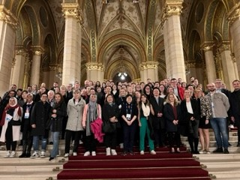
IIHF Women’s Ice Hockey Summit
Over half of the IIHF membership represented – first such global event
108 registered participants
Upcoming second edition as part of the 2025 Global Hockey Forum, September 30-October 1, 2025
Themed around the topic of leadership from the wide business angle narrowing it down to other sports and finally ice hockey’s best practices

Slide 13
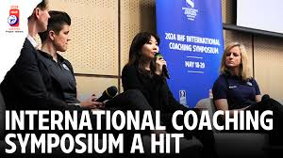
Coaching and HER Coaching Network
Increased representation at WM Coaching Symposium – in 2024 an entire day was dedicated to coaching women’s hockey
IOC co-operation – WISH program

Slide 15
Amount of Female Coaches in Top Female Divisions
HER is a program to “Raise the Bar and Close the Gap“ of female coaches in the female game & create a network of SUPPORT for female coaches

Slide 16
QUANTITY WILL PROMPT QUALITY

Slide 17
Reasons that led to HER
Lack of female leaders in the game for younger girls to look up too
Want to encourage women to transition from playing to coaching
There is no network of female hockey coaches in the world which is an under-represented section of the game
Ensure younger coaches have an outlet to talk and learn
*All confirmed by top female coaches in the game and at Initial Meeting

Slide 18
HER Objectives
Attract all levels of female coaches to the network that creates a community of support and learning
Open dialogue for women to share stories and experiences that other coaches can learn from – Focusing on both negative and positive experiences
Allow younger girls to join the community and understand what it takes to become a coach
Show the female coaching community that IIHF is supporting their efforts and enabling the growth of the game
Host digital and in-person events throughout the year i.e webinars or networking events at championships

Slide 19
Player Leadership Seminar – 2025 WW
April 17-21, 2025
51 countries confirmed to participate with a player that the MNA envisions in a future leading role
Argentina, Australia, Austria, Bahrain, Bosnia&Herzegovina, Bulgaria, Brazil, Canada, Chinese Taipei, Colombia, Croatia, Czechia, Estonia, Finland, France, Germany, Great Britain, Hong Kong, Hungary, Iceland, India, Indonesia, Iran, Italy, Japan, Korea, Kuwait, Latvia, Lithuania, Luxembourg, Malaysia, Mexico, Netherlands, New Zealand, Norway, Oman, Philippines, Poland, Portugal, Puerto Rico, Serbia, Singapore, South Africa, Slovakia, Slovenia, Spain, Sweden, Switzerland, Turkiye, UAE, USA
Day and a half long seminar with a wide range of topics all circled around helping the participants become the future leaders they have the potential for

Slide 20
Promotional activities
World Girls’ Ice Hockey Weekend (WGIHW)
The World Girls' Ice Hockey Weekend is a global opportunity for girls to try out hockey as a new sport. Thousands of participants took part since the start in 2011.
National Federations, leagues, clubs, teams, or any group who has a passion for sharing the great sport of ice hockey with the next generation of female hockey players are eligible to register as hosts. This is not a difficult event to hold and you can make it as big or small as you want. The goal is to give girls the chance to play.
Global Girls’ Game (GGG)
From New Zealand to Asia, Europe and the Americas – the IIHF has organized seven editions of the GGG since its launch in the 2015-2016 season. Each year Team White and Team Blue battle it out in games around the globe, each MNA has to nominate its official entry game but may host several side games.

Slide 21
WGIHW
October 11-13, 2024
Over 400 events in 41 countries – 2024 edition
“Mommy, I still like figure skating, but I now really want to learn ice hockey.”

Slide 22
Global Girls’ Game
February 14-16, 2025
Provisional Scoreboard (after 45 games)
Team Blue | Team White
264 | 219

Slide 23
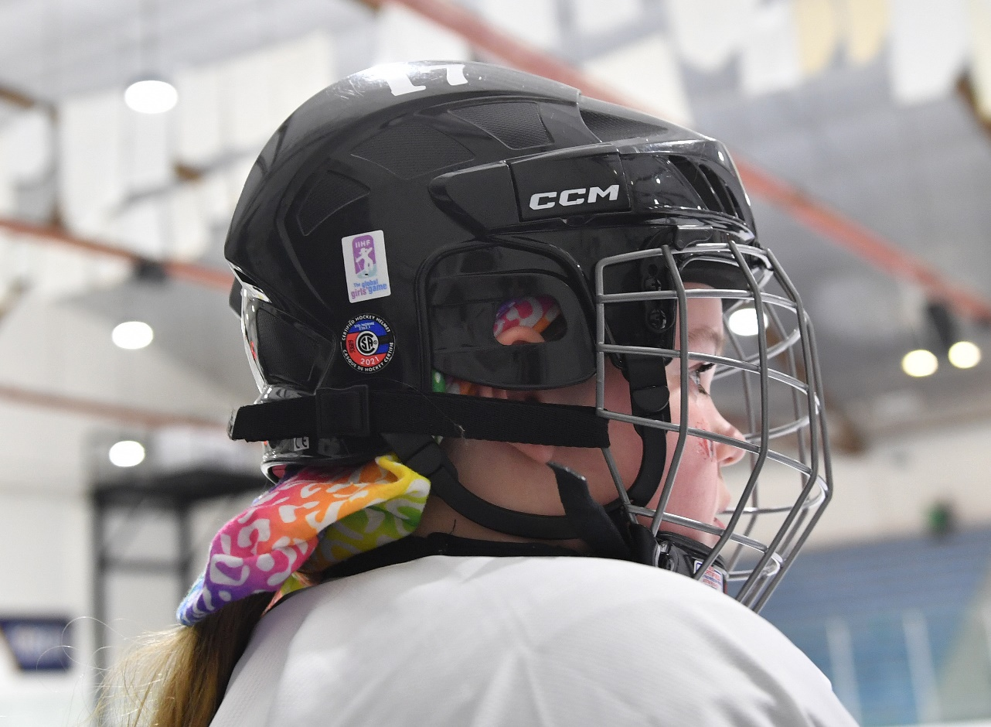
Upcoming editions
WGIHW, October 17-19, 2025
GGG, March 6-8, 2026

Slide 24
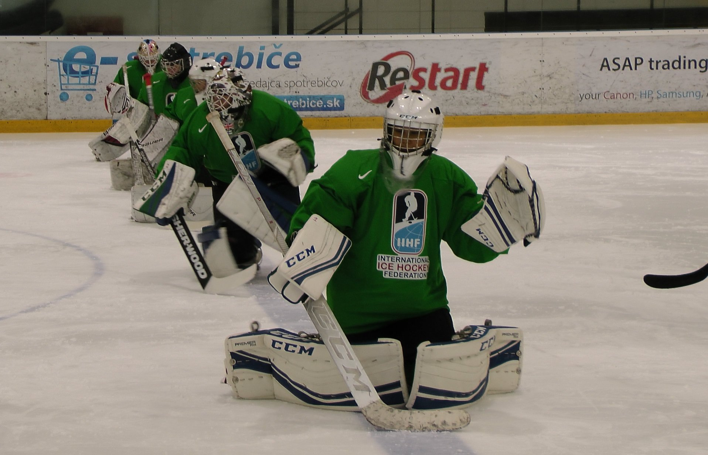
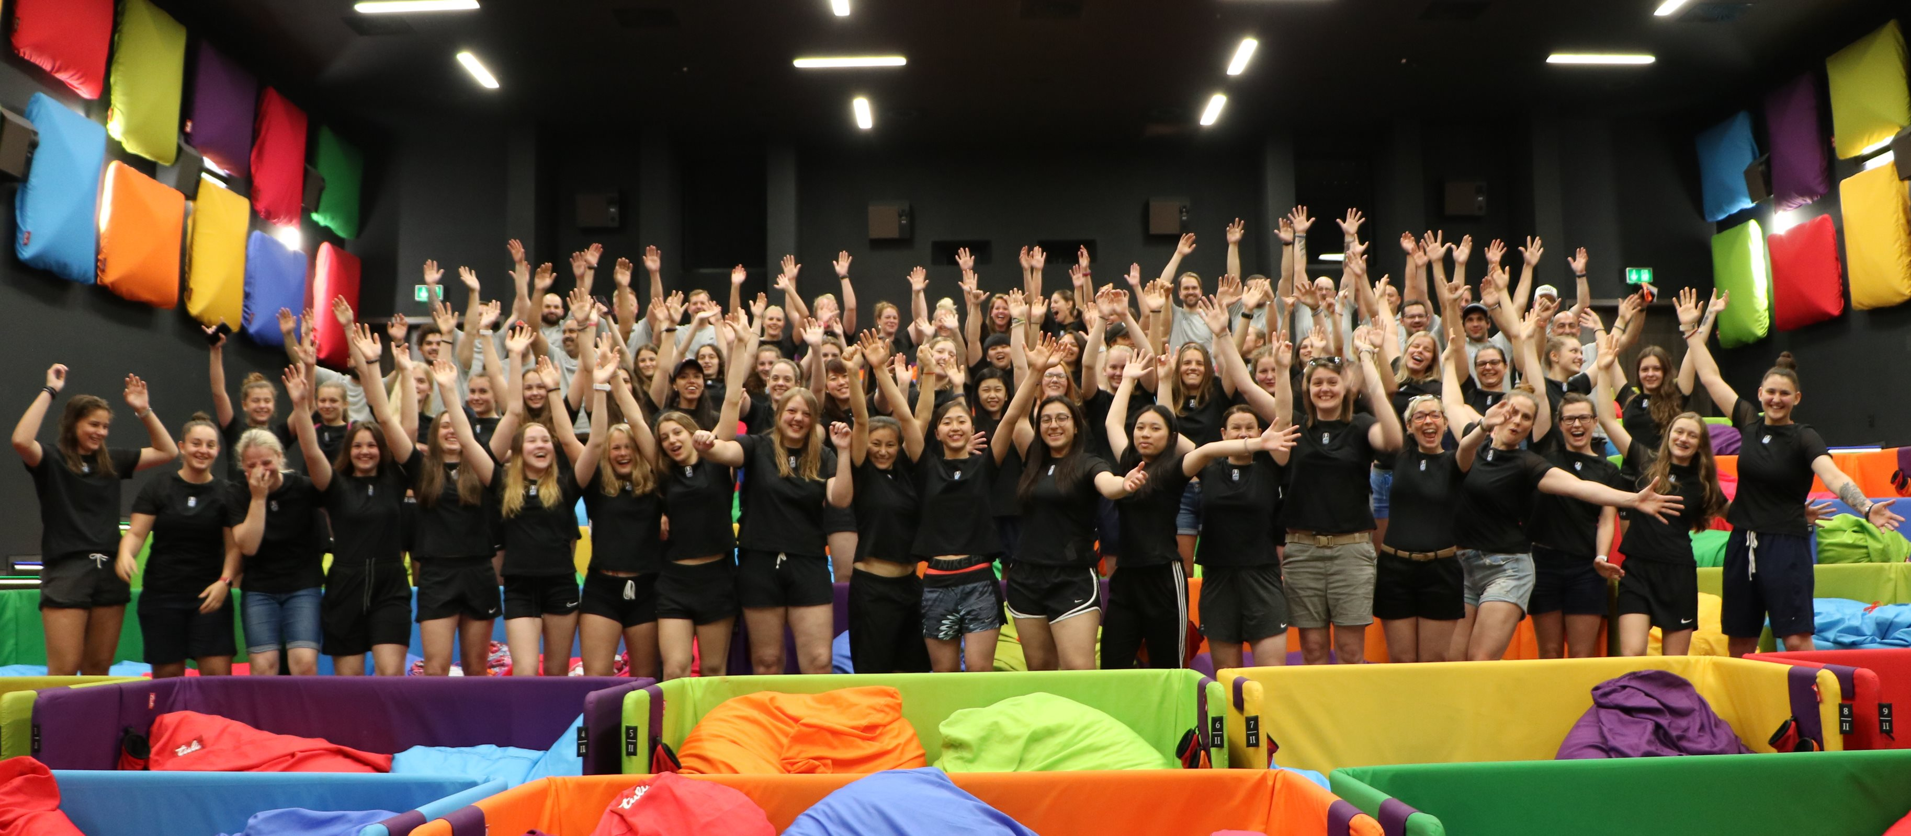
Other women’s activities
Camps – bi-annual high performance camps, goaltending camps
Annual Development Cup – camp activities involved
ERASMUS co-operations – WHPP, others upcoming
E.H.C. Professional Women’s Seminar

Slide 25
Officiating
International Licenses for Game Officials
Problems Identified:
Most females lacking large number of games
3-official, 4-official system not implemented at hoe
The female officials do not always officiate women’s game (officiating primarily junior)
Long distance games with not enough renumeration
Lack of introduction/learning process, officiating coaches
ROAD TO MILAN AND BEYOND
License | Female Game Officials | Male Game Officials
A License | 70 | 130
B License | 90 | 280
C License | 70 | 300
Total | 230 | 710

Slide 28
Key Message
INSPIRE THE NEXT_
This is the basis for women to confidently create the next chapter of ice hockey today.
And shape it with their own highlights, stories and experiences.
Change the narrative and have women inspiring women.

Slide 29
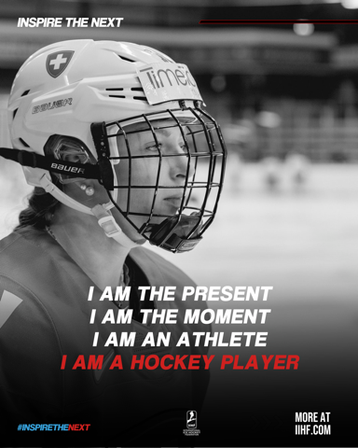
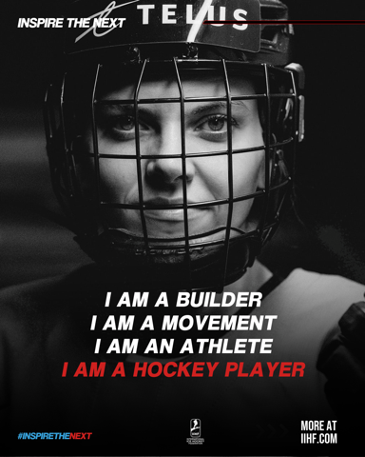
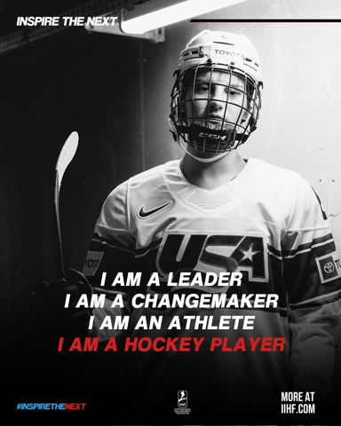
“Who I Am”
Strong, powerful images
Bold text to break down stereotypes of women in hockey
Showcase players, coaches, GMs, etc.

Slide 30
Thank you for your attention!

