Slide 1
Postfinance Women’s League

Slide 3
Postfinance Women’s LEague
Structure of the female leagues in Switzerland
PostFinance Women’s League
8 Teams
SWHL-B
10 Teams
SWHL-C - East
7 Teams
SWHL-C - West
7 Teams
SWHL-D - East
6 Teams
SWHL-D - Central
6 Teams
SWHL-D - West
7 Teams

Slide 4
Postfinance Women’s LEague
Teams
HC Ambrì-Piotta Girls
SC Bern
HC Davos Ladies
HC Fribourg-Gottéron
SC Langenthal
Neuchâtel Hockey Academy
EV Zug
ZSC Lions

Slide 5
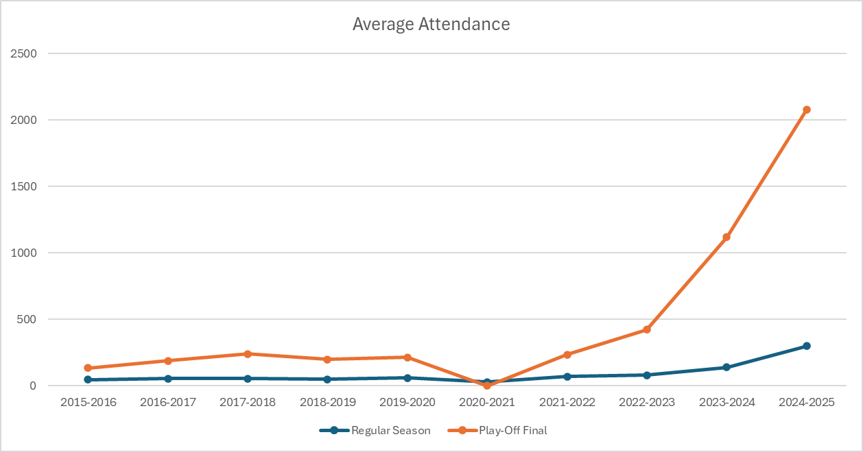
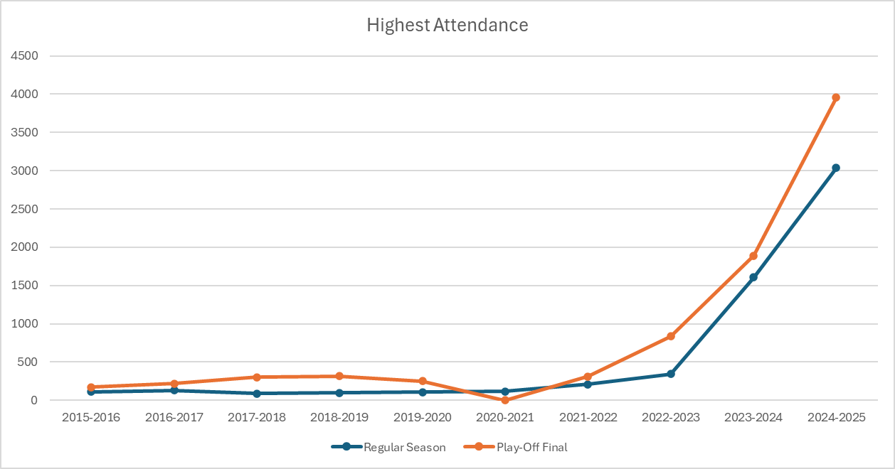
Postfinance Women’s League
Attendance – Strategy 2022-2026 as a booster
+1‘272%
+888%
+1‘439%
+436%
New strategy (2022-2026)
New strategy (2022-2026)
Inclusion of professional clubs
Professional structures
Role of politics and sponsors
- 21/22: 1 team out of 6 24/25: 6 teams out of 8
- Possibility to start in the SWHL-B under strict conditions
- Professional facilities and training programs
- 4 new employees fully dedicated to female ice hockey
- Professional coaches for youth female national teams
- New recruiting and development programs
- More visibility on TV and social medias
- Equal treatment incentives
- Financial support for female programe
- Financial restrictions to professional clubs not investing in female programs

Slide 6
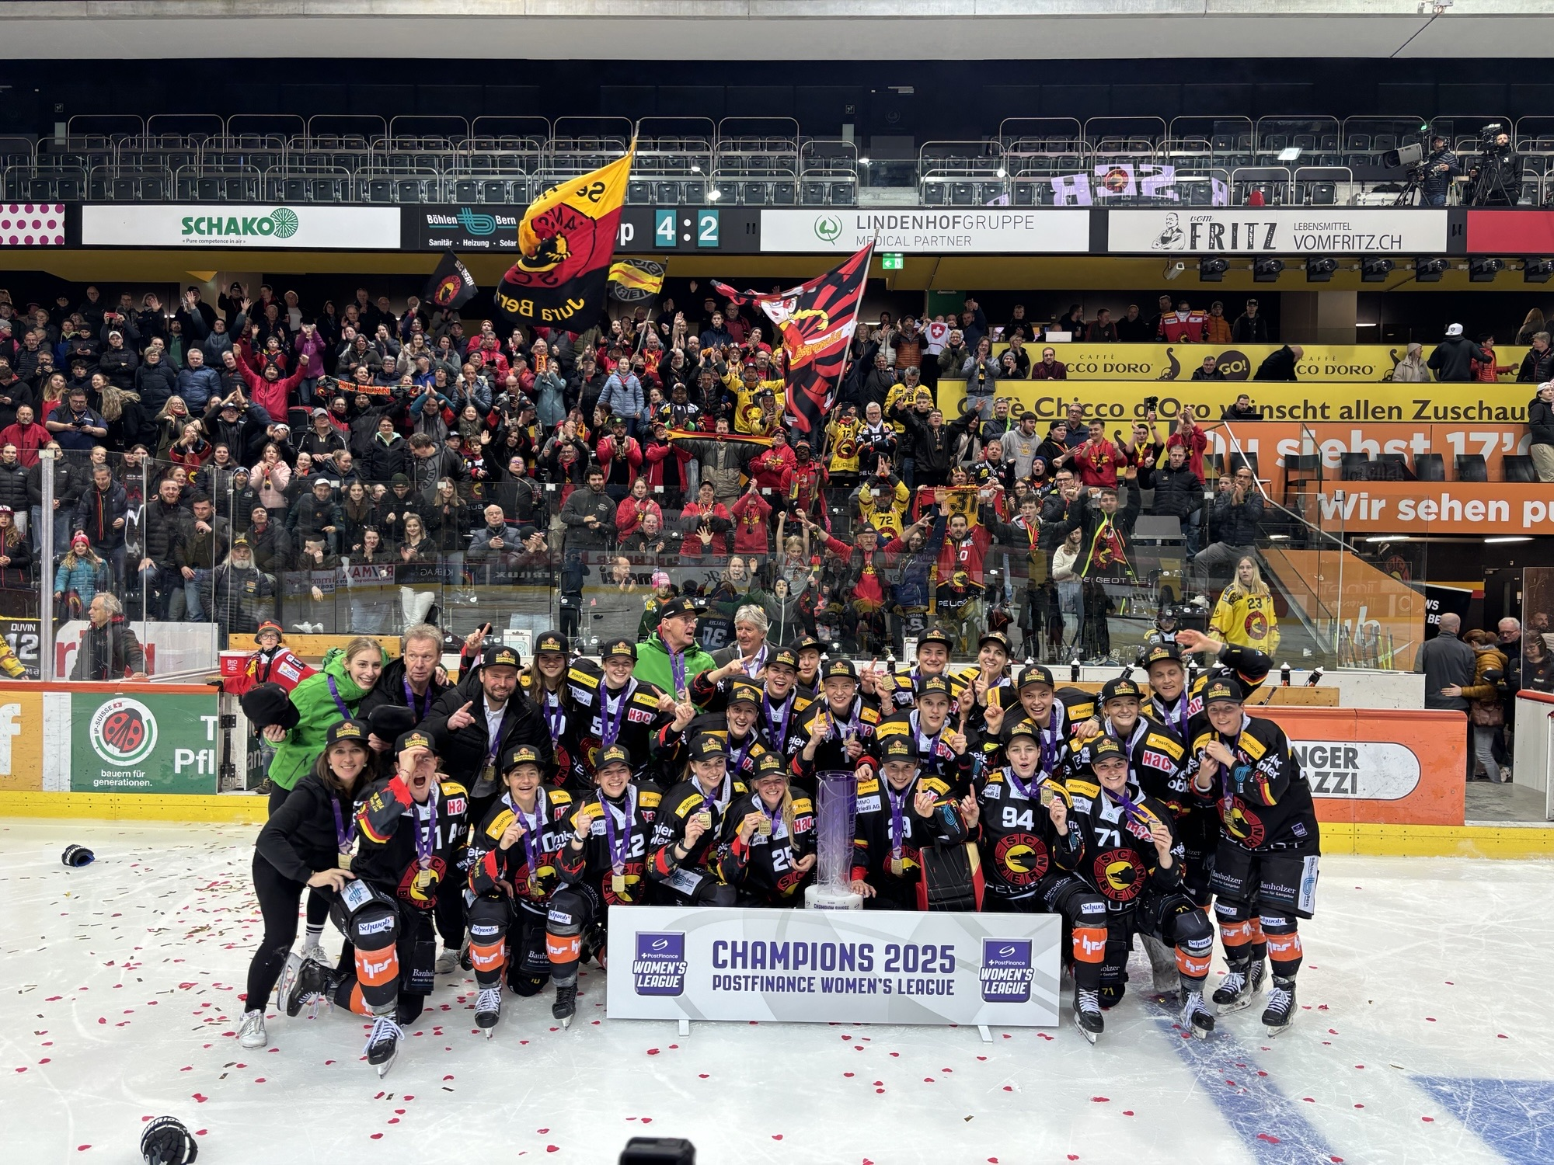
Postfinance Women’s LEague
Danke !

